Slide 1
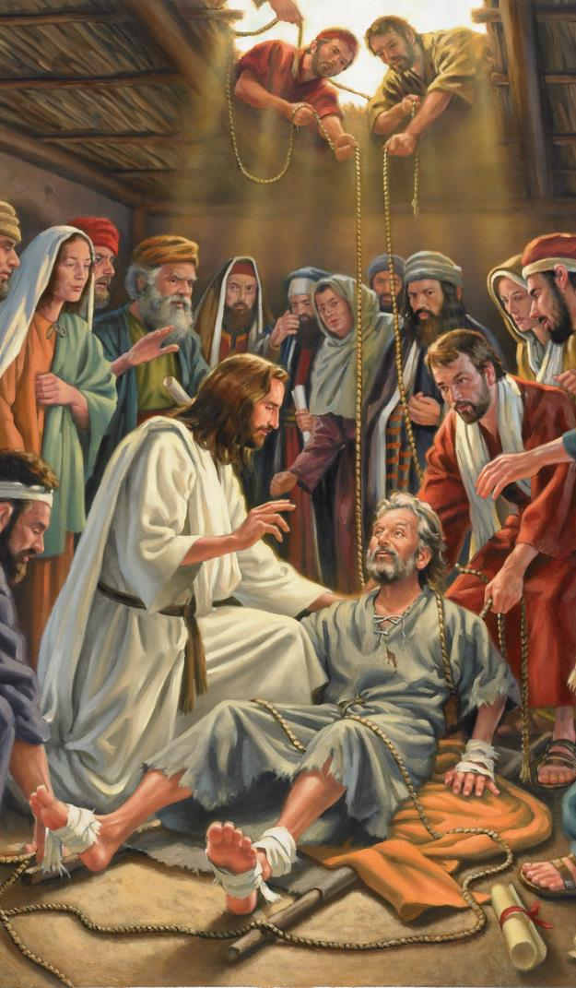
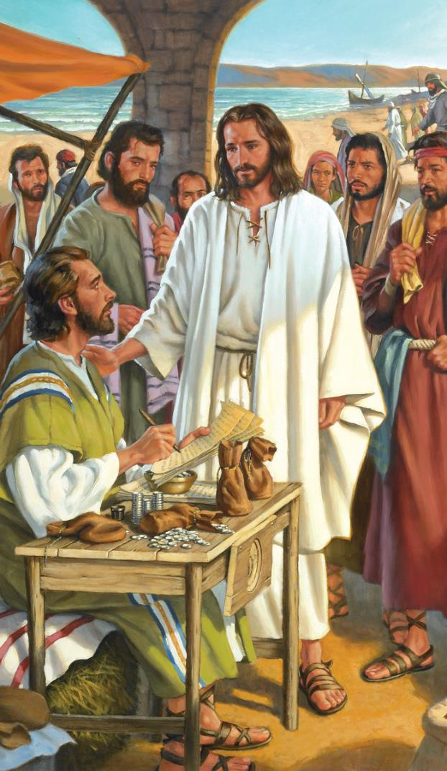
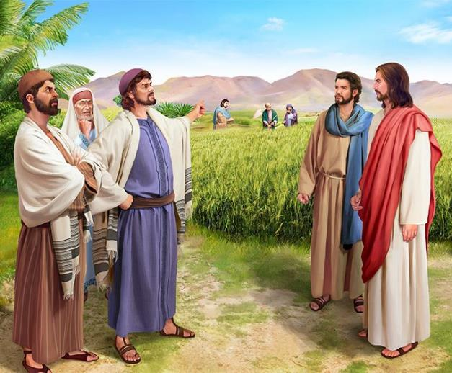
IMPAKA
Icyigisho cya 3
cyo ku wa
20 Nyakanga 2024

Slide 2
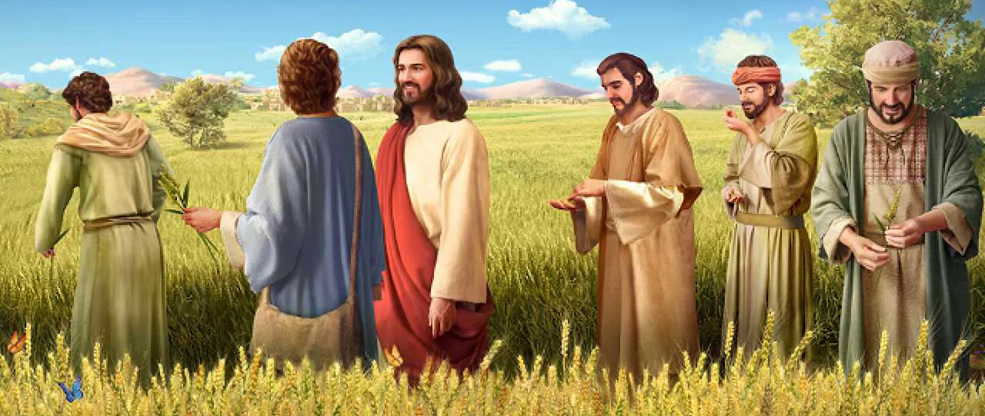
“Arababwira ati ‘Isabato yabayeho ku bw’abantu, abantu si bo babayeho ku bw’Isabato. Ni cyo gituma Umwana w’umuntu ari Umwami w’isabato na yo.’ ” (Mariko 2:27,28)

Slide 3
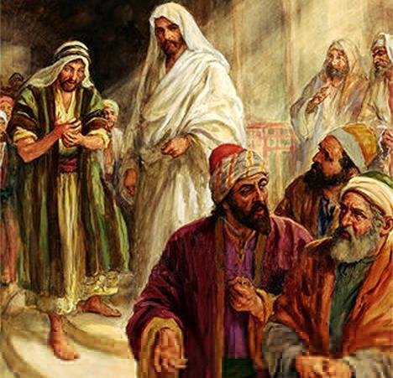
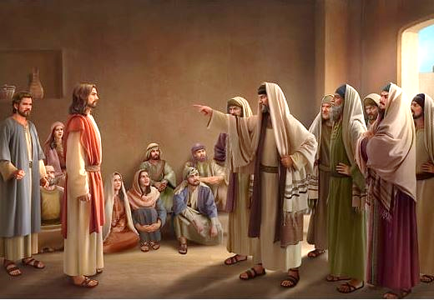
Imyitwarire ya Yesu, uburyo Bwe bwo kubwiriza, ndetse no gukiza indwara Kwe, byavuguruje imigenzo y’abayobozi b’idini.
Bamubonaga nk’utuka Imana; igisahiranda n’inshuti y’abanyabyaha; uzirura Isabato ... Ndetse bamushinje gukorana na Belizebuli!
Benewabo bwite bemeje ko Yesu yataye umutwe kubera akazi kenshi.
Nta gushidikanya, imibereho ya Yesu yateye benshi impaka.
Impaka ku byo kubabarira ibyaha. Mariko 2:1–12.
Impaka ku byokurya. Mariko 2:13–22.
Impaka ku bijyanye n’Isabato. Mariko 2:23–3:6.
Ibibazo biteje impaka kuri Yesu:
Akora ibitangaza kubw’ubuhe bubasha? Mariko 3:22–30.
Ese Yesu afite ikibazo cyo mu mutwe? Mariko 3:20–21, 31–35.

Slide 4
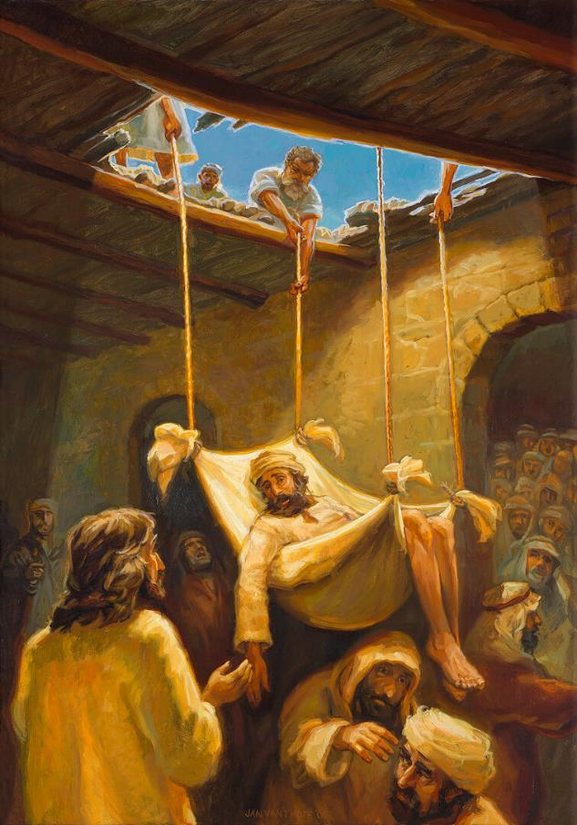
IMPAKA KU BYO KUBABARIRA IBYAHA
“Yesu abonye kwizera kwabo abwira ikirema ati ‘Mwana wanjye, ibyaha byawe urabibabariwe’ ” (Mariko 2:5)
Igihe Yesu yasubiraga kwa Petero i Kaperinawumu, abantu benshi baje kumutega amatwi (Mariko 2:1–2). Inshuti enye zasanze Yesu kugira ngo akize inshuti yabo yamugaye, ariko ntibashobora kumwegera. Nk’abiyemeje kumuzana kuri Yesu, bamuzamuye ku gisenge maze basakambura aho bamumanurira. Ibyo byarogoye ikibwiriza cya Yesu, abantu bose baraceceka, bategereza kureba icyo Yesu yajyaga gukora (Mariko 2:3–4).
“Ibyaha byawe urabibabariwe” (Mariko 2:5). Uwamugaye yashoboraga kuvuga ati: “icyo nkeneye ni ukugenda”. Ariko ntiyabikoze. Yesu yakijije umuzi w’uburwayi bw’uwo muntu. Ntabwo yongeye kurazwa ishinga no kugenda, ahubwo yitaye ku mbabazi zamuhaye amahoro yo mu mutima.
Ku banditsi, ibyo byari ugutuka Imana (byajyaga kuba ukuri iyo Yesu ataba Imana). Yesu yagaragaje ko afite ububasha bwo kubabarira ibyaha, akiza uwamugaye (Mariko 2:8–11).
Abantu bashimiye Imana yahaye Yesu ububasha bwo kubabarira ibyaha (Mariko 2:12; Matayo 9:8). Uwamugaye aragenda; ariko abanditsi basigaranye ubuhumyi, ntibashobora kubona ko Yesu ashobora gusoma intekerezo zabo, kubabarira umunyabyaha, no kumukiza.

Slide 5
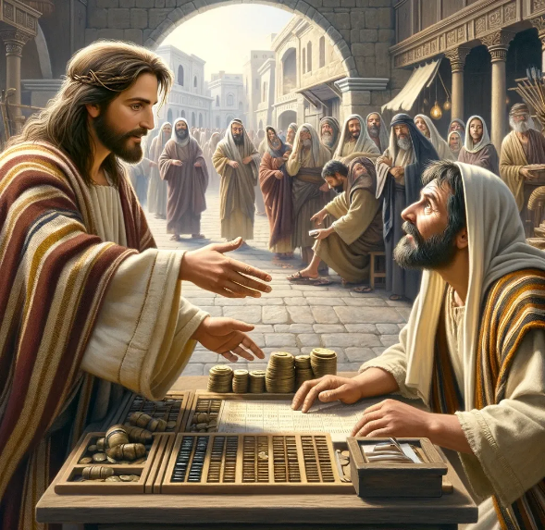
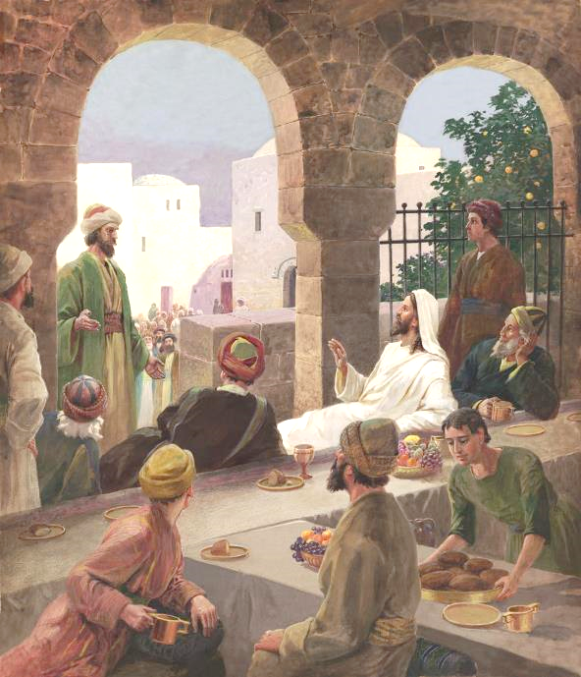
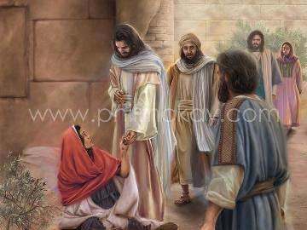
IMPAKA KU BYOKURYA
“Nuko akigenda abona Lewi mwene Alufayo yicaye aho yakoresherezaga ikoro, aramubwira ati ‘Nkurikira’ ” (Mariko 2:14).
Ntibikomeye kwiyumvisha impaka zakuruwe no guhamagarwa kwa Lewi (Mariko 2:13–14). Ku Muyuda utajenjetse, umukoresha w’ikoro yari mubi kurusha Umunyamahanga. Yari Umuyuda w’umugambanyi, waguzwe n’abanzi be. Ntibashoboraga gusangira na we cyangwa kumukoraho.
Ariko ibintu byarushijeho kuyoberana. Uretse no kuba Yesu yararīriye mu nzu y’umukoresha w’ikoro, yanicaye hagati ya benshi bameze nk’uwo (Mariko 2:15). Kunegura ntibyabujije gukoresha neza amahirwe: “Mbega asangira n’abakoresha b’ikoro n’abanyabyaha!” (Mariko 2:16).
Mu buryo bwumvikana, Yesu ntiyagendeye kuri ibyo: ni he haruta aha nabona abanyabyaha nkiza? (Mariko 2:17). Ikigeretse kuri ibyo, yabasabye gusuzuma ibyiyumvo byabo. Bagombaga kwiga gukunda (Matayo 9:12–13).

Slide 6
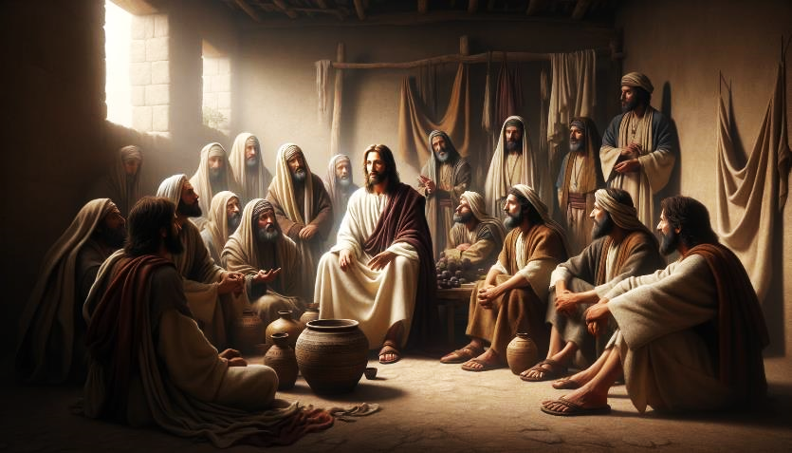
IMPAKA KU BYOKURYA (2)
“Yesu arabasubiza ati ‘Mbese abasangwa bakwiyiriza ubusa bakiri kumwe n’umukwe? Bakiri kumwe na we ntibakwiyiriza ubusa’ ” (Mariko 2:19)
Aho kwiga gukunda, Abafarisayo bashishikarije abigishwa ba Yohana kwifatanya nabo mu kunegura: “Bishoboka bite ko abigishwa ba Yohana n’abigishwa b’Abafarisayo biyiriza ubusa, ariko abawe ntibabikore?” (Mariko 2:18).
Umugani w’ubukwe (Mariko 2:19–20).
Ni gute umuntu ashobora kwiyiriza ubusa mu gihe cy'ubukwe? Umukwe ni Yesu; abatumirwa ni abigishwa. Igihe Yesu yapfaga akazuka, ni bwo abigishwa be bashoboraga gukenera kwiyiriza ubusa.
Imigani y’ikintu gishya gishyizwe mu gishaje (Mariko 2:21–22).
Inyigisho nzima za Yesu ntizari zifite umwanya mu nyigisho zipfuye z’ibihimbano; kandi n’inyigisho zipfuye z’ibihimbano ntizari zifite umwanya mu nyigisho nzima za Yesu.
Yesu yasubije mu buryo bw’imigani:

Slide 7
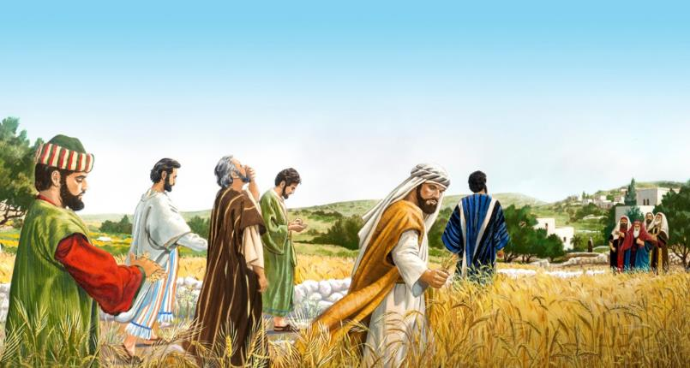
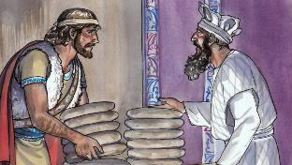
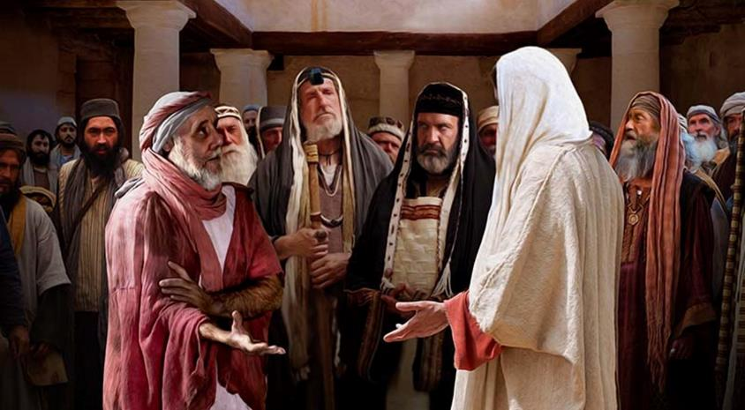
IMPAKA KU BIJYANYE N’ISABATO
“Abafarisayo baramubaza bati ‘Ni iki gitumye bakora ibizira ku isabato?’ ” (Mariko 2:24)
Abafarisayo bigishije uburyo 39 bw’imirimo izirura ikiruhuko cy’Isabato yashyizweho n’Imana.
Ubwo abigishwa bacaga amahundo bagatonora bagata ibishishwa ngo barye impeke, bari bakoze imirimo itatu ibuzanijwe ku Isabato: gusarura, gutonora, no kugosora (Mariko 2:23–24; Matayo 12:1–2).
Igisubizo cya Yesu: “Ntimwari mwasoma icyo Dawidi yakoze, ubwo yari ashonje, yariye imitsima yo kumurikwa, ubudni yaribwaga n’abatambyi bonyine? (Mariko 2:25–26).
Hanyuma, Yesu yakoze “umurimo” utari warashyizwe muri ya yindi 39, ariko kandi wafashwe nko kuzirura Isabato: gukiza indwara (Mariko 3:1–3).
Igisubizo cya Yesu: “Mbese icyemewe ni ugukora neza cyangwa nabi ku isabato, gukiza umuntu cyangwa kumwica?” (Mariko 3:4).
Muri ibyo byose, Yesu ni Umwami w’Isabato, kandi yayiduhaye ngo itunezeze (Mariko 2:27–28).
Igitangaje, abari bafite ishyaka ryo kuziririza Isabato ni bo baciye igico cy’ubwicanyi (Mariko 3:6).

Slide 8
IBIBAZO BITEJE IMPAKA KURI YESU

Slide 9
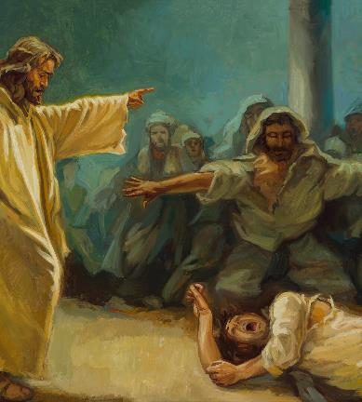
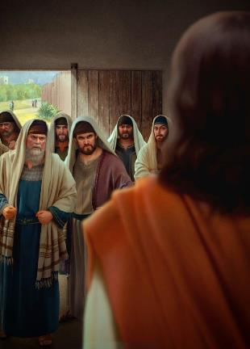
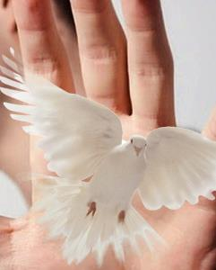
AKORA IBITANGAZA KUBW’UBUHE BUBASHA?
“Kandi abanditsi bavuye i Yerusalemu na bo bati ‘Afite Belizebuli!’ kandi bati ‘Umukuru w’abadayimoni ni we umuha kwirukana abadayimoni’ ” (Mariko 3:22)
Mariko atangira inkuru ivuga ku muryango wa Yesu, ariko akayirogoya kugira ngo avuge iby’impaka n’Abafarisayo. Nyuma, agaruka ku nkuru ya mbere. Ubu buryo (inkuru ikubiye mu yindi) bwagiye bukoreshwa na Mariko inshuro nyinshi kugira ngo ahūze inkuru ebyiri zisa, yerekana inkuru irimo hagati nk’iy’ingenzi cyane.
Ab’umuryango wa Yesu baza kumushaka
Mariko 3:20–21
Mariko 3:22–30
Ibirego by’Abafarisayo
Ahangaha, inkuru y’ingenzi ni ibirego by’abanditsi bibaza aho Yesuakura ububasha imbaragbwo kwirukana abadayimoni (Mariko 3:22).
Ab’umuryango wa Yesu baza kumushaka
Mariko 3:31–35
Na none, Yesu yakoresheje umugani kugira ngo yerekane ko ibyo bamushinja bidafite ishingiro (Mariko 3:23–27). Yesu yinjiye mu nzu y’umunyamaboko (Satani), aramuboha, maze abona uko asahura inzu ye (kubohora uwatewe n’abadayimoni).
Yaboneyeho no kuburira abantu ku kaga ko kwitirira Satani umurimo w’Umwuka Wera (Mariko 3:28–30).

Slide 10
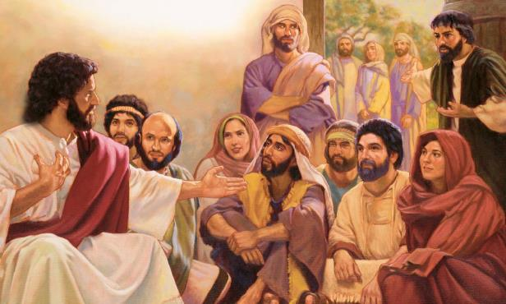
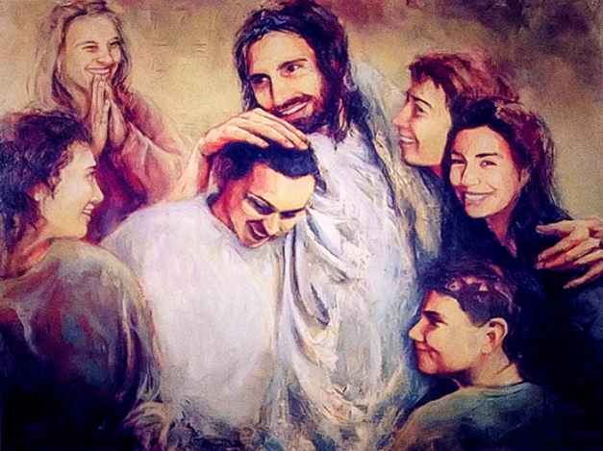
ESE YESU AFITE IKIBAZO CYO MU MUTWE?
“Nuko ab’iwabo babyumvise barasohoka ngo bamufate, kuko bagiraga ngo yasaze” (Mariko 3:21)
Ni iki cyateye umuryango wa Yesu kwibwira ko yasaze (Mariko 3:20–21)?
Gukora cyane, imirire mibi, guhangayikishwa n’impaka zihoraho agirana n’abanditsi n’Abafarisayo...
Nyuma yo kwītsa, Mariko asubukura inkuru, avuga kuri bene wabo ba Yesu bari baje kumushaka: nyina na bene se (Mariko 3:31).
Mbega ukuntu bisa n’aho Yesu atitaye ku muryango we! (Mariko 3:32–33).
Ariko ibigaragara birashukana. Nyina na bene se baribeshyaga. Gusiga umurimo We ngo abitabe muri ako kanya byajyaga kubangamira ubutumwa Bwe ndetse na bo ubwabo.
Icy’ingenzi kuruta isano y’umubiri ni amasano ahuza Yesu n’umuryango We mu bya mwuka: “umuntu wese ukora ibyo Imana ishaka ni we mwene data, ni we mushiki wanjye, ni we mama” (Mariko 3:35).

Slide 11
“Umwuka w’akarengane ntuzakongerezwa kurwanya abatagirana n’Imana umubano uhamye, abadafite imico-mbonera ihamye. Uwo mwuka uzakongerezwa kurwanya ab’indahemuka, batagwabizwa n’isi kandi ntibanyeganyezwe n’ibitekerezo byayo, cyangwa gutoneshwa nayo, cyangwa kwangwa nayo. Idini rifite ibihamya byerereza ukwera, kandi ryamagana ubwibone, inarijye, kwikanyiza, n’ubuhenebere mu nyifato, rizangwa n’isi ndetse n’abakristo badafite ishyikizo... Nimuhura n’ababarwanya ndetse n’akarengane, bizaba byerekana ko muri mu itsinda rizima; kuko Yesu yihanganiye ibyo byose, n’ibindi byinshi. Niba muri intumwa z’indahemuka z’Imana, muzishimira ibi. Abantu b’intwari, abazashikama nubwo baba bahagaze bonyine, ni bo bazahembwa ikamba ritangirika."
E.G. White, The Medical Ministry, p. 282

