Slide 1
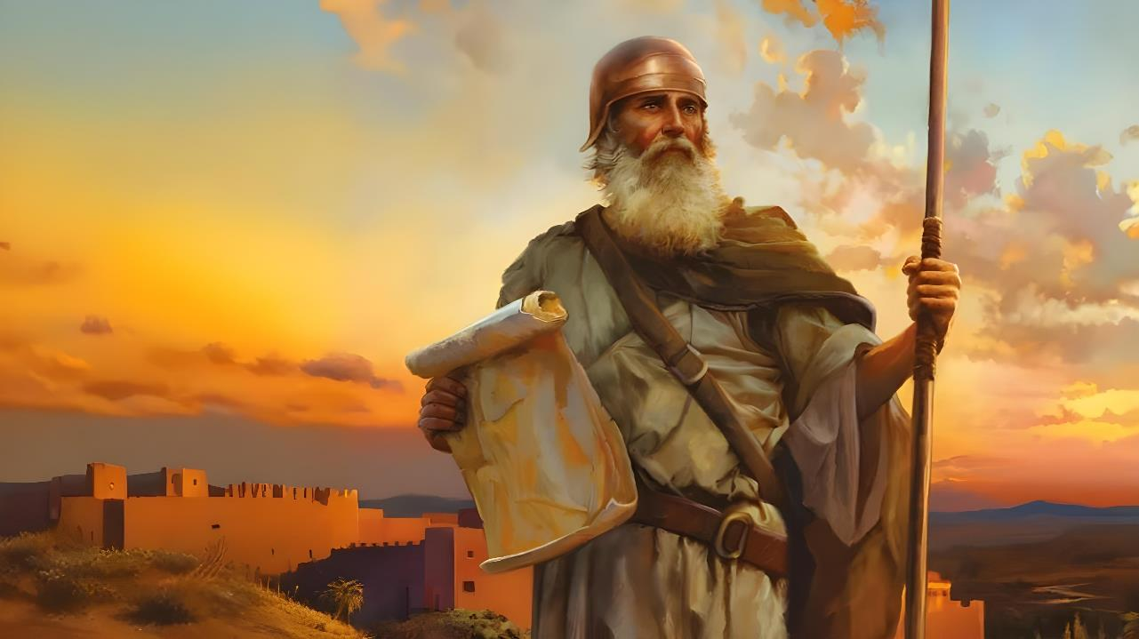

AMABWIRIZA YO KUGERA KU NTEGO
Icyigisho cya 1 cyo ku wa 4 Ukwakira 2025

Slide 2
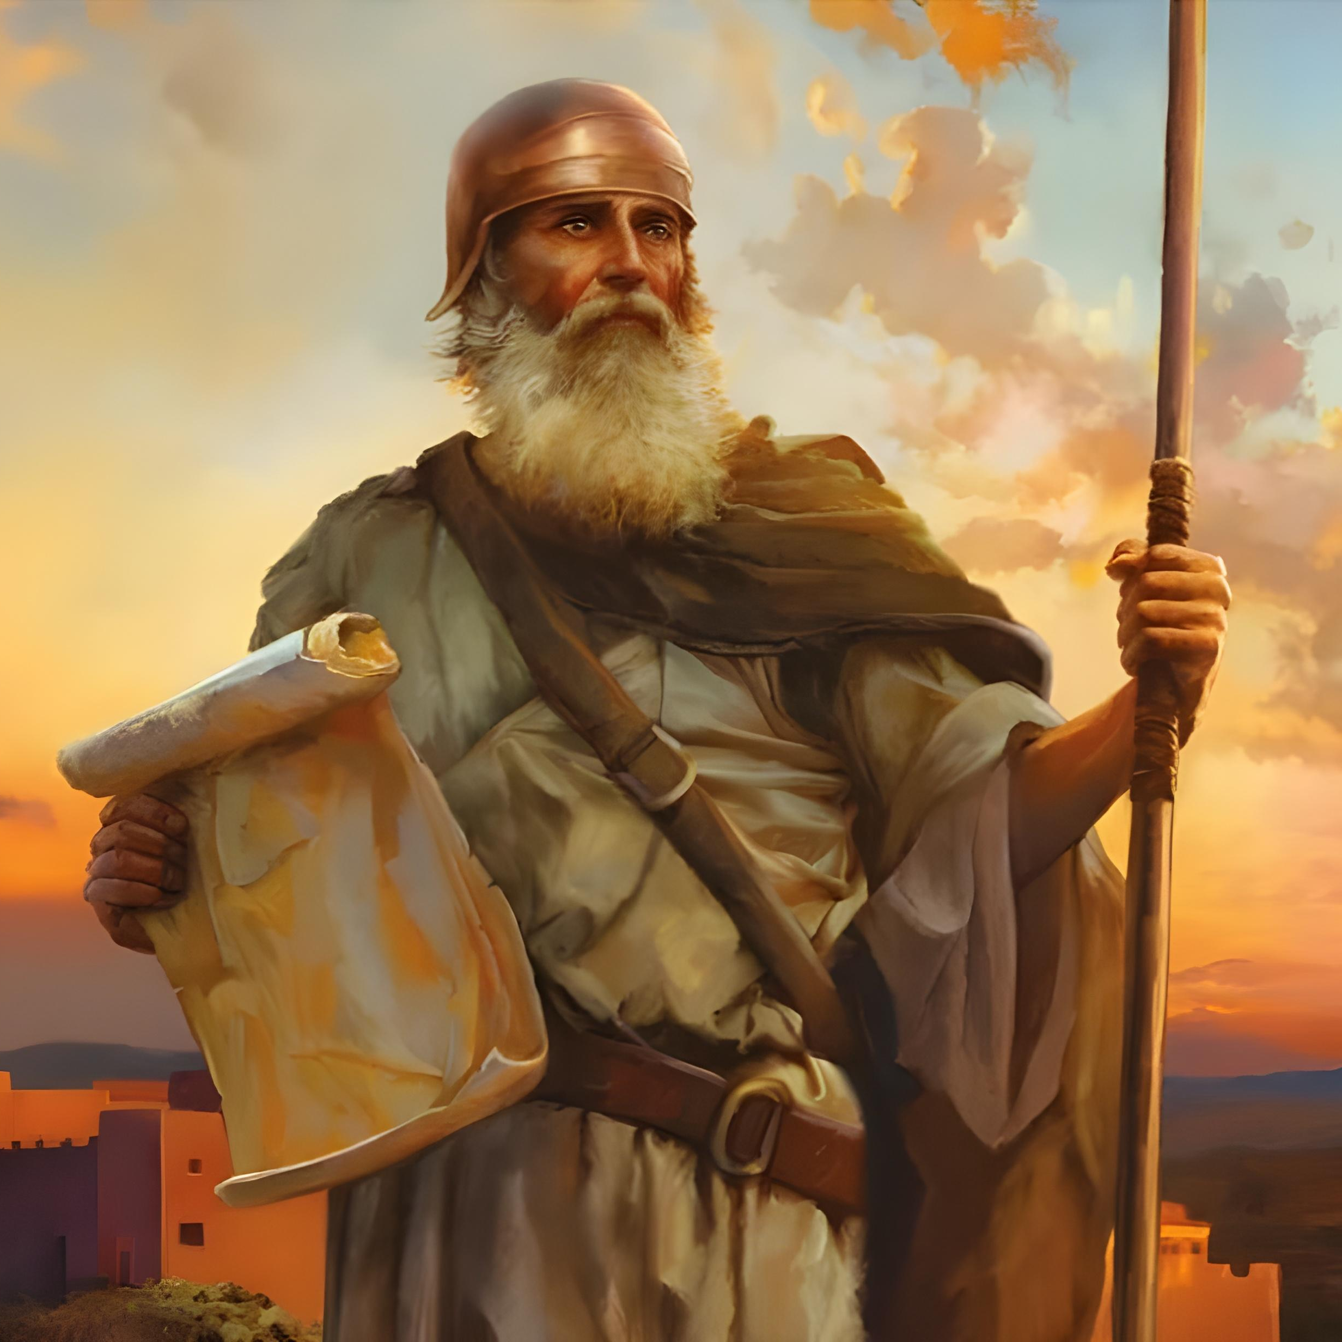
“Icyakora ukomere ushikame cyane, kugira ngo witondere amategeko yose umugaragu wanjye Mose yagutegetse. Ntuzayateshuke uciye iburyo cyangwa ibumoso, kugira ngo ubashishwe byose aho uzajya hose” Yosuwa 1:7

Slide 3

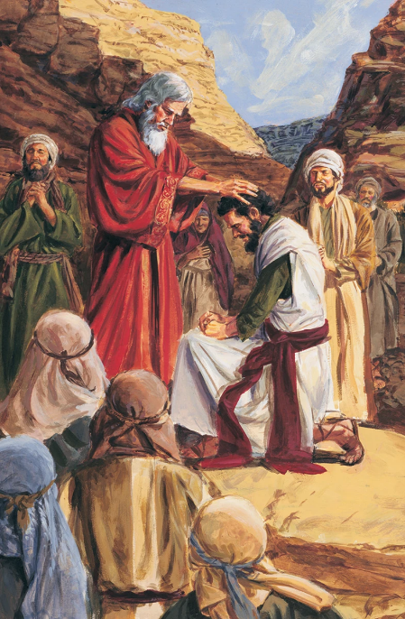
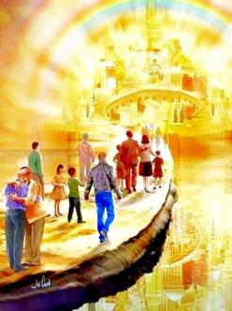


Nyuma y’imyaka 40 y’uruzerero, igisekuru gishya cyaraje, kandi igihe cyari kigeze cyo guhīndūra Igihugu cy’Isezerano. Mose yari yarapfuye, maze Imana itoranya umuyobozi mushya kubw’iyi nshingano: Yosuwa.
Mbere yo gutangira urugamba, umuyobozi mushya ndetse n’ab’igisekuru gishya bararikiwe kwiringira Imana byimazeyo.
Mu gihe ab’igisekuru cy’iki gihe (twebwe) bahagaze ku ngabano za Kanani yo mu ijuru, irarika ry’Imana riracyumvikana mu mbaraga zikomeye: “ukomere ushikame cyane” (Yosuwa 1:7).
Ibibanza (Yosuwa 1:1–3):
Mose na Yosuwa
Ibikubiye mu gitabo
Umurimo wa Yosuwa (Yosuwa 1:4–9):
Kuragwa ibyasezeranywe
Gukomera no gushikama
Kugera ku ntego y’umurimo

Slide 4
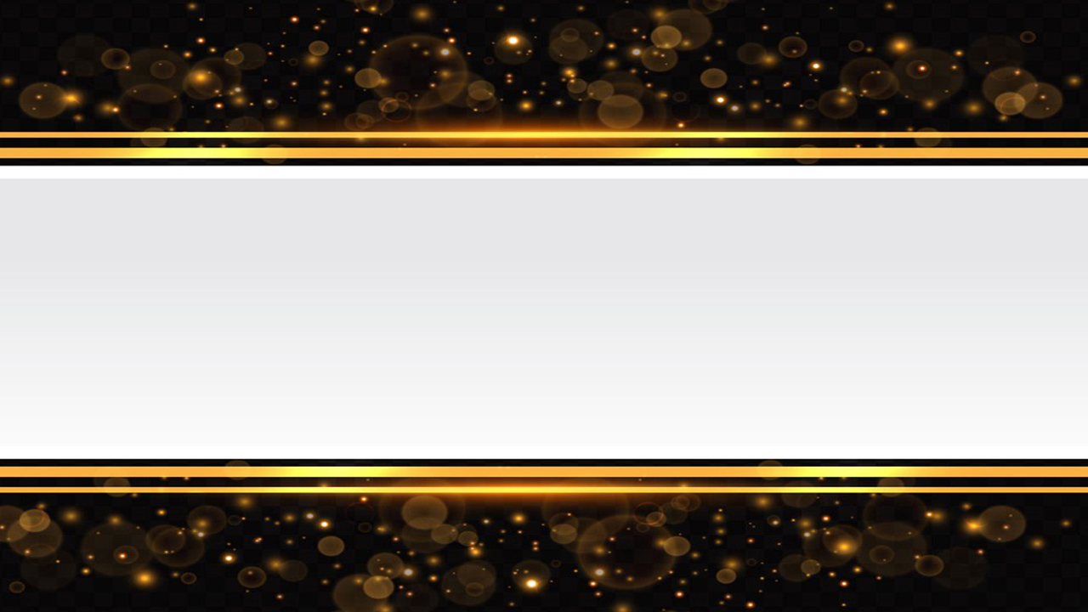
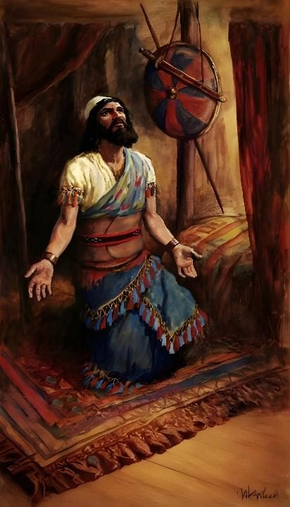
IBIBANZA
(YOSUWA 1:1–3)

Slide 5







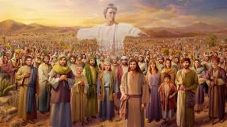
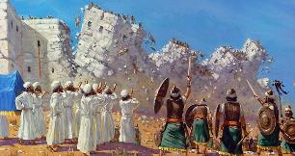








MOSE NA YOSUWA
Imana yarababonekeye (Kuva 3:2–4; Yosuwa 5:13–14)
Basabwe gukwetura inkweto zabo (Kuva 3:5 ; Yosuwa 5:15)
Imana yabasezeranije kubana nabo (Kuva 3:12; Yosuwa 1:5)
Biziririje Pasika (Kuva 12:21–23; Yosuwa 5:10)
Bambutse amazi banyuze ku butaka bwumutse (Kuva 14:21–22; Yosuwa 3:14–17)
Manu yaje mu gihe cy’umwe, igenda mu gihe cy’undi (Kuva 16:4–5, 31; Yosuwa 5:11–12)
Bohereje abatasi bo gutata igihugu (Kubara 13:1–3; Yosuwa 2:1)
“Ubwo Mose umugaragu w’Uwiteka yari amaze gupfa, Uwiteka abwira Yosuwa mwene Nuni umufasha wa Mose” (Yosuwa 1:1)
Mose avugwa inshuro cumi n’imwe mu gice cya mbere cy’igitabo cya Yosuwa, kandi izina rye rikagaruka inshuro nyinshi mu bindi bice by’iki gitabo.
Hariho byinshi aba bayobozi bombi bahuriyeho:
Nubwo igice cya mbere cya Yosuwa kivuga ibyerekeranye n’isimburana hagati y’abayobozi babiri bakomeye ba Isirayeli, muri bo nta n’umwe ugaragara nk’uw’ibanze muri iki gitabo. Uw’ingenzi ni Imana ubwayo, nyir’amagambo atangira iki gitabo, kandi ubuyobozi bwayo bukaba insanganyamatsiko yiganje muri cyo. Nta gushidikanya guhari ku muyobozi nyawe wa Isirayeli uwo ari We.

Slide 6
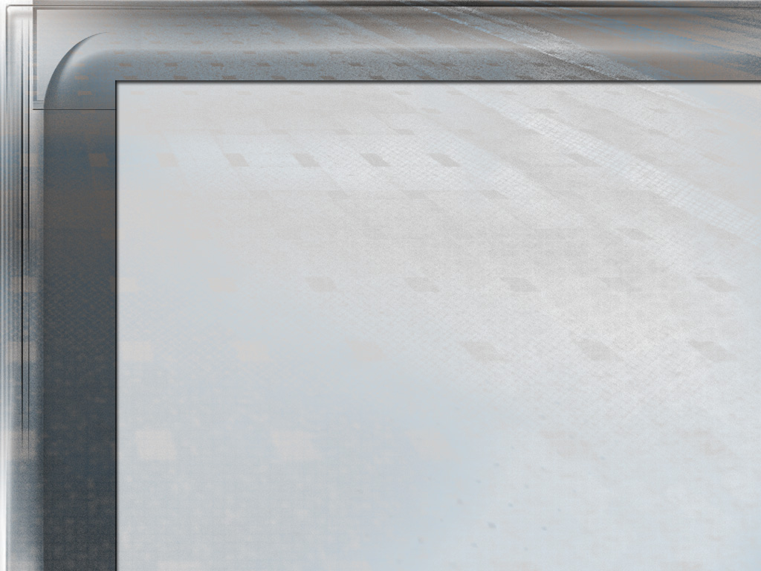
“Ubwo Yosuwa ni we wari umuyobozi wemewe w’Abisirayeli. Yari azwi cyane ko ari umuntu w’intwari, kandi icyo gihe impano ze n’ubupfura bwe byahawe agaciro mu buryo bwihariye mu mateka y’ubwoko bwe. Kugira ubutwari, kudakebakeba, kwihangana, ubutungane ndetse no kutita ku nyungu ze bwite kubwo kwita kubo yari ashinzwe, ndetse ikiruta byose agakoreshwa no kwizera Imana kuzima; iyo ni yo mico yarangaga umugabo watoranyijwe n’Imana kugira ngo ayobore ingabo z’Abisirayeli azinjize mu Gihugu cy’Isezerano. Mu gihe Abisirayeli babaga mu butayu, Yosuwa yari yarakoze nka minisitiri w’intebe wa Mose, kandi kubwo kuba umwizerwa nyakuri ndetse utuje, gushikama kwe ubwo abandi badohokaga, kudateshuka kwe ku kuri ari mu byago, byari byarabaye igihamya cy’uko ari we muntu ukwiriye gusimbura Mose na mbere y’uko ijwi ry’Imana rimuhamagarira kujya mu mwanya we.”
E.G. White, Abakurambere n’Abahanuzi, p. 329

Slide 7

IBIKUBIYE MU GITABO
“Umugaragu wanjye Mose yarapfuye, none ubu haguruka wambukane n’aba bantu bose ruriya ruzi rwa Yorodani, mujye mu gihugu mbahaye mwebwe Abisirayeli” (Yosuwa 1:2)
Igitabo cya Yosuwa cyerekana isohozwa ry’amasezerano Imana yahaye Isirayeli igihe yabavanaga muri Egiputa, ari yo kubaha Kanani. Haba ibibanza (igice cya 1) haba n’igitabo ubwacyo, bigabanyijemo imigabane ine y’ingenzi:
AMBUKA ujye i Kanani
Yosuwa 1:1–9
Yosuwa 1:1–5:12
UHĪNDŪRE Kanani
Yosuwa 1:10–11
Yosuwa 5:13–12:24
UGABANYE igihugu
Yosuwa 1:12–15
Yosuwa 13:1–21:45
UNKORERE wumvira Amategeko
Yosuwa 1:16–18
Yosuwa 22:1–24:33

Slide 8
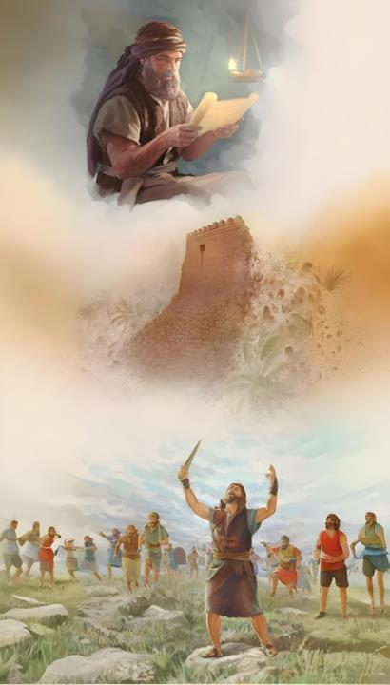
UMURIMO WA YOSUWA
(YOSUWA 1:4–9)

Slide 9

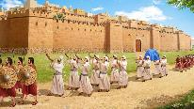
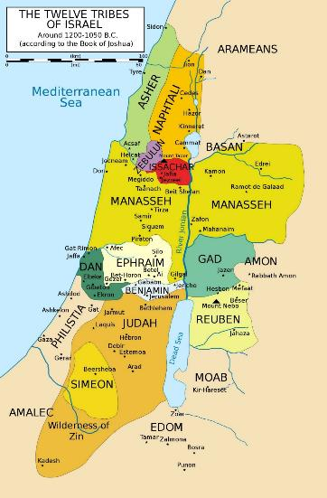
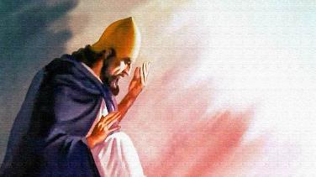
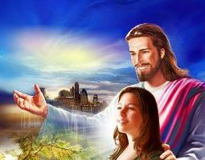
KURAGWA IBYASEZERANYWE
“Aho muzakandagira hose ndahabahaye nk’uko nabwiye Mose” (Yosuwa 1:3)
Muri Yosuwa 1:3, Imana ivuga ikoresheje indagihe ya gihanuzi. Ivuga Kanani nkaho Isirayeli yari yaramaze kuyihabwa. Ibi bivuze ko Imana yabahaye ibyiringiro byuzuye byo kuyigarurira.
UFURATE
Nuko ibibutsa ingabano z’aho bazigarurira (Yosuwa 1:4): ni akarere kari hagati y’uruzi rwa Yorodani (iburasirazuba) n’inyanja ya Mediteraneya (iburengerazuba), kuva mu butayu (mu majyepfo) kugera ku ruzi rwa Ufurate (mu majyaruguru).
INYANJA YA MEDITERANEYA
Ikurikizaho kubwira Yosuwa imwizeza ko nakomera agashikama, nta muntu n’umwe uzashobora kumuhagarara imbere (Yosuwa 1:5–6).
YORUDANIYA
Ariko ntabwo kunesha byari mu butwari bwa Yosuwa ubwe, ahubwo kwajyaga kubonerwa mu kuba imbere y’Imana. Yamwijeje, nk’uko yizeza buri wese muri twe iti: “Nzabana nawe” (Yosuwa 1:5; Matayo 28:20).
UBUTAYU

Slide 10

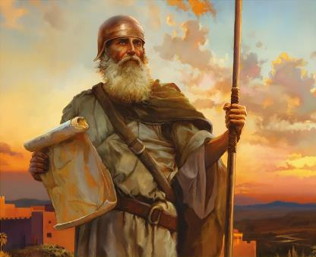
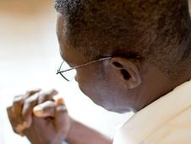
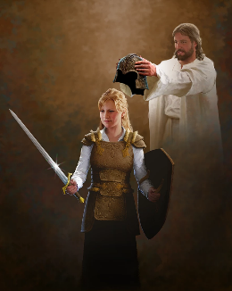
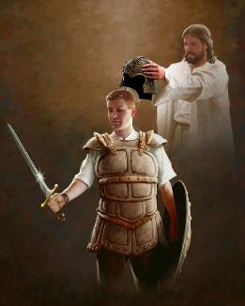
GUKOMERA NO GUSHIKAMA
“Mbese si jye ubigutegetse? Nuko komera ushikame, ntutinye kandi ntukuke umutima, kuko Uwiteka Imana yawe iri kumwe nawe aho uzajya hose.” (Yosuwa 1:9)
Mbere yo gusaba Yosuwa gukomera no gushikama mu rugamba (Yosuwa 1:9), Imana yamusabye gukomera no gushikama mu kumvira Amategeko (Yosuwa 1:7).
Uku ni ko bimeze no muri iki gihe. Imana idusaba gutwaranira gukurikiza Amategeko yayo (Ibyahishuwe 14:12). Ibi bidusaba ubutwari bukomeye.
Ku ruhande rwayo, isezeranya iti “nzabana nawe aho uzajya hose” (Yosuwa 1:9), idufasha kurwana urugamba turimo. Ntabwo ari intambara turwana n’abafite amaraso n’umubiri, ahubwo turwana “n’abatware n’abafite ubushobozi n’abategeka iyi si y’umwijima, n’imyuka mibi y’ahantu ho mu ijuru” (Abefeso 6:12). Kugira ngo tubigereho, [Imana] yaduhaye intwaro zikenewe (Abefeso 6:13–17).
Ibanga ryo kunesha ni ukwiringira Imana byimazeyo. Kandi kubw’ibyo, dukeneye kugirana umubano na Yo buri munsi (Abefeso 6:18).

Slide 11


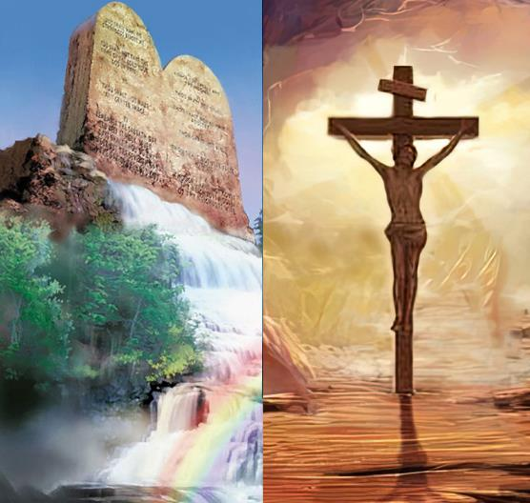
KUGERA KU NTEGO Y’UMURIMO
“Ibiri muri iki gitabo cy’amategeko ntukarorere kubihamisha akanwa kawe, ahubwo ujye ubitekereza ku manywa na nijoro kugira ngo ubone uko ukurikiza ibyanditswemo byose. Ni ho uzahirwa mu nzira zawe, ukabashishwa byose.” (Yosuwa 1:8)
Uburyo Imana ibona kugera ku ntego kwacu ntibihura n’uburyo umuntu abibona.
Kugera ku ntego by’igihwayihwayi muri iyi si bishobora kugerwaho binyuze mu kwica amategeko y’Imana n’ay’abantu, ariko si ko biri ku kugera ku ntego by’ukuri kandi by’iteka ryose (Yosuwa 1:8).
Tuzagera ku ntego niba dukurikiza amahame n’imicombonera bigaragarira mu Mategeko y’Imana. None se ubwo ibi ntibyaba ari agakiza gashingiye ku mirimo?
Ntabwo ari ko biri rwose. Kwizera n’amategeko ntabwo ari ibintu birwanyana hagati yabyo, ahubwo biruzuzanya (Abaroma 3:31). Iyo tuvuze Amategeko, tuba tuvuga uburyo tugomba kubaho, ntabwo ari uburyo twakijijwemo. Umubano wacu n’Imana ugaragarira mu kumvira ubushake bwayo.

Slide 12
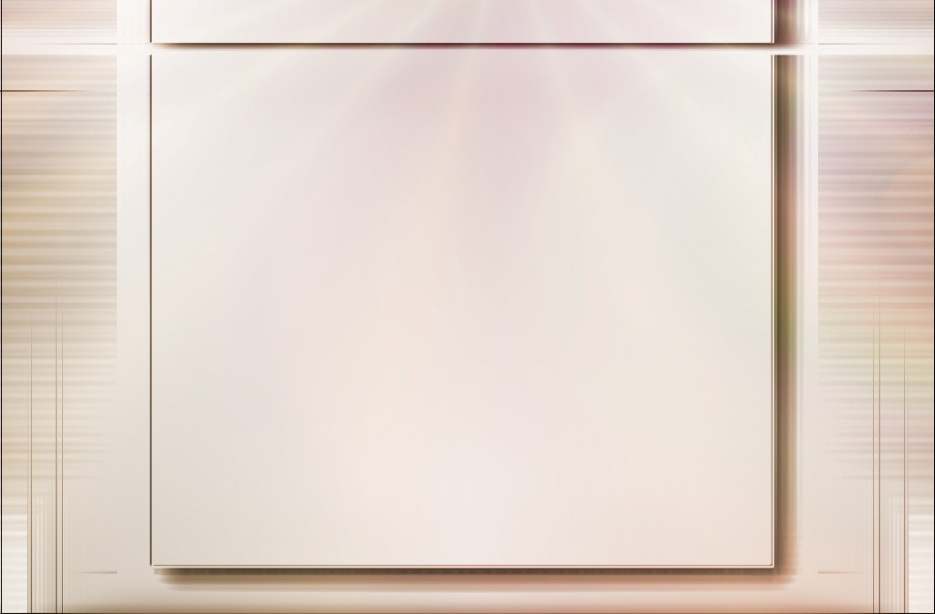
“Iteka Umukristo aba afite Uwiteka ho umufasha ukomeye. Dushobra kutamenya inzira Uwiteka adufashirizamo; ariko ibi tubizi neza: Ntazigera atererana abamwiringira. Iyaba Abakristo basobanukirwaga incuro nyinshi Uwiteka yabaciriye inzira kugira ngo imigambi umwanzi abafitiye idasohora, ntibagwaguje bitotomba. Ukwizera kwabo kwashikama ku Mana, kandi nta kigeragezo cyagira imbaraga yo kubakura mu byimbo. Bazirikana ko Imana ari yo bwenge bwabo n’ububasha bwabo, kandi Imana na Yo izatuma ibyo ishaka ko bibakorerwamo bibaho.”
E.G. White, Abahanuzi n’Abami, p. 535

