Slide 1
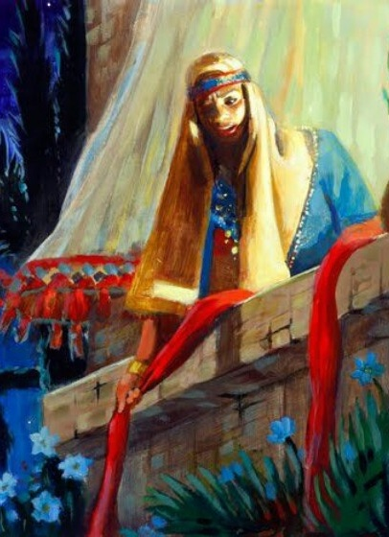
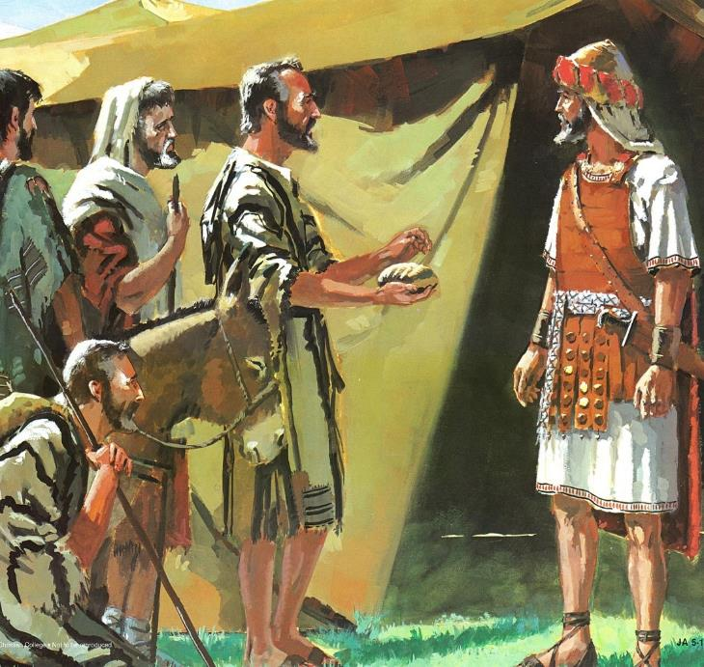
GUTUNGURWA N’UBUNTU
Icyigisho cya 2 cyo ku wa 11 Ukwakira 2025

Slide 2

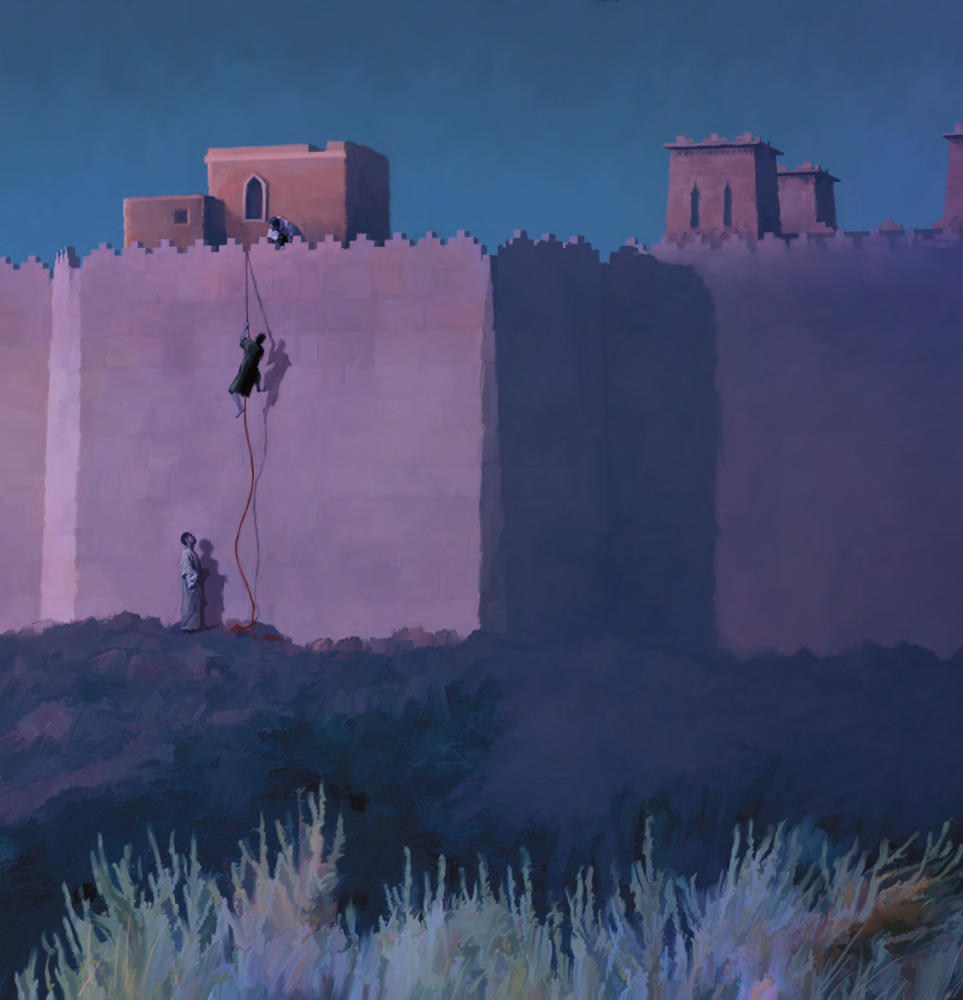
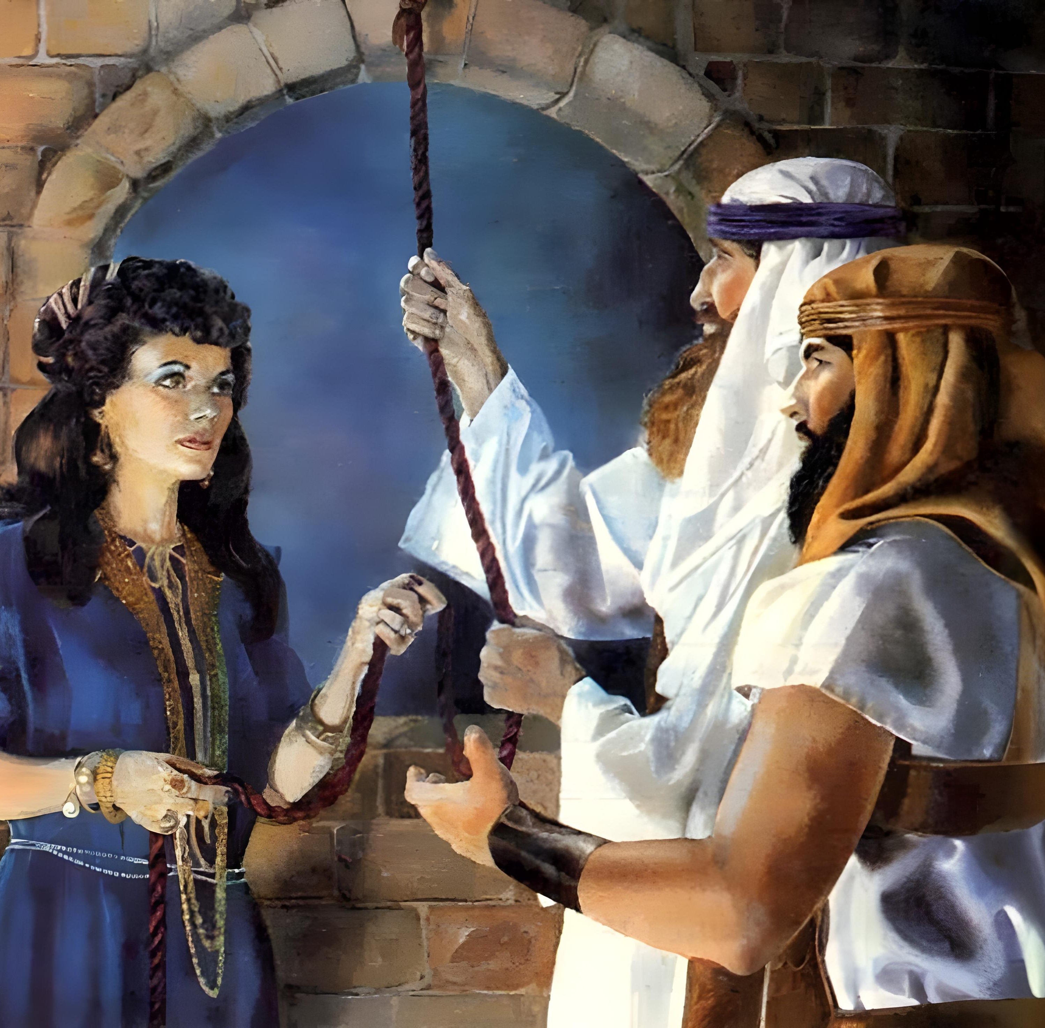
“Kwizera ni ko kwatumye maraya uwo Rahabu atarimburanwa n’abatumviye Imana, kuko yakiranye abatasi amahoro”
(Abaheburayo 11:31)

Slide 3

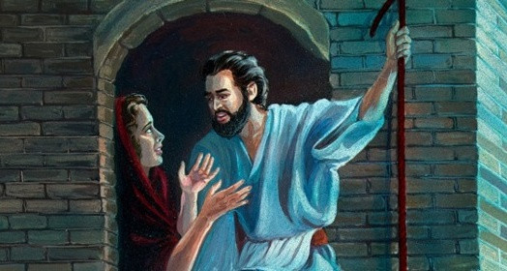
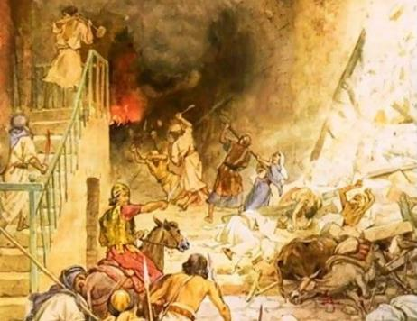



Abanyakanani bari bararenze ingabano z’ubuntu. Kubera iyo mpamvu, itegeko ryahawe Isirayeli ryari iri ngo: injira, ubarimbure, kandi wigarurire ibyo batunze.
Icyakora, muri Kanani hari hakiri abantu bamwe bari batararenga izo ngabano. Abantu bose bemeye kwakira ubuntu Imana yashakaga kubaha barokowe ukurimbuka.
Ubuntu ku bwoko bw’Abisirayeli (Yosuwa 2:1, 22–24):
Amahirwe ya kabiri
Ubuntu kuri Rahabu (Yosuwa 2:2–21):
Kwizera kw’akabuto ka sinapi
Isezerano ryageze kuri Rahabu
Ubuntu ku Bagibeyoni (Yosuwa 9):
Intumwa zishukana
Umugisha n’umuvumo

Slide 4
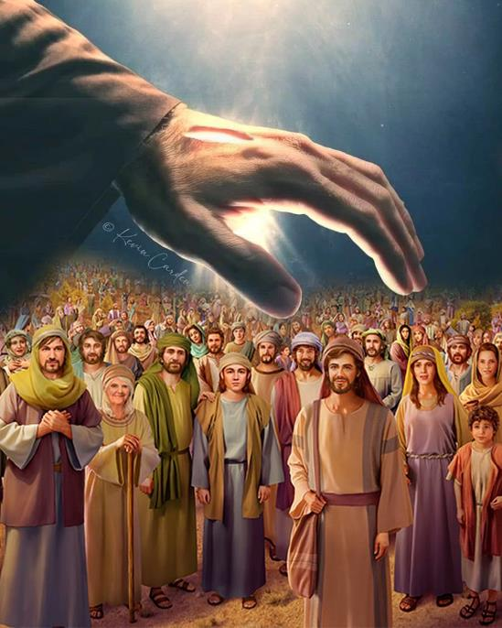
UBUNTU KU BWOKO BW’ABISIRAYELI (YOSUWA 2:1, 22–24)

Slide 5


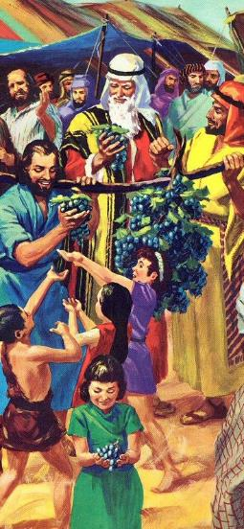
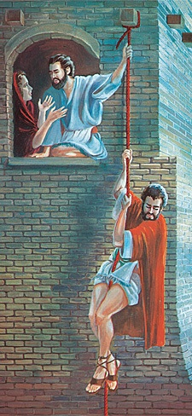
AMAHIRWE YA KABIRI
“Bari i Shitimu, Yosuwa mwene Nuni yohereza abagabo babiri rwihishwa ngo bajye gutata,’ Arababwira ati ‘cyane cyane i Yeriko’ ” (Yosuwa 2:1a)
Igihe Mose yoherezaga abatasi gutata Kanani, abantu banze kuyijyamo. Nyuma y’imyaka 40, abatasi bashya baroherejwe, umusaruro uza utandukanye n’uwa mbere.
Abatasi baroherezwa
Ku mugaragaro (abatasi 12)
Mu ibanga (abatasi 2)
Imikorere y’abatasi
Iminsi 40 yo kugenzūra
Iminsi 3 mu bwihisho
Abatasi bavuga ibyo bagezeho
Baciye intege abantu
Bateye imbaraga Yosuwa
Nubwo igisekuru gishya cyari cyaratsinzwe bikomeye imbere y’ikigeragezo cya Balamu, Imana yabahaye amahirwe ya kabiri (Kubara 25:1–3, 31:16; Yosuwa 2:1).
Icyo gihe nta mbuto z’inzabibu, cyangwa izindi mbuto bakuye muri icyo gihugu. Bazanye gusa inkuru yo kwizera (ya Rahabu), yashishikarije Isirayeli kwigarurira Igihugu cy’Isezerano.

Slide 6
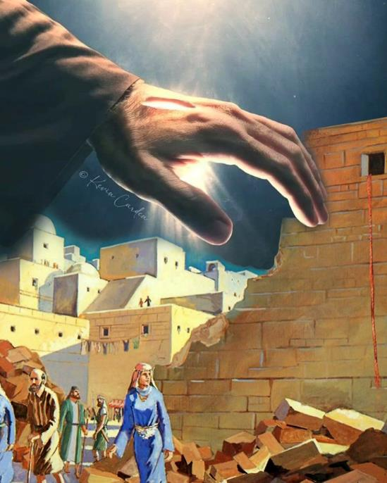
UBUNTU KURI RAHABU
(YOSUWA 2:2–21)

Slide 7

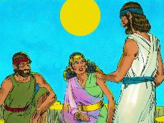
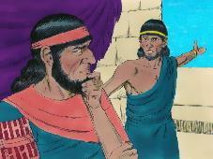
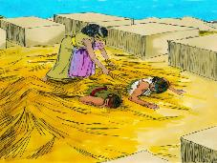
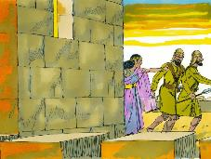
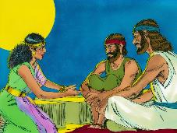
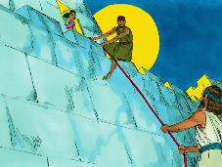
KWIZERA KW’AKABUTO KA SINAPI
“Kwizera ni ko kwatumye maraya uwo Rahabu atarimburanwa n’abatumviye Imana, kuko yakiranye abatasi amahoro” (Abaheburayo 11:31)
Ukwizera kwa Rahabu kwari gushingiye kuki (Yosuwa 2:9–11)?
Menya ko Rahabu avuga ibintu byari bizwi na bose, nko kwambuka Inyanja Itukura. Ariko mu gihe abandi batinye Imana y’Abaheburayo, we yahisemo guhungira munsi y’amababa yayo (Yosuwa 2:12–13).
Niba yarizeraga Imana, kuki yakoresheje ikinyoma kugira ngo afashe abatasi?
Ukwizera kwe kwari kutarakura ntabwo kwashoboye kumva neza ubushake bw’Imana. Yakoze uko abyumva kugira ngo afashe abatasi ndetse arokore ubuzima bwe n’ubw’ab’umuryango we. Ubumenyi bwajyaga kuza hanyuma.
Bibiliya imushimira icyemezo yafashe; kubera gusobanukirwa uburyo Imana ikora; n’uburyo yashyigikije amagambo ye imirimo ifatika (Yakobo 2:25).
Rahabu ni urugero rw’ibyajyaga kuba ku muturage wese wa Yeriko wari kwiyegurira Imana.

Slide 8

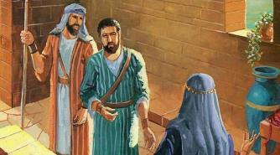
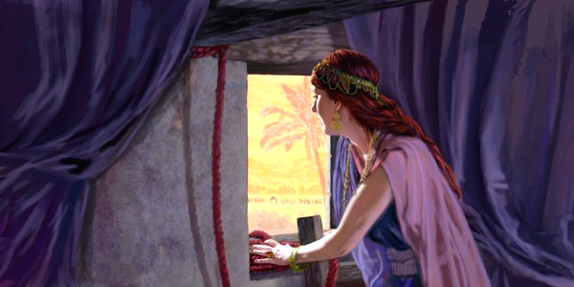
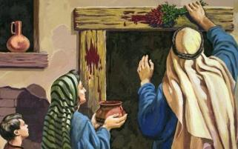
ISEZERANO RYAGEZE KURI RAHABU
“Nihagira umuntu uva mu nzu yawe agasohoka, amaraso ye ni we azabaho twe nta rubanza ruzatubaho. Kandi umuntu wese uzaba ari hamwe nawe mu nzu, amaraso ye azatubeho nihagira umwakura” (Yosuwa 2:19)
Isirayeli kuri Pasika
Bagombaga gusīga amaraso ku nkomanizo (Kuva 12:7)
Uwari kuva mu nzu, yari gupfa (Kuva 12:13)
Rahabu i Yeriko
Yagombaga gushyira akagozi gatukura mu idirishya rye (Yosuwa 2:18)
Iyo aramuka avuye mu nzu, yari gupfa (Yosuwa 2:19)
Igitekerezo cya Rahabu nticyashidikanywaho: Nagize neza [hesed] ndabakiza; noneho namwe mugire neza munkizanye na bene wacu (Yosuwa 2:12–13).
Nubwo Rahabu atari abizi, yasabye Abisirayeli kumugirira nk’uko Imana ubwayo yagiriye Abisirayeli, ni ukuvuga kubagirira ineza [hesed] (Gutegeka 7:12).
Abatasi basabye Rahabu kubahiriza ibyo basohoje kugira ngo barokoke urupfu muri Egiputa. Muri ubwo buryo, yashyizwe mu isezerano Imana yahaye Isirayeli.

Slide 9
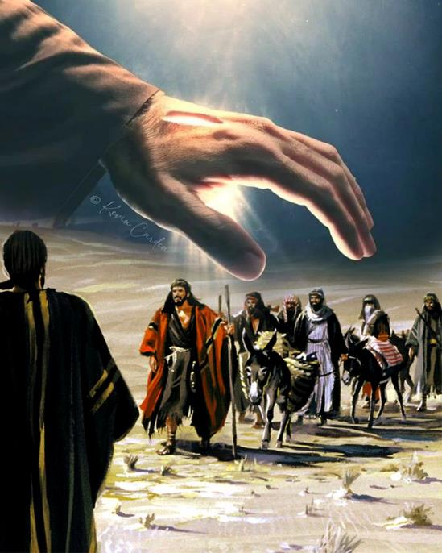
UBUNTU KU BAGIBEYONI (YOSUWA 9)

Slide 10


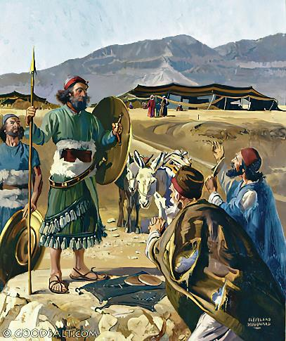
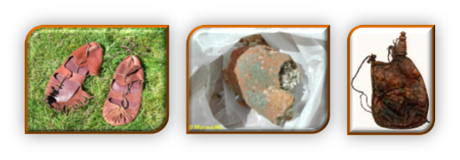
INTUMWA ZISHUKANA
“Barahaguruka basanga Yosuwa n’Abisirayeli mu ngando y’i Gilugali barababwira bati ‘Turaturuka mu gihugu cya kure, nuko mudusezeranye isezerano’ ” (Yosuwa 9:6)
Reba isano n’itandukaniro hagati ya Rahabu n’Abagibeyoni :
Ibyo kwizera | Rahabu | Abagibeyoni
Ishingiro | Kumva (2:10) | Kumva (9:3)
Uburyo | Ikinyoma (2:4-5) | Ikinyoma (9:4)
Intego | Kurokoka (2:13) | Kurokoka (9:24)
Igisubizo cy’ako kanya | Gutabarwa (6:23) | Gutabarwa (9:26)
Igisubizo gishyize kera | Ubwenegihugu bwuzuye (6:25) | Uburetwa (9:27)
Rahabu yabeshye bya gitunguro kugira ngo arokore abatasi. Ariko, Abagibeyoni babeshye nkana, bagambiriye kubeshya, bakoresheje amayeri (reba Itangiriro 3:1a). Byongeye kandi, abayobozi ba Isirayeli bananiwe kugisha inama Imana (Yosuwa 9:14).
Ibi byabashyize mu gihirahiro: hagati yo kurimbura Abagibeyoni, cyangwa kubahiriza indahiro (Yosuwa 9:18).

Slide 11

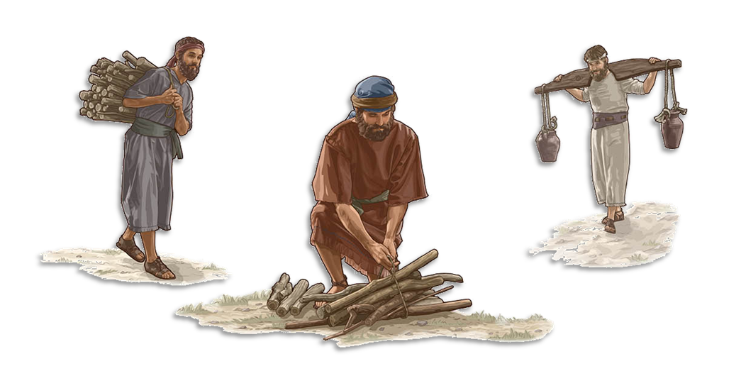
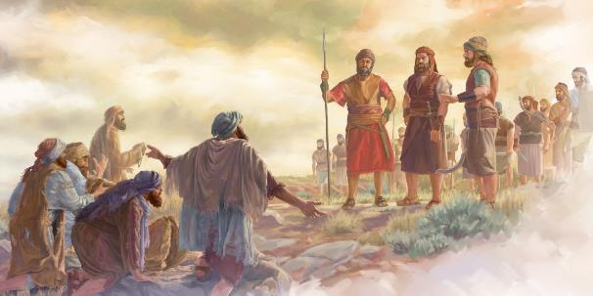
UMUGISHA N’UMUVUMO
“Nuko rero muravumwe, ntabwo muzabura kuba abaretwa n’abashenyi n’abavomyi b’inzu y’Imana yanjye” (Yosuwa 9:23)
Kurokora ubuzima bw’Abagibeyoni byari kuba ukutumvira itegeko ritaziguye riva ku Mana (Gutegeka 7:1–2). Kurenga ku ndahiro nk’iyo bari barabarahiriye nabyo byari gufatwa nk’icyaha (Yosuwa 9:19; Zaburi ya 15:4b). Iki gihirahiro bakivuyemo gute?
Ubuzima bwabo bwararokotse, ariko bashyizwe mu muvumo (Yosuwa 9:20–23). Umuvumo wari uwo kuba abaretwa uko ibisekuru bihaye ibindi. Ibi byabashyize mu mubano wa bugufi n’ubwoko bw’Imana, ubwo batigeze batandukana nabwo (Nehemiya 7:6, 25).
Ikigeretse kuri ibyo, kuba abavomyi n’abashenyi b’inkwi mu nzu y’Imana byabashyiriyeho umubano uhoraho n’Imana. Ku bw’ubuntu bw’Imana, umuvumo wahindutse umugisha. “Sinezezwa no gupfa k’umunyabyaha, ahubwo nezezwa n’uko umunyabyaha ahindukira akava mu nzira ye maze akabaho” (Ezekiyeli 33:11).

Slide 12

“Abana ba Isirayeli bagombaga kwigarurira akarere kose Imana yabashyiriyeho. Ayo mahanga yanze kuramya no gukorera Imana y’ukuri yagombaga kwamburwa aho yari afite. Ariko umugambi w’Uwiteka wari uwo guhishura imico Ye binyuze muri Isirayeli maze abantu bakareherezwa kuri We. Irarika ry’ubutumwa bwiza ryagombaga kugezwa ku bantu bose. […] nk’uko byagendekeye Umunyakananikazi Rahabu ndetse n’Umumowabukazi Rusi, abantu bose bari guhindukira bakava mu gusenga ibigirwamana bakaramya Imana y’ukuri, bagombaga kwiyunga ku bwoko bwayo yatoranije.”
E.G. White, Christ’s Object Lessons, p. 290

