Slide 1
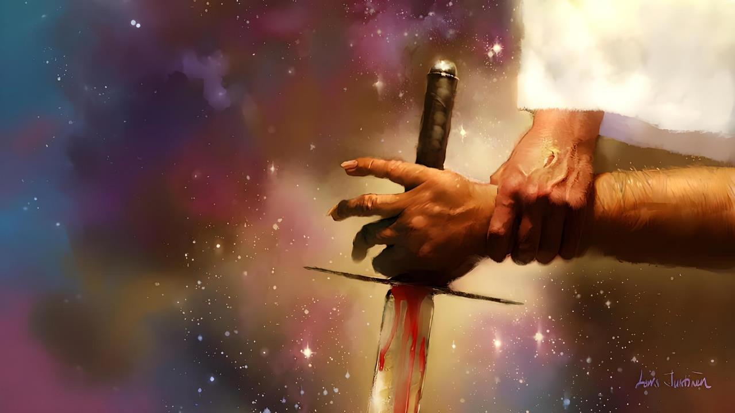
AMAKIMBIRANE YIHISHE INYUMA Y’AMAKIMBIRANE YOSE
Icyigisho cya 4 cyo ku wa 25 Ukwakira 2025

Slide 2
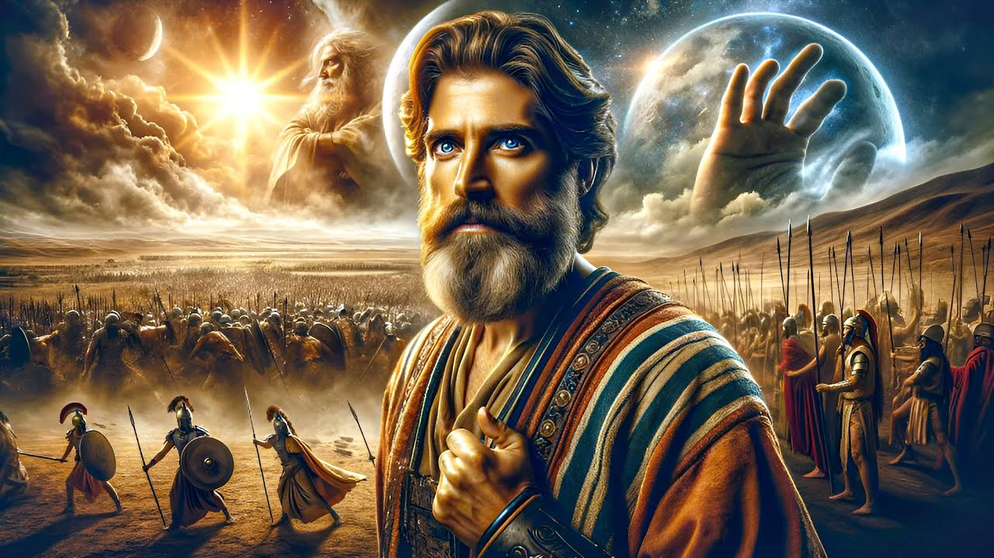
“Kandi nta munsi wahwanye n’uwo mu yawubanjirije cyangwa mu yawukurikiye, ubwo Uwiteka yumvaga umuntu kuko Uwiteka ari we warwaniye Abisirayeli”
Yosuwa 10:14

Slide 3

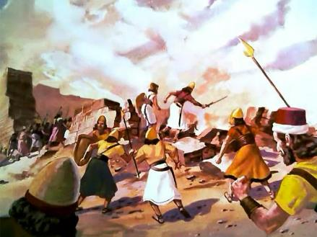
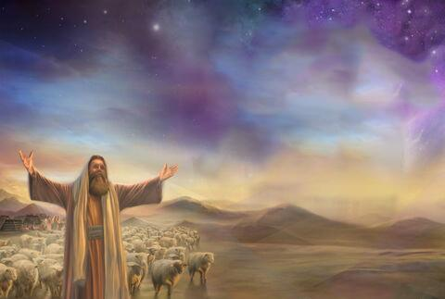
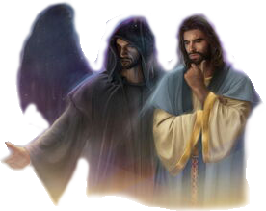
Kwigarurira Kanani ni intambara yo kurimbura yategetswe n’Imana. Ariko se niba Imana ari urukundo, kuki yategetse kurimbura nk’uko?
Kugira ngo tubone impanvu z’ibyabaye, dukeneye kwimbika.
Tugomba kwagura intekerezo tukarenga ibigaragara, kugeza aho twumva amakimbirane ari inyuma y’amakimbirane yose (harimo no kwigarurira Kanani): intambara ikomeye hagati ya Kristo na Satani, hagati y’icyiza n’ikibi.
Impande zihanganye:
Umugaba w’ingabo z’Imana.
Umutware w’ingabo z’ikibi.
Intwari irusha izindi mu ntambara.
Amayeri y’intambara:
Imana iturwanirira.
Turwanirira Imana.

Slide 4
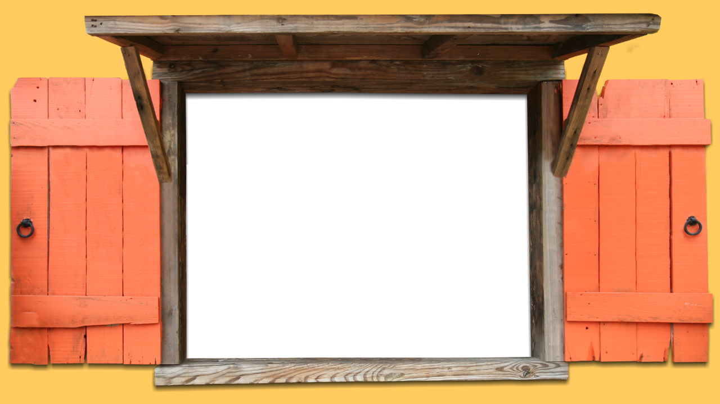
IMPANDE ZIHANGANYE

Slide 5


UMUGABA W’INGABO Z’IMANA
“Aramusubiza ati ’Oya, ahubwo nje nonaha kubera ingabo z’Uwiteka umugaba.’ Yosuwa yikubita hasi yubamye aramuramya, aramubaza ati ‘Mutware, jyewe umugaragu wawe untegetse iki?’ ” (Yosuwa 5:14)
Igihe Yosuwa yasengaga ari hafi ya Yeriko asaba ubuyobozi bw’Imana mu kwigarurira uwo murwa, umurwanyi ufite inkota yahagaze amwerekeye (Yosuwa 5:13).
Ubwo Yosuwa yamubazaga, uyu mugabo yahakanye kuba mu ngabo izo ari zo zose zo ku isi. Yari Umugaba w’ingabo z’Imana (Yosuwa 5:14).
Mu gusaba kuramywa, yerekanye ko ari Imana ubwayo, muri Yesu—uzwi nka Mikayeli mu gitabo cya Daniyeli (Yosuwa 5:15; Daniyeli 12:1).
Isengesho ryari ryasubijwe. Imana ubwayo yayoboye urwo rugamba, bitera Yosuwa kwituriza. Nk’umuyobozi ugaragara wa Isirayeli, Yosuwa yagombaga gusa gukurikiza amategeko y’Umugaba w’Ikirenga nyakuri: Imana.

Slide 6

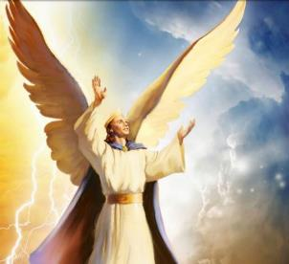
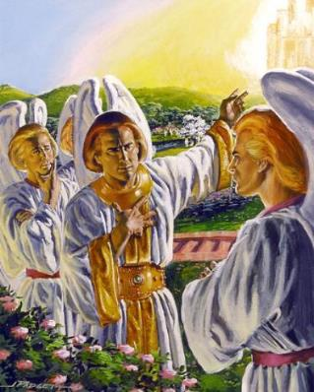
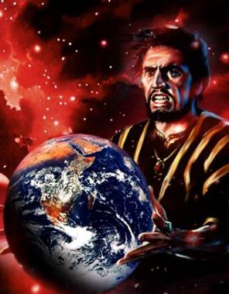
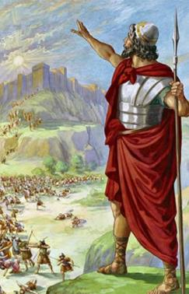
UMUTWARE W’INGABO Z’IKIBI
“Wa nyenyeri yo mu ruturuturu we, mwana w’umuseke ko uvuye mu ijuru, ukagwa! Uwaneshaga amahanga ko baguciye bakakugeza ku butaka!” (Yesaya 14:12)
Dushobora kuvuga ko ari we wadukanye intambara. Yaremwe ari umutware; umukerubi wo mu rwego rwo rusumba izindi; uba iruhande rw’Imana; yagenderaga mu birimi by’umuriro; akomeye; atunganye… (Ezekiyeli 28:12–15).
Yahawe umudendezo wo guhiramo—kimwe n’ibindi biremwa by’Imana byose bifite ubwenge—Lusiferi yahisemo kwigomeka no kwiyitirira intebe y'Imana (Yesaya 14:12–14).
Nubwo kwigomeka kwe kwaneshejwe, kuva icyo gihe isanzure ryinjiye mu ntambara. Satani amaze kwigarurira Isi, we n’abamarayika be bafite intego imwe: kuburizamo imigambi y’Imana yo gukiza abantu.
Kwigarurira Kanani byari urugamba rukomeye muri ayo makimbirane.

Slide 7

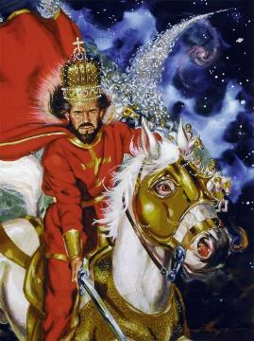
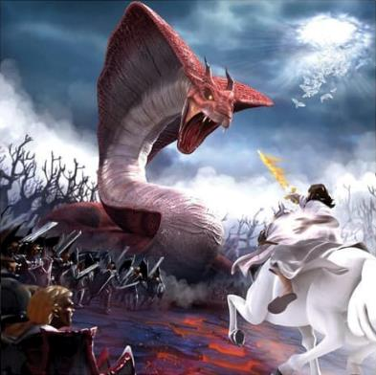
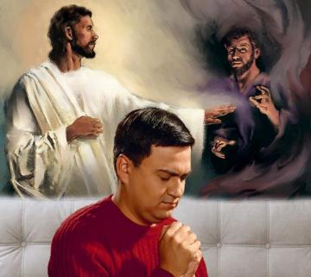
INTWARI IRUSHA IZINDI MU NTAMBARA
“Uwiteka ni intwari mu ntambara, Uwiteka ni ryo zina rye.” (Kuva 15:3)
Imana ubwayo yerekanwe nk “nk’umurwanyi,” nk’intwari irusha izindi mu ntambara (Kuva 15:3; Zaburi ya 24:8).
Ariko Imana ntabwo irwana n’abantu, ahubwo irwana n’imbaraga z’umwuka abantu bizirikaho. Muri ubwo buryo, ibyorezo bivugwa nk’intambara yo kurwanya imana zo muri Egiputa, ni ukuvuga abadayimoni (Kuva 12:12; Gutegeka 32:17).
Imana yifuza kurandura ikibi ku isi. Ni cyo cyatumye yirukana i Kanani abari barahisemo gushyigikira Satani, maze iha igihugu abantu bari ku ruhande rwayo.
Uyu munsi intambara irakomeje, ariko ntabwo ari iyo kwigarurira impugu. Intambara ni iya buri muryango, buri muntu. Nta ruhande rudafite aho rubogamiye ruhari. Turi kumwe n’Imana cyangwa turi kumwe n’umwanzi.

Slide 8
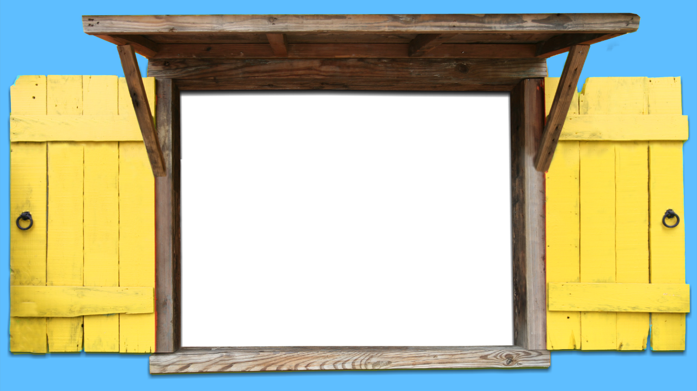
AMAYERI Y’INTAMBARA

Slide 9

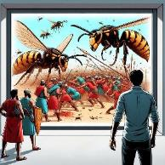
IMANA ITURWANIRIRA
“Uwiteka ari bubarwanire, namwe mwicecekere” (Kuva 14:14)
Yaroshye ingabo za Egiputa mu Nyanja Itukura (Kuva 14:24–28)
Yakoresheje urubura irwanya Abanyakanani (Josuwa 10:11)
Yarimbuye abasuzuguye Eliya (2 Abami 1:9–10)
Yohereje idubu kurwanya abasuzuguye Elisha (2 Abami 2:23–24)
Yazanye amahoro kubwo guhumisha ingabo za Siriya (2 Abami 6:14–23)
Yateye Abamoni n’Abamowabu gusubiranamo (2 Ngoma 20:15–17, 22–24)
Yishe Abāshūri 185.000 mu ijoro rimwe (2 Abami 19:35)
Yoherereje Herode indwara yica (Ibyakozwe 12:21–23)
Umugambi w’ikubitiro w’Imana kwari ukunesha Kanani mu buryo ndengakamere, Isirayeli itagombye kurwana (Kuva 23:28). Iyo abantu batagira kutizera, ni ko byari kugenda.
Bibiliya yanditsemo ingero zimwe zerekana icyo Imana ishobora gukora kugira ngo ikize ubwoko bwayo, bitabaye ngombwa ko bo bafata intwaro izo ari zo zose zo kurwanya abanzi babo:

Slide 10

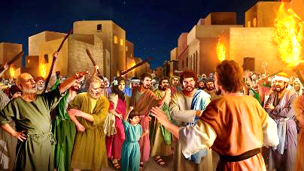
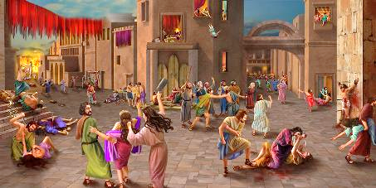

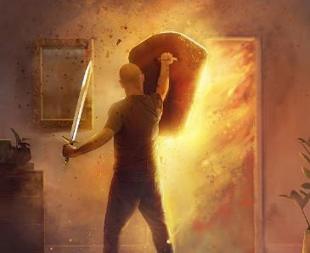
TURWANIRIRA IMANA
“Barimbura rwose ibyari muri uwo mudugudu byose, abagabo n’abagore, abato n’abakuru, inka n’intama n’indogobe babyicisha inkota” (Yosuwa 6:21)
Kimwe n’abo mu gihe cyabanjirije umwuzure, cyangwa ab’i Sodomu na Gomora, Abanyakanani bari bararenze ingabano z’ubuntu, barishyira mu ruhande rwa Satani (Itangiriro 6:5; 18:20–21; 15:16).
Bose bari bakwiriye urupfu rwa kabiri, urupfu rw’iteka. Kubaha gukomeza kurambira hano ntabwo byajyaga guhindura amaherezo yabo. Maze muri icyo gihe (kwigarurira Kanani), Imana yemerera Isirayeli kugira uruhare mu kubatsemba.
Kuki itabyikoreye yonyine, nkuko yari yarabiteguye? Kubera kutizera kwabo. Isirayeli yasogongeye ku ntambara bwa mbere nyuma yo gutangaza bati “Mbese Uwiteka ari hagati muri twe cyangwa ntahari?” (Kuva 17:7–9).
Mu kugira uruhare rugaragara mu ntambara (igaragara kuri bo, iya mwuka kuri twe), dukuramo kwiringira bidasubirwaho ubufasha bw’Imana.

Slide 11

“Intambara zigomba kurwanwa buri munsi. Intambara ikomeye ibera muri buri muntu, hagati y’umutware w’umwijima n’Umutware w’ubugingo.... Nk’intumwa z’Imana, mugomba kuyiyegurira, kugira ngo itegure kandi iyobore ndetse irwane urugamba rwanyu, mubyemeye. Umutware w’ubugingo ari ku ruhembe rw’umurimo We. Abana nawe mu rugamba rwawe rwa buri munsi rwo kwirwanya, kugira ngo uhagarare mu kuri; kugira ngo mu gihe irari ryarwanira kugutegeka, rineshwe n’ubuntu bwa Kristo; kugira ngo ubivemo urushishijweho kunesha kubw’Uwadukunze.”
E.G. White, Conflict and Courage, April 21

