Slide 1
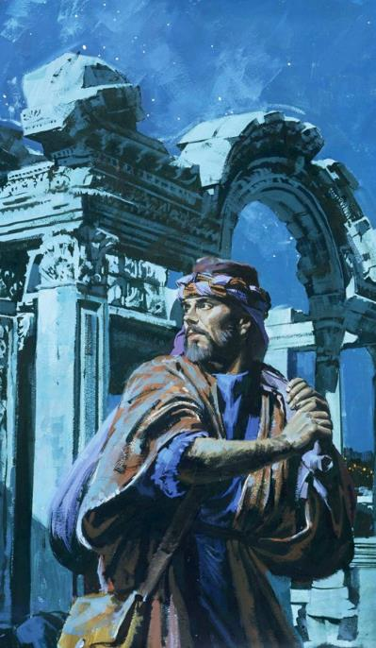
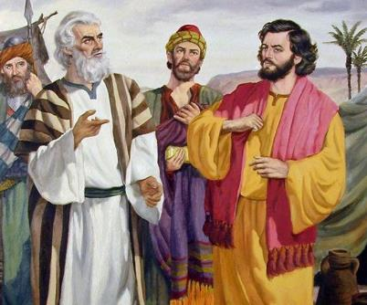
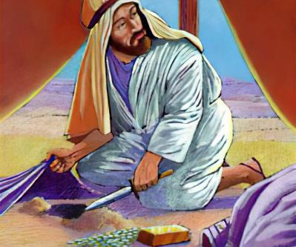
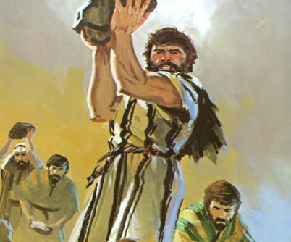
Icyigisho cya 6 cyo ku wa 8 Ugushyingo 2025
UMWANZI UBARIMO

Slide 2


“Jye Uwiteka ni jye urondora umutima nkawugerageza, nkitura umuntu wese ibihwanye n’inzira ze, uko imbuto ziva mu mirimo ye ziri”
Yeremiya 17:10

Slide 3


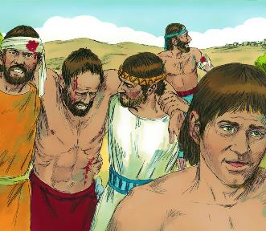
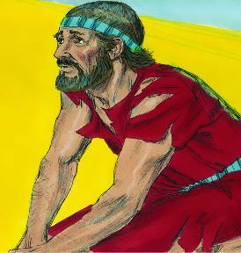





Nyuma y’amayeri y’intambara atasobanurwa n’inyurabwenge, inkike za Yeriko zararidutse. Abisirayeli binjiye mu murwa barawusenya. Kunesha! Ni ukwa nde? Ni ukw’Imana, kuko Isirayeli nta ruhare rugaragara yabigizemo.
Nyuma y’amayeri y’intambara batekerejeho neza, Ayi yarabanesheje. Kuneshwa! Ni ukwa nde? Ni ukw’Abisirayeli, kuko batari bishingikirije ku Mana.
Ubwo bageragaho bakabaza Imana, igisubizo cyari gikangaranije: Isirayeli yaracumuye kandi yashobora kutongera kunesha abanzi bayo. Ni gute yajyaga kongera kwitabwaho n’Imana?
Impamvu yo kuneshwa (Yosuwa 7:1–5, 10–13)
Kwiheba no kubabara (Yosuwa 7:6–9)
Kuvumbura uwakoze icyaha (Yosuwa 7:14–19)
Icyaha cya Akani (Yosuwa 7:20–26)
Kongera kuba abaneshi (Yosuwa 8:1–29)

Slide 4

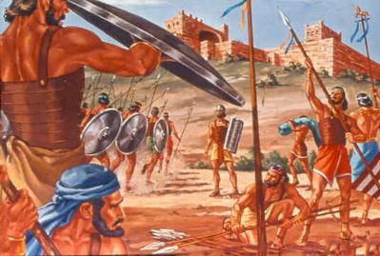
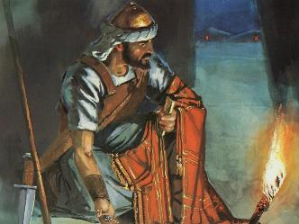
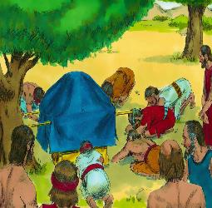
IMPAMVU YO KUNESHWA
“Abisirayeli baracumuye kuko baciye ku itegeko ryanjye nabategetse, bagatwara ku bintu byashinganywe, bakabyiba bakirengagiza, ndetse bakabishyira mu bintu byabo” (Yosuwa 7:11)
Nyuma y’inkuru nziza iturutse ku batasi boherejwe i Yeriko, Yosuwa yabajije Imana maze imuha ingamba zo kwigarurira uwo murwa.
Iyo Yosuwa akora atyo na nyuma yo kubona raporo iturutse ku batasi boherejwe kuri Ayi, urupfu rw’abantu 36 rwari kwirindwa (Yosuwa 7:1–5).
Ariko se impamvu nyayo yo kuneshwa yari iyihe, cyangwa se ni iyihe mpamvu Imana yari kubuza Yosuwa gutera Ayi (Yosuwa 7:11)?
Imana yari yabonye ko “Isirayeli yacumuye.” Nta hantu na hamwe muri Bibiliya havugwa icyaha mu buryo burambuye nk’ubu “baciye ku itegeko… batwaye… bibye… barabeshye… babishyize mu bintu byabo.”
Reba uburyo bavuzwe mu bwinshi. Icyaha cyakozwe n’umuntu umwe, ariko Imana yakibaze ku bantu bose. Bari bishe isezerano; icyaha cyagombaga kurandurwa kugira ngo bashobore gukomorerwa.

Slide 5

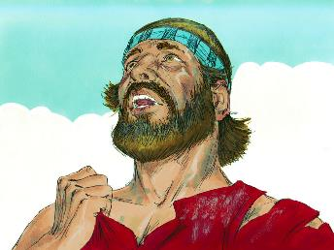
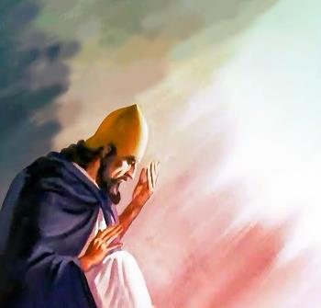
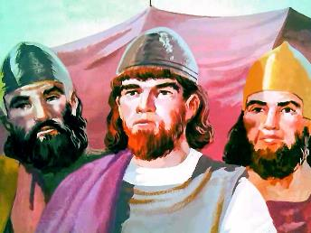
KWIHEBA NO KUBABARA
“Nuko Yosuwa aravuga ati ‘Ayi we, Nyagasani Mana! Ni iki cyatumye wambutsa aba bantu Yorodani, ukaba udushyize mu maboko y’Abamori ngo baturimbure? Erega iyaba twarigumiye hakurya ya Yorodani!’ ” (Yosuwa 7:7)
Yosuwa n’abakuru barihebye cyane kubwo kuneshwa na Ayi, maze bagaragaza ibimenyetso by’akababaro (Yosuwa 7:6).
Nuko Yosuwa agira uburakari nk’ubwo Abisirayeli bakunze kugaragaza mu myaka 40 bamaze bazerera: “Kuki watuzanye aha hantu…? Iyaba twarigumiye…!” (Yosuwa 7:7).
Ariko, umwuka wa Yosuwa ntabwo wari umeze nk’uw’Abisirayeli mu butayu. Kwitotomba kwe ntabwo kwatewe no kubura ibyo bari biteze, ahubwo kwatewe no gutinya ko izina ry’Imana ryasuzugurwa mu banyamahanga (Yosuwa 7:8–9).
Yabonye neza ko imico y’Imana yajyaga kuvugwa n’abatizera hashingiwe ku buryo abantu bayo bitwaye. Uyu munsi dukomeje kuba abahamya b’Imana ku isi. Mbega inshingano ikomeye!

Slide 6
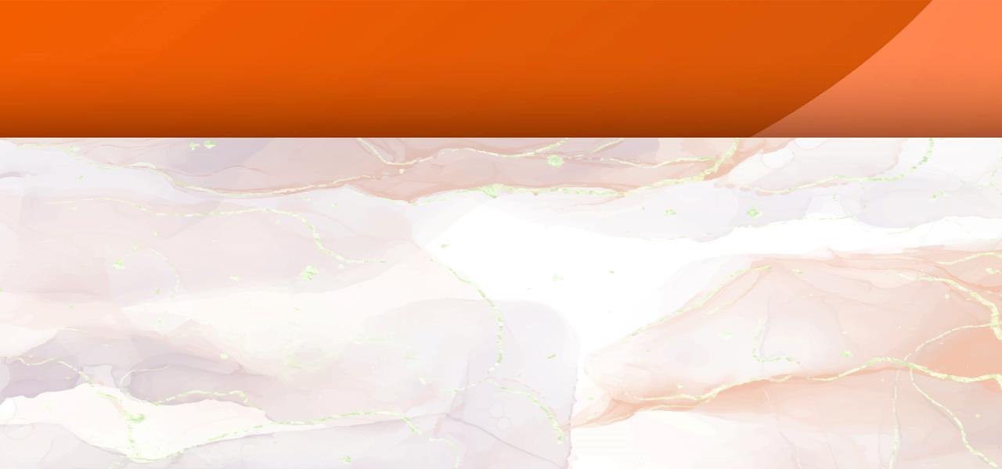
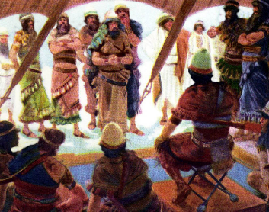
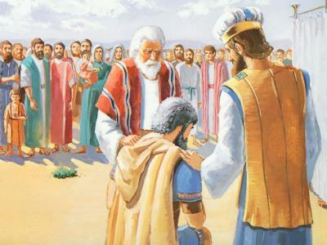
KUVUMBURA UWAKOZE ICYAHA
“Mu gitondo muzaterane uko imiryango yanyu iri, nuko umuryango Uwiteka azarobanura uzaterane uko amazu yawo ari, maze inzu Uwiteka azarobanura izaterane uko imbyaro zayo ziri, kandi urubyaro Uwiteka azarobanura ruzaterane hazajye haza umuntu umwe umwe.” (Yosuwa 7:14)
Kugira ngo icyaha cya rusange (icyaha cy’abantu bose) gikurweho, uwacumuye yagombaga gukurwaho (Yosuwa 7:15). Gukurwaho? Ese ntiyajyaga kubabarirwa iyo yihana? Birumvikana ko byari kuba uko! Ariko Akani nta kimenyetso cyo kwihana nyakuri yagaragaje (kandi yari afite amahirwe menshi yo kubikora).
Urubanza kagenzuzi rwaratangajwe rusubikwa kugeza ku munsi ukurikiyeho (Yosuwa 7:14–15)
Umuryango wa Yuda uratoranywa (Yosuwa 7:16)
Umuryango wa Zera urafatwa (Yosuwa 7:17a)
Umuyobozi Zabudi arafatwa (Yosuwa 7:17b)
Akani arafatwa (Yosuwa 7:18)
Akani aryumaho
Akani aryumaho
Akani aryumaho
Akani aryumaho
Akani aryumaho
Yosuwa yagaragaje ubuntu n’urukundo by’Imana, asaba Akani kwatura icyaha cye (Yosuwa 7:19).
Akani yatsinzwe n’urubanza. Yemeye icyaha, ariko ntiyasabye imbabazi (Yosuwa 7:20). Nyamara Imana yababajwe n’ukwinangira umutima kwe, nk’uko bigaragazwa muri buri rarika ryo kwihana.

Slide 7
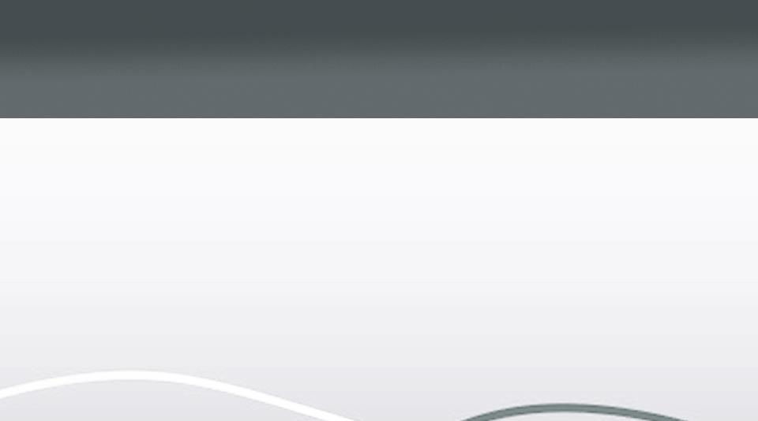
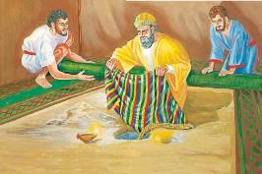
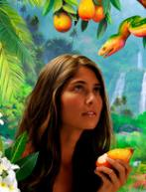
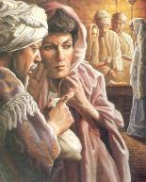
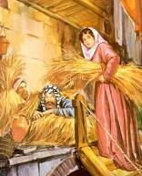
ICYAHA CYA AKANI
“nabonye mu minyago umwambaro mwiza wa Shinari, na shekeli z’ifeza magana abiri, n’umuhimba w’izahabu w’igipimo cya shekeli mirongo itatu, ndabyifuza mperako ndabyenda mbihisha mu gitaka, biri mu ihema ryanjye hagati, n’ifeza iri munsi yabyo” (Yosuwa 7:21)
Rahabu
Yahishe abatasi mu gisenge cy’inzu
Yagiriye Isirayeli neza
Akani
Yahishe iminyago mu butaka
Yazaniye Isirayeli akaga
Yateye kunesha kubwo kwizera kwe
Yateye kuneshwa kubw’imirimo ye
Yagiranye isezerano na Isirayeli
Yishe isezerano rya Isirayeli
Yarokoye ubuzima bwe n’ubw’umuryango we
Yapfanye n’umuryango we
Yosuwa yasabye Akani guha Imana icyubahiro, akatura icyaha cye (Yosuwa 7:19). Ni yo yari amahirwe ye ya nyuma. Iyaba yarasabye imbabazi ubwo yaturaga icyaha… Ariko ntiyabikoze, bityo nta mbabazi yahawe (Kubara 15:30–31).
Kimwe na Eva, Akani “yabonye,” “yifuje,” “yafashe,” kandi icyaha cye cyagize ingaruka kuri benshi (Itangiriro 3:6). Kimwe na Ananiya na Safira, Akani yafashe bimwe mu bintu byashinganywe, byeguriwe Imana, maze arabizira (Ibyakozwe 5:1–2).
Ibyemezo Akani yafatiye i Yeriko byari bihabanye cyane n’ibya Rahabu:

Slide 8

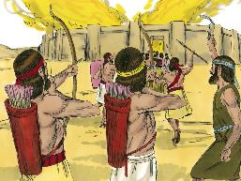
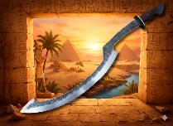
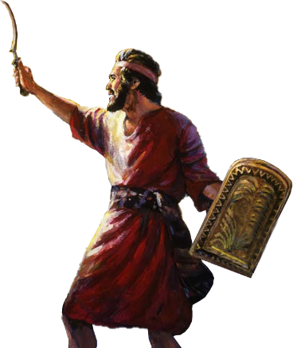
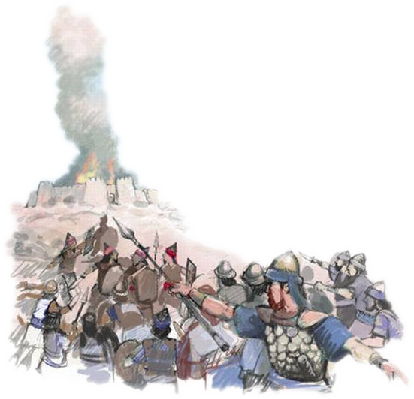
KONGERA KUBA ABANESHI
“Uwiteka abwira Yosuwa ati ‘Ntutinye kandi ntukuke umutima. Jyana ingabo zose uhaguruke utere kuri Ayi, umenye ko nshyize umwami waho n’abantu be n’umudugudu we n’igihugu cye mu maboko yawe.’ ” (Yosuwa 8:1)
Nk’uko byagenze muri Yeriko, Imana yahaye Yosuwa ingamba zo kunesha Ayi (Yosuwa 8:1–2).
Nijoro, hanze y’umurwa hashyizweho igico. Mu gitondo cya kare, ingabo zegereye Ayi, zisa n’izerekana ko zongeye guhunga.
Ubwo Mose yazamuraga inkoni ye kugeza banesheje Abamaleki, ku itegeko ry'Imana, Yosuwa yazamuye “intwaro” ye (ishobora kuba yari inkota igōndōye yakoreshwaga n’Abanyegiputa), maze akomeza kuyizamura kugeza banesheje burundu (Yosuwa 8:18–22, 26).
Imana yongeye guha abantu bayo kunesha. Ikibaya cya Akori, aho Akani n’umuryango we biciwe, cyafunguye urugi rwo kunesha, “urugi rw’ibyiringiro” (Hoseya 2:15).
Iyo twemeye imbabazi z’Imana ku bwo kwizera, Imana ihamba ibyaha byacu muri Akori, maze igakingura irembo ry’ibyiringiro.

Slide 9

“Imbaraga zikomeye itorero rikwiriye gutinya si iz’abarirwanya ku mugaragaro, abatizera, n’abatuka Imana, ahubwo ni iz’abiyitirira Kristo badahamye. Abo ni bo bakingiranira hanze umugisha w’Imana ya Isirayeli maze bakazana urucantege mu itorero, igitutsi kigoye gusibangana …
Ubukristo ntibugomba kwerekanwa ku Isabato cyangwa mu rusengero gusa; bugomba kuba ubwa buri munsi mu cyumweru n’ahantu hose. Ibisabwa nabwo bigomba kwemerwa no kubahirizwa aho dukorera, imuhira, no mu byo duhuriramo na bene Data, n’isi yose …”
E.G. White, Conflict and Courage, April 23

