Slide 1

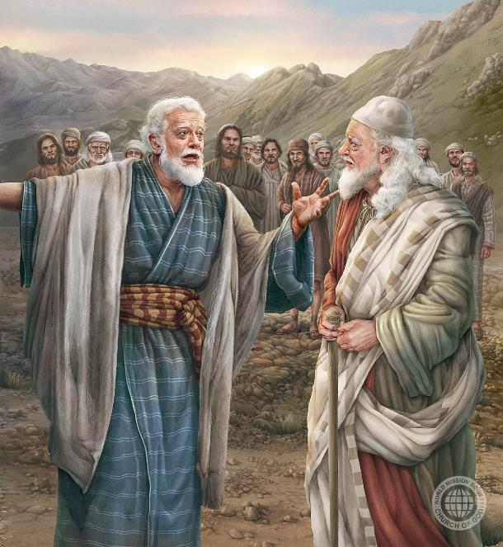
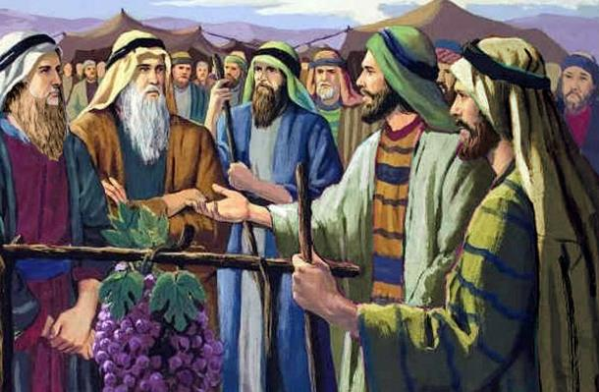
INTWARI ZO KWIZERA:
YOSUWA NA KALEBU
Icyigisho cya 8 cyo ku wa 22 Ugushyingo 2025

Slide 2
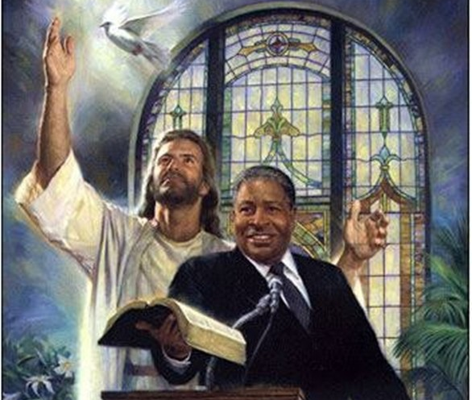
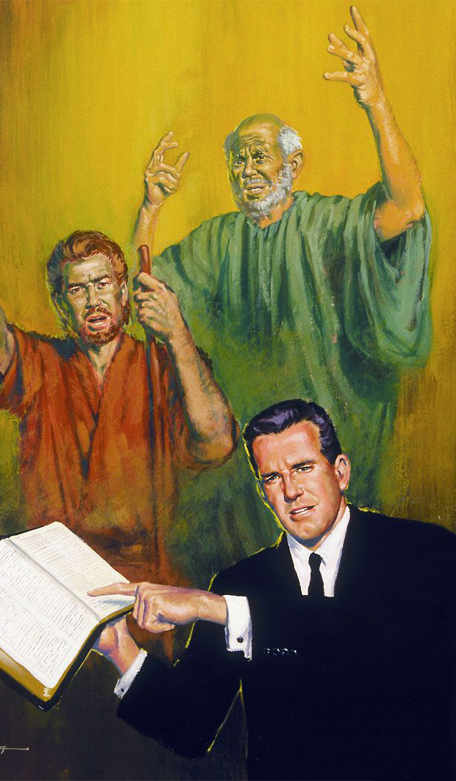
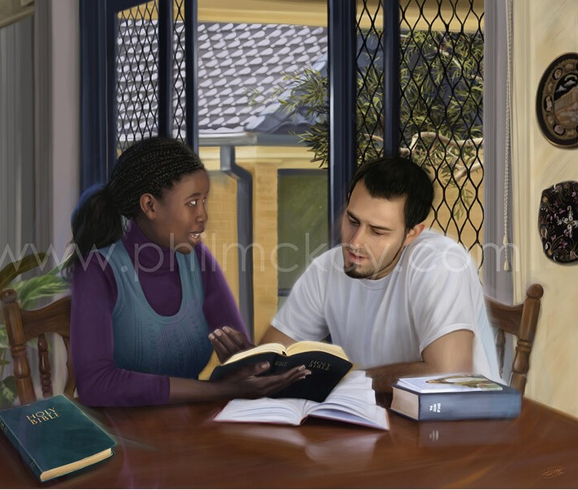
“Mwibuke ababayoboraga kera, bakababwira ijambo ry’Imana. Muzirikane iherezo ry’ingeso zabo, mwigane kwizera kwabo”
(Abaheburayo 13:7)

Slide 3


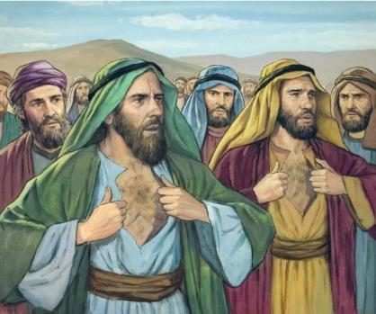




Waba uzi abo bantu cumi: Shamuwa, Shafati, Igalu, Paluti, Gadiyeli, Gadi, Amiyeli, Seturi, Nakibi, na Geweli?
“Bazwiho” kutizera imbaraga z’Imana, bityo bikabakururira urupfu ubwabo ndetse n’ab’igisekuruza cyabo bose (Kubara 14:36–37).
Nyamara ushobora kuba warumvise iby’aba bantu babiri: Yosuwa na Kalebu. Bahagaze bashikamye, bizera amasezerano y’Imana, kandi babayeho birebera uburyo asohozwa (Kubara14:38).
Ni gute twakwīgāna ukwizera kwabo maze tukiringira byuzuye ko Imana ishobora gukora ibidashoboka, nk’uko nabo bagenje?
Kwizera kwa Kalebu:
  Gutuma ibidashoboka bishoboka.
  Kwizera gushyizwe mu ngiro.
  Guhererekanya umucyo.
Kwizera kwa Yosuwa.
Uburyo bwo kubona ukwizera.

Slide 4

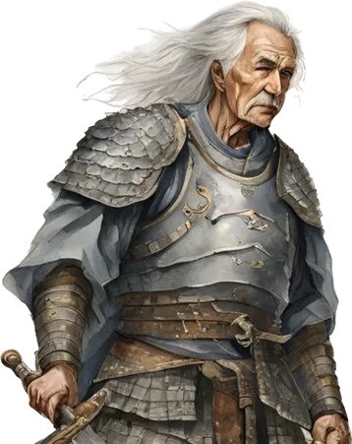
KWIZERA KWA KALEBU

Slide 5

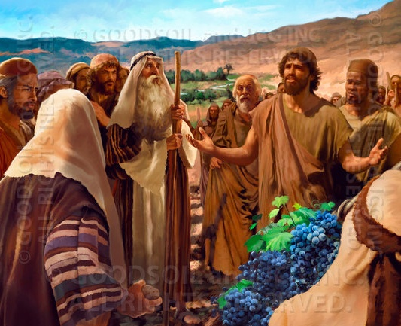
GUTUMA IBIDASHOBOKA BISHOBOKA
“Ariko bene data twajyanye bahīsha imitima y’abantu ubwoba, jyeweho nomatanye n’Uwiteka Imana yanjye rwose” (Yosuwa 14:8)
Izina “Kalebu” risobanura “imbwa.” Nk’uko imibereho ye yabigaragaje, ntabwo yahawe iryo zina mu buryo busuzuguritse, ahubwo yarihawe kubera ubudahemuka bwe budatezuka. Yabaye indahemuka aho abandi bahemutse. Yakomeje kuba indahemuka ku Mana aho abandi batinyaga.
Aho abatasi cumi babonye imijyi itākwīgarurirwa, n’ibihangange bitānēshwa, Kalebu we yabonye imijyi yigaruriwe n’ibihangange “byariwe nk’imitsima” (Kubara 13:28–33; 14:6–9).
Hamwe na Yosuwa (wari muto kuri we), yahagaze ku gitekerezo cye ashikamye, ndetse n’igihe rubanda rwashakaga kubatera amabuye (Kubara 14:10).
Urugero rwe rudushishikariza gukomeza kwizera Imana dushikamye, Yo ishobora gutuma ibidashoboka kuri twe bishoboka.

Slide 6
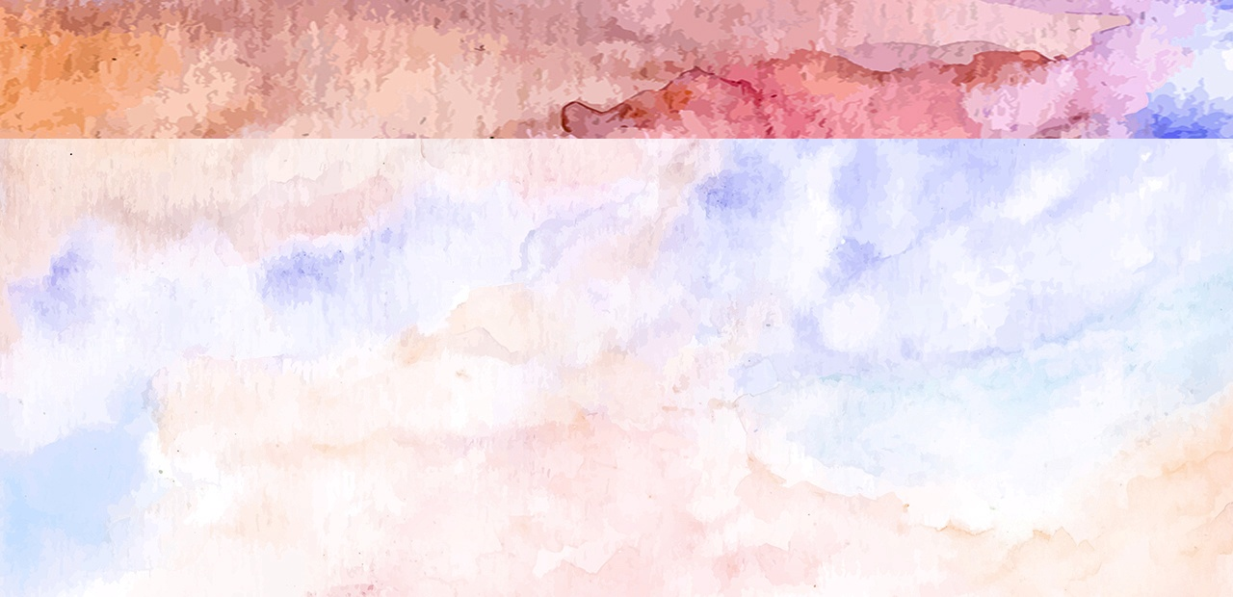
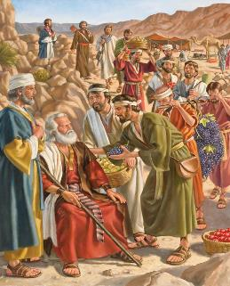
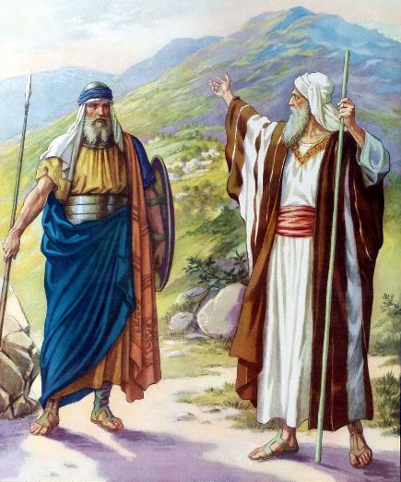

KWIZERA GUSHYIZWE MU NGIRO
“None umpe umusozi Uwiteka yavuze urya munsi. Icyo gihe wumvaga ko Abānaki bari bahari, kandi ko hariho imidugudu minini igoswe n’inkike z’amabuye. None ahari aho Uwiteka azaba ari kumwe nanjye, mbirukane nk’uko Uwiteka yavuze.” (Yosuwa 14:12)
Nk’uko Kalebu ubwe yabivuze, igihe Mose yasabaga amagēnzi, “muhamiriza ibyo nari nabonye n’umutima utabeshya” (Yosuwa 14:7), kandi “nomatanye n’Uwiteka Imana yanjye rwose” (Yosuwa 14:8). Kubera ubudahemuka bwe, yasezeranijwe ko azaragwa aho ibirenge bye byakandagiye mu gihe cyo gutata (Yosuwa 14:9).
Kalebu yari afite imyaka 40 ubwo yoherezwaga gutata. Imyaka itanu bamaze guhīndūra igihugu, yari ageze ku myaka 85 (Yosuwa 14:10). Umubiri we n’ubwenge bwe byari bikiri muryerye, kandi ibitekerezo bye bikiri bya bindi (Yosuwa 14:11).
Igihe cyari kigeze cyo gusaba gusohorezwa isezerano no kwerekana ko amagambo ye atari ay’ubusa. Kubwo gufashwa n’Imana, yari agiye guhangamura ibihangange no kwigarurira imijyi yabyo (Yosuwa 14:12–14).

Slide 7

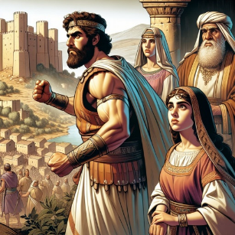
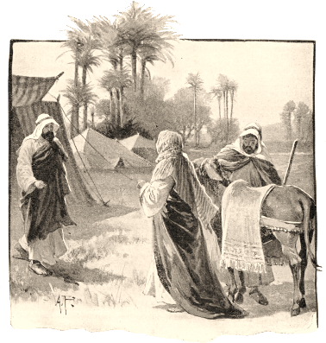
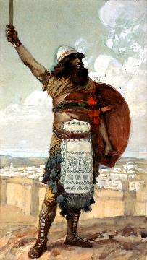
GUHEREREKANYA UMUCYO
“Kalebu aravuga ati ‘Umuntu uzatera i Kiriyatiseferi akahanesha, nzamushyingira umukobwa wanjye Akisa’ ” (Yosuwa 15:16)
Kalebu amaze kwigarurira igice cya gakondo yari iye bwite, yatekereje ku murage yajyaga gusiga. Ese abamukomokaho bajyaga gukomeza kwiringira Imana nk’uko yabigenje?
Yari yaragaragaje ko Imana ishobora kwizerwa, nuko yifuza gushaka umuntu ufite ukwizera nk’ukwe, kugira ngo amusigire umucyo.
Kubw’iyo mpamvu, yasezeranije gushyingira umukobwa we uwajyaga kunesha Kiriyatiseferi, ari naho hitwaga Debiri (Yosuwa 15:15–16).
Otiniyeli, umuhungu w’umuvandimwe we, ni we wabaye intwari yanesheje uwo mujyi, maze aba umucamanza wa mbere wa Isirayeli (Yosuwa 15:17; Abacamanza 3:9–11).
Nyuma yo gushaka Akisa umukobwa wa Kalebu, Akisa yemeje se ko yakwemerera umukwe we kwāgūra ibikingi (Yosuwa 15:18–19), bityo agaragaza ko ari we muragwa ukwiriye wa Kalebu.

Slide 8

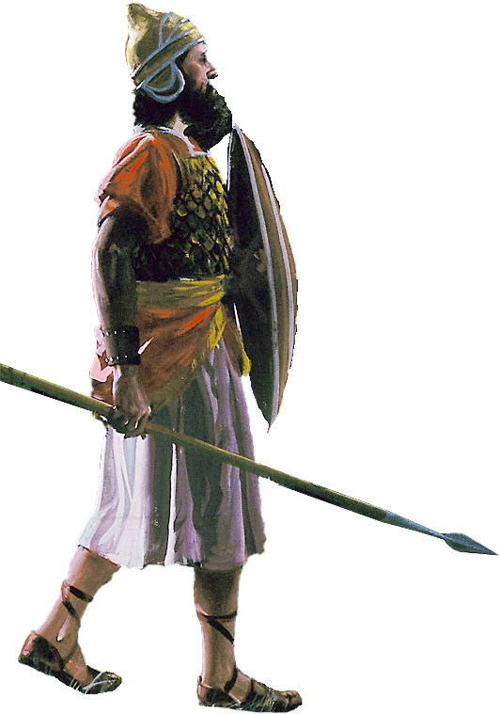
KWIZERA KWA YOSUWA

Slide 9
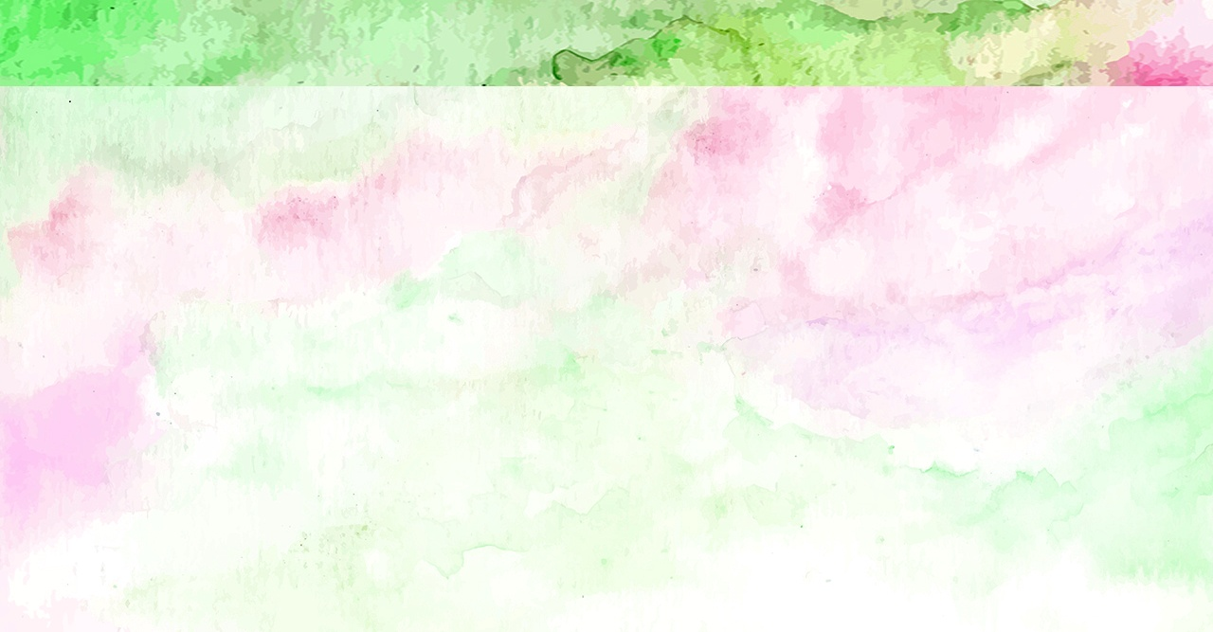
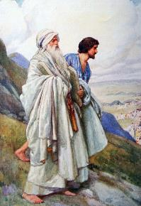
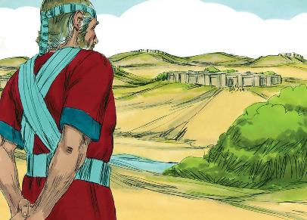
“Nuko barangiza kugabanya igihugu mo gakondo bakurikije ingabano zacyo, kandi Abisirayeli baha Yosuwa mwene Nuni gakondo hagati muri bo” (Yosuwa 19:49)
Yosuwa akiri umusore, yatoranijwe na Mose ngo abe umwungirije. Yagaragaje kumvira, ubutwari, ubudahemuka, ingirakamaro, kandi ukunda iby’Imana (Kuva 33:11).
Igihe cyo gusaba gakondo ye cyarageze, yari yarategereje kugeza igihe imiryango yose iboneye gakondo yayo, maze asaba “gakondo y’igisigarira” [Timunatisera] (Yosuwa 19:50), umujyi wari hafi ya Shilo, aho Ihema ry’Ibonaniro ryari ribambye.
Mu nkuru ye, twigiramo ko :
Kwizera ntikwirengagiza ibiriho; ahubwo gutanga ubundi buryo bwo kumva ibintu
Aho kwitotomba, duhamagariwe kwiringira Imana no kwiyegurira imigambi yayo
Imigisha iza ku baguma mu Mwami byuzuye
Imibereho mu mpande zayo zose igomba gukurikiza imigambi yashyizweho n’Imana
Birakwiriye kuba hafi y’Imana (Zaburi ya 84:10)

Slide 10

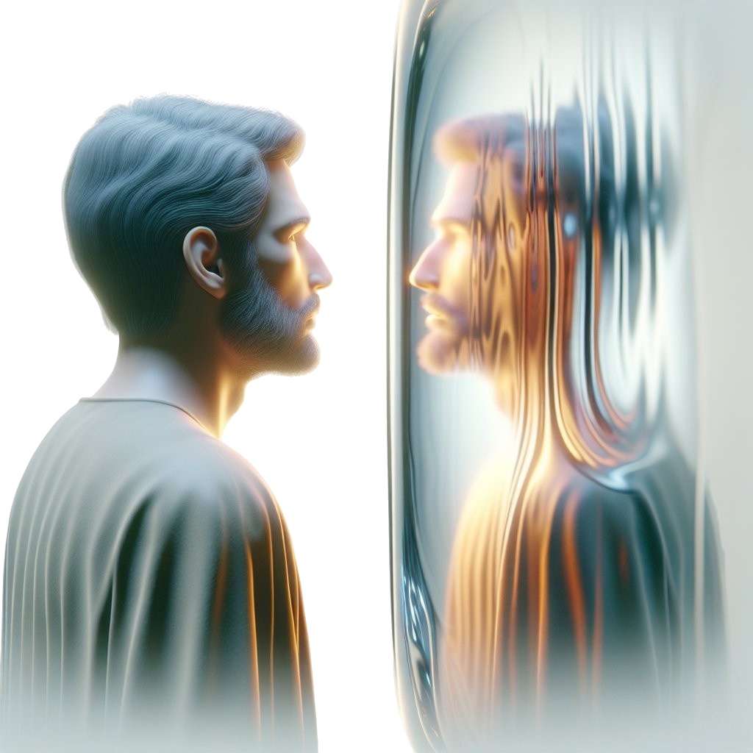
UBURYO BWO KUBONA UKWIZERA

Slide 11

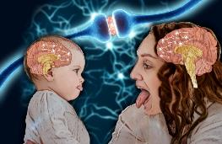
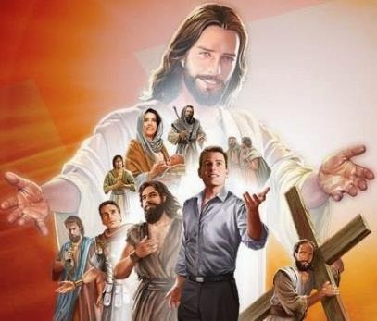
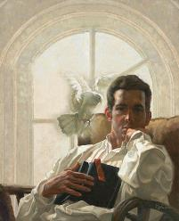
“Nuko natwe ubwo tugoswe n’igicucu cy’abahamya bangana batyo, twiyambure ibituremerera byose n’icyaha kibasha kutwizingiraho vuba, dusiganirwe aho dutegekwa twihanganye dutumbira Yesu wenyine, ari we Banze ryo kwizera kandi ari we ugusohoza rwose, yihanganiye umusaraba ku bw’ibyishimo byamushyizwe imbere ntiyita ku isoni zawo, yicara iburyo bw’intebe y’Imana.” (Abaheburayo 12:1—2)
Imyitwarire yacu ikunda gukurikiza ibyo tureba. Hari n’ibyo bita “imitsi-ndorerwamo” yijimisha itandukaniro riri hagati yo kureba ikintu no kugikora.
Bibiliya iturarikira gukurikiza urugero rw’intwari zikomeye zo kwizera, tukibanda kuri Yesu, We rugero ruhebuje (Abaheburayo 12:1–2).
Mu kwiga imibereho y’abantu bafite ukwizera nka Kalebu na Yosuwa, twiga kwiringira Imana nk’uko babigenje, kwicisha bugufi nk’uko bari bateye, no guhamya ukuri dushize amanga nk’uko babigenje.
Ariko se twahinduka dute? Bibiliya irabisobanura neza: twemerera Umwuka Wera gukorera muri twe (2 Abakorinto 3:18). Uyu ni umurimo-ngiro. Tugomba guhitamo guhinduka, kandi nka Kalebu, tugatangira gukora. Twahamagariwe kuba ibitambo bizima bishimwa n’Imana (Abaroma 12:1–2).

Slide 12
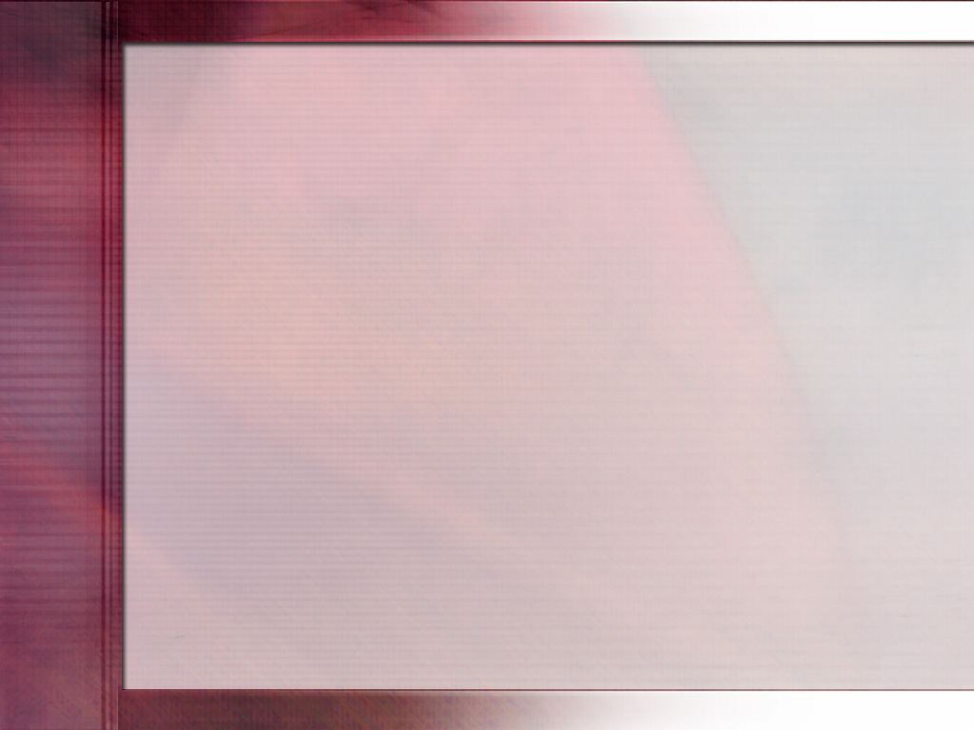
“Muri iki gihe dukeneye abantu b’indahemuka rwose, abantu bakurikira Umwami byuzuye, abagabo batiteguye guceceka igihe bagomba kuvuga, bashikamye ku mahame nk’icyuma, badashaka kwigaragaza nk’abafite isumbwe, ahubwo bagendana n’Imana bicishije bugufi, abantu bihangana, b’abagiraneza, b’abanyamwete, b’abanyarugwiro, basobanukiwe ko ubuhanga bwo gusenga ari ugukorera mu kwizera no kugira imirimo izagaragaza icyubahiro cy’Imana n’ineza y’abantu bayo.... Gukurikira Yesu bisaba guhinduka bivuye ku mutima uhereye mu ntangiriro, no guhora tuvugurura uku kwitanga buri munsi.
Ukwizera Imana kwa Kalebu ni ko kwamuteye ubutwari, kwamubujije gutinya abantu, kandi kwatumye ahagarara ashize amanga kandi adacogora mu kurengera ukuri. Binyuze mu kwishingikiriza kuri iyo mbaraga, ari yo Mugaba w’ingabo zo mu ijuru, buri musirikare nyakuri w’umusaraba ashobora kubona imbaraga n’ubutwari byo kunesha inzitizi zisa n’izidashobora gusimbukwa.
E.G. White, Sons and Daughters of God, July 19

