Slide 1
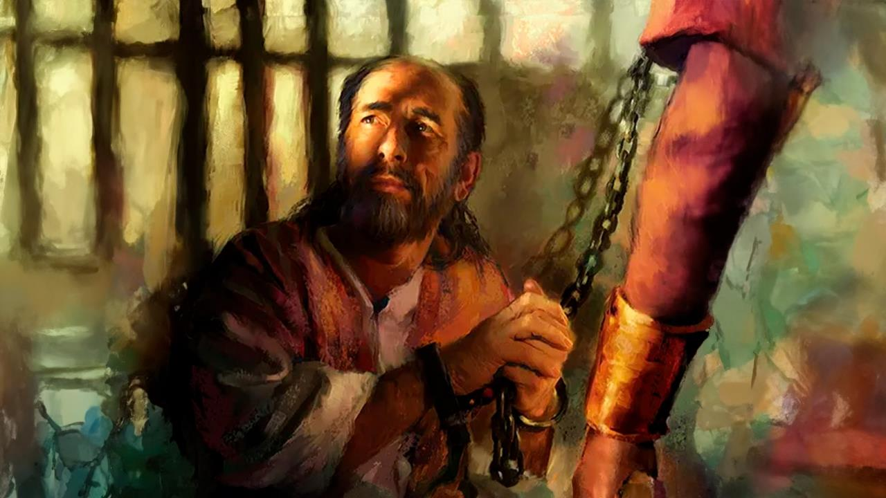
BARATOTEJWE ARIKO NTIBARETSWE
Icyigisho cya 1 cyo ku wa 3 Mutarama 2026

Slide 2

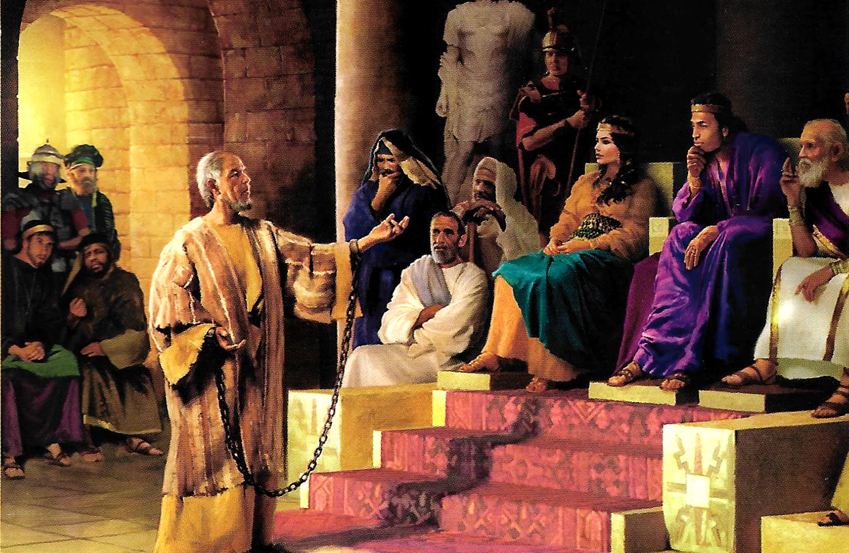
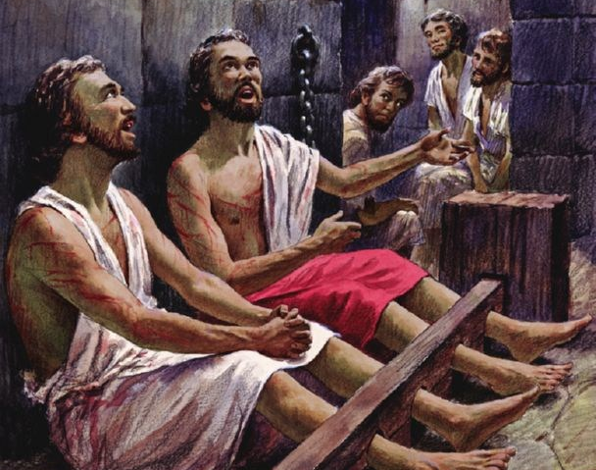
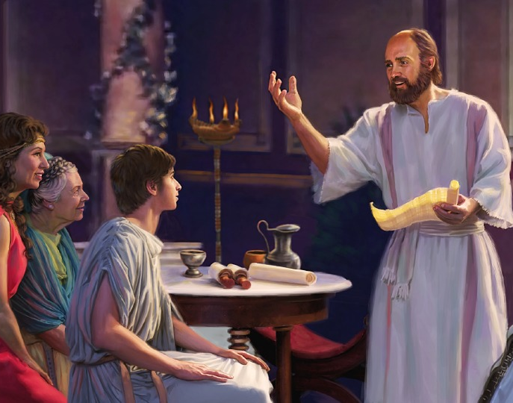
“Mujye mwishimira mu Mwami wacu iminsi yose. Yewe, nongeye kubivuga nti ‘Mwishime!’ ”
Abafilipi 4:4

Slide 3

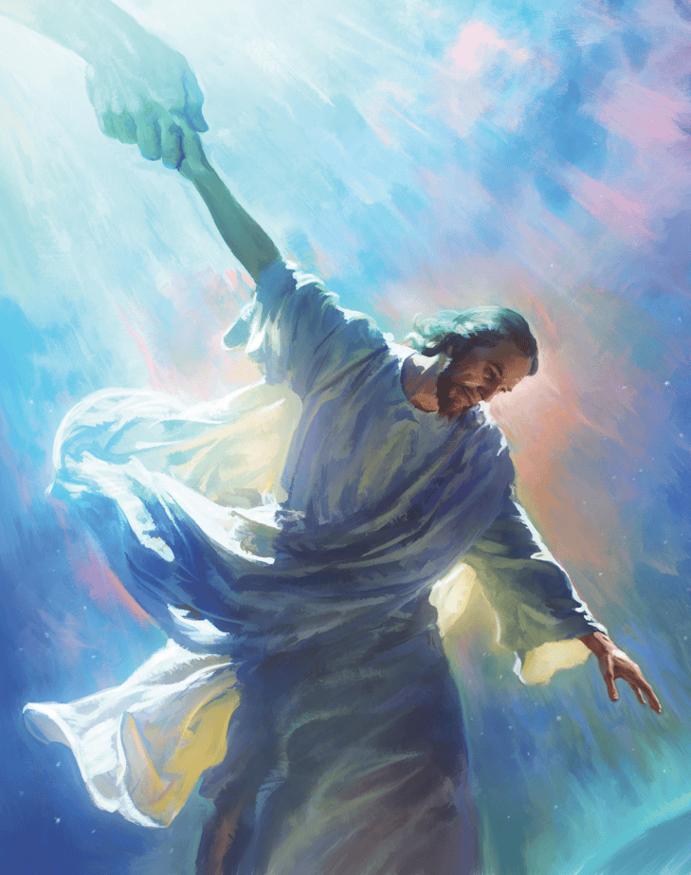


Mu murimo wa Pawulo wose, yagambiriye kugeza ku bantu bose bajyaga kumwumva, Umwe rukumbi ushobora guhuza Ijuru n’Isi: Yesu Kristo, Umukiza.
Mu kwandika inzandiko yandikiye Abafilipi n’Abakolosayi, yakoze ibishoboka byose kugira ngo yegereze itorero Ijuru, kandi Abakristo abegereze abandi.
Mu gukora atyo, yatweretse uburyo itorero ry’Imana muri iki gihe rishobora kwiyunga n’Ijuru kugira ngo risohoze ku Isi inshingano Yesu yadushinze.
Umwanditsi w’izi nzandiko:
  Pawulo aboshywe
  Intumwa (ambasaderi) mu minyururu
Abo zandikiwe:
  Amateka ya Filipi
  Amateka ya Kolosayi
  Amatorero y’i Filipi n’i Kolosayi

Slide 4
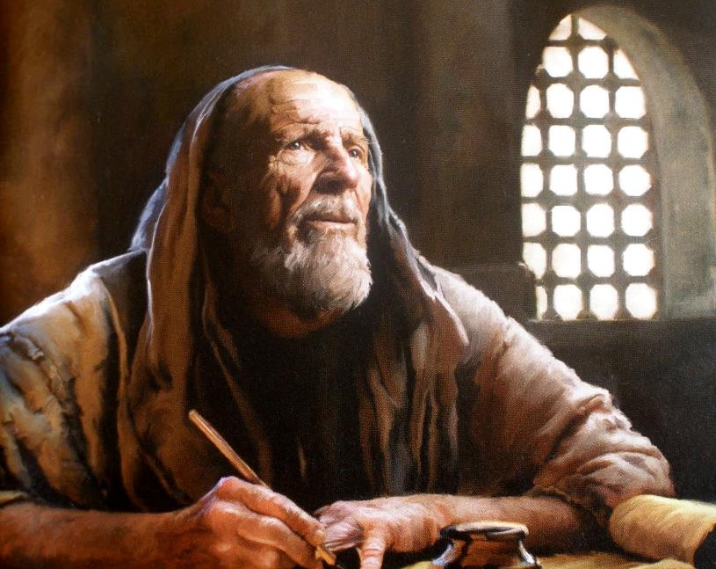

UMWANDITSI W’IZI NZANDIKO

Slide 5

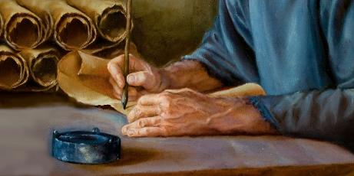
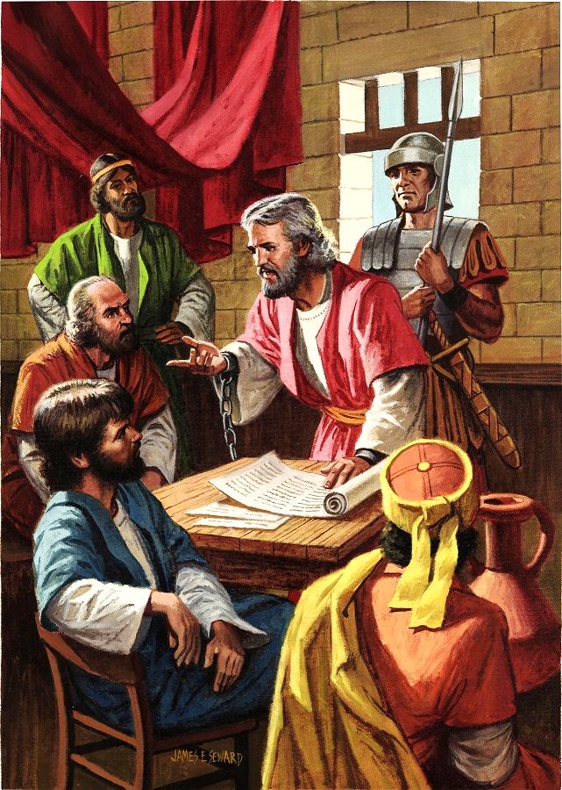
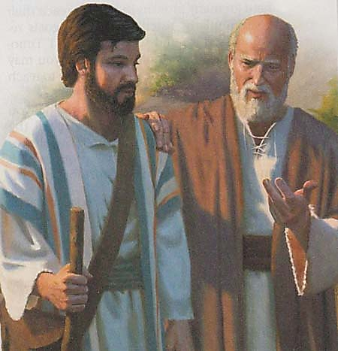
PAWULO ABOSHYWE
“Pawulo imbohe ya Kristo Yesu na Timoteyo mwene Data, turakwandikiye Filemoni ukundwa dusangiye umurimo” (Filemoni 1:1)
Mu gihe cyo kuboherwa i Roma kwa mbere kwa Pawulo—hagati y’imyaka ya 60 na 62 NK—Pawulo yanditse inzandiko nibura eshanu: Abefeso, Abafilipi, Abakolosayi, Filemoni, n’urw’itorero rya Lawodikiya (rutatugezeho).
Kubera ko nta byaha bikomeye yaregwaga, yemerewe kuba mu nzu yakodeshwaga, agahora arinzwe n’umusirikare w’Umuroma (Ibyakozwe 28:16). Ibi byamubashishije gukomeza kubwiriza ubutumwa bwiza, ndetse no ku barindaga umwami w’abami (Abafilipi 1:13).
Iyo dusuzumye izi nzandiko, tubona ko Pawulo yari afite abantu benshi bakoranaga (Abakolosayi 4:7–14; Filemoni 23–24). Yari anafite aho ahurira n’abo mu rugo rwa Kayisari (Abafilipi 4:22).
Pawulo yari yizeye kurekurwa vuba (Filemoni 22), ariko ibyo byiringiro ntiyari akibifite igihe yabohwaga ku nshuro ya kabiri (2 Timoteyo 4:6).

Slide 6

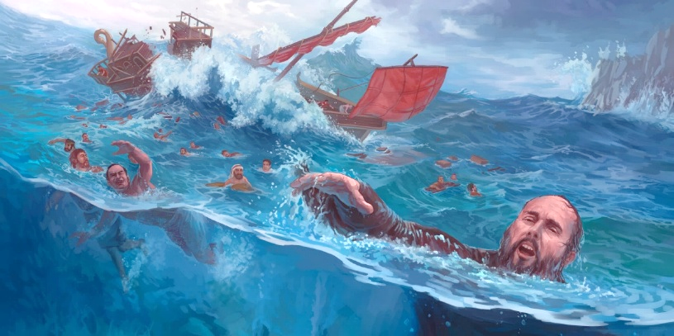
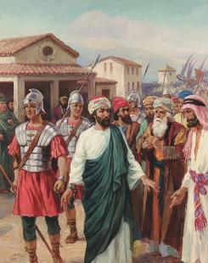
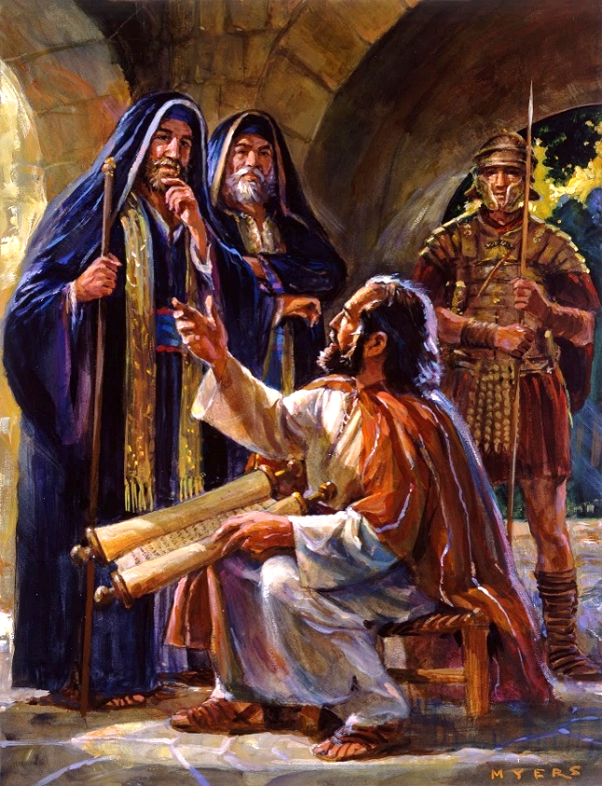
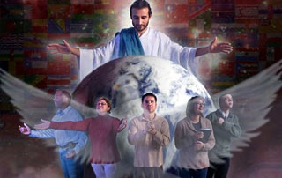
INTUMWA (AMBASADERI) MU MINYURURU
“Ari bwo mbereye intumwa yabwo kandi mbohesherejwe umunyururu, mvuge ibyabwo nshize amanga nk’uko binkwiriye” (Abefeso 6:20)
Kuva igihe Pawulo yahitagamo kuba intumwa mu cyimbo cya Kristo, ubuzima bwe ntibworohewe (2 Abakorinto 6:4–5).
Bibiliya ivuga ku gufungwa k’ubugira gatatu kwa Pawulo mbere yuko ajyanwa i Roma: i Filipi (Ibyakozwe 16:22–24); i Yerusalemu (Ibyakozwe 23:10); n’i Kayisariya (Ibyakozwe 23:33–35). Ariko nta gushidikanya ko habayeho n’ukundi kwinshi (2 Abakorinto 11:23).
Muri ibyo birushya byose, Pawulo ntiyigeze yibwira ko yaretswe (2 Abakorinto 4:7–9). Igihe atari agishoboye kubwiriza yisanzuye, yahindutse “intumwa mu minyururu” (Abefeso 6:20).
Imyifatire ya Pawulo itwigisha ko igihe duhuye n’ingorane kubera kubwiriza ubutumwa bwiza, tugomba kwiringira Imana byuzuye, tugahoza intekerezo zacu ku Ijambo ryayo (2 Timoteyo 2:15); kandi tukikomeza kuri Mwuka Wera, We Mufasha udutera imbaraga n’umwete (Zekariya 4:6).

Slide 7
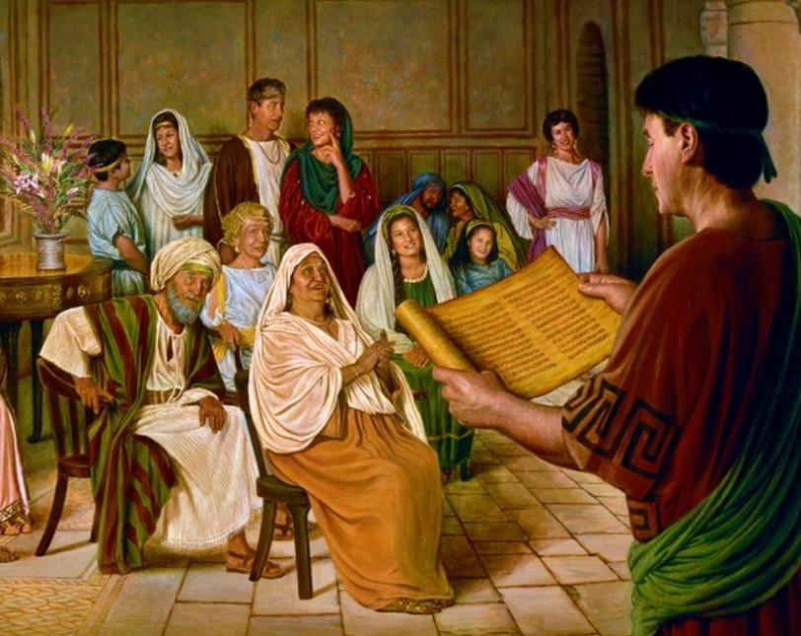

ABO ZANDIKIWE

Slide 8

“Pawulo yumvise ko afite inshingano ikomeye ku bantu bihanye mu gihe yamamazaga ubutumwa bwiza. Ibirenze ibindi byose, yifuzaga ko baba abiringirwa. Yaravuze ati, “Mwerekane ijambo ry’ubugingo; kugira ngo mbone uko nzirata ku munsi wa Kristo, yuko ntirukiye ubusa, kandi nkaba ntaruhijwe n’ubundi.” Abafilipi 2:16. Yahangayikishwaga n’umusaruro wavuye mu murimo we w’ivugabutumwa. Yumvaga ko n’agakiza ke ubwe kari mu kaga mu gihe ananiwe gusohoza inshingano ye ndetse n’Itorero rikananirwa gukorana na we mu murimo wo gukiza abantu.”
E.G. White, Ibyakozwe n’Intumwa, p. 130

Slide 9

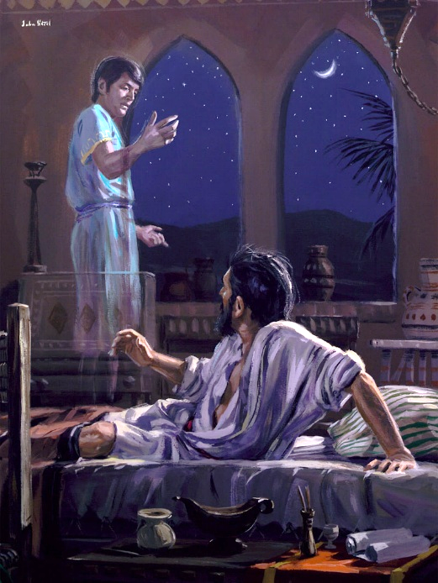
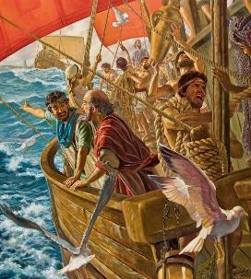
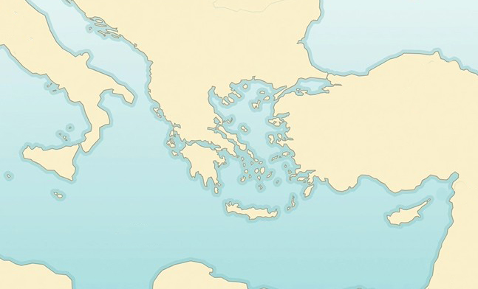

AMATEKA YA FILIPI
“Nijoro Pawulo ararota, abona umugabo w’Umunyamakedoniya ahagaze amwinginga ati ‘Ambuka uze i Makedoniya udutabare.’ ” (Ibyakozwe 16:9)
Intara ya Makedoniya
Filipi
Neyapoli
Bituniya
Samotirake
X
Mu rugendo rwa Pawulo rwa kabiri rw’ivugabutumwa, gahunda ze zarahindutse. Umwuka Wera ni We wayoboraga intambwe ze (Ibyakozwe 16:6–12):
Tirowa
Musiya
Galatiya
Furujiya
Pawulo yagiye i Furugiya (6a)
Ntiyashoboye kubwirizayo cyangwa i Galatiya (6b)
Yageze i Musiya (7a)
Yagerageje kujya i Bituniya, ariko ntiyakundirwa (7b)
Yagiye i Tirowa, aho yabonekewe (8–10)
Yafashe ubwato ajya i Samotirake (11a)
Avuye aho ajya i Neyapoli (11b)
Amaherezo, yageze i Filipi (12)
Ibyakozwe 16:6–12
Filipi ni ho hantu hatoranijwe n’Umwuka Wera kugira ngo hatangirire kwamamaza Ubutumwa Bwiza mu Burayi. Nk’umurwa w’Abaroma mu buryo bwuzuye, Abafilipi ntibagombaga gutanga ikoro, kandi bagiraga ubwenegihugu bw’Abaroma bw’inkomoko.

Slide 10

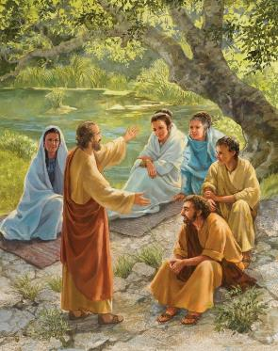
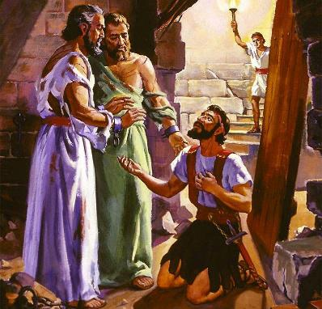
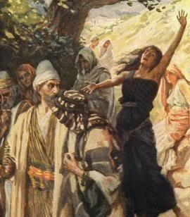
AMATEKA YA FILIPI
“Nijoro Pawulo ararota, abona umugabo w’Umunyamakedoniya ahagaze amwinginga ati ‘Ambuka uze i Makedoniya udutabare.’ ” (Ibyakozwe 16:9)
Akamenyero ka Pawulo uko yabaga ageze mu murwa mushya, kwari ukujya mu isinagogi. Ariko i Filipi nta sinagogi yari ihari! Ku Isabato babonye ahantu ho gusengera maze babwiriza abagore bari bateraniye aho (Ibyakozwe 16:13).
Muri iri teraniro ni ho habonetse umuntu wa mbere w’i Burayi wihannye: Lidiya. Yabatirijwe hamwe n’umuryango we wose (Ibyakozwe 16:14–15).
Ariko umwanzi ntiyicaye ubusa. Yasabye umupfumu gushyira abantu mu rujijo, yigira nk’aho ashyigikiye Pawulo (Ibyakozwe 16:16–17). Igihe umukobwa yakiraga, ingorane za Pawulo na Sila zatangiye ubwo (Ibyakozwe 16:18–24).
Ibyakurikiyeho: guhinduka k’umurinzi w’inzu y’imbohe n’umuryango we (Ibyakozwe 16:25–33). Nta gushidikanya ko Ubutumwa Bwiza bwinjiye mu Burayi mu mbaraga n’ubuyobozi bya Mwuka Wera.

Slide 11

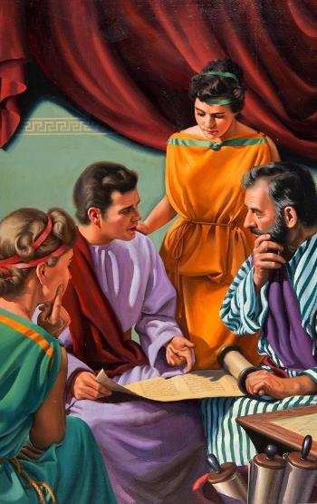
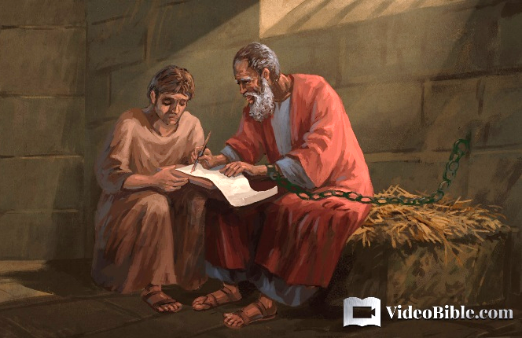
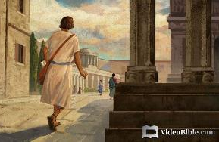
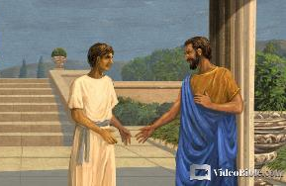
AMATEKA YA KOLOSAYI
“nk’uko mwigishijwe na Epafura umugaragu mugenzi wacu dukunda, wababereye umukozi ukiranuka wa Kristo wo kubagaburira ibye” (Abakolosayi 1:7)
Epafura yafashaga Pawulo mu gihe yari abohewe i Roma (Filemoni 23). Akomoka i Kolosayi (Abakolosayi 4:12), ni we wazanye ubutumwa bwiza muri uwo murwa (Abakolosayi 1:7).
Kolosayi wari umurwa wo mu ntara ya Furugiya, hafi ya Lawodikiya na Heriyapoli, naho habwirijwe na Epafura (Abakolosayi 4:13). Warimo Abayuda benshi. Umwe mu Bayuda bazwi bari batuye aho ni Filemoni, wakoranye na Pawulo, ndetse itorero rikaba ryarateraniraga mu nzu ye (Filemoni 1–2).
Onesimo, umwe mu bagaragu ba Filemoni, yahungiye i Roma, aho yakiriye Yesu binyuze kuri Pawulo (Filemoni 10–11). Ubwo Pawulo gusubizaga Onesimo kwa shebuja, yagaragaje uburyo umubano uri hagati y’abatware n’abagaragu, cyangwa abayobozi n’abayoborwa, ukwiriye kuba umeze (Filemoni 12–17).

Slide 12

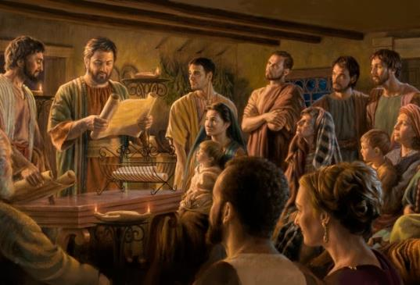
AMATORERO Y’I FILIPI N’I KOLOSAYI
“Pawulo na Timoteyo imbata za Kristo Yesu, turabandikiye mwebwe abera bo muri Kristo Yesu b’i Filipi bose, hamwe n’abepisikopi n’abadiyakoni” (Abafilipi 1:1)
Intangiriro z’inzandiko zandikiwe Abafilipi n’Abakolosayi, zirasa cyane, zikatwereka ibintu bibiri by’ingenzi (Abafilipi 1:1; Abakolosayi 1:1–2)
Mu maso y’Imana, abagize itorero ni abera n’abiringirwa, nubwo bāgira amafuti
Mu itorero harimo gahunda, aho bamwe mu bayoboke baryo bafite ububasha n’inshingano kurusha abandi:
Pawulo ni intumwa, urwego rw’ubuyobozi rwo hejuru
Timoteyo ni uwo bakorana (pasitori)
Abepiskopi ni abayobozi b’ibanze (abakuru b’itorero)
Abadiyakoni bita ku itorero
Pawulo ari mu nzu y’imbohe yashimiye Abafilipi ku bw’ubufasha bamwoherereje (Abafilipi 4:18).
Abakolosayi bo yaboherereje abamufashaga, ngo babahumurize (Abakolosayi 4:7–9).

Slide 13

“Mutyo twigire gato ku byabaye kuri Pawulo. Mu gihe nyir’izina byagaragaraga ko imihati y’intumwa yari ikenewe cyane kugira ngo ikomeze itorero ryariho rigeragezwa kandi rirenganywa, umudendezo we [Pawulo] wakuweho, maze aboherwa mu minyururu. Ariko iki ni cyo cyari igihe ngo Uwiteka yigaragaze, kandi kunesha kwabonetse kwabaye ukw’igiciro gikomeye.
Igihe mu bigaragara Pawulo atashoboraga kugira igifatika yakora, ni bwo ukuri kwabonye akito ko kurombereza kukinjira mu ngoro y’umwami. Icyakuruye intekerezo z’abo bantu bakomeye ntabwo ari inyigisho z’ubuhanga za Pawulo, ahubwo ni iminyururu ye. Mu kubohwa kwe, yabaye umuneshi ku bwa Kristo. Ukwihangana n’ukwicisha bugufi yagaragaje yemera kubohwa igihe kirekire kandi arengana, byateye aba bagabo gushyira imico ku gipimo.”
E.G. White, Reflecting Christ, December 10

