Slide 1
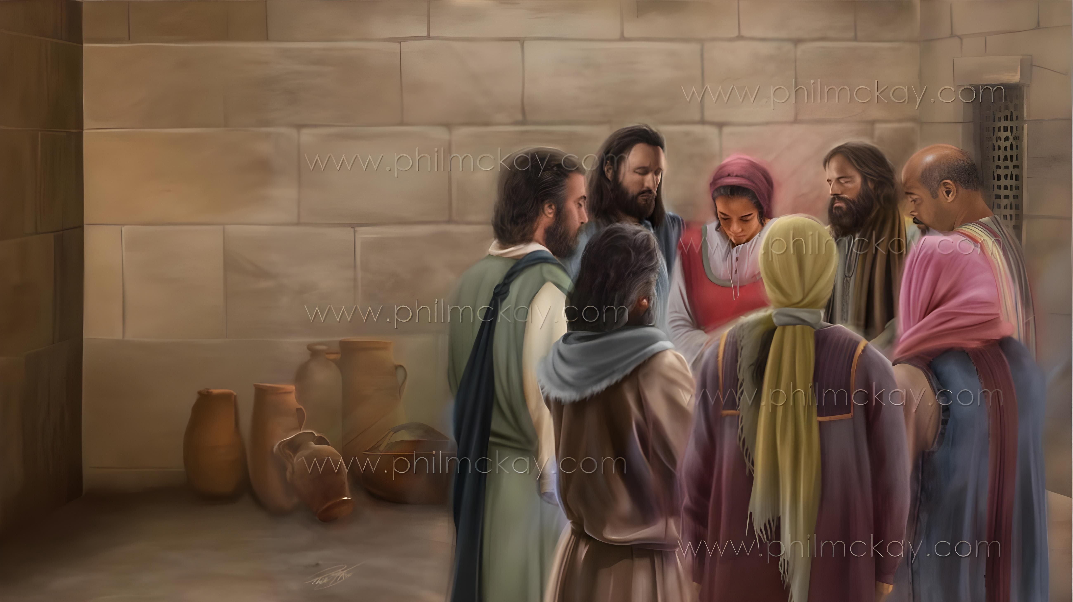
IMPAMVU ZO GUSHIMA NO GUSENGA
Icyigisho cya 2 cyo ku wa 10 Mutarama 2026

Slide 2


“Icyo nzi neza rwose ntashidikanya, ni uko Iyatangiye umurimo mwiza muri mwe izawurangiza rwose, kugeza ku munsi wa Yesu Kristo”
Abafilipi 1:6

Slide 3

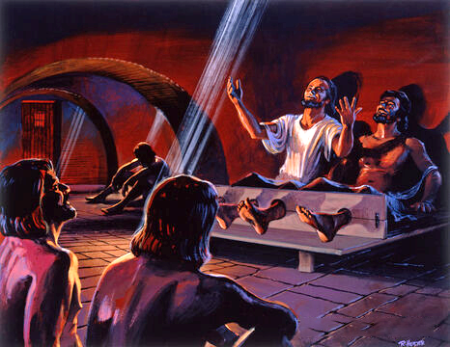
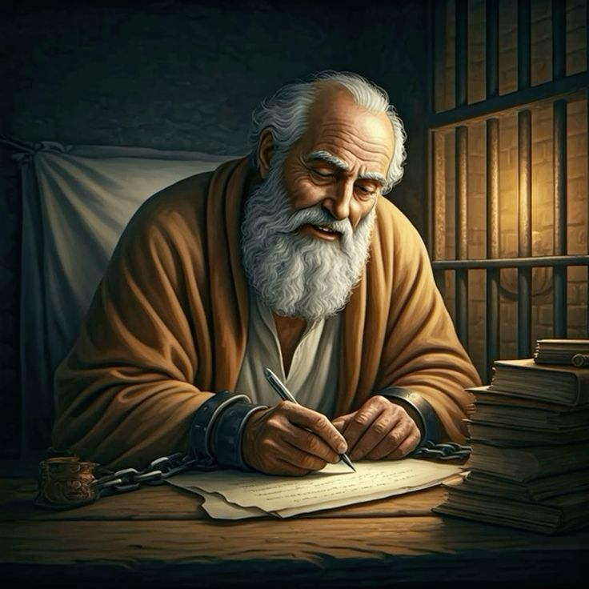







Ibi ntibyari ibihe byoroshye kuri Pawulo. Ibyajya kumworohera ni ukwiheba kuko yavukijwe umudendezo.
Ariko, nk’uko Pawulo yari yararirimbye indirimbo z’Imana ari mu nzu y’imbohe ishishana yo muri Filipi, yanabonye impamvu zo gushimira abavandimwe be b’i Filipi n’i Kolosayi.
Kugirwa imbohe kwe ntibyamubujije gukomeza kuvugana na Se, no gusabira abandi binyuze mu gusenga.
Impamvu zo gushima no gusenga, mu rwandiko rw’Abafilipi:
  Impamvu zo gushima (Abafilipi 1:3–8)
  Ibyifuzo byo gusengera (Abafilipi 1:9–11)
Gushima no gusenga mu bihe bigoye (Abafilipi 1:12–18)
Impamvu zo gushima no gusenga, mu rwandiko rw’Abakolosayi:
  Impamvu zo gushima (Abakolosayi 1:3–8)
  Ibyifuzo byo gusengera (Abakolosayi 1:9–12)

Slide 4
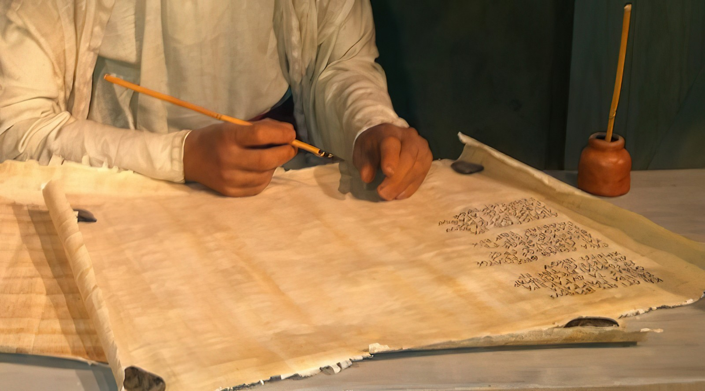
Impamvu zo gushima no gusenga, mu rwandiko rw’Abafilipi

Slide 5

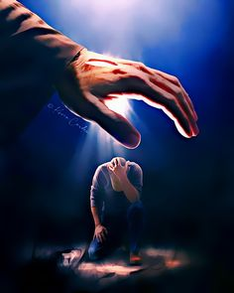
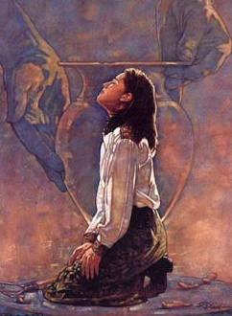
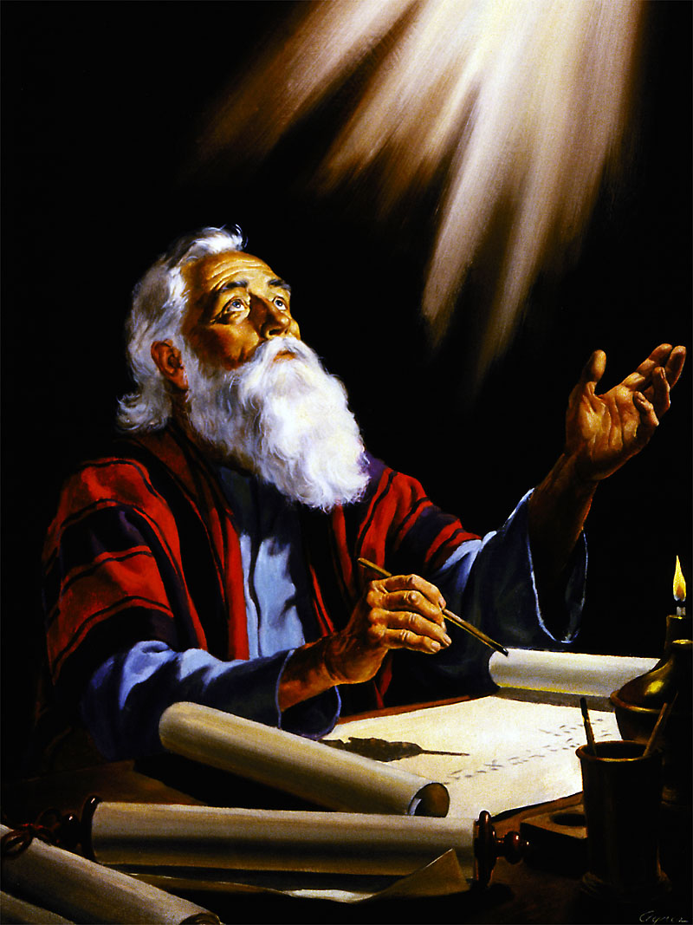
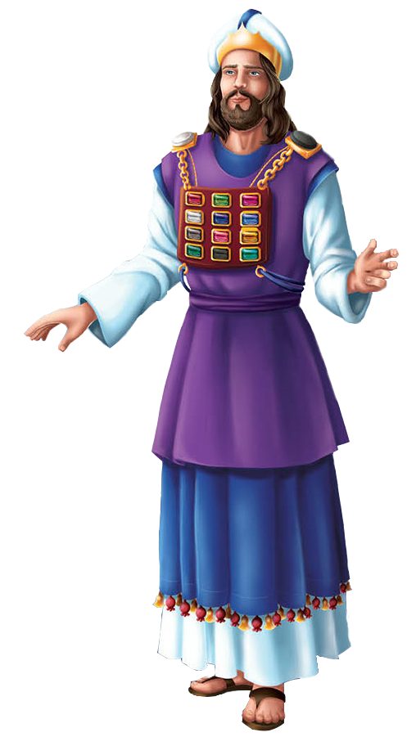
IMPAMVU ZO GUSHIMA
“Icyo nzi neza rwose ntashidikanya, ni uko Iyatangiye umurimo mwiza muri mwe izawurangiza rwose, kugeza ku munsi wa Yesu Kristo” (Abafilipi 1:6)
Pawulo atangira urwandiko rwe ashimira Imana ku bw’abizera b’i Filipi (Abafilipi 1:3), yakundaga cyane (Abafilipi 1:8).
Nk’uko umutambyi mukuru, igihe yahagararaga imbere y’Imana, yambaraga ku mwambaro wo ku gituza cye, hafi y’umutima we, amazina y’imiryango ya Isirayeli yanditswe ku mabuye y’igiciro, ni na ko Pawulo yari afite “mu mutima we” buri wese mu bagize itorero, igihe yahagararaga imbere y’Imana asenga kugira ngo abasabire (Abafilipi 1:7).
Mu byo yashimiye harimo kuba Abafilipi barakomeje kuba indahemuka ku butumwa bwiza, kandi ko Imana yakomezaga kubeza buri munsi (Abafilipi 1:5–6).
Impamvu ya gatatu yo gushima ni uko Abafilipi bafatanyije na we “mu ngoyi zanjye no mu mpaka ngira kurwanira ubutumwa bwiza” (Abafilipi 1:7).

Slide 6


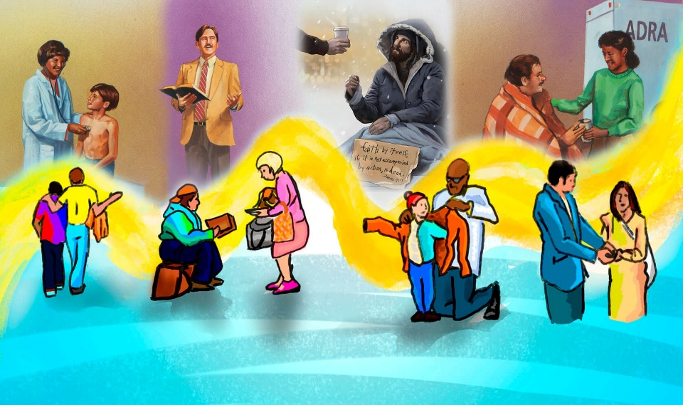
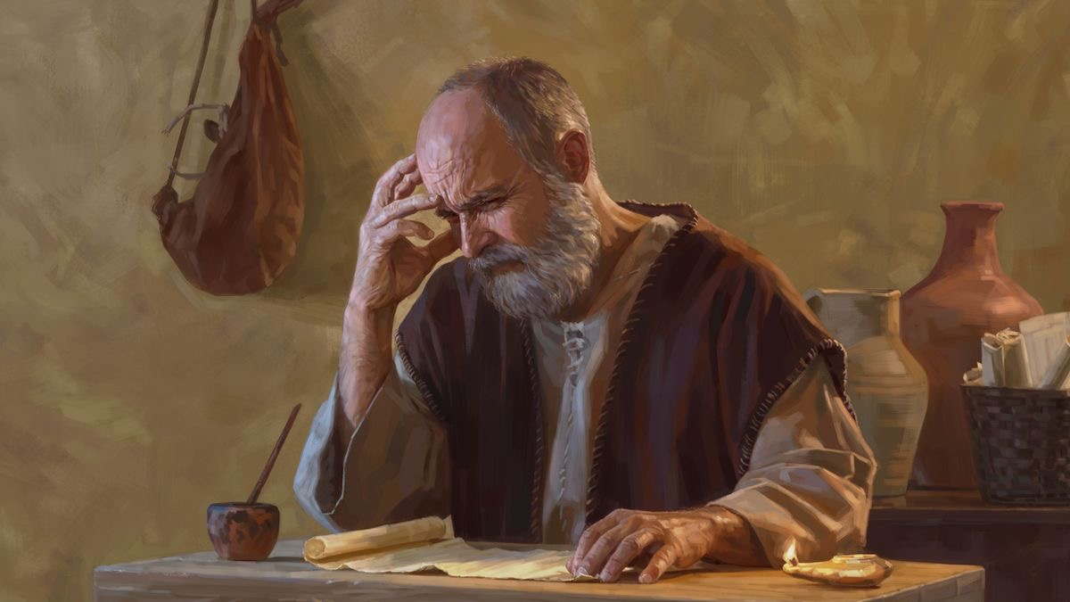
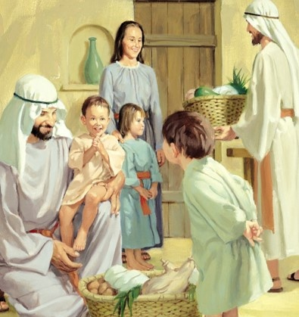
IBYIFUZO BYO GUSENGERA
“Kandi iki ni cyo mbasabira, ni ukugira ngo urukundo rwanyu rurusheho kugwiza ubwenge no kumenya kose, mubone uko murobanura ibinyuranye, kandi mubone uko muba abataryarya n’inyangamugayo kugeza ku munsi wa Kristo, mwuzuye imbuto zo gukiranuka ziheshwa na Yesu Kristo, kugira ngo Imana ishimwe kandi ihimbazwe.” (Abafilipi 1:9–11)
Dushobora gufata isengesho Pawulo yasenze nk’ “nk’umurunga w’impamvu” (Abafilipi 1:9–11):
Urukundo rugwire muri mwe
Rubatere kugwiza ubwenge
Mubone uko murobanura ibinyuranye
Mube abataryarya n’inyanga-mugayo
Muheshwe na Yesu Kristo kwera imbuto
Ibi bizatuma Imana ishimwa kandi ihimbazwe
Ni gute urukundo rwacu “rwarushaho kugwira”? Kuki ibyo ari ingenzi cyane ku mibereho ya gikristo?

Slide 7
GUSHIMA NO GUSENGA MU BIHE BIGOYE

Slide 8

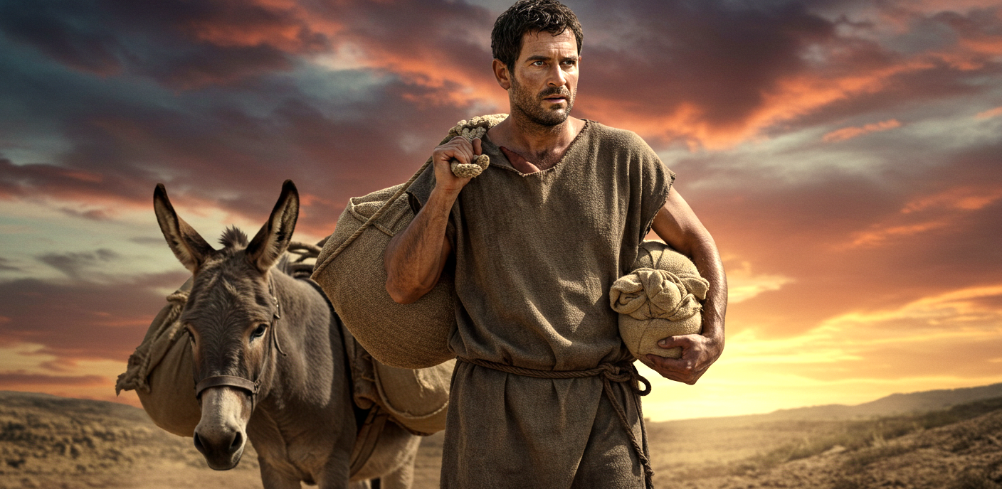
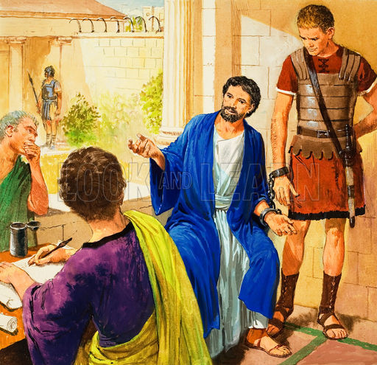
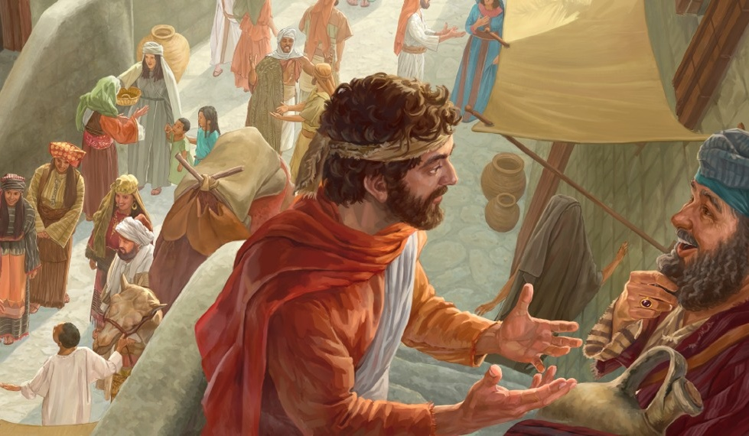
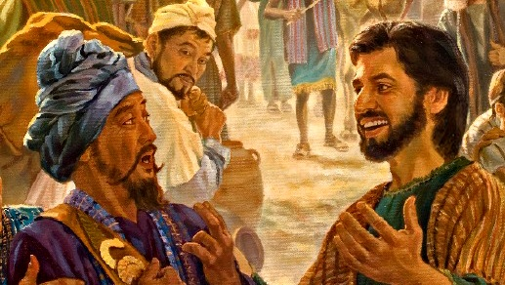
UMWANYA WO KURWANIRIRA UBUTUMWA BWIZA
“Bene Data, ndashaka ko mumenya yuko ibyambayeho bitabereye ubutumwa bwiza inkomyi ahubwo byabushyize imbere.” (Abafilipi 1:12)
Igihe Abafilipi bamenyaga ko Pawulo yari mu nzu y’imbohe i Roma, barababaye cyane, maze bohereza Epafuradito ngo yite kuri iyi ntumwa (Abafilipi 4:18).
Mu cyimbo cyo kubura amahwemo, ibiri amambu, Pawulo yashimiye Imana kubera kuba imbohe kwe. Kuki yashimye? Kuko muri ubwo buryo yashoboye kubwiriza abo atari gushobora kugeraho mu bundi buryo (Abafilipi 1:13).
Byongeye kandi, abandi bavandimwe bizerwa babonye iyi myifatire y’intumwa, bibatera imbaraga, batangira kubwiriza ubutumwa bwiza batitaye ku birushya byari bihari (Abafilipi 1:14).
Abandi, bibwiraga ko kuvuga ubutumwa bwiza byeruye byazanira Pawulo ingorane, nabo— batabigambiriye—bafashije mu kubwamamaza (Abafilipi 1:15—18).

Slide 9
Impamvu zo gushima no gusenga, mu rwandiko rw’Abakolosayi

Slide 10


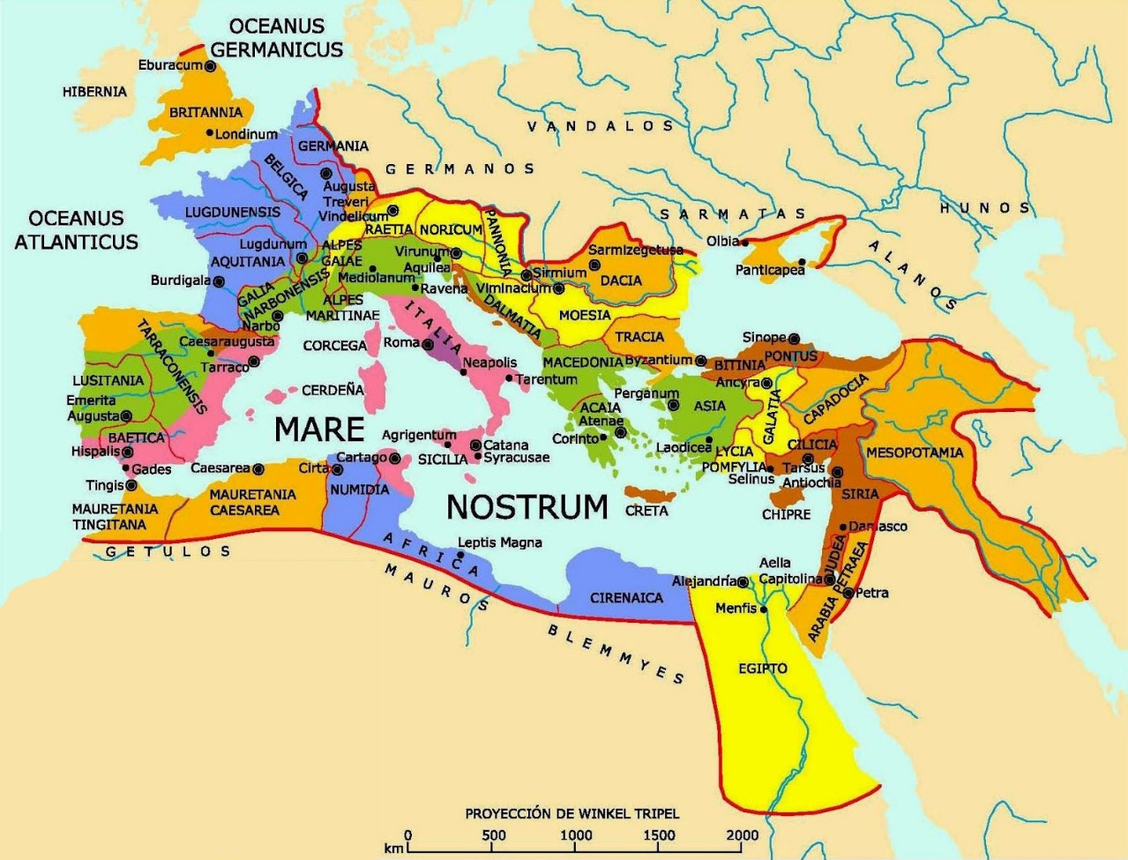
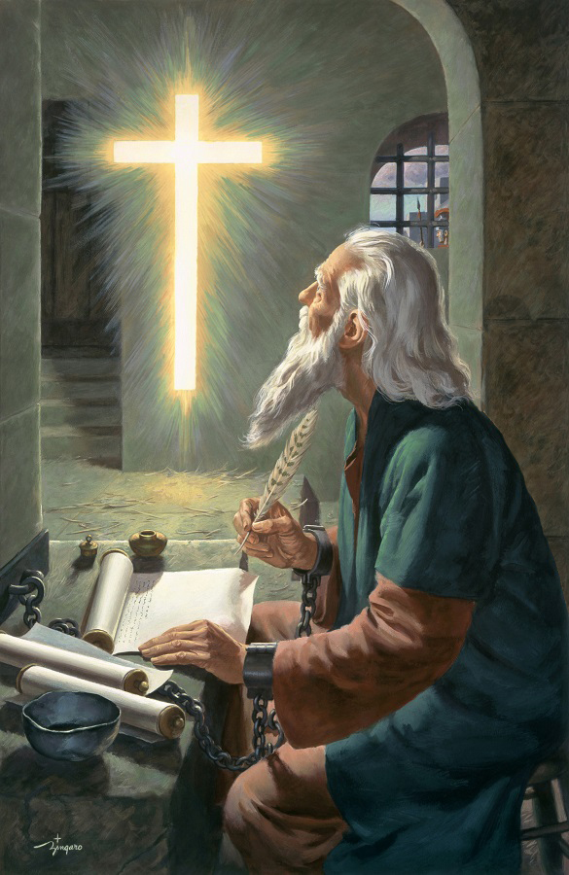

IMPAMVU ZO GUSHIMA
“Dushima Imana Se w’Umwami wacu Yesu Kristo uko tubasabiye iteka ryose” (Abakolosayi 1:3)
Pawulo arenguriza ku magambo yo mu 1 Abakorinto 13:13, ashimira Imana kuko Abakolosayi bafite izi ngeso nziza eshatu za Gikristo: ukwizera, ibyiringiro, n’urukundo (Abakolosayi 1:4–5).
Izi ngeso nziza ziva “muri Kristo Yesu”, zigira ingaruka ku mibanire yacu n’“abera bose”, kandi zatugezeho binyuze mu “ijambo ry’ukuri ry’ubutumwa bwiza”.
Pawulo ashimangira ko ubu butumwa bwiza butabwirijwe Abakolosayi gusa, ahubwo bwabwirijwe “mu isi yose” (Abakolosayi 1:6)... kandi mu myaka 30 gusa!
Imbaraga z’Imana, zitangwa binyuze mu butumwa bwiza kubw’umurimo w’Umwuka Wera, zituma Bibiliya iba “ijambo ry'ubugingo” (Abafilipi 2:16). Ibi bivuze ko iyo twemeye ubutumwa bwiza, tubona ubugingo buhoraho n’umurage “twabikiwe mu ijuru” (Abakolosayi 1:5).

Slide 11



IBYIFUZO BYO GUSENGERA
“Ni cyo gituma tudasiba kubasabira uhereye igihe twabyumviye, twifuza ko mwuzuzwa ubwenge bwose bw’Umwuka no kumenya kose ngo mumenye neza ibyo Imana ishaka.” (Abakolosayi 1:9)
Isengesho rya Pawulo ririmo ibintu byinshi byiza ku Bakolosayi (Abakolosayi 1:9–11):
Ngo bākīre kumenya Imana, bizabaheshe ubwenge n’ubumenyi bw’umwuka.
Babeho nk’abana b’Imana, bayishimisha muri byose.
Bēre imbuto kandi bakure mu kumenya.
Bakomezwe n’imbaraga y’Imana kugira ngo bagire kwihangana.
Iri sengesho ririmo “mushima Data wa twese” (Abakolosayi1:12)
Hari inzira enye Imana ikoresha kugira ngo isengesho rya Pawulo ribe impamo muri twe:
Bibiliya
(Zaburi ya 119:105)
Umwuka w’Ubuhanuzi (Ibyahishuwe 19:10), wigaragarije muri Elina White
Kuyoborwa n’Imana (Abakolosayi 4:3)
Umwuka Wera
(Yesaya 30:21)

Slide 12

“Imibereho yacu igomba kuba ishingiye ku mibereho ya Kristo; tugomba kuvoma kuri We buri gihe, tukamusangiza abandi, We Mutsima muzima wamanutse uva mu ijuru, tukavoma ku isoko ihora ifutse, tugasakaza ubutunzi bwinshi bwayo. Nidukomeza guhora tugira Umwami nyambere, tukemerera imitima yacu gufungukira kumushimira no kumuhimbaza, tuzahorana imbaraga mu mibereho yacu yo mu by’idini. Amasengesho yacu azamera nk’ikiganiro cy’urugwiro tugirana n’Imana nk’uko twaganira n’inshuti. Izaduhishurira ubwiru bwayo, buri wese ku giti cye. Akenshi hazabaho ibyishimo byinshi kubwo kumva ko Yesu ari kumwe natwe. Akenshi imitima yacu izagurumanira muri twe, uko Imana izaba itwireherezaho ngo tuyegere nk’uko yabigenje kuri Henoki. Iyo mu by’ukuri ibi ari byo mibereho y’Umukristo, imibereho ye igaragaramo ubworoherane, kwicisha bugufi, ubugwaneza, no kwiyoroshya, bikagaragariza abo ahura nabo bose ko yabanye na Yesu kandi ko yamwigiyeho.”
E.G. White, Christ’s Object Lessons, p. 129

