Slide 1

KUNGA UBUMWE BINYUZE MU KWICISHA BUGUFI
Icyigisho cya 4 cyo ku wa 24 Mutarama 2026

Slide 2

“Musohoreshe umunezero wanjye guhuriza imitima mu rukundo, mwibwira kumwe, muhuje imitima”
Abafilipi 2:2

Slide 3







Pawulo yari amaze gushishikariza abizera b’i Filipi guhagarara bashikamye mu ngorane n’ibibazo byo mu mibereho ya Gikristo. Yabasabye kwitwara mu buryo bukwiriye abenegihugu b’ijuru, ashimangira kugira ubumwe.
Pawulo akoresheje imvugo ngo “nuko”, atangira igice gishya aduha imfunguzo zo gusobanukirwa uburyo bwo kugera kuri ubwo bumwe buboneye: kwigana urugero rwa Yesu.
Isōko yo kwīrema ibice (Abafilipi 2:1–3a)
Ubumwe binyuze mu kwicisha bugufi (Abafilipi 2:3b–4)
Gutekereza nka Yesu (Abafilipi 2:5)
Inyifato ya Yesu (Abafilipi 2:6–8)

Slide 4



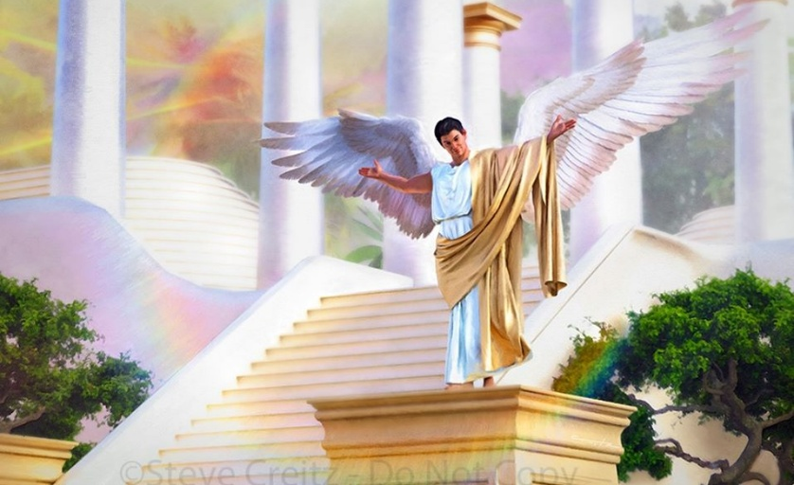

ISŌKO YO KWĪREMA IBICE
“Ntimukagire icyo mukorera kwirema ibice cyangwa kwifata uko mutari” (Abafilipi 2:3a)
Mbere y’uko Pawulo atunga urutoki ikibazo cyari gihari, ngo agaragaze impamvu zo kwirema ibice kwagaragariye mu Bafilipi, ni izihe nama z’ingenzi yabahaye kugira ngo bagere ku bumwe, basohoze ibyishimo bye (Abafilipi 2:1–2)?
Gukomezwa muri Kristo
Guhumurizwa mu rukundo
Gusangira Umwuka
Impuhwe zivuye ku mutima
Kugira neza
Guhuriza imitima mu rukundo
Yabashishikarije kwiga no kwigana imibereho ya Kristo nk’icyitegererezo
Urukundo bakunda Kristo rugira imbaraga ku ntekerezo zabo
Bagomba kugandukira ubuyobozi bwa Mwuka
Bagomba kugaragaza amarangamutima y’urukundo ruvuye ku mutima
Kugaragaza ko urukundo nyakuri rubaho binyuze mu mirimo yo kugira neza
Gukundana bitera guhuza ibitekerezo maze bikaganisha ku gukorera hamwe
Ibi byose bashoboraga kubigeraho mu gihe bāshyira ku ruhande icyabatandukanyaga: ubwibone n’impaka (Abafilipi 2:3a).
Ibi bibazo byombi byagaragariye mu kwigomeka kwa Lusiferi, kandi biri mu bibazo bikomereye cyane imibanire y’abantu (Abagalatiya 5:26; Yakobo 3:16).

Slide 5




UBUMWE BINYUZE MU KWICISHA BUGUFI
“… ahubwo mwicishe bugufi mu mitima, umuntu wese yibwire ko mugenzi we amuruta, Umuntu wese muri mwe areke kwizirikana ubwe gusa, ahubwo azirikane n’abandi.” (Abafilipi 2:3b–4)
Uburyo bwo kugera ku bumwe Pawulo atanga si ikintu kiva hanze, ahubwo ni inyifato y’imbere: kwicisha bugufi. Uretse no kuba ari umuco uranga Yesu, We ubwe yashishikarije abamwumvaga kwicisha bugufi (Matayo 11:29; 18:4; 23:12).
Kugira ngo tugere kuri uku kwicisha bugufi, Pawulo atanga igitekerezo ko dukwiriye kubona abandi nk’abaturuta (Abafilipi 2:3). Ariko se twese ntitureshya imbere y’Imana? Ese ntihakwiriye kubaho ukureshya kugira ngo habeho ubumwe?
Pawulo ntavuga ko turi hasi y’abandi, ahubwo avuga ko tugomba kwibwira ko turi nk’abandi. Nk’uko umugaragu ashakira shebuja ibyiza, ni ko natwe tugomba gushakira ibyiza abo twibwira ko baturuta (Abafilipi 2:4).
Kugira ngo dushobore gufasha abandi, tugomba kwiga kubatega amatwi no kumva uko babona ibintu. Nta gushidikanya ko ibi byose ari umurimo w’Umwuka Wera.

Slide 6

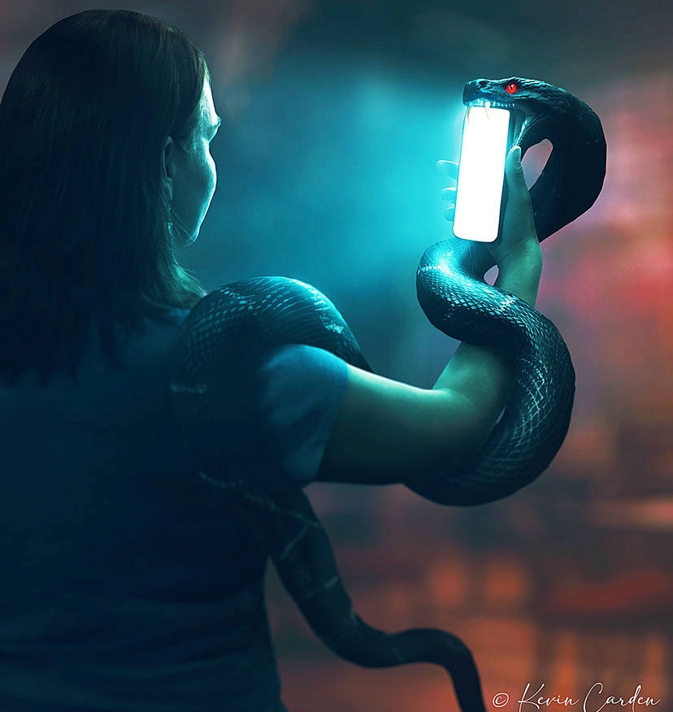


GUTEKEREZA NKA YESU
“Mugire wa mutima wari muri Kristo Yesu” (Abafilipi 2:5)
Ibitekerezo byacu biremwa bite? Binyuze mu “nzira z’ubugingo,” ni ukuvuga ibyumviro byacu. Ibyo dusoma, tubona, cyangwa twumva byose mu buryo runaka biraduhindura. Kandi, birumvikana ko Satani atera ibyumviro byacu kugira ngo ahindurire imitekerereze yacu kuba nk’uko we ubwe atekereza.
Pawulo ntakebakeba. Ntabwo aturarikira gusa kwitondera intekerezo zacu, ahubwo anadusaba gutekereza nk’uko Kristo yatekerezaga (Abafilipi 4:8; 2:5).
Ahari, dushyizeho umwete mwinshi, dushobora kugera ku cya mbere. Ariko guhindura intekerezo zacu kugira ngo zihuze n’imitekerereze ya Yesu bishobora gukorwa muri twe na Mwuka Wera gusa.
Ibi biterwa nuko intekerezo zacu ari iza kamere, n’imitima yacu ikaba ishukana (Yeremiya 17:9). Umwuka azahindurira intekerezo zacu z’umubiri kuba iza mwuka, nk’iza Kristo (Abaroma 8:1, 5).

Slide 7

E.G. White, Abakurambere n’Abahanuzi, p. 315
“Nyamara dufite umurimo tugomba gukora kugira ngo tuneshe ibigeragezo. Abadashaka kugwa mu mitego ya Satani bagomba kurinda neza inzira zinjira mu ntekerezo zabo. Bagomba kwirinda gusoma, kureba cyangwa kumva ibibazanira ibitekerezo bibi. Ntabwo intekerezo zikwiriye kurekwa ngo zībaze kandi zitinde ku ngingo yose umwanzi w’ubugingo abasha kuzishyira imbere.”

Slide 8

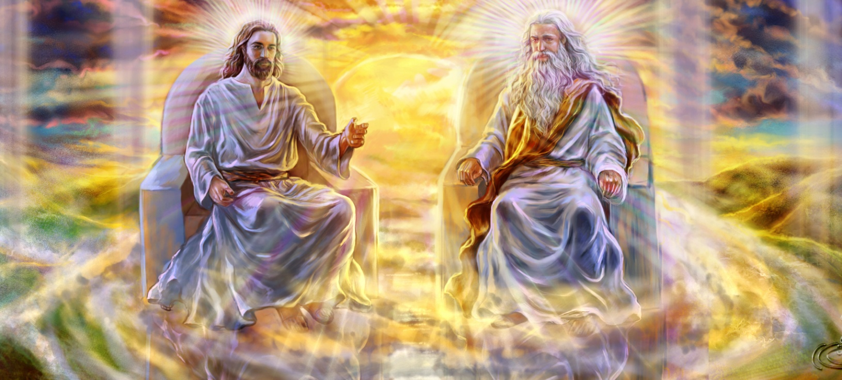


INYIFATO YA YESU (1)
“Uwo nubwo yabanje kugira akamero k’Imana, ntiyatekereje yuko guhwana n’Imana ari ikintu cyo kugundirwa”
(Abafilipi 2:6)
Pawulo agaragaza imico itatu ya Yesu:
Yasize icyubahiro Cye cy’ubumana (Abafilipi 2:6)
Yabaye umuntu kugira ngo adukorere (Abafilipi 2:7)
Yumviye yicishije bugufi muri byose, kugeza ku rupfu Rwe (Abafilipi 2:8)
Umuremyi, yabaye nk’ikiremwa. Yemeye kugirirwa nabi no gupfira ku musaraba kugira ngo aducungure.
Nubwo Yesu yari ku rwego rumwe n’abandi babiri bagize Ubutatu Bwera, kwirundurira ubushake bwa Se Kwe kwari gutunganye. Nta na rimwe yigeze yanga kuyoboka.
Iyo dutekereje kuri ibi, dushobora gusa kūbama tukaramya Umukiza wacu utangaje.
Ni We rugero rwacu. Tugomba kwiyemeza kwicisha bugufi no kwitanga ku bw’ineza y’abandi.

Slide 9


INYIFATO YA YESU (2)
“Si ugushidikanya, ubwiru bw’ubumana burakomeye cyane: Imana kwerekanwa ifite umubiri, ikagaragara ko ari umukiranutsi mu mwuka, ikabonwa n’abamarayika, ikamamazwa mu banyamahanga, ikizerwa mu isi, ikazamurwa igahabwa ubwiza” (1 Timoteyo 3:16)
Ukwicisha bugufi gutangaje kwa Kristo mu guhinduka umuntu bizaba ingingo abacunguwe baziga iteka ryose.
Biratangaje kubona Utagira iherezo, Uwiteka, yarabaye umuntu ufite iherezo, upfa. Ibi ni byo Pawulo yise “ubwiru bw’ubumana” (1 Timoteyo 3:16).
Yesu yasize ingoma y’isanzure yose ajya mu bucakara bwuzuye. Ibi bihabanye by’ihabya n’ibyahagizaga Lusiferi, we nk’umugaragu, wifuje ubutware bw’isanzure yose.
Uru rugero rudusaba kureka inarijye yacu n’icyifuzo cyacu cyo gukorerwa, tukabisimbuza kwicisha bugufi no kugira ubushake bwo gukorera abandi.

Slide 10

“Imana yemerera buri muntu wese gukora akurikije uko abyumva. Ntiyifuza ko hagira umuntu ucengeza intekerezo ze mu bwenge bwa mugenzi we. Abifuza guhinduka mu ntekerezo no mu mico ntibagomba kureba abantu, ahubwo urugero rwabo rugomba kuba Imana. Imana itanga irarika igira iti: ‘Mugire wa mutima wari muri Kristo Yesu.’ Kubwo guhinduka no kuba bashya, abantu bagomba kugira umutima wa Kristo.”
E.G. White, That I May Know Him, May 8

