Slide 1
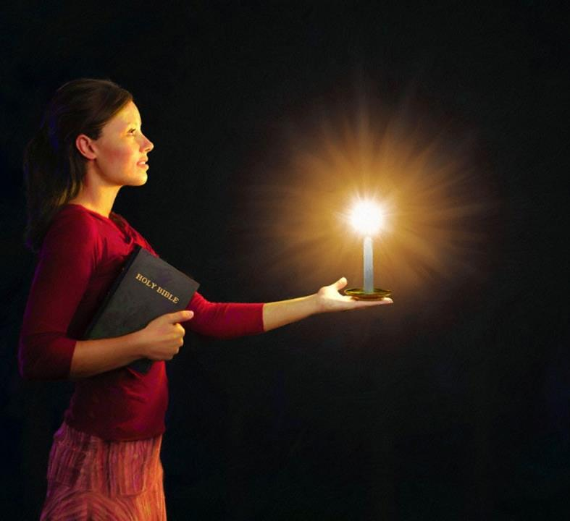
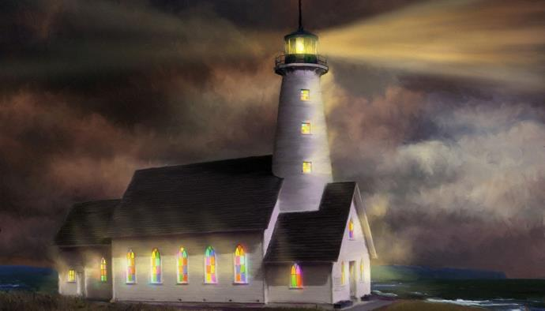

Icyigisho cya 5 cyo ku wa 31 Mutarama 2026
BIBILIYA YERA
KUMURIKA NK’AMATARA YA NIJORO

Slide 2

“Mukore byose mutitotombana, mutagishanya impaka kugira ngo mutabaho umugayo cyangwa uburyarya, mube abana b’Imana batagira inenge hagati y’ab’igihe kigoramye cy’ubugoryi, abo mubonekeramo nk’amatabaza mu isi”
Abafilipi 2:14, 15

Slide 3

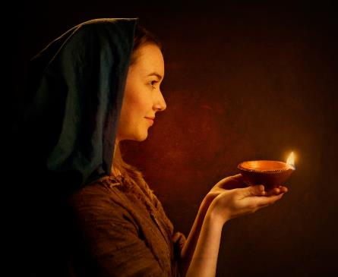



“Abe ari ko umucyo wanyu ubonekera imbere y’abantu, kugira ngo babone imirimo yanyu myiza, bahereko bahimbaze So wo mu ijuru” (Matayo 5:16).
Mu Bafilipi 2:12–18 dushobora kuhasoma iri tegeko rya Yesu mu buryo ryavuzwe na Pawulo.
Kubera ko tuba mu isi aho Amategeko y’Imana ahora aribatwa, twebwe Abakristo, bifuza gukorera Imana tubaho dukurikije ayo mategeko, turi amatara amurikira mu mwijima.
Amatara mu isi:
Kugaragaza Imana (Abafilipi 2:12–13)
Umucyo mu isi (Abafilipi 2:14–16)
Igitambo kizima (Abafilipi 2:17–18)
Ingero z’umucyo:
Timoteyo (Abafilipi 2:19–24)
Epafuradito (Abafilipi 2:25–30)

Slide 4

AMATARA MU ISI

Slide 5




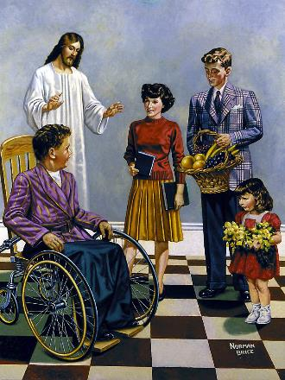
KUGARAGAZA IMANA
“Kuko Imana ari yo ibatera gukunda no gukora ibyo yishimira” (Abafilipi 2:13)
Nyuma yo gusobanura neza uburyo Yesu yasuzuguwe hanyuma akererezwa, Pawulo yongeyeho ati “nuko.” Ni ukuvuga ko, nk’uko Yesu yicishije bugufi maze akererezwa kugira ngo “indimi zose zihamye ko Yesu Kristo ari Uwiteka, ngo Imana Data wa twese ihimbazwe” (Abafilipi 2:11), abizera b’i Filipi (ndetse natwe twese) tugomba kubyitaho.
Inshingano yacu ya mbere ni ugusohoza agakiza kacu “dutinya kandi duhinda umushyitsi” (Abafilipi 2:12). Niba Imana ari yo idukiza (Tito 2:11), kuki twagomba kubijyamo?
Gutinya no guhinda umushyitsi ni imvugo z’ihuzanyito n’imvugo “gukorera Imana” (Zaburi 2:11). Bityo, Pawulo ashimangira ko Imana ari Yo idutera gushaka no gukora ibyiza, kandi ikaduha imbaraga zo kubisohoza (Abafilipi 2:13).

Slide 6




UMUCYO MU ISI
“Kugira ngo mutabaho umugayo cyangwa uburyarya, mube abana b’Imana batagira inenge hagati y’ab’igihe kigoramye cy’ubugoryi, abo mubonekeramo nk’amatabaza mu isi.” (Abafilipi 2:15)
Pawulo atanga uburyo butatu bwazatuma abizera barabagirana mu isi:
Kubumbatira ubumwe (Abafilipi 2:14)
Mu gihe dukorera hamwe, hagati yacu ntidukwiriye kugira amazimwe, kunenga, gushyamirana, cyangwa impaka.
Imibereho itagira umugayo (Abafilipi 2:15)
Kumvira Data twiyoroheje bitandukanye by’ihabya n’ikibi n’ubusambo biri hirya no hino.
Kuba indahemuka ku Ijambo ry’Imana (Abafilipi 2:16)
Ibyo dukora n’ibyo dutekereza bigomba kuba bihuye n’ibyo Bibiliya yigisha.
Aho umwijima ubuditse cyane, ni ho umucyo urabagiranira cyane. Mu isi, aho Imana yanzwe mu buryo bushimikiriye, twe Abakristo tugomba kurabagirana mu mucyo wa Kristo.

Slide 7




IGITAMBO KIZIMA
“Ariko nubwo amaraso yanjye yaba ayo kumishwa ku gitambo cyo kwizera kwanyu ngo abe ituro, ibyo nabyishimira nkanezeranwa namwe mwese.” (Abafilipi 2:17)
Nubwo Pawulo yari yizeye kurekurwa, byaranashobokaga ko yacirwaho iteka. Kuba yacirwaho iteka abigaragaza nko “kumīshwa nk’ituro risukika” (Abafilipi 2:17).
Ituro ry’ibisukika ryabaga rigendanye no kumīsha ibisukika ku gitambo cyabaga kiri gutambwa (Kuva 29:39–40). Ibyerekezwagaho na Pawulo, nuko igitambo cyari Abafilipi.
Ese Abafilipi bendaga gupfa? Oya rwose. Igitambo cyabo cyari “umurimo wo kwizera kwanyu.” Cyari igitambo kizima, igitambo twese tugomba gutambira Imana (Abaroma 12:1).
Pawulo ntiyatinyishwaga no gupfa kuko uguhamya kwe kwajyaga gukomeza abizera bari basanzwe ari abahamya b’indahemuka b’Ubutumwa Bwiza, bavugaga ibyabwo bashize amanga, kandi bakitwara nk’abana b’Imana bakwiriye.

Slide 8

INGERO Z’UMUCYO

Slide 9

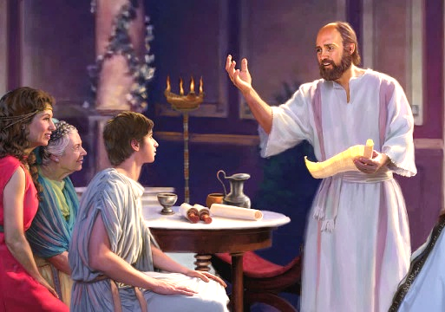


TIMOTEYO
“Ariko muzi yuko uwo we yagaragaye ko ari mwiza, ubwo yakoranaga nanjye umurimo wo kwamamaza ubutumwa bwiza nk’uko umwana akorana na se” (Abafilipi 2:22)
Timoteyo yakoranye na Pawulo cyane, akaba yaramufashije kwandika inzandiko esheshatu (2 Abakorinto, Abafilipi, Abakolosayi, 1 Abatesalonike, 2 Abatesalonike, Filemoni). Pawulo ubwe ni we wamutoranirije kuba umuvugabutumwa (Ibyakozwe 16:1–3). Ni iki cyihariye Pawulo yabonye kuri uyu musore?
Icya mbere, abantu bose “bamuvugaga neza.” Kuba akwiriye kuba mu murimo byemejwe n’amagambo y’ubuhanuzi (1 Timoteyo 1:18). Kuko yari akiri umusore, Pawulo yamufataga nk’umwana we (1 Timoteyo 1:2; 4:12). Ku ruhande rwa Timoteyo, yubahanaga Pawulo urukundo nk’umwana ukunda se (Abafilipi 2:22).
Pawulo yamufataga nk’umukozi mwiza nk’uko na we yari ari (1 Abakorinto 6:10). Yamuhaye inshingano zo kureberera amatorero menshi, nka Korinto (1 Abakorinto 4:17), Filipi (Abafilipi 2:19), na Tesalonike (1 Abatesalonike 3:2). Kimwe na Pawulo, na we yashyizwe mu nzu y’imbohe (Abaheburayo 13:23).

Slide 10

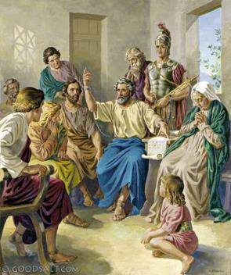


“Icyakora nibwira yuko binkwiriye ko mbatumaho Epafuradito, mwene Data dufatanije umurimo n’ubusirikare. Ni we ntumwa yanyu kandi ni we unkorera ibyo nkennye” (Abafilipi 2:25)
EPAFURADITO
Igihe Abafilipi bamenyaga ko Pawulo abohewe i Roma, bahisemo kumwoherereza ubufasha kugira ngo bumumare ubukene (kwishyura inzu, ibyokurya, imyambaro, n’ibindi). Epafuradito ni we wari ushinzwe kuzanira intumwa ubwo bufasha (Abafilipi 4:18; 2:25).
Epafurodito ntiyamugezagaho ubufasha gusa, ahubwo baranajyanye, akamufasha mu byo yari akeneye, kandi bafatanya kwamamaza ubutumwa bwiza.
Mu kugira ishyaka ry’ubutumwa bwiza, yashyize ubuzima bwe mu kaga maze ararwara bikomeye (Abafilipi 2:27, 30). Abafilipi bubyumvise, baramuhangayikiye. Iyi ni yo mpamvu Pawulo yahisemo kumwohereza kubashyikiriza urwandiko (Abafilipi 2:26, ​​28).
Pawulo asaba agira ati “abasa n’uwo mujye mububaha” (Abafilipi 2:29). Nta gushidikanya ko Epafurodito yari Umukristo wizerwa.

Slide 11

“Mu gihe Yesu, nk’Umuvugizi wacu, adusabira mu ijuru, Umwuka Wera aradukoreramo, kugira ngo dushake kandi dukore ibyo ashaka. Ijuru ryose rishishikajwe n’agakiza k’ubugingo. None se ni iyihe mpamvu dufite yo gushidikanya ko Umwami azadufasha kandi ko adufasha? Twebwe twigisha abantu tugomba ubwacu kugirana isano ikomeye n’Imana. Mu Mwuka no mu Ijambo, twagombye kubera abandi isōko y’amazi, kuko Kristo muri twe ari isōko y’amazi adudubiza kugeza mu bugingo buhoraho. Agahinda n’umubabaro bishobora kugerageza kwihangana kwacu n’ukwizera kwacu, ariko umucyo w’Utagaragara uri muri twe, kandi tugomba kwihisha muri Yesu.”
E.G. White, You Shall Receive Power, December 8

