Slide 1

UBWENEGIHUGU BW’IJURU
Icyigisho cya 7 cyo ku wa 14 Gashyantare 2026

Slide 2
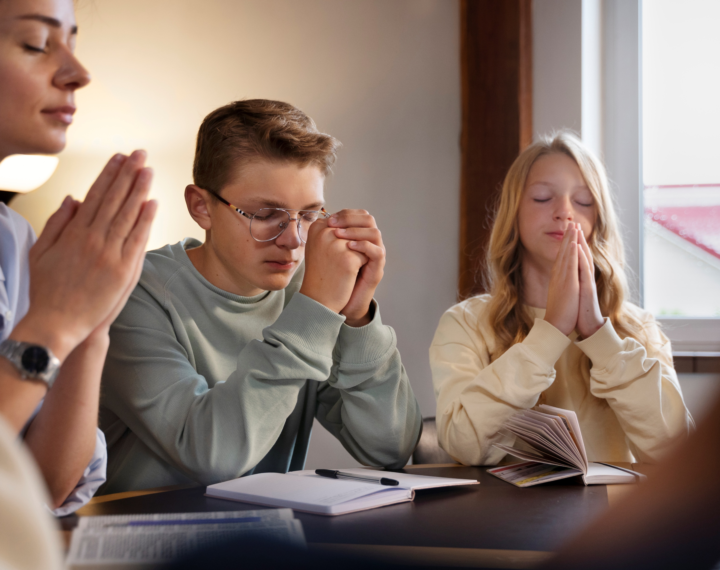
“Ntimukagire icyo mwiganyira, ahubwo ibyo mushaka byose bimenywe n'Imana mubisabiye, mubyingingiye, mushima”
Abafilipi 4:6

Slide 3


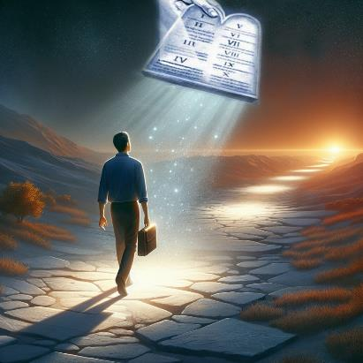


Mu nzandiko za Pawulo zose, agaragaza neza ko tutari abaturage b’iyi si. Iyo twakiriye Yesu nk’Umukiza wacu, tuba tuvutse ubwa kabiri. Muri uku kuvuka bundi bushya, duhinduka abenegihugu b’Ijuru.
Nubwo twubaha kandi tugakurikiza amategeko n’amahame y’iyi si, mu by’ukuri imibereho yacu iragutse cyane, ifite amahame y’imicombonera iheranije.
Ubwenegihugu bw’Ijuru:
Kwīgāna inyangamugayo (Abafilipi 3:17–19)
Ubwenegihugu bwuzuye (Abafilipi 3:20–21)
Kugeza ubwo tuzahagera:
Kubana amahoro, n’ibyishimo (Abafilipi 4:1–6)
Ibitekerezo biboneye (Abafilipi 4:7–9)
Kunyurwa (Abafilipi 4:10–13, 19)

Slide 4

UBWENEGIHUGU BW’IJURU

Slide 5
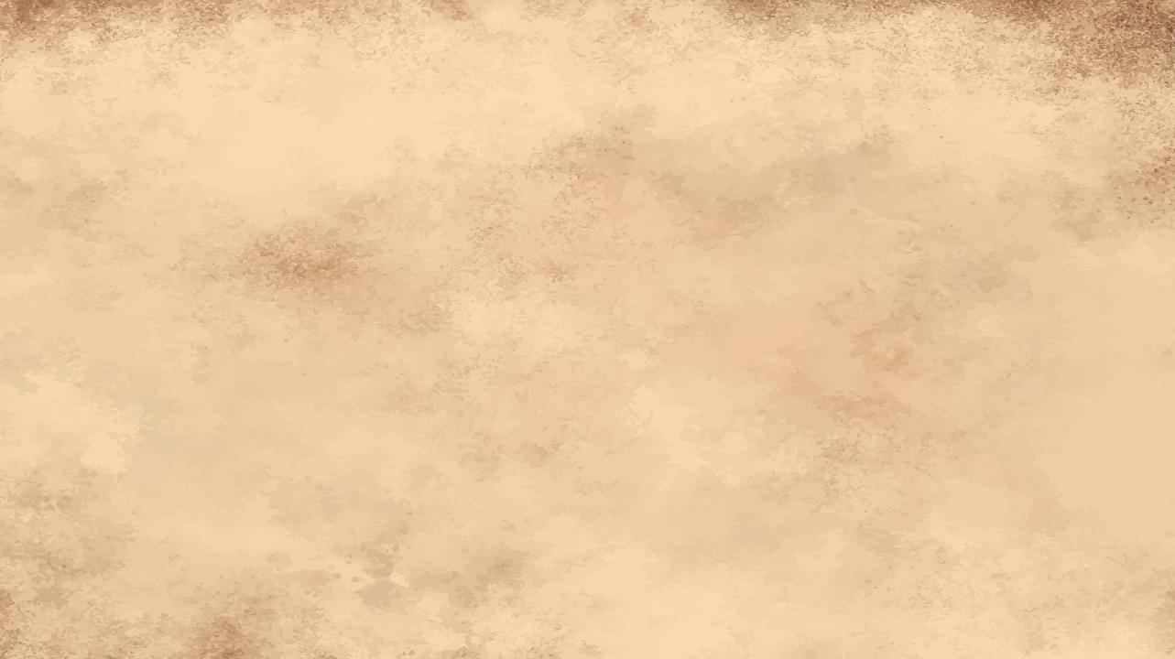

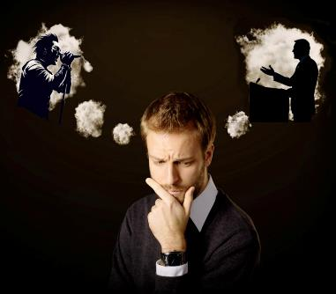
KWĪGĀNA INYANGAMUGAYO
“Bene Data, mugere ikirenge mu cyanjye muhuje imitima, kandi mwite ku bakurikiza ingeso zacu, izo mudufiteho icyitegererezo.” (Abafilipi 3:17)
Twese dufite abantu, mu buryo bumwe cyangwa ubundi, bahinduye ubuzima cyangwa ibitekerezo byacu. Yaba umuhanzi, umukinnyi, umucuranzi, umuririmbyi. Yaba umugabura, umuvugabutumwa, cyangwa umuvandimwe w’inyangamugayo.
Ese aba bantu “b’icyitegererezo” badufashije gukura ku giti cyacu, cyangwa se batuyoboye mu nzira tutagombaga kugerageza?
Pawulo aturarikira kwīgāna abatubēra ingero zidukomeza kandi zituboneza (Abafilipi 3:17). Aranatuburira ko, ndetse no mu bizera, hari abantu badakwiriye kwīgānwa (Abafilipi 3:18–19).
Ni iki kibatandukanya? Bamwe batekereza ku bintu byo mu isi gusa, naho abandi bagahanga amaso yabo kuri Yesu wenyine. Bityo rero, ab’icyitegererezo bazima, nabo ni abīgāna Kristo (1 Abakorinto 11:1).

Slide 6

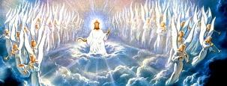

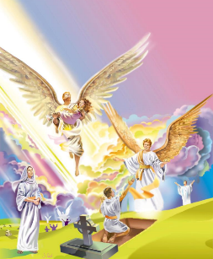
UBWENEGIHUGU BWUZUYE
“Naho twebweho iwacu ni mu ijuru, ni ho dutegereje Umukiza ko azava ari we Mwami Yesu Kristo.” (Abafilipi 3:20)
Mutyo tubyemere. Twebwe Abakristo dufite ikibazo: ubwenegihugu bubiri. Twese turi abaturage b’iyi si ndetse n’abenegihugu b’ijuru. Ibi bidutera kubura amahwemo cyane (Abaroma 7:22–23).
Imibiri yacu izaba iy’umwuka, idapfa, kandi idashobora kubora (1 Abakorinto 15:42–44, 50–54)
Tuzahabwa ubwiza (Abakolosayi 3:4; Abafilipi 3:21)
Tuzagira umubiri ufatika, kandi amaso yacu ubwacu azabona Imana. (Yobu 19:25–27)
Tuzagera ku bwenegihugu bwuzuye ryari? Ni ryari tuzareka kuba abaturage b’iyi si y’icyaha? Ku gihe cyo Kugaruka kwa Yesu (Abafilipi 3:20).
Bizagenda bite igihe tuzaba tuzutse (cyangwa duhinduwe), urupfu rutagifite ububasha kuri twe?

Slide 7

KUGEZA UBWO TUZAHAGERA

Slide 8



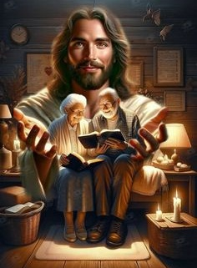
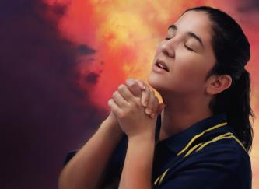
KUBANA AMAHORO, N’IBYISHIMO
“Mujye mwishimira mu Mwami wacu iminsi yose. Yewe, nongeye kubivuga nti ‘Mwishime!’ ” (Abafilipi 4:4)
Mu gusoza urwandiko rwe, Pawulo yakubiye hamwe intashyo ze bwite n’inama-ngiro. Yasabye Sizigo [uwo bakoranaga wiringirwa] na Kilementi gufasha Ewodiya na Sintike kubana mu bwumvikane. Abo bose, bakoranaga na Pawulo, yabavuzeho ko “amazina yabo yanditswe mu gitabo cy’ubugingo” (Abafilipi 4:2–3).
Inama ikurikira ishobora kutubera urujijo: “Mujye mwishima iminsi yose […] Ntimukagire icyo mwiganyira” (Abafilipi 4:4, 6). Ibi byashoboka bite muri iyi si yuzuyemo ibibazo n’imibabaro?
Ibi birashoboka kuko ibyishimo byacu biri “mu Mwami” (Abafilipi 4:4a). Tumwikoreza ibiduhangayikisha twizeye ko ashobora kubitwikorerera (Matayo 6:31–34; 1 Peteto 5:7).
None se twakwikoreza Yesu ibiduhangayikisha dute? Binyuze mu gusenga (Abafilipi 4:6).

Slide 9


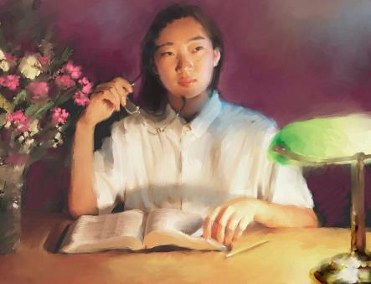
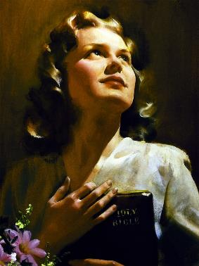
IBITEKEREZO BIBONEYE
“Ibisigaye bene Data, iby’ukuri byose, ibyo kubahwa byose, ibyo gukiranuka byose, ibiboneye byose, iby’igikundiro byose n’ibishimwa byose, nihaba hariho ingeso nziza kandi hakabaho ishimwe abe ari byo mwibwira.” (Abafilipi 4:8)
Iby’ukuri byose
Ibyo kubahwa byose
Ibyo gukiranuka byose
Ibiboneye byose
Iby’ igikundiro byose
Ibishimwa byose
Ingaruka zo kwikoreza Yesu ibiduhangayikisha, no kwishima ni amahoro (Abafilipi 4:7). Ni amahoro isi idashobora gutanga cyangwa kwambura (Yohana 14:27; 16:33).
Nk’uko Pawulo abivuga, aya mahoro azaba uburinzi—umurinzi—urinda ibyiyumvo byacu n’ibitekerezo byacu (Abafilipi 4:7b). Kugira ngo uyu murinzi abigereho, ni ibihe bintu tugomba gutekerezaho (Abafilipi 4:8)?
Muri make: “nihaba hariho ingeso nziza kandi hakabaho ishimwe abe ari byo mwibwira” (Abafilipi 4:8b).

Slide 10

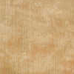




KUNYURWA
“Kandi Imana yanjye izabamara ubukene bwanyu bwose, nk’uko ubutunzi bw’ubwiza bwayo buri muri Kristo Yesu” (Abafilipi 4:19)
Turishimye; nta kintu kiduhangayikishije; dufite amahoro; ibitekerezo byacu ni bizima. Dufite imibereho itunganye kandi igera ku ntego… Ese ni ko biri?
Kimwe na Aguri, twiringira ko Imana itaduha ibirenze cyangwa ibiri munsi y’ibyatugirira umumaro (Imigani 30:8–9).
Iyo tubayeho dufite ibi ibyiringiro, tuba twizeye ko “Nshobozwa byose na Kristo umpa imbaraga” (Abafilipi 4:13).
Dushobora kugira uburumbuke; dushobora kugira ubukene cyangwa ibibazo. Kimwe na Pawulo, niba dufite ubwishingizi bwuzuye ko Imana iyobora imibereho yacu, tuzakomeza kuyiringira uko twaba tumerewe kose (Abafilipi 4:11–12, 19).

Slide 11

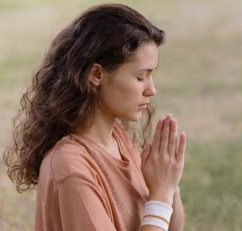
KUNYURWA
“Kandi Imana yanjye izabamara ubukene bwanyu bwose, nk’uko ubutunzi bw’ubwiza bwayo buri muri Kristo Yesu” (Abafilipi 4:19)
Bigenda bite iyo tudafite ibyo twibwira ko dukeneye?
Tubisabe Umwami, kandi niba biri mu bushake Bwe, azabiduha (Yakobo 4:2b; 1 Yohana 5:14–15).
Ntabwo buri gihe tuba tuzi niba icyo dusaba gihuye n’ubushake Bwe, ariko hari ibyo dusaba twizeye ko bihora bihuye n’ubushake Bwe:
Agakiza k’umuntu dukunda cyangwa inshuti (1 Timoteyo 2:3, 4)
Umwete wo gusangiza abandi ukwizera kwacu (Ibyahishuwe 22:17)
Imbabazi, iyo twaturiye ibyaha tubireka (1 Yohana 1:9)
Imbaraga zo kumvira amategeko y’Imana (Abaheburayo 13:20, 21)
Gukunda abatwanga n’abatugirira nabi (Matayo 5:44)
Ubwenge mu bihe biruhije (Yakobo 1:5)
Gusobanukirwa n’ukuri kw’Ijambo ry’Imana (Yohana 8:32)

Slide 12

“Tugomba kubaho ku bw’isi y’ahazaza. Birababaje cyane kubaho imibereho idashinga kandi itagira intego. Twifuza ikintu kimwe mu buzima—kubaho imibereho ifite intego. Imana idufashe twese kwitanga, kutaba abihugiraho, ahubwo turushaho kwiyibagirwa, tukareka kwikunda. Ikindi ni ugukora ibyiza, tutiteze kubyiturirwa hano, ahubwo kuko ari yo ntego y’imibereho yacu kandi ikaziturwa ku iherezo ry’ubuzima yacu.”
E.G. White, Our High Calling, August 24

