Slide 1

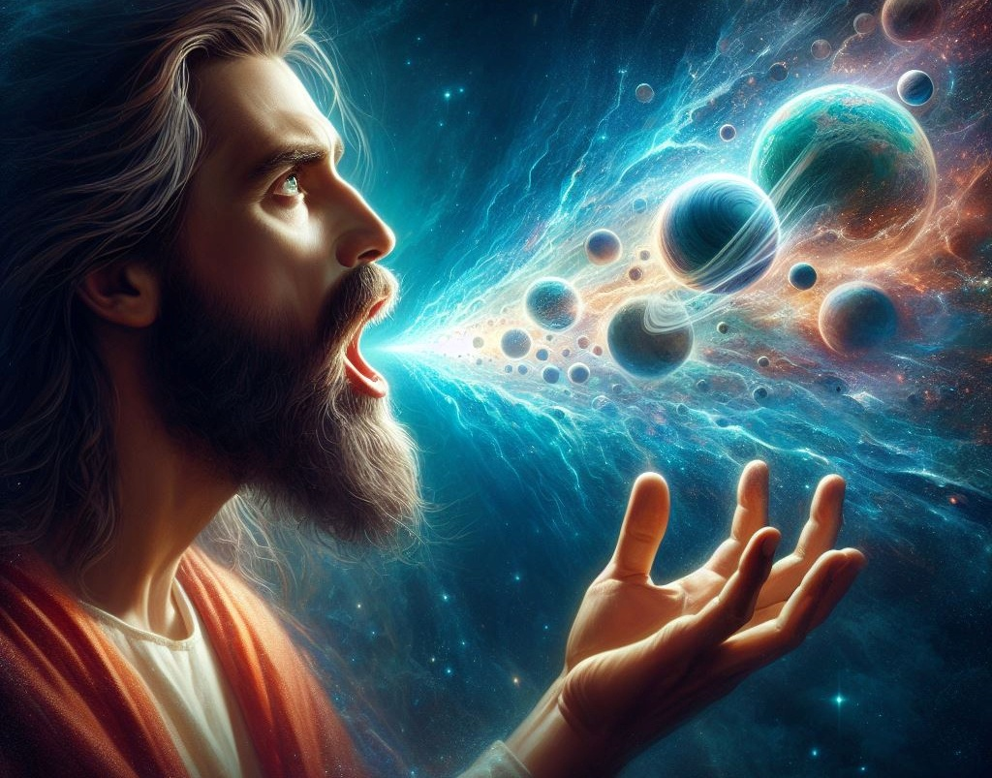
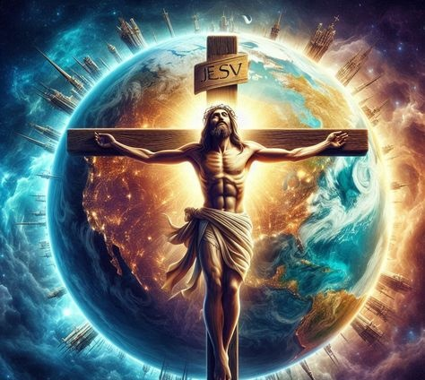
Icyigisho cya 8 cyo ku wa 21 Gashyantare 2026
ISUMBWE RYA KRISTO

Slide 2
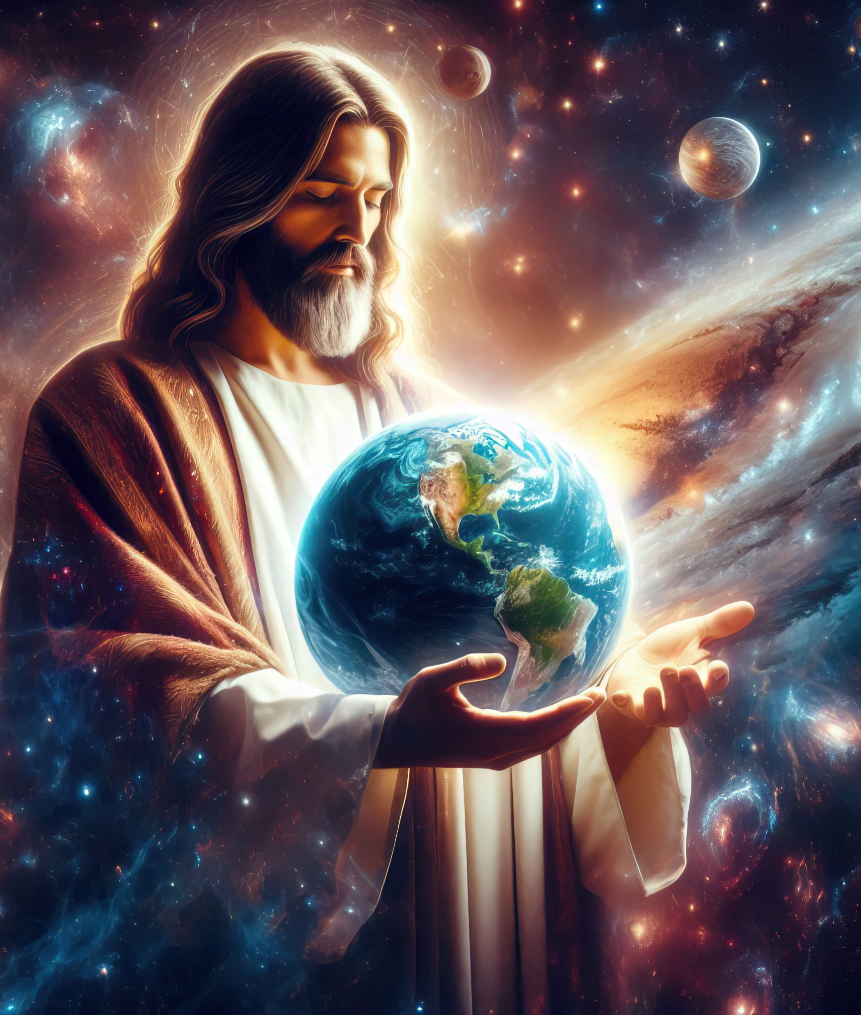
“Ni na we [Kristo] shusho y’Imana itaboneka, ni we mfura mu byaremwe byose, kuko muri we ari mo byose byaremewe, ari ibyo mu ijuru cyangwa ibyo mu isi, ibiboneka n’ibitaboneka, intebe z’ubwami n’ubwami bwose, n’ubutware bwose n’ubushobozi bwose. Ni we wabiremye byose kandi rero ni na we byaremewe. Yabanjirije byose kandi byose bibeshwaho na we”
Abakolosayi 1:15–17

Slide 3


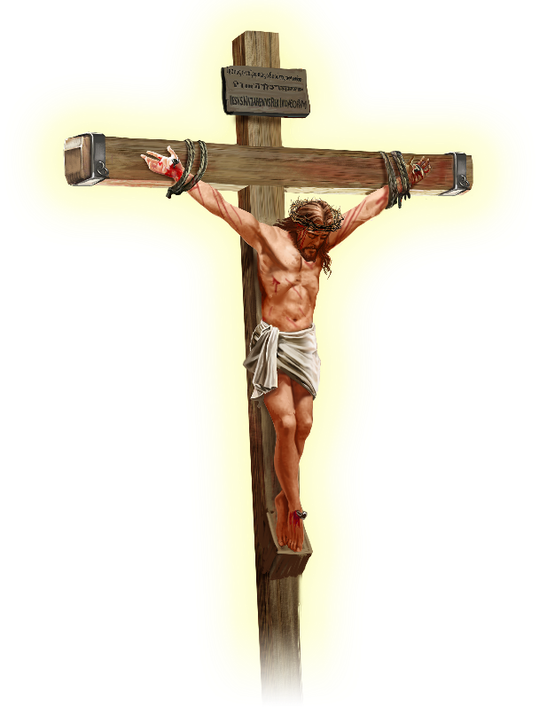






Pawulo avuga ko Yesu yazanye amahoro mu isi yose, ku “bintu byose, ari ibyo ku isi cyangwa ibyo mu ijuru” (Abakolosayi 1:20).
Mbere yuko tugera kuri iri jambo, intumwa itubwira uwo Yesu ari We by’ukuri. Si umwigisha ukomeye, cyangwa umuhanga mu by’ubucurabwenge, cyangwa umuhanuzi, cyangwa umubwiriza, cyangwa se intumwa y’inkuru nziza.
Yesu Kristo ni…
Ishusho y’Imana (Abakolosayi 1:15a)
Imfura (Abakolosayi 1:15b–17)
Umutwe w’Itorero (Abakolosayi 1:18a)
Inkomoko (Abakolosayi 1:18b)
Umuhūza (Abakolosayi 1:19–20)

Slide 4





ISHUSHO Y’IMANA
“Ni na we shusho y’Imana itaboneka” (Abakolosayi 1:15a)
Ishusho ishobora kuba kopi y’ukuri (ifoto, ikibumbano), cyangwa se ikintu cy’igihimbano (igishushanyijwe). Ariko icyo Bibiliya iba yerekezaho iyo ivuga ishusho kirenze ibyo.
Imana yaremye Adamu na Eva mu ishusho yayo (Itangiriro 1:27), maze Adamu abyara umuhungu mu ishusho ye (Itangiriro 5:3). Ibi si kopi y’ukuri, ibyīgānano, cyangwa ibihimbano byabo. Kwari ugusa ku mubiri, mu mitekerereze no mu mibanire …
Pawulo avuga ko amategeko y’imihango yari igicucu, “adafite ishusho yabyo ubwabyo” (Abaheburayo 10:1), bivuze ko “ishusho = iby’ukuri.”
Ikibazo ni iki ngo: Ese Yesu yasaga n’Imana, cyangwa angana n’Imana? Ikigeretse ku kwiyita kenshi izina ry’Imana “NDI”, Yesu yavuze yeruye ati: “Jye na Data turi umwe” (Yohana 10:30); “Umbonye aba abonye Data” (Yohana 14:9).

Slide 5

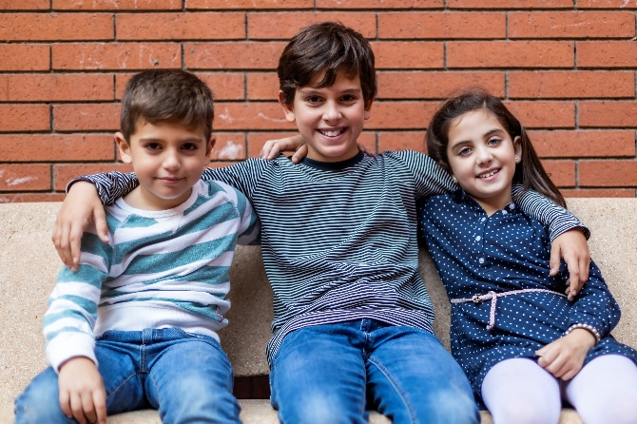


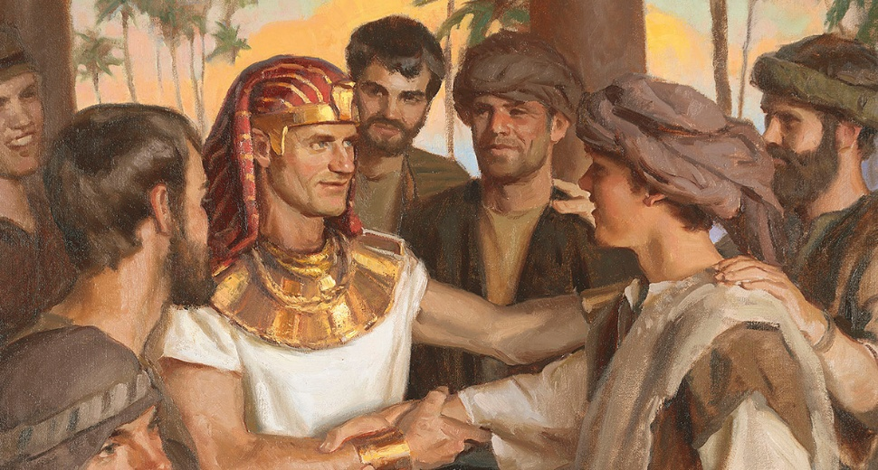
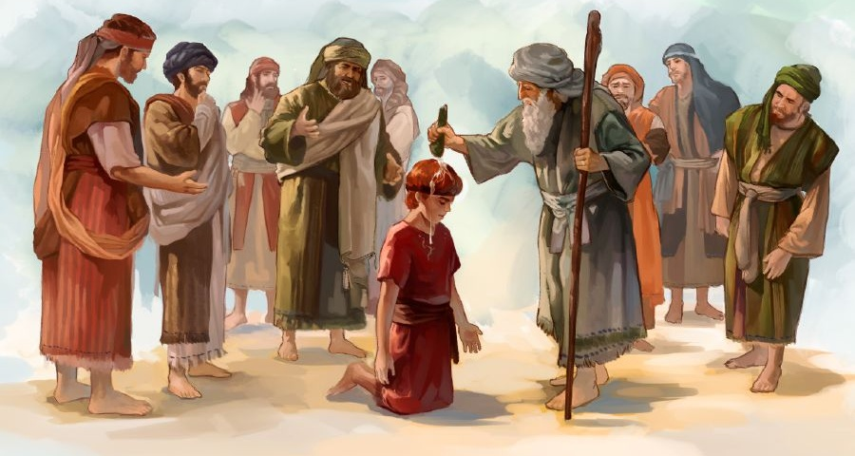

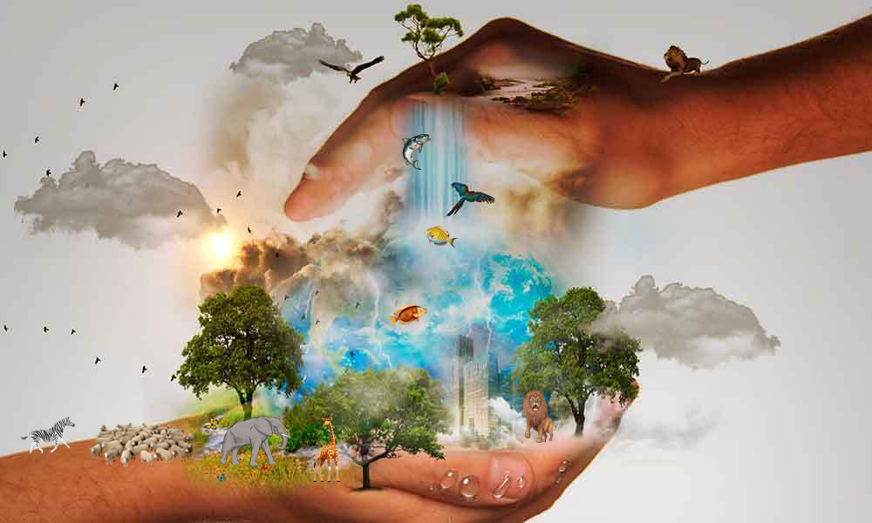
IMFURA
“Yabanjirije byose kandi byose bibeshwaho na we.” (Abakolosayi 1:17)
“Imfura” bivuga uwabyawe mbere. Ibyo bituma bamwe bigisha ko Yesu ari We wa mbere waremwe n’Imana (Abakolosayi 1:15). Ariko, kimwe n’ijambo “ishusho,” ijambo “imfura” muri Bibiliya rifite ubusobanuro bwagutse.
Isaka yari imfura, Ishimayeli si we wari yo; Yakobo yari imfura, Esawu si we wari yo; Yosefu yari imfura, Rubeni si we wari yo; Dawidi yari imfura, aho kuba Eliyabu (Zaburi ya 89:27). Bose bari imfura kuko bari bafite umwanya w’isumbwe kurusha abavandimwe babo, atari uko bavutse mbere.
Mu Bakolosayi, Pawulo avuga kuri iri sumbwe. Kugira ngo Pawulo yirinde gukekeranya ku miterere y’iryo sumbwe, yarishyize ku kamero k’inyabubiri k’Imana: kurema ibiriho byose (Abakolosayi 1:16; Yesaya 45:18); no kubibeshaho (Abakolosayi 1:17; Zaburi ya 119:91).

Slide 6



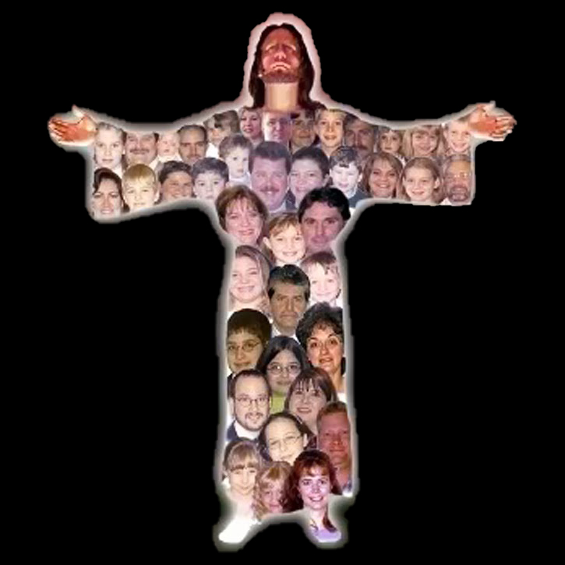
UMUTWE W’ITORERO
“Ni we Mutwe w’umubiri, …Itorero” (Abakolosayi 1:18a)
Mu ndimi zimwe na zimwe (nk’Igikatalani cyangwa Ikinyarwanda) ijambo “umutwe” risobanurwa kandi nk’“umutware” cyangwa “umuyobozi,” kuko ari bwo busobanuro-shusho bw’ijambo “umutwe.” Ibi ni ko bimeze no mu Giheburayo. Urugero, “bitoranyirize umutwe umwe” (Hoseya 1:11) byagombye guhindurwa ngo “bazashyiraho umuyobozi umwe”.
Twese turakenewe (1Abakorinto 12:15)
Buri wese afite umurimo we (1Abakorinto 12:17)
Ntidukwiriye gusuzugura umuntu uwo ari we wese (1Abakorinto 12:21)
Nta bizera “b’insina-ngufi” babaho
(1Abakorinto 12:22–24)
Buri wese yita ku wundi (1Abakorinto 12:25–26)
Ubu ni bwo buryo Pawulo akoreshamo iri jambo iyo arikoresha kuri Kristo (Abakolosayi 1:18a).
Ariko Pawulo yongeraho n’ubusobanuro-shusho ku mubiri. Kuba Kristo ari umutwe, twebwe—itorero—turi umubiri. Muri ubu buryo, hakurikiraho ko :

Slide 7


INKOMOKO
“Ni we Tangiriro, ni imfura yo kuzuka mu bapfuye kugira ngo abe uwa mbere uhebuje byose.”
(Abakolosayi 1:18b)
Ijambo ryahinduwe ngo “intangiriro” ni archē (ἀρχή), ijambo ry’Ikigiriki risobanura intangiriro, inkomoko, impamvu cyangwa ihame muri gatanga ya mbere, ariko kandi risobanura umutegetsi, imbaraga, ububasha cyangwa ubutegetsi, bitewe ahanini n’ibyerekezwaho.
Dushobora kuvuga ko iri jambo, iyo rikoreshejwe kuri Kristo, rishobora kugira ubwo busobanuro bwose (Abakolosayi 1:18). Yesu ni We nkomoko ya byose [ishusho y’Imana], ni We mpamvu yatumye byose biremwa [imfura y’ibyaremwe], ni We mutware usumba abandi bose [umutwe]. Ibi byose bimuha isumbwe.
Hano Pawulo ahagikamo izina “imfura yo kuzuka mu bapfuye” (nubwo Yesu atari We wa mbere wazutse, ahubwo ari Mose). Kunesha urupfu Kwe binasobanuye kunesha icyaha Kwe n’ububasha Bwe bwo kuturema bundi bushya mu ishusho Ye.

Slide 8

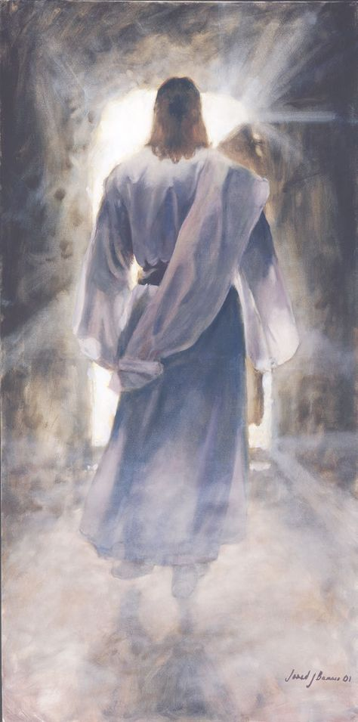



UMUHŪZA
“Kandi imaze kuzanisha amahoro amaraso yo ku musaraba we imwiyungisha n’ibintu byose, ari ibyo ku isi cyangwa ibyo mu ijuru” (Abakolosayi 1:20)
Ibyo Yesu yakoze byatumye afata umwanya wa mbere muri byose. Nk’uko Pawulo abivuga, Kristo akwiriye aya mazina yose “kuko Imana yashimye ko kuzura kwayo kose kuba muri we” (Abakolosayi 1:19). Mu yandi magambo, Yesu yari Imana yuzuye kandi yari umuntu wuzuye. “Tubona ubwiza bwe, […] yuzuye ubuntu n’ukuri ” (Yohana 1:14).
Yesu, mu gupfira ku musaraba no kuzuka, yujuje ibisabwa kugira ngo yunge abantu n’Imana (Abakolosayi 1:20).
Dushobora gusobanukirwa ko yunze Imana n’“ibintu byo mu isi.” Ariko se, ni gute yiyunze n’ibiri mu ijuru?
Isanzure yose yashoboye kubona neza imiterere y’ikibi. Bityo rero, imico y’Imana iragaragazwa haba mu Ijuru, haba no ku Isi.

Slide 9

“Yesu yari umunyacyubahiro mu ijuru, Umugaba ukundwa w’ingabo z’abamarayika, bishimira gukora ibyo ashaka. Yari kumwe n’Imana, “ari mu gituza cya Se” (Yohana 1:18), nyamara ntiyatekereje ko guhwana n’Imana ari ikintu cyo kugundirwa igihe umuntu yari aguye mu cyaha no mu kangaratete. Yasize intebe y’ubwami aramanuka, areka ikamba ry’Ubwami n’inkoni y’ubwami, ubumana Bwe abutwikiriza ubumuntu. Yicishije bugufi ubwe ndetse agera ku rupfu rw’umusaraba, kugira ngo umuntu ashobore kwicarana na We ku ntebe y’ubwami. […] Mu rukundo, azanwa no kugaragaza Se, kunga umuntu n’Imana.”
E.G. White, Ubutumwa Bwatoranyijwe, umuzingo wa 1, p. 254

