Slide 1

KUMENYA IMANA
Icyigisho cya 2 cyo ku wa 11 Mata 2026

Slide 2
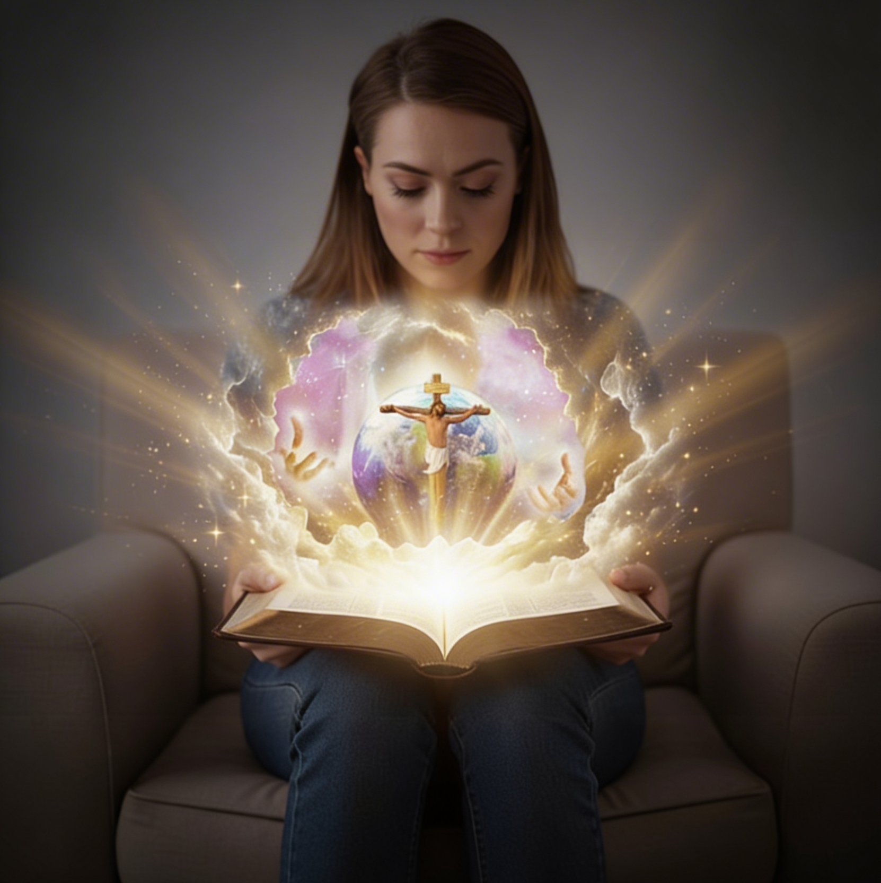
“Ubu ni bwo bugingo buhoraho, ko bakumenya ko ari wowe Mana y’ukuri yonyine, bakamenya n’uwo watumye ari we Yesu Kristo”
(Yohana 17:3)

Slide 3

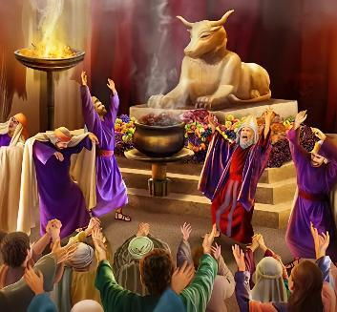

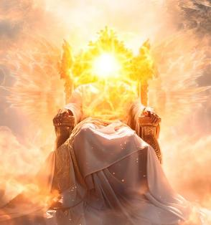
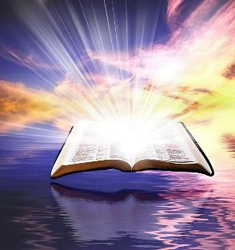
Kumenya Imana kwacu kwarangiritse kubera icyaha. Twagerageje kuyigaragaza mu bigirwamana bibajwe bisa n’inyamaswa cyangwa abantu. Yagaragajwe nk’inyamwaga cyangwa inyarukoni. Agahebuzo, ni uko abantu baremye ishusho y’Imana mu ishusho yabo bwite.
Ariko se koko Imana imeze ite? Ese irahambaye cyane ku buryo kuyisobanukirwa bitadushobokera? Birumvikana ko uko twagerageza kose, ubwenge bwacu budashobora gusobanukirwa Imana. Dukeneye ubufasha.
Nyamara ubufasha bwaraje. Urashaka kumenya uko Imana iteye? Muri Bibiliya dufite ihishurwa ry’ukuri kw’imiterere y’Imana.
Ibiranga Imana.
Imico y’Imana:
Imana irēra
Imana ni urukundo
Kumenya Imana:
Imana yahishuriwe mu byaremwe
Imana yahishuriwe muri Yesu (Emanuweli)

Slide 4


IBIRANGA IMANA

Slide 5


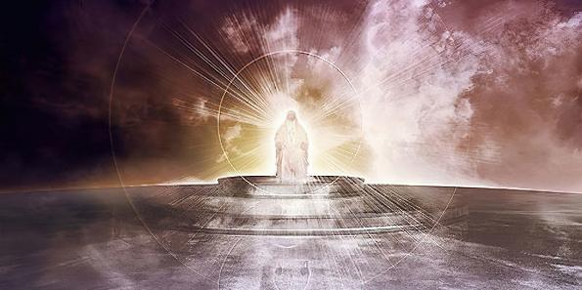
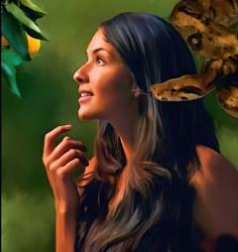
“Uwiteka, Mana Nyiringabo, Ni nde munyambaraga uhwanye nawe, Uwiteka? Umurava wawe urakugose impande zose” (Zaburi ya 89:8)
IBIRANGA IMANA
Bibiliya yerekana ishusho y’Imana mu buryo buhebuje, busobanutse kandi budahindagurika. Bumwe muri bwo ni ukutubashisha kumenya Imana kubw’ibiyiranga.
BIMWE MU BIRANGA IMANA
Irakiranuka (Zaburi ya 11:7)
Inyebambe (Gutegeka 4:31)
Irihangana kandi irahumuriza (Abaroma 15:5)
Itanga ubuntu (Abaroma 3:24)
Irababarira (Zaburi ya 86:5)
Umwami (Zaburi ya 47:8)
Ihoraho (Itangiriro 21:33)
Ishobora byose (Itangiriro 17:1)
Izi byose (1 YOhana 3:20)
Izi iby’ahazaza (Yesaya 46:10)
Ku ruhande rwa Satani, uhereye mbere hose yagerageje guhindanya imico y’Imana, ayerekana nk’Imana yikunda, yishakira inyungu zayo (Itangiriro 3:4–5).

Slide 6
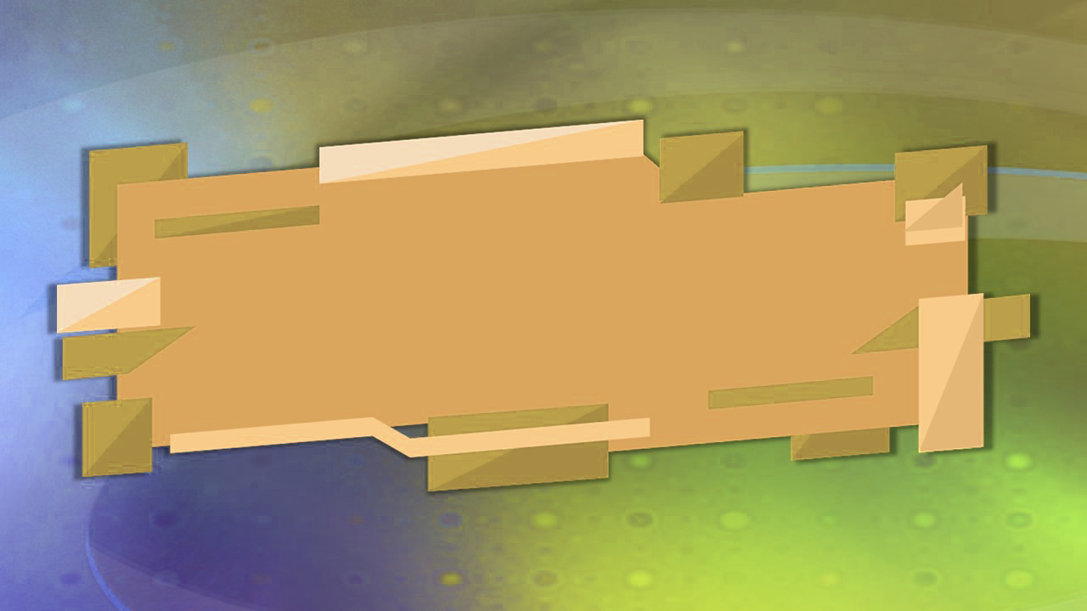
IMICO Y’IMANA

Slide 7

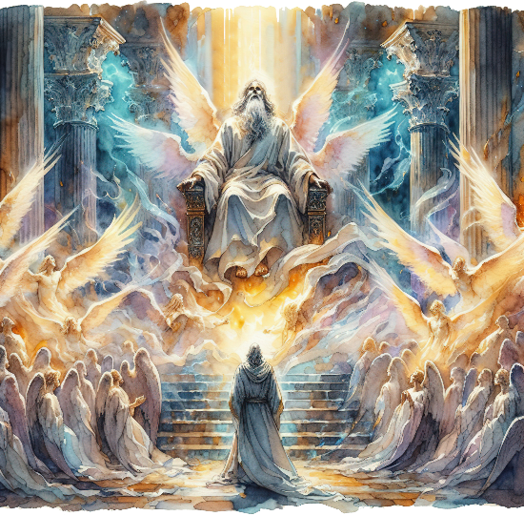
“Umwe avuga ijwi rirenga abwira mugenzi we asingiza ati ‘Uwiteka Nyiringabo arera, arera, arera. Isi yose yuzuye icyubahiro cye.’” (Yesaya 6:3)
IMANA IRĒRA
Abamarayika bahagaze iruhande rw’Imana bayiramya bagira bati “Uwera, Uwera, Uwera” (Yesaya 6:3; Ibyahishuwe 4:8). Ibi bifitanye isano ikomeye n’imico y’Imana ku buryo Yesaya ayikoresha nk’izina ry’Imana bwite: “ni ko Uwera avuga” (Yesaya 40:25; 57:15).
Kuba uwera bisobanura iki? Bisobanura kurobanurwa, kwegurirwa, kubonera. Tuba abera iyo tuzibukiriye ikibi maze tugakora umurimo Imana yadushinze (Kubara 15:40; Abalewi 11:44; 1 Petero 2:9).
Ariko se ni gute ibi bireba Imana ? Itandukanye rwose n’ikibi kandi nta sano ifitanye n’icyaha.
Ibi bivuze ko, kubera ko ari Uwera, urukundo rwayo ni urwera, ruratunganye, kandi ntirugira inarijye. Kubera ko ari Uwera, kuba ushobora byose kwayo kose kurera, kuratunganye, kandi ntikugira inarijye. Ibiyiranga byose byūje ukwera n’ugutungana.

Slide 8


IMANA NI URUKUNDO
“Natwe twamenye kandi twizeye urukundo Imana idukunda. Imana ni urukundo, kandi uguma mu rukundo aguma mu Mana, Imana ikaguma muri we.” (1 Yohana 4:16)
Imana ntabwo ifite urukundo cyangwa ngo ibe itanga urukundo gusa (nubwo byombi ari ko ibifite), ahubwo “Imana NI urukundo” (1 Yohana 4:8, 16). Kimwe n’ukwera, urukundo ni kimwe mu bigize akamero k’Imana.
Kubera urukundo, yaremye umuntu, yaba umugabo yaba umugore, kandi “yabategetse” gukundana (Itangiriro 2:24)
Kubera urukundo, igihe Adamu na Eva bagwaga, yarabashatse kandi ibaha ibyiringiro (Itangiriro 3:9, 15)
Kubera urukundo, yagiranye isezerano na Aburahamu maze isezeranya abantu bose imigisha (Itangiriro 26:4)
Kubera urukundo, yatanze Umwana wayo—Yesu Kristo—kugira ngo apfe kubera ibyaha byacu (Yohana 3:16)
Nakwitura iki urukundo rwayo?
“Turayikunda kuko ari yo yabanje kudukunda” (1 Yohana 4:19).
Notes:
SmartArt with large images (the four “for love”)

Slide 9

KUMENYA IMANA

Slide 10



IMANA YAHISHURIWE MU BYAREMWE
“Ijuru rivuga icyubahiro cy’Imana, Isanzure ryerekana imirimo y’intoki zayo.” (Zaburi ya 19:1)
Bibiliya itangira ivuga Imana nka אֱלֹהִ֑ים (elohim). Nubwo ubusobanuro busanzwe bw’iri zina ari “imana (nyinshi),” rikoreshwa nk’ijambo rivuga “umwe” gusa. Ni ko biri ahavuga ngo “Mbere na mbere, Imana zaremye ijuru n’isi” (Itangiriro 1:1).
Itwereka Umuremyi, binyuze muri Jambo [Yesu Kristo], no mu kwigaragaza kwa Mwuka, kandi ifite imbaraga zo kurema ibiriho byose (Itangiriro 1:1–3; Yohana 1:1–3).
Mu Itangiriro igice cya 2, hongeweho izina bwite ry’Imana: יְהוָ֥ה (Yahweh). Noneho ntabwo ivuga gusa ngo “Nihabeho.” Ifata umuntu ikamubumba n’amaboko yayo. Imana ikomeye yigaragaza nk’Imana y’umuntu ku giti cye kandi ishobora kwēgērwa.
Idukoraho, ikatuvugisha, ikatwigisha, ikaduha umurimo wo gukora… iradukunda.

Slide 11

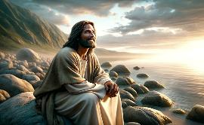
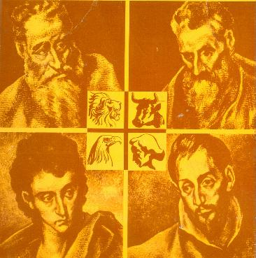
IMANA YAHISHURIWE MURI YESU (EMANUWELI)
“Uhereye kera kose nta muntu wigeze kubona Imana, ahubwo Umwana w’ikinege uri mu gituza cya Se, ni we wayimenyekanishije.” (Yohana 1:18)
Niba dushaka kumenya uko Imana iteye, tugomba kumenya Yesu. Ni Imana yigize umuntu (Yohana 1:14), yigaragaje yihinduye umuntu kugira ngo tuyibone kandi tuyumve (Yohana 1:18; 14:9; 1 Yohana 5:20).
Yatangajwe mu izina rya gihanuzi ryagaragazaga intego y’imibereho Ye: Emanuweli, Imana iri kumwe natwe (Yesaya 7:14; Matayo 1:23). Ibitabo by’ubutumwa bwiza uko ari bine bimutwereka mu buryo butari bumwe.
Matayo
Umuyuda ubwira Abayuda
Mariko
Umuyuda ubwira Abanyamahanga
Luka
Umunyamahanga ubwira Abanyamahanga
Yohana
Umuyuda ubwira Abayuda n’Abanyamahanga
Ni we Mesiya usohoza ibyo yasezeranye
Ahora yitaye ku gukorera abandi
Umuntu w’umunyabuntu n’umunyampuhwe
Utanga ubuzima bw’umubiri n’ubwa mwuka

Slide 12

“Abantu ibihumbi bafite imyumvire itari yo ku Mana no ku mico yayo… Imana ni Imana y’ukuri. Ubutabera n’imbabazi ni byo biranga intebe yayo. Ni Imana y’urukundo, y’ibambe ndetse y’impuhwe zūje urugwiro. Ni ko igaragazwa n’Umwana wayo, Umukiza wacu. Ni Imana yo kwihangana. Niba uwo ari We turamya kandi tugashaka kwigana imico Ye, ni ukuri twaba turamya Imana y’ukuri.”
E.G. White, God Cares for Us, August 8

