Slide 1
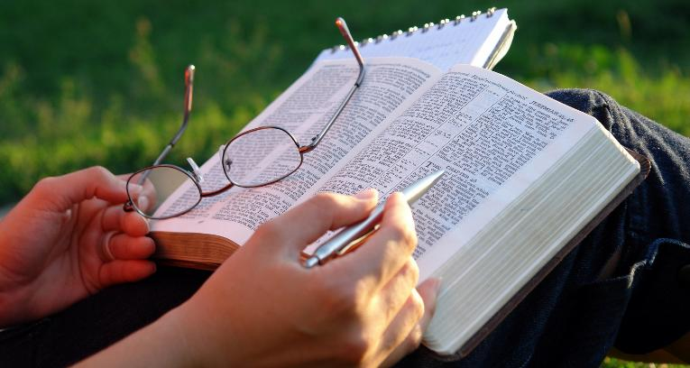
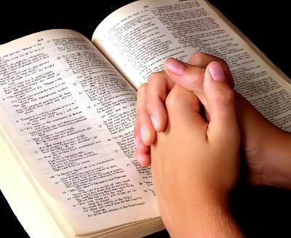
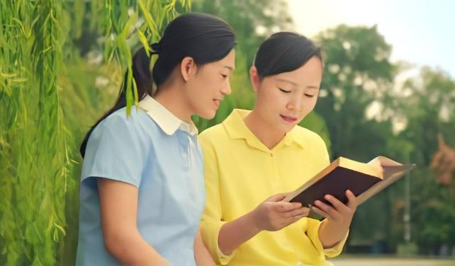
UBURYO BWO KWIGA BIBILIYA
Icyigisho cya 5 cyo ku wa 2 Gicurasi 2026

Slide 2
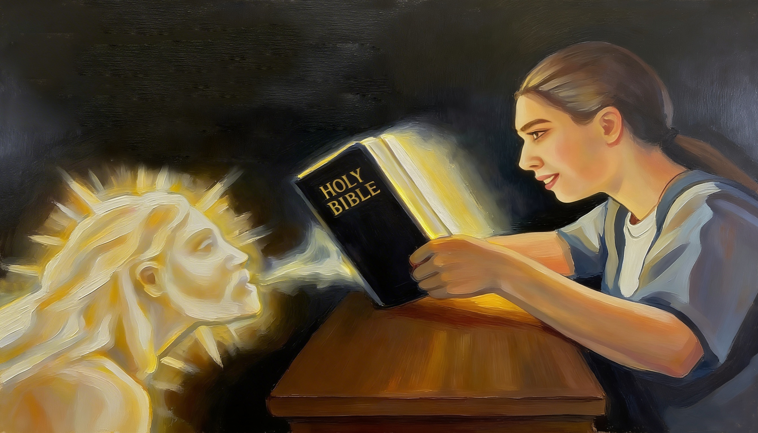
“Ni ko ijambo ryanjye riva mu kanwa kanjye rizamera. Ntirizagaruka ubusa ahubwo rizasohoza ibyo nshaka, rizashobora gukora icyo naritumye” (Yesaya 55:11)

Slide 3

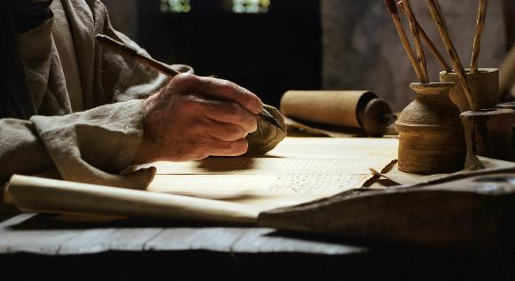
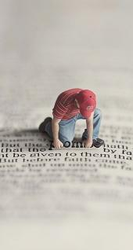
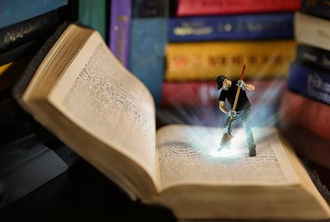
“Abantu b’Imana bavugaga ibyavaga ku Mana bashorewe n’Umwuka Wera” (2 Petero 1:21), maze bandika ubutumwa bwabo ku mpapuro za Bibiliya.
Muri yo dusangamo imaragarita z’agaciro zitanga ubugingo, ibyiringiro, imbaraga, ihumure, ... Zimwe zihita zigaragaza, izindi zigomba gushakishwa mu bwitonzi.
Ni gute twacukumbura muri Bibiliya izi maragarita z’agaciro Imana yaduteguriye, kandi ni iki twungukira mu kuyiga?
Uburyo bwo kwiga Bibiliya:
Igihe
Ahantu
Uburyo
Inyungu zo kwiga Bibiliya:
Inyungu zo kuyisangiza abandi
Inyungu zo kuyirya

Slide 4

UBURYO BWO KWIGA BIBILIYA

Slide 5
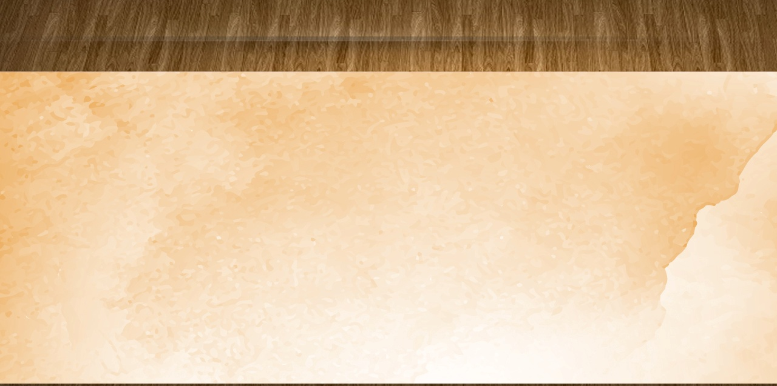
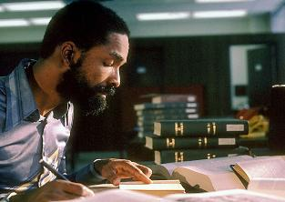
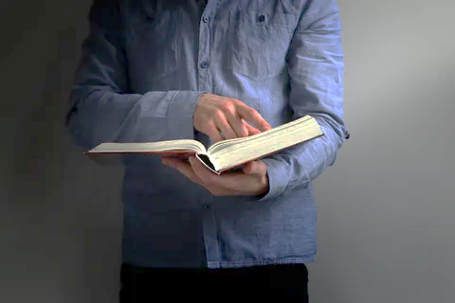

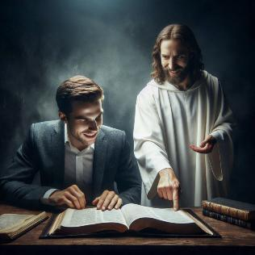
IGIHE
“Muzanshaka mumbone, nimunshakana umutima wanyu wose.” (Yeremiya 29:13)
Ni ikihe gihe cyiza cyo kwiga Bibiliya?
Tugomba gusesengura igisubizo cyacu dukurikije ibintu bibiri: igihe no kwiga neza.
Birumvikana ko tuzungukira cyane mu kugena isaha imwe mu ngengabihe yacu yo kwiga Bibiliya kuruta kugena iminota itanu gusa.
Nyamara igihe tugenera kwiga ntikigomba kugarukira ku gusoma gusa. Aha ni ho intego yacu igaragarira. Kuki nsoma Bibiliya? Ese ndimo gushaka ubumenyi gusa, cyangwa mfite icyifuzo gikomeye cyo kumenya byinshi ku Mana?
Twungukira cyane mu kwiga Bibiliya iyo bihindutse igihe cyo kubana n’Imana (Yeremiya 29:13), no kuyishimira (Zaburi ya 37:4); ni igihe dushakira mu mapaji yayo ubutumwa bwihariye bw’Imana kuri twe.

Slide 6

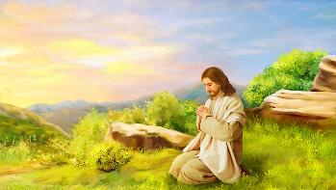

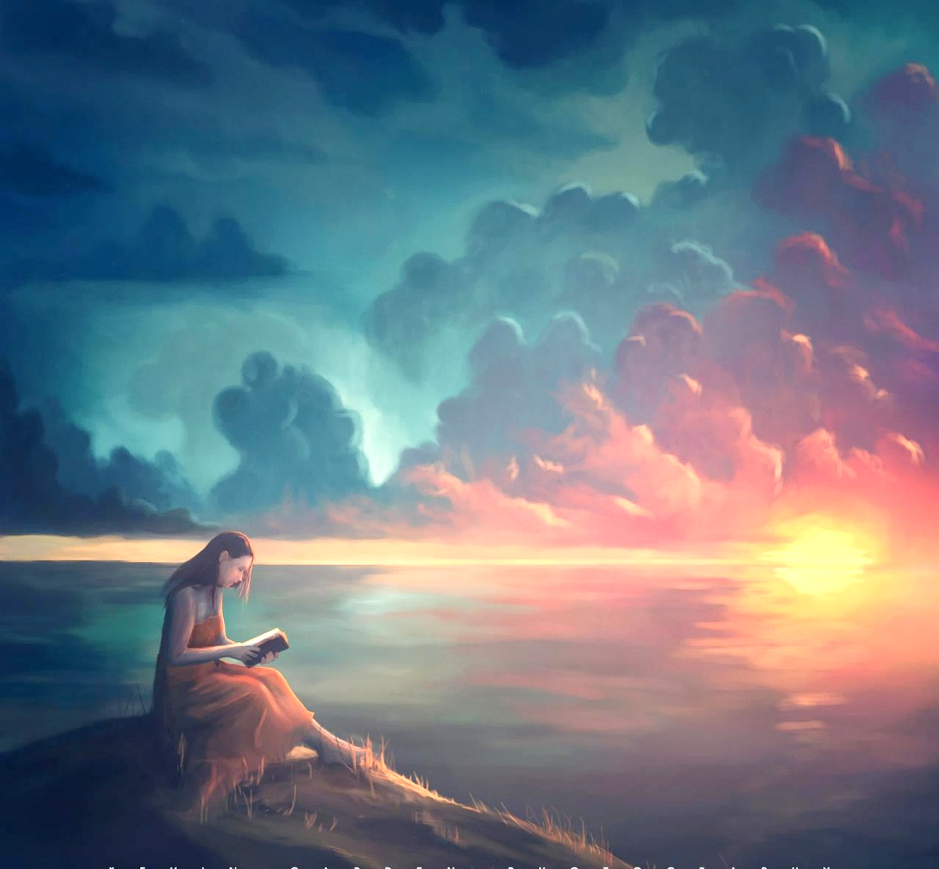
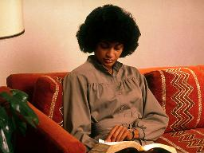
AHANTU
“Nuko mu museke arabyuka, arasohoka ajya mu butayu asengerayo.” (Mariko 1:35)
Iyo Yesu yabaga ashaka umwanya wihariye wo kuvugana n’Imana, yabyukaga kare agashaka ahantu hatuje (Mariko 1:35). Ibi bishobora kuba akabarore haba mu gusenga ndetse no mu kwiga Bibiliya.
Biragoye kwiga ushishikaye uri ahantu hari urusaku cyangwa hari ukunyuranamo. Biroroshye kubikorera ahantu heza, hatuje kandi hiherereye.
Amasaha ya mbere cyangwa ya nyuma y’umunsi, igihe haba hari ituze ryinshi, ashobora kuba igihe kitworoheye kugumisha ibitekerezo byacu ku Mana.
Tumaze kubona igihe n’ahantu bya nyabyo, dukwiriye kubigira (kwiga) ikintu gihoraho. Ahari ikintu kidasanzwe cyaturogoya, ariko ntitukareke ngo igihe kinini kigende tudakoresheje Bibiliya yacu buri munsi.

Slide 7


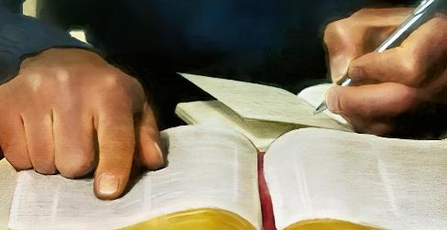
UBURYO (1)
“Ni ko ijambo ryanjye riva mu kanwa kanjye rizamera. Ntirizagaruka ubusa …” (Yesaya 55:11)
Kwiga Bibiliya mu buryo bwimbitse bigizwe n’imigabane ine
Gusenga
Gusoma no gusobanukirwa [inama itangwa]
Gusenga
Gusangiza abandi
Rarikira Umwuka Wera kukubera umuyobozi mu myigire yawe
Hitamo umurongo cyangwa umugabane wo muri Bibiliya
Azagukora ku mutima no mu ntekerezo kugira ngo usobanukirwe ibyo usoma
Wandike kugira ngo bigufashe kuwinjiza mu bwenge bwawe
Ca umurongo ku ngingo z’ingenzi
Andika ibitekerezo bijyanye n’izo ngingo z’ingenzi
Saba Imana kugufasha gushyira mu bikorwa ingingo wize
Tekereza uwo ushobora gusangiza ibyo wize

Slide 8

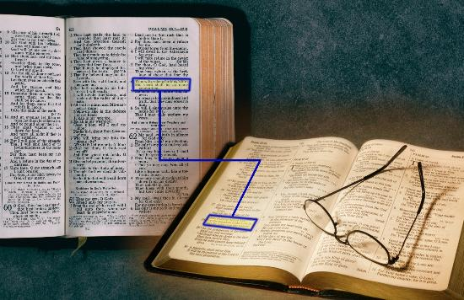
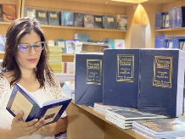
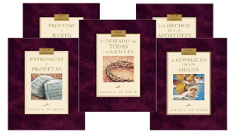
UBURYO (2)
“Ni ko ijambo ryanjye riva mu kanwa kanjye rizamera. Ntirizagaruka ubusa …” (Yesaya 55:11)
Ubundi buryo bwo kwiga Bibiliya
Gereranya umurongo n’undi murongo (Yesaya 28:10)
Wige ibice cyangwa ibitabo uko byakabaye
Wige ingingo cyangwa ijambo ukoresheje guhūza n’indi migabane ivuga kuri iyo ngingo
Reba ubusobanuro bwa Bibiliya cyangwa inkoranyamagambo
Soma unajyanisha n’imigabane iri mu bitabo “by’Umwuka w’Ubuhanuzi” bya Elina White

Slide 9

INYUNGU ZO KWIGA BIBILIYA

Slide 10


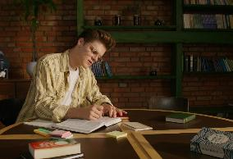
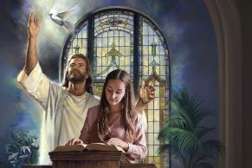
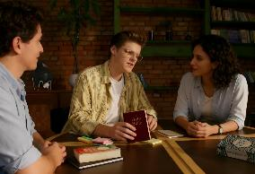
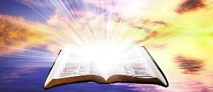
INYUNGU ZO KUYISANGIZA ABANDI
“Umwami Imana impaye ururimi rw’abigishijwe kugira ngo menye gukomeresha urushye amagambo, inkangura uko bukeye, ikangurira ugutwi kwanjye kumva nk’abantu bigishijwe.” (Yesaya 50:4)
Tuvuge ko wasabwe gutegura ikibwiriza cyo mu materaniro yo ku Isabato. Ufata umwanya wihariye wo kwiga usenga, ingingo Umwuka Wera yaguhumekeye guhitamo. Ku Isabato, ubwirije mu mbaraga. Ni nde uzabonera inyungu cyane muri iki kibwiriza?
Icyigisho cya Bibiliya dusangije abandi—haba mu kibwiriza cyangwa ku giti cyacu—gifite inyungu ebyiri.
Iya mbere, twungukira ku byo twize. Iya kabiri, abantu dusangiza ibyo twamenye bungukiramo kandi bagashishikarizwa kwimbika cyane muri ubwo bumenyi.
Muri ibyo bihe byombi, umubano n’Imana urakomera kandi ukarushaho kwimbika. Ubwo ni bwo bubasha bw’Ijambo ry'Imana, “ntirizagaruka ubusa” (Yesaya 55:11).

Slide 11

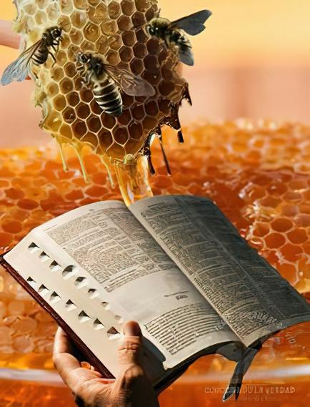
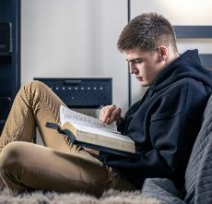
INYUNGU ZO KUYIRYA
“Amagambo yawe aryohereye ubu bugeni mu nkanka zanjye, Arusha ubuki kuryohera mu kanwa kanjye!”
(Zaburi ya 119:103)
Tugomba kurya Ijambo ry’Imana (Yeremiya 15:16)!
Nubwo iryoshye kurusha ubuki, ntabwo tuyirya mu buryo bufatika (Zaburi ya 119:103). Gusoma Bibiliya ni ibyokurya by’ubugingo, ni isōko nyakuri ikiza ubugingo bwacu kandi igahindura imico yacu.
Kandi ikirenzeho, ibi byokurya ni ubuntu (Yesaya 55:1)!
Tugomba kwegera no kumva icyo Imana itubwira binyuze muri Bibiliya (Yesaya 55:3). Uko tumara igihe kinini twigira ku mapaji yayo, ni ko turushaho kubona ibyokurya biryoshye, kandi tukagira imigisha myinshi.
“Uko amajyambere y’ubwenge bw’umuntu yaba ari kose, ntagatekereze n’akanya gato ko nta mpamvu yo gushakisha mu Byanditswe Byera mu buryo bwimbitse kandi buhoraho kugira ngo abone umucyo urushaho kuba mwinshi. Nk’ubwoko, buri wese yahamagariwe kuba umwigishwa w’ubuhanuzi.” EG. White, Counsels to Writers and Editors, p. 41

Slide 12

“Gusoma Ijambo gusa ntabwo bizagera ku musaruro wagenwe n’Ijuru; rigomba kwigwa no gukundwa mu mutima. Ntabwo kumenya Imana byagerwaho hatabayeho kubiha agaciro mu ntekerezo. Tugomba kwiga Bibiliya dushyizeho umwete, dusaba Imana ko tuyoborwa na Mwuka Wera, kugira ngo dusobanukirwe Ijambo ryayo. Tugomba gufata umurongo umwe, tugashyira ubwenge bwacu ku kumenya igitekerezo Imana yadushyiriye muri uwo murongo. […]
Ijambo ry’Imana ni umutsima w’ubugingo. Abarya kandi bakūza iri Jambo, bakarigira umugabane wa buri gikorwa n’icyiciro cyose cy’imico, bakurira mu mbaraga z’Imana. Riha ubugingo imbaraga zidacogora, rigatunganya imibereho kandi rigatanga ibyishimo bizahoraho iteka ryose.
E.G. White, Lift Him Up, April 7

