Slide 1





Icyigisho cya 11 cyo ku wa 13 Kamena 2026
INGORANE

Slide 2

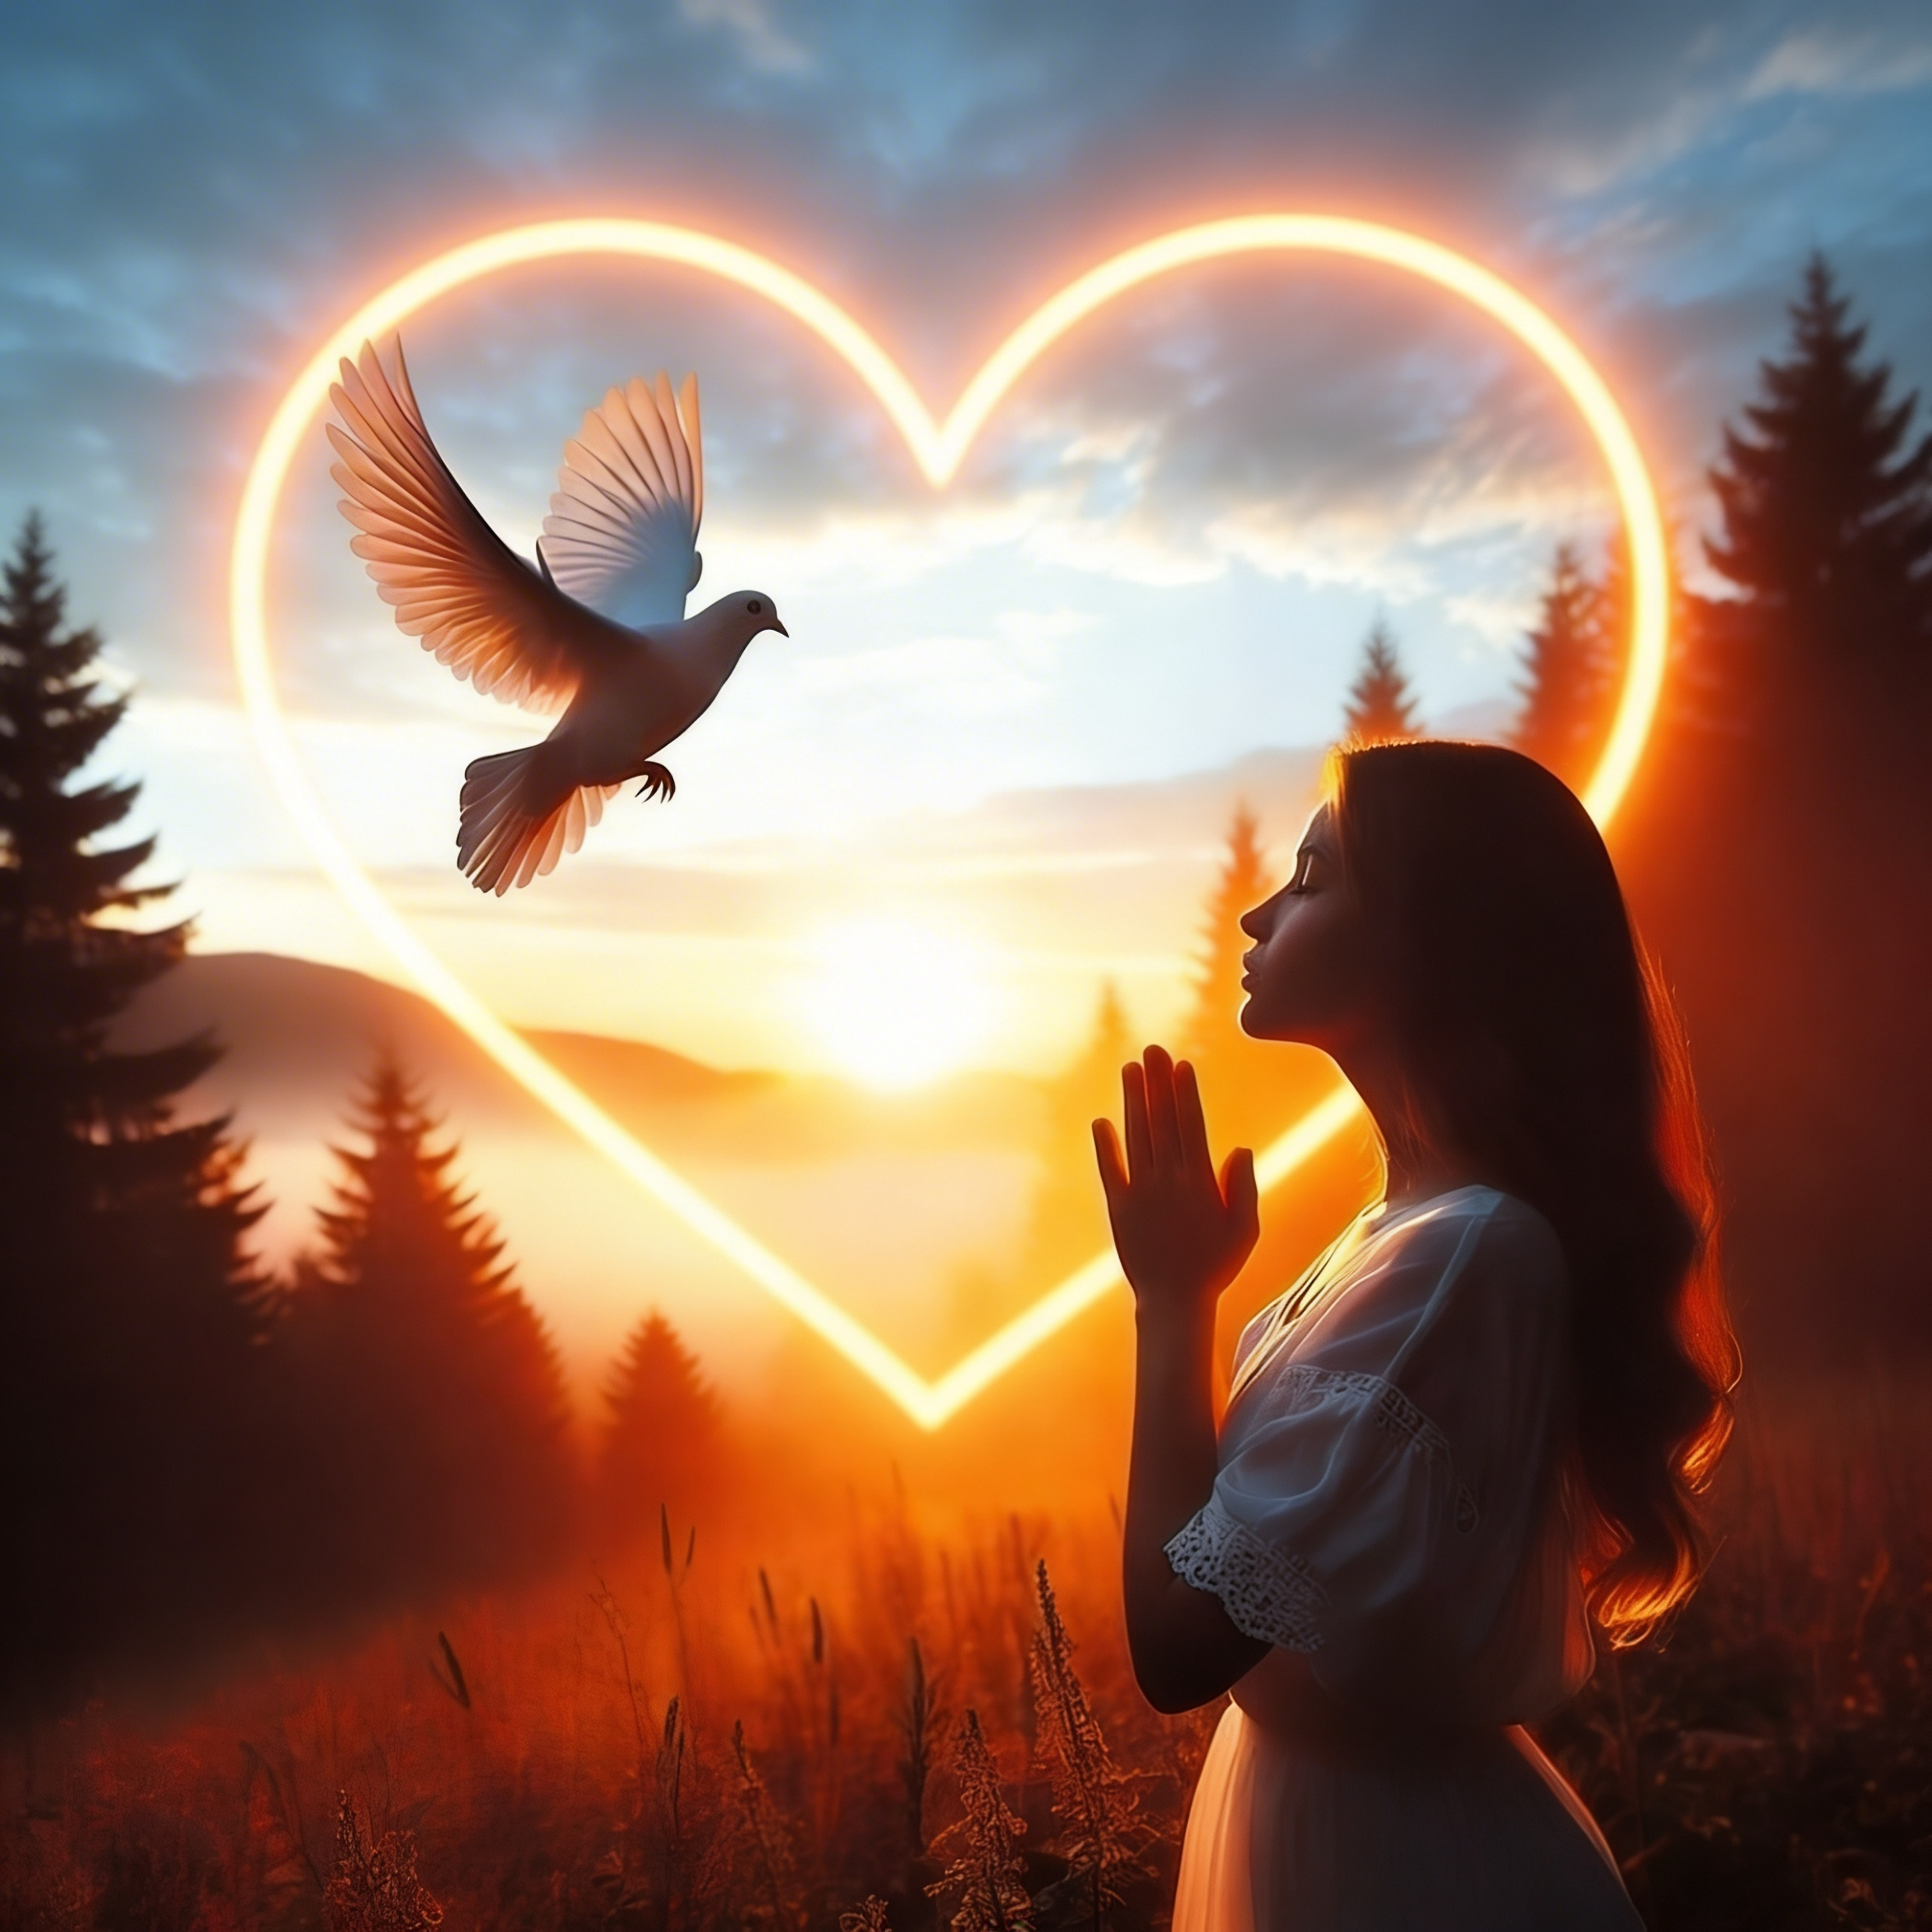
“Ariko si ibyo byonyine, ahubwo twishimira no mu makuba yacu, kuko tuzi yuko amakuba atera kwihangana, kandi kwihangana kugatera kunesha ibitugerageza, uko kunesha kugatera ibyiringiro. Bene ibyo byiringiro ntibikoza isoni, kuko urukundo rw’Imana rwasabye mu mitima yacu ku bw’Umwuka Wera twahawe”
(Abaroma 5:3–5)

Slide 3
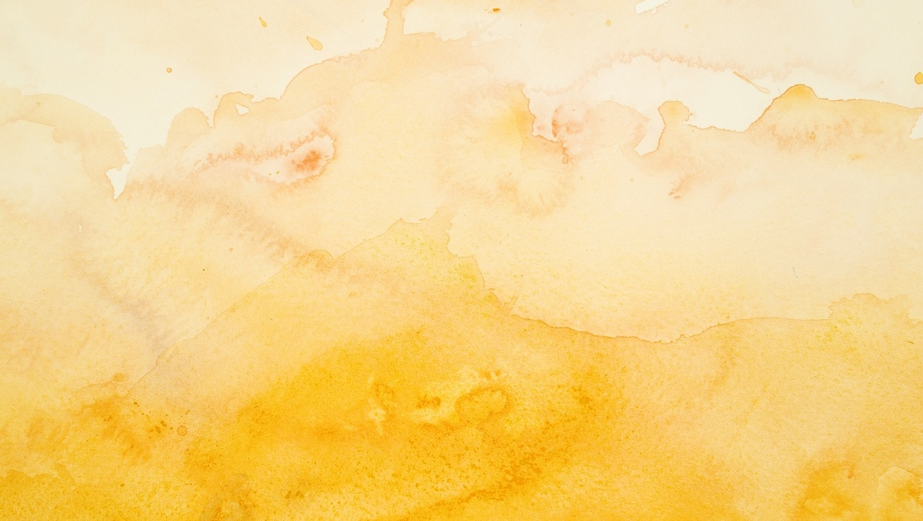

Tuba mu isi yuzuyemo ibyaha n’imibabaro. Mu gihe runaka twese duhura n’ingorane zishobora gutuma dushidikanya ku rukundo rw’Imana.
Twākīra izo ngorane dute?
Turiga uburyo bamwe mu bantu bo muri Bibiliya bitwaye mu bihe bigoranye bitari bimwe, n’uburyo urugero rwabo rwadufasha guhangana n’ibibazo nk’ibyo.
Imiraba yo mu buzima
Indwara
Amakuba
Kubura ibyari byitezwe
Reba Yesu

Slide 4




IMIRABA YO MU BUZIMA
“Nuko ishuheri y’umuyaga iraza, umuraba wisuka mu bwato bigeza aho bwenda kurengerwa” (Mariko 4:37)
Kwambuka inyanja ya Galilaya mu gicuku, ndetse no mu gihe cy’umuraba, ntibyari bishya kuri Petero, Andereya, Yakobo na Yohana, bari abarobyi b’abahanga.
Ariko ubu noneho, umuraba warabarenze. Umuyaga warundanije imiraba, amazi yuzura ubwato, maze ubuzima bwabo burageramirwa. Noneho babona ko… Yesu ari he? Arasinziriye? Kuki atadutabara? Ntabwo yitaye ku bitubaho? (Mariko 4:35–38).
Mu buzima bwacu tunyura mu miraba. Dusaba Yesu kudutabara, ariko bigasa nk’aho asinziriye. Ntitwumva ko ahari. Nyamara aba ahari.
Tegereza igihe cyo gucyaha umuraba wacu: “Ceceka utuze” (Mariko 4:39). Atwitaho (1 Petero 5:7). Ashobora gutuza inkubi y’umuyaga. Ntiwibagirwe kumushimira ibyo akora (Mariko 4:4–41).

Slide 5





INDWARA
“kuko yari yibwiye ati ‘Ninkora imyenda ye gusa ndakira’ ”
(Mariko 5:28)
Umugore wababaye kubwo kuba imugongo mu gihe cy’imyaka cumi n’ibiri atabona umuganga umukiza, byari byaramuteye kubura icyo akora kandi abura n’ibyiringiro (Mariko 5:25–26). Muri iki gihe, hari ibihugu bitagira ubuvuzi butangirwa ubuntu, aho iyi nkuru ishobora kuba yaba impamo.
Uko byaba biri kose, twese dushobora guhura n’ibihe aho uburwayi butwizingiraho ndetse bukatubuza epfo na ruguru, tukabura ihumure.
Uyu mugore yabonye igisubizo muri Yesu, ukwizera kwe kuramukiza (Mariko 5:27–29).
Tugomba kwiringira ko Yesu ashobora gukoresha abaganga babihugukiye kugira ngo dukire, cyangwa se akadukorera igitangaza cyahuranije.
Uko byagenda kose, Yesu aturarikira kumwikoreza imitwaro yacu yose n’amaganya yacu yose (Matayo 11:28–30).

Slide 6





AMAKUBA
“Kandi uruhu rwanjye nirumara kubora, Nzareba Imana mfite umubiri.” (Yobu 19:26)
Intambara, imivurungano, n’amakuba byahinduye ubuzima bwa Yobu mu buryo budasubirwaho (Yobu 1:13–19). Twese duhura n’amakuba, yaba ayizanye cyangwa se aterwa n’ikibi kīgānje muri iyi si.
Tubyitwaramo dute? Yobu yabyitwayemo ate?
Ntiyigeze ashinja Imana cyangwa ngo ayīhakane
Yayīkomejeho n’imbaraga ze zose
No mu bihe by’umwijima ubuditse, yakomeje kwiringira
Intekerezo ze zatumbiriye ahazaza hahebuje ubwiza (Yobu 19:25–27)
Nitutagwa isari, tuzabona ko no mu birushya bikomeye duhura na byo, Imana ihora ihari. Iradukunda kandi iduha ubushobozi bwo kubonera imbaraga mu ntege nke, ubutwari mu gutentebuka, n’ibyiringiro mu makuba (Yoweli 3:10; Abaroma 5:3–5).
Niba uri mu bihe bigoye, menya ko urukundo no kugira neza rw’Imana kuri wowe ari byo mahoro no gutunganirwa nyakuri mu buzima bwawe.

Slide 7






KUBURA IBYARI BYITEZWE
“Kandi twiringiraga yuko ari we uzacungura Abisirayeli…” (Luka 24:21a)
Ibyiringirwaga: Yesu ni Mesiya uzacungura Isirayeli. Uko byagaragaye: yarapfuye (Luka 24:18–21).
Baciwe intege cyane no kubura ibyo bari biteze, ku buryo batashoboraga kwemera ibimenyetso byumvikana neza by’uko Yesu yazutse (Luka 24:22–24).
Yesu yihanganye, yabafashije kongera kugira ibyiringiro. Amaherezo, “amaso yabo arahumuka” (Luka 24:31), birukanswa no kujya gukomeza abari bagitentebutse (Luka 24:32–35; 2 Abakorinto 1:4). Ni iki twakwigira ku byababayeho?
Ntitugomba kwemera ko gushidikanya gushinga imizi mu ntekerezo zacu
Yesu atugenda iruhande nubwo twaba dutengushywe
Nitumwemerera, azakuraho ibituziga
Yesu azi neza uko turi kurusha uko twe tubizi
Notes:
Jesus died and was resurrected

Slide 8


REBA YESU
“Mbonye yuko imibabaro y’iki gihe idakwiriye kugereranywa n’ubwiza tuzahishurirwa.” (Abaroma 8:18)
Ubwo Elina G. White yari mu bihe by’umubabaro mwinshi, yagize iyerekwa aho yabonye Yesu.
Yasobanukiwe ko Yesu azi neza ibintu byose yari arimo kunyuramo. Igihe kimwe, Yesu yashyize ikiganza Cye ku mutwe we, aramubwira ati “Witinya.”
Yabonye ibihebuje cyane, kandi byasaga nk’aho yari amaze kugera ku mutuzo n’amahoro byo mu ijuru.
Izi nzozi zamuteye ibyiringiro n’ukwizera, ndetse n’ubwishingizi ko yashoboraga kwiringira Imana.

Slide 9


“Kandi tuzi yuko ku bakunda Imana byose bifataniriza hamwe kubazanira ibyiza, ari bo bahamagawe nk’uko yabigambiriye.” (Abaroma 8:28)
“Ntimukagire icyo mwiganyira, ahubwo ibyo mushaka byose bimenywe n’Imana mubisabiye, mubyingingiye, mushima. Nuko amahoro y’Imana ahebuje rwose ayo umuntu yamenya, azarindire imitima yanyu n’ibyo mwibwira muri Kristo Yesu.” (Abafilipi 4:6–7)
“Bene Data, mwemere ko ari iby’ibyishimo rwose nimugubwa gitumo n’ibibagerageza bitari bimwe, mumenye yuko kugeragezwa ko kwizera kwanyu gutera kwihangana. Ariko mureke kwihangana gusohoze umurimo wako, mubone gutungana rwose mushyitse mutabuzeho na gato. […] Hahirwa umuntu wihanganira ibimugerageza, kuko namara kwemerwa azahabwa ikamba ry’ubugingo, iryo Imana yasezeranije abayikunda.” (Yakobo 1:2–4, 12)
“Ariko arampakanira ati ‘Ubuntu bwanjye buraguhagije, kuko aho intege nke ziri ari ho imbaraga zanjye zuzura.’ Nuko nzanezerwa cyane kwirata intege nke zanjye, ngo imbaraga za Kristo zinzeho.” (2 Abakorinto 12:9)

Slide 10

“Mu byo abantu bose banyuramo hajya habaho ibihe byo kubura ibyo bari biteze no gucika intege gukomeye: iyo aba ari iminsi y’umubabaro, kandi biba bikomeye cyane kwizera ko Imana ikiri kwita ku bana bayo bari ku isi. Aba ari ibihe akaga kibasira ubugingo kugeza ubwo bisa naho gupfa biruta kubaho. Icyo gihe ni ho abantu benshi bareka kwiringira Imana maze bakabatwa no gushidikanya, bagafatwa mu ngoyi yo kutizera. Iyaba muri ibyo bihe twabashaga kurebesha amaso y’umwuka maze tukamenya ubusobanuro bw’ubuntu bw’Imana, twabona abamarayika baharanira kudukiza kwirwanirira, bakora uko bashoboye kose kugira ngo bashinge ibirenge byacu ku rufatiro rushikamye kurusha imisozi y’iteka ryose, kandi ukwizera gushya n’ubugingo bushya byakongera kubabamo.”
E.G. White, Abahanuzi n’Abami, p. 145

