Slide 1

BABWIRE YESU
Icyigisho cya 12 cyo ku wa 20 Kamena 2026

Slide 2

“Umwami Imana impaye ururimi rw’abigishijwe kugira ngo menye gukomeresha urushye amagambo, inkangura uko bukeye, ikangurira ugutwi kwanjye kumva nk’abantu bigishijwe”
(Yesaya 50:4)

Slide 3







Abantu ibihumbi byinshi ntibazi Yesu by’ukuri. Tubita “intama zazimiye,” ariko ntibazi ko bazimiye. Nonese bazamenya bate ko bakeneye Yesu niba nta ubibasobanuriye?
Imana yita ku muntu wese kuri uyu mubumbe kandi “ishaka ko abantu bose bakizwa bakamenya ukuri” (1 Timoteyo 2:4). Aba bakubiyemo abatamuzi ndetse n’abigeze kumumenya nyamara bakava mu nzira Ze.
Imana yahisemo kugera kubantu bose ikoresheje ubuhe buryo? Binyuze muri twe. Iyi ni yo “nshingano yacu ikomeye.”
Ni iki tugomba gusangiza abandi?
  Inshingano ikomeye
Tumubwira abandi dute?
  Kurebera kuri Yesu
  Kubaka ubucuti
Ni gute twagarura abazimiye?
  Imana irashaka abana bayo
  Turimo gushaka uwazimiye

Slide 4

NI IKI TUGOMBA GUSANGIZA ABANDI?

Slide 5







INSHINGANO IKOMEYE
“Nuko mugende muhindure abantu bo mu mahanga yose abigishwa, mubabatiza mu izina rya Data wa twese n’Umwana n’Umwuka Wera” (Matayo 28:19)
“Mugende… [mu] mahanga yose” ni ryo tegeko Yesu yahaye abantu bari bateranijwe no kumureba nyuma yo kuzuka Kwe (Matayo 28:18–19a).
Bagombaga gukora iki? Bagombaga kujya guhindura abantu abigishwa. Ni ukuvuga kwegera abantu, kubigishiriza kuba abigishwa ba Yesu, no kubabatiza (Matayo 28:19–20).
Abo bigishwa, nabo bigishaga abandi bigishwa… bityo bityo mu myaka ibihumbi bibiri… kugeza kuri iki gihe cyacu. Ubu noneho, ni twe twakiriye itegeko rya Yesu.
Nka Petero na Yohana, “ntitubasha kwiyumanganya ngo tureke kuvuga ibyo twabonye kandi twumvise” (Ibyakozwe 4:20). Dushobora kuvugira ku ruhimbi, tukarangururira mu mayira, tugahamiriza abandi ku mbuga nkoranyambaga, cyangwa tugahamiriza umuntu ku giti cye. Twese dufitemo uruhare.

Slide 6

TUMUBWIRA ABANDI DUTE?

Slide 7





KUREBERA KURI YESU
“Urukundo rwa Kristo ruraduhata, kuko twemejwe yuko nk’uko Umwe yapfiriye bose” (2 Abakorinto 5:14a)
Ni iki cyateye Yesu gushaka “intama yazimiye” (Matayo 15:24)?
Nta gushidikanya, ni urukundo yadukunze (Matayo 9:36; Abefeso 5:2). Yanashyize urukundo Rwe muri twe, kugira ngo turusangize abataramenya Yesu. Hari igihe abantu bagerageza guhatira abandi kwakira Yesu ku bw’inyungu zabo bwite. Ariko ubwo si bwo buryo Imana yahisemo.
Imana ntiyahatiye Adamu na Eva kudakora icyaha. Ntiyahatiye abantu babanjirije umwuzure kwinjira mu nkuge. Ntiyahatiye Abanyaninive kuyemera. Yavuganye nabo mu rukundo kandi ibaburira ingaruka zo gukurikiza inzira zabo bwite.
Mu kwigāna Yesu, twereka abandi urukundo Rwe, kandi tukabararikira kumukurikira.

Slide 8



KUBAKA UBUCUTI
Menyana n’umuntu kandi mwubake ubucuti mu gihe runaka
Sengera Umwuka Wera gukora ku mutima w’uwo muntu. Sengera kubona amahirwe akwiriye yo kuvugana na we
Shaka uburyo busanzwe bwo kuvuga ku byo wanyuzemo mu kwizera kwawe cyangwa umusengere
Shaka uburyo bwo guhuza inshuti yawe nshya n’abandi bo mu itorero ryawe
Sengera ibyifuzo cyangwa ibibazo byihariye inshuti yawe nshya ishobora kuba ifite
Shaka uburyo bwo kumwereka uburyo Bibiliya itanga ihumure, inama, n’icyerekezo mu mibereho yacu
Igihe kizagera ubwo uzashaka kubaza inshuti yawe niba yifuza ko mwigana Bibiliya. Hanyuma, inshuti yawe ishobora kwifuza kubatizwa
“… mube mwiteguye iteka gusubiza umuntu wese ubabajije impamvu z’ibyiringiro mufite, ariko mufite ubugwaneza, mwubaha.” (1 Petero 3:15)
Twese turi ababwiriza bavuga Yesu kandi twahamagariwe kubyitegura (1 Petero 3:15). Ariko si ko twese tuzi kubwiriza. Ariko, dufite isezerano ry’uko Imana ubwayo izaduha amagambo akenewe (Yesaya 50:4).
Dore inama zoroshye zo kuzirikana mu gihe utekereza ku buryo warushaho kugira intego yo gusangiza abandi Yesu:

Slide 9

NI GUTE TWAGARURA ABAZIMIYE?

Slide 10
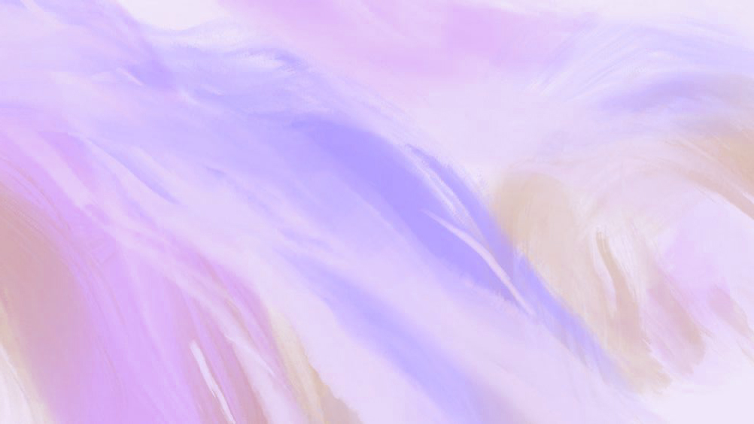




IMANA IRASHAKA ABANA BAYO
“ ‘Mbese Efurayimu si umwana wanjye nkunda? Si umwana ufite igikundiro se? Kuko iteka ryose iyo ngize icyo muvugaho mugaya ndushaho kumwibuka, ni cyo gituma umutima wanjye umufitiye agahinda. Ni ukuri nzamugirira imbabazi.’ Ni ko Uwiteka avuga.” (Yeremiya 31:20)
Hari igihe ubwoko bw’Imana bwacitsemo ibice: Efurayimu (ubwami bwo mu Majyaruguru) yataye Imana; u Buyuda (Amajyepfo) bwakomeje kuba indahemuka.
Nubwo Efurayimu yari yarataye, Imana yakomeje kuyibona nk’umwana wayo ukundwa (Yeremiya 31:20). Ni ko kugaragaza nyirakuru Rasheli, nk’uririra abahungu be, bapfiriye mu byaha byabo (Yeremiya 31:15).
Abakoreye Imana hanyuma bakayitera umugongo, Imana ikomeza kubahamagara mu rukundo. Ni abana bayo, kandi irabakunda kandi ikomeza kubararikira kuyigarukira.
Ahari, bamwe mu bana bacu, bahoze bafite kwizera, baragutaye. Aho kubatera umugongo, tugomba gukomeza kubakunda no kubabwiza ineza. Imana itwibutsa ko ibagirira impuhwe zayo zuzuye, kandi yifuza cyane ko bayigarukira.

Slide 11





TURIMO GUSHAKA UWAZIMIYE
“Nzababiba mu mahanga, bazanyibuka bari mu bihugu bya kure, bazabana amahoro n’abana babo kandi bazagaruka” (Zekariya 10:9)
Uwo twashakanye, umuhungu wacu, umukobwa wacu, inshuti yacu, umuturanyi wacu, umuvandimwe yakundaga kwicara kuri iyo ntebe… Umunsi umwe basenganye natwe, anonese ubu bari he?
Hari impamvu nyinshi zituma abantu bava mu itorero. Ntitwahamagariwe gucira urubanza impamvu zabo, kunenga ibibibatera, cyangwa ngo tubibagirwe gutyo gusa.
Inshingano yacu ni ukujya kubashaka no kubagarura mu ruhongore. Twabikora dute? Icya mbere, dusenga. Icya kabiri, tubabera urugero rw’urukundo n’ineza.
Ubuhamya bw’imibereyo yawe, imirimo yawe, amagambo yawe, n’amasengesho yawe ku muntu wataye Imana, bishobora guhindura burundu ubuzima bwe n’ejo hazaza he.

Slide 12

“Imana yashoboraga guha abamarayika bo mu ijuru umurimo w’ubutumwa bwiza, n’umurimo wose w’igikundiro. Yashoboraga gukoresha ubundi buryo kugira ngo isohoze umugambi wayo. Ariko mu rukundo rwayo rutagira akagero yahisemo kutugira abakozi bakorana na Yo, na Kristo ndetse n’abamarayika, kugira ngo dusangire n’abandi bantu umugisha, ibyishimo, no kuzahurwa mu bya mwuka, biva muri uyu murimo wo kwitanga. […]
Nujya ku murimo nk’uko Kristo yabigambiririye abigishwa Be, maze ukamuronkera imitima, uzumva ukeneye kurushaho kwimbika mu kubana na We no kumenya iby’Imana; uzagira inzara n’inyota byo gukiranuka. Uzabana n’Imana, maze kwizera kwawe gukomere, umutima wawe uzanywa amazi menshi ku iriba ry’agakiza. Gusakirana n’ibirushya ndetse n’ibigeragezo bizakujyana kuri Bibiliya no gusenga. Uzakura mu buntu no kumenya Kristo, maze ugire ubuhamya buhebuje”.
E.G. White, Steps to Christ, pp. 79–80

