Slide 1



IBIRANGA URUKUNDO
Icyigisho cya 7 cyo ku wa 15 Kanama 2026

Slide 2
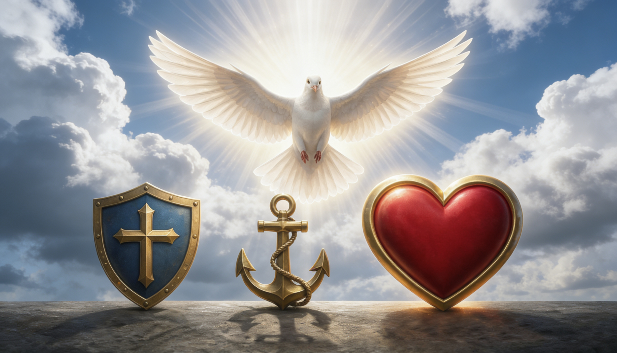
“Ariko none hagumyeho kwizera n’ibyiringiro n’urukundo, ibyo uko ari bitatu, ariko ikiruta ibindi ni urukundo” (1 Abakorinto 13:13)

Slide 3



1 Abakorinto 13 hazwi nk’“igice kivuga urukundo.” Ntabwo hasobanura urukundo rw’amajyejuru, ahubwo hasobanura urukundo rwimbitse cyane: urukundo rw’Imana.
Pawulo asobanura neza cyane uburyo bwo kugaragaza mu mibereho yacu urukundo rw’Imana rwasutswe mu mitima yacu (Abaroma 5:5).
Urukundo ni rwo ruduhatira gukora ibikorwa byacu byose, ari na yo mpamvu dukora ibigirira umumaro abo duhura nabo.
IBIRANGA URUKUNDO
Uguhebuza k’urukundo
Inzira ihebuje
Ibiranga urukundo
Icyo urukundo rukora
Icyo urukundo ruDAkora
Ibiranga Yesu
Ukudacogora k’urukundo
Umuco-mbonera uhebuje indi

Slide 4


UGUHEBUZA K’URUKUNDO

Slide 5




INZIRA IHEBUJE
“Ariko nimwifuze cyane impano ziruta izindi. Nyamara dore ndabereka inzira irushaho kuba nziza.” (1 Abakorinto 12:31)
Ni ubuhe bwoko bw’urukundo Pawulo agaragaza mu 1 Abakorinto 13, kandi kuki ruruta impano ya mwuka iyo ari yo yose? (1 Abakorinto 12:31–13:3)
Mu Kigiriki hari amagambo menshi asobanura urukundo. Pawulo yahisemo agape (urukundo rutagira inarijye, rudafite ikigombero, kandi rutekerejweho, rugashaka gusa ineza y’abandi), ari ryo Yohana akoresha mu kuvuga ngo “Imana ni urukundo” (1 Yohana 4:8).
Nta mpano ya mwuka igira akamaro iyo idakoreshejwe n’urukundo nk’uru. Mu kuri, ibikorwa byacu byose n’ibitekerezo byacu byose bigomba kuba byuzuyemo urukundo rwa agape.
Yesu yaduhaye umuburo ko kubera ubuhenebere, urwo rukundo ruzakonja (Matayo 24:12). Ariko ntitugomba kwemera ko ibi bidusohoreraho ubwacu, mu ngo zacu, cyangwa mu matorero yacu.

Slide 6

IBIRANGA URUKUNDO

Slide 7


ICYO URUKUNDO RUKORA
“Urukundo rurihangana rukagira neza; […] rubabarira byose, rwizera byose, rwiringira byose, rwihanganira byose.” (1 Abakorinto 13:4–7)
Rurihangana
Rugira neza
Rwishimira ukuri
makrothymeō: kugira umutima wagutse, gushikama, kwihangana
Rugaragaza kwihangana no kwihanganira amafuti y’abandi
jrēsteuomai : gukorana umutima w’ubushake
Rugira imbabazi n’impuhwe
synjairō: kugaragarza ukwifatanya, gushimira
Rwishimana n’abashyigikiye ukuri
Rubabarira byose
stegō: kurenga ku kintu utuje (gushikama mu kwihangana)
Rurenga ku mafuti y’abandi rucecetse, nta kuyashyira ku ka rubanda
Rwizera byose
pisteuō: kugira kwizera, gutanga ishimwe, kwiringira
Ntiruciraho iteka, rutegereza isohozwa ry’ibyashidikanywaho
Rwiringira byose
Elpizō: gutegereza cyangwa kwiringira
Buri gihe rutekereza ko habaho ibyiza
Rwihanganira byose
hypomenō: gukomera, gushikama, kugira ubutwari, kutagamburura
Rwihanganira ibirushya, ibigeragezo, n’akarengane

Slide 8


ICYO URUKUNDO RUDAKORA
Ntirugira ishyari
zeloō: kugira akayihayiho
Ntirugirira ishyari abafite izindi mpano cyangwa imico-mbonera
Ntirwirarira
perpereuomai : kwiyemera, kwirata
Ntirushaka gushimwa n’abandi
Ntirwihimbaza
fysioō: kwikuza, guhinduka umwibone
Ntirwigira umuntu w’igitangaza
Ntirukora ibiteye isoni
asjēmoneō: gukora mu buryo budakwiriye
Ntirukora ibihabanye n’amahame y’imico-mbonera
Ntirushaka ibyawo
zēteō: gushakashaka
Kubw’ineza y’abandi, ruhara uburenganzira bwarwo
Ntiruhutiraho
paroxynō : gutyariza ikintu kubabaza, kwiyenza cyangwa kurakaza
Ntirugira inzika cyangwa ngo rushotorwe
Ntirutekereza ikibi
logizomai : kurōndōra urutonde
Rurababarira kandi rukibagirwa ikibi rwagiriwe
Ntirwishimira gukiranirwa
jairō: kunezerwa, kwīshīma, cyangwa kumva utunganiwe
Ntirwishimira amafuti, ahubwo rushaka kuyakosora
“[…] urukundo ntirugira ishyari, urukundo ntirwirarira, ntirwihimbaza, ntirukora ibiteye isoni, ntirushaka ibyarwo, ntiruhutiraho, ntirutekereza ikibi ku bantu, ntirwishimira gukiranirwa […]” (1 Abakorinto 13:4–7)

Slide 9
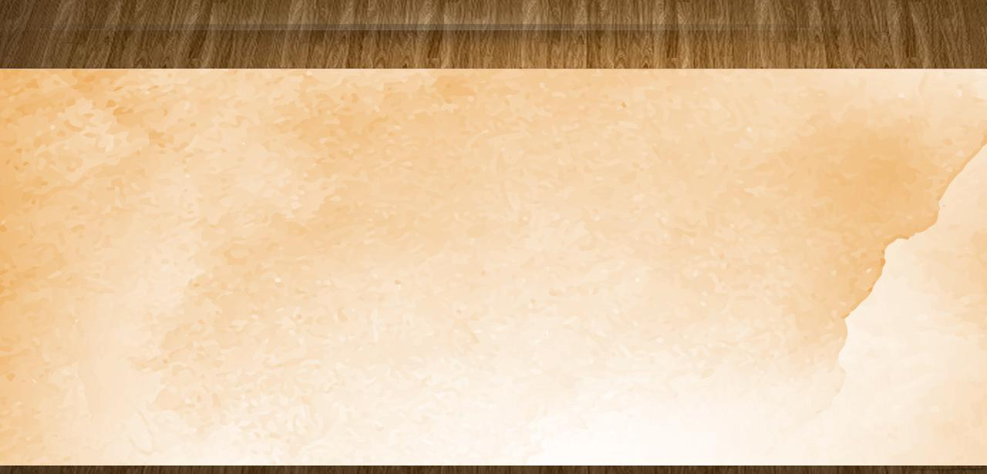
IBIRANGA YA YESU
“Ngiri itegeko ryanjye: mukundane nk’uko nabakunze.” (Yohana 15:12)
Yihanganiye gukubitwa, gutukwa no gusuzugurwa
(Matayo 27:27–31)
Agira neza
Yitaye ku muntu wese wabaga ababaye
Yarihanganye cyane
Yishimira ukuri
Yigishije ukuri mu buryo busobanutse kandi bwemeza imitima
Ababarira byose
Ntabwo yaciriyeho iteka umugore w’umunyabyaha, ahubwo yamuhaye imbabazi
(Yohana 8:10–11)
Yizera byose
Yizeye ukutaryarya k’umutima wa Zakayo
(Luka 19:8–9)
Yiringira byose
Yateguriye abagabo 12 gukora umurimo “udashoboka”
Yihanganira byose
Yihanganiye inzara, kwangwa, umubabaro, n’akarengane

Slide 10

IBIRANGA YA YESU
“Ngiri itegeko ryanjye: mukundane nk’uko nabakunze.” (Yohana 15:12)
Ntagira ishyari
Ntiyashakaga icyubahiro, ahubwo yifatanyaga n’abicisha bugufi
Ntiyihimbaza
Nubwo yari Umwami w’Isanzure, ntiyigeze abyirata
Ntiyishyira hejuru
Yari yiteguye gukora imirimo yoroheje cyane
Ntakora ibiteye isoni
Yākīraga abantu bose mu rugwiro n’ubupfura
Ntiyishakira ibye
Yahoraga akora ibyo Se ashaka (Yohana 6:38)
Ntahutiraho
Ndetse n’igihe bamukubitaga, yabasubizanije ubupfura
(Yohana 18:22–23)
Nta kibi atekereza
Yasabiye imbabazi abamubambye
(Luka 23:34)
Ntiyishimira gukiranirwa
Yabwije abafarisayo b’abagome imvugo ikomeye
(Matayo 23:27–28)

Slide 11


UKUDACOGORA K’URUKUNDO

Slide 12


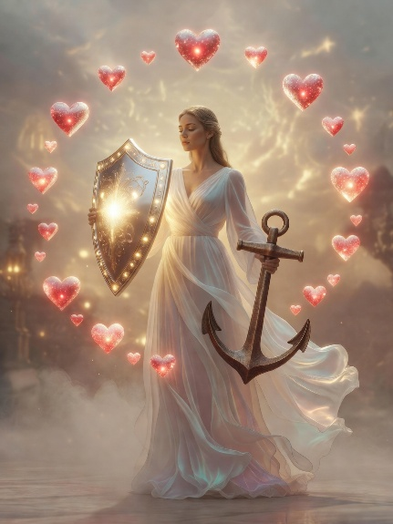

UMUCO-MBONERA UHEBUJE INDI
“Ariko none hagumyeho kwizera n’ibyiringiro n’urukundo, ibyo uko ari bitatu, ariko ikiruta ibindi ni urukundo.” (1 Aabakorinto 13:13)
Abakorinto bagaragazaga mu myifatire yabo ibyo urukundo rudakora: bari abanyeshyari, birarira, bishyira hejuru, bakoraga ibidakwiriye, barikundaga, barakaraga vuba, bari abagome, kandi bihanganiraga icyaha.
Kimwe na bo, tugomba kureka ayo mafuti, tukagwiza imico-mbonera y’urukundo, nk’uko Pawulo atwigisha, kugira ngo dukoreshe impano za mwuka neza. Anaturarikira kugwiza indi mico-mbonera ibiri: ukwizera n’ibyiringiro.
Yesu naza, icyaha kizakurwaho, kandi tuzishimira ubugingo buhoraho turi kumwe na We. Icyo gihe, guhanura, kuvuga indimi, n’izindi mpano, hamwe no kwizera n’ibyiringiro, ntibizaba bigikenewe. Ariko urukundo ruzahoraho iteka ryose (1 Abakorinto 13:8).

Slide 13

“Imana ni urukundo. Urukundo rwa Data n’Umwana ni rwo ruranga buri mwizera. Ijambo ry’Imana ni inzira y’Imana yo kumenyesha umuntu urukundo imufitiye. Ukuri kw’Imana ni inzira yo kumurikira ubwenge. Umwuka Wera ahabwa umuntu ukora afatanyije n’abakozi b’Imana. Ahindura imitekerereze n’imico, agatera umuntu gushikama nk’ureba Utagaragara. Urukundo nyakuri rushobora kwishimirwa gusa binyuze mu kwizera ukuri no kwakira Umwuka Wera.”
E.G. White, Our Father Cares, October 9

