Slide 1
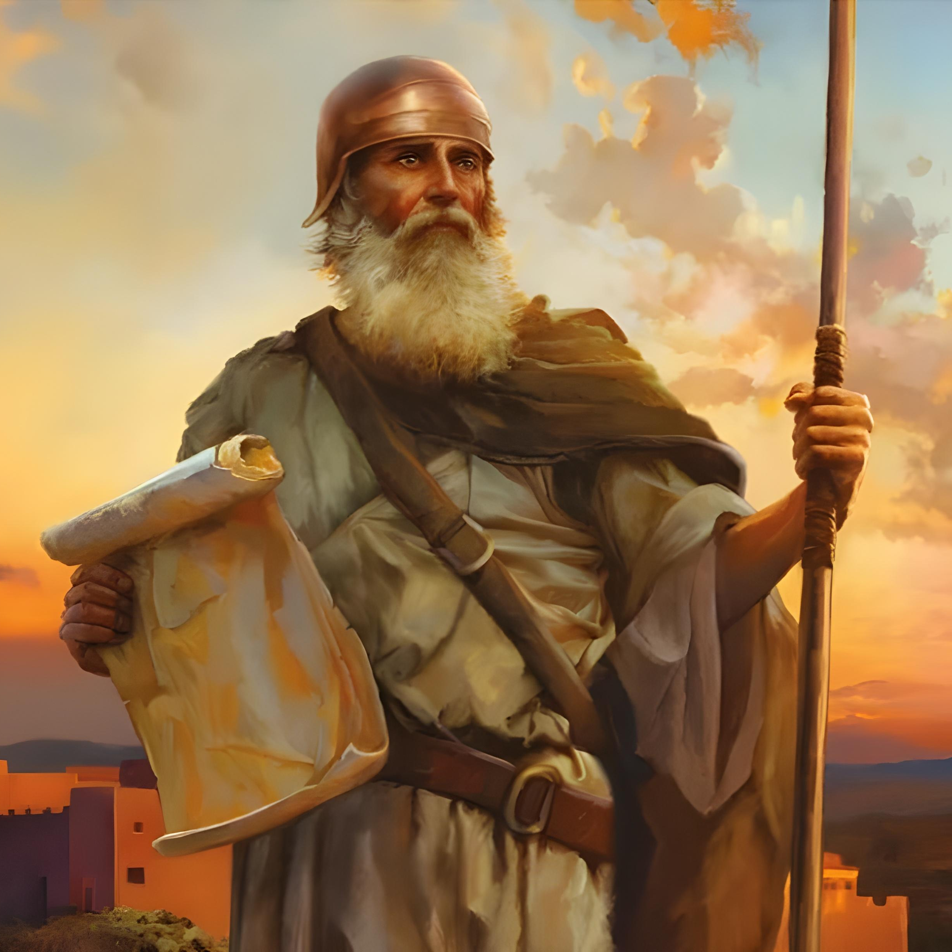
“Icyakora ukomere ushikame cyane, kugira ngo witondere amategeko yose umugaragu wanjye Mose yagutegetse. Ntuzayateshuke uciye iburyo cyangwa ibumoso, kugira ngo ubashishwe byose aho uzajya hose” Yosuwa 1:7

Slide 2

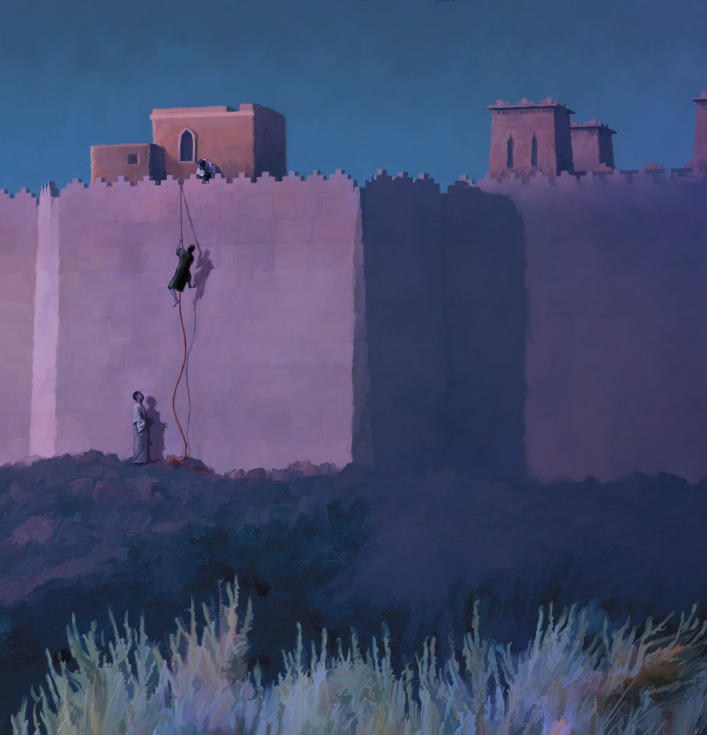
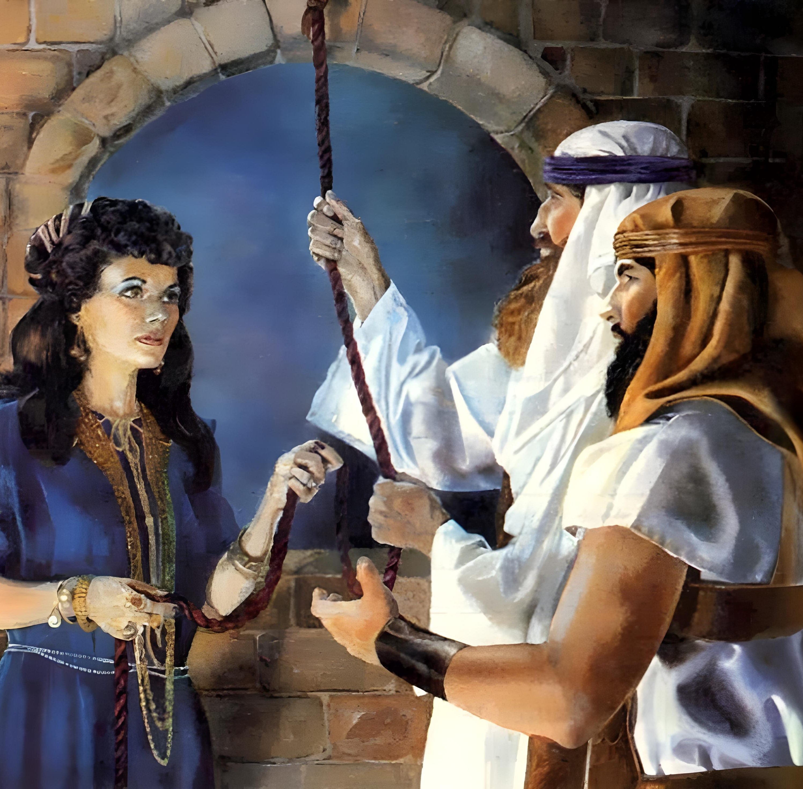
“Kwizera ni ko kwatumye maraya uwo Rahabu atarimburanwa n’abatumviye Imana, kuko yakiranye abatasi amahoro”
(Abaheburayo 11:31)

Slide 3

“Kuko Uwiteka Imana yanyu yakamije amazi ya Yorodani imbere yanyu kugeza aho mwambukiye, nk’uko Uwiteka Imana yanyu yagize Inyanja Itukura ubwo yayikamirije imbere yacu kugeza aho twambukiye, kugira ngo amahanga yose yo mu isi amenye ko Uwiteka agira amaboko akomeye, bajye batinya Uwiteka Imana yanyu iteka ryose”
Yosuwa 4:23, 24

Slide 4
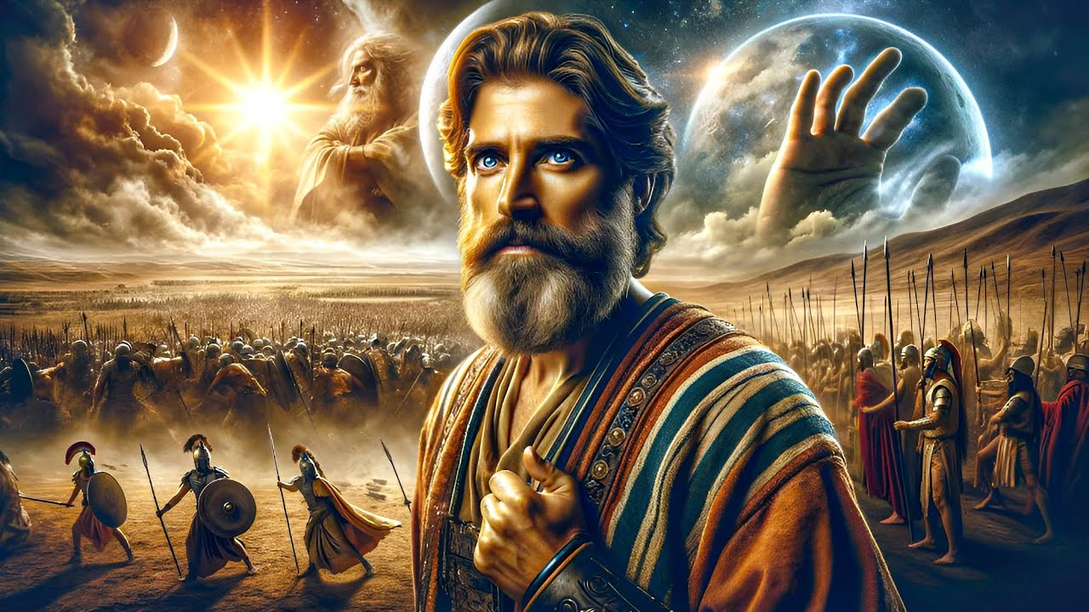
“Kandi nta munsi wahwanye n’uwo mu yawubanjirije cyangwa mu yawukurikiye, ubwo Uwiteka yumvaga umuntu kuko Uwiteka ari we warwaniye Abisirayeli”
Yosuwa 10:14

Slide 5

“Nuko abo bami bose n’ibihugu byabo Yosuwa abaneshereza icyarimwe, kuko Uwiteka Imana y’Abisirayeli yabarwaniye”
Yosuwa 10:42

Slide 6
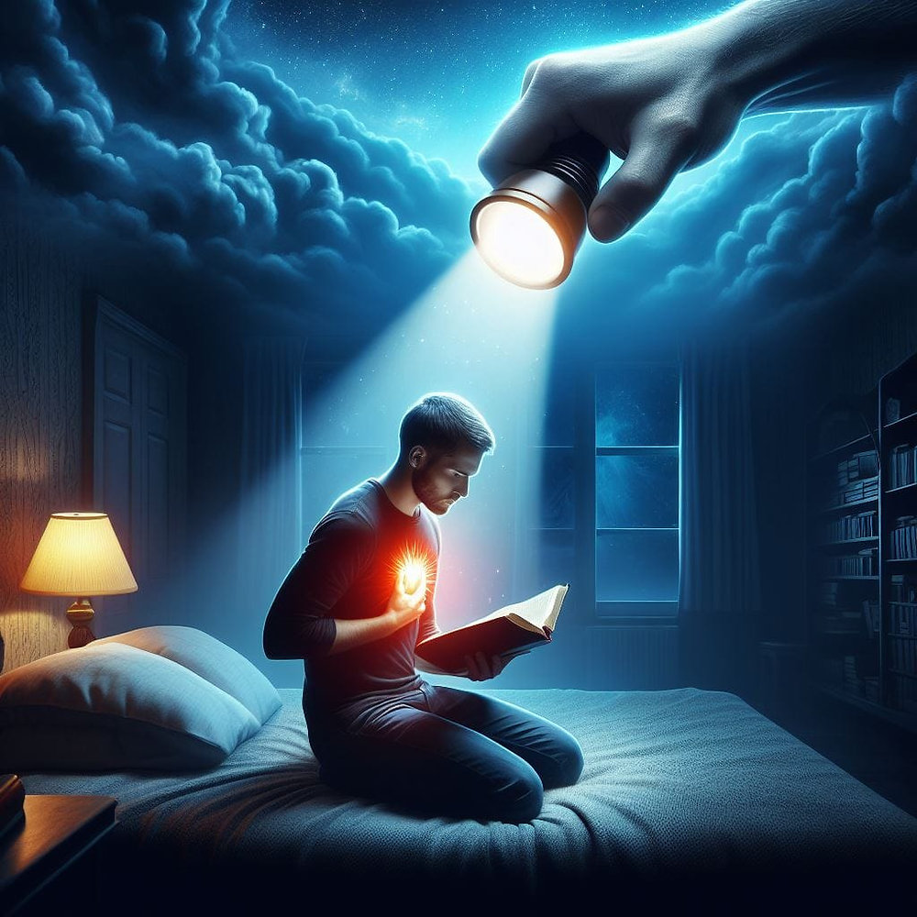

“Jye Uwiteka ni jye urondora umutima nkawugerageza, nkitura umuntu wese ibihwanye n’inzira ze, uko imbuto ziva mu mirimo ye ziri”
Yeremiya 17:10

Slide 7
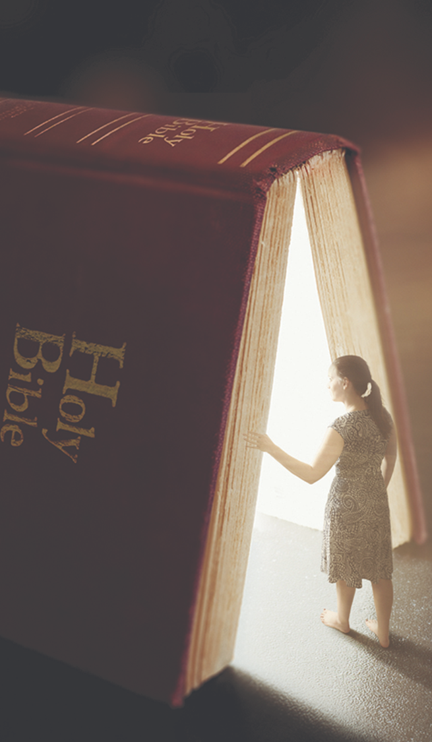
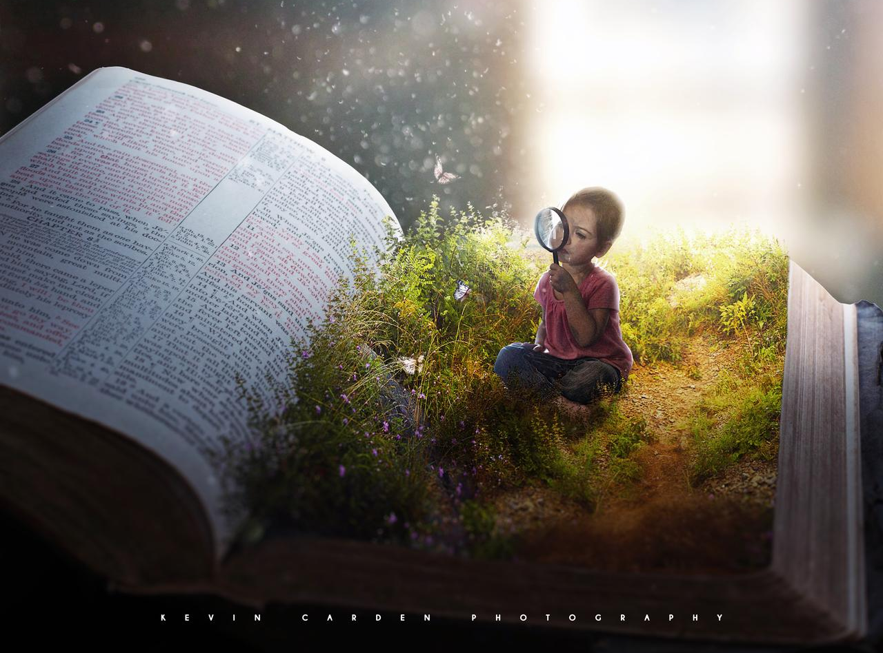
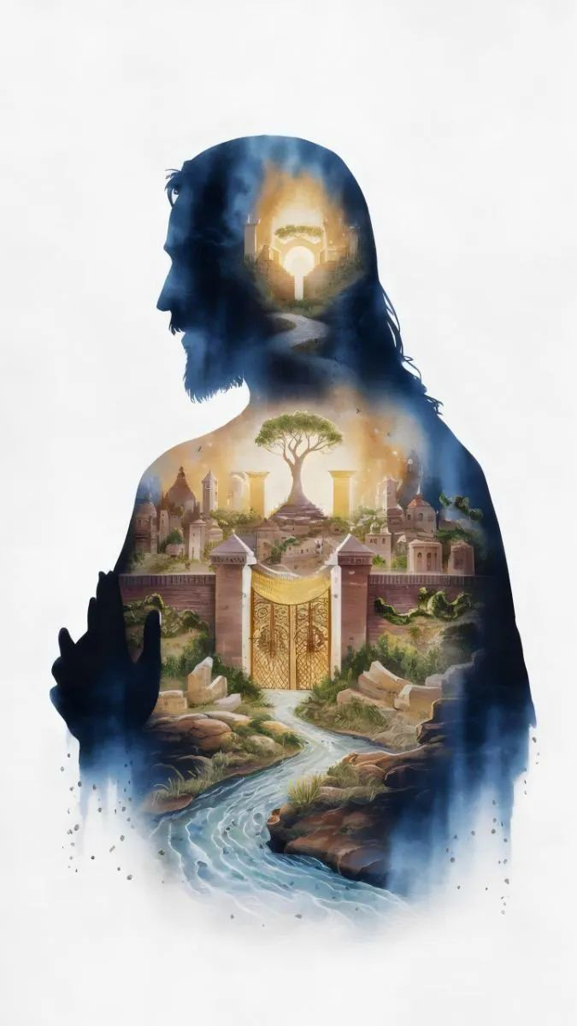
“Ahubwo mubanze mushake ubwami bw’Imana no gukiranuka kwayo, ni bwo ibyo byose muzabyongerwa”
Matayo 6:33

Slide 8
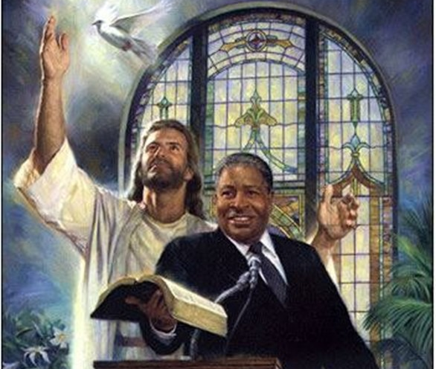
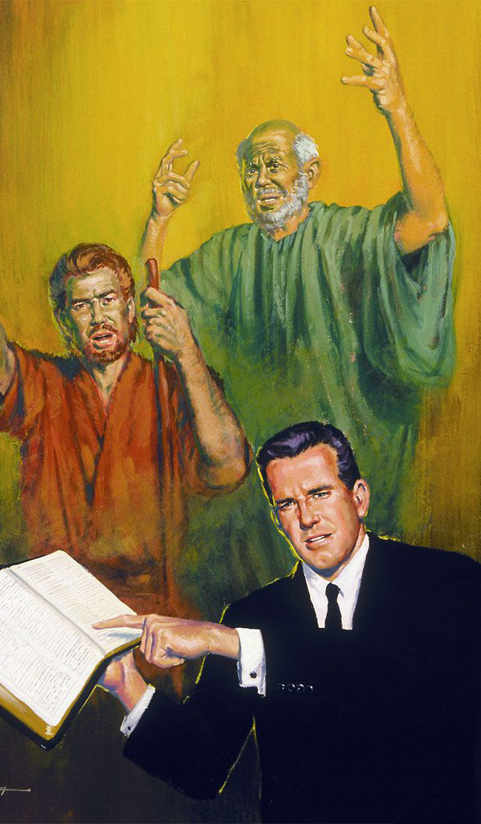
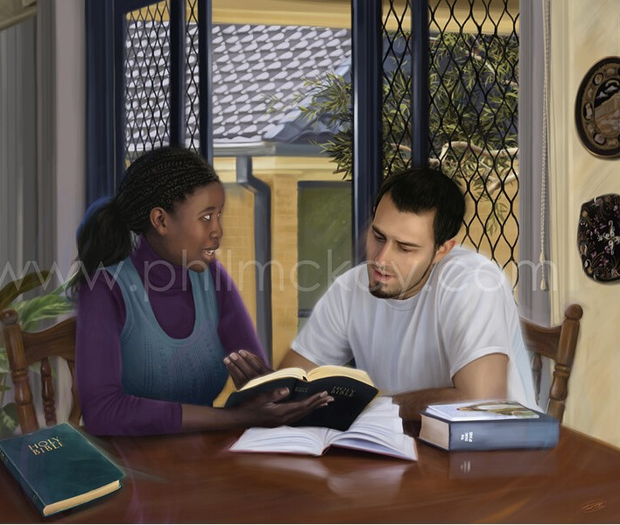
“Mwibuke ababayoboraga kera, bakababwira ijambo ry’Imana. Muzirikane iherezo ry’ingeso zabo, mwigane kwizera kwabo”
(Abaheburayo 13:7)

Slide 9
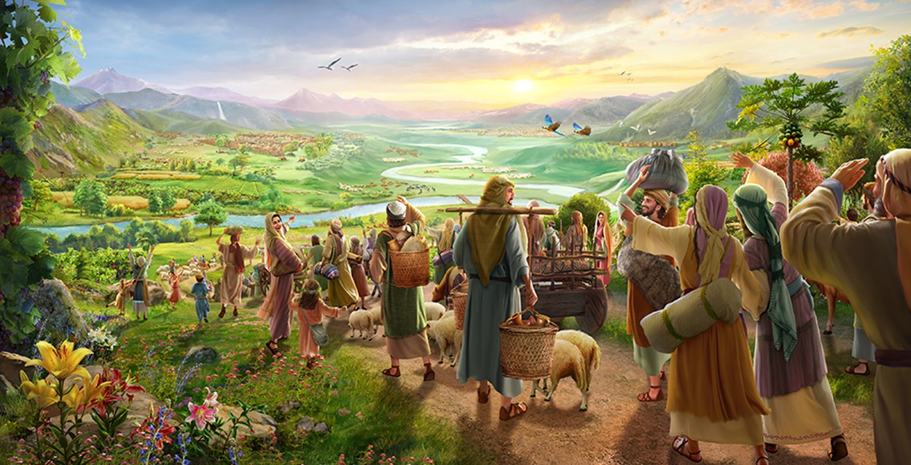
“Nimuhindukirire igihome gikomeye, mwa mbohe zifite ibyiringiro mwe. Uyu munsi ndahamya yuko nzabashumbusha kabiri” (Zekariya 9:12)

Slide 10
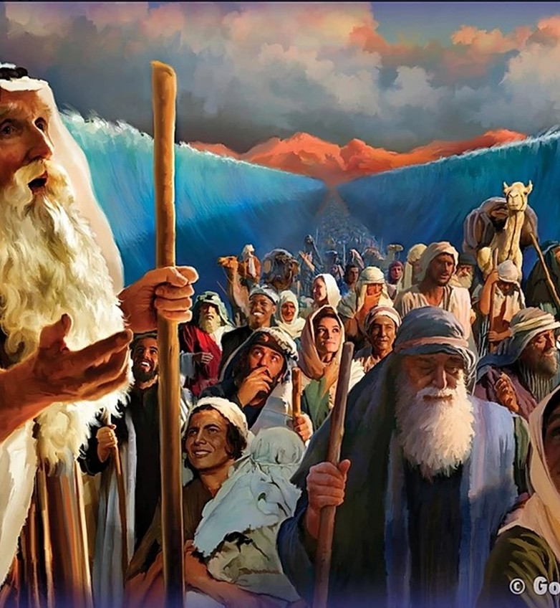
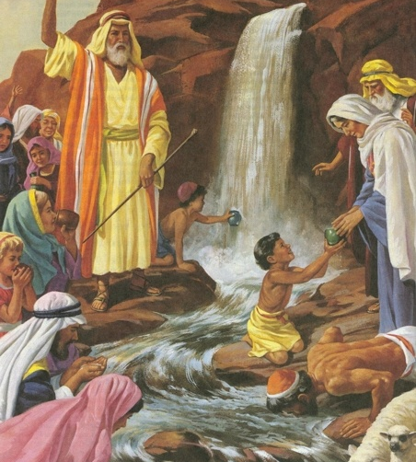
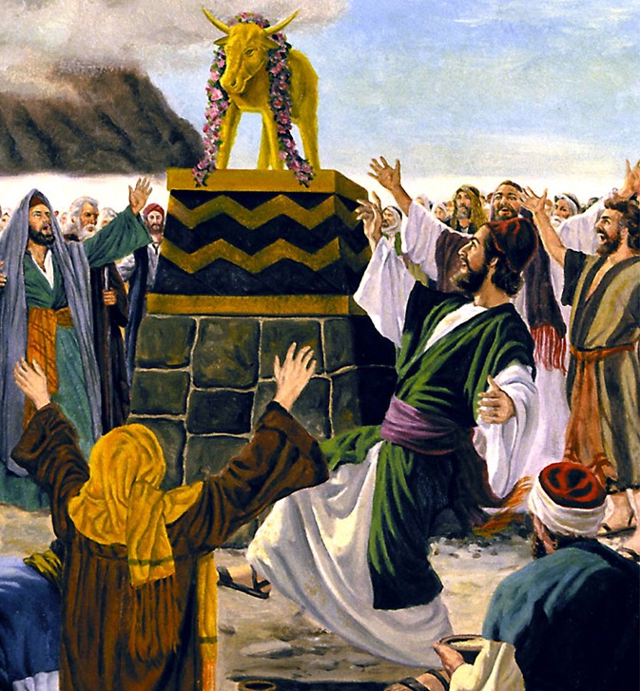
“Ibyo byababereyeho kutubera akabarore, kandi byandikiwe kuduhugura twebwe abasohoreweho n’imperuka y’ibihe” (1 Abakorinto 10:11)

Slide 11
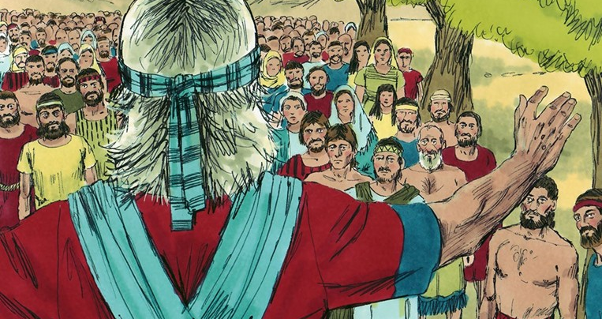

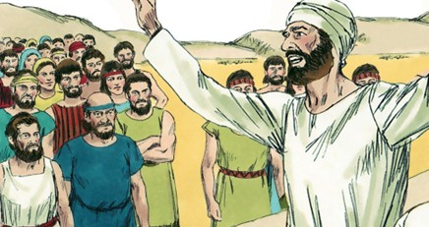
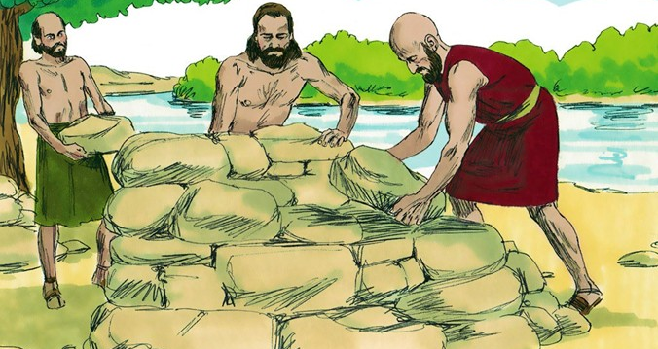
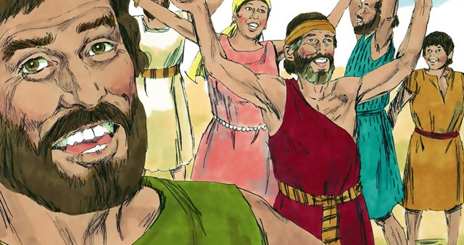
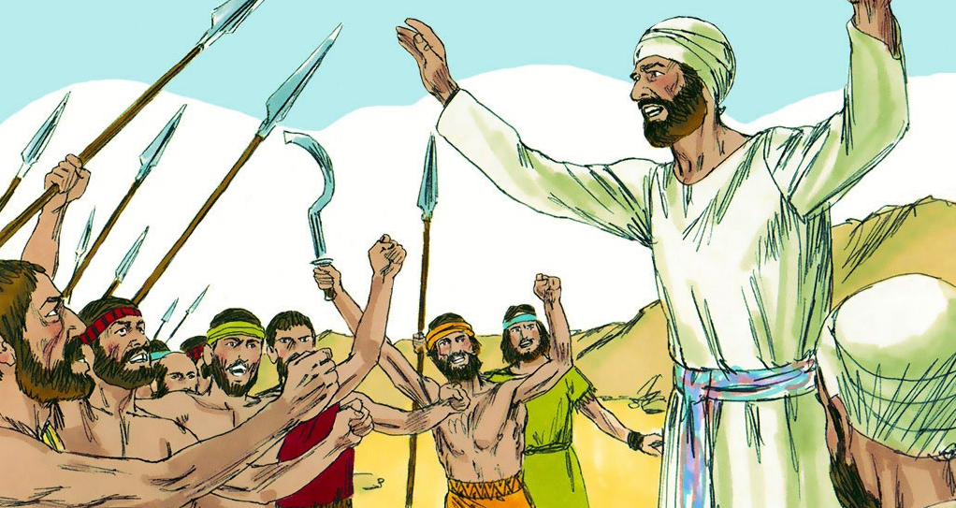
“Gusubizanya ineza guhosha uburakari, Ariko ijambo ribabaza ribyutsa umujinya” (Imigani 15:1)

Slide 12

“Nta jambo ryiza na rimwe mu yo Uwiteka yasezeranyije ubwoko bw’Abisirayeli ryakūtse, ahubwo byose byarasohoye” (Yosuwa 21:45)

Slide 13
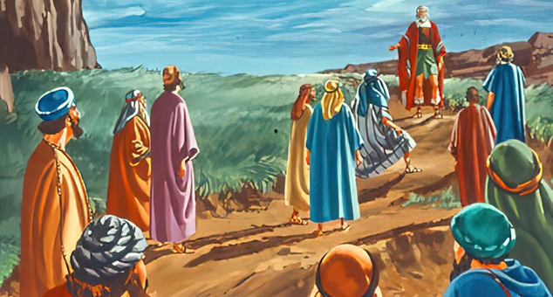
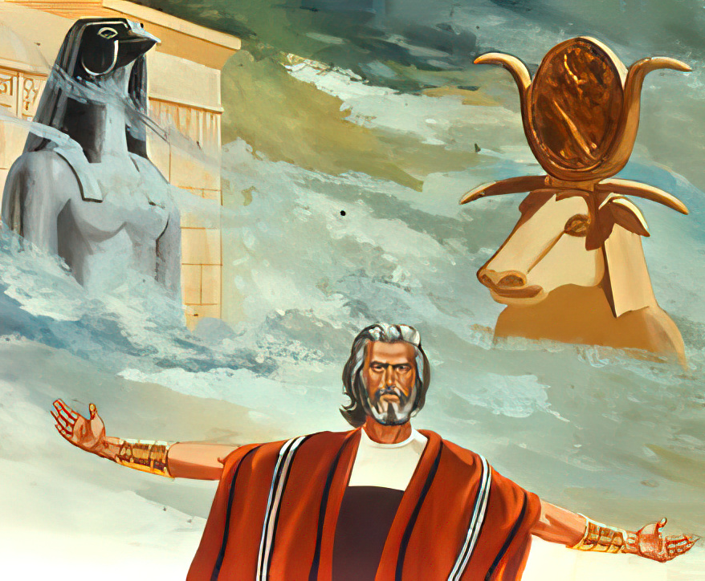
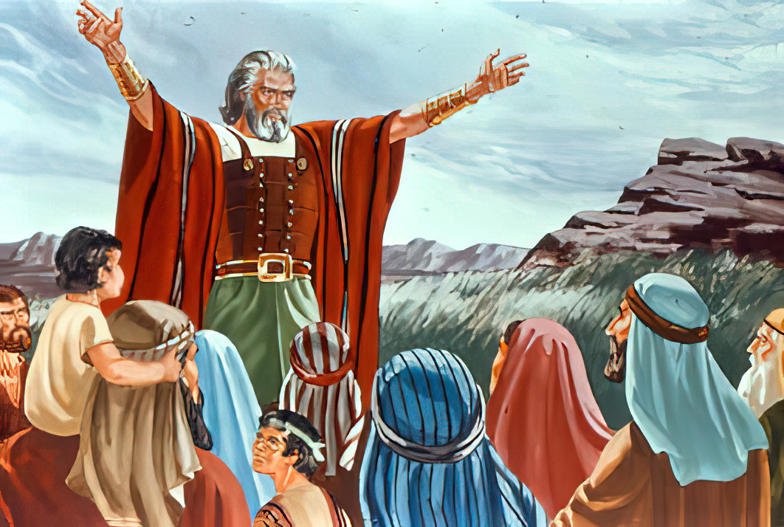
“Kandi niba mutekereza ko ari bibi gukorera Uwiteka, uyu munsi nimwitoranyirize uwo muzakorera. ... Ariko jye n’inzu yanjye tuzakorera Uwiteka”
(Yosuwa 24:15)

