Slide 1

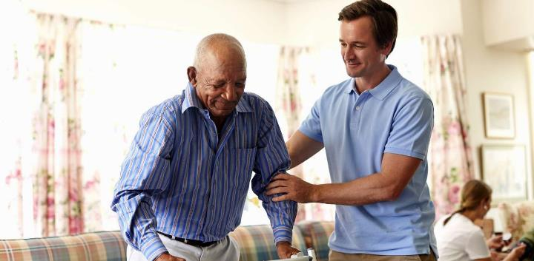
NYAYA IRI PANHONGONYA:
RUDO KANA CHINDINI?
Chidzidzo 2 cha Kubvumbi 13, 2024

Slide 2
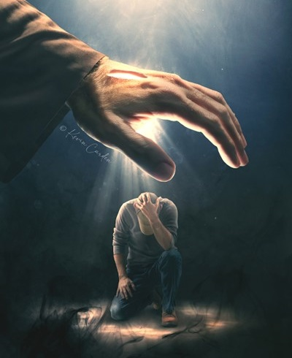
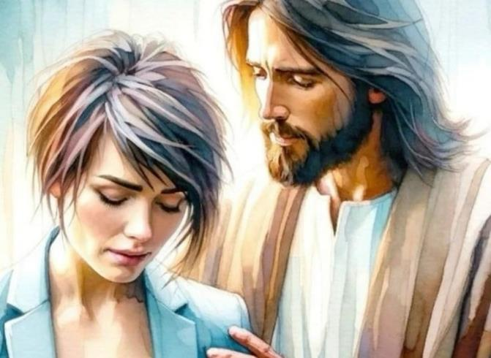
“Usatya, nokuti ndinewe; usavunduka, nokuti ndiri Mŋari wako; ndicakusimbisa, ɀirokwaɀo, ndicakuɓatsira; ɀirokwaɀo, ndicakutsigira noruʋoko rwaŋgu rworudyi rwokururama” (Isaya 41:10)

Slide 3

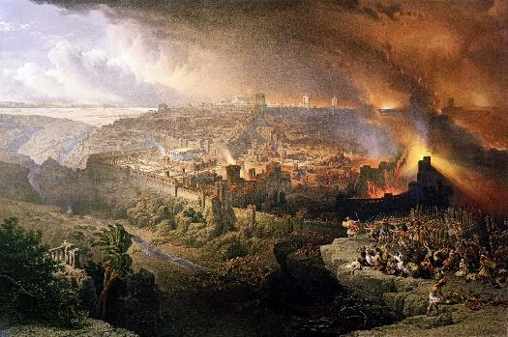
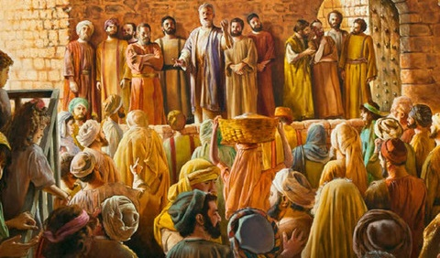


Isiraeri yakaguma sorudzi mugore rechi70. Kunyange zvazvo yaiva Roma yakaparadza Jerusarema neTemberi, mamwe masimba akabatanidzwa muhondo iyoyo.
Kune rumwe rutivi, Satani akafurira vaIsiraeri kuti varambe Mesiya, zvaizopa maruramiro ake okuparadza rudzi rwacho.
Ukuwo, Mwari akanyevera anyevera anyeverazve nezvemigumisiro yokumuramba; akanonotsa kuitwa kwemutongo; uye akagadzirira vanhu, Sangano, kuti vatore mwenje wezvokwadi uye vavhenekere nyika neshoko rerudo rwaMwari.
Zvidzidzo kubva pakuparadzwa kweJerusarema:
  Kurambwa kwerudo rwaMwari.
  Hanya yaMwari kuvanhu vake.
Zvidzidzo kubva kumaKristu ekutanga:
  Kutendeka pakutambudzwa.
  Batsirai avo vanoshaiwa.
  Rudo, chiratidzo chedu chekuzivikanwa.

Slide 4
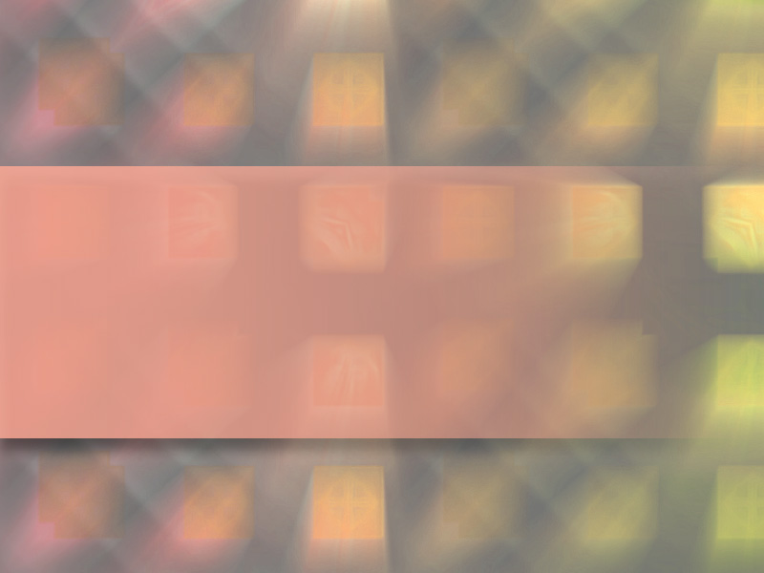
ZVIDZIDZO KUBVA PAKUPARADZWA KWEJERUSAREMA

Slide 5
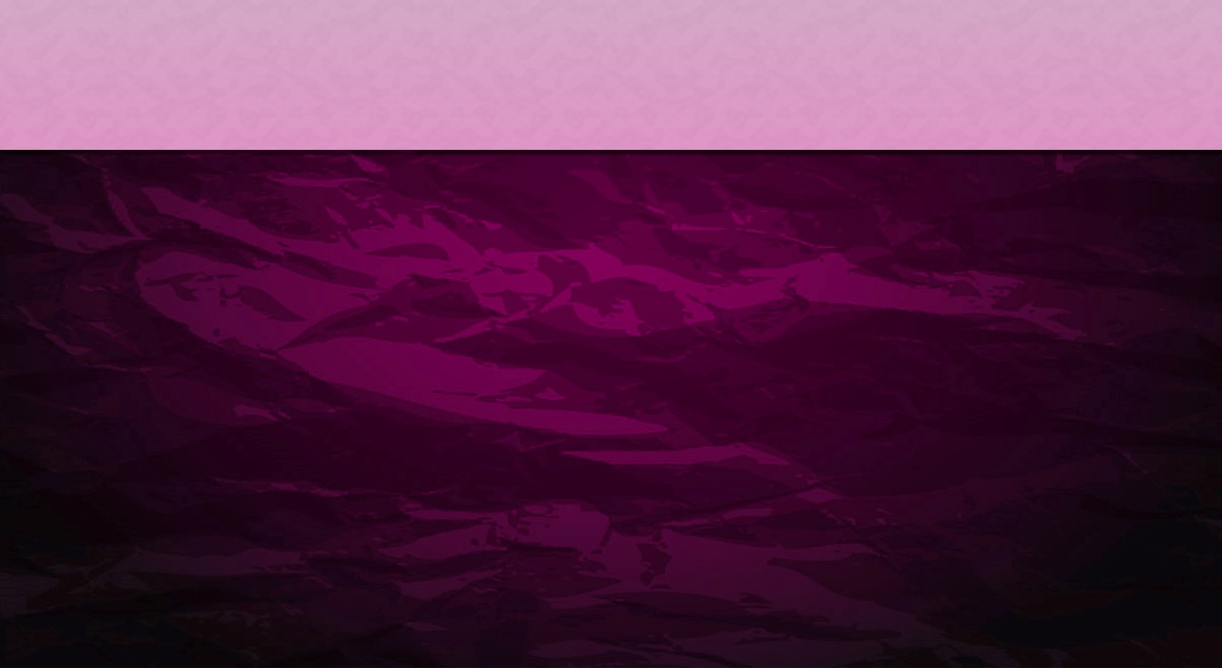
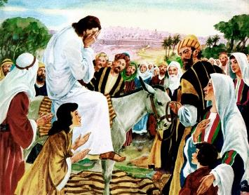
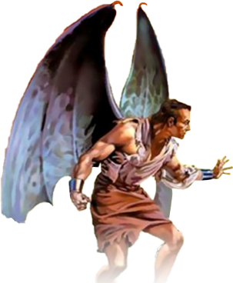
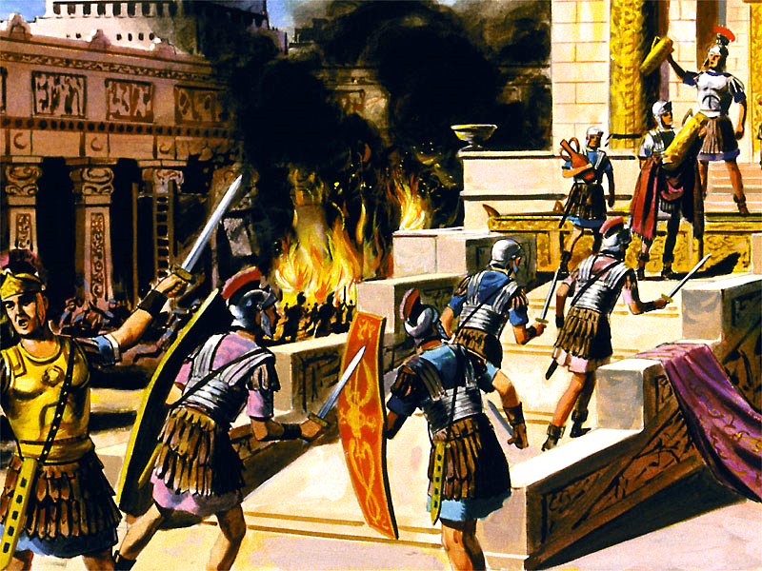
KURAMBWA KWERUDO RWAMWARI
“Jerusarema! Jerusarema! iwe unoʋuraya ʋaprofita, nokutaka namabge aʋo ʋakatumŋa kwauri! Ndakaŋga ndiciɗa kazhinji sei kuʋuŋganidza ʋana ʋako, semhambo inoʋuŋganidza hukwana dzayo munyasi mamapapiro ayo, mukaramba!” (Mateo 23:37)
Jesu akachema paakanga ava kusvika kuJerusarema ( Ruka 19:41-44 ). Aiziva kuti vaizotambura izvo zvaiva zvakafanira nokuda kwokuramba kwavo uye vakasindimara pakudanwa kworudo rwaMwari(Mat. 23:37).
Akachema nekuti njodzi yacho yaigona kunzvengwa. Nokuti Mwari anotida zvikuru zvokuti haadi kuti mumwe munhu afe, asi kuti munhu wose ave noupenyu husingaperi(Jn. 5:39-40; Izik. 18:31-32).
Nhoroondo inotiudza kuti vaJudha vakapanduka mugore ra66 pakubatwa zvisina kufanira navaRoma. Mapoka akasiyana-siyana echiJudha akarwisana, apo vaRoma vakakomba guta racho. Mugore ra70 zvinhu zvose zvakapera. Tito akaparadza Jerusarema neTemberi. MaJuda miriyoni imwe chete akaparara
.
Asi nhoroondo haitiudzi kuti Satani akakurudzira sei vaJudha kuti vapanduke, uye vaRoma kuti vatsive. Kuparadzwa kweJerusarema rakanga riri basa radhiabhorosi. Kubudikidza nokutsauka patsime roupenyu, Isiraeri yakanga isisina dziviriro kumuvengi anotsvaka bedzi ruparadziko norufu.

Slide 6

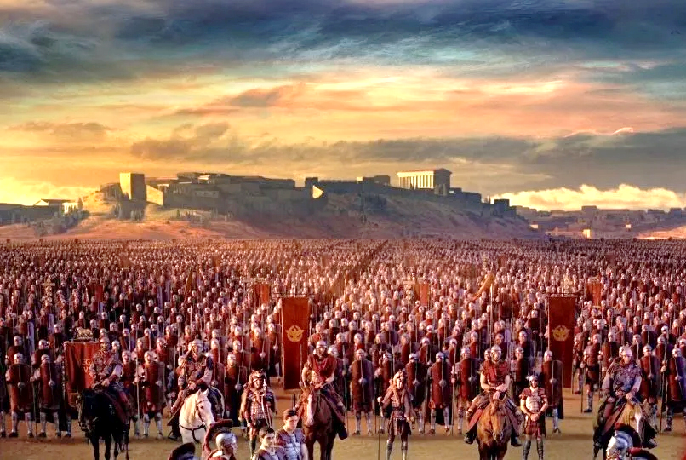
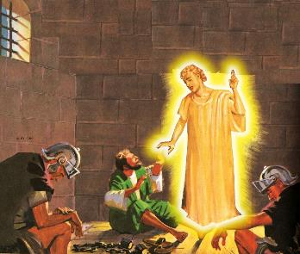
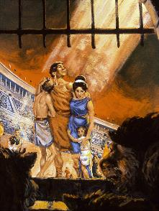
HANYA YAMWARI KUVANHU VAKE
“Usatya, nokuti ndinewe; usavunduka, nokuti ndiri Mŋari wako; ndicakusimbisa, ɀirokwaɀo, ndicakuɓatsira; ɀirokwaɀo, ndicakutsigira noruʋoko rwaŋgu rworudyi rwokururama” (Isaya 41:10)
Murudo rwake, Mwari akapa mukana kumunhu wose aida kupukunyuka ruparadziko. Akapa chiratidzo: Jerusarema rakakombwa nemauto (Ruka 21:20).
Gaius Cestius Gallus akazadzika chiratidzo ichocho mugore ra66. Kukomba kwakabviswa, uye mutungamiriri weZealot(boka remaJudha rairwisa hutongi hwemaRoma) anonzi Eleazar ben Simon akadzingirira vaRoma ndokuvakunda.
Munhu wose aitenda mashoko aJesu akashandisa nguva iyoyo kutiza apo Jerusarema rakasiyiwa risina kurindwa.
Mushure memwedzi mishomanana yakateera, Nero akatuma Vespasian kuti anomisa kupandukira uku. Kubva mugore ra67 kusvika ku70, kukomba kwacho kwaiva kwechigarire.
Mwari anogona uye anoda kudzivirira vana vake, kunyange munguva dzakaoma zvikuru (Mapis. 46:1; Is. 41:10 ). Zvisinei, vakawanda vakarasikirwa noupenyu hwavo nemhaka yokutendeka kwavo kuna Mwari(VaHeb. 11:35-38).
Ngenyi vamwe vachidzivirirwa uye vamwe, sezviri pachena, vachiraswa naMwari?

Slide 7

“Hanya dzaMwari dzisinganzwisisike dzinobvumira vakarurama kutambudzwa newakaipa dzange dziri chisakiso chekusanzwisisa kukuru kuvazhinji vasina simba mukutenda. Vamwe vakatogadzirira kurasa chivimbo chavo muna Mwari nokuti anotendera vanhu vakaderera kuti vabudirire, asi vakanaka nevakachena vanotambudzwa uye vachitambudzwa nesimba ravo routsinye. Ko, kunobvunzwa,Uyo akarurama neane ngoni, uye ane simba risingaperi, anogona sei kushivirira kusaruramisira kwakadaro nokudzvinyirira? Uyu mubvunzo watisina chekuita nawo. Mwari akatipa humbowo hwakakwana hwerudo Rwake, uye hatifanirwe kupokana kunaka Kwake nekuti hatigone kunzwisisa kushanda kwehanya dzake.” -Non Official Translation by Gift Mawoyo
EGW (The Great Controversy, pg. 47)

Slide 8

ZVIDZIDZO KUBVA KUMAKRISTU EKUTANGA

Slide 9

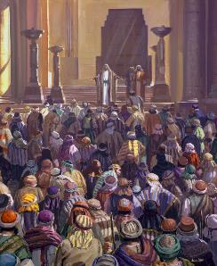
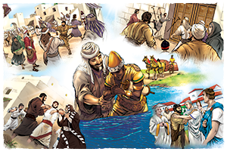
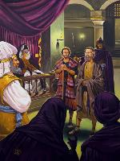
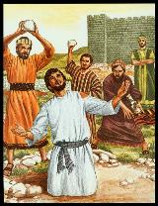
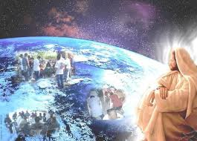
KUTENDEKA PAKUTAMBUDZWA
“Ɀino Sauro akaparadza kereke, acipinda mudzimba dzose, acikakata ʋarume naʋakadzi, nokuʋaisa mutoroŋgo” (Mabasa 8:3)
Mavambo aiva netariro zvechokwadi: kutendeuka kwaisvika zviuru ( Mabasa 2:41; 4:4 ); vatendi vakaparidza nesimba (Mabasa 4:31; 5:42).
Asi muvengi akanga asina kugadzikana. Akatanga nekutyisidzira( Mabasa 4:17-18 ); ndokutevera, zvirango ( Mabasa 5:40 ); pakupedzisira, rufu (Mabasa 7:59).
Nokuda kwekutambudzwa kwakamutswa naSauro, vadzidzi vakapararira (Mabasa 8:1). Asi, kure nokudzima kwechiedza, nemhaka yokutendeka kwevatendi, chakapenya nokupenya kukuru zvikuru munyika yose yaizivikanwa ( Mabasa 8:4; 11:19-21; VaRoma 15:19; VaKorose 1:23).
Jesu akanga apa Sangano Rake basa nesimba rokuriendesa mberi (Mabasa 1:8). Hapana simba, renyama kana remweya, rinogona kumisa kufambira mberi kwevhangeri(Matt. 16:18). “Kana Mŋari acitirwira, ndianiko ucatirwisa!” (VaRoma 8:31)

Slide 10

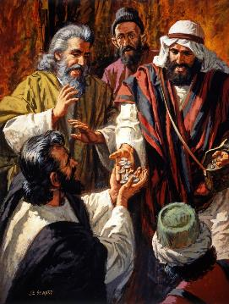
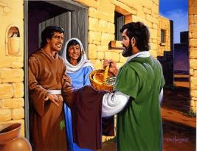
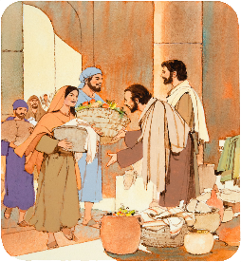
BATSIRAI VANOSHAIWA
“ʋakateŋgesa fuma yaʋo nenhumbi, ʋakagoʋana naʋose, mumŋe nomumŋe paakashaiwa napo” (Mabasa 2:45)
Evhangeri yakaitei pamaKristu okutanga (Mabasa 2:42-47)?
Vakatenda mudzidziso yaJesu
Vaiva nechipo vakaporesa varwere
Vaiva nezvinhu zvose zvakafanana
Vakagovana zvavaiva nazvo nevanoshayiwa
Vaiva nemisangano yavose
Vaiva nemisangano mudzimba, umo vaiva Chidyo Chatenzi
Vairarama nemufaro nemoyo wakapfava
Vairumbidza Mwari
Sevamiririri vaKristu, vakatevedzera Jesu. Kuburikidza nokutarisira zvinodikanwa zvaavo vakavapoteredza, vakawana tsigiro yeguta rose.
Senguva iyoyo, Sangano rinofanira kuonekwa nerudo rwemaKristu kune mumwe nemumwe, uye nehanya nenharaunda yavo.

Slide 11
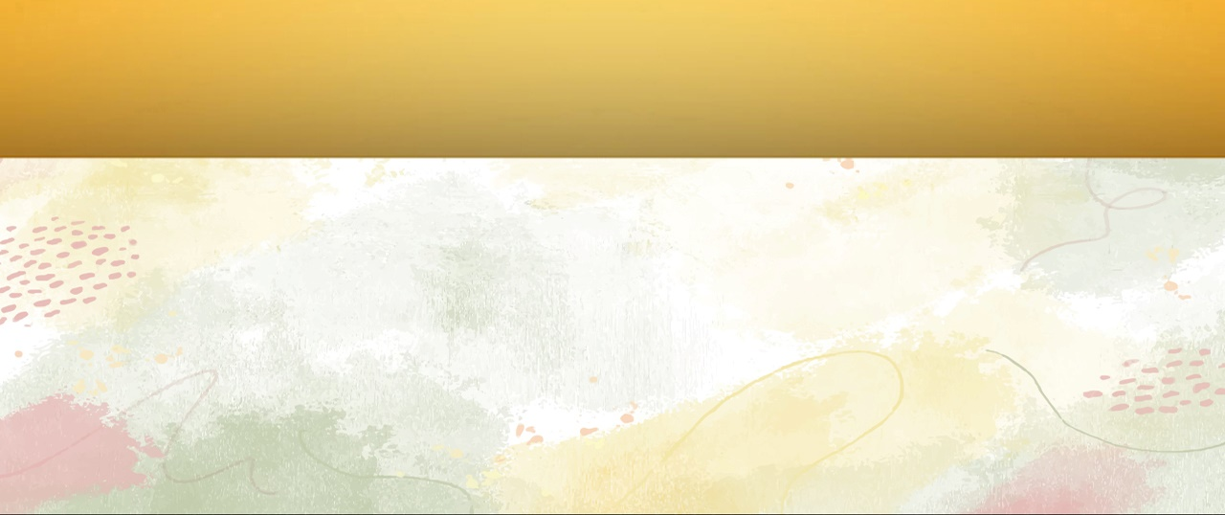
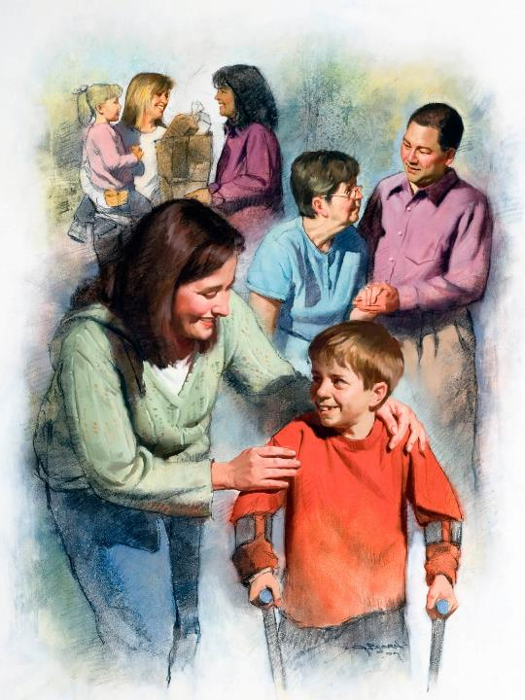
RUDO,CHIRATIDZO CHEDU CHEKUZIVIKANWA
“Ʋose ʋacaziʋa naiɀoɀi kuti muri ʋadzidzi ʋaŋgu, kana munoruɗo pakati penyu” (Johani 13:35)
Rimwe nerimwe remapato ari mukurwisana kwemuchadenga nepasi rine maitiro aro: Satani anovenga uye anoparadza; Mwari anoda uye anodzoredzera.
Vateveri vebato rimwe kana rimwe vanoita zvinoenderana nemaitiro aya. Kana tikatevera Mwari, tichazviratidza norudo runoratidzwa vamwe(1Jn. 4:20-21).
MaKristu vomuzana remakore rechipiri nerechitatu vakashandisa rudo rusina udyire. Mukati mehosha mbiri huru (mumakore 160 ne265), vakazvitsaurira vamene kutarisira avo vakanga vawirwa, pasina kurangarira chengeteko yavo vamene.
Vakazvipa nokuda kworudo, uye vakabetsera mamiriyoni avanhu. Asi havana kuita kuti vapihwe mbiri ivo, asi kuna iye wavakanga vachida kupa upenyu hwavo nokuda kwake, Muponesi wavo: Jesu.

Slide 12

“Mukana wemweya wega wega kuve mugero mupenyu uyo ​​Mwari anogona kutaura nawo kunyika pfuma yenyasha Dzake, upfumi husinganzverwi hwaKristu. Hapana chinhu chinodiwa naKristu zvakanyanya sevamiririri vanozomiririra kunyika Mweya nehunhu Hwake. Hapana chinhu chinodiwa nenyika sekuratidzwa kuburikidza muvanhu rudo rwaMuponesi. Denga rose rakamirira migero iyo inogona kudururwa nayo mafuta matsvene kuti ave mufaro nechikomborero kumwoyo yevanhu.” -Non Official Translation by Gift Mawoyo
EGW (God's Amazing Grace - Unsearchable Riches, June 28)

