Slide 1
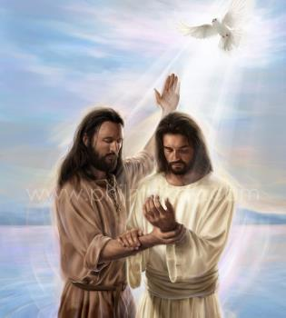
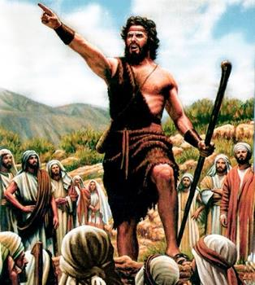
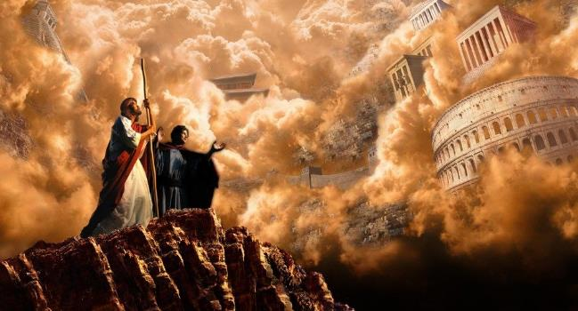
KUTANGA KWEVHANGERI
Chidzidzo 1 cha Chikunguru 6, 2024

Slide 2
“Johane wakati asuŋgwa, Jesu akaȿika Garirea, aciparidza Evaŋgeri yaMŋari,aciti, ‘Ŋguʋa yazad ziswa, ʋushe bgaMŋari bgasweɗera pedyo; tendeʋukai, mutende Evaŋgeri’ ” (Marko 1:14, 15)

Slide 3
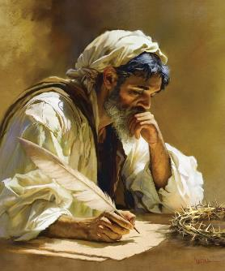
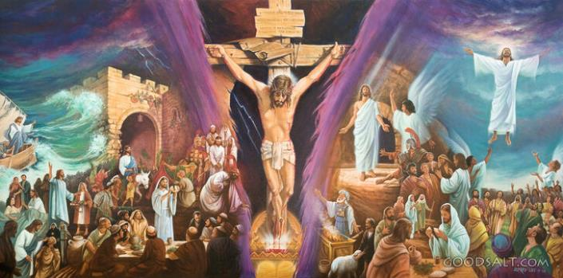
Vhangeri raMako ndiro ripfupipfupi pamavhangeri mana anorondedzera hupenyu hwaJesu.
Inyaya inokurumidza, inomhanya, ine simba, yakapfupikiswa. Zviono zvinopenya pamberi pameso edu. Hapana chaungapotse, sezvo zvakanyanyokosha zviri izvo zvirimo.
Muchidimbu, Mako ndiyo vhangeri yezana remakore rechi21, apo zvinhu zvose zvinoitika nokukurumidza, uye vanhu vasina nguva. Ngatishandise nguva iyoyo kudzidza chinhu chinokosha zvikuru: “Kutaŋga kweEvaŋgeri yaJesu Kristu, Mŋanakomana waMŋari” (Marko 1:1).
Munyori wevhangeri:
Mumishinari akakoniwa.
Kubatsira pabasa.
Kutanga kwevhangeri:
Kugadzirira. Marko 1:1-8.
Rubhabhatidzo. Marko 1:9-13.
Shoko. Marko 1:14-15.

Slide 4
MUNYORI WEVHANGERI

Slide 5
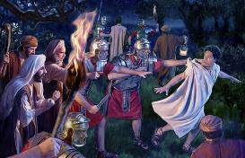
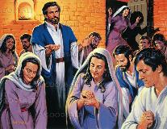
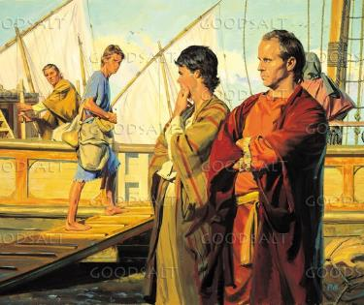
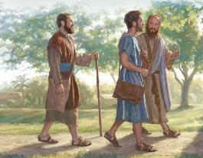
MUMISHINARI AKAKONIWA
“Ɀino Barnabasi naSauro, ʋakati ʋapedzisa ɓasa raʋo, ʋakadzokera Jerusarema, ʋakaenda naJohane, wainzi Marko” (Mabasa 12:25)
Kufanana nevamwe vaevhangeri vose, Marko haazvidudzi nezita. Aiva mukomana pakaitika zvinhu zvaanorondedzera, izvo zvimwe akadzidza nezvazvo kuburikidza noukama hwake hwepedyo nomuapostora Petro(1 Pet. 5:13).
Mai vaJohani Marko ndivo vaive muridzi wenzvimbo muJerusarema paiungana kereke kuti inamate panguva yekusungwa kwaPetro (Mabasa 12:12).
Nguva pfupi pashure pacho, Bhanabhasi naSauro (vakanga vaenda kuJerusarema kunopa chipo) vakatora Johani Mako vakaenda naye kuAntiokia (Mabasa12:25).
MuAntiokia, Mweya Mutsvene pawakadana Bhanabhasi naSauro kuti vave mamishinari pakati pevaHedheni, vakatora Johani Mako semubatsiri wavo (Mabasa 13:2-5).
Asi upenyu hwoumishinari hwakaratidza kuva hwakaoma zvikuru kuna Marko aiva achiri muduku, uyo akasarudza kudzokera kuJerusarema (Mabasa 13:13).

Slide 6
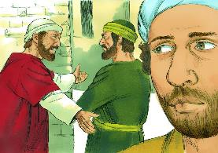
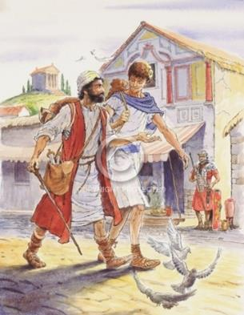
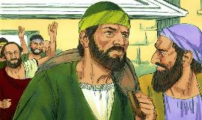
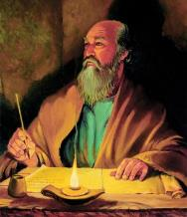
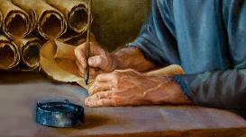
KUBATSIRA PABASA
“Ruka oga uneni. Tora Marko uʋuye naye, nokuti unondiɓatsira kwaɀo paɓasa” (2 Timotio 4:11)
Pauro paakaronga rwendo rwechipiri rweumishinari, akaramba kugamuchira Mako somubatsiri (Mabasa 15:36-38). Pauro aida vabatsiri vakasimba, vaizova tsigiro, kwete mutoro. Marko haana kukwana muchimiro ichi.
Zvisinei, Bhanabhasi aiva nechokwadi chokuti muzukuru wake Marko, akanga ane mukana wakakwana wokuva mumishinari akanaka. Saka akatora Marko akaenda naye kuKupro, Pauro naSirasi vakananga kuAsia (Mabasa 15:39-41).
Hatizivi zvakazoitika, asi tinoziva kuti Bhanabhasi akanga ataura zvirizvo. Nokutaura katatu nezvake mutsamba dzake, Pauro akasvika pakurangarira Marko se“unoɓatsira kwaɀo paɓasa,” mubatsiri kwaye (VaKorose. 4:10; Firimoni. 24;2 Tim. 4:11).
Nekuda kwemukana uyu wechipiri, nhasi tinogona kunakidzwa nenyaya inofadza yevhangeri yaMarko.

Slide 7
KUTANGA KWEVHANGERI

Slide 8
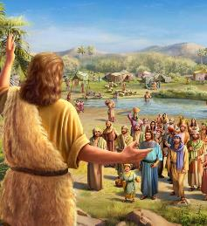
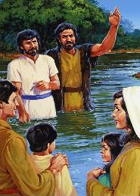
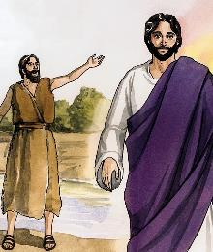
KUGADZIRIRA
“Akaparidza, aciti: “Shure kwaŋgu kunoʋuya mumŋe unesimba kupfuʋureni, wandisino‐kufanira kukotama kuti ndisunuŋgure rukanda rweshaŋgu dzake” (Marko 1:7)
Marko anotanga nekutisuma kuna Mwari achigadzirira rwendo rweMwanakomana wake ( Marko 1:1-2; Maraki 3:1 ). Rwendo rwunotanga mumatare ekudenga, uye rwuchatora Jesu Kristu pamuchinjikwa, kuti agamuchirwe zvakare Kudenga (Marko16:19).
Kugadzirira nzira iyi, Mwari anosarudza Johani Mubapatidzi “Inzwi rounoɗana murenje” (Mk. 1:3; Is. 40:3).
Jesu asati atanga rwendo rwake rwokutipira upenyu hwake, Johani akagadzirira mwoyo yevanhu nokuvatungamirira kuti vatendeuke uye achivakoka kuti vabhabhatidzwe(Marko 1:4-6).
Akavagadzirira kugamuchira Mwanakomana waMwari: ane simba kupfuura Johani pachake; akanyanya kufanira; uye kuti achabhabhatidza norubhabhatidzo runoshanda zvikuru(Marko 1:7-8).

Slide 9
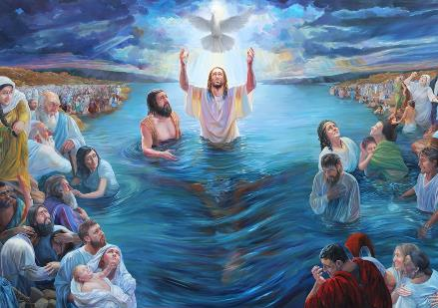
RUBHABHATIDZO
“Namazuʋa iwayo Jesu wakabva Nazareta muGarirea, akabapatidzwa naJohane muJordani” (Marko 1:9)
Jesu anotanga rwendo rwake nenzira inoshamisa: Mwari Baba vanomuratidza seMwanakomana wake, uye Mweya Mutsvene anoratidza huvepo hwake muchimiro chemuviri ( Marko 1: 10-11 ). Kubvira pamavambo chaipo, Jesu anoratidzwa somunhu woumwari, Mwanakomana waMwari. Asi anoratidzwawo somunhu:
Anobhabhatidzwa naJohani, kwete kuti Johani abhabhatidzwe naiye
(Marko 1:9)
Anotungamirirwa neMweya (Marko 1:12)
Anofanira kuva oga naMwari (Marko 1:13a)
Anoedzwa nadhiabhorosi (Marko 1:13b)
Anosangana nenjodzi dzinokuvadza muviri (Marko 1:13c)
Ngirozi dzinomushumira (Marko 1:13d)
Aya ndiwo mataurirwo anoitwa Jesu kwatiri: ane humwari zvizere uye ari munhu akazara. Ndiye zvose Muponesi uye Hama, Ishe uye Muenzaniso. Ndiko kuratidzwa kuzere kwerudo rwaMwari kuvanhu.

Slide 10
«Kubwinya kwakazorora pana Kristu chitsidzo cherudo rwaMwari kwatiri. Kunotiudza nezvesimba remunamato-kuti izwi remunhu ringasvikire sei nzeve yaMwari uye zvikumbiro zvedu zvigamuchirwe muvazhe dzedenga.... Chiedza chakadonha kubva pamasuwo akazaruka pamusoro weMuponesi wedu chichawira pamusoro wedu patinenge tichinyengeterera kubatsirwa kuti tikunde muedzo. Inzwi rakataura kuna Jesu rinoti kumweya wose unotenda, “Uyu ndiye Mŋanakomana waŋgu unoɗikanwa, wandinofarira.”» -Non Official Translation by Gift Mawoyo
EGW (In the Heavenly Places - God Has Chosen Me, January 20)

Slide 11
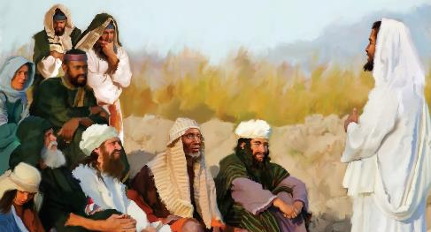
70 weeks = 490 years
SHOKO
7 weeks
62 weeks
½ week
½ week
49 years
434 years
7 years
“Johane wakati asuŋgwa, Jesu akaȿika Garirea, aciparidza Evaŋgeri yaMŋari” (Marko 1:14)
Shoko rokutanga raJesu raitaura zvitatu(Marko 1:15)
“ʋushe bgaMŋari bgasweɗera pedyo”
“tendeʋukai, mutende Evaŋgeri”
"Ŋguʋa yazadziswa"
Kunongedzerwa kuuprofita hwemavhiki 70(Dan . 9:24).
Kubva pachirevo chaAtashasta, gore ra457 BC, kusvika pakuzodzwa kwaMesiya, mavhiki 69 aizopera(v. 25).
Izvi zvakazadziswa pakubhabhatidzwa kwaJesu, AD 27. Mushure mehafu revhiki rakateera, AD 31, Jesu akafa(v. 27).
Chitsidzo chekuti sungano yeruponeso yakanga yava kutanga kuzadzikiswa.
Rukoko rwekutora chikamu musungano, nekugamuchira ruregerero kuburikidza nekutenda muna Jesu.
Shoko redu razvino uno rinobatanidzawo zvitatu izvi: Nguva yazadzikiswa; Jesu ari kuuya; uye tinofanira kutendeuka uye totenda kuti tigoenda Naye.

Slide 12
“Mutoro wekuparidza kwaKristu waive, “Ŋguʋa yazad ziswa, ʋushe bgaMŋari bgasweɗera pedyo; tendeʋukai, mutende Evaŋgeri.” Nokudaro shoko revhangeri, sekupiwa kwaro neMuponesi pachake, rakanga rakavakirwa pazviporofita. “Ŋguʋa” iyo yaakazivisa kuti ichazadzikiswa ndiyo nguva yakaziviswa Dhanieri nomutumwa Gabrieri…
Sezvo shoko rokuuya kwokutanga kwaKristu rakazivisa humambo hwenyasha dzake, naizvozvo shoko rokuuya kwake kwechipiri rinozivisa humambo hwokubwinya kwake. Uye shoko rechipiri, serokutanga, rinobva pazviporofita."-Non Official Translation by Gift Mawoyo
EGW (The Desire of Ages, pg. 233, 234)

