Slide 1
ZUVA MUHUSHUMIRI HWAJESU
Chidzidzo 2 cha Chikunguru 13, 2024

Slide 2
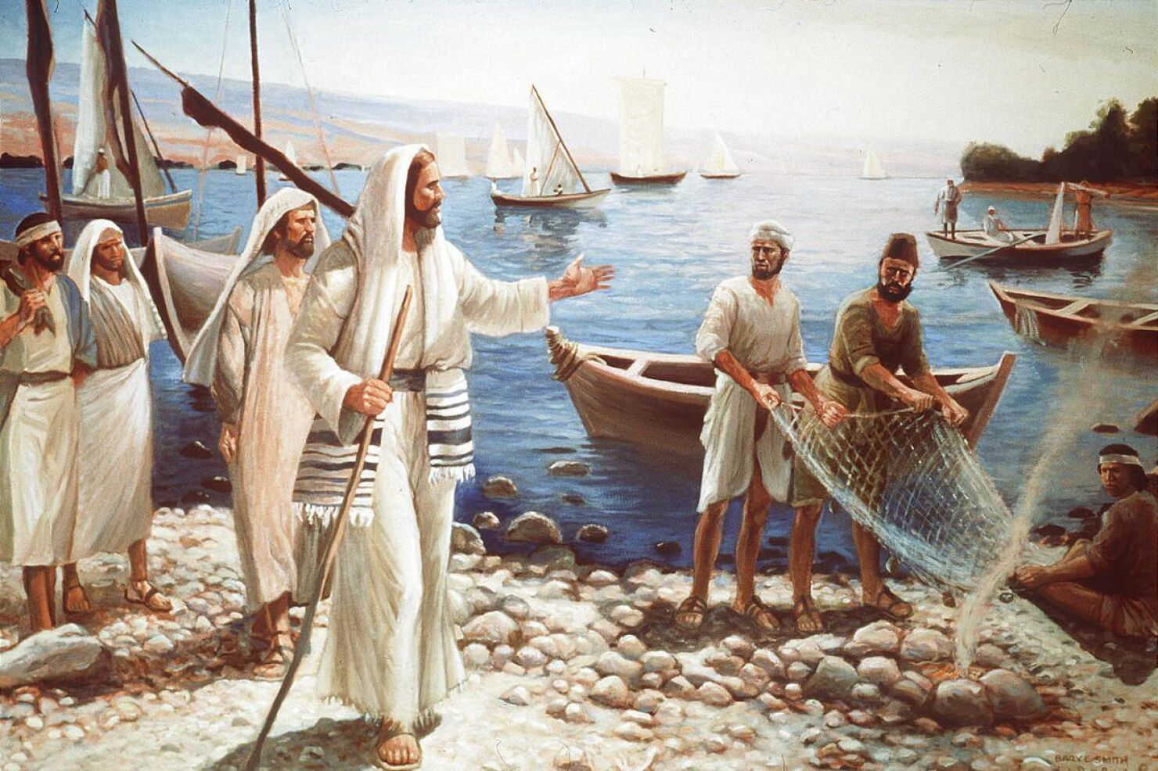
“Jesu akati kwaʋari, ‘Nditeʋerei, kuti ndikuitei ʋaɓati ʋaʋanhu’ ”
(Marko 1:17)

Slide 3
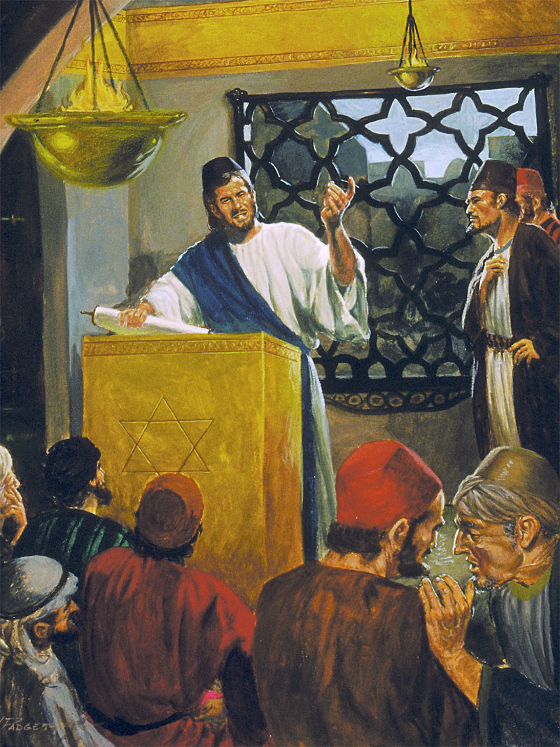
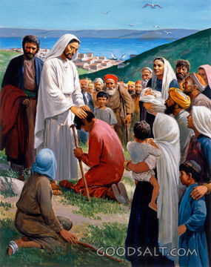
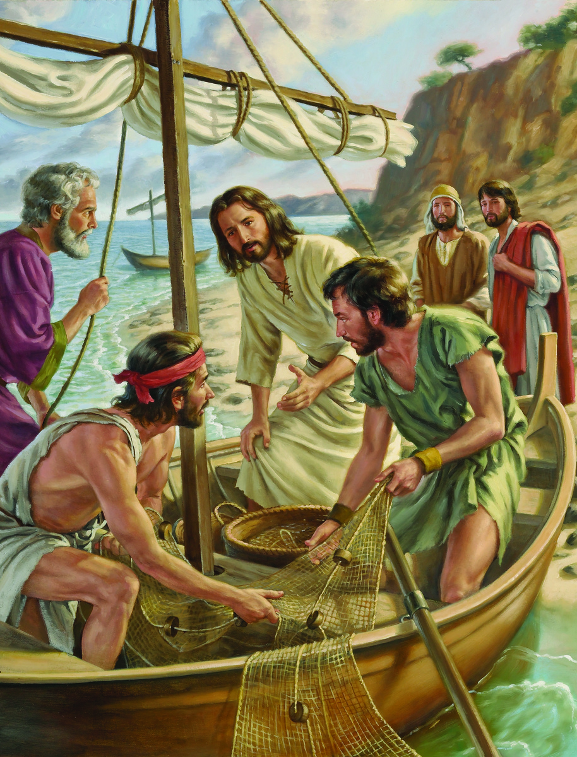
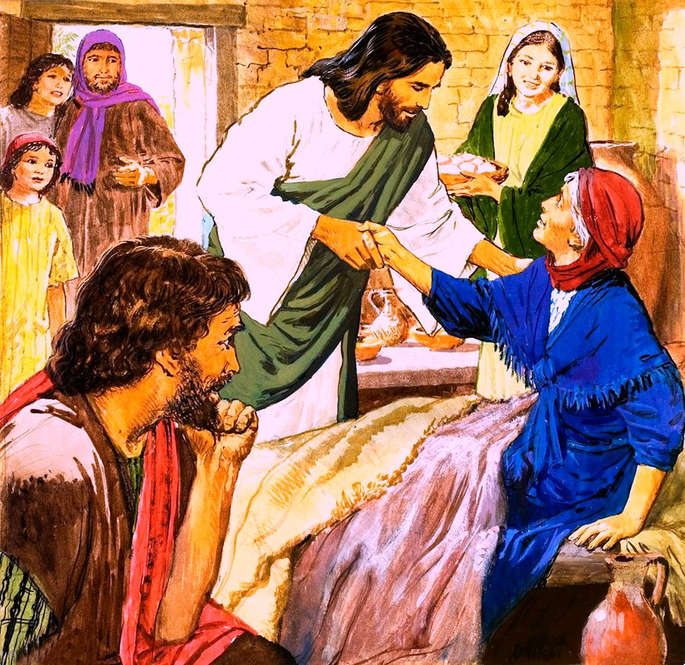
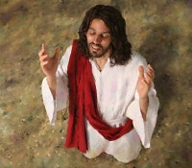
Zuva muupenyu hwaJesu raizova rakaita sei? Ko kana tikange tiinaye kwevhiki rose?
Marko anotibatsira kurarama chiitiko ichi muchikamu chekupedzisira chechitsauko chake chekutanga(Marko 1:16-45).
Tichaperekedza Jesu nokudana boka revaredzi kuti vamutevere nguva yose; kunakidzwa nezuva reSabata rakabatikana; uye, pakupedzisira, tichaona kuti tsika dzavo dzemazuva ose dzaive dzipi.
Mabasa anokosha:
Kudana vadzidzi. Marko 1:16-20.
Zviito zveSabata:
Kuparidza musinagogi. Marko 1:21-28.
Kuporesa. Marko 1:29-34.
Zviito zvezuvanezuva:
Kunamata nekuparidza. Marko 1:35-39.
Kurapa uye kuremekedza Mutemo. Marko 1:40-45.

Slide 4
MABASA ANOKOSHA

Slide 5
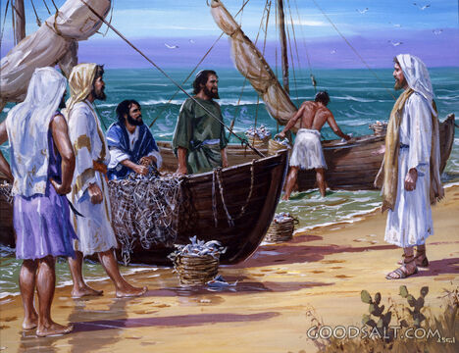
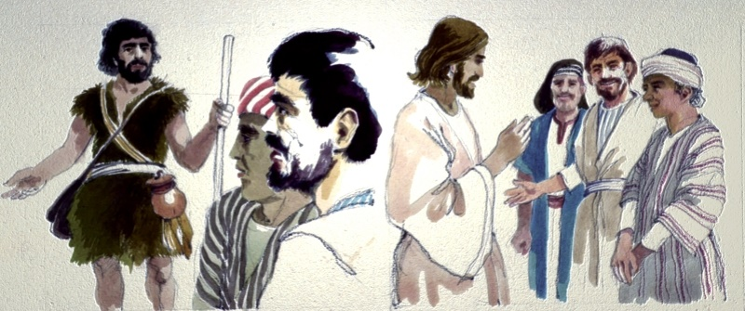
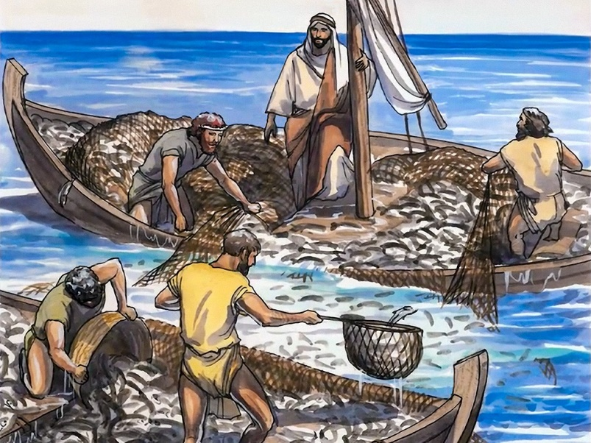
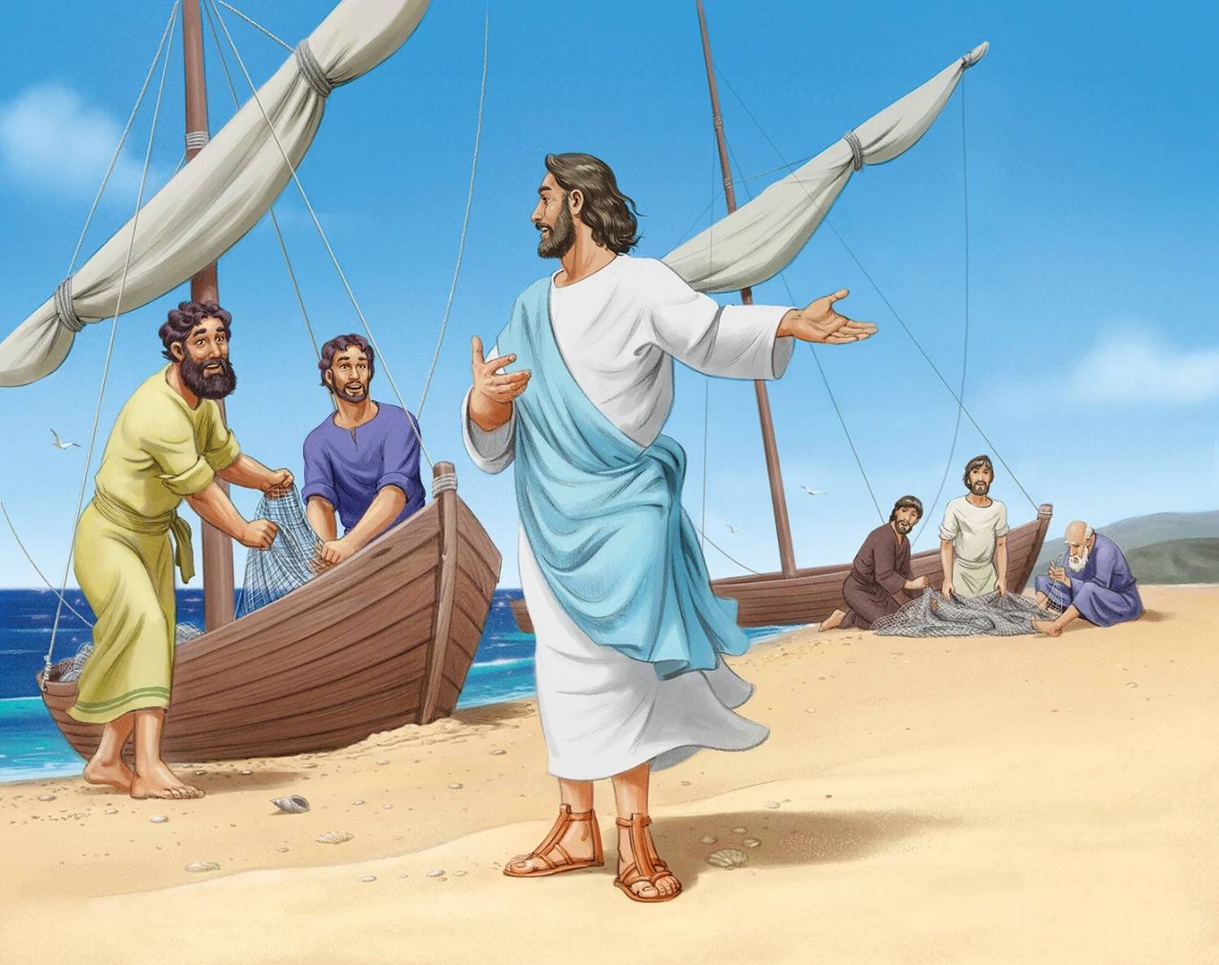
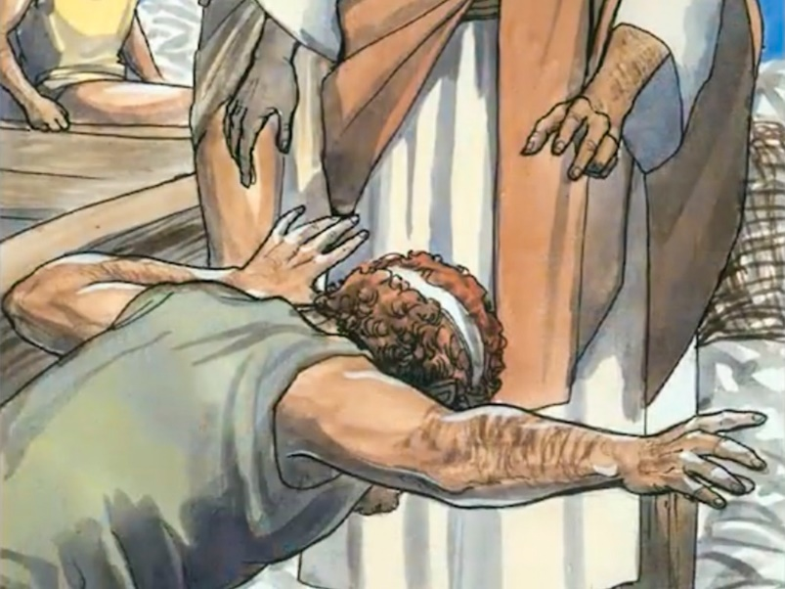
KUDANA VADZIDZI
“Jesu akati kwaʋari “Nditeʋerei, kuti ndikuitei ʋaɓati ʋaʋanhu.” (Marko 1:17)
Mako anozivikanwa nekupfupikisa kwake. Dai tisina kunzvera mamwe evhangeri, tingasvika pamhedziso dzisiridzo pamusoro pokudana uku.
Aka kakanga kasiri kekutanga varume ava kusangana naJesu. Savateveri vaJohani Mubhabhatidzi, vakanga vanzwa mashoko ake pamusoro paJesu, uye vakamutevera. Vakatanga kuita izvozvo vaiva Andreya naJohani, vachiteverwa nevakoma vavo(Jn. 1:35-42).
Jesu anoparidza ari muchikepe chaPetro, uye ipapo kubata kunoshamisa kunoitika. Mambure ehama ina akapotsa abvaruka nehuwandu hwehove (Ruka 5:1-7). Apo Jakobho naJohani vaigadzira mambure, Petro anowira patsoka dzaJesu (Ruka 5:8-11).
Jakobho naJohani vakasiya baba vavo vachitarisira bhizimisi remhuri, uye Petro naAndrea vakasiya raramo yavo kuti vave vawani vemweya. Nekuteerera kudanwa kwaJesu, vakashandura hupenyu hwavo, nehupenyu hwenyika yose.

Slide 6
ZVIITO ZVESABATA

Slide 7
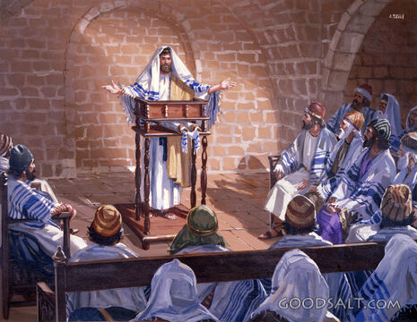
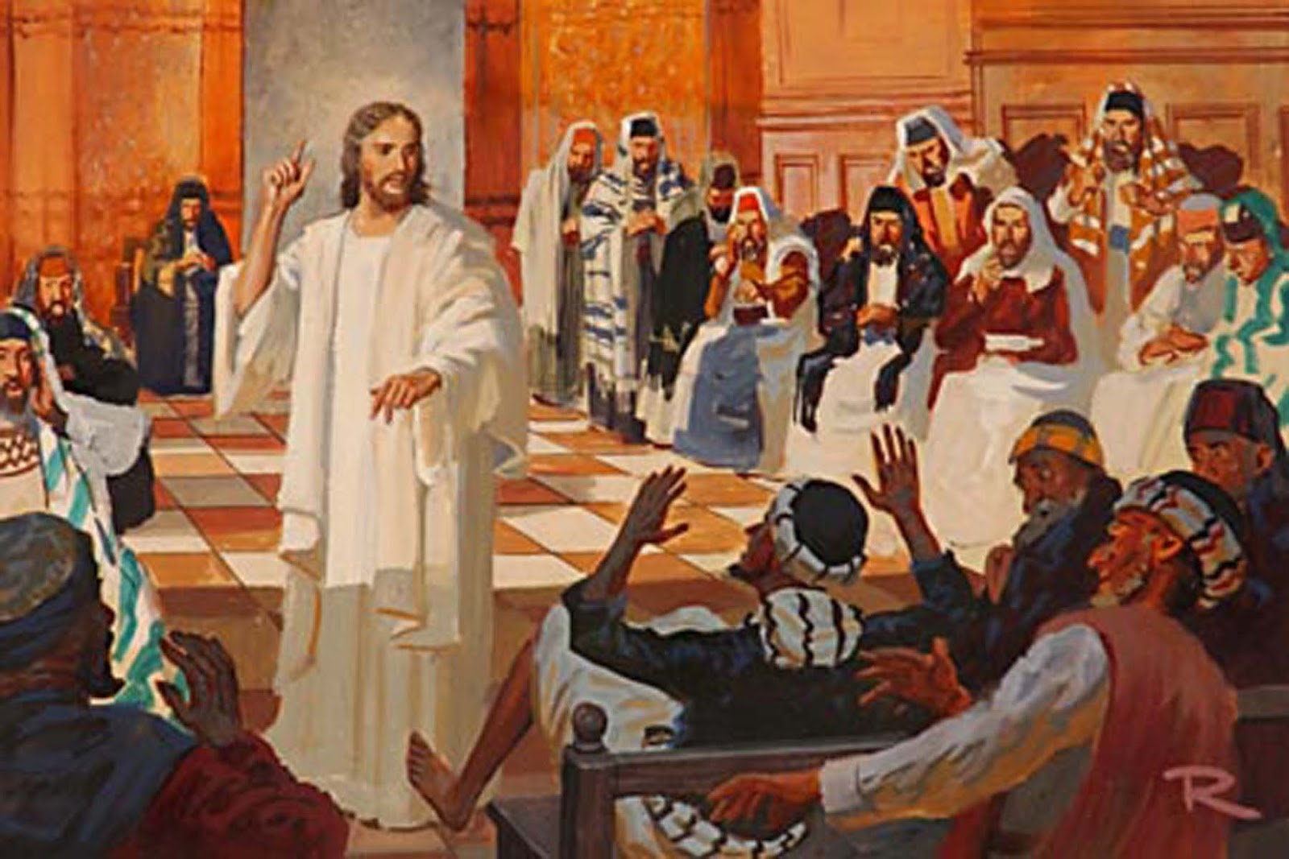
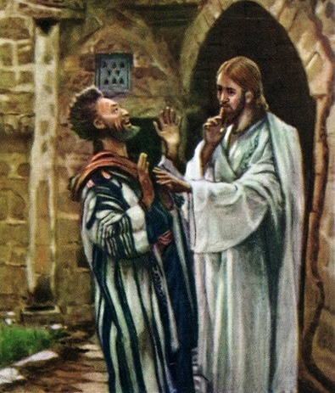
KUPARIDZA MUSINAGOGI
“Ʋakapinda Kapernaume; pakarepo nomusi wesaɓata akapinda musinagoge, akadzidzisa” (Marko 1:21).
Evhangeri dzinojekesa kuti kuenda kusinagogi neSabata yaive tsika yaJesu, kwete chiitiko chemusi uyu chete (Ruka 4:16).
Vanhu vakaita sei nekuparidza kwaJesu? (Marko 1:22).
Asi havasi vose vaifara. Muvengi akafunga kukanganisa shumiro, achitarisira kubvisa simba raJesu ( Marko 1:23-26 ). Kupindira kwechimbichimbi kwakakonzera kuti vanhu vatonyanya kurunzirwa Naye (Marko 1:27-28).
Zvinhu zvitatu zvinobuda munyaya iyi:
Musangano maiva nedhimoni. Kune “mashawi” musangano, uye hatigoni kuasiyanisa(Mt. 13:24-30).
Dhimoni raiziva kuti Jesu aive ani, uye rakatsvaga nzira yekupedza kurunzira kwake.
Jesu akamurayira kuti anyarare. Yakanga isati yava nguva yokuzvizivisa amene pachena saMesiya.

Slide 8
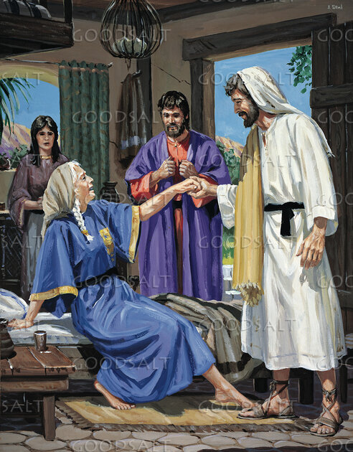
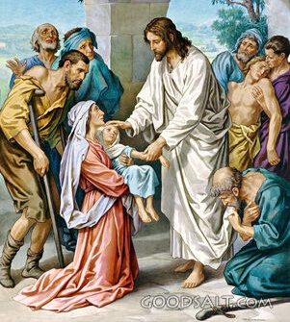
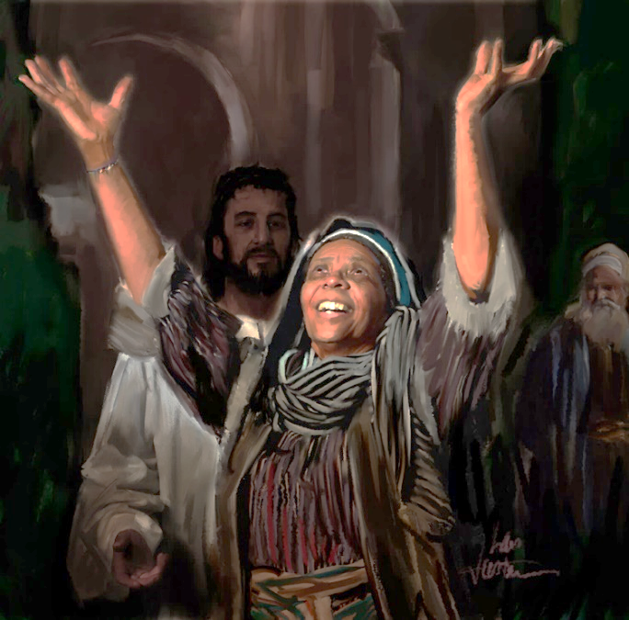
KUPORESA
“Maɗekwana, zuʋa raʋira, ʋakaisa kwaari ʋose ʋakaŋga ʋacirwadziwa, naʋakaŋga ʋakaɓatwa nemŋeya yakaipa” (Marko 1:32)
Pakupera kwebasa musinagogi, Jesu akaenda nevadzidzi vake vana kumba kwaPetro kuti vanodya vari voga(Marko 1:29).
Pavakanga vachigadzira tafura, vakaudza Jesu pamusoro pambuyawasha vaPetro, vakanga vabatwa nefivha ( Marko 1:30 ). Paakangoporeswa, mukadzi uyu akazvipira kushandira vaenzi ( Marko 1:31 ). Kubatsirwa kwatinoitwa naJesu kunoita kuti tide kuzviudzawo vamwe.
Chishamiso chedhimoni chakanga chiri musoro wehurukurirano mumisha mizhinji muKapernaume. Naizvozvo, pakupera kwemaawa matsvene eSabata, zuva parakanga ranyura, vakaunza vanhu vazhinji vairwara kuna Jesu kuti vaporeswe (Marko 1:32-34).
Mufaro wakadini! Kuchema kwakadini kwerumbidzo kwakanzwika mumba maSimoni! Uye kwete bedzi kurumbidza vakaporeswa, Jesu amene akafara mukuvaunzira kuporeswa.
Pashure pezuva rinonetesa, kusvikira pakati pousiku, Jesu pakupedzisira akakwanisa kuzorora.

Slide 9
ZVIITO ZVEZUVANEZUVA

Slide 10
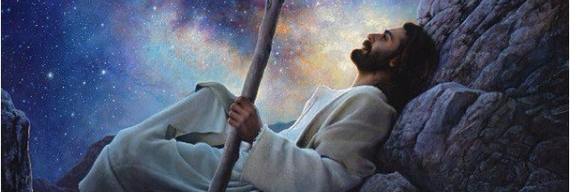
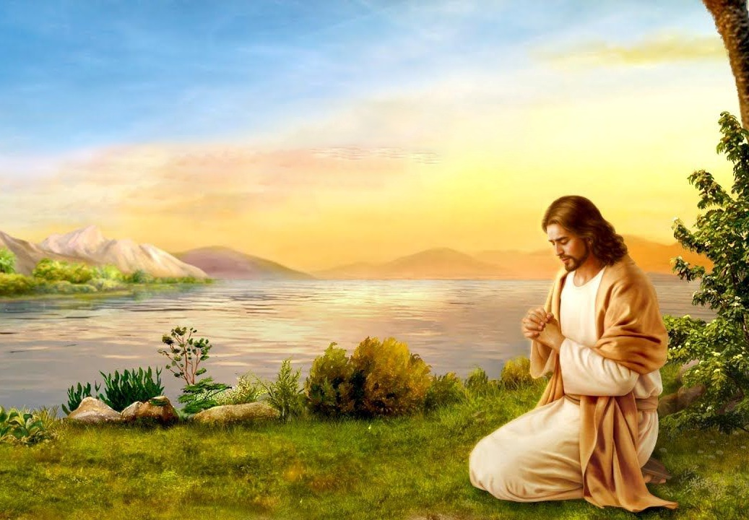
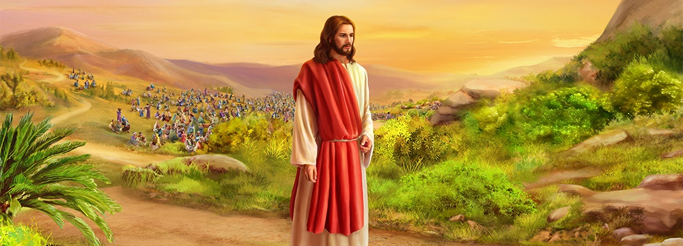
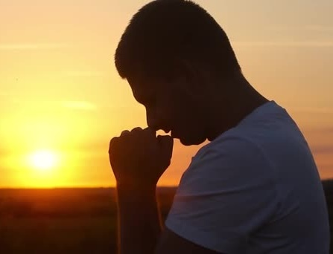
KUNAMATA NEKUPARIDZA
“Maŋgwanani kucinerima, wakamuka akaɓuɗa, akaenda kunɀimbo murenje, akandonyeŋgetera’po” (Marko 1:35)
Musi weSvondo, vadzidzi vakamirira Jesu kuti aparidze muguta. Asi zvirongwa zvaJesu zvakanga zvakasiyana. Aizobatsira vamwe vakawanda nemashoko ake nezviito(Marko 1:36-39).
Asi Jesu akanga asiri kuita zvaanoda iye pachake. Semazuva ese ndiye ainge atanga ataura naBaba vake kuti vamuudze zvaaifanira kuita musi uyu(Mk. 1:35; Jn. 8:28 ).
Zuva nezuva Jesu aitsvaka Mwari mumunyengetero, uye anotikoka kuti timutevedzere ( Marko 6:46; Ruka 3:21; 5:16; 9:18; 11:1; 18:1 ). Mumamiriro ezvinhu anokosha, akatotsaurira usiku hwose kumunyengetero(Rk . 6:12-13; Mt. 14:21-23).
Hatifaniri here, kufanana naJesu, kutsvaka Mwari zuva nezuva mumunyengetero kuti tizive kuda kwake? Mumamiriro ezvinhu akakosha, hatingamutsvage here kunyanya mumunamato?

Slide 11
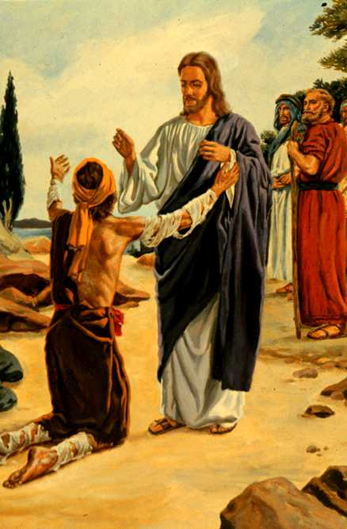
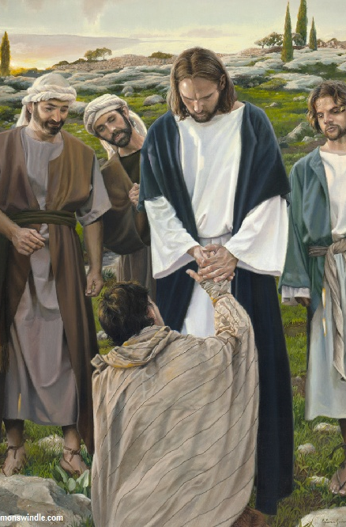
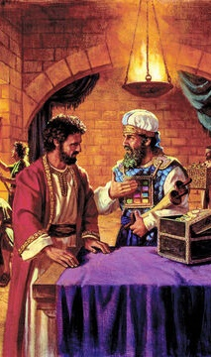
KURAPA UYE KUREMEKEDZA MUTEMO
“Cenjera kuti urege kuʋudza munhu cinhu; asi enda uɀiratidze kumuprista, uɓayire pamsoro pokunatswa kwako ɀakarairwa naMosesi, ciʋe capupu kwaʋari.” (Marko 1:44)
Murume ane maperembudzi, akanga aparadzaniswa nomunhu wose nokuda kwourwere hwake, akapfugama pamberi paJesu achikumbira kuporeswa(Rev. 13:45; Marko 1:40).
Pamberi peboka, Jesu anoita chimwe chinhu chinopesana nomutemo: anobata ane maperembudzi uye naizvozvo anova asina kuchena. Asi, panzvimbo pokugamuchira kusachena kwomunhu ane maperembudzi, ane maperembudzi akagamuchira kuporesa kwaJesu.
Sezvatinouya kuna Jesu nezvivi zvedu netsvina, haabvi kwatiri. Achatipa kukanganwirwa uye kuporeswa, achitiita kuti tive vakachena saIye.
Mushure mokumuporesa, akapa mirairo miviri nechinangwa chakapetwa kaviri (Mk. 1:44)
Zviratidze kuvaprista
Akaratidza kuremekedza kwake mutemo
Zvakapa vapristi mukana wokumugamuchira saMesiya.
Kunyarararidza
Akaita kuti vapristi vasafungira munhu aiva nemaperembudzi
Akadzivisa kumutsa kariro youmesiya mumhomho

Slide 12
“Hupenyu hweMuponesi panyika hwakange husiri nyore. Asi haana kumboneta nekushanda kuti aponese vanhu vakarasika. Akararama hupenyu husina chindini kubva pakuzvarwa kwake kusvika pakufa kwake. Haana kuedza kusununguka pabasa rakaoma uye nzendo dzinonetesa. Akati Mŋanakomana womunhu “haana‐kuʋuya kuzoshumirwa, asi kushumira, nokupa ʋupenyu bgake ruʋe rudzikinuro rwaʋazhinji.” Mateo 20:28. Ichi ndicho chaiva chinangwa chikuru chehupenyu Hwake. Zvimwe zvose zvakanga zvisinganyanyi kukosha. Kuita kuda kwaMwari uye kupedza basa Rake kwakanga kwakaita sezvokudya nezvokunwa kwaari. Pakanga pasina kuzvifunga pabasa Rake."-Non Official Translation by Gift Mawoyo
EGW (Steps to Christ, pg. 77)

