Slide 1
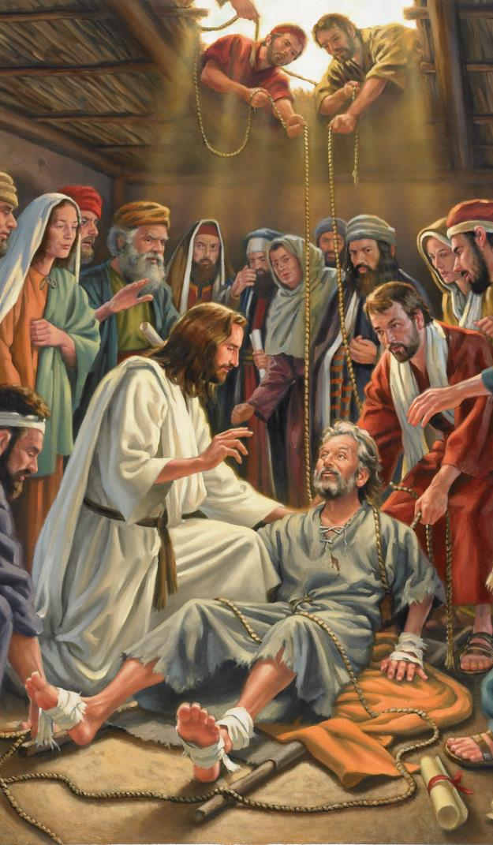
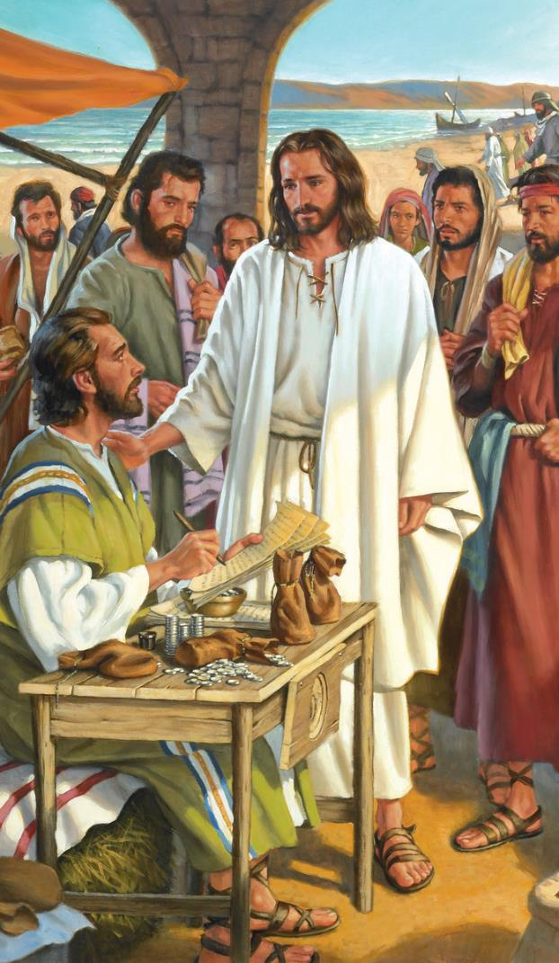
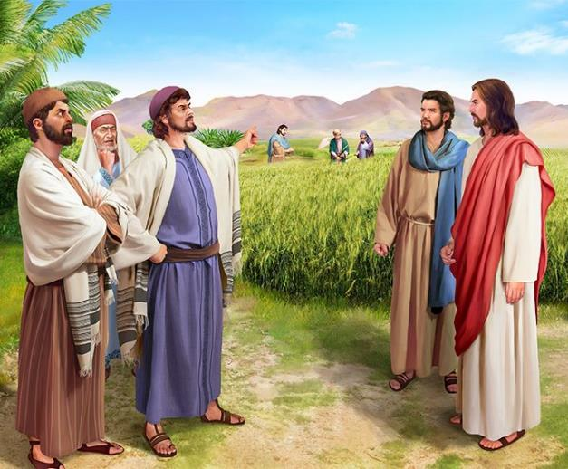
MAKAKATANWA
Chidzidzo 3 cha Chikunguru 20, 2024

Slide 2
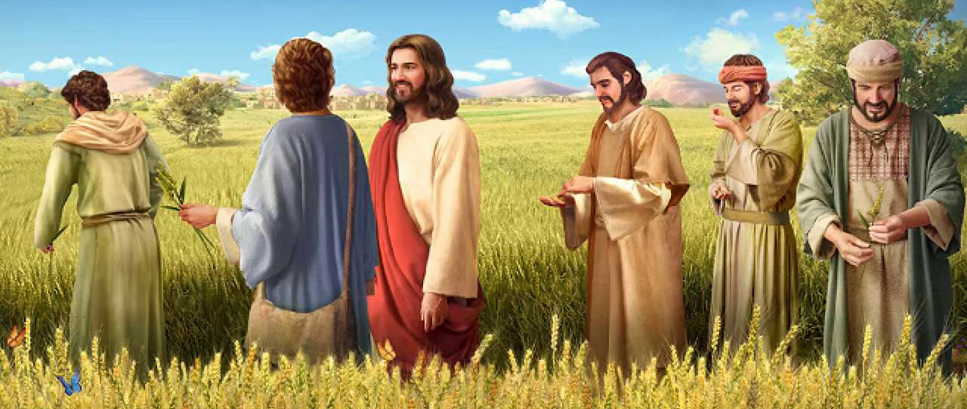
“Akati kwaʋari, ‘Saɓata yakaitirwa munhu, munhu haana‐kuitirwa saɓata’ ” (Marko 2:27, 28)

Slide 3
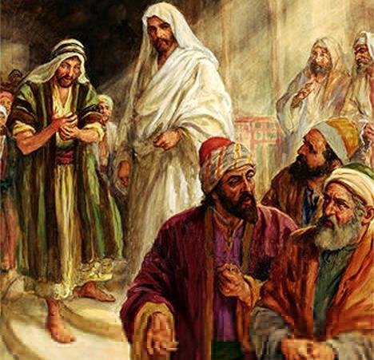
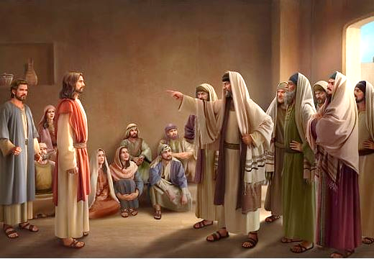
Mufambiro waJesu, nzira yake yokuparidzira, uye kunyange kuporesa kwake, zvakapinda murwisano yakananga namagamuchidzanwa ezviremera zvechitendero.
Vakamutora seanomhura Mwari; madyo neshamwari yevatadzi; Mudariki weSabata... Vakatomupomera mhosva yekushandira Beerzeburi!
Hama dzake chaidzo dzakasvika pakudavira kuti Jesu akanga arasika njere nemhaka yokushanda zvakanyanyisa.
Pasina panikiro, upenyu hwaJesu hwaiva upenyu hwokukakavadzana.
Makakatanwa pamusoro pekuregerera. Marko 2:1-12.
Makakatanwa pamusoro pezvekudya. Marko 2:13-22.
Makakatanwa pamusoro peSabata. Marko 2:23-3:6.
Mibvunzo ine makakatanwa pamusoro paJesu:
Anoita minana nesimba ripi? Marko 3:22-30.
Jesu anopenga here? Marko 3:20-21, 31-35.

Slide 4
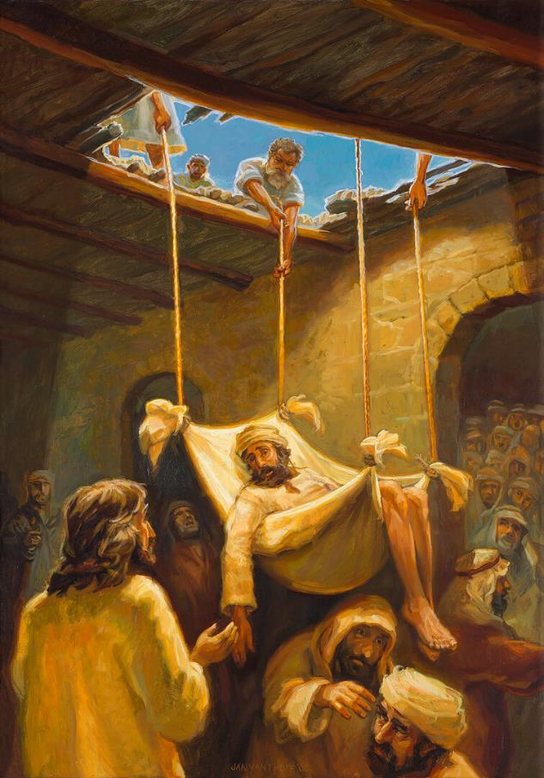
MAKAKATANWA PAMUSORO PEKUREGERERA
“Jesu wakati aciʋona kutenda kwaʋo, akati kunowakaŋga akafa mitezo, “Mŋana, wakaŋganwirwa ɀiʋi ɀako.” (Marko 2:5)
Jesu paakadzokera kumba kwaPetro muKapenaume, vanhu vakawanda vakauya kuzomuteerera ( Mako 2:1-2 ). Shamwari ina dzakauya kuti Jesu arape shamwari yadzo yakanga yakaoma mitezo, asi hadzina kukwanisa kuswedera pedyo naye. Vachida kumuuyisa kuna Jesu, vakakwira padenga remba vakazarura suo kuti vamuburutse. Kutaura kwaJesu kwakamiswa, uye munhu wese akaramba akanyarara, akamirira kuona zvaizoitwa naJesu (Marko 2:3-4).
“Wakaŋganwirwa ɀiʋi ɀako” (Marko 2:5). Akaoma mitezo angadai akati: “Chandinoda kufamba.” Asi haana kuzviita. Jesu akarapa mudzi wechirwere chake. Aive asina hanya nekusafamba zvakare, asi nezveruregerero rwakapa rugare kumweya wake.
Kuvanyori, uku kwaiva kumhura (kwechokwadi, kana Jesu akanga asiri Mwari). Kuti aratidze kuti ane simba rokukanganwira, Jesu akaporesa akanga akafa mitezo(Marko 2:8-11).
Vanhu vakarumbidza Mwari nokupa Jesu simba rokukanganwira zvivi ( Marko 2:12; Mt. 9:8 ). Munhu akafa mitezo akafamba; asi vanyori vakasiyiwa vari mapofu, vasingakwanisi kuona kuti Jesu aigona kuona ndangariro dzavo, kukanganwira mutadzi, uye kumupa kuporeswa.

Slide 5
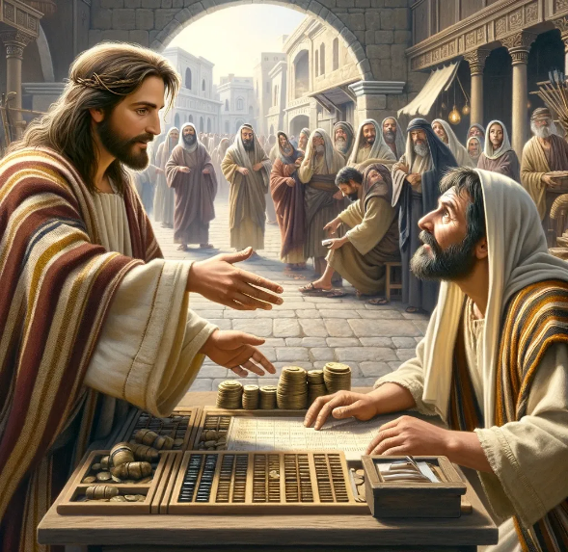
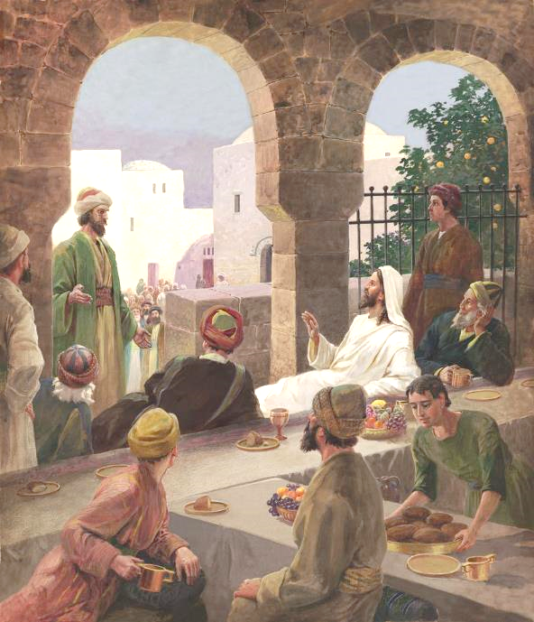
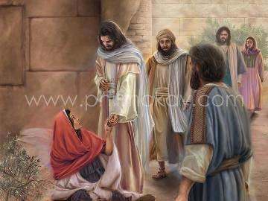
MAKAKATANWA PAMUSORO PEZVEKUDYA
“Wakati acipfuʋura, akaʋona Revi, mŋanakomana waArfeo, agere panotereswa, akati kwaari. “Nditeʋere,” Akasimuka, akamuteʋera” (Marko 2:14).
Hazvina kuoma kufungidzira makakatanwa awo kudanwa kwaRevhi kwakamutsa ( Marko 2:13-14 ). KumuJudha weOrthodox, muteresi akanga akaipa kupfuura muHedheni. Akanga ari muJudha akapanduka, akatengeswa kuvavengi vake. Vaisagona kudya naye kana kumubata.
Asi zvinhu zvakatonyanya kuipa. Jesu haana kungodyira mumba momuteresi chete, akazvikomberedza navazhinji vakaita saiye ( Marko 2:15 ). Vatsoropodzi havana kutambisa mukana wacho: “Mudzidzisi unodyireiko naʋateresi naʋatadzi?” (Mark 2:16).
Jesu akavapikisa zvine musoro: ndepapi pari nani pane pano pandichawana vatadzi kuti ndiponese? ( Mako 2:17 ). Uyezve, akavakurudzira kuti vaongorore manzwiro avo. Vaifanira kudzidza kuda(Mt. 9:12-13).

Slide 6
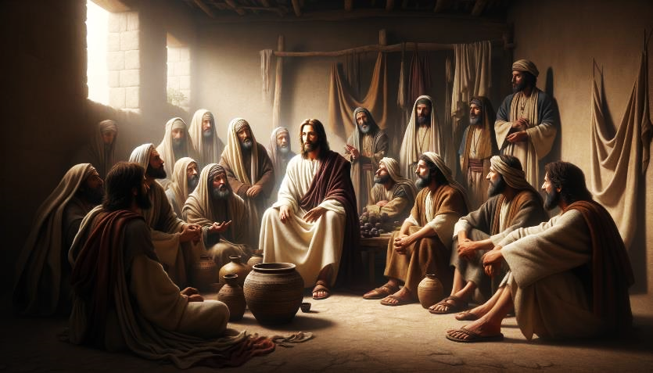
MAKAKATANWA PAMUSORO PEZVEKUDYA(2)
“Jesu akati kwaʋari: shamŋari dzecikomba dziŋgaɀinyima ɀokudya seiko ciciri kwaʋari? Haʋaŋgaɀinyimi ɀokudya cikomba ciciri kwaʋari” (Marko 2:19)
Pane kuti vadzidze kuva norudo, vaFarisi vakakurudzira vadzidzi vaJohani kuti vabatane navo pakutsoropodza kwavo: “Ʋadzidzi ʋaJohane naʋadzidzi ʋaʋaFarise ʋanoɀinyimireiko ɀokudya, asi ʋadzidzi ʋenyu haʋaɀinyimi neiko?” (Marko 2:18).
Mufananidzo wemuchato(Marko 2:19-20).
Munhu angatsanya sei ari pamuchato? Chikomba ndiJesu; vadzidzi vakakokwa. Jesu paakafa ndokumutswa, vadzidzi vake vaizofanira kutsanya.
Mufananidzo wezvitsva nezvitsaru(Marko 2:21-22).
Dzidziso mhenyu dzaJesu dzakanga dzisina nzvimbo mudzidziso dzakafa dzegamuchidzanwa; uye dzidziso dzakafa dzegamuchidzanwa dzakanga dzisina nzvimbo mudzidziso mhenyu dzaJesu.
.
Mhinduro yaJesu yakauya nenzira yemifananidzo:

Slide 7
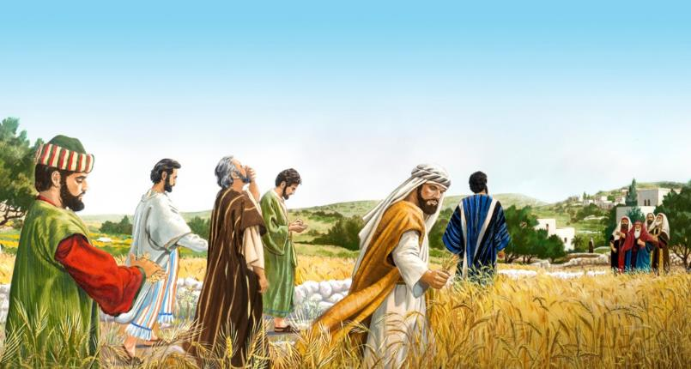
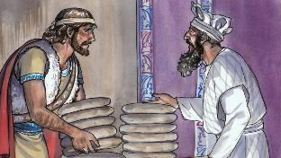
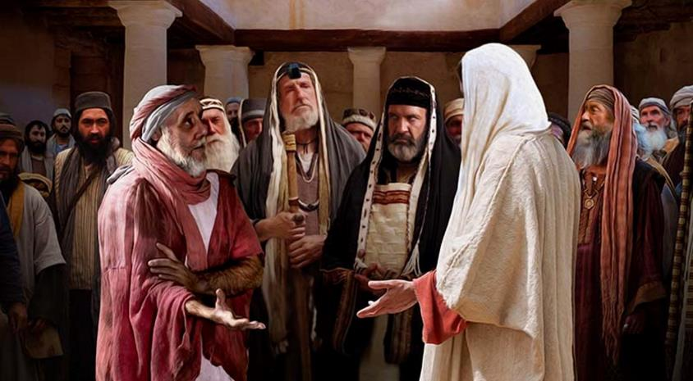
MAKAKATANWA PAMUSORO PESABATA
“ƲaFarise ʋakati kwaari, “Tarirai, ʋanoitireiko ɀisina‐kutenderwa nomusi wesaɓata?” (Marko 2:24)
VaFarisi vakadzidzisa marudzi 39 ebasa aityora zororo reSabata rakazodzwa naMwari.
Kuburikidza nokutora zviyo nokubvisa tsako kuti vadye, vadzidzi vakaita mabasa matatu akarambidzwa paSabata: kucheka; mupuro; uye kuurutsa. (Mk. 2:23-24; Mt. 12:1-2).
Mhinduro yaJesu: Hamurangariri here kuti Dhavhidhi, paakanga ava nenzara, akadya chingwa chakatsaurwa, chaidyiwa nevapristi chete? (Marko 2:25-26).
Gare gare, Jesu akaita “basa” rakanga risingabatanidzwi pakati peaye 39, asi iro rairangarirwawo sokudarika kweSabata: kuporesa(Marko 3:1-3).
Mhinduro yaJesu: “Ɀakatenderwa here nesaɓata kuita ɀakanaka kana ɀakaipa, kuponesa munhu kana kuʋuraya?” (Marko 3:4).
Pakupedzisira, Jesu ndiye Ishe weSabata, uye akatipa kuti zvitinakire(Marko 2:27-28).
Sezvineiwo, vachengeti veSabata vaipfuuridza mwero vakaronga kuuraya(Marko 3:6).

Slide 8
MIBVUNZO INE MAKAKATANWA PAMUSORO PAJESU

Slide 9
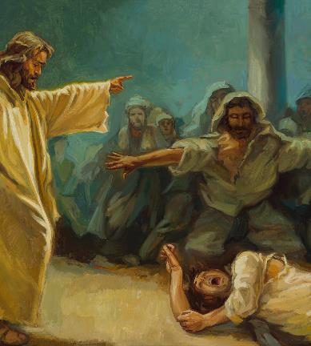
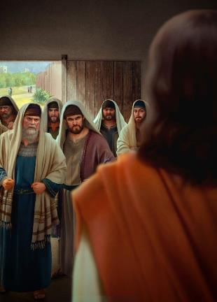
ANOITA MINANA NESIMBA RIPI?
“Naʋanyori ʋakaŋga ʋaɓuruka ʋacibva Jerusarema, ʋakati, “UnaBeerzeburi, unoɓuɗisa mŋeya yakaipa nomucinda wemŋeya yakaipa” (Marko 3:22)
Marko anotanga nyaya yemhuri yaJesu, asi anoidimburira kuti atsanangure makakatanwa avakaita nevaFarisi. Gare gare, achadzokera kungano yokutanga. Iyi pateni inoshandiswa naMarko kakati wandei kubatanidza nyaya mbiri dzakafanana, kuratidza yepakati seyakanyanya kukosha.
Mhuri yaJesu iri kumutsvaka
Marko 3:20-21
Kupomera kweVaFarisi
Marko 3:22-30
Panyaya iyi, nyaya inokosha kupomera kwevanyori kuti isimba ripi rakabvumira Jesu kudzinga madhimoni(Marko 3:22).
Mhuri yaJesu iri kumutsvaka
Marko 3:31-35
Zvakare, Jesu anoshandisa mufananidzo kuratidza upenzi hwezvaari kupomerwa ( Marko 3:23-27 ). Jesu anopinda mumba momurume ane simba (Satani), anomusunga, uye nokudaro anogona kupamba pfuma yake (kusunungura dhimoni).
It also takes the opportunity to warn of the danger of attributing the work of the Holy Spirit to the devil (Marko 3:28-30).

Slide 10
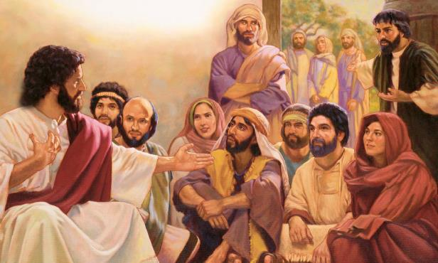
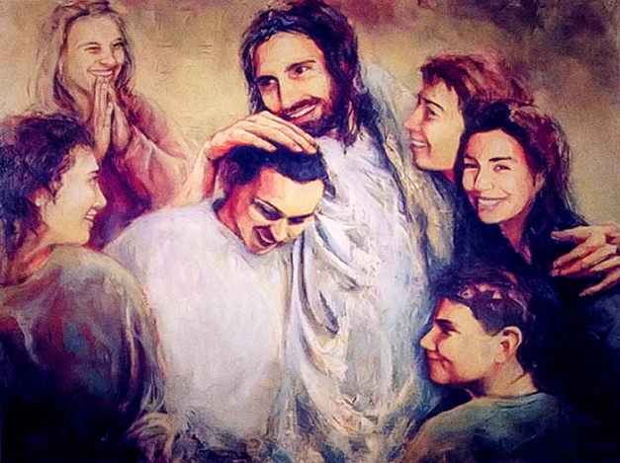
JESU ANOPENGA HERE?
“Ʋanhu ʋokwake ʋakati ʋaciɀinzwa, ʋakaɓuɗa kuzomuɓata, nokuti ʋakati, “Unopeŋga” (Marko 3:21 )
Chii chakaita kuti mhuri yaJesu ifunge kuti akanga ava kupenga(Marko 3:20-21)?
Kunyanya kushanda, kusadya zvakanaka, kunetseka nekuda kwehurukuro dzake dzisingaperi nevanyori nevaFarisi...
Pashure pekakumbofema kapfupi, Marko anoenderera mberi nenyaya yacho, achisuma hama dzaitsvaka Jesu: amai vake nevanun’una vake(Marko 3:31).
Kushaya hanya kwakadini kumhuri yake Jesu! (Marko 3:32-33).
Asi zvitarisiko zvinonyengera. Mai vake nevanin'ina vake vakanga vakanganisa. Kusiya basa rake kuti vavatarise panguva iyoyo kwaikanganisa basa rake uye ivo pachavo.
Chinokosha zvikuru kupfuura hukama hwenyama zvisungo zvinobatanidza Jesu nemhuri yake yomweya: “Nokuti aninani unoita kuɗa kwaMŋari, ndiye munuŋuna waŋgu, nehanɀadzi, namai” (Marko 3:35).

Slide 11
“Mweya wekutambudza hauzomutswi kurwisa avo vasina kubatana naMwari,nokudaro vasina simba rekuita zvakanaka. Uchamutswa kuti urwise vakatendeka, vasingabvumirani nenyika uye havazotsauswi nemirangariro wayo, nyasha dzawo, kana kuti kushora kwawo. Chitendero chinopa uchapupu upenyu nokuda kweutsvene, uye chinotsiura kuzvikudza, udyire, pfuma, uye zvivi zvine mukurumbira iko zvino, chichavengwa nenyika uye nevaKristu vanoonekera kunze chete.... Paunoshorwa nekutambudzwa unenge uri muboka rakanaka kwazvo. ; nekuti Jesu wakatsungirira pazvose, uye zvizhinji kwazvo. Kana muri vatariri vakatendeka kuna Mwari, zvinhu izvi irumbidzo kwamuri. Magamba chete, ndiwo achava echokwadi kana akamira ari ega, achakunda opihwa korona isingaori."-Non Official Translation by Gift Mawoyo
EGW (The Medical Ministry, pg. 282)

