Slide 1
MIFANANIDZO
Chidzidzo 4 cha Chikunguru 27, 2024

Slide 2
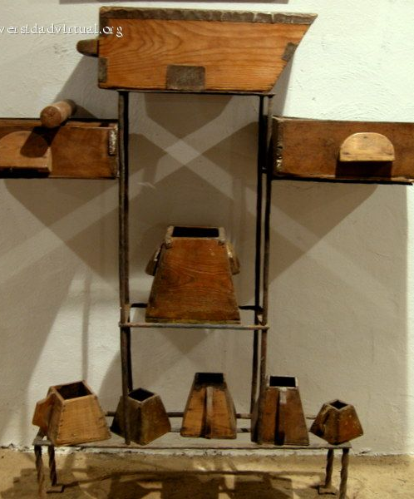
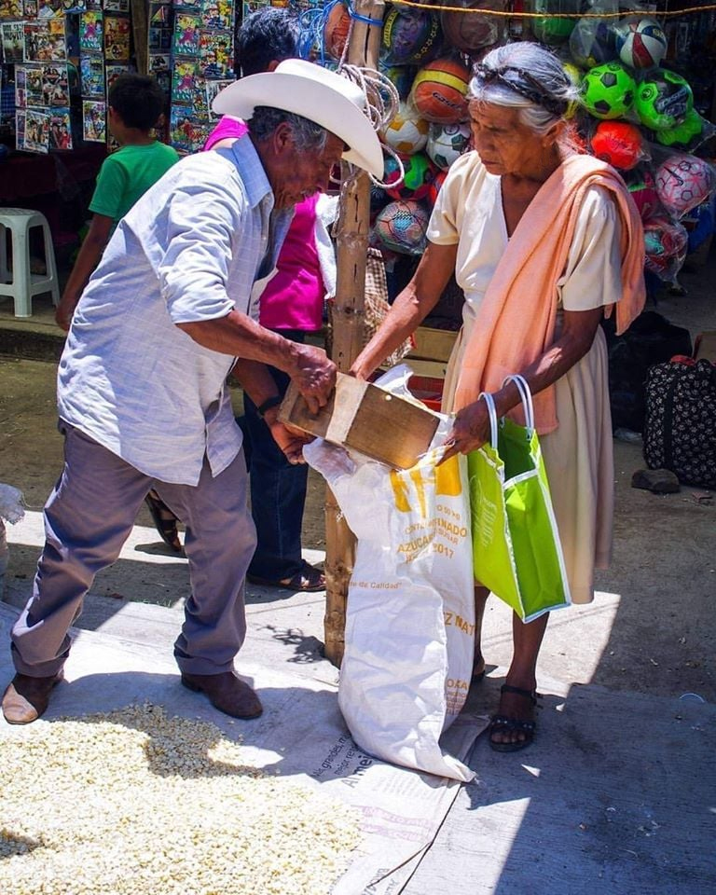
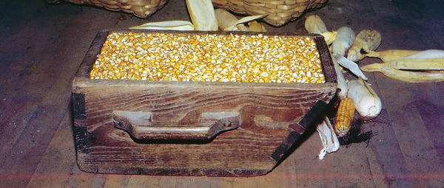
“Ɀino akati kwaʋari: Cenjerai ɀamunonzwa. Ciyero camunoyera naco, nemi mucayerwa naco; mukawedzerwa.Nokuti unaco ucapiwa, asi usina, ucatorerwa necaanaco’ ”
(Marko 4:24, 25)

Slide 3
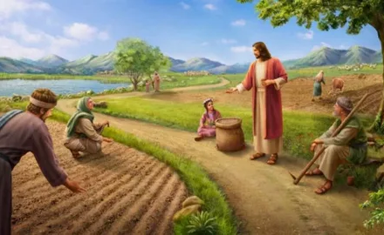
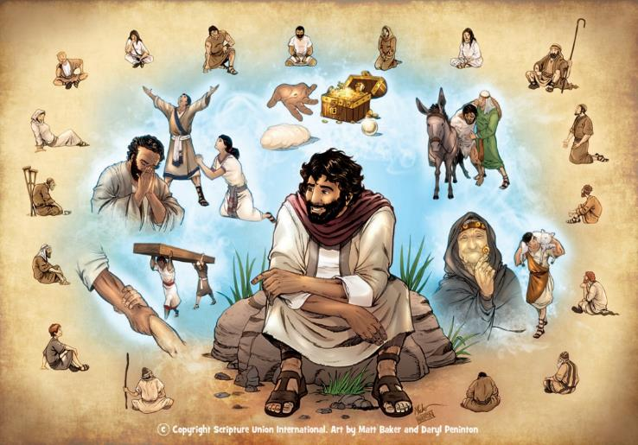
Mufananidzo kurondedzerwa kwechiitiko chisina kuitika (chakavakirwa kana kuti chisina kuvakirwa pazviitiko chaizvo) umo chokwadi chakakosha kana dzidziso yetsika inoburitswa nekuenzanisa kana kufananidza.
Iyi ndiyo nzira iyo Jesu ainyanya kushandisa mudzidziso dzake ( Mako 4:34 ). Mifananidzo yake yaiwanzotorwa muupenyu hwezuva nezuva uye, naizvozvo, iri nyore kurangarira nokushandisa.
Apo vateereri vake vaidzokera kumusha, vaigoverana zvavakadzidza kumhuri neshamwari dzavo.
Chikonzero chekuvapo kwemifananidzo. Marko 4:10-12.
Mufananidzo womukushi:
Mukushi wakabuda kundokusha… Marko 4:1-9.
Tsanangudzo yemufananidzo. Marko 4:13-20.
Mimwe mifananidzo:
Mŋenje nechiyero. Marko 4:21-25.
Kukura nemastarda. Marko 4:26-32.

Slide 4
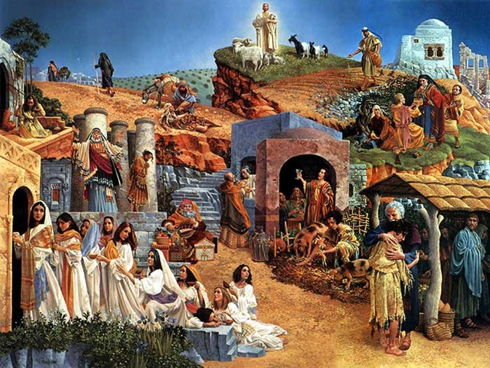
CHIKONZERO CHEKUVAPO KWEMIFANANIDZO
“Kuti kuʋona ʋaʋone, asi ʋarege kuʋonesesa, nokunzwa ʋanzwe, asi ʋarege kunzwisisa, kuti ɀimŋe ʋarege kutendeʋuka, ʋakaŋganwirwe!” (Marko 4:12)
Kuparidza kwaJesu kwaitenderera paUmambo hwokudenga ( Marko 1:14-15 ). Mizhinji yemifananidzo yake yaitaurwa kuti itsanangure zvakaita Umambo hwakadaro(Marko 4:30).
Sezvineiwo, chikonzero chakataurwa naJesu pachake chekushandisa mifananidzo chinoshamisa zvechokwadi: kuti varege kunzwisisa, kana kutendeuka, kana kukanganwirwa! (Marko 4:12).
Izvi zvakanga zvisiri zvitsva. Paaimurayira kuparidza, Mwari akaudza Isaya: “Rambai henyu mucinzwa, asi musanzwisisa, rambai henyu muciʋona, asi musaʋonesesa. […] kuti ʋarege kuʋona nameso aʋo, kana kunzwa nenzeʋe dzaʋo, kana kunzwisisa nemŋoyo yaʋo, ʋadzoke ʋapodzwe” ( Is. 6:9-10).
Ane nzara yeShoko raMwari achanzwa chokwadi uye ofara. Asi avo vasingadi kunzwa, zvisinei kuti chokwadi ichi chinotaurwa chakareruka sei, vacharamba kunzwisisa, kushanduka, uye kuwana ruponeso.

Slide 5
MUFANANIDZO WOMUKUSHI

Slide 6
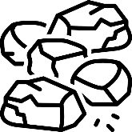
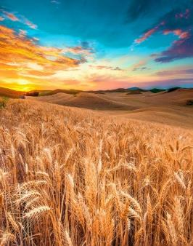
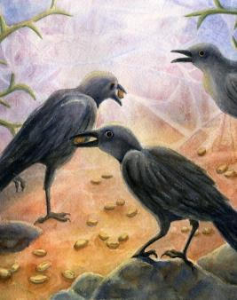
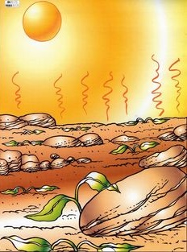
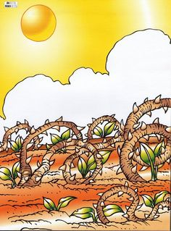
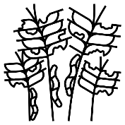
MUKUSHI WAKABUDA KUNDOKUSHA...
“Akaʋadzidzisa ɀizhinji nemifananidzo, akati kwaʋari pakudzidzisa kwake: “Mukushi wakaɓuɗa kundokusha” (Marko 4:2-3)
Panzira
Mumazuva mashoma, mbeu inofa (Marko 4:4)
parukaŋgarabge
Mumavhiki mashomanana, mbeu inofa(Marko 4:5-6)
muminzwa
Mumwedzi mishomanana, mbeu inofa(Marko 4:7)
muvu rakanaka
Pakupera kwemwaka, mbeu inobereka zvibereko(Marko 4:8)
Mudzvari nembeu hazvisiyani. Nekudaro, mhedzisiro yacho yakasiyana zvachose kune imwe neimwe yenzvimbo ina. Zvose zvinoenderana nenzira iyo mbeu inogamuchirwa nayo.

Slide 7
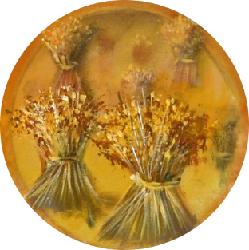
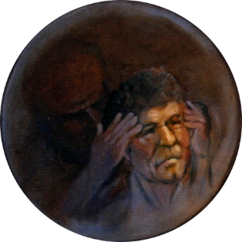
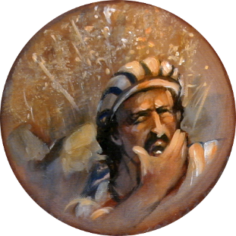
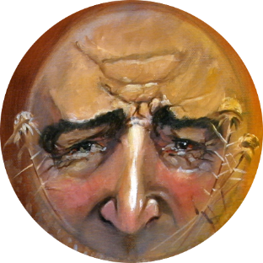
TSANANGUDZO YEMUFANANIDZO
“Mukushi unokusha shoko” (Marko 4:14)
Mbeu iShoko raMwari, uye mukushi munhu wose anoriparadzira.
Panzira
Havana chavanoda, uye Satani anovatsausa(Marko 4:15)
parukaŋgarabge
Vanogamuchira shoko, asi havatsungiridzwi nemiedzo(Marko 4:16-17)
muminzwa
Vanogamuchira shoko, asi vanobva vadekara(Marko 4:18-19)
muvu rakanaka
Vanodzivisa miedzo.Vanobereka zvibereko(Marko 4:20)
Ndiri ivhu rudzii? Chii chandinofanira kuita kuti ndibereke?

Slide 8
MIMWE MIFANANIDZO

Slide 9
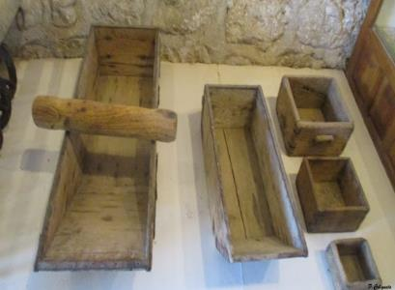
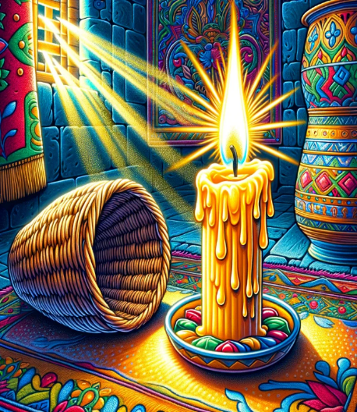
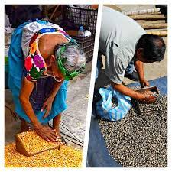
MŊENJE NE CHIYERO
“Ɀino wakati kwaʋari, “Mŋenje uri’po kuti uiswe pasi peɗeŋgu, kana pasi pomubeda here? Hauzi’po kuti uiswe pacigadziko here? (Marko 4:21)
“Ɀino akati kwaʋari. “Cenjerai ɀamunonzwa. Ciyero camunoyera naco, nemi mucayerwa naco; mukawedzerwa” (Marko 4:24).
Fungidzira nhaurirano: "Unounza ...?" "Aihwa!"; “hausi kuzviisa…?” “Zvakanaka!"
Mumigwagwa yemuguta, vatengesi vaitengesa zvinhu zvavo vachishandisa zviyero zvizhinji kana zvishoma kuti vaone huwandu hwechigadzirwa chaidiwa nemutengi.
Jesu aiziva nzira yokuita kuti vateereri vake vateerere. Zvino vakanga vagadzirira kugamuchira chidzidzo chemweya.
Zvishoma nezvishoma, Jesu akazivisa chokwadi chevhangeri kuti rigozivikanwa kune vose (Marko 4:22).
Kana mutengesi aive akanaka, aiwedzera chimwe chigadzirwa pachiyero kuti agutse mutengi wake.
Usiku ihwohwo, pavakanga vachitungidza mwenje yavo kumba, “Kana munhu anenzeʋe dzokunzwa” (Marko 4:23) pasina mubvunzo akarangarira chidzidzo chacho.
Kana mumwe munhu achigamuchira chokwadi, achawana zvakatowanda. Asi kana ukachiramba, nyangwe chokwadi chaunacho chinorasika (Marko 4:25).

Slide 10
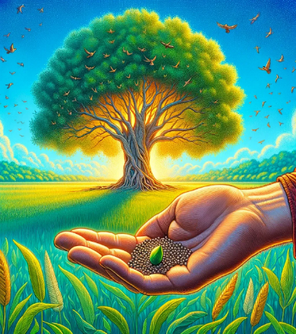
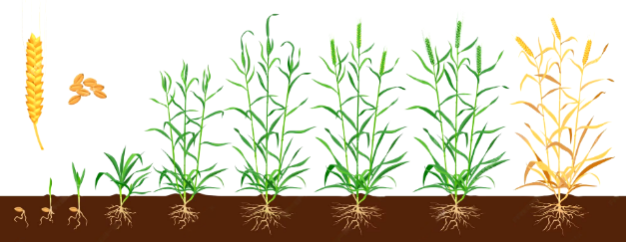
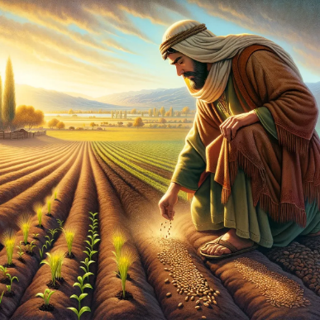
KUKURA NEMASTARDA
“Ɀino akati, “Ʋushe bgaMŋari bgakafanana nomunhu unodɀara mbeu muvu” (Marko 4:26)
“Bgakafanana netsaŋga yemastarda, iyo kana icidɀarwa muvu iɗuku kumbeu dzose dzapanyika” (Marko 4:31)
Jesu anoyeuka makuriro ezviyo(Marko 4:28):
Humambo hweKudenga hwakafanana netsanga duku yemastarda(Marko 4:30-31).
Chipande
Hura
Zviyo
Mushure memazuva 50 ekudyara, mastarda inosvika 30-40 cm kureba, uye yatove inokwanisa kubereka michero inokohwewa. Inogona kukura kusvika mamita 7 kureba.
Inzira inotsamira pana Mwari, kwete munhu (Marko 4:27).
Iyi ndiyo mbeu yevhangeri yakadyarwa muvhu rakaorera remutendi.
Kapoka kaduku, chokwadika, kwakanga kuri mavambo: 120 vanhu “vasina kudzidza” vakavanda mukamuri muJerusarema.
Kuburikidza nekuita kweMweya Mutsvene tinowedzera kukura muchokwadi... kusvikira Jesu auya(Marko 4:29; Mt. 13:39).
Asi wedzero yacho yakasvika munyika yose, ichiva chitendero chine nhamba hurusa yavatendi.

Slide 11
“Mumifananidzo nemienzaniso, Akawana nzira yakanakisisa yokutaura nayo chokwadi chaMwari. Mumutauro wakapfava, achishandisa mienzaniso yakatorwa kubva mune zviri munyika, Akazarurira vateereri vake chokwadi chemweya, uye akazivisa nezvenheyo dzinokosha dzingadai dzakabva mupfungwa dzavo, pakasasara kana kadikidiki, dai Akanga asina kubatanidza mashoko ake nokutaura zviitiko zvehupenyu,kana zvinoitika kuzvisikwa. Nenzira iyi Akadana kufarira kwavo, akamutsa kubvunza, uye apo Akanga aita kuti vanyatsoteerera, Akaroverera pavari uchapupu hwechokwadi. Neiyi nzira Akakwanisa kurovedzera zvakakwana pamwoyo kuitira kuti pashure vateereri Vake vagogona kutarira pachinhu icho Iye akabatanidza chidzidzo Chake, uye kurangarira mashoko oMudzidzisi wohumwari. -Non Official Translation by Gift Mawoyo
EGW ( Fundamentals of Christian Education, 236)

