Slide 1
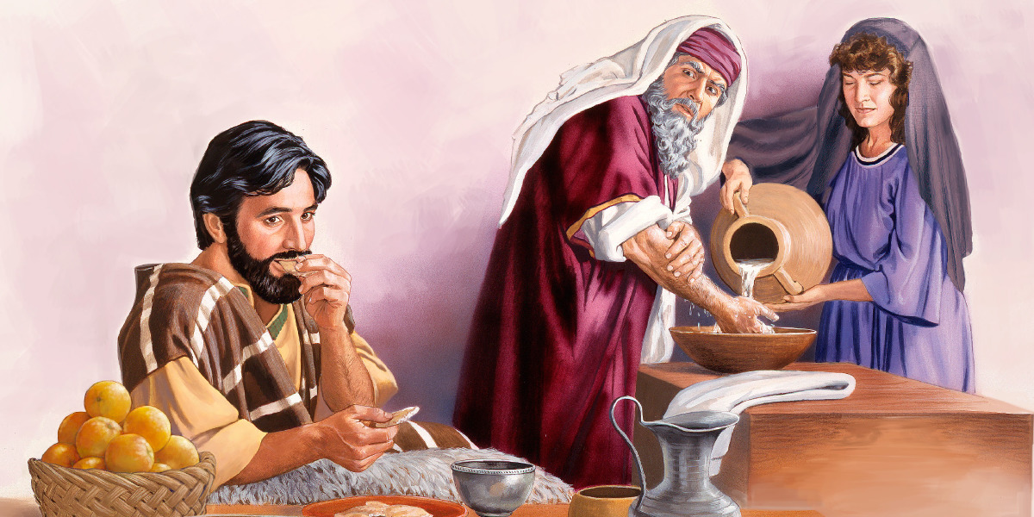
KUPINDIRUDZA
Chidzidzo 6 cha Nyamavhuvhu10, 2024

Slide 2
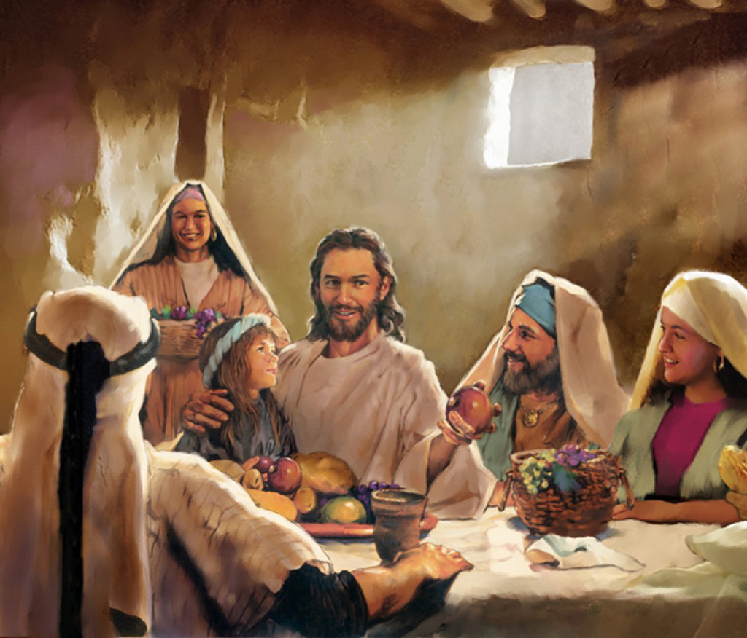
“Hapanecinhu kunze kwomunhu ciŋgamuȿiɓisa, kana cicipinda maari; asi ɀinoɓuɗa maari, ndiɀo ɀinoȿiɓisa munhu”
(Marko 7:15)

Slide 3
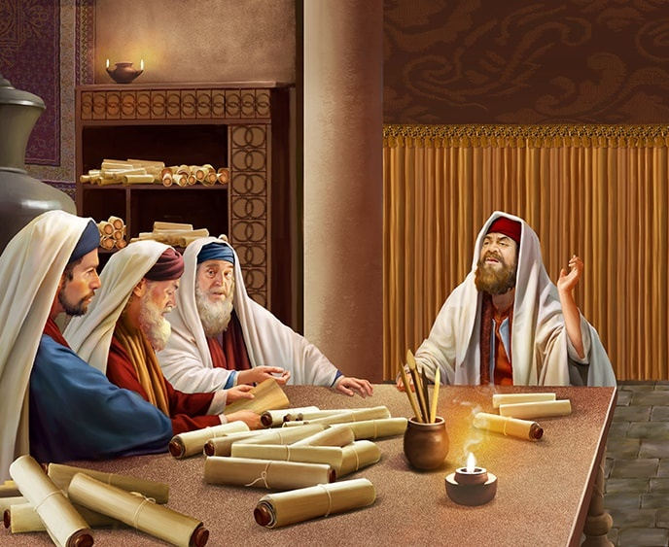
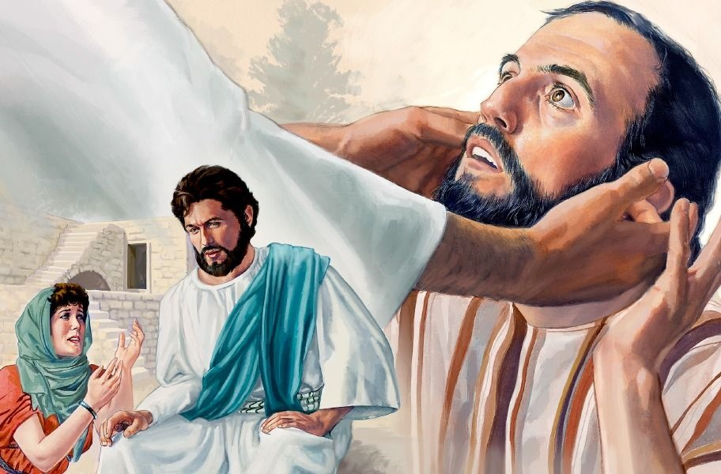
Nhau yakanangana navaFarise naJesu panhambo dzakasiyana-siyana yakanga iri gamuchidzanwa.
Kukwiza zviyo noruoko rwako paSabata; kudya usina kuchenesa maoko ako; kupira zvinhu kubasa raMwari kuti zvidzivise vamwe kunakidzwa nazvo; kusabata muHedheni kana kudya naye... Tsika zhinji uye dzakasiyana-siyana dzaiita kuti chitendero chavaFarisi chiome uye chiome kutevera.
Nemhaka yetsika dzavo, vaiva vatungamiriri mapofu ( Mt. 23:16 ), avo vakavharira vanhu kupinda muUmambo hweKudenga(Mt. 23:13).
Matambudziko etsika:
Dzinotsiva mitemo yaMwari. Marko 7:1-13.
Chinosvibisa nechisingasvibisi. Marko 7:14-19.
Tsika nevaHedheni:
Mbwanana dzinopfuura vatenzi vadzo. Marko 7:24-30.
Nzeve dzakasiiwa dzakavhurika. Marko 7:31-37.
Mbiriso yetsika. Marko 8:11-13.

Slide 4
MATAMBUDZIKO ETSIKA

Slide 5
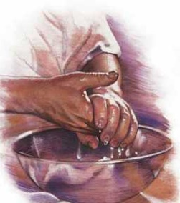
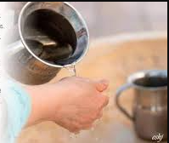
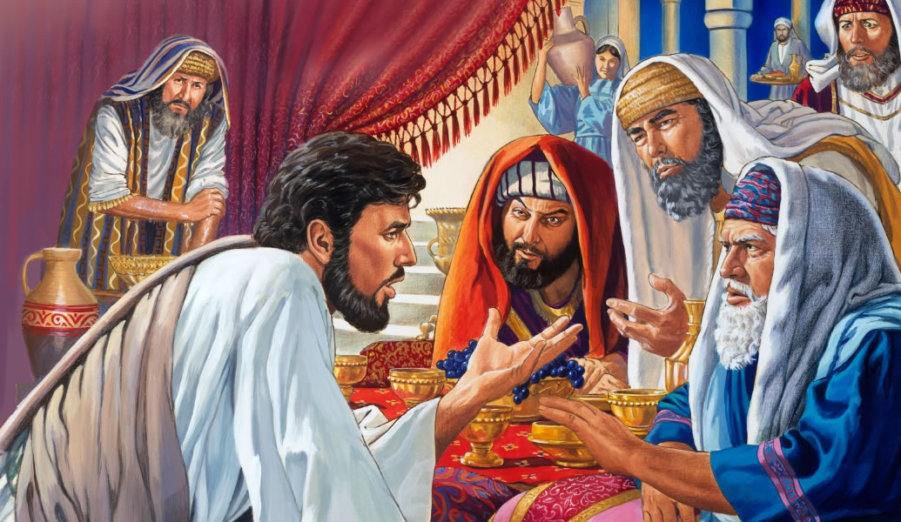
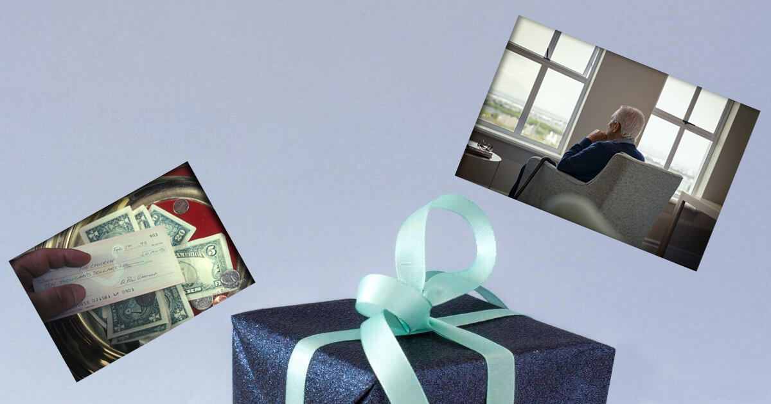
DZINOTSIVA MITEMO YAMWARI
“Akati kwaʋari, “Ɀirokwaɀo, munoramba murairo waMŋari, kuti muceŋgete tsika dzenyu.’” (Marko 7:9)
Mwari akanga arayira kuti vaprista vazvichenese nemvura vasati vashanda muSenjuwari(Ekisodho 30:17-21).
Vachisundwa neshungu dzakanyanyisa, vaJudha vakanga vatambanudzira uyu murairo kuvanhu vose, kudzivisa kusvibiswa kwetsika.
Mubvunzo wevanyori nevaFarisi waiitirwa kuratidza kuti Jesu aisaremekedza Mitemo ( Marko 7:5 ). Asi mubvunzo iwoyo wakavapindukirira.
Jesu airemekedza Mirairo. Ndivo vakaityora ndokuitsiva netsika dzavo(Marko 7:6-8).
CORBAN
Muenzaniso: Kana vakatsaurira chimwe chinhu kuna Mwari[Corban ] – chakaita semba – michero yacho yaisazova yavo ivo vatsaurira kusvika pakufa kwavo, asi vaisagona kuchishandisa kune chimwe chinangwa, sekubatsira vabereki vavo(Marko 7:9-13).

Slide 6
“Kukonana kukuru kwekupedzisira pakati pechokwadi nekukanganisa kunongova kurwisana kwekupedzisira kwegakava rakagara riripo maererano nemutemo waMwari. Paiyi hondo yatiri kupinda zvino—hondo pakati pemitemo yavanhu nemirairo yaJehovha, pakati pechitendero cheBhaibheri nechitendero chengano netsika.” -Non Official Translation by Gift Mawoyo
EGW (Preparation for What Lies Ahead, December 12)

Slide 7
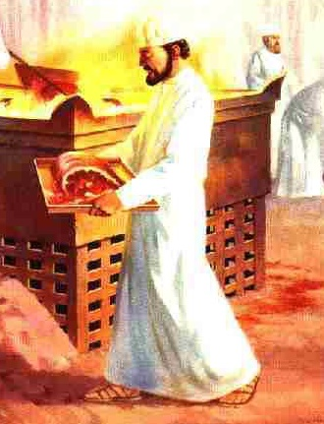
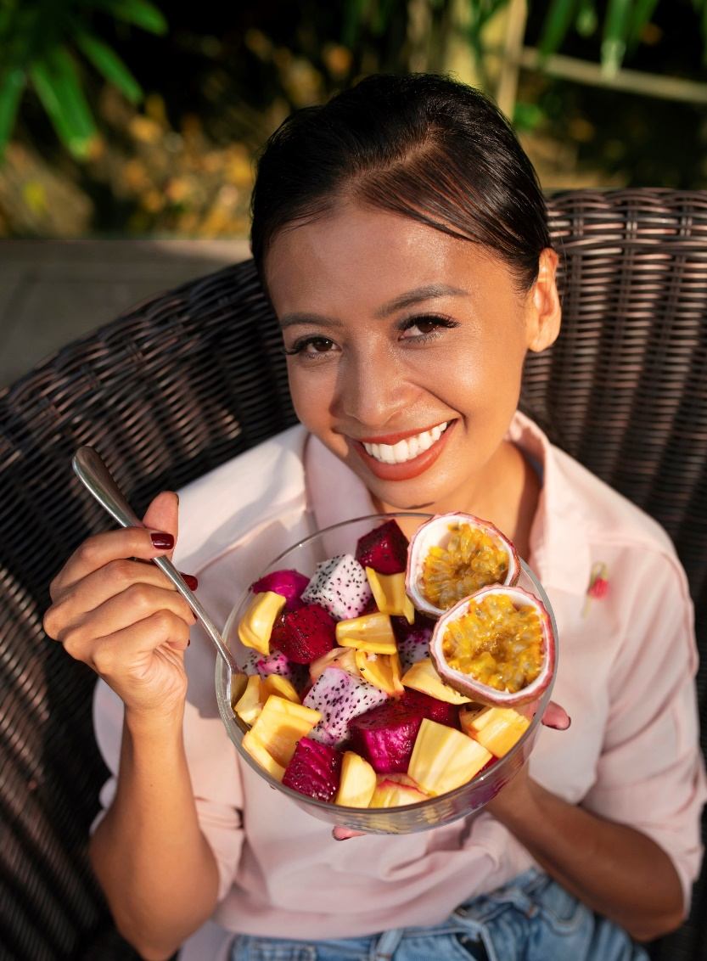
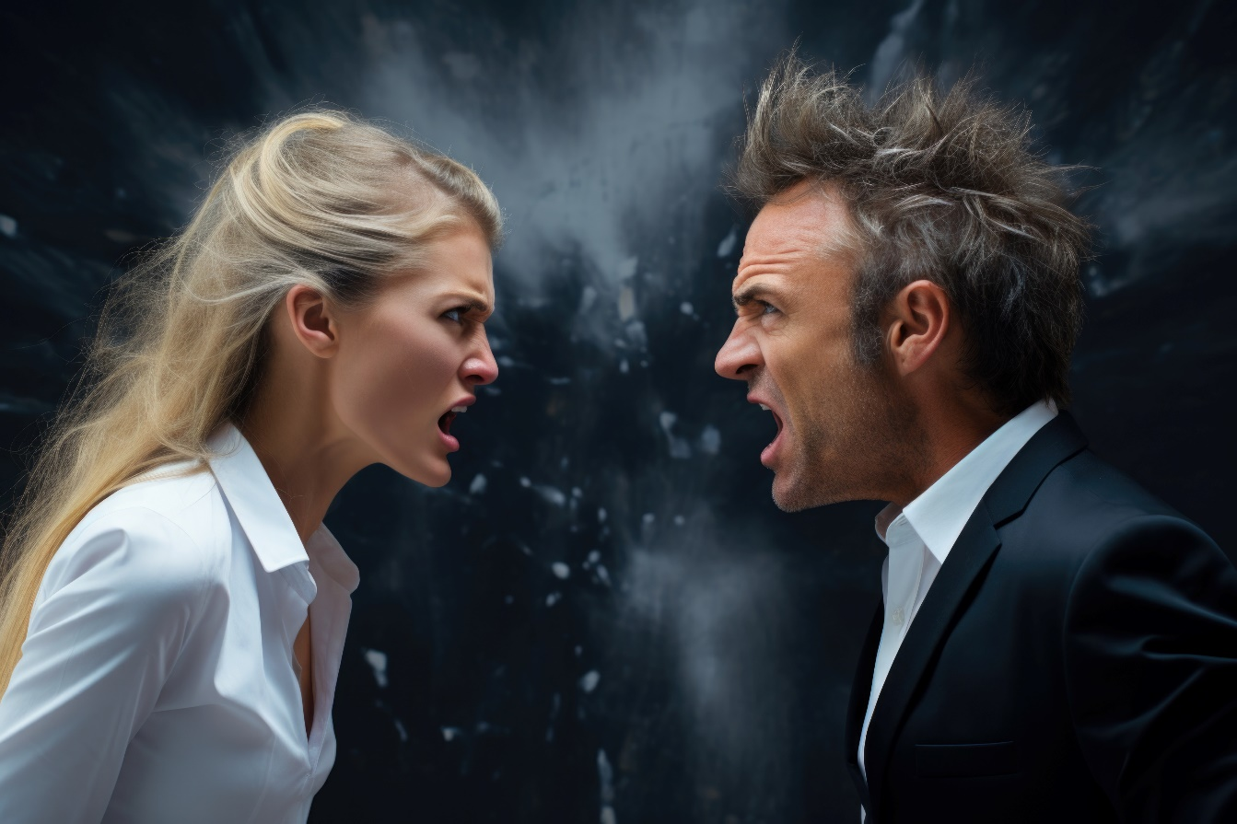
CHINOSVIBISA NECHISINGASVIBISI
“Hapanecinhu kunze kwomunhu ciŋgamuȿiɓisa, kana cicipinda maari; asi ɀinoɓuɗa maari, ndiɀo ɀinoȿiɓisa munhu” (Marko 7:15).
“Nyama tȿene” (yemhuka yechibairo) yakava “isina kuchena” apo yakabatwa nomumwe munhu asina kuchena mutsika (Hagai 2:12-13).
Mutsika yevaFarisi, izvi zvaiwedzerwa kune chero chikafu (chaibvumirwa naRevhitiko 11), uye kumunhu chero upi zvake, angave asina kuchena kana kuti akachena. Mubvunzo wakamutswa wakanga usina chekuita nezvokudya zvaigona kana kusadyiwa, asi nemadyirwo azvaiitwa (nemaoko akacheneswa - akagezwa - kana asina kucheneswa - asina kuchena).
Naizvozvo, kana usina kugeza maoko ako neimwe nzira, zvokudya zvawadya zvakanga zvisina kuchena. Asi Jesu akajekesa kuti zvokudya zvakachena hazvisvibi nokuzvidya pasina kuita zvetsika (Marko 7:18-19).
Zvisinei, zvinosvibisa munhu ndizvo zviri mukati make. Zvivi zvedu zvinobva pazvishuvo nemifungo yedu(Marko 7:20-23).

Slide 8
TSIKA DZAVAHEDHENI

Slide 9
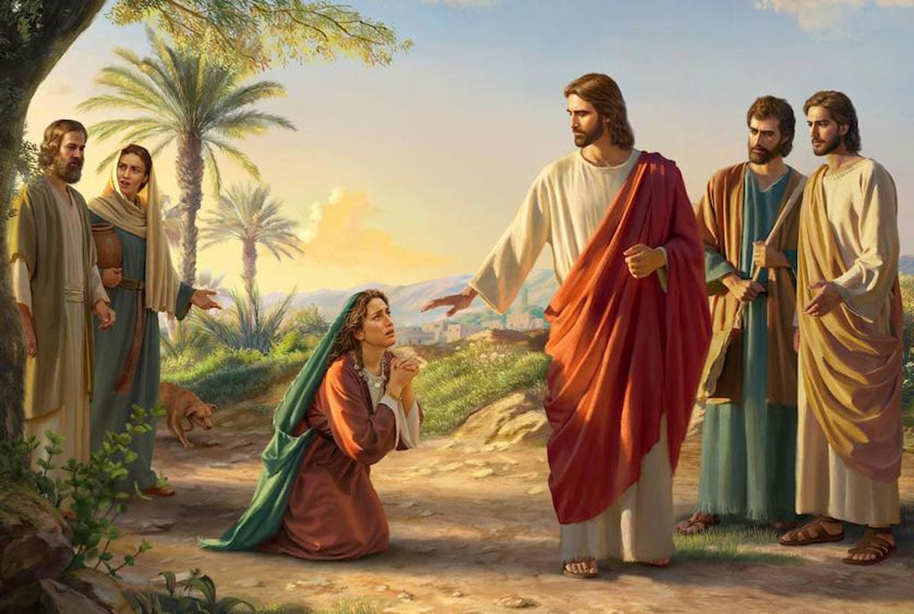
MBWANANA DZINOPFUURA VATENZI VADZO
“Akapindura, akati kwaari: Hoŋo, Ishe, kunyaŋge nembganana ʋo dzinodya pasi petafura ɀimeɗu ɀaʋana” (Marko 7:28)
Maererano netsika, muJudha aisagona kubata Mamwe Marudzi (muhedheni, mutorwa), kupinda mumba make, kana kuti kudya naye.
Mukubata nomukadzi uyu wechiGiriki, Jesu anoita seanotsigira tsika idzi: “Handigoni kuporesa mwanasikana wako nokuti uri muhedheni; ndinoporesa vaJudha chete” ( Marko 7:26-27 ). Murondedzero iyi, vaJudha vana vaMwari, uye vahedheni “imbwa” (imbwa dzinogara pamba).
Mudzimai uyu akabata zviratidzo zvakasiiwa naJesu mumharidzo yake, akabatirira pazviri nokutenda, uye akakunda nharo pamusoro paJesu! (Marko 7:28).
“Tanga wasiya”
“Mbwanana”
Aigona kukumbira nzvimbo yechipiri uye kutora mukana wezvimedu zvevakaguta.
Imbwa dzinochengetwa (kwete dzinorasika) dzakanga dziri rutivi rwemhuri uye naizvozvo dzaigona kufarikanya zvaiwanikwa mumhuri.

Slide 10
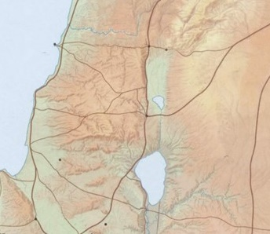
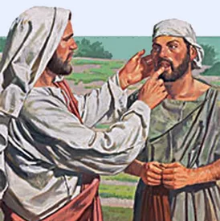
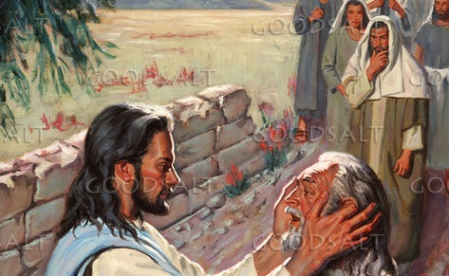
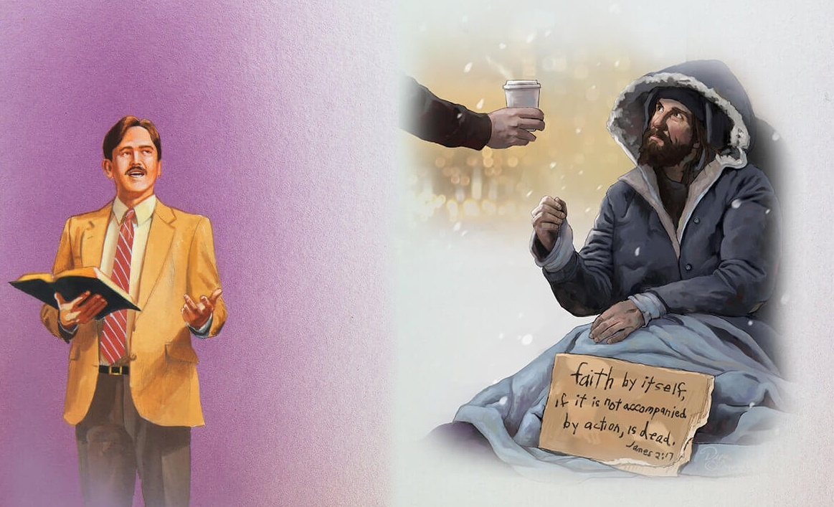
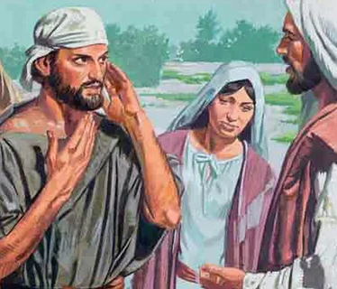
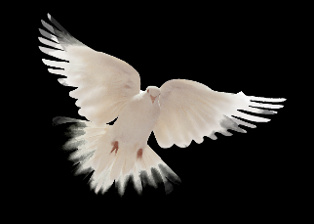
Zidon
NZEVE DZAKASIIWA DZAKAVHURIKA
Tyre
“Ipapo akatarira kuɗeŋga, akagomera, akati kwaari, “Efata!” (ndokuti“Dziʋuka!”) (Marko 7:34)
Kubva kuTire, Jesu akaita rwendo rwemaune kuti atize Garireya (Marko 7:31). Neiyi nzira, akakwanisa kupedza nguva navadzidzi vake.
Decapolis
Pavakasvika kuDhekapori vakauya nomunhu kuti aporeswe. Achimutora parutivi, akashandisa imwe nzira yokumuporesa(Marko 7:32-34).
Nezviito zvake, Jesu akabvumira murume uyu kushandisa kutenda kuti Agone kumuporesa. Somugumisiro, vazhinji vakashamiswa naJesu(Marko 7:35-37).
Asi nei Jesu akagomera sezvaaidanidzira, “Dziʋuka”?
Murume aiva matsi akanga akunyatsonzwa, uye mashoko aakatanga kunzwa aiva aJesu. Asi Jesu akafunga nezveavo, pavakanzwa, vakanga vasingadi kunzwa mashoko ake kana kugamuchira shoko rake.
Jesu anoda kuti tive nenzeve dzedu dzakagadzirira kuteerera mashoko ake, uyewo kuti tinzwe kuchema kwevaya vanoda kunzwa shoko panguva yakakodzera kubva kwatiri.

Slide 11
MBIRISO YETSIKA

Slide 12
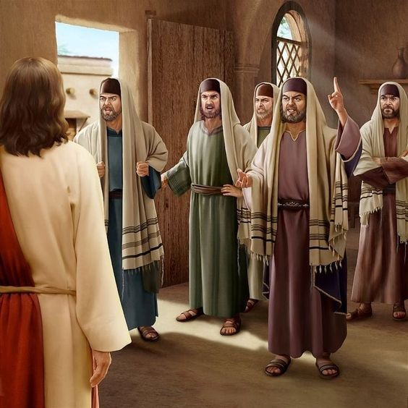
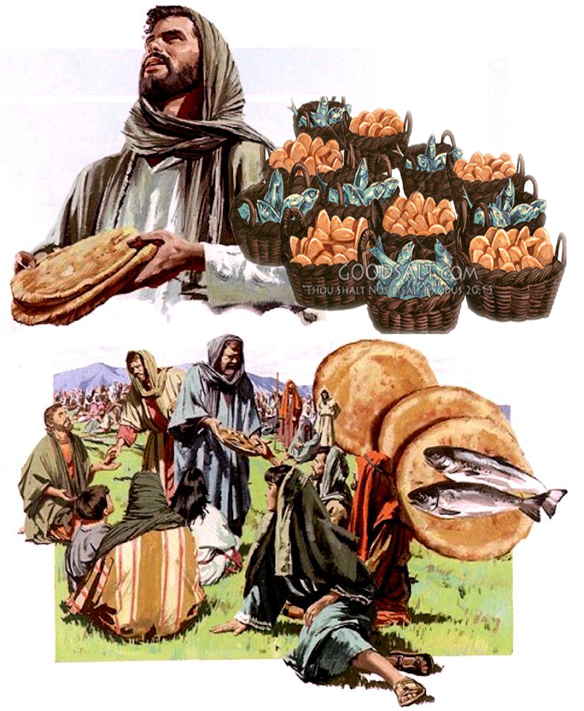
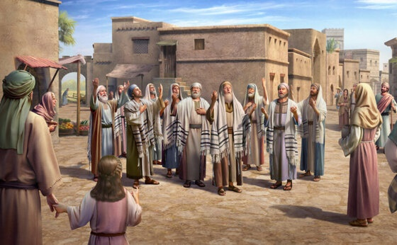
“Ɀino akaʋaraira, akati. “Cenjerai, mutye mbiriso yaʋaFarise nembiriso yaHerode.” (Marko 8:15)
Pavakasvika kuDalmanuta, Jesu akasangana ne“vaFarisi matsi,” avo vakamukumbira chiratidzo chechiremera/simba chake(Marko 8:10-11).
Akaramba kuvapa chiratidzo chipi nechipi. Hapana chaigona kugutsa avo vaisada kugutsikana. Aora mwoyo, akabva munzvimbo yacho, akatanga rwendo nevadzidzi vake(Marko 8:12-13).
Murwendo rwavo, Jesu akataura kwavari nezve“mbiriso yaʋaFarise ,” kureva dzidziso netsika zvakapinda muchitendero nokuchikanganisa(Marko 8:15).
Vadzidzi havana kunzwisisa dimikira. Vakafunga kuti akanga ari kuvatuka nokuda kwokusauya nechingwa, uye vakatenda kuti vaisafanira kutenga chingwa kumunhu muFarise kana kuti muSadhusi.
Vakakanganwa kuti Jesu anogona kuita kuti pfuma isingaperi iwanikwe kwatiri(Marko 8:16-21).

Slide 13
“Hazvizoiti kuti tiyangamire pamwe chete nekuri kuendwa, tichitungamirirwa netsika uye manyepo ekuzvikudza. Tinonzi vashandi pamwe chete naMwari. Saka ngatisimukei tivhenekere. Hapana nguva yekupedza mukukakavadzana. Avo vane zivo yezvokwadi sezvairi muna Jesu vanofanira zvino kuva mumwe mumwoyo nedonzo. Misiyano yese inofanira kukukurwa. Nhengo dzekereke dzinofanirwa kushanda dzakabatana pasi peMusoro mukuru wekereke. Vane ruzivo rwechokwadi ngavasimuke vapenye. “Ƌanidzira kwaɀo, usarega, ɗanidzira nenzwi rako sehwamanda” (Isaya 58:1).Mweya ngaudanidzire kuna Mwari mupenyu.” -Non Official Translation by Gift Mawoyo
EGW (Selected Messages, volume 1, page 108)

