Slide 1

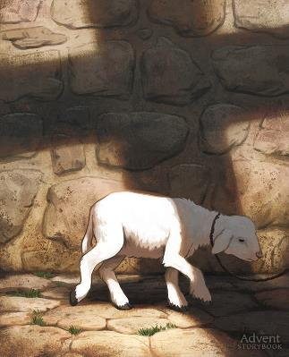
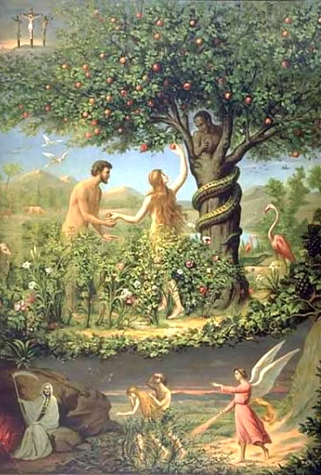
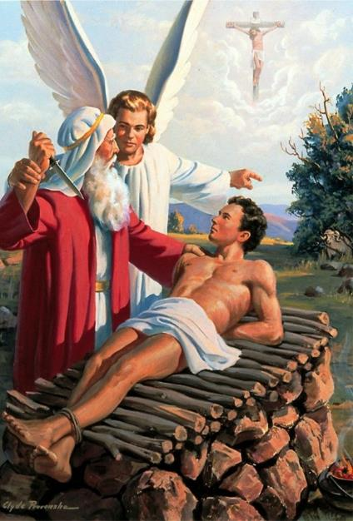
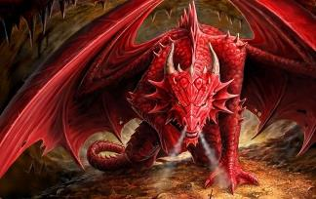
HWARO HURI MUNA GENESISI
Chidzidzo 2 cha Kubvumbi 12, 2025

Slide 2
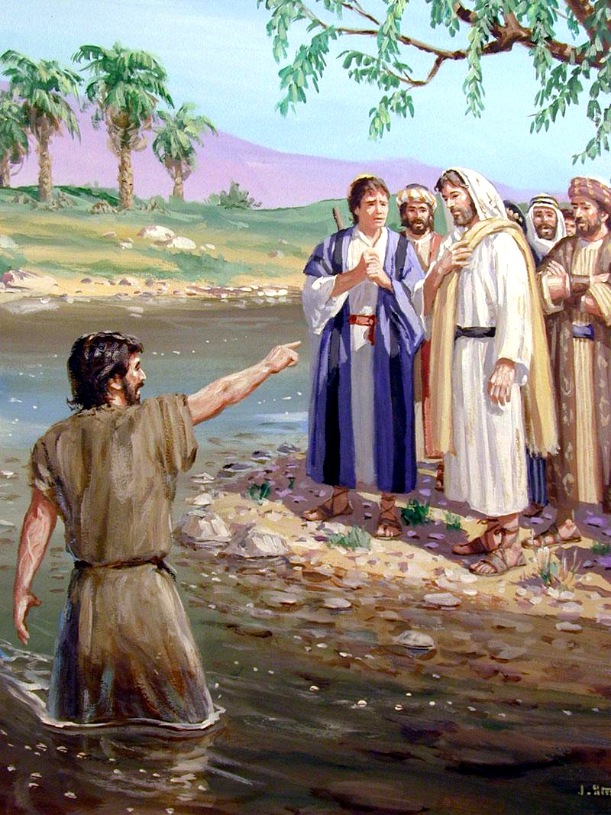
“Aʋa maŋgwana wakaʋona Jesu aciʋuya kwaari, akati, ‘Tarirai, Gwaiana raMŋari, rinobvisa ɀiʋi ɀenyika!’ ”
Johani 1:29

Slide 3

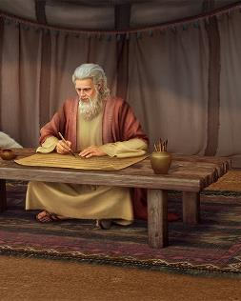
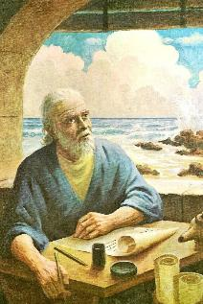
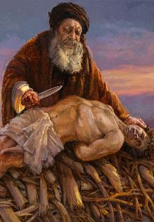
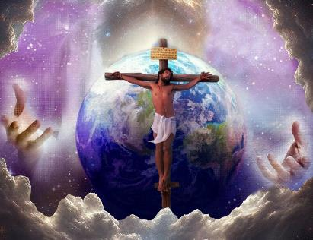







Bhaibheri rinoumbwa nemabhuku 66 emarudzi akasiyana-siyana, uye rakanyorwa nevanhu vanopfuura 40 mumakore 1 500.
Tinogona kutarisira kuti pave nekusiyana uye kupokana pakati pevanyori vakasiyana. Zvisinei, zvatinoona patinoridzidza tinobvumirana. Uyezve, kune zvikamu zveBhaibheri zvisingagoni kunzwisiswa pasina kunzvera zvimwe zvikamu zvaro
.
Tichadzidza musimboti wekududzira uyo uchatibatsira kuwana zvinorehwa nechiratidzo, kana kuti kuenderana(parallelism), nekufamba muBhaibheri rose.
Nheyo yekutanga kutaurwa.
Genesisi 22: Rudo neGwayana.
“WAUNODA”
“GWAYANA riripi?”
Genesisi 2-3: Rufu neShato.
“UCHAFA zvirokwazvo”
“NYOKA yaiva nemano kupfuura mhuka dzose”

Slide 4

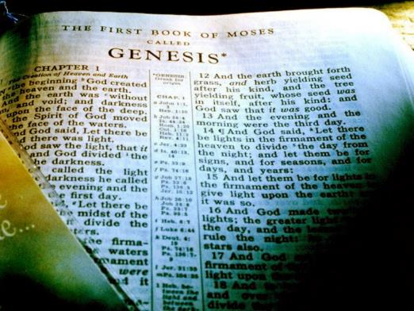
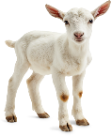


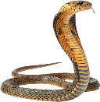
NHEYO YEKUTANGA KUTAURWA
“Jesu Kristu unogara akaɗaro zuro, nanhasi, nokusiŋgaperi” (VaHebhuru 13:8)
Kosi yega yega yekudzidza inotanga nechidzidzo chekutanga. Iyo inowanzo tsanangura misimboti inozotsigira chidzidzo chacho.
MuBhaibheri, tinowana “chidzidzo chokutanga” ichi muna Genesisi. Imomo, mashoko anokosha mazhinji anooneka kekutanga, achitibetsera kunzwisisa Zano Reruponeso muBhaibheri rose.
Mwari haashanduki ( Mar. 3:6a; VaH. 13:8 . ) Shoko rake harishanduki ( Isa. 40:8 . ) Saka, Bhaibheri haripikisani. Zano reruponeso rinotsanangurwa mariri zvishoma nezvishoma, kusvikira ranyatsonzwisiswa—kana kuti, kunzwisiso yatinoda iye zvino(2 Pet. 1:19.)
Tinogona kunzwisisa zviri nani Jesu, uye zvaakatiitira, kuburikidza nokududzwa kwokutanga, muna Genesisi, mamwe mashoko anokosha: RUDO, GWAYANA, RUFU, uye NYOKA.

Slide 5
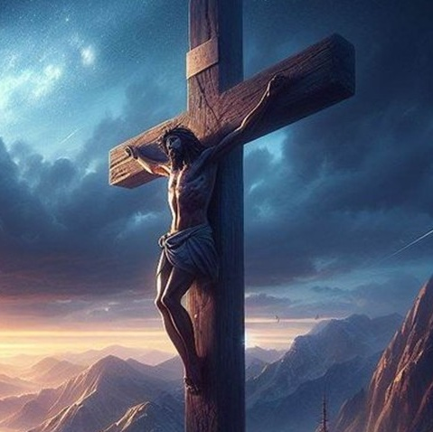
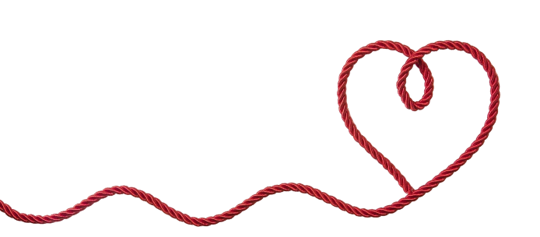

GENESISI 22:
RUDO NEGWAYANA

Slide 6

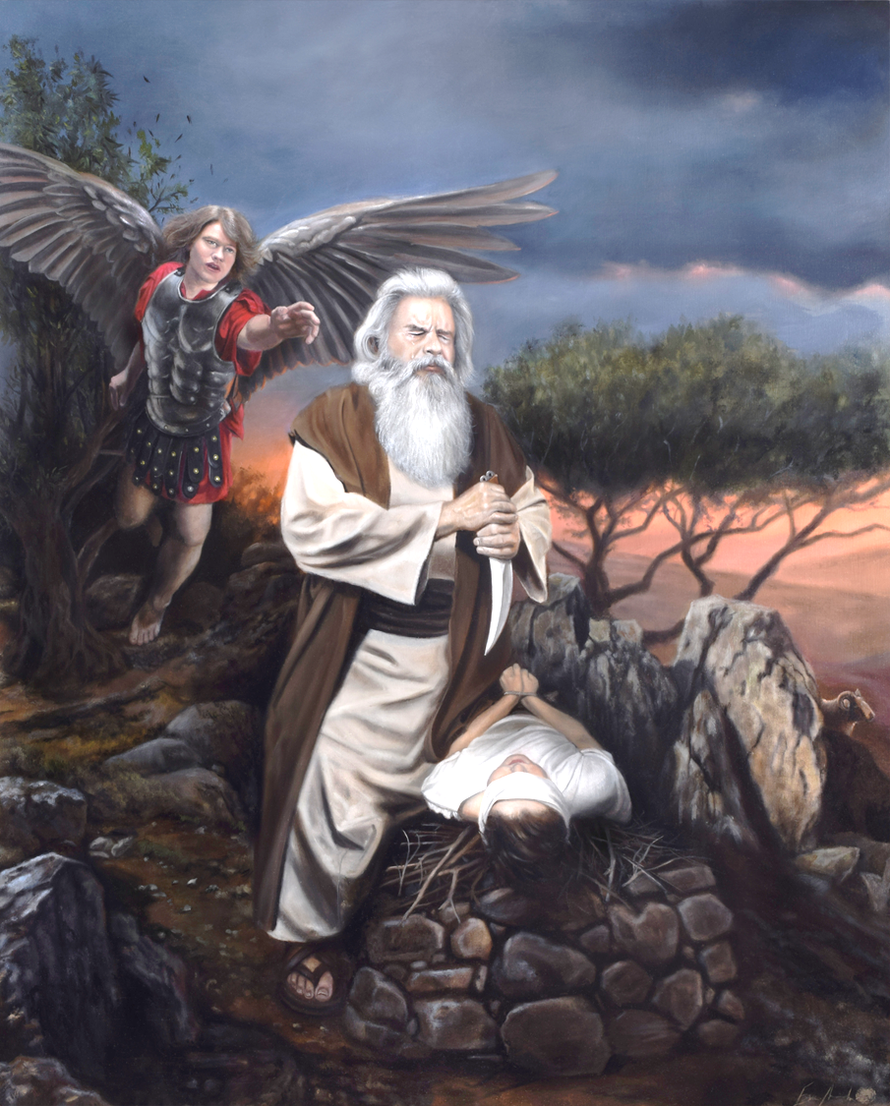
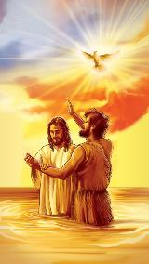
“WAUNODA”
“Akati, ‘Ɀino tora mŋanakomana wako, mŋanakomana wako mumŋe cete, waunoɗa, Isaka, uende kunyika yeMoria umuite ciɓayiro cinopiswa panerimŋe gomo randicakuʋudza” (Genesisi 22:2)
Rudo! Tinotsanangura sei rudo? Mafungiro edu nezvarwo anonyatsokanganiswa nechivi. Saka, tinganzwisisa sei rudo rwaMwari, rwakachena uye rutsvene?
Kududzwa kwokutanga kweBhaibheri kworudo kunoreva ukama hwababa nomwanakomana wavo: Abhurahama naIsaka ( Gen. 22:2 . ) Pakutanga, mashoko akapoteredza anoratidzika kuva akaoma: Abhurahama aifanira kubayira mwanakomana wake waaida! (Usanetseka, haana kuzopedzisa kuzviita.)
Enzanisa kutaurwa uku nekutaurwa kwekutanga kwerudo kwatinowana muevhangeri dzinoenderana: “Uyu [Jesu] ndiye Mŋanakomana waŋgu unoɗikanwa” (Mt. 3:17; Mk. 1:11; Rk. 3:22.)
Uye usapotsa kutaurwa kwokutanga muEvhangeri yaJohani ( Jn. 3:16 . ) Chiito chaAbhurahamu chokubayira mwanakomana wake chinoratidza kuti Mwari akatida sei zvokusvika pakupa Mwanakomana wake sechibayiro kuti tirarame nokusingaperi.

Slide 7

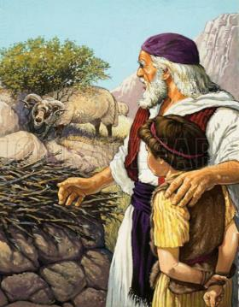
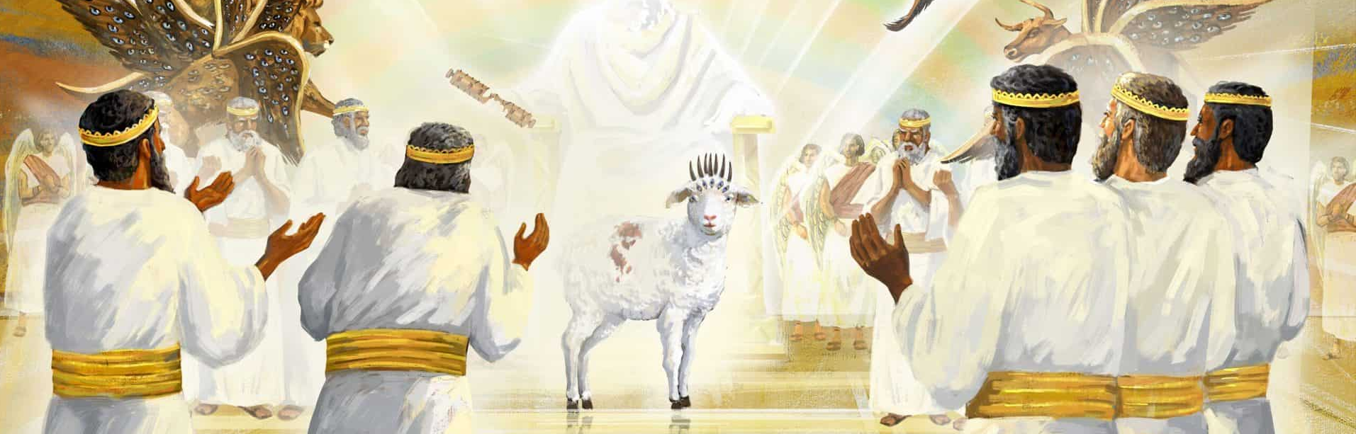
“GWAYANA riripi?”
“Isaka akataura naAbrahama, ɓaɓa ʋake, akati, “Ƃaɓa ʋaŋgu?”.Iye akati “Ndiri pano haŋgu, mŋana waŋgu?” Akati:. “Hoyu mŋoto nehuni; asi gwaiana reciɓayiro cinopiswa riripiko?” (Genesisi 22:7)
Kududzwa kwokutanga kweshoko reGWAYANA hakusi kwetsaona ( Gen. 22:7 . ) Ndiro hwaro hwokunzwisisa kududzwa kunodzokororwa kweGwayana muna Zvakazarurwa ( Zva. 5:6.)
Rakadzivisa kufa kwematangwe(Eki. 12:13)
Chakanga chiri chipo chaigara chichifungwa naMwari(Eki. 29:38-41)
Ndaifanira kufira zvivi zvangu (Is. 53:6-8)
Johani Mubapatidzi akazivisa Gwayana(Jn. 1:29)
Ona kuti gwayana rakapiwa naMwari raitova gondohwe ( Gen. 22:8, 13 . ) PaPaseka, gwayana raibayirwa, kunyange zvazvo raigona kuva gwayana kana mbudzana ( Eki. 12:3, 5 . ) Kureva kuti, shoko rokuti “gwayana” rakasvika pakureva chibayiro chikuru. Zvishoma nezvishoma, Bhaibheri rinowedzera revo yokufananidzira yegwayana:
Hazvishamisi kuti Zvakazarurwa zvisingatsananguri kuti Gwayana ndiyani. Gwayana ndiJesu, uyo akabayirwa zvivi zvangu uye anogara achindireverera kuna Baba(VaHeb. 7:25.)

Slide 8

“Zvanga zvakaoma kunyange kungirozi kunzwisisa chakavanzika choruponeso—kunzwisisa kuti Mutungamiriri wokudenga, Mwanakomana waMwari, anofanira kufira munhu ane mhaka. Apo murairo wakapiwa kuna Abhurahama wokupira mwanakomana wake,zvisikwa zvose zvokudenga zvakada kuona zvaizoitika. Nekushingairira kukuru zvakatarisa nhanho imwe neimwe mukuzadzika kwemurairo uyu. Apo abhurahama akapa mhinduro kumubvunzo waIsaka, “gwaiana reciɓayiro cinopiswa riripiko?” achiti, “Mŋari ucapa amene gwaiana reciɓayiro cinopiswa;” uye apo ruoko rwababa rwakadziviswa apo vakanga voda kuuraya mwanakomana wavo, uye gondohwe rakanga rapihwa naMwari rakapirwa panzvimbo yaIsaka—ipapo chiedza chakavhenekerwa pamusoro pechakavanzika chorudzikinuro, uye kunyange ngirozi dzakanzwisisa zvakajeka zvikuru gadziriro inoshamisa iyo Mwari akanga aita nokuda kworuponeso rwomunhu..” -Non Official Translation by Gift Mawoyo
EGW (Patriarchs and Prophets, pg. 155)

Slide 9
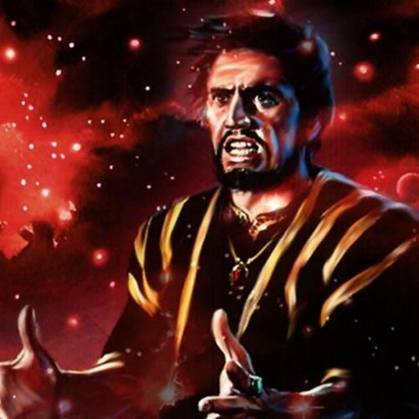
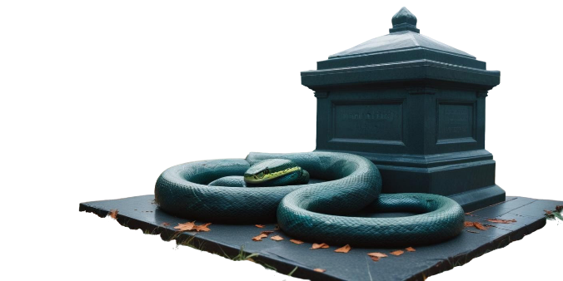
GENESISI 2-3:
RUFU
NENYOKA

Slide 10

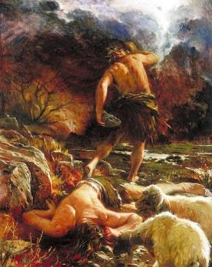
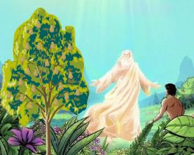
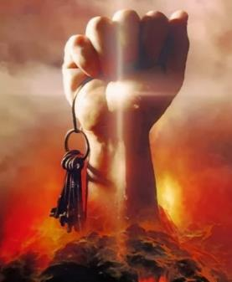
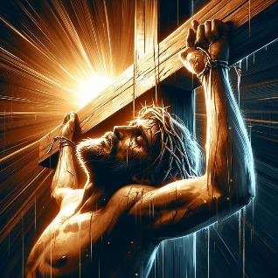
“UCHAFA zvirokwazvo”
“asi muti wokuziʋa ɀakanaka neɀakaipa usaudya; nokuti nomusi waunoudya, ucafa ɀirokwaɀo” (Genesisi 2:17)
Mwari ndiye akatanga kutaura nezverufu ( Gen. 2:17 . ) Asi rufu rwaigona kungovapo somugumisiro wechivi. (VaRoma 5:12.)
Rufu runowanzobatanidzwa nokukwegura. Asi rufu rwokutanga rwakanyorwa rwakanga rwuri rwejaya: Abheri ( Gen. 4:8 . ) Iye, kunyange zvazvo akanga ari munhu akarurama, akafira mumaoko omunhu asina kururama(VaHeb. 11:4; 1 Jn. 3:12.)
Nhoroondo yakadzokororwa mazana amakore gare gare, apo Munhu Akarurama akafira mumaoko avanhu vasina kururama ( Marko 15:14 . ) Kusiyana naAbheri, Jesu—uyo angadai akadzivisa rufu rwake—akazvibvumira kuurawa ( VaEf. 5:2.)
Jesu akaita zvaisagona kuitwa naAbheri: akakunda rufu ( VaRoma 6:9 . ) Uye, sezvinoratidzwa naZvakazarurwa 1:18 , akagamuchira “kiyi dzorufu,” dzaaigona kuzarura nayo makuva(“hell” kana “Hades”.)

Slide 11

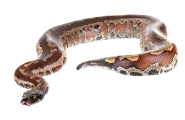
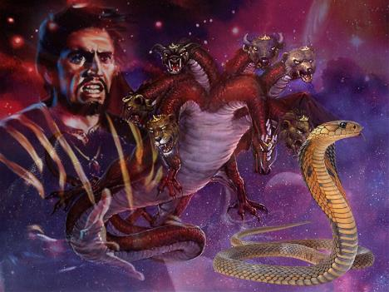
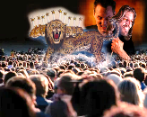
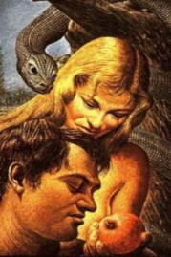
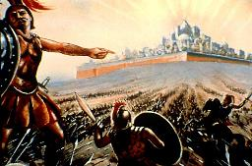
“NYOKA yaiva nemano kupfuura mhuka dzose”
“Ɀino nyoka yakaŋga inamano kupfuʋura mhuka dzose dzesaŋgo dzakaŋga dzaitwa naJehova Mŋari” (Genesisi 3:1a)
Zvakazarurwa zvinoratidzira shato ( Zva. 12:3-4 . ) Inotiudzawo kuti iyi shato mufananidzo waSatani ( Zva. 12:9.)
Mukuzivisa chiratidzo cheshato, iye anowedzera chiratidzo chitsva: Satani i“nyoka yekare.” Ndeipi nyoka yaari kureva?
Chokwadika, nyoka yokutanga inodudzwa muBhaibheri ( Gen. 3:1 . ) MuEdheni, Satani (nyoka) akanyengera nyika yose (kureva, Adhamu naEvha.)
Muna Zvakazarurwa, tinoyeuchidzwa kuti ichi chave chiri chinangwa chake munhoroondo yose, uye kuti ndicho chichava chinangwa chake chaicho pakuguma kwenyika ( Zva. 13:14 . ) Achatoedza kunyengera munhu wose ari pamberi paMwari ( Zva. 20:8.)
Tingazvidzivirira sei pamanomano ake? Imwe nzira ndeyokudzidza kuti akazviita sei pakutanga. Mazano ake makuru haana kuchinja mumazana emakore apfuura.

Slide 12

EGW (Manuscript) Releases, vol. 10, pg. 156)
“Vhangeri rinoratidzwa muzviporofita zvese zvekuuya kwekutanga kwaKristu seMuponesi wevanhu. Chiito chese chenguva yekare chekubvisa vanhu kubva kuchivi kana kuvaunzira ruregerero chakaitwa chakanangana neMuponesi aizouya. Ndiye aiva danho raizosimudzirwa munhu.” -Non Official Translation by Gift Mawoyo

