Slide 1

KUZIVA MWARI
Chidzidzo 2 cha Kubvumbi 11, 2026

Slide 2
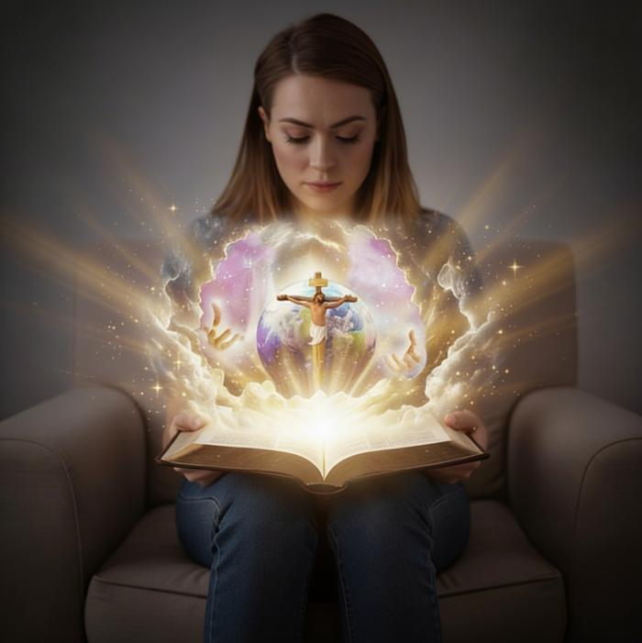
“Ʋupenyu bgusiŋgaperi ndibgo, kuti ʋakuziʋei imi, Mŋari uri woga waɀokwaɗi, naJesu Kristu, wamakatuma.”
(Johani 17:3)

Slide 3

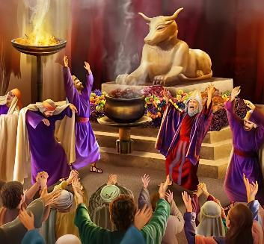

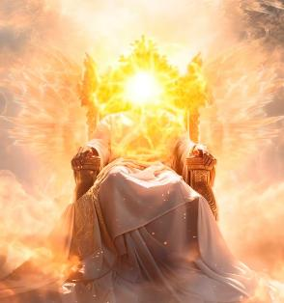
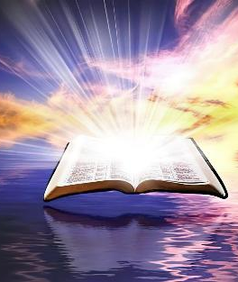
Kunzwisisa kwedu Mwari kwakashatiswa nechivi. Takaedza kumumiririra muzvifananidzo zvakaumbwa semhuka kana vanhu. Ave achifananidzirwa seasina maturo kana kuti ane udzvinyiriri. Pakupedzisira, vanhu vakagadzira mufananidzo waMwari mumufananidzo wavo.
Asi Mwari akaita sei chaizvo? Akakura here zvekuti hatingamunzwisise? Chokwadi, pasinei nokuti tingaedza zvakadini, pfungwa dzedu hadzigoni kunzwisisa Mwari. Tinoda rubatsiro.
Asi rubatsiro rwasvika. Unoda kuziva kuti Iye akaita sei? MuBhaibheri, tine chizaruro chechokwadi chechimiro chaMwari.
Hunhu(attributes) hwaMwari.
Hunhu(character) hwaMwari:
  Mwari Mutsvene
  Mwari rudo
Kuziva Mwari:
  Mwari anozarurwa muKusika
  Mwari anozarurwa muna Jesu (Emmanueri)

Slide 4


HUNHU (ATTRIBUTES) HWAMWARI

Slide 5
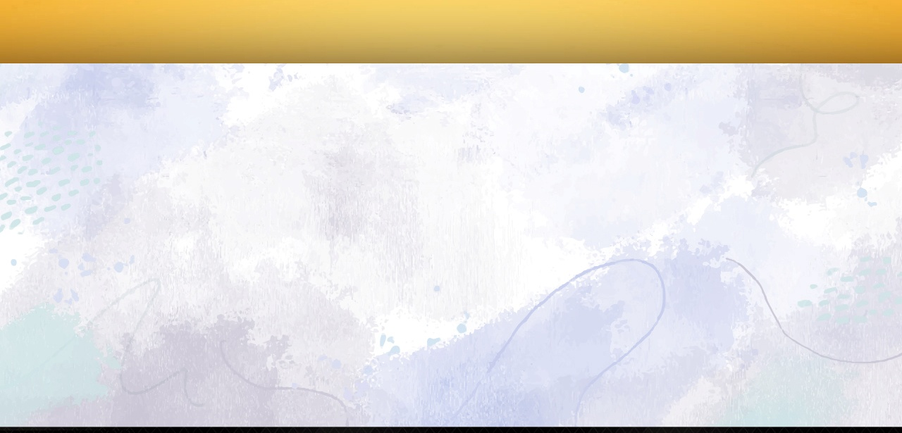

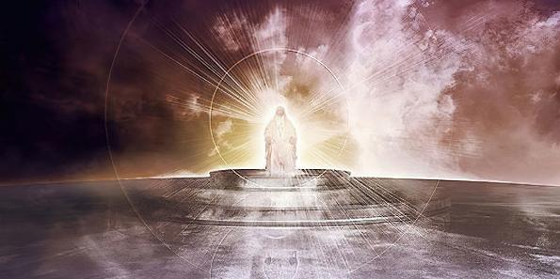
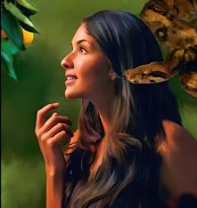
“Haiwa, Jehova, Mŋari wehondo,Ndianiko unesimba, wakafanana nemi, Jehova?Kutendeka kwenyu kunokukomberedzai” (Mapisarema 89:8)
HUNHU( ATTRIBUTES) HWAMWARI
Bhaibheri rinopa mufananidzo waMwari wakatendeka, wakajeka, uye usingachinji. Imwe yenzira dzainotibvumira kuti timuzive kuburikidza nehunhu(attributes) Hwake.
HUMWE HUNHU(ATTRIBUTES) HWAMWARI
Akarurama (Mapisarema 11:7)
Ane nyasha (Deuteronomio 4:31)
Anotsungirira nekunyaradza (VaRoma 15:5)
Mupi wenyasha (VaRoma 3:24)
Anoregerera (Mapisarema 86:5)
Anobata hushe (Mapisarema 47:8)
Anogara nokusingaperi (Genesisi 21:33)
Wamasimba ose (Genesisi 17:1)
Muzivi wezvose (1 Johani 3:20)
Anoziva zvichaitika mune ramangwana (Isaya 46:10)
Kana ari iye, Satani akaedza kubvira pakutanga kukanganisa hunhu hwaMwari, achimuratidza saMwari ane udyire, anongotsvaka zvakamunakira iye oga. (Gen. 3:4-5).

Slide 6

HUNHU (CHARACTER) HWAMWARI

Slide 7

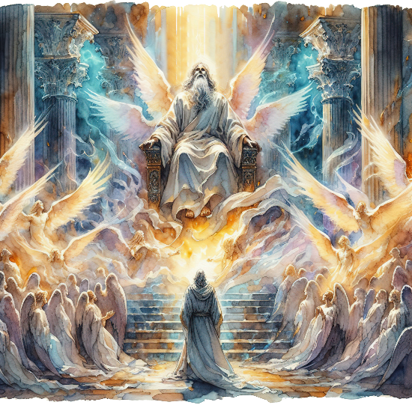
“Imŋe yakaɗanidzira kuneimŋe, iciti: “Mutȿene, mutȿene, mutȿene, iye Jehova wehondo; nyika yose izere nokubginya kwake.” (Isaya 6:3)
MWARI MUTSVENE
Ngirozi dzinomira pedyo naMwari dzinomurumbidza se “Mutȿene, mutȿene, mutȿene” (Isa. 6:3; Rev. 4:8). Hunhu uhwu hwakabatana chaizvo nehunhu Hwake zvekuti Isaya anohushandisa sezita chairo raMwari: “ndiɀo ɀinotaura Mutȿene”. (Isa. 40:25; 57:15).
Zvinorevei kuva mutsvene? Zvinoreva kukumikidzwa, kutsaurwa, kuchena. Tinova vatsvene kana tikasiya zvakaipa tichiita basa ratakaronzeswa naMwari. (Num. 15:40; Rev. 11:44; 1 Pet. 2:9).
Asi izvi zvinoshanda sei kuna Mwari? Akaparadzana zvachose nezvakaipa uye haana ukama nechivi.
Izvi zvinoreva kuti, nekuti Iye Mutsvene, rudo rwake rutsvene, rwakachena, uye haruna udyire. Nokuti Iye Mutsvene, masimba ake ose matsvene, akachena, uye haana hundini. Hunhu Hwake hwose hwakazadzwa nehutsvene nekuchena.

Slide 8


MWARI RUDO
“Nesu takaziʋa, tikatenda ruɗo urwu, Mŋari rwaanarwo kwatiri. Mŋari ruɗo; unogara muruɗo, unogara munaMŋari, naMŋari maari.” (1 Johani 4:16)
Mwari haana rudo bedzi kana kuti kupa rudo (kunyange zvazvo achiita zvose zviri zviviri), asi “Mwari rudo” ( 1 Johani 4:8, 16 ). Kufanana noutsvene, rudo rutivi rwomukati rwechimiro chohumwari.
Nemhaka yorudo, akasika vanhu murume nomukadzi, uye “akavarayira” kuti vadanane(Gen. 2:24)
Nemhaka yorudo, apo Adhama naEvha vakatadza, Iye akavatsvaka ndokuvapa tariro
(Gen. 3:9, 15)
Nemhaka yorudo, akaita sungano naAbrahama uye akapikira zvikomborero nokuda kworudzi rwose rwomunhu (Gen. 26:4)
Nemhaka yorudo, akapa Mwanakomana wake—Jesu Kristu—kuti afire zvivi zvedu (Johani 3:16)
Ndingapindura sei kurudo Rwake?
“Isu tinoɗa, nokuti iye wakataŋga kutiɗa” (1 Johani 4:19).
Notes:
SmartArt with large images (the four “for love”)

Slide 9

KUZIVA MWARI

Slide 10



MWARI ANOZARURWA MUKUSIKA
“Kuɗeŋga‐ɗeŋga kunoparidzira kubginya kwaMŋari;
Ʋuye ɗeŋga rinoratidza ɓasa ramaʋoko ake.” (Mapisarema 19:1)
Bhaibheri rinotanga nekunongedzera kuna Mwari sa אֱלֹהִ֑ים (elohim). Kunyange zvazvo shanduro chaiyo yezita iri iri rokuti “vamwari,” rinoshandiswa seshoko riri kureva munhu mumwe chete. Sokuti "Pakutanga, Vamwari vakasika denga nenyika” (Gen. 1:1).
Inotipa Musiki uyo, kuburikidza neShoko [Jesu Kristu], uye nokupindira kwoMweya, ane simba rokuunza chinhu chiri chose chiripo.(Gen.1:1-3; Jn. 1:1-3).
Muna Genesisi chitsauko 2, zita raMwari pachake rinowedzerwa: יְהוָ֥ה (Yahweh). Zvino haangoti, “Ngakuve.” Anotora munhu ndokumuumba nemaoko Ake. Mwari ane simba anozviratidza saMwari anosvikirika, anotaurika Naye.
Anotibata, anotaura nesu, anotidzidzisa, anotipa basa redu… anotida.

Slide 11
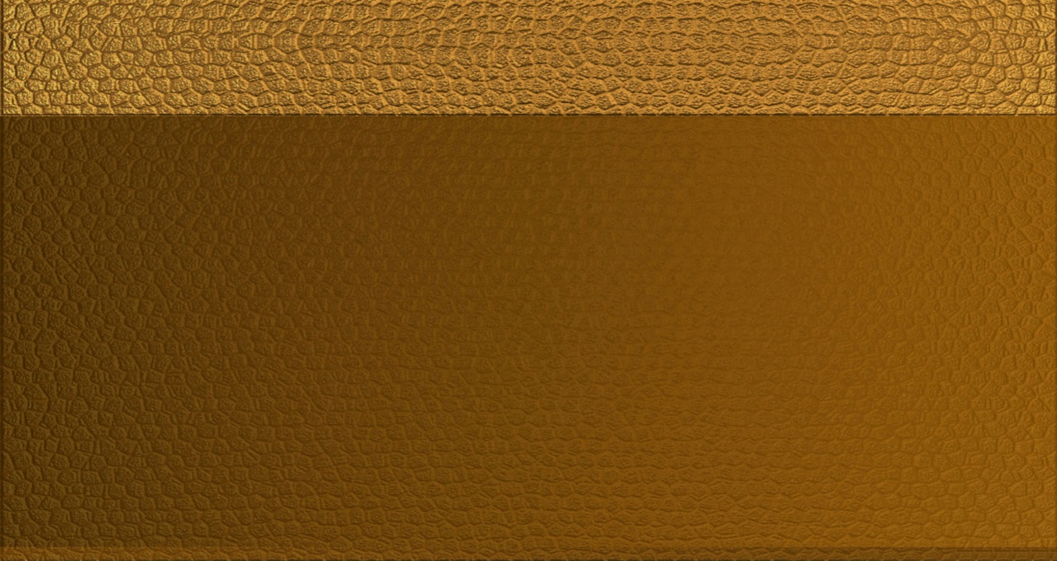
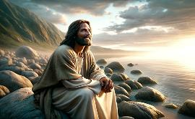
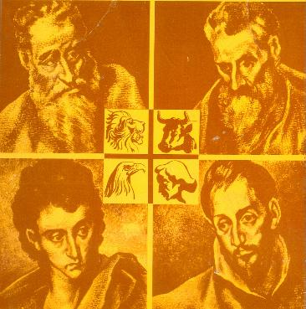
MWARI ANOZARURWA MUNA JESU (EMMANUERI)
“Hakunomunhu wakatoŋgoʋona Mŋari; Mŋari wakaɓerekwa ari mumŋe woga, uri pacifuʋa caƂaɓa, ndiye wakamuziʋisa isu.” (Johani 1:18)
Kana tichida kuziva zvakaita Mwari, ngatisvike pakuziva Jesu. Iye ndiMwari munyama ( Johani 1:14 ), uyo akazvizivisa amene kuburikidza nokupfeka hunhu kuti agogona kuonekwa nokunzwiwa nesu ( Johani 1:18; 14:9; 1 Johani 5:20).
Akaziviswa pasi pezita rohuprofita rairatidza chinangwa chohupenyu hwake: Emanueri, Mwari anesu ( Isaya 7:14; Mateo 1:23 ). Vaevhangeri vana vanomuratidza kwatiri nenzira dzakasiyana.
Mateo
Kubva kumuJuda kuenda kumaJuda
Marko
Kubva kumuJudha kuenda kuvaHedheni
Ruka
Kubva kumuHedheni kuenda kuvaHedheni
Johani
Kubva kumuJuda kuenda kumaJuda nevaHedheni
Ndiye Mesiya anozadzisa zvaakavimbisa
Anogara akangwarira kushandira vamwe
Hunhu uye kunzwira
Mupi wehupenyu hwenyama nehwemweya

Slide 12

“Zviuru zvine pfungwa yenhema pamusoro paMwari nehunhu Hwake… Mwari ndiMwari wechokwadi. Kururama netsitsi ndiwo hunhu hwechigaro Chake cheushe. NdiMwari ane rudo, ane tsitsi netsitsi. Nokudaro anomiririrwa muMwanakomana Wake, Muponesi wedu. NdiMwari ane mwoyo murefu. Kana akadaro ari watinonamata uye ane unhu hwatiri kutsvaka kutevedzera, tiri kunamata Mwari wechokwadi.”-Non-Official translation by Gift Mawoyo
EGW (God Cares for Us, August 8)

