Slide 1
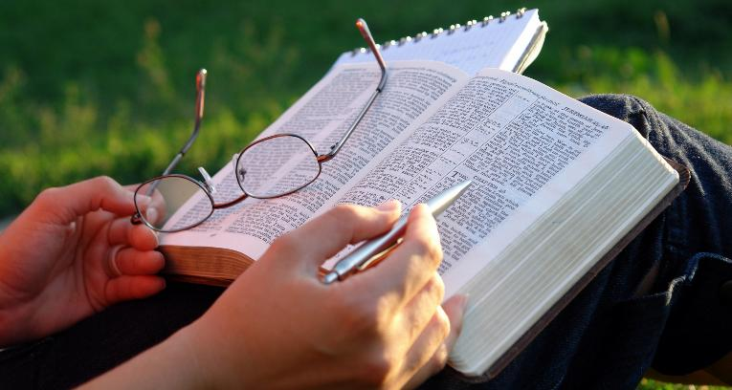
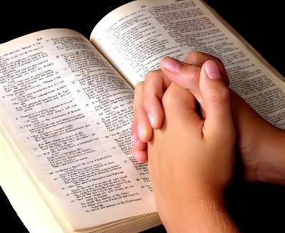
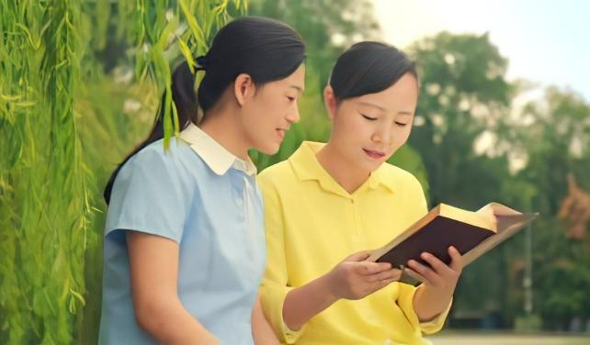
MADZIDZIRO EBHAIBHERI
Chidzidzo 5 cha Chivabvu 2, 2026

Slide 2
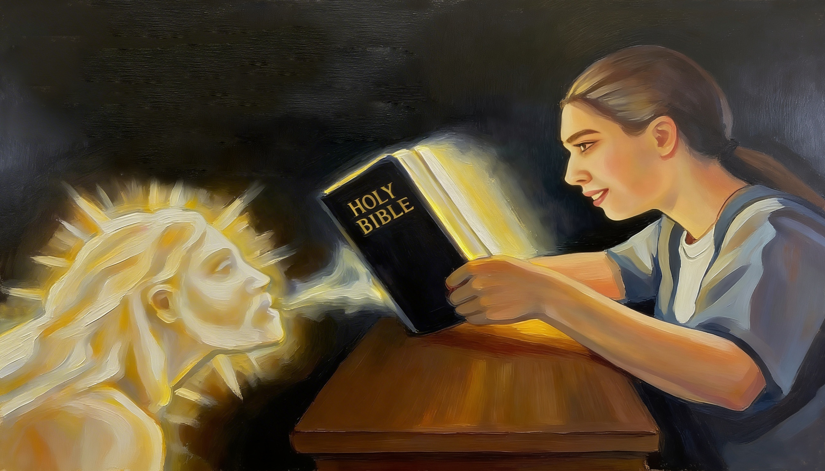
“ndiɀo ɀicaita shoko raŋgu rinoɓuɗa mumuromo maŋgu; hariŋgadzokeri kwandiri risina, asi ricaita ɀandinoɗa, riciendika paneɀandakaritumira” (Isaya 55:11)

Slide 3

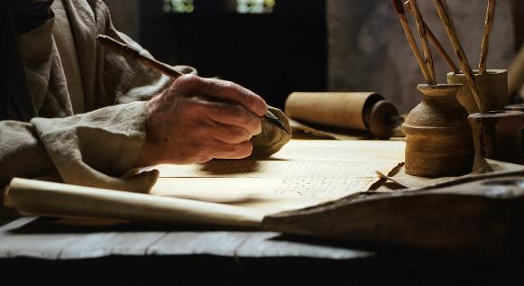

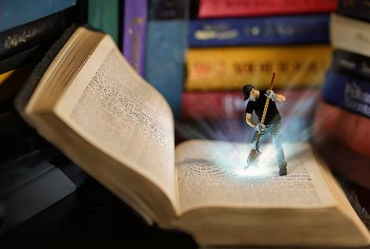
“ʋanhu ʋaMŋari ʋakataura, ʋacimutswa noMŋeya Mutȿene.” (2 Petro 1:21), uye vakanyora mashoko avo pamapeji eBhaibheri.
Mariri tinowana matombo anokosha anopa upenyu, tariro, kurudziro, nyaradzo, ... Zvimwe zvinoonekwa pakutanga, zvimwe zvinofanira kutsvakwa zvakanyatsonaka.
Tingatora sei matombo anokosha aya atakagadzirirwa naMwari muBhaibheri, uye tinobatsirwa sei nokuridzidza?
Madzidziro eBhaibheri:
Nguva
Nzvimbo
Nzira
Zvakanakira kudzidza Bhaibheri:
Zvakanakira kugoverana
Zvakanakira kuridya

Slide 4

MADZIDZIRO EBHAIBHERI

Slide 5
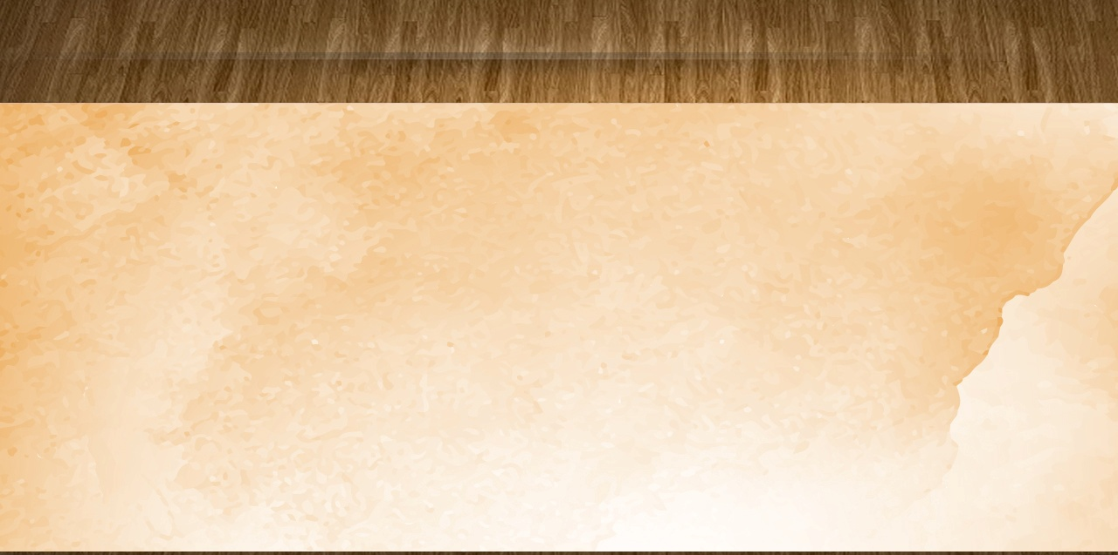
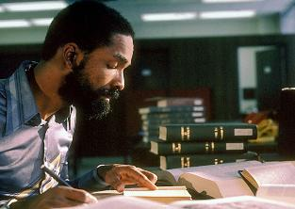
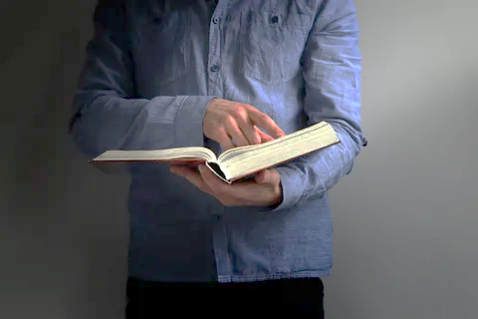

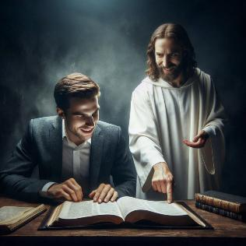
NGUVA
“Mucanditȿaka, mukandiwana, kana mucinditȿaka nomŋoyo wenyu wose.” (Jeremiya 29:13)
Ndeipi nguva yakanakisisa yekudzidza Bhaibheri?
Tinofanira kuongorora mhinduro yedu tichifunga zvinhu zviviri: nguva uye mhando.
Sezviri pachena tichabetserwa zvikuru nokutsaura awa kuti tifunde Bhaibheri kupfuura kutsaura maminiti mashanu bedzi.
Zvisinei, nguva yatinotsaurira pakudzidza haingogumiri pakuverenga zviri pamusoro. Apa ndipo panopinda kukurudzira kwedu. Nei ndichiverenga Bhaibheri? Ndiri kungotsvaka zivo here, kana kuti ndine chido chakadzama chokuziva zvakawanda nezvaMwari?
Tichabatsirwa zvikuru nokudzidza kwedu Bhaibheri kana yava nguva yokuva naMwari ( Jer. 29:13 ), uye kufara maAri ( Mapis. 37:4 ); patinotarisa mumapeji aro kuti tiwane shoko rinokosha raMwari kwatiri.

Slide 6

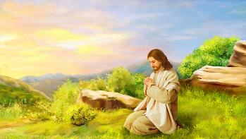


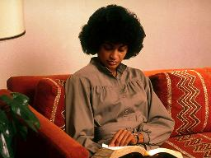
NZVIMBO
“Maŋgwanani kucinerima, wakamuka akaɓuɗa, akaenda kunɀimbo murenje, akandonyeŋgetera’po.” (Marko 1:35)
Jesu paaida nguva yakakosha yekuyanana naMwari, aimuka mangwanani-ngwanani otsvaka nzvimbo yakanyarara (Marko 1:35). Izvi zvinogona kushandiswa pazvose zviri zviviri munyengetero nefundo yeBhaibheri.
Zvakaoma kuisa pfungwa pakudzidza munzvimbo ine ruzha kana kuti ine vanhu vakawanda. Zviri nyore kuzviita munzvimbo yakagadzikana, yakanyarara, uye isina vanhu.
Maawa okutanga kana ekupedzisira ezuva, pakunenge kwakanyanyorara, anogona kuva nguva dzatinogona kunangidzira pfungwa dzedu pana Mwari zviri nyore.
Kana tawana nguva nenzvimbo chaiyo, ngatiitei ichi chiitiko chenguva dzose. Zvichida mamwe mamiriro ezvinhu anokosha achatitadzisa kubata nguva iyoyo, asi ngatisarega nguva yakawandisa ichipfuura tisina kudzidza Bhaibheri zuva nezuva.

Slide 7


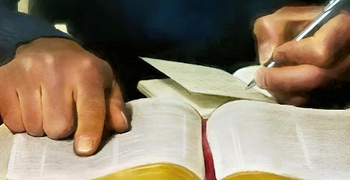
NZIRA(1)
“ndiɀo ɀicaita shoko raŋgu rinoɓuɗa mumuromo maŋgu; hariŋgadzokeri kwandiri risina…” (Isaya 55:11)
Kudzidza Bhaibheri kwakadzama kune zvikamu zvina
Namata
Kuverenga nekunzwisisa [nzira irikupihwa sezano]
Namata
Govera
Koka Mweya Mutsvene kuti ave mutungamiri wako muzvidzidzo zvako
Sarudza vhesi kana ndima kubva muBhaibheri
Achabata mwoyo nepfungwa dzako kuti unzwisise zvaunoverenga
Rinyore pasi kuti zvikubatsire kuti riNyoreke mupfungwa dzako
Nyora pasi pfungwa huru
Nyora pasi pfungwa dzinokurudzira pfungwa huru idzodzo
Kumbira Mwari kuti akubatsire kushandisa pfungwa dzawakadzidza
Funga kuti ndiani waungaudza zvawadzidza

Slide 8

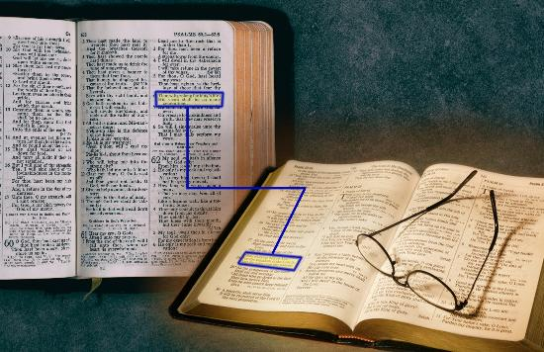
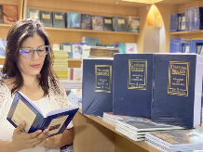

NZIRA (2)
“ndiɀo ɀicaita shoko raŋgu rinoɓuɗa mumuromo maŋgu; hariŋgadzokeri kwandiri risina…” (Isaya 55:11)
Dzimwe nzira dzokudzidza nadzo Bhaibheri
Enzanisa vhesi nevhesi (Isaya 28:10)
Dzidza zvitsauko kana mabhuku ose
Kudzidza musoro kana izwi nerubatsiro rwekonikodhenzi
Ongorora tsinhiro dzebhaibheri kana maduramazwi
Verenga mukufambirana nendima kubva mu "Conflict of the Ages" akatevedzana akanyorwa naEllen White

Slide 9

ZVAKANAKIRA KUDZIDZA BHAIBHERI

Slide 10



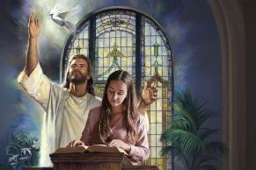
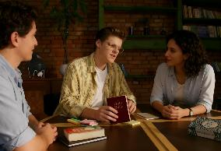
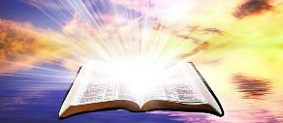
ZVAKANAKIRA KUGOVERANA
“Ishe Jehova wakandipa rurimi rwaʋakadzidziswa, kuti ndiziʋe kusimbisa ʋakaneta namashoko; unondimutsa maŋgwanani ose, unomutsa nzeʋe dzaŋgu kuti ndinzwe saʋanodzidziswa.” (Isaya 50:4)
Wakumbirwa kugadzirira mharidzo yeshumiro yeMugovera. Unopa nguva yakakosha yekudzidza nekunamatira chidzidzo chawakafemerwa naMweya Mutsvene kuti usarudze. Musi weSabata, unoparidza nesimba. Ndiani anonyanya kubatsirwa nemharidzo iyi?
Chidzidzo cheBhaibheri chatinoudza vamwe—mumharidzo kana kuti kumunhu mumwe—chinobatsira zvakapetwa kaviri.
Kutanga, tinobatsirwa nezvatakadzidza. Chechipiri, vanhu vatinogoverana navo zivo iyi vanobatsirwa uye vanokurudzirwa kunyura zvakadzama muzivo iyoyo.
Muzviitiko zvose zviri zviviri, ukama naMwari hunosimbiswa uye hunodzama. Iro ndiro simba reShoko raMwari, iro“hariŋgadzokeri kwandiri risina”(Isaya 55:11).

Slide 11

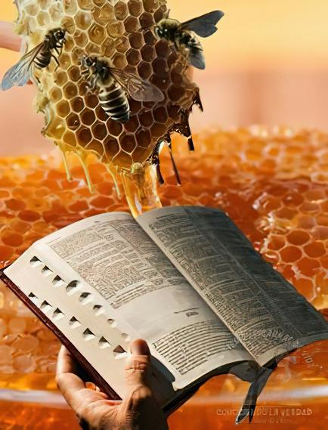

ZVAKANAKIRA KURIDYA
“Mashoko enyu anonaka seiko mumukanwa maŋgu!Ɀirokwaɀo, anokunda ʋuci mumuromo maŋgu!!” (Mapisarema 119:103)
Tinofanira kudya Shoko raMwari(Jer. 15:16)!
Kunyange richitapira kupfuura huchi, hatifanire kuhudya (Mapisarema 119:103). Kuverenga Bhaibheri chikafu chemweya, zororo rechokwadi rinoporesa mweya wedu uye rinoshandura hunhu hwedu. Open.
And what's more, this food is free (Isaiah 55:1)!
Tinongofanira kuswedera pedyo nekuteerera zvatinoudzwa naMwari kuburikidza neBhaibheri (Isaya 55:3). Kana tichipedza nguva yakawanda tichiongorora mapeji aro, tichawana zvokudya zvinovaka muviri zvakawanda, uye tichawana zvikomborero zvakawanda.
"Chero kungava kufambira mberi muungwaru kwomunhu, kwechinguvana ngaarege kufunga kuti hapana dikanwo yokunzvera Magwaro zvakakwana uye kunopfuurira nokuda kwechiedza chikuru. Sevanhu, tinodanwa somunhu mumwe nomumwe kuti tive vadzidzi vouporofita.” -Non-Official translation by Gift Mawoyo. Ellen G. White, Counsels to Writers and Editors, p. 41

Slide 12

“Kungoverenga Shoko chete hakuzopedze mhedzisiro yeDenga; rinofanira kudzidzwa, uye kukosheswa mumwoyo. Zivo yaMwari haiwaniki pasina nhamburiko yendangariro. Tinofanira kushingaira kudzidza Bhaibheri, tichikumbira Mwari kuti atibatsire naMweya Mutsvene, kuti tinzwisise Shoko Rake. Tinofanira kutora vhesi rimwe, toisa pfungwa dzedu pakuona pfungwa iyo Mwari akaisa mundima iyoyo kwatiri. […]
Shoko raMwari ndiro chingwa chehupenyu. Avo vanodya nokudzeya Shoko iri, vachiriita chikamu chechiito chose uye chehunhu hwose, vanokura musimba raMwari. Rinopa simba risingafi kumweya, uye richiunza mufaro uchagara nokusingaperi. -Non-Official translation by Gift Mawoyo
EGW (Lift Him Up, April 7)

