Slide 1

CHITEMA MUSANGANO
Chidzidzo 4 cha Chikunguru 25, 2026

Slide 2

“Hamuziʋi here kuti muʋiri wenyu itembere yoMŋeya Mutȿene, uri mukati menyu, wamakapiwa naMŋari? Hamuzi ʋenyu;nokuti makateŋgwa nomuteŋgo; naiɀoɀo kudzai Mŋari mumuʋiri wenyu”
(1 VaKorinte 6:19, 20)

Slide 3




Muzvitsauko 5 kusvika ku7 zveTsamba yekutanga kuVaKorinte, Pauro anonyanya kushanda kubvisa chivi chakanga chadzika midzi musangano reKorinte: unzenza hwepabonde.
Chivi ichi chainge chakawedzerwa nezvimwe zvakadai sekugumburana nekubiridzirana pakati pehama pachadzo, izvo zvakazopedzisira vakuendesana kumatare emutemo.
Achishandisa mutauro wakajeka uye wakananga, Pauro haangoratidzi chivi chete, asi anopawo nzira dzekugadzirisa nayo, pamwe chete nedzekudzivirira kuwira machiri zvakare.
Chitema musangano
Chitema chekuziva
Kubviswa zvachose kwechitema
Kugadzirisa matambudziko emukati
Nzira yekudzivirira nayo chivi musangano
Temberi dzaMweya Mutsvene
Hukama hwepabonde huri pamutemo

Slide 4

CHITEMA MUSANGANO

Slide 5



CHITEMA CHEKUZIVA
“Munoɀikudza, haɀizaiʋa nani here kana makacema, kuti uyo wakaɓateɓasa iri abviswe pakati penyu?” (1 VaKorinte 5:2)
Musangano reKorinte maivemo“ʋupombge bgakaɗaro bgusiŋgazikanwi kunyaŋge pakati paʋahedeni” (1 VaKo. 5:1).
Nyaya yehukama hwepabonde pakati pehama dzepedyo mukati mesangano yaiva nyaya yakakomba zvikuru. Asi mamiriro ezvinhu akatonyanya kuipa nekuti, pachinzvimbo chekunzwa kusvotwa nechiito ichi, nhengo dzesangano dzaitozvirumbidza nekuchirega chichienderera mberi (1 VaKorinte 5:2)
Sangano raiwanzova nevanhu vasiri vaJudha. Hana dzavo dzaivaudza kuti ukama hwepedyo hwepabonde (incest) haufaniri kushivirirwa. Pamusoro pezvo, ruzivo rwavo rweMagwaro rwaitsigira pfungwa iyi (Revhitiko 18:8).
Kana vaiziva zvakajeka kuti hukama uhwu hwaiva hwechivi… sei vaizvirumbidza nahwo (1 VaKorinte 5:6)? Mhuri yacho irimunyaya yaiva nesimba here musangano? Vaizvirumbidza here kuti vaiva musangano rinoshivirira vatadzi? …

Slide 6


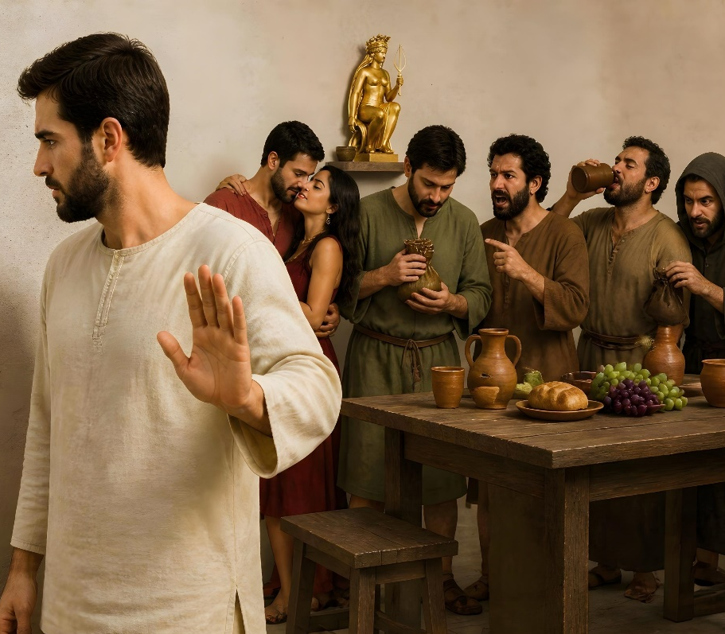


KUBVISWA ZVACHOSE KWECHITEMA
“Asi aʋo ʋari kunze. Mŋari unoʋatoŋga. Bvisai pakati penyu munhu uyo wakaipa.” (1 VaKorinte 5:13)
Nyaya yacho yehupombwe hwepedyo (incest) yakanga yatova chinhu "chinozivikanwa nevanhu vose" (1 VaKorinte 5:1), saka paifanira kutorwa matanho ekukurumidza kudzivirira kukanganisa mukurumbira wesangano. Ndeapi matanho aifanira kutorwa?
Kuita mutongo unosimbisa, kana kusasimbisa, mhosva yemunhu (1 VaKorinte 5:3)
Usabatana nemutadzi, kana kutombodya naye, chero bedzi achiramba achiti inhengo yesangano asi asingadi kusiya chivi chake (1 VaKorinte 5:11)
Kudzinga mutadzi nekumuisa mumaoko aSatani, sezvo nekuda kuchengetedza chivi ichi, akazvisarudzira ega kuisa hupenyu hwake pasi pejoko raSatani (1 VaKorinte 5:2b, 5a, 13b)
Kuranga kwesangano (zvisinei nekurema kwechivi) kunofanira kugara kune chinangwa chekudzikinura. Kukanganisa kwomunhu wacho kunofanira kujekeswa kuti agozviziva, atendeuke, uye “aponeswe pazuʋa raShe”(1 VaKorinte 5:5).

Slide 7



KUGADZIRISA MATAMBUDZIKO EMUKATI
“Ko kana mumŋe wenyu anemhoȿa nomumŋe, uŋgatsuŋga kumukwirira kunaʋasakarurama, akasamukwirira kunaʋatȿene here?” (1 VaKorinte 6:1)
Mushure mekutsanangura nzira yekugadzirisa nyaya dzechivi mukati mesangano, Pauro anovatsiura nekusatevedzera gwara rakakodzera uye nekutora makakatanwa ari pakati pevatendi vachiendesa kudare renyika (1 VaKorinte 6:1-6). Asi Pauro anoenda mberi achibata mudzi wedambudziko racho.
Chekutanga, hakufaniri kuva nekukakavadzana pakati penhengo dzechechi (1 VaKorinte 6:7a) uye, zvechokwadi, nhengo hadzifaniri kuitira imwe nhengo zvakaipa kana kuibira (1 VaKorinte 6:8).
Chechipiri, hama dzinofanira kunge dzichida kuregerera mhosva yacho (1 VaKo. 6:7b).
Chechitatu, kana pasina chibvumirano pakati penhengo, sagano rinofanira kutonga kana kureverera pakati pavo (1 VaKo. 6:2).
Kunze kwekunge iri nyaya yemhosva(criminal matter) (VaRoma 13:1-5), matambudziko ari mukati mesangano anofanira kugadziriswa mukati mesangano racho.

Slide 8

“Ibasa redu kuziva zvikanganiso nezvivi zvedu zvakakosha, izvo zvinounza rima nekushaya simba pamweya, uye zvinodzima rudo rwedu rwekutanga. Ko inyaya yekuda zvinhu zvenyika here? Kuzvida iwe pachako here? Kuda kukudzwa kana kuzvikudza here? Kushuvira kuva wekutanga here? Chivi chekutevera zvido zvenyama chine simba guru here? Chivi chevaNikoiraita here, chekushandisa nyasha dzaMwari senzira yekuzvipira kuhupombwe netsvina? Kushandisa zvisizvo chiedza chikuru, mikana, nekukudzwa kwatakapiwa, tichizvirumbidza nehuchenjeri neruzivo rwechitendero, asi hupenyu nehunhu hwedu zvisingaenderane nazvo uye zvichiratidza tsika dzakaipa here? Chero chii zvacho chawakachengetedza nekukudziridza kusvika chava nesimba guru uye chava kukukunda, ita nhamburiko dzakasimba kuti uchikunde, kana zvisina kudaro uchaparara.” -Non-Official translation by Gift Mawoyo
EGW (Ye Shall Receive Power, December 18)

Slide 9
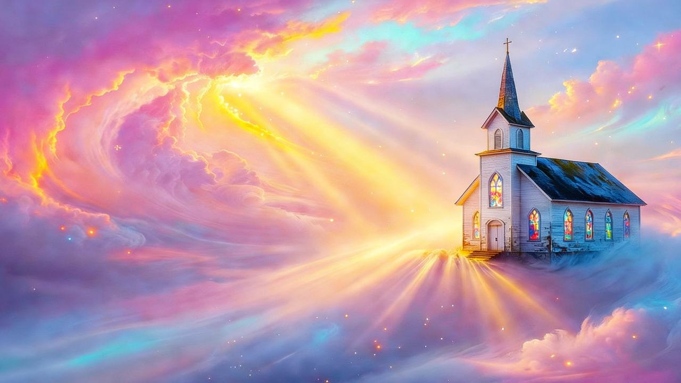
NZIRA YEKUDZIVIRIRA NAYO CHIVI MUSANGANO

Slide 10




TEMBERI DZAMWEYA MUTSVENE
“Hamuziʋi here kuti muʋiri wenyu itembere yoMŋeya Mutȿene, uri mukati menyu, wamakapiwa naMŋari? Hamuzi ʋenyu”
(1 VaKorinte 6:19)
Mushure mekutaura nezvenyaya yekupomerana mumatare, Pauro anodzokera kunyaya huru: unzenza hwepabonde mukati mesangano. Ngenyi zvakanga zviripo?
MaKristu anodanirwa kuva vatsvene (1 VaKorinte 6:11), uye izvi zvinoreva kusava nechivi zvachose. Asi vamwe vaitoti sezvo zvivi zvavo zvakanga zvatorergererwa, vaigona kuita zvavaida nemiviri yavo. Ndosaka Pauro achijekesa kuti“muʋiri hauzi woʋupombge” (1 VaKo. 6:12-13).
Nharo yake: miviri yedu mitezo yaKristu. Hatingatore nhengo yaKristu toibatanidza nepfambi kana mhombwe (1 VaKo. 6:15-18).
Pakupedzisira, inotitungamirira kukufungisisa pamusoro pechinhu chakakosha: miviri yedu itemberi dzaMweya Mutsvene uye, naizvozvo, haisi pfuma yedu, asi ndeyaMwari (1 VaKo. 6: 19). Mwari akatitenga neropa rinokosha roMwanakomana wake, saka tinofanira kukudza Mwari mumuviri nomumweya wedu (1 VaKo. 6:20).

Slide 11





HUKAMA HWEPABONDE HURI PAMUTEMO
“Asi nokuɗa kwoʋupombge, murume mumŋe nomumŋe ŋgaaʋe nomukadzi wake, nomukadzi mumŋe nomumŋe ŋgaaʋe nomurume wake.” (1 VaKorinte 7:2)
Nokupindura mimwe mibvunzo yakanga yamutswa nesangano reKorinte, Pauro anotibatsira kunzwisisa kuti tingatiza sei upombwe (1 VaKo. 7:1).
Muchidimbu: vanhu vakaroorana vanofanira kunakidzwa nehukama hwepabonde huri pamutemo nemumwe wavo; vanhu vasina kuroora kana kuroorwa havafaniri kuita zvepabonde nemunhu chero upi zvake.
Varoorani havafaniri kuramba kuita zvepabonde kuitira kudzivirira kukonzera mumwe wacho kuti angangopinda muupombwe(1 VaKo. 7:3-5).
Vanhu vasina kuroora kana kuroorwa vane chipo chokuzvidzora vanogona kushandisa zviri nani mikana yokushumira Mwari pasina ganhuriro dzinobva mukutarisira mhuri
(1 VaKo. 7:6-8, 32-34).
Vanhu vasina kuroora kana kuroorwa vasina chipo chekuzvidzora vanofanira kuedza kuroora kuti vadzivise miedzo (1 VaKo. 7:9).

Slide 12

“Pakubatsira avo vari kutsauka panzira kwayo, meso ose ngaatarisire kuna Kristu. […] Ngavataure kune avo vari kutsauka nezve tsitsi dzoMuponesi dzekuregerera. Ngavakurudzire mutadzi kuti atendeuke, uye atende muna Iye anokwanisa kuregerera. […]
Sagano ngarigamuchire nekutenda kwakadzama kutendeuka kwemutadzi. Uyo ari kutendeuka ngaabudiswe murima rekusatenda achipinzwa muchiedza chekutenda nekururama. Ruoko rwake runodedera ngaruiswe muruoko rwaJesu rune rudo. Kuregererwa kwakadai kunosimbiswa kudenga. -Non-Official translation by Gift Mawoyo
EGW (The Desire of Ages, p. 806)

