Slide 1
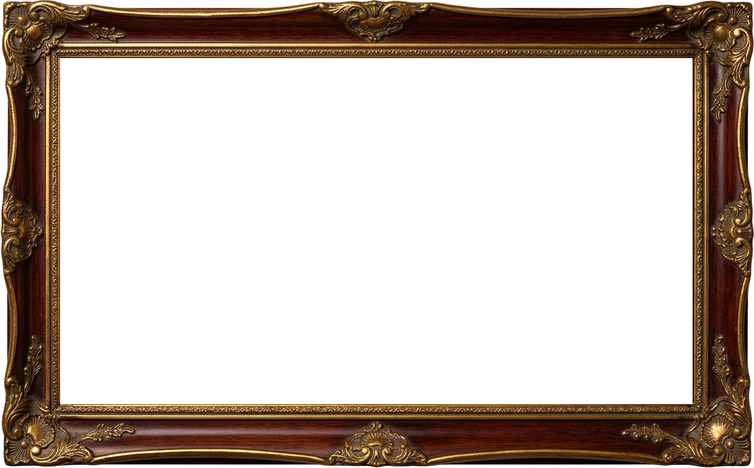


MUFANANIDZO WERUDO
Chidzidzo 7 cha Nyamavhuvhu 15, 2026

Slide 2

“Ɀino kutenda, netariro, noruɗo, ɀitatu iɀi, ndiɀo ɀinogara; asi cikuru pakati paɀo ndirwo ruɗo.”
(1 VaKorinte 13:13)

Slide 3
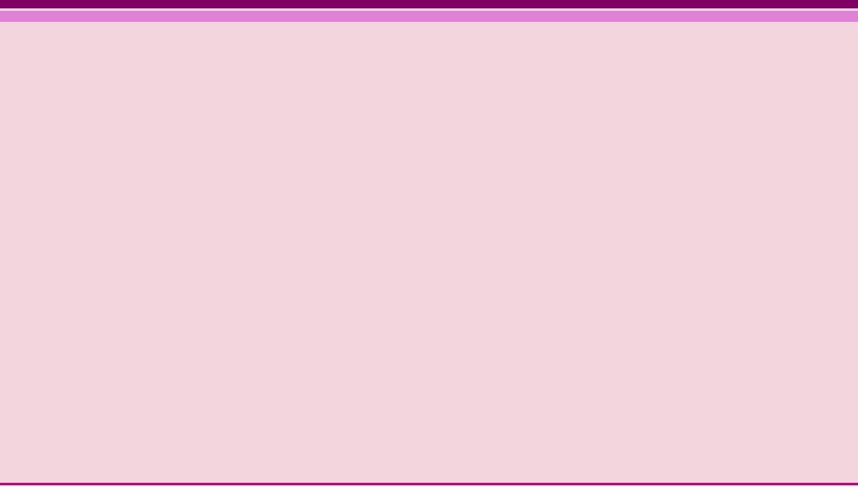

Chitsauko 13 cha1 Vakorinte chinozivikanwa se "chitsauko cherudo." Hachitsananguri rudo rwevakaroorana kana rwepabonde, asi rudzi rwakadzama zvikuru rwerudo: rudo rwaMwari.
Pauro anotsanangura zvakanaka kwazvo nzira yekuratidza nayo muhupenyu hwedu rudo rwaMwari rwakadururirwa mumoyo yedu(VaRoma 5:5).
Rudo ndirwo runotungamirira zviito zvedu zvese, uye chikonzero chinoita kuti tiite zvinhu zvinobatsira avo vatinosangana navo.
MUFANANIDZO WERUDO
Kupfuura zvose kwerudo
Nzira yakaiȿo‐naka inopfuʋura dzose
Hunhu hwerudo
Zvinoitwa nerudo
Zvisingaitwe nerudo
Mufananidzo waJesu
Kutsungirira kwerudo
Hunhu Hukuru Kupfuura Hwose

Slide 4


KUPFUURA ZVOSE KWERUDO

Slide 5




NZIRA YAKAIȿO‐NAKA INOPFUƲURA DZOSE
“Asi shiŋgairirai ɀipo ɀikuru.Ndinokuratidzai ʋo nzira yakaiȿo‐naka inopfuʋura dzose.” (1 VaKorinte 12:31)
Rudzi rwerudo rwakaita sei rwuri kuratidzwa naPauro mu1 VaKorinte 13, uye nei ruchipfuura chipo chipi zvacho chemweya? (1 VaKo. 12:31-13:3)
Mumutauro wechiGiriki mune mazwi akawanda anotsanangura rudo. Pauro anosarudza shoko rekuti agape (rudo rusingazvifunge, rusingatarisiri chimwe chinhu, uye runotsvaga zvakanakira munhu anodiwa chete), iro riri iro shoko rimwe chete rinoshandiswa naJohani paanoti“Mŋari ruɗo” (1 Johani 4:8).
Hapana chipo chemweya chinobatsira kana chisiri kushandiswa tichitungamirirwa nerudo rwerudzi urwu. Kutaura zvazviri, zviito zvedu nemafungiro edu zvese zvinofanira kuzadzwa nerudo rwe agape.
Jesu akatinyevera kuti, nekuda kwehuipi, rudo urwu ruchatonhora (Mateu 24:12). Asi hatifaniri kubvumira kuti izvi zviitike kwatiri, mudzimba dzedu, kana mumasangano edu.

Slide 6

HUNHU HWERUDO

Slide 7


ZVINOITWA NERUDO
“Ruɗo runomŋoyo murefu, runomŋoyo munyoro; […] runofarira ɀokwaɗi; runofukidza ɀose, runotenda ɀose, runetariro paɀose, runotsuŋgirira paɀose.” (1 VaKorinte 13:4-7)
Runomŋoyo murefu
Runomŋoyo munyoro
Runofarira ɀokwaɗi
makrothymeō:kuva nemoyo murefu, kutsungirira
Ratidza moyo murefu uye shivirira zvikanganiso zvevamwe
jrēsteuomai : kuita zvine mutsa
Iva netsitsi
synjairō: kuratidza tsitsi, kukorokotedza
Fara neavo vanotsigira chokwadi.
Runofukidza ɀose
stegō: kufukidza nekunyarara (kutsungirira nemoyo murefu)
Vanza uye nyarara pamusoro pezvikanganiso zvevamwe, pasina kuzviburitsa pachena
Runotenda ɀose
pisteuō: kuva nekutenda, kupa rukudzo, kuvimba
Hapana kutonga zvakaipa, asi panopihwa mukana wekufunga zvakanaka
Runetariro paɀose
Elpizō: kumirira kana kuvimba
Gara uchitarisira kuti pane chinhu chakanaka
Runotsuŋgirira paɀose
hypomenō: kuramba, kutsungirira, kuva nesimba usingapererwi, kuramba wakatsiga
Tsungirira kuomerwa, miedzo, uye kutambudzwa.

Slide 8


ZVISINGAITWE NERUDO
Harunegoɗo
zeloō: kuva negodo
Haruna godo nevaya vane zvimwe zvipo kana hunhu hwakanaka.
Haruɀikudzi
fysioō: kuzvitutumadza
Haruzvioni rwakanyanyisa kukosha kupfuura zvarwuri
Haruiti ɀisiŋgafaniri
asjēmoneō: kuita zvisina kufanira
Harupikisani nemitemo yemagariro netsika dzakanaka
Haruɀitȿakiri ɀarwo
zēteō: kutsvaga
Runosiya kodzero dzarwo nekuda kwevamwe
Harutsamŋi
paroxynō :Kurodza chinhu; kutsamwisa, kukurudzira kana kushatirisa
Harukurumidza kutsamwa
Haruneɀishura
logizomai : kuverenga zvinhu zviripo
Runoregerera nekufuratira zvinogumbura zvayakaitirwa.
Harufariri ɀisakarurama
jairō: kuva nemufaro, kana kunzwa zvakanaka
Harufari nezvikanganiso, asi runotsvaka kuzvigadzirisa
Harunamanyawi
Harudi kurumbidzwa nevamwe
perpereuomai : kuzvirumbidza, kuzvikudza
“[…] ruɗo harunegoɗo; ruɗo harunamanyawi, haruɀikudzi; haruiti ɀisiŋgafaniri, haruɀitȿakiri ɀarwo; harutsamŋi, haruneɀishura; harufariri ɀisakarurama […]” (1 VaKorinte 13:4-7)

Slide 9
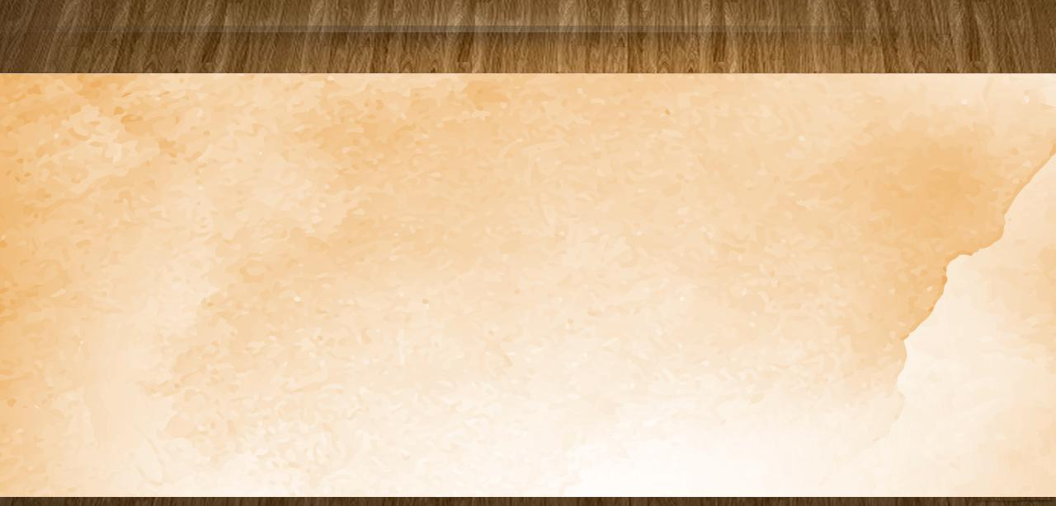
MUFANANIDZO WAJESU
“Uyu ndiwo murairo waŋgu, kuti muɗane, seni ndakakuɗai imi.” (Johani 15:12)
Akatsungirira kurohwa, kutukwa, uye kuzvidzwa(Mat. 27:27-31)
Unomŋoyo munyoro
Aiitira hanya ani zvake ainge achitambura
Unomŋoyo murefu
Unofarira ɀokwaɗi
Akadzidzisa chokwadi zvakajeka uye nechivimbo chakazara
Unofukidza ɀose
Haana kutonga mukadzi ane chivi, asi akamuregerer(Johani 8:10-11)
Unotenda ɀose
Akavimba nekurevesa kwaZakeyo
Unetariro paɀose
Akagadzirira varume 12 kuti vaite basa raionekwa serisingagoneke
Unotsuŋgirira paɀose
Akatsungirira nzara, kurambwa, kurwadziwa, uye kutambudzwa
(John 8:10-11)
(Rk. 19:8-9

Slide 10

MUFANANIDZO WAJESU
“Uyu ndiwo murairo waŋgu, kuti muɗane, seni ndakakuɗai imi..” (Johani 15:12)
Haana godo
Akanga asingatsvagi rukudzo, uye aiwanzova nevanhu vanozvidzikisira
Haana manyawi
Kunyange zvazvo aiva Mambo weZvose, haana kuzvirumbidza nazvo.
Haazvikudzi
Ainge achida kuita mabasa akaderera zvikuru
Haaite zvisingafaniri
Aiitira munhu wese zvinhu neruremekedzo uye nenzira yakakodzera
Haazvitsvakiri zvake
Aigara achiita kuda kwaBaba vake.(Jn. 6:38)
Haatsamwi
Kunyange pavaimurova, akapindura neruremekedzo
(Johani 18:22-23)
Haana mashura
Akakumbirira ruregerero kune avo vakamuroverera pamuchinjikwa
(Rk. 23:34)
Haafariri zvisakarurama
Akataura nehasha kuvaFarisi vasina kururama
(Mt. 23:27-28)

Slide 11


KUTSUNGIRIRA KWERUDO

Slide 12




HUNHU HUKURU KUPFUURA HWOSE
“Ɀino kutenda, netariro, noruɗo, ɀitatu iɀi, ndiɀo ɀinogara; asi cikuru pakati paɀo ndirwo ruɗo.”
(1 VaKorinte 13:13)
Kuburikidza nemafambiro avo, vaKorinte vairatidza zvinhu zvisingaitwe nerudo: vaiva negodo; vaizvirumbidza; vaizvikudza; vaiita zvinhu zvisina kufanira; vaingofunga zvavo chete; vaitsamwa nyore; vaiva nemweya wekutsiva; uye vaishivirira zvivi.
Sezvavakaita, tinofanira kusiya maitiro aya akaipa tova nehunhu hwerudo —sezvinotidzidzisa Pauro—kuitira kuti tikwanise kushandisa zvipo zvemweya nenzira kwayo. Anotikurudzirawo kuti tirambe tiine humwe hunhu huviri: kutenda netariro.
Kana Jesu auya, chivi hachichazovapo, uye tichava neupenyu husingaperi naye. Panguva iyoyo, chiporofita, kutaura nendimi, nezvimwe zvipo, pamwe chete nekutenda netariro, hazvichazodiwi. Asi rudo ruchagara nekusingaperi (1 Vakorinte 13:8).

Slide 13
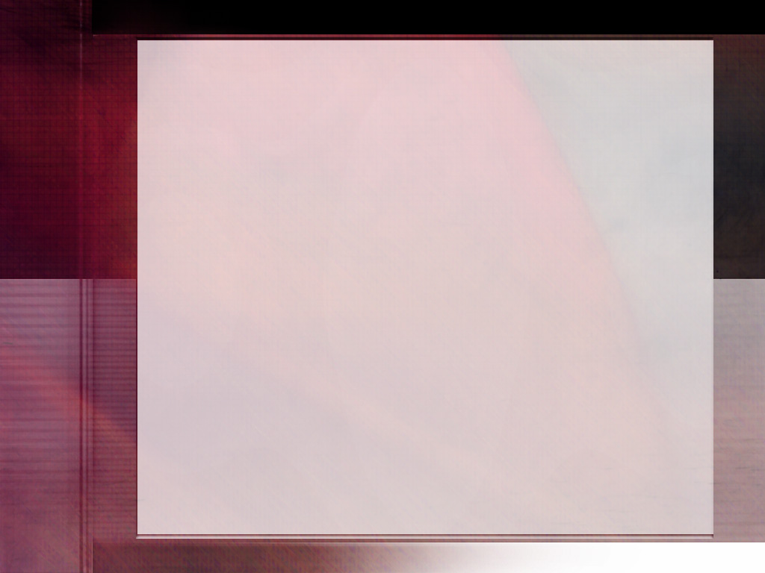
“Mwari rudo. Rudo rwaBaba nerwoMwanakomana hunhu hunowanikwa mumutendi mumwe nomumwe. Shoko raMwari ndiro nzira inosvika nayo rudo rwaMwari kumunhu. Chokwadi chaMwari ndicho chinosvika kupfungwa dzemunhu. Mweya Mutsvene unopihwa munhu anoshanda pamwe chete nezvatumwa naMwari. Anoshandura pfungwa nemaitiro, zvichiita kuti munhu akwanise kutsungirira sokunge ari kuona Iye asingaoneki. Rudo rwakakwana runogona kuwanikwa chete kuburikidza nekutenda chokwadi nekugamuchira Mweya Mutsvene.”-Non-Official translation by Gift Mawoyo
EGW (Our Father Cares, October 9)

