Slide 1
BUOINA BULPI:
NGAILUT HAM, PAPSIET JOH HAM
Simmun 2: April 13, 2024

Slide 2
“Kicha hih in, ijeh in em iti leh keiman kaumpi jing nai; lungthoi hih in, ajieh chu keima naPathien kahi; keiman nahatsah ing ting, kapanpi ding nahi; kagaljona khutjet lam a kadopsang jing ding nahi” (Isaiah 41:10)

Slide 3
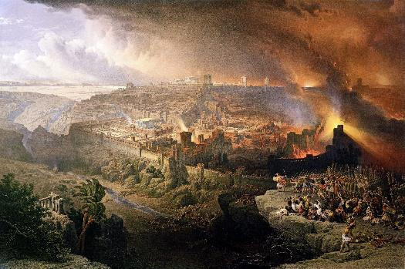
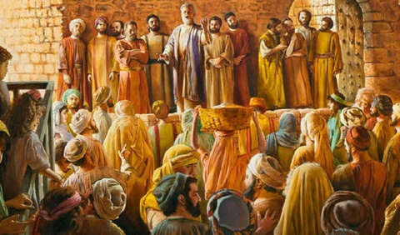
Kum 70 lhin chu Israel nampi din kichaina khat ahung hitai. Jerusalem khopi leh Hou-in Rome suhsiet ahivang in thaneina dang kikumlut jong ana um e.
Alangkhat a, Satan in Israelte Messiah nungsun din atiildoh in, anampi u suhmangpeh din thuneina akilah tan ahi.
Alangkhat kit a, Pathien in athununlou jeh uva achung u sietna lhung ding vel tampi anagahchahsa ahitai; achung u thutan lhung ding akhongaisah phot in, mi honkhat, ahoubung, chu thudih meisal a vannuoi Pathien ngailutna thupha detvahpeh din asiem tai.
Jerusalem khopi kisuhsiet a kuon jildoh ding:
Pathien ngailut kinungsun.
Amite dia Pathien khohsahna.
Christian masaho a kuon jildoh ding:
Tahsanna kitah tah a dingpi ding.
Ngaichatna neiho kithopi.
Ngailut, eiho kihetna melchihna.

Slide 4
JERUSALEM KHOPI KISUHSIET A KUON JILDOH DING

Slide 5
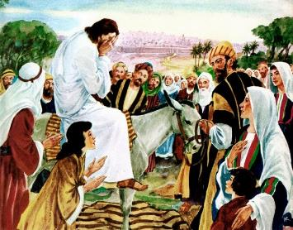
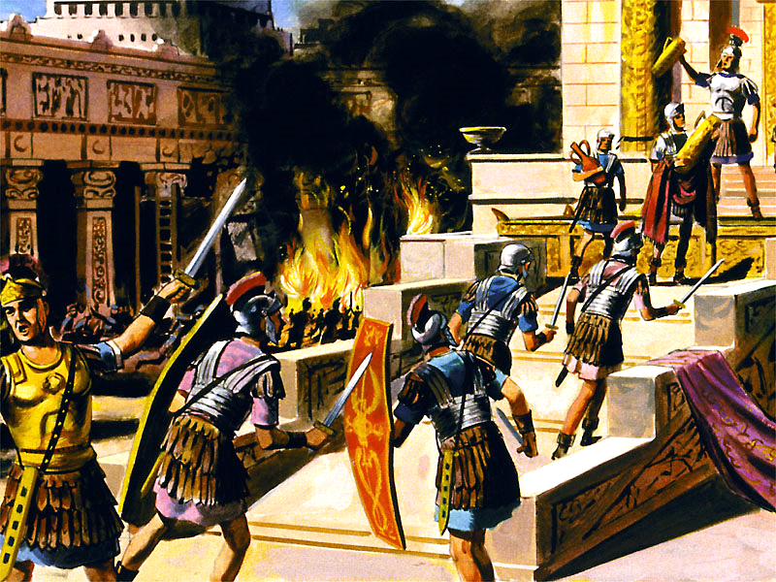
PATHIEN NGAILUT KINUNGSUN
“Vo Jerusalem, Jerusalem, thiemgaoho that leh ahieng a kisolteho suong a seplih, ahpi’n anoute alha nuoi a aopkhum bang a keiman jong nachate ijat vei opkhum ding a kaguot hitam! Ahin nangho nanuompo uve!”(Matt 23:37)
Jerusalem aphahkuon chun Jesu’n akacham e (Luke 19:41-44). Louchal tah a Pathien ngailut kouna anungsun ga athuohtei diu ahe’n ahi (Matt. 23:37).
Manthahna hung lhung ding peldohthei ahijeh a akacham ahi. Pathien in eingailut behseh jieh un khat jieng jong ithi diu anuompon, tuonsot hinna inei chieh diu adei ahi (Jn. 5:39-40; Ezek. 18:31-32).
Thusimbu’n Romete khansiet douna’n Judate kum 66 AD chun anakiphin uve ati. Judate loitum tampi akidoutuo kah un Romete’n akhopi u ahin u’mkimvel tauve. Kum AD 70 chun kichaina ahung um tai. Titus in Jerusalem khopi leh Hou-in chu asuse tan, Juda mi lakh som jong asuhmangtha tai.
Ahin thusimbu’n Satan in Judate kiphin dia chuleh alethuh dia Romete atiildoh dan aphapoh pon ahi. Jerusalem kisuhchimit chu Satan natoh mong mong ahibouve. Hinna tuinah anungsun jieh un Israel chu suhmang le tha ding bou gel melma khut ah aumlo tan ahi.

Slide 6
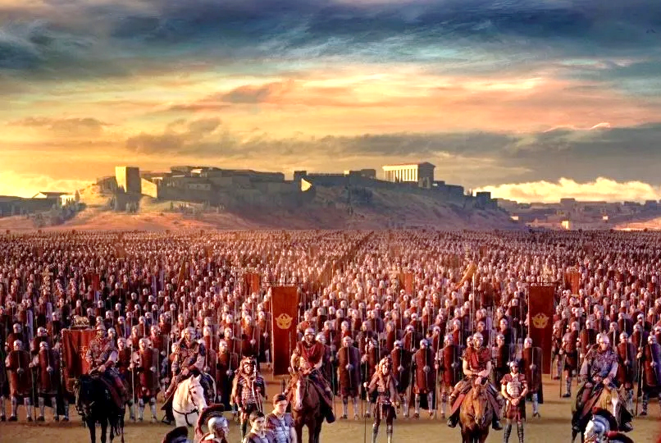
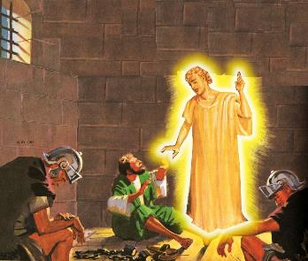
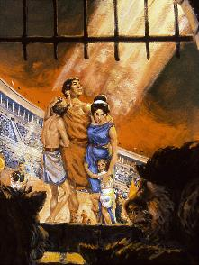
AMITE DIA PATHIEN KHOHSAHNA
“Kicha hih in, ijeh in em iti leh keiman kaumpi jing nai; lungthoi hih in, ajieh chu keima naPathien kahi; keiman nahatsah ing ting, kapanpi ding nahi; kagaljona khutjetlam a kadopsang jing ding nahi.” (Isaiah 41:10)
Ngailut jal in, suhmang a aumlouna diuvin jamdohtheina lemchang anahon peh e. Melchihna anape e: Sipai hon Jerusalem khopi ahin u’mkimvel u chu (Luke 21:20).
Gaius Cestius Gallus chun AD 66 chun hiche melchiha chu anasubulhit e. Sipaiho nung lahdoh ahi chun Hougut pipu Eleazar ben Simon lamkaina’n Romete nung adelpeh un, tampi athat un ahi.
Jesu hilchahna kamcheng tahsan jousen hiche phaat ong lemchang ala un, Jerusalem khopi ngah ding umlou pet in ajamsan tauve.
Lha phabep jouvin, Nero’n kiphinho suchimit din Vespasian ahinsol e. Tunvang AD 67 apat AD 70 gei in khopi chu khaotah in u’mkimvel ahikit tai.
Pathien in achate agelkhoh in, avengbit thei e, phat hahsa pen pet in jong (Ps. 46:1; Is. 41:10). Ahin, tampi’n Pathien a kitah jieh in hinna achaanlo kit uve (Heb. 11:35-38).
Ibol a kimkhat venbit a um a, adangho Pathien dalhah bang a kilang hin tem?

Slide 7
“Pathien umpina hetthiemjouhuoihilou chun iti dan a chondihte chu chondihloute suhgenthei a aum diu aphal hin tem ti hi tahsanna a geuchao tampi din lungdon umtah ahung hijing e. Abang kimkhat chun mihiem lah a vetsiet le thanghuoi pen pen ho inchenthei amu uva, hiteho khut a mipha le thiengthou tah tah ho bolgenthei a aum amu tieng u leh alunglha uvin, Pathien atahsanna u jong pailhah ding agelji tauve. Thudih tah leh hepina a dimset, atha khonna umlou, chun hitobang dihlou tah a amite kibolna chu iti avetjou ahi dem tin tampi’n adongleji uve. Hiche thu umdol dohna chungthu a hin eiho bolthei ding aumpon ahi. Pathien ngailutna dimset in eimusah na uve, ama ngailut ginchalel ding ihipo uve, ajieh chu a umpina umdol hethiemjou ding ihipo uve.”
EGW (The Great Controversy, pg. 47)

Slide 8
CHRISTIAN MASAHO A KUON JILDOH DING

Slide 9
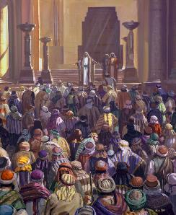
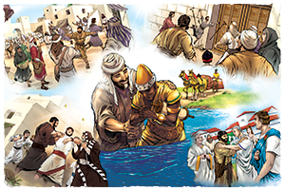
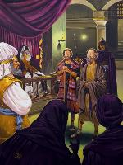
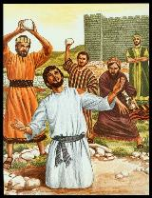
GIMBOLNA A JONG KITAH JING DING
“Saul vang chun houbung suhmangna habol in abol in, inn tin ah alut in, anumei apasal in ajandon in, suongkul ah akhum akhum in ahi.” (Solchahte 8:3)
Akipattiil chun kinepna’n adimset un ahi: tahsanna a lut asang a sim ahi jing uve (Acts 2:41; 4:4); tahsan chate’n thanei tah in alhangsam uve (Acts 4:31; 5:42).
Ahin melma chu akichol pon ahi. Amasan gihna abol in (Acts 4:17-18); aban in gotna alhunsah in (Acts 5:40); akhonna’n thina alhunsah e (Acts 7:59).
Saul suhgentheina apat chun seijuite akithecheh gam tauve (Acts 8:1). Ahin vah suhmit tah sang in, tahsante kitah jal in, hetphah gam chan ah, hapi tah in avahjo tan ahi (Acts 8:4; 11:19-21; Rom. 15:19; Col. 1:23).
Jesu’n houbung chu natoh leh tohjoutheina tha ape’n ahi (Acts 1:8). Tahsa le lhagao tha dang in gospel machal atin joulou ahi (Matt. 16:18). “Pathien eiho lam a apan leh koi ham eidou thei ding uva!” (Rom. 8:31)

Slide 10
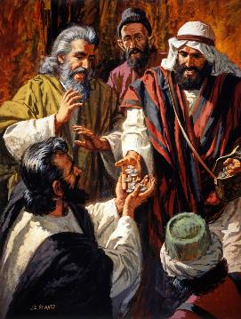
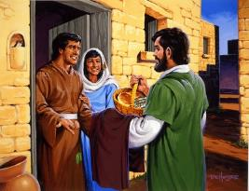
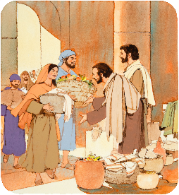
NGAICHATNA NEIHO KITHOPI
“Chuleh anei u, athilkeo u ajoh un, aboncha uvin angaichat akin tuohkham bep chieh in akihomji uvin ahi” (Acts 2:45)
Christian masaho chung a gospel natoh iti kilang em (Acts 2:42-47)?
Jesu tahsan thuhil (doctrine) atahsan ui.
Sudamtheihon damlou asudam ui.
Anei cheng u akikhong ui.
Ngaichatna neiho akihoppi dil del ui.
Jalhang kihoukhomna aneiji ui.
Insung a jong akikhomji un, Pakai Anthiengjon abolji uve.
Kipa leh lungthim chamdel in aumji uve.
Pathien avahchoi ui.
Christa palai ahijieh un Christa chondung chan phah ding ago un ahi. Avel uva ngaichaho ngaichat abolpeh jeh un khopi sung mite deisahna achang un ahi.
Hiche lai bang chun, tun jong Houbung hi Christian ngailutna nei tah, khat le khat chule hon a ding gelkhoh le ngaito ahi jing angai e.

Slide 11
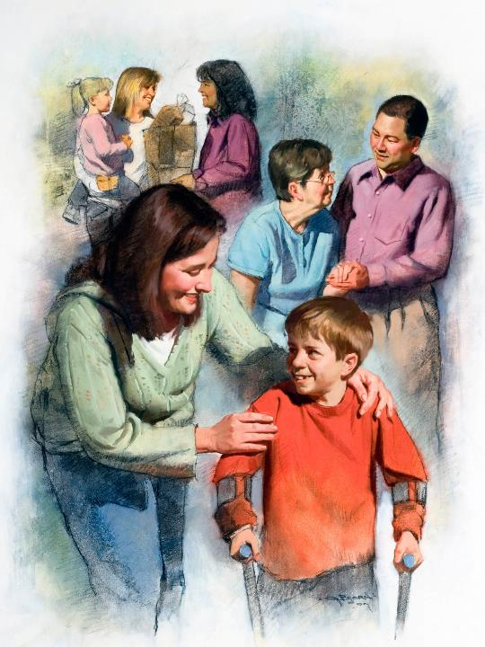
NGAILUT, EIHO KIHETNA MELCHIHNA
“Nangho naki-ngailuttuo chieh uva nahi u leh, nangho chu keima seijui nahi u hiche a chu mijouse’n ahet ding ahi" (John 13:35)
Vanmun jouse a Kidouna Lentah hin alangto gel hina jong atahlah e. Satan chun hot le suhmang ding bou angaito’n, Pathien in ngailut le lhatdoh ding bou angaito’i.
Langkaina nei jouse’n hitobang hina khat joh sang atahlah chieh un ahi. Pathien jui chun midang ngailut achan a kuon avetsah ding ahi (1Jn. 4:20-21).
Kumjabi 2 leh 3 a Christianho chun chang ding gellou khop a ngailutna anei u atahlah ui. Gamna hise nivei alaan ( Kum AD160 leh AD 265) chun hiseveiho buoipina’n hinkho amang un, amaho damthei ding gelman louvin, tampi jong athilo un ahi.
Ngailut vang in akipedoh un, million tampi phattheina alhutpeh ui. Ahin amaho natohphat mite akomu po uve, ahinna u jeng jong aphalpeh u, ahuhhingpu u, Christa joh akomu un ahi.

Slide 12
“Pathien in vannuoi mite kom a alungsiet haosatna thupha, Christa haona seijoulou, aseipehtheina a hung pang ding, hing jing lhacha ihi diu, chu mijouse dia chanpha tah chanthei chu ahi.
Christa lhagao le chonchan tahlang thei ah manchah pha ihi diu adang dang sang in eideipehjo un ahi. Huhhingpu ngailutna tahlangpehthei ding mihiem vannuoi in angaichat bang in ngaichat dang anei poi. Vanmun a um jouse’n thao thiengthou tah mite kinupehtheina a hung pang thei dingho chu ngahlel tah in agaldot uve, hichu mihiem lungsung kipa le phatthei channa hi ding ahi.”
EGW (God's Amazing Grace - Unsearchable Riches, June 28)

