Slide 1

VAH IN MUTHIM ASALVAH TAI
Simmun 3: April 20, 2024

Slide 2

“Jesu’n ajah uvah, ‘Vah hi nalah uvah chomcha khat um nalai ahi; muthim in naphahlouna ding un vah umpet hin vahle uvin; muthim a vahle a chun achena ding ahepoi’ ”
(John 12:35)

Slide 3

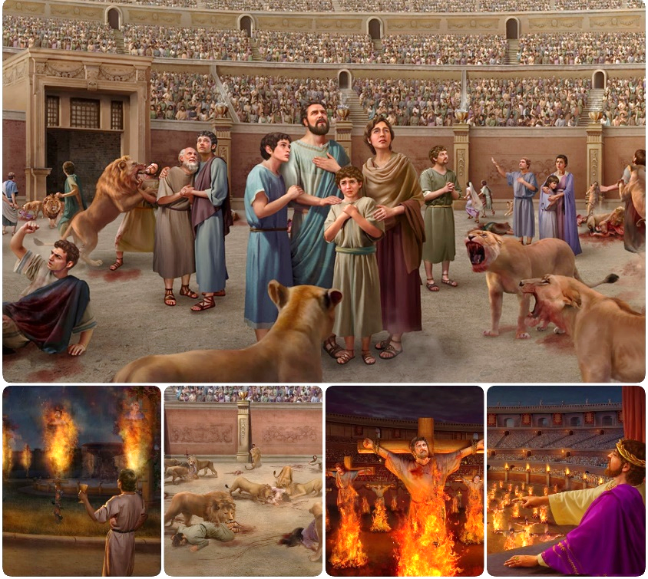
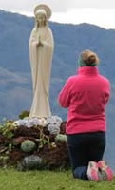

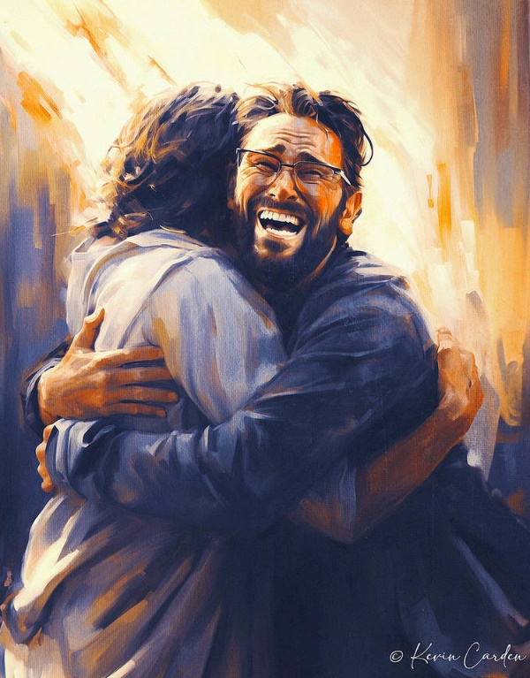








Galjo leh gallelna chu kidouna chung a kingai ahi.
Satan suhgentheina gal alosap phat in galboldan akhel in, kihoutheina lampi apandoh tan ahi.
Thudih le thujou ahalkhom in, million tampi chu hiche thujou jaona, thudih tah bang a kilang, chu atahsansah tan ahi.
Hiche kidouna a isochatna diu lampi umsun chu Jesu kitudet ding chu ahi, ajieh chu ama Thudih le Hinna ahi.
Thudih ding a galsat:
  Thudih le thujou kidintena.
  Houbung in kihoutheina lampi akilhen.
Pathien Thu ding a galsat:
  Bible a huoidohna um.
  Mihiem lungsuhtuo.
Lungsung ding a gal kisat.

Slide 4

THUDIH DING A GALSAT

Slide 5


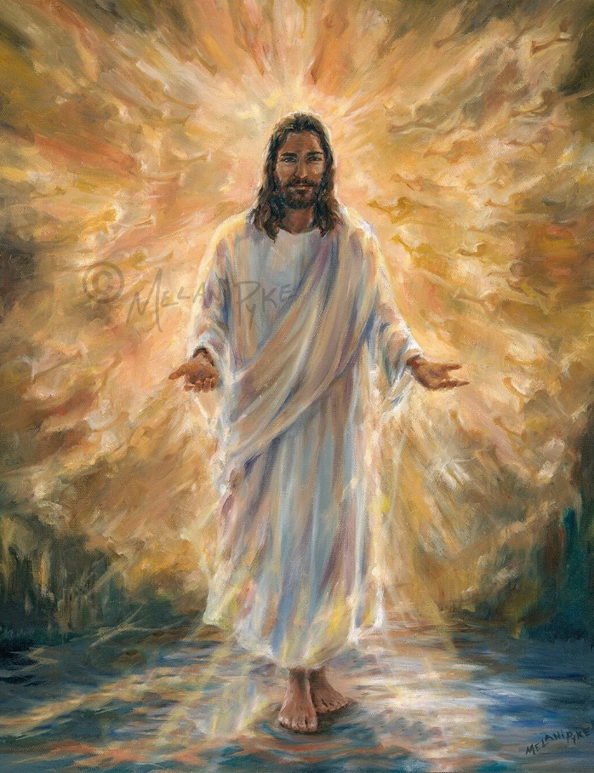
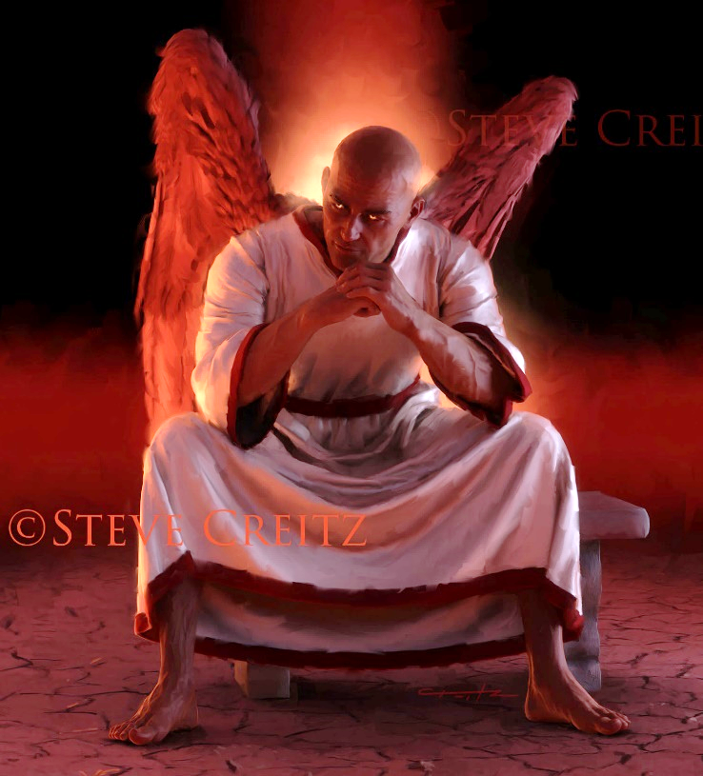
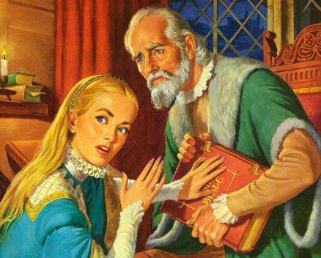
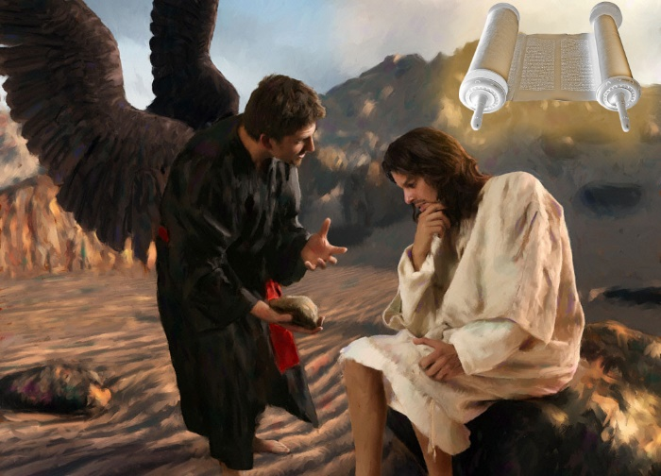
THUDIH LE THUJOU KIDINTENA
“Jesu’n ajah a, ‘Keihi lampi le thutah, chuleh hinna chu kahi; kei a chelou chu koima Pa kom alhung poi’ (ati) ” (John 14:6)
Jesu Thudih ahi, hijieh chun thudih jouse kuonna pa chu ahi (John 14:6). Thildih taphot, muon um taphot, kuondohna Ama ahi. Athudih in hinna eipe uve.
Alangkhat ah, Satan chu jou kuonna pa ahi (Jn. 8:44). Duha, kilhep, thujou le thudih kihalhom kitiho jouse ama a kuon ahi. Athujou chun thina eilhutpeh uve.
Melmapa toh kidintena ah Jesu’n thudih jouse kuonna Bible amangcha jing e: “Hitin akisun e” kiti chu aphongdoh jing e (Mt. 4:4; 21:13).
Hijieh chun Diabol chun Bible suhmang ding ago tan, selmang ding ham, athu heikoi ding ham, tin abol tai. Hichu Middle Ages, Dark Ages jong kiti, phaat lai chun Roman Houbung mangcha’n lolhinna (bukimjeplou) ananei in ahi.

Slide 6


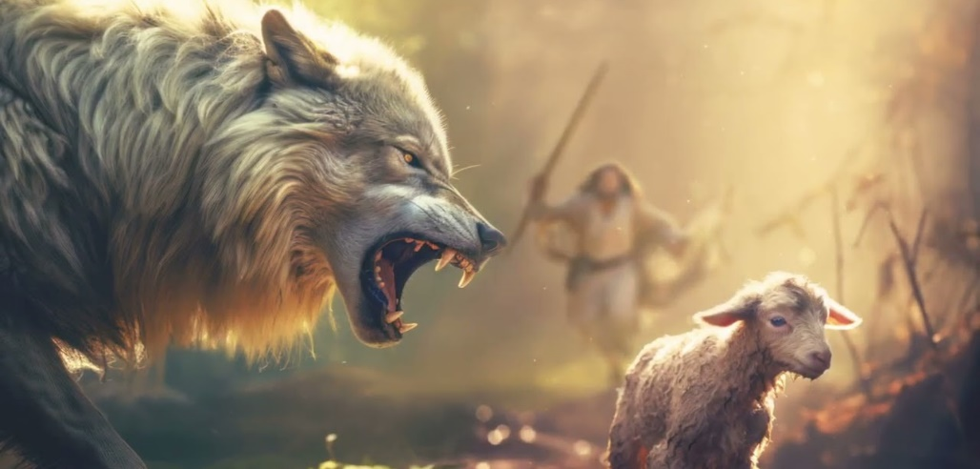
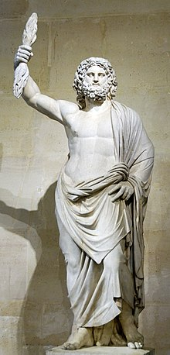
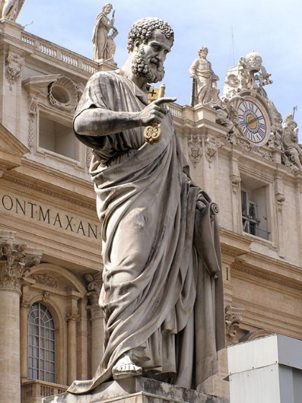
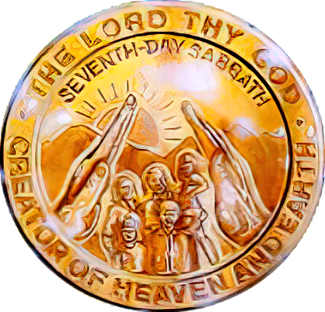

HOUBUNG IN KIHOUTHEINA LAMPI AKILHEN
“Kache nung leh ngei gilou nalah uva alut a, ahon hi ahuoilou ding kahe’i; chule nangho lah a kuon a jong abang bang potdoh a, amaho nung chu ajuina ding a, aluoilutna ding uva, thu akaleh a hil a hung um ding ahi, hiche jong hi kahe’i” (Acts 20:29-30).
Ephesia upate vailhahna asei chun Paul in houbung sung le polam a kuon gitlouna hung kuondoh ding chungchang gahchahna ape’n ahi ( Acts 20:29-30).
Ngei gilou. Kum AD 64 apat 311 gei in ( Serdica suongphu a kimu) houbung Rome kumpi suhgenthei in anaum e.
Mi kilelah. Kum jabi 4 a kuon chun tahnsanna a kiphutdetlou tampi houbung sung panmun akichansah in, hiteho a kuon chun houdihlou chondan leh Christa thudih chopolna ahung umdoh tai.
Captol Hill mun a Romete pathien Jupiter suonglim chu Solchah Peter ahi tin akiminvo e.
Satan chun “sunglam” tohguon mangcha in thudih chopolna toh milim houna le Sunday nitna ahin polut in tan ahi.
Paul gahchahna bang in thudihlouho ahung kipomthei tan, akhonni gei a thudih ngaisahloute lah a um den ding ahi tai (2 Thes. 2:7-12). Kidouna nukhah pen Sabbath thudol nungchonna chungchang hiding ahi.

Slide 7

PATHIEN THU DING A GALSAT

Slide 8

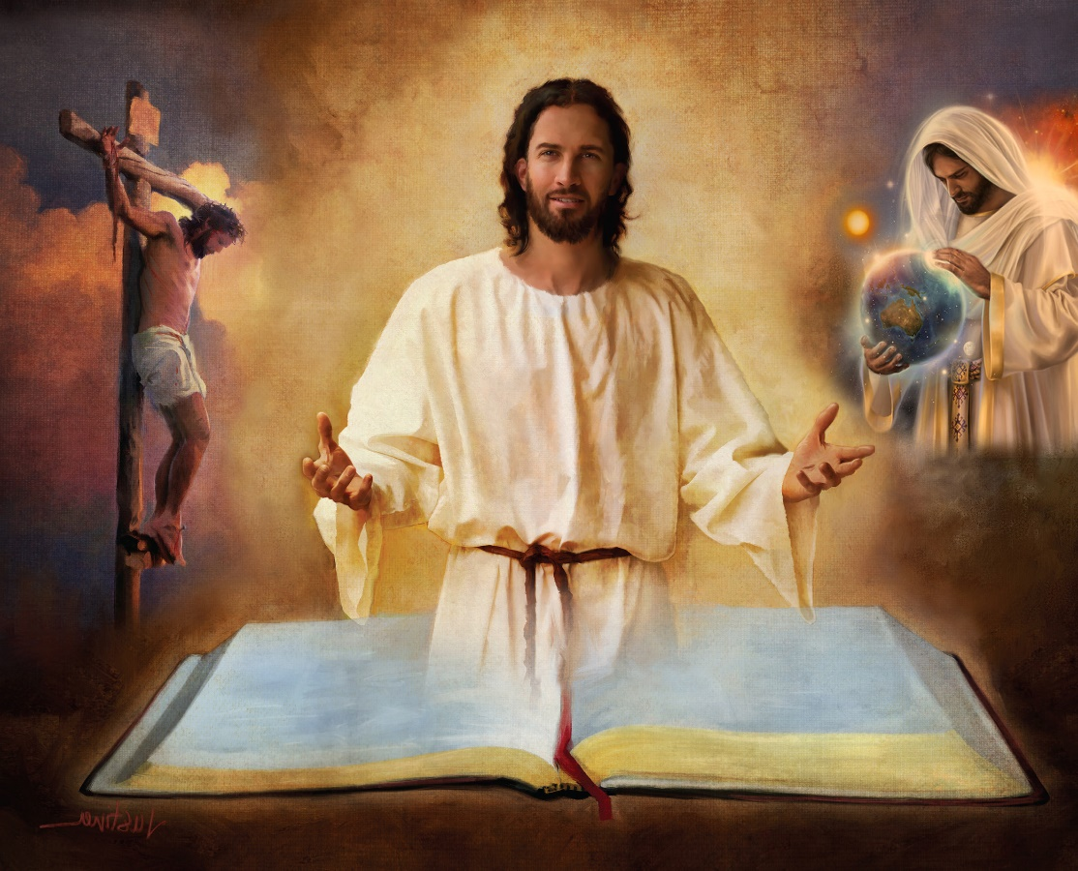
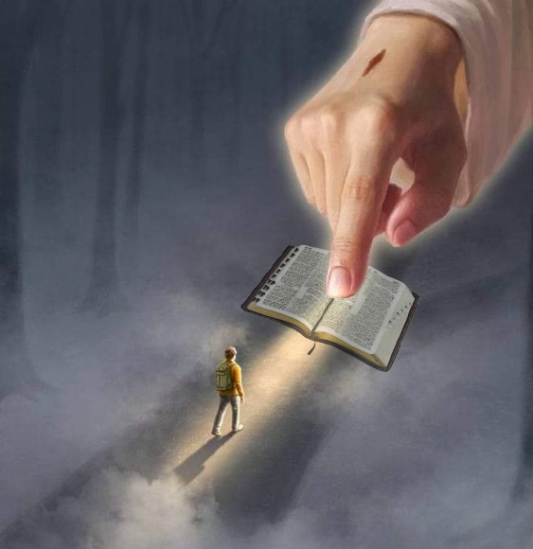
BIBLE A HUOIDOHNA UM
“Thutah chun amaho hi suthieng in; nangma thu chu thutah ahi” (John 17:17)
Bible hi Pathien lungdei kiphuonna, lengtheilou hiel, chu ahi. Mihiemte huhhing ding a Van tohguon chu ahi.
Hijieh chun ihuoidohna diu Bible bouva akimun, asung a lekhabu jouse, abung le achang jouse a hin akimui (2Tim. 3:16).
Hiva hin Diabol tohguon mudoh in aum e; thilsiem; piendol, hinna, thina, thokitna chule Christa palai natoh; chonsiet ngaidamna; Jesu hungkitna; Lei Thah a tuonsot hinna… abon in mudoh in aum e.
“Nathu kakeng din thaomei ahin, ka lampi din khovah ahi” (Ps. 119:105)
Nungsunnalai inei u leh (vetsahna’n, Genesis 1 le 2 a Thilsiem natoh chungchang), aban thuhil dang nungsunna ineibe kit thei u ahi. Aban ban in chal in tin, Bible tahsan thei ahina ilhaso diu ahitai.
“Nathu akihomjal tieng leh kho avah jiengji’n, milhamho gei hetthiemna aneisah thei e”
(Ps. 119:130)

Slide 9




MIHIEM LUNGSUHTUO
“Mihiem khat din lampi khat chu lamdih bang in akimun, ahivang in hiche lampi chu atopna thina ahiji e” (Thuchihbu 16:25)
Pathien chothouva Bible kisundoh ahileh koidang in bah ahilthiem thei ding ham? (2 Pet. 1:20; John 14:26)
Pathien Lhagao chennalou mi chun Lhagaova hung kuon chu apomtheijilou ahin, ngolhuoi tah in agelji e; iti bah ahetthei ding ham, lhagao kuon bouva kihethei thil ahibouve (1Co. 2:14 ).
Mihiem lungsuhtuo ahung hat lheh tan, kum jabi 18 AD vel apat Bible thulhung jong “lekha jilsangna” toh kituoh a hilchien ahi ngai tai tin awgin ahung um tai.
Mihiem lungsuhtuo hin bolmo kidang kisunho apompon, khonung hung lhung ding gaodoh masah jong hitheihuoi in agel poi. Hiche lungput neiho bang a Pathien thahat le khonung thudol ahet masah itahsanlouvu leh Pathien thu (Bible) ipi iphatchuompi diu hitam?
Kichieh tah in vang melmapa’n lampi dihtah bang a kilang khat asiem in, alhutna vang chu thina ahi (Prov. 16:25).

Slide 10

EGW (Selected Messages, volume 1, page 17)
“Lhagao muthim in leisiet atuomdim tan, muthimpi hin mihiemte aluonkhum tai. Houbung tampi ah Lekhabu Thieng kihilna thudol ginchatlelna le dindetlouna aum tai. Tampi’n Lekhabu Thieng thudih le tahsan um ahina jieng jong apomnuom tapovin ahi. Mihiem lungsuhtuo le mihiem lungsung kuondoh chu Pathien Thu puihuoina sang a chungnungjo’n akikoi tan ahi […]
Satan chun mi chonsete toh kithokhom in Pathien khutnung kilahna jouse meilom le muthim tuomchah bang a selmang ding agot jing vang in hiche Lekhabu Thieng hin Satan dounaho ahin ting galkai peh in ahi. Athahat kidangtah jal chun hiche Lekhabu Thieng hi tu dinmun chan ahin vengbit e- mihiemte din vangam jotna lampi limmuthei le simthei in akoipeh e.

Slide 11

LUNGSUNG DING A
GAL KISAT

Slide 12




“Hiche ho sung a hiche vannuoi pathien in atahsanlouho lungmit asuhchot ahi; hiche Pathien lim a um Christa loupi Kipana Thupha chun amaho chu asavahlouna ding a ahi.” (2 Corinth 4:4)
Spain te thuchih khat in: “Khomunuomlou khel a mitchojo aum poi” ati. Khat chu ahetnuomlou thu seipeh a, hetthiemsah tei guot hi phachuomlou tah ahi tina ahi. Hitobang chun “hiche vannuoi pathien in alungmit asuhchotpehho” jong ahi uve (2 Cor. 4:4).
Mangthah dingho hetna lhahsam hi amaho hettheina lhahsam jieh ahipon ahi. Ahetnuomlou jieh u joh ahibouve. Amaho ding a poimo pen- huhhingna thu- ahetmanlouna ding un Diabol chun alungsung u luodimsah ding akoipeh jing in ahi.
Ahin hiti a umden ding mong ihipo uve. Lungsung muthim in atuomdim tieng, asalvah thei le asalvah ding mong vah aum nalai e: “Chuin vah (Jesu) chun muthim lah ahin sal in, ahin muthim in ating jou poi” (John 1:5).
Eiho lah a hiche vah kisaan jouse chun melma natoh akisuhlhap jou ding, Jesu vah chu muthim lah a avahsah jou ding ahi.

Slide 13

“Vanmun lhung lampi jot jouse din lamhil dihtah ngaichat ahi. Mihiem chihna a lam ijot lou ding u ahi. Hinkho tonglam ijot jing lai uva Christa awgin ja a, ngai a iumthei u hi chanvou phatah chu ahi, athu chihna thu jieng ahi jieh in…
Ihuoidohna diu lampi umsun chu Christa khonung ijui jing diu chu ahi, Ama chihna lampi ijot ding u, Athudih a ichon diu chu ahi. Satan natoh bailam tah a he jieng thei ihipo uve, athaangkam hoilai mun ahi ihe jieng theipo uve. Ahin Jesu’n melmapa duha thuhtah natoh chu ahethiem in, lampi bit a lam eijotsah uve."
EGW (Our High Calling, January 10)

