Slide 1
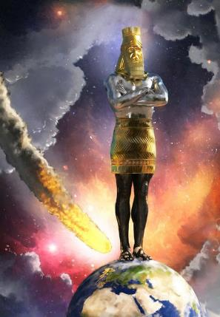

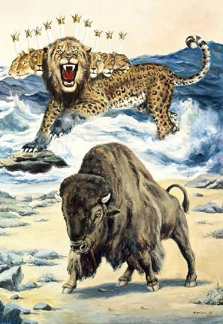

CHITIN NAMTIN- 2
Simmun 5: May 3, 2025

Slide 2

“Um thim uving lang, kei hi Pathien kahi he uvin!
Namtin vaipi lah ah keima choisang in ka um in, leisiet chung ah keima ei kichoisang tai”
Labu 46:10

Slide 3

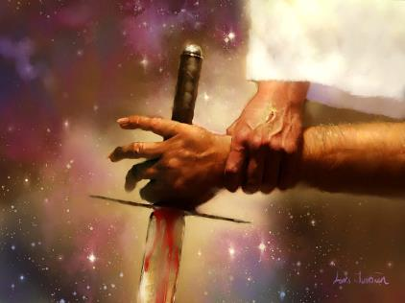
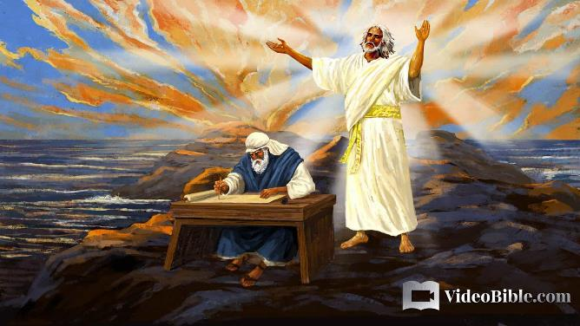



Pathien in se le pha, Christa le Satan, kikah gal hung umdoh leh machal thusim ihet ding u adei e.
Hijieh hin hiche kidouna abih bih a amachal dan thiemgao ho amusah in, namtin vaipi ho panlah dan ahetsah e.
Hiche kidouna thudol hetna pipen chu Daniel lekhabu leh John sut Thuphuon Bu hi ahi. Hi teni a kuon hin kidouna khumkhana thilsuoh ding dan jong akimui.
Se le pha thudol hetna
Khang thusim hetna:
Sana dangka
Sahiem kidang tah tah ho
Khang kichaina mite kipe hetna:
Leisiet le tuipi
Tahsan amohcheng ho

Slide 4

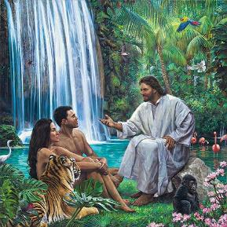

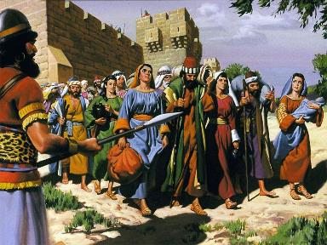
SE LE PHA THUDOL HETNA
‘ “Ajieh chu hiche naneh ni ni lhon le chun namitlam lhon kikeo doh in tin, Pathien toh nabah lhon a, thilpha thilse hethei a na um lhon ding ahi ti Pathien in ahet jieh a asei ahibou e” ati’ (Siemtiil Bu 3:5).
Evi chu se le pha hetna nei a Pathien toh bah din patep in aum e. Apet chun alungtup akimu abang nai (Gen. 3:5, 22).
Hiche hetna hi Pathien in aphal pih lhon lou anahi (Gen. 2:16-17). Pathien in nupa masa pen teni hiche se le pha hetna ibol a ana phalpih lhon lou hin tem?
Siemtiil Bu 3 ivet tieng hiche hetna hin thilpha ima alhutpih lhon lou akimui. Hetna anei lhon hi se hipon tin, hetna akisaan lhon dan dihlou ahi jieh joh hi khat inte. Pathien in nupa teni hi sikul chapang hetna a akhantou tou bang a ol ol a ahilthiem nuom joh ahi. Hinlah, amani’n athilbol lhon a kuon thilse ajildoh lhon jo tai.
Hitobang chun Israel miten leng athuum u chun abolkhiel ta uve. Akhonna’n, Pathien in nam dang ho suohkol hi din aphal pih tan, ama nuoi a um toh nam dang ho nuoi a um itobang a kikhe ahi ahetna ta uve (2 Thusim Bu 12:8).

Slide 5
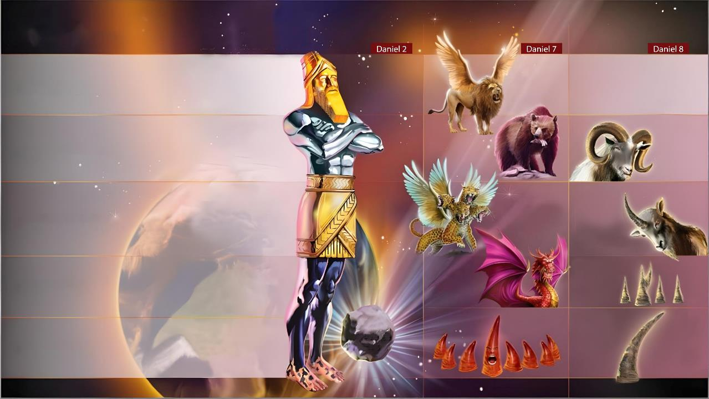
KHANG THUSIM HETNA

Slide 6

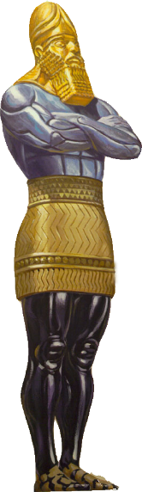
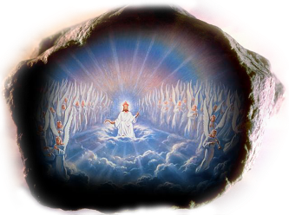

SANA DANGKA
“Aluchang chu sana thiengsel hoi tah ahin, a omlhang le abaanjaang teni dangka jieng ahin, a oipoh le akheldung sum eng jieng ahi; akeng teni thih ahin, chule akengphang teni chu thih le leisiet kihal tong tobang ahi ” (Daniel 2:32-33)
Leng Nebuchadnezzar chu leisiet khang thusim hiche gimnei tah melsuo nei milim a kuon musah in ana um e (Dan . 2:31-45).
Babylon (605 BC-539 BC)
Milim chu sana apat dangka a ahung khehsuh hi mihiem te imalam jouse a alhahsuh vetsah ahi.
Medo-Persia (539 BC-331 BC)
Industrial Revolution ti a kihe mihiem khantouna leh Darwin le Marx tiho thuhil a kuon mite’n Pathien panglou a khantouna chamkim kilhung thei inte tin atahsan ta uve. Kum jabi 20 kipat pat chun leisiet mite kineppi chamna le bitna chu hui lah a mangthai ahung bang tan ahi.
Greece [Macedonia] (331 BC-168 BC)
Rome (168 BC - 476 AD)
Gaothu’n ei gahchah sa u ahi; tu nikho thilsuoh in jong aphochien tou peh e: mihiem te imalam jouse, adieh a kitahna lampang ah, alhasuh suh ta uve. Tuchan din vang alhung ding kiti jouse alhung peh e ti akimui.
The eternal kingdom
Rome divided (476 AD-???)

Slide 7

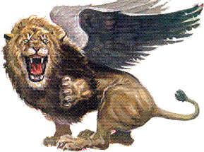
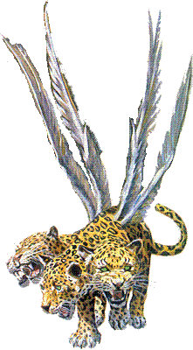
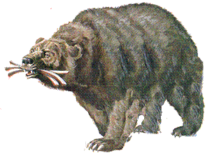
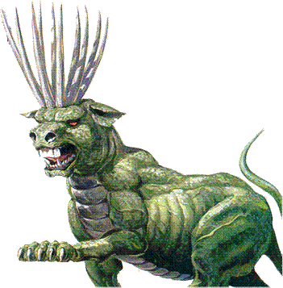
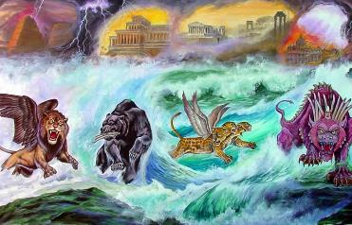

SAHIEM KIDANG TAH TAH HO
“Keiman jaan mang a thiemgao thilmu tobang a thil kamu chun, vetan, van ning li akuon khopi hui hung nung chu tuikhanglien lien pa chu asem liing hiel suoh tai. Hichu tuikhanglien a kuon in sahiem li ahung potdoh uvin, akilimlo beihiel in, achuom chieh ahi uve” (Daniel 7:2-3).
Khang thusim a leng vaipo hung kikhel ding ho ibol a Daniel gao a kimusah kit hin tem (Dan. 7:2-3, 16-18)?
Babylon (605 BC-539 BC)
Akhatna’n, hiho chu lhung tei ding ahi ahetsah nuom jieh ahi (Gen. 41:32). Anina’n, Pathien mite toh nam dang khang thusim thudol ahetsah nuom jieh ahi, ajieh chu Hebrew thiemgao khat kom a hiche gao hi kipe ahi.
Medo-Persia (539 BC-331 BC)
Lenggam ho hi bai tah a hung um doh ahipon, gal le chemjam a kuon bouva hung um doh ahi u avetsah ahi (Is.17:12).
Greece [Macedonia] (331 BC-168 BC)
Lenggam ho kidouna a hin Israel ajao poi; suohkol in apang in, lenggam ho nuoi a gam beh neocha leh atum a kivaipuohna nei jou lou khat chu anahi.
Pagan Rome (168 BC-476 AD)
Pathien in ading uva aguotpih lenggam chu abang jou tapo uve! (Jer. 29:11).
Papal Rome (476 AD-???)

Slide 8

“Namtin khang thusim a kuon hin Pathien thu sim jing din gaothu kisei bang chet aguilhun akilang jieng thei e. Akhonna’n Babylon achehchao in, akihomjal tan, amangthah tai; ajieh chu aphattheina uva Pathien ataitom un, alenggam loupina jong mihiem tohdoh le kiboldoh in agel ta uve. Pathien dan kengto chutpha a anei tah jieh un Medo-Persia lenggam Pathien lungsatna’n alhunkhum tai. Alenggam mite lungsung ah Pathien ginna aum pon, khansiet, Pathien taitom chuleh chondihlouna jieng in alungsung u aluodim tai. Anung a hung kisepdoh lenggam ho chu khansietna le chondihlou nasa jo cheh in abom un; chonchan vetsiet umtah a chun akhehsuh, akhehsuh ta uve.”
EGW (Prophets and Kings, pg. 501-502)

Slide 9

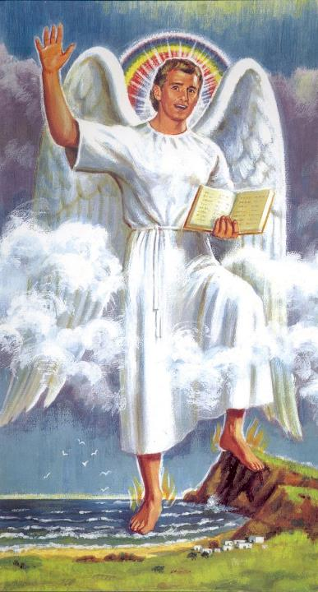

KHANG KICHAINA MITE KIPE HETNA

Slide 10

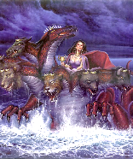
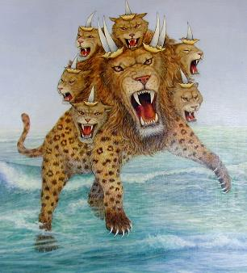
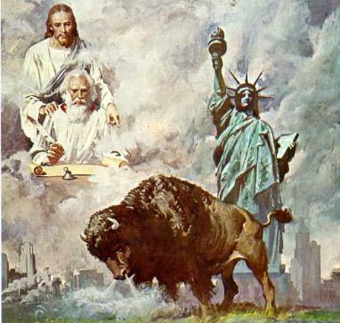
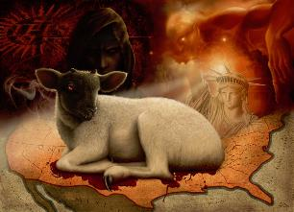
LEISIET LEH TUIPI
“[…] tuikhanglien a kuon a hung kipat doh
sahiem khat kamui […] sahiem chuomkhat ma leisiet a kuon ahung kamui[…]” (Thuphuon 13:1, 11)
Tuipi in gal le chehchaona avetsah ahi ihe uve. Thuphuon 17 hin aseibe in, tuipi hin Pathien sang a Diabol kilhen joh namtin mitin ho vetsah jong ahi ati.
Tuipi a kuon hung doh sahiem chun ni nunung Pathien mite adou ding ahi (Rev. 13:1, 17).
Leisiet a chun mi lhomcha abou aum e; mangthah chate’n tahsan chate suhmang agot u chun leisiet chu kiselna’n amang uve (Rev. 12:15-16); zalenna gam ahung hi tai (USA).
Leisiet a kuon kelngoinou tobang (atil a Pathien a kitah tah ho), ahivang a dragon bang a thusei, khang kichai nikho a tahsan chate bolgim ding, chu ahung kisepdoh e (Rev. 13:11-15).

Slide 11

TAHSAN AMOHCHENG HO
‘Chu in kajah a, “Miho chuleh chitin namtin le paotin paotang, chule lengho tamtah chungchang thu nasei doh kit tei ding ahi” ati’ (Thuphuon 10:11)
Thuphuon 13 hin leisiet le tuipi a hung kuondoh Pathien mite boldim ding thaneina chu ei musah uve. Thuphuon 10 hin leisiet le tuipi a ni nunung thupha Pathien mite’n asaple ding u ei musah uve.
Rev. 10:1
Vantiil hat tah
Christa amatah ahi
Rev. 10:2
Leisiet le tuipi a saple ding thupha ahin po’i
Daniel lekhabu a kisei masa thupha chu ahi
Rev. 10:3-4
Ipi kiseina ahi aki-imchah tai
Daniel kiseipih gaothu chu ipi kiseina ahi hetdoh phaat ahi nai poi.
Rev. 10:5-7
Daniel 12:7 a bang hin kitepna kibolpih akimui
Thupha chu ni nunung a ding ahi
Rev. 10:8-10
Thupha chu kamsung a lhum, oi sung a kha ahi.
Jesu hung kit ding thupha kisam chu lhahdahna nasa tah in alhunkhum e.
Rev. 10:11
Ahin gao thu sei kit ding ngai ah ahi.
Lhahdahna nasa tah a kuon a hung kisepdoh Adventist houbung hin thupha asaple jing ngai ahi.

Slide 12

“Thuphuon 14 a Pathien thutan vaihom phaat ahung lhung tai kiti hi nikho kichaina ding a kisei ahi. Thuphuon 10 a vantiil hin tuikhanglien akeng langkhat in achon in, langkhat joh ah leisiet achon e; hichun hiche thupha gamtin le muntin lhut hi ding, tuipi ho pal galkai hi ding, tuikuol gam jouse’n jong hiche ni nunung thupha chu ajah suohkei ding ahi ti avetsah ahi.[…]
Pathien hetlou in ahoubung chung a hahsatna meilom khat jieng jong chu kha pon, aman ahet masah lou douna natoh hung lhung khat jieng jong aum poi. Athiemgao te kamcheng a aphuon masah bang tah a guilhung jieng ahi jo’i. Ahoubung chu muthim lah ah adalha den pon, gao in ahung lhung ding ho apho masa’n; aumpi jingna pum in, athiemgao ho aphuondoh masah sah ho jouse leisiet khang thusim a hin khat khat in aguilhun sah e. Aguot chan bulhit le muolso a um ding ahibou e”.
EGW (Christ Triumphant, November 29)

