Slide 1
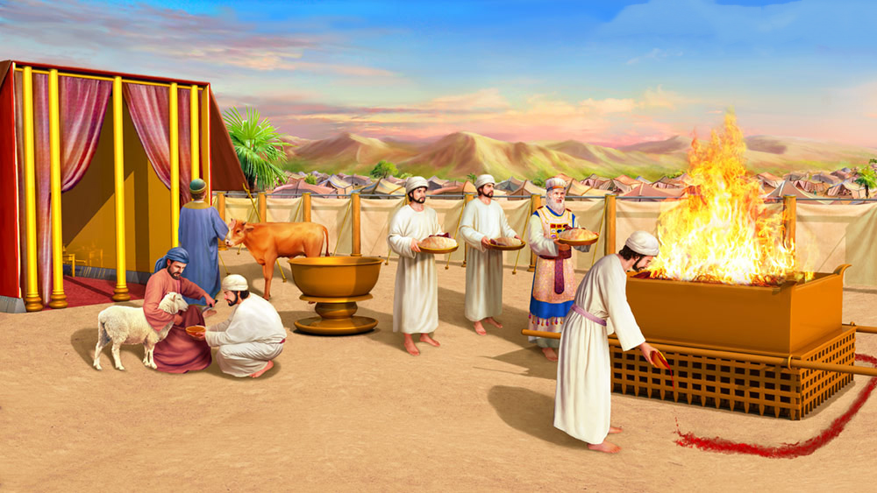
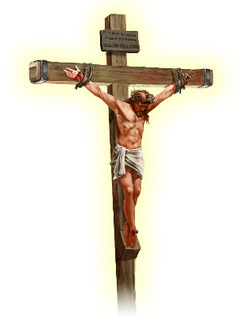
PUMGO THILTUO MAICHAM
HETTHIEMNA
Simmun 6: May 10, 2025

Slide 2
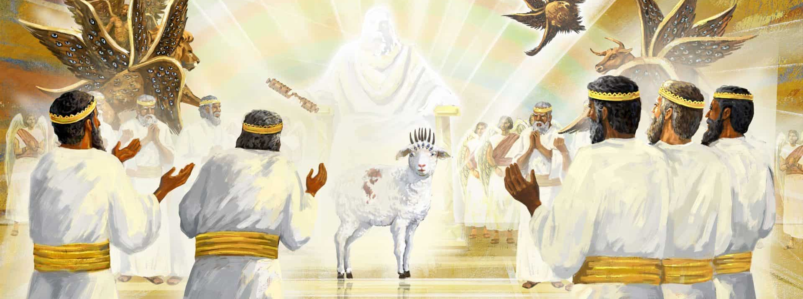
“Amaho chun la thah khat asa uvin, Lekhabu chu ala ding leh asinkhana lhamlha ding a lom nangma bou nahi; ajieh chu nangma kithat tasa nahi. Phungtin le chitin namtin a mi, paotin paotang a mi, gam vaipi namjouse mi, Pathien a ding a nangman nathisan a na chohdoh ahi tai”. (Thuphuon 5:9)

Slide 3

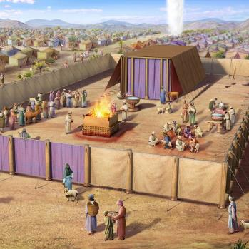
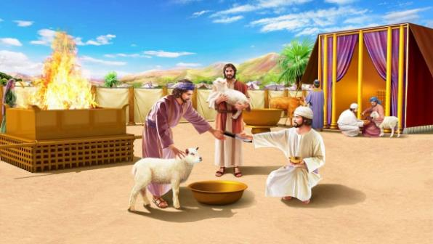
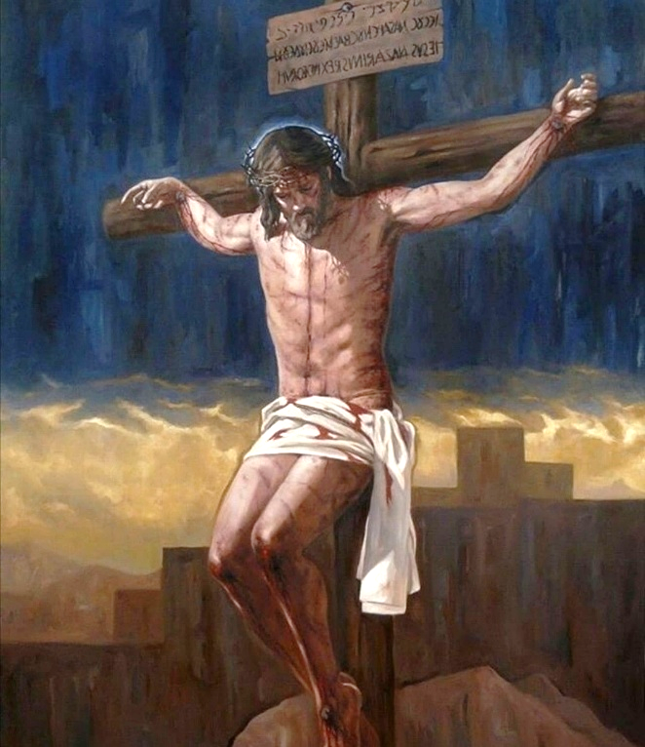





Nisieh in gan tampi akithat e. Sa kithana mun a kuon chun thisan tui luon in ahung luong e. Juoh ding sa kibolna mun ham, sa puul um jieh a thilsuoh thudol ham isei u ahi poi.
Israel mite Pathien houna Houbuh thudol isei u ahibou e. Kilhaina pumgo ding a gan kithat chu Pathien ama tah thusah ahibou e. Hibang se a khangitlou le mona neilou gan kithana ibol a um a hin tem?
Abon un vetsah le komu khat anei uve. Gan thisan kiso jouse’n kilhaina bolpa achonsiet jieh a thi ding lom ahi avetsah e. Gimnei tah a kithat gan chun kalheng a bolsiet leh thina hung tuoh Pathien Kelngoinou, Jesu, thudol asei ahibou e.
Pumgo kilhaina’n avetsah:
Kipah kilhaina leh kipahlou kilhaina.
Houbuh a kilhaina.
Kalchuh kut ding kelngoinou.
Jesu, Pathien Kelngoinou:
Hou-in a Kelngoinou.
Vanmun a Kelngoinou.

Slide 4
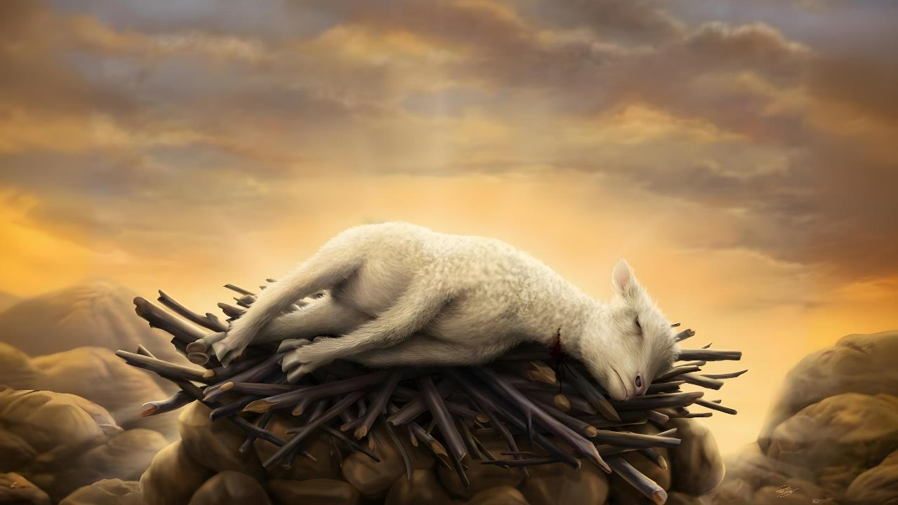
PUMGO KILHAINA’N AVETSAH

Slide 5


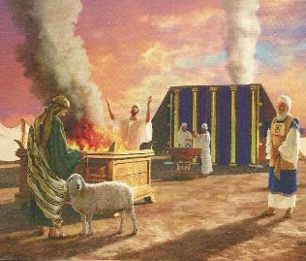
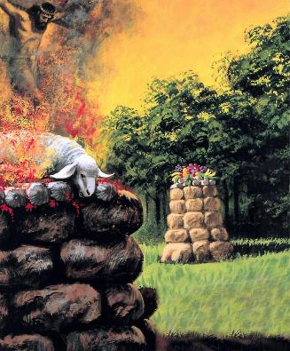
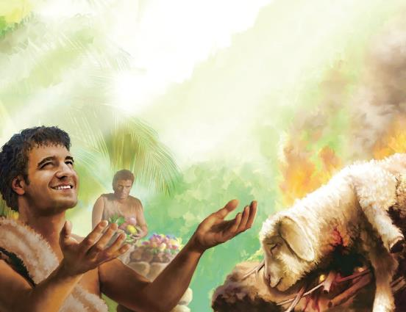
KIPAH KILHAINA LEH KIPAHLOU KILHAINA
“Na kilhaina u gantha hijat pi hi Ken ipi ding kati ding ham? Keiman kelngoi chal pumgo thiltuo tampi kanei in, gancha kivah thao tah tah jieng jong kanei e; kelngoite…kelchate thisan hijong leh ka kipapi poi” (Isaiah 1:11)
Pathien in ama houna gan a kilhai apatdoh pih ahi. Tu’n hichu “ka kipapi poi” ati (Isaiah 1:11). Chomkhat jou in “apumgo thiltuo u ahin, akilhaina gantha u ahin…kasanpih chieh ding ahi uve” (Isaiah 56:7 ) ati kit e. Kilhaina chu akipapi kan, akipapi lou kan um ji hin tem?
Cain le Abel thusim a kuon hiche dohna hi donbut jieng thei ahi. Abel kilhaina akipapi’n, Cain kilhaina chu asanpih tapoi (Gen. 4:3-5).
Akilhaina lhon pumgo jal chu ahipon, akilhai lhon lungput joh Pathien in avetpih lhon ahi joi.
Isaiah khang Israel mite bang in Cain chun ahinkho Pathien deilam toh kilhon ding angaisah pon, huhhing channa kilhaina jong nahsah in akoipoi. Abel in vang chonse ahi akipom in, Kelngoinou chu huhhing achanna’n atahsan e.

Slide 6

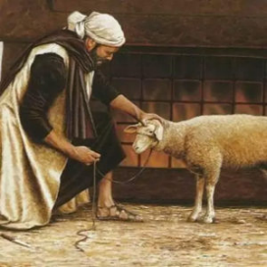

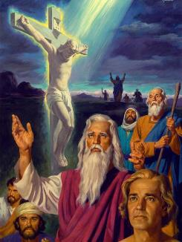
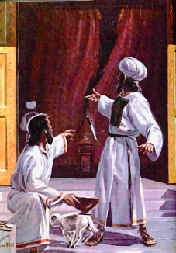
HOUBUH A KILHAINA
“Ahinlah hicheng chun kumtin in achonsietna u ageldoh sah jo ta uve; ajieh i ham iti leh bongchal leh kelcha thisan a chonsiet suhbei huoi hilou ahi.” (Heb. 10:3-4)
Chonsiet man thina ahi (Rom. 6:23). Ahileh,gan khat thi chu ka chonsiet man a sim thei hin tem? Ahithei poi! KA chonsiet man chu KEI thi ding chu ahi.
Khuti ahi leh ibol a chonsiet lamang theilou gan kilhaina kibol jing ana hi dem? (Heb. 10:3-4)
Gan chu Jesu vetsah ahin, thisan kiso chu Jesu thingpel ahung thi vetsah ahi. Jesu melse tah a tha a aum masang se’n gantha chu um jing ah ahi. Jesu KEI mun ah KA chonsiet jal a gotna ahung chang in, ahung thi tai.
Thingpel gei alhun masang se’n hiche kilhaina ho hin gaothu asei sei jieng u ahi. Pathien Kelngoinou tahsan chan chu ngaidamna akichan in, thina apeldoh un ahi.
Jesu thi jou puondal kehni akiso chun hiche gan kilhaina hi ngai talou ahung hi. Tu hin Pathien Kelngoinou thina tahsan chan chu ngaidam chang in akisim pih tai.

Slide 7


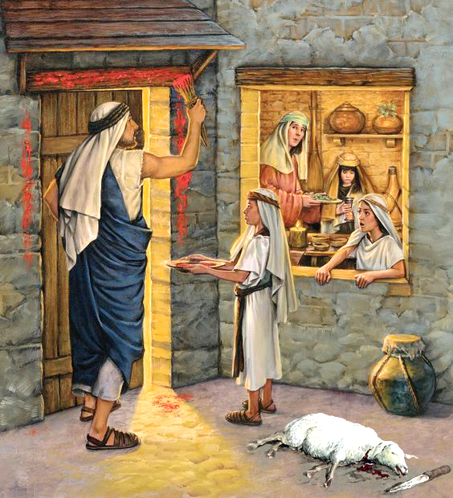
KALCHUH KUT DING KELNGOINOU
“Tu a nangho cholsolou nahi bang u chun…chollui chu thehngim un, paidoh un; i jieh in em iti leh i kalchuh kut satha ding un Christa tah chu akithat tan ahi. (1 Corinth 5:7)
Kalchuh kut masa pen chun kotphung jouse gan thisan aloi un, thina vantiil chun akalchuh ji tan ahi. Hiche insung a pieng masa pen chu huoidoh ahi ji tai.
Hiche thisan chu Jesu thisan vetsah ahi (1 Pet. 1:18-19). Kum sieh a anaman u Kalchuh Kut jong Jesu thi ding vetsah melchihna ahibou e (1 Cor. 5:7b).
Kalchuh kut
Abib lha nisim 10 apat 14 gei kelngoinou chu kihen ahi (Ex. 12:3)
Kelngoinou chu nisim 14 nilhah in akithat ji e (Ex. 12:6)
Jesu
Hiche nikho ho chun Jesu’n hou-in jieng ah thu ahil e (Jn. 18:20)
Jesu hiche nikho nilhah lam chun athi tai (Luke 23:44-46)
Jesu bou thiengthou chungnung Pathien ang a mihiem chonpha chu ahi. Ama thisan a ka kisil a, thina’n ei peldohna din, ama athi gei in chonse lou ahi (Rev. 7:14).

Slide 8
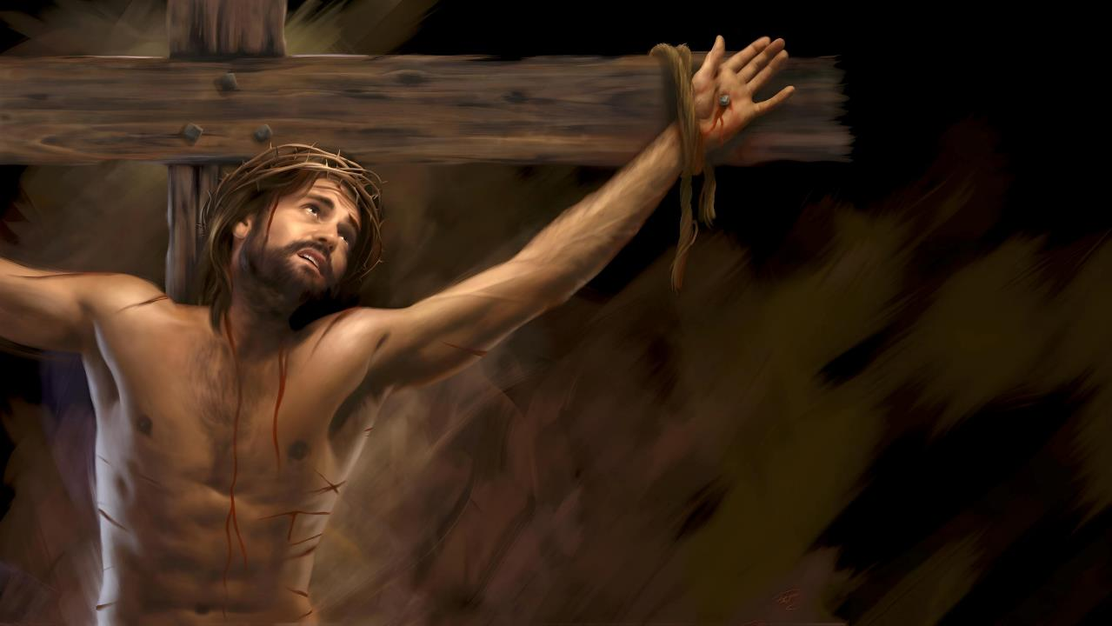
PATHIEN KELNGOINOU JESU

Slide 9

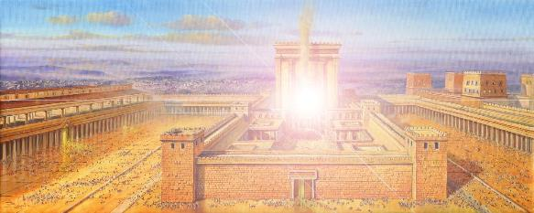
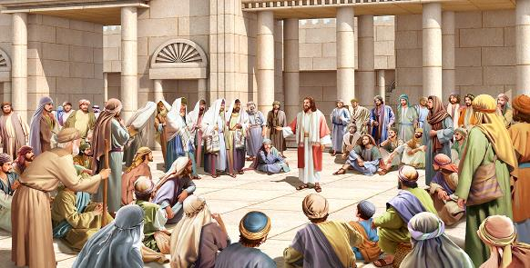
HOU IN A KELNGOINOU
“Nampi vaipi jouse kaholiing suohkei a, chutieng leh namtin vaipi lah a thil kikhol jouse hi hung lutsuohkei a, hiche hou in loupi tah a kadip suoh hiel ding ahi” (Haggai 2:7).
Hou in masa kithiensuo a thingkuong ahin puohlut u chun Pathien loupina’n hou-in asal dimset e (1 Lengte 8: 5-10).
Babylon agampemna uva kuon ahung kile u chun Hou-in athahsah kit uve. Ahin, hiva chun thingkuong aum ta pon, Pathien loupina’n jong ahin dimset tapoi. Hichu tampi’n anakapi uve (Hag. 2:3).
Ahin, Pathien in aloupina a hou-in adimset kit ding ateppih e; hichu Alunglam Mipa a abulhit ding ahi (Hag. 2:7). Hiche Mipa chu koi hin tem?
Jesu chu “Pathien in ei umpi uve” jong akiti (Matt.1:21-23). Avale, ahille, chuleh hou-in a tampi aboldam chu hiche hou-in Pathien loupina’n adimset kit chu ahi tai. Abol jouse Pathien loupi kiphuonna ahi. Siempa amatah amite lah a lha a, achenpi a, ahung thipi ahi.

Slide 10

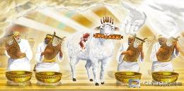
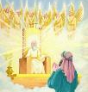
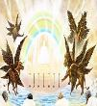
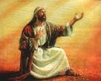
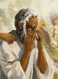
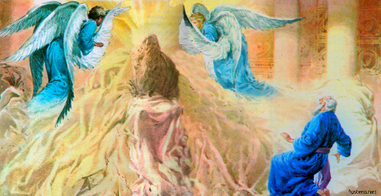
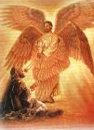
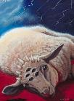
VANMUN A KELNGOINOU
“Amaho chun aw sang tah in, “Akithatsa kelngoinou chu ijakai boltheina thahat, hao, chih, thahat, choi-at, loupi, pachat chang a lom ahi” ati uve.” (Thuphuon 5:12)
Thiemgao thum—Ezekiel, Isaiah chuleh John—hon gao in Pathien laltouna amu uve. Ezekiel in avettho in, Isaiah leh John vang alailut lhon e.
Vantiil hon “Athieng, Athieng, Athieng” ati uva avahchoi u amu uve. (Is . 6:1-3; Rev. 4:8)
Isaiah in athienlou je akimui; John chun alhing koima amulou akapi e
(Isa . 6:5; Rev. 5:4)
Isaiah chonsiet akilahmang pih e; John in achonsiet jal a Kelngoinou kithat chu amui (Isa . 6:6-7; Rev. 5:6)
Eiho lhinlelna chun Kelngoinou hoina akilahsah cheh cheh e. Jesu thi chun thil ni ei tahlah pih uve:
Pathien in ei ngailut u hi ama kipiehdoh ding jong khohsa lou ahi.
Chonse leh lhusa ihi tah dan u, thingpel louva sochatna lampi neilou ihi ta uve.

Slide 11

“Jesu eiho kiselna ahi. “Ve uvin, vannuoi chonsiet pomang Pathien Kelngoinou khu!” Christa, eiho kalchuh kut satha ding gan, chu ahung thi tai.
Juda te kilhaina thisan valha jouse’n Pathien Kelngoinou lam ei komu uve. Avetsahna ding a kilhaina kibol jouse ama ah bulhit in ahung um tai. Thingpel a ahung thi chun vetsahna kibol jouse akivetsahlona thil toh ahung kimaito tan ahi.
Chonsiet pomang din, thi din ahung kipe’n, ahung muolsuo tai. Eiho lhatdoh man chu ape tai. Man kipe a kilhatdoh ihi uve; Christa’n i chonsiet u ama lahdoh sah ding, achonphatna eiho khu pih din ei kou kou uve.”
EGW (The Review and Herald, July 19, 1898)

