Slide 1
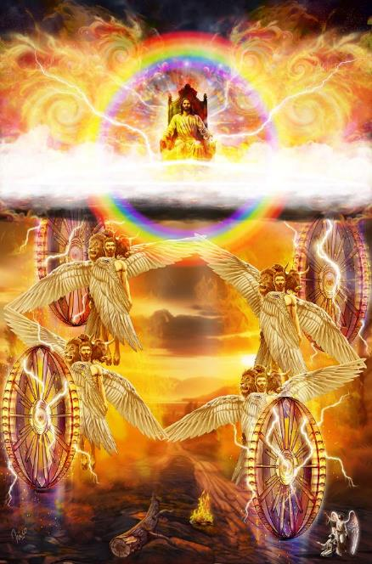
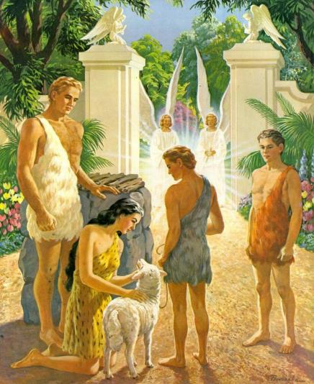
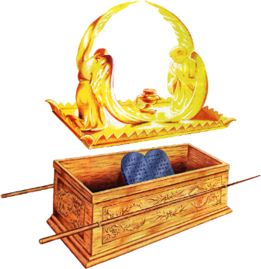
GAOTHU
KIBULPHUNA
Simmun 7: May 17, 2025

Slide 2
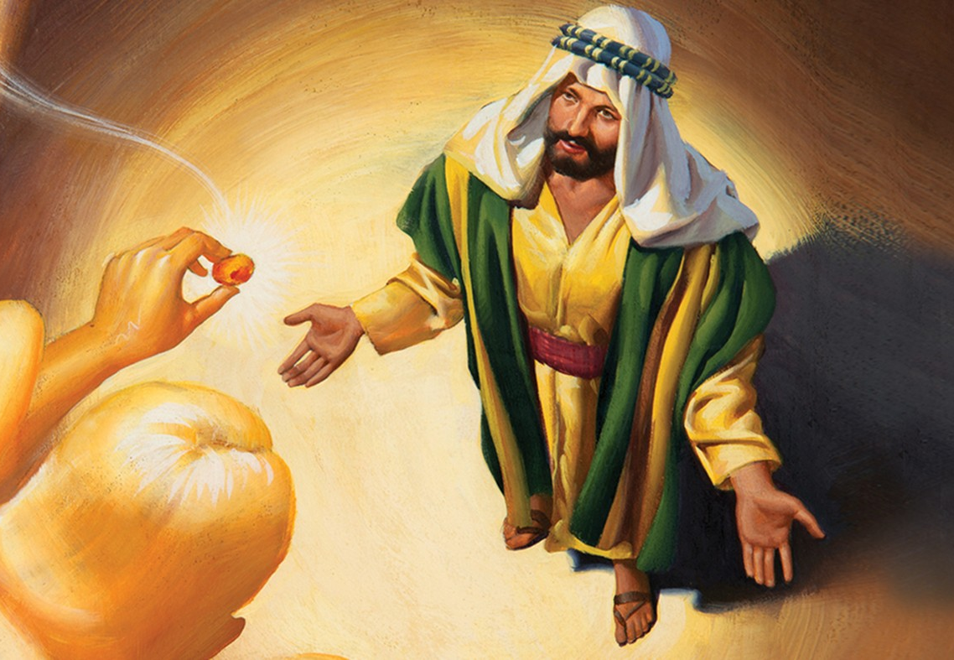
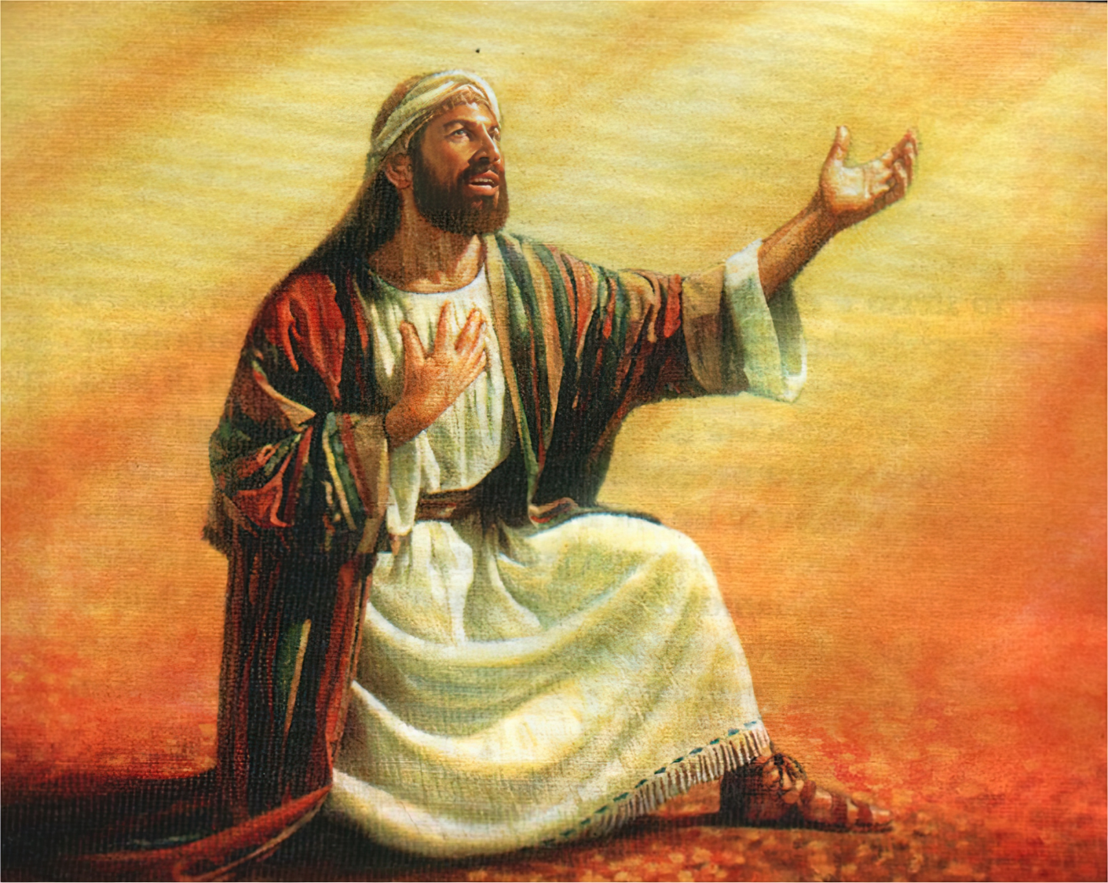
“Hichun Pakai awgin hita kisei kaja’i: ‘Koi ham keiman kasol ding mi chu, chule koi pen ham keiho ding a che ding mi chu?’ ” Isaiah 6:8

Slide 3



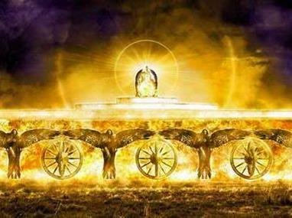
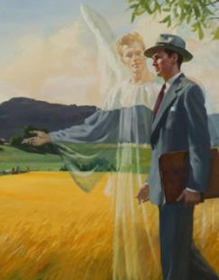

Vanmun leimun jouse Pathien laltouna thusah nuoi a um ahi. Vantiil Cherubim kiti ho chu akinaipi pen ahi. Amahon vantiil te jouse apuihuoi kit ahi.
Vannuoi chonsiet a alhah jou chun Pathien toh mite kinai tah ahi kitna ding in vantiil Cherubim ho panlahna tampi akimui.
Gaothu jal in muphahlou, sophahlou thilguonho hetthei in aum tai. Hiche Cherubim ho Pathien kom nai tah a aum leh ama thusah bang tah a atoh muolsuo uva, mite akithopi jong akimui.
Pathien toh Cherubim ho:
  Meikuong solchah
  Cherubim hon ipi abol ji um?
  Pathien loupi kilahna ahi uve
Cherubim ho leh mihiem te:
  Keipi, bongnou, mihiem leh mulaopi
  Alhusa ho thalheng a pang ahi uve

Slide 4
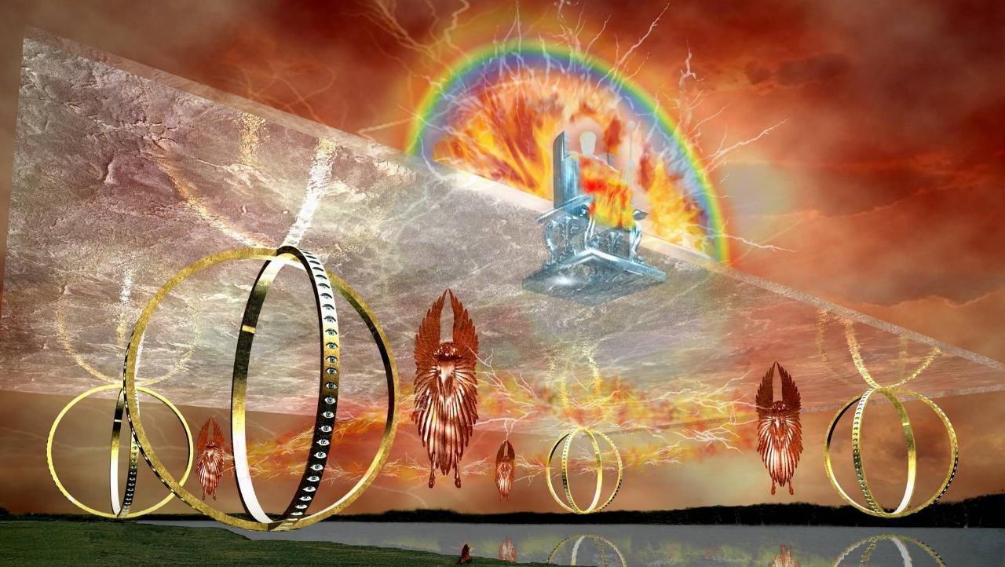
PATHIEN TOH CHERUBIM HO

Slide 5


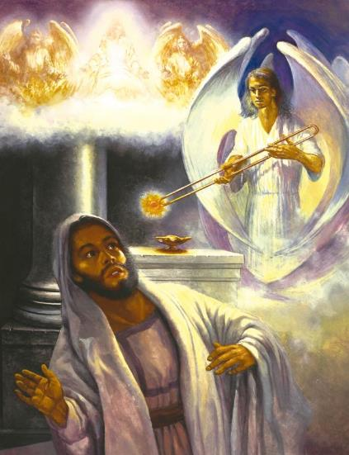
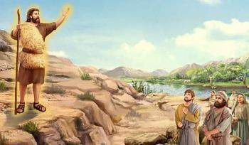
MEIKUONG SOLCHAH
“Hichun Seraphim ho lah a kuon in khat chu kahieng ahung leng in, akhut a chun maicham phung a kuon a chaiche a ahin che doh mei-al chu ahin choi e.” (Isaiah 6:6)
Gal gel tiem in, vah nasa tah leh lamdang tah in nahin sal a, nalungsung um jouse jong muthei asodoh ding chu! Pathien laltouna Isaiah in amu chun hitobang chu anatuoh e. Hichun “Awhe, ada kahi tai!” ati (Isaiah 6:5).
Hichun meikuong a dimset (Hebrew pao a Seraph kiti) khat chun Pathien thienthou je avahchoi chu ataang in, maicham phung a kuon mei-am ala’n, Isaiah chonsietna ngaidam ahi tah aseipih e (Is. 6:1-7)
Hiche Seraph chun Isaiah chonsiet angaidam pih ahipoi. Athu chu apiehson ahi bou e; hichu Seraph natoh ahi jieh ahi.
Hiche a pat chun Isaiah in jong thu piehson natoh atong pan tai (Is. 6:8). Jesu’n John Baptist thudol: “Ama chu thaomei kuong le salvah” ahi ati chu toh ahung kilhon e” (Jn . 5:35).

Slide 6


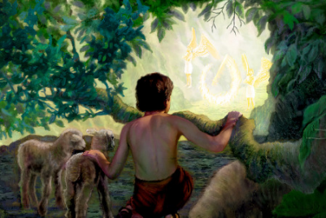
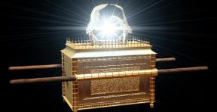
CHERUBIM HON IPI ABOL JI UM?
“Hiti chun mihiem pa chu adelmang in, Eden huon niso lam a chun hinna thingphung lampi ngah ding in vantiil lha nei chu achensah in, chule chemjam koujeju chu akipei kiimvelle sah tan ahi” (Siemtiilbu 3:24).
Bible a hin Cherubim thudol Adam le Evi chonsiet a alhah jou lhon chun akimu ngal e. Pathien in atoh diu ipi apieh em? (Gen. 3:24)
“Hinna thingphung lampi ngah” ding ahi uve. Mihiem te Eden huon aluttheilouna ding u chu ahi. Ahin, thatgam ding a um ahipo uve. Eden huon chu Pathien touna munthieng, ahepina kimuna mun, ahidan tahlah a pang ahi uve.
Hebrew paocheng ‘shakan’ kiti ‘munthieng’ tina chu akimang e. Hiva kuon hin houbuh thingkuong vah ‘Shekinah’ kiti thucheng jong kilamdoh ahi. Hiche vah loupi kiimvel a chun vantiil Cherubim ho aum un, Pathien ‘chenna’ jong atahlah ji ahi (1 Chron. 13:6; Is. 37:16).
Laltouna phung a ipi abol u hin tem? Pathien avahchoi uva, Pathien thusah bang tah a huhhingna natoh muolsuo ding a um ahi uve (Rev. 4:8; Rev. 5:8-9; Heb. 1:14).

Slide 7

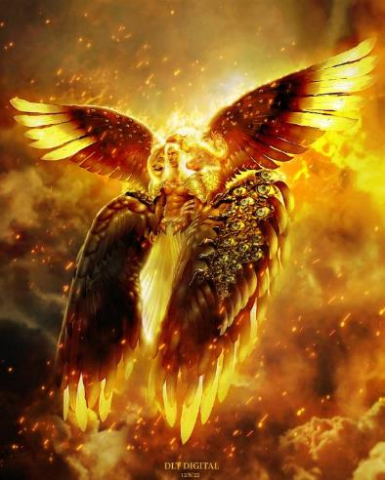
PATHIEN LOUPI KILAHNA AHI UVE
“Chule laltouna mai a chun crystal suong val a val phatvet tuikhanglien tobang khat kamui; hiche laltouna lai a chun, chule laltouna kiimvel a chun ganhing li aum e. Amaho chu amalam anunglam amit jieng amit jieng dimset ahi” (Thuphuon 4:6).
Isaiah 6:1-4
Ezekiel 1:5-14
Revelation 4:6-8
Meikuong lah a um (Seraphim )
Meikuong vah
Ganhing tobang
Lhaving gup
“Athieng, Athieng, Athieng” ati u
Hou in sung meikhu’n adimsah tai
Lhaving li
Mai li: mihiem, keipi, bongchal, mulaopi
Avah emset uve
Lhaving gup
“Athieng, Athieng, Athieng” ati u
Keipi, bongnou, mihiem le mulaopi tobang
Mit jieng a dimset
Isaiah, Ezekiel, leh John hon asut Pathien laltouna kiimvel a vantiil Cherubim um ho limput dan akibang e.
Cherubim ho chu avah emset jieng un (‘mit’ chu vah a dimset vetsah ahi), Pathien loupina’n avah un ahi. Pathien thilsiem jouse ama vah a vahdoh ding a kisiem ahi uve, ama mel a kisiem mihiem te leh akom nai a um jing vantiil ho jong.

Slide 8
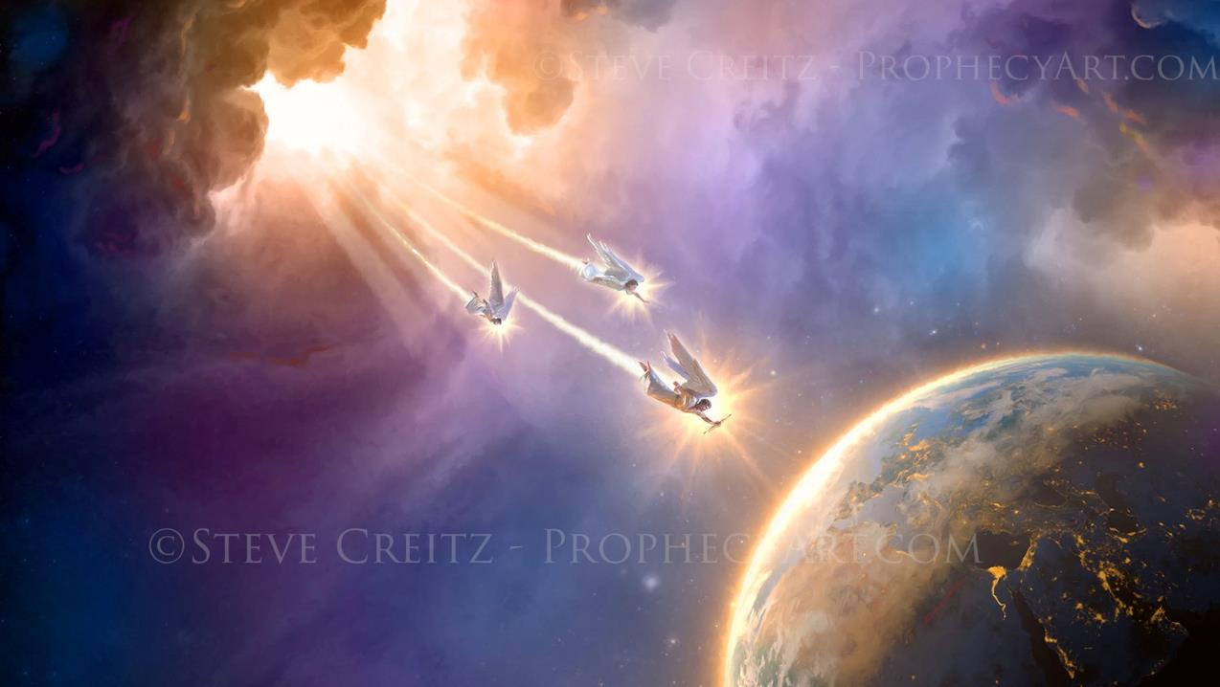
CHERUBIM HO LEH MIHIEM TE

Slide 9








KEIPI, BONGNOU, MIHIEM LEH MULAOPI
“Ganhing amasa pen chu keipi toh abang in, anina chu bongnou toh abang in, athumna chun mihiem mai apui, alina chu alengle mulaopi tobang ahi.” (Thuphuon 4:7)
EPHRAIM
+ Manasseh
+ Benjamin
DAN
+ Asher
+ Naphtali
Pathien laltouna kiimvel a Cherubim um kisei chu Pathien Houbuh kiimvel a Israel phung li um ding kiseiho toh ahung kilhon e (Ezek. 1:10; Rev. 4:7).
Hiti a chu Jerusalem Thah kiimvel a kiguol ding jong um ding ahi: kotpi 12, thum thum a kiguol ding ahi (Rev. 21:12-13).
RUBEN
+ Simeon
+ Gad
JUDAH
+ Issachar
+ Zebulun
Cherubim hon akiimvel bang a Pathien in amite avel akitit dim sah nuom ahi.
Pathien eiho toh chenkhom nuom ahi. Hichu Jesu ahung kit tieng bulhit a um ding ahi (Rev. 21:3).
Ahin hiche nikho lhun masang jieng a jong Pathien laltouna kom nai tah um hinkho iman pat thei u ahi tai (Eph. 2:4-6).

Slide 10

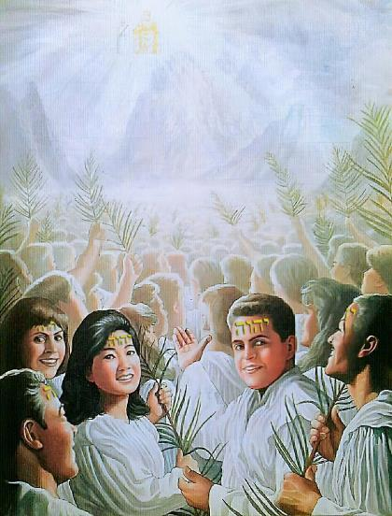

ALHUSA HO THALHENG A PANG AHI UVE
“Chujou chun ve uvin, kelngoinou chu Zion muol chung a adin chu kamu’n, mi sang jakhat le sang somli le li toh ahi; amaho chu achal uva ama min le a Pa min kisun ah ahi” (Thuphuon 14:1)
Cherubim jousen natoh kipe atong muolsuo poi. Hoina le loupina a kijem Cherubim khat chun Pathien sang in amatah kivahchoi ding anuom jo tai (Ezek. 28:14, 17).
Lucifer leh avantiil ho “Pathien muolchung a um” anahi uvin, ahin hiva kuon chun nodoh ahi ta uve. Amaho mun chu Kelngoinou ding a kitah jing ho kipe ding ahi tai (Rev. 14:1).
Pathien natoh kidang tah jal hin vanmun a mithieng jouse’n “Nangma (Jesu) bou achang ding lom nahi” ti a asah ding u, “Ajieh chu nangma kithat tasa, phungtin le chitin namtin nathisan a nachoh doh ahi tai; amaho gamsung mi leh thiempu a napansah ahitan, vannuoi leisiet chung a vai apuoh ding u ahi tai” ti a asah ding u ahi (Rev. 5:9-10).

Slide 11

“Vanmun mithieng te’n lungsung a agel pipen u, athanopna pen u, chu khansietna mun a Pathien houbung khankho ding chu ahi. Christa lam nga a, atahsan chan bulhing set a huhhing ahina ding un Christa thusah abol un ahi.
Vanmun thilsiem kidang tah tah ho hi huhhingna natoh muolsuo dia kipumpieh jieng ahi uve. Pathien lunglam natohna ding a kipumkhat, kin chungnung bol ding, thingpel a kikhenbehpa thahat, hepina, ngailutna leh loupina tahlang ding a pang jing ahi uve.
Christa’n amite thalheng in van houbuh ah atong jing in, alhacha ho leisiet kol kiimvel jouse ah asol in, amin jal a bol gelthei a umho kithopi din, lhagao hinna le hetna aneina ding un.
EGW (The Truth About Angels, pg. 250-251)

