Slide 1

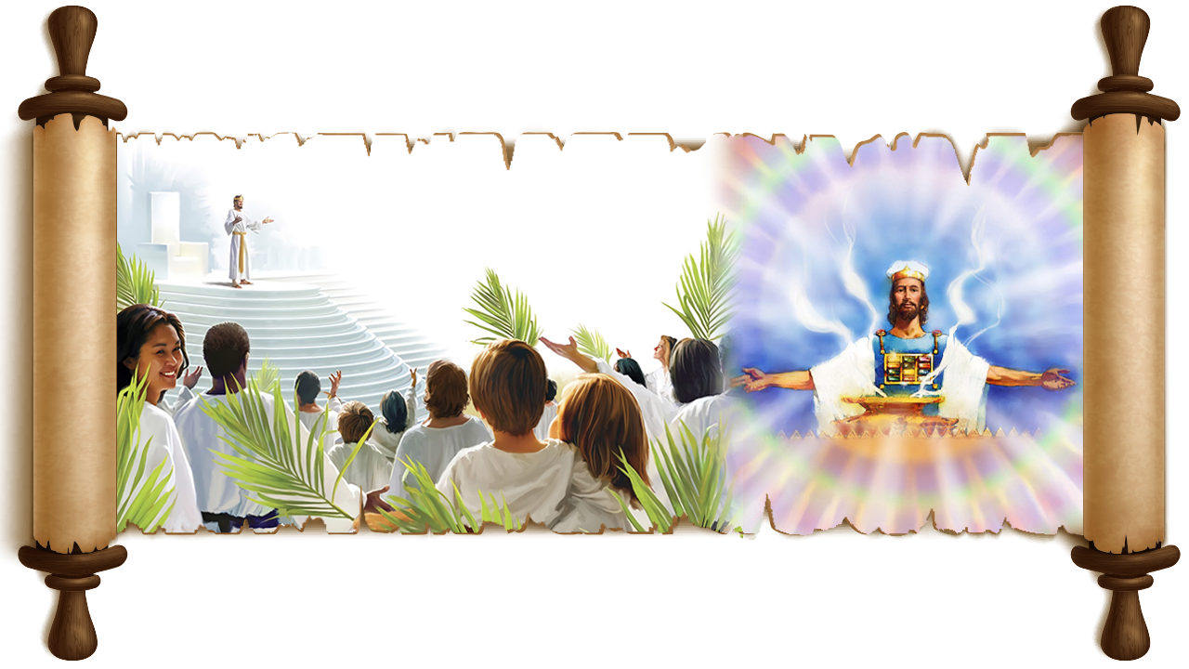

LABU SUNG A:
Part-1
Simmun 8: May 24, 2025

Slide 2
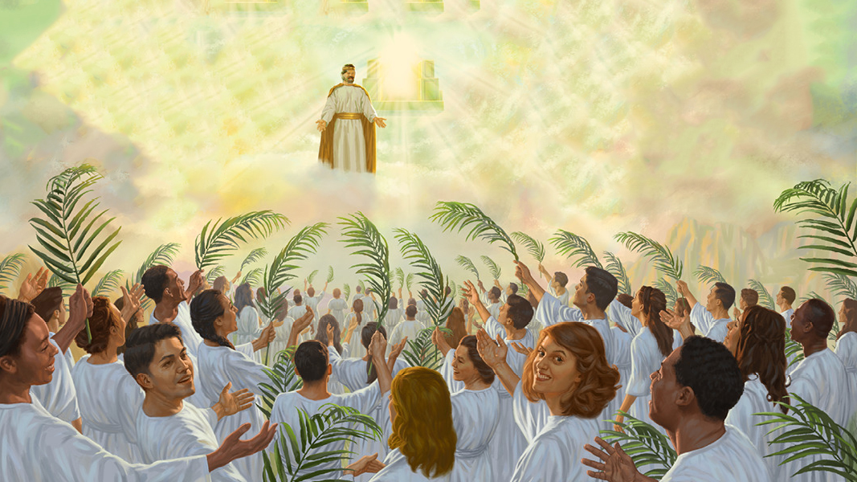
“Chujou chun ve uvin, Kelgnoinou chu Zion muolchung a chu adin kamu’n, mi sang jakhat le sang somli le sang li toh ahi; amaho achal uva ama min le apa min kisun a ahi”
Thuphuon 14:1

Slide 3

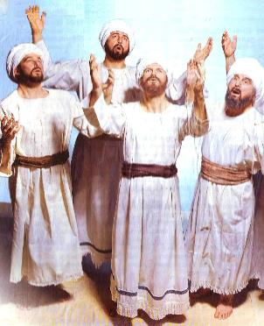
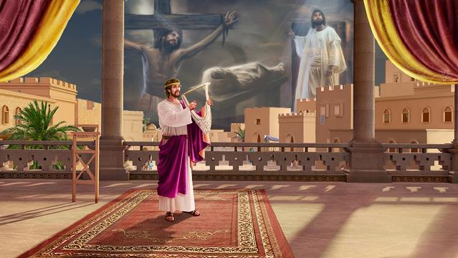





Psalm kiti Labu hi hon leh chang Pathien houna ding a kimang ahina ban a jong gaothu tampi thiemgao hon asutna lekhabu a het ahi (Acts 2:30-31).
Thulhun Thah hin sunho’n hiche Labu hi Jesu Messiah ahi photchietna in amang uve (Acts 13:33; Heb. 1:8).
Jesu’n lei a huhhing natoh atoh ding kisei masahna ahina ban ah Labu hi huhhingna thusim thulu ho kitahlahna jong ahi.
Labu 122: Vanmun Houbuh
Labu 15 leh 24: Lhaang thieng
Labu 119: Pathien min
Labu 5: Lhatsa te ho
Labu 51: Gospel kilhangsap

Slide 4

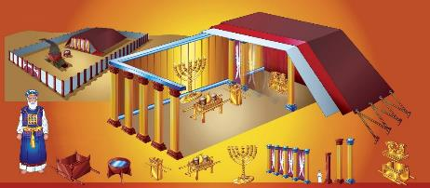

VANMUN HOUBUH
“Pakai hou inn kai in che ute ti a ei tiem u chun keima katha anuom lheh jieng e” (Labu 122:1).
Israel te Houbuh leh Hou inn umdol phatah a ivet tieng Pathien in amite toh kinai tah aum ding, Huhhingna Tohguon musah tei ding aguot akimu thei e.
David in thingkuong chu Jerusalem ah atol lut in, Pathien hou chu alailung pen ahisah tai. Hilai mun a chun Pathien inn ahung kitung doh tai.
Labu 122 hin gao in lhatsa te Jerusalem Thah ahung kikhopkhom uva, vanmun a um houbuh dih tah a chu Pathien ahoukhom ding u aphuong e (Heb. 8:1-2; 9:11-12, 24; Rev. 14:17; 21:3).
Thuphuon lekhabu a jong Vanmun Houbuh kiminphah akimui [polam aleituol, leisiet vetsah chu, jaolou in (Rev. 11:2)]:
MEIVAH SAGI
Thuphuon 4:5
MAICHAM PHUNG
Thuphon 8:3; 14:18; 16:7
THINGKUONG
Thuphuon 11:19
Labu 122 a hin Thuphuon lekhabu a kihasei lheh- ‘vahchoi’ (v. 4); ‘thutan’ (v. 5); ‘chamna’ (v. 6, 8); ‘muonna’ (v. 7)- tiho jong akimui.

Slide 5

“Christa, eiho Thiempu Chungnung chu “houbuh dih tah, mihiem tundoh hilou a, Pakai tundoh Houbuh tahbeh leh munthieng lhacha le a” pang chu ahi .Hebrews 9:9, 23; 8:2. […] Thiemgaopa chu vanmun houbuh pindan masa mu ding akiphalpih in, hiva chun “meivah khompi sagi” leh “sana maicham phung” chu amui. Hi teni chu lei houbuh a kikoi sana meivah sagi leh sana maicham phung in avetsah chu ahi. Hiva hin “kitepna thingkuong” jong chu amui (Thuphuon 11:19), hichu Mosi’n Pathien Dan suongpheng teni akoina thingkuong kisiem vetsah chu ahi.
Mosi’n lei houbuh asiem in, “muolchung a kivetsah bang tah” in abol in ahi. Paul in hiche “houbuh leh lhachale ho manchah chengse jong” vanmun houbuh limguon bang tah chu ahi” tin asei e (Acts 7:44; Hebrew 9:21, 23). John in hiche vanmun houbuh chu kamui ati. Hichu Jesu eiho thalheng a palai na atohna mun, houbuh dihtah pen, alim le aguong Mosi’n asiem chu ahi.
EGW (Patriarchs and Prophets, pg. 324)

Slide 6

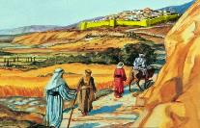
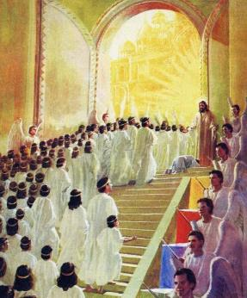
“Vo Pakai, koi ham na houbuh a vahle thei? Koi ham, Pakai, na lhaang thieng a cheng ding?” (Labu 15:1)
LHAANG THIENG
Nuolna bei mi chu chondih tah leh adih jieng sei hi ding ahi (Ps. 15:2)
Alep a ima seilou, aguol apai ding thilse le engsiet bollou hi ding ahi (Ps. 15:3)
Pakai ging te jabol tah a nei, akitepna khel ngei lou hi ding ahi (Ps. 15:4)
Sum ngailou lou, nehguh kilah lou hi ding ahi (Ps. 15:5)
Thilse bolkha lou, lungthim thieng, kiletsah leh jou bollou hi ding ahi (Ps. 24:4)
Zion muol hin Jerusalem khopi lien tah aluo’i, hijieh chun Hou-inn kisahna mun chu Zion muol tin jong akihe’i. Atiil abul chun Moriah muol kiti anahi. Pathien laltouna (Is. 8:18) vetsah ahi jieh chun lhaang thieng (Ps. 2:6) tin jong akihe’i.
Gaothu kisutna ah hichu lhatsa te kikhopkhomna ding mun in jong akisei e (Is. 37:32; Ps. 74:2; Rev. 14:1). Zion muol a Jesu toh ding khom ding chu koi hin tem?
Eima ho changseh a vang hiti ho neidoh thei ding ihi po uve. Pathien hepina le thahatna vang a hilai mun chu lhung thei ding bou ihi uve. Ama chu vahchoi in um ta hen!
Labu 15 leh 24 hin hitobang mite chu itobang ahi u asei e.

Slide 7

“Thiemgao thilmu chun amaho chu Zion muol chung a ding a, kinthieng bol ding a kivonsa a um a, mithieng te chondih kihetna tupat puon banglieh a kivon un asei e.
Ahin, vanmun a Kelgnoinou nung nung a kijot ho chun lei a jong anung nung ajuisa u hi ding ahi. Geuchao tah leh gitahlou tah a ajuisa u hi ding ahipon, kelngoi hon achingpa tahsan tah, ngailu tah chuleh thunung tah a ajui u bang tah a ajuisa u hi ding ahi jo’i.”
EGW (The Acts of the Apostles, p. 591)

Slide 8

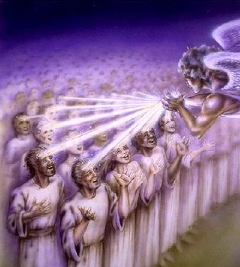
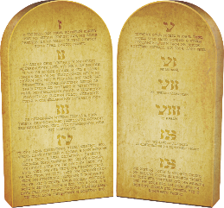
PATHIEN MIN
“Aw Pakai, jaan tieng leh naming kageldoh ji’n, na danthu kanit jing e!” (Labu 119:55)
Zion muol hi Pathien min umna ahi (Is. 18:7; Rev. 14:1). Hiche min hi mihiem chonchan kiseina’n jong ana kimang e (Gen. 32:28).
Hijieh chun lhatsa te chalpaang a Pathien min kisun chu Hebrew thucheng khat יהוה (YHWH) mai mai bou vetsah ahipoi.
Pathien min chu ama tobang umlou, hina kidang anei vetsah chu ahi: “KEIMA CHU KEIMA KAHI” (Ex. 3:14). Ahina chu amin ahin, hichu aloupina le aphatna jong ahi (Ex. 33:18-19).
Labu sunpa’n Pathien aminphah chu Pathien hina giltah a agel chu ahi. Hichun Pathien danthu nit dia thanopna kidang ahin nei tai (Ps. 119:55).
Iti dan hin tem? Pathien danthu chu ahina lekha jem a kisundoh ahi jieh ahi. Pathien min chu ama ngailu leh adanthu nit ding nuom jouse chal a kisun ding ahi.

Slide 9

“Christ loupina chu ahina achonchan chu ahi; ahina achonchan chu Pathien danthu kilahna jieng ahi. Aman danthu chu ahel ahel in abulhit in, ahinkho man a kuon chun Pathien toh kithokhom a panla jouse dia bolmo leh jolel umlou ahi dan ei musah uve.
Mihiem melpo a aum sung chun van thahat muna din Pa kom abel jing in, nuolna bei chonchan anei theina din Pa kom athuum jing e”.
EGW (The Signs of the Times, December 12, 1895)

Slide 10

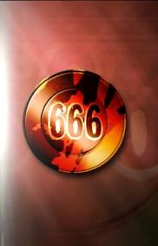
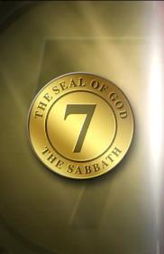
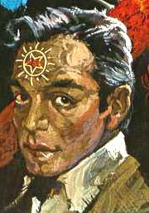
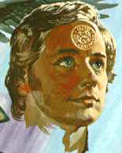
“Ajieh chu nang hi thilse a kipah ji Pathien nahi pon, thilse chu nang toh kilhon thei lou hiel ahibou e (Labu 5:4)
LHATSA TE HO
Labu 5 hin Pathien kisaan ho leh nungsun ho kibahlouna tah ho atahlah e; phaat kichai nikho tieng hiche loitum ni- Pathien mohor kisaan ho leh sahiem melchihna neiho- hung kimaito ding amu masa’n ahi (Rev. 13 and 14).
SAHIEM MIN
Pathien toh chengkhom lou ding u ahi (Ps. 5:4)
Sahiem chibai abuoh ui (Rev. 13:8)
PATHIEN MIN
Pathien toh chengkhom ding u ahi (Rev. 14:1)
Pathien chibai abuoh ui (Ps. 5:7)
Lei naal hieu a thusei ahi uve (Ps. 5:9)
Huhhingna kipa tah in aphuong uve (Ps. 5:11; Rev. 14:6-7)
Amona u akipuoh ding u ahi (Labu 5:10)
Jouthu tahsah lou ahi uve (Rev. 14:5)
Pathien chohdohsa te ahi uve
(Rev. 14:4)
Pathien taitom ahi uve (Rev. 13:6)

Slide 11

“Tahsanna leh thuohhatna patep ding hahsatna te hung lhung ding ahi. Hangsan tah in kimaituopi in. Kipana hung lhung ding ho geldoh in. […] Vangam chu kipana jieng umna ahi. Hi a chu mihiem te huhdoh ding a kilhaanna kidang chungnung hin bolpa vahchoi leh pachatna awgin a kithong jing jieng ding ahi. Lei a houbung jong hiche kipana le vahchoina a chu dim lou ding u ham? Vannuoi a Christian hon Christa a kipana chu asapphuong lou ding u ham?[…]
Nabolkhielna um jong leh na gallelna chu galjona suo go’n. Pathien in aphaat phaat ding kihilna ei pieh u hetthiem go ji leu hen eiho panhu le thahat muna a pang ding ahi. Pathien tahsan in, tao jing in, gingchalel hih in. Kinepna tuhdet in, Tuonsot Thahat chu kolchah jing in, chuti leh galjou ho khelpeh nahi ding ahi.
EGW (Testimonies for the Church, volume 7, page 244)

Slide 12

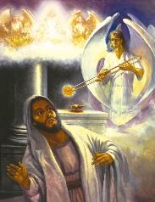
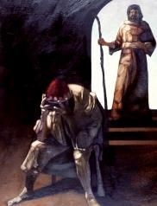
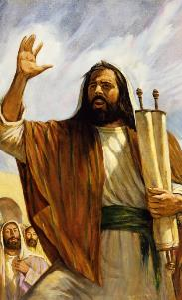
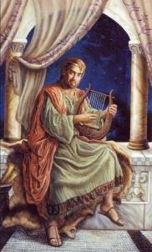

GOSPEL KILHANGSAP
“Chutieng keiman suhkhiel neiho lampi kahil ding; chonse ho jong nahieng a hung kile kit diu ahi” (Labu 51:13)
Mi jouse chonse ahi: koi ham kahi poi ti ding (Ps. 14:3;
Rom. 3:10; 1 Jn. 1:8). Chonse hina jal a huhhingna thupha lhangsap dia lhinglousa kihi ahi tai. Hiti chun Isaiah (Is. 6:5) leh Leng David (Ps. 51:3-5) jong akigel lhon tai .
Ahin kipa um tah chu: eiho jong hiche thiemgao teni bang chanvou changthei ihi uve! Ani lhon in chonsiet akingaidam pih in (Is. 6:7; Ps. 51:12); vannuoi ah Pathien thu alhangsap lhon tai (Is. 6:8; Ps. 51:13).
Khang nunung pen a kilhangsap ding thupha thum lah a ni chu chonsiet dalhah ding kouna ahi (Rev. 14:8-10). Hi teni lhangsap masang chun thupha akhatna in asei chonsiet thoidamna thupha chu lhangsap masah ngai ah ahi (Rev. 14:6-7).

Slide 13

“Thuphuon lekhabu 18 a gaothu kiseidoh ho bulhit a um loi ding ahi. Vantiil thumna thuphuon kiphuon jing lai hin “vantiil achuom khat” van a kuon hung kumlha ding, ama chu “thunei tah” hi ding, “aloupi chun vannuoi asalvah suoh” jieng ding ahi.
Pakai Lhagao chun ading a kisuthieng amanchah mihiem ho phattheina achan ding, numei, pasal chuleh chapang hon jong akam akeh ding u, Pathien thangvah leh vahchoina jieng aphuon ding u, Pathien geldohna a vannuoi aluodim sah ding u, tuipi’n tuikhanglien achup bang a Pathien loupina muntin a dopsang a um ding ahi.”
EGW (Maranatha: The Angel of Revelation 18, July 29)

Slide 14

«Bible a thulu pen, Bible lekhabu jouse’n lailung pen a asei jing, chu huhhingna tohguon, mihiem te Pathien mel putsah kit ding tohguon, chu ahi.
Eden huon a kinepna thucheng kipieh masatna pen apat Thuphuon lekhabu a kitepna loupi kipe nukhah pen, “ama hon amai amu ding u ahi; chule achal uva amin um ding ahi” (Thuphuon 22:4) gei in, Bible lekhabu jouse’n aphuon nuom leh akomu nuom pen chu- mihiem te lhatdoh ding- chu ahi. Hichu Christa Jesu vang a Pathien thahat in galjona ei chan ding u chu ahi.”»
EGW (Education, p. 125)

