Slide 1
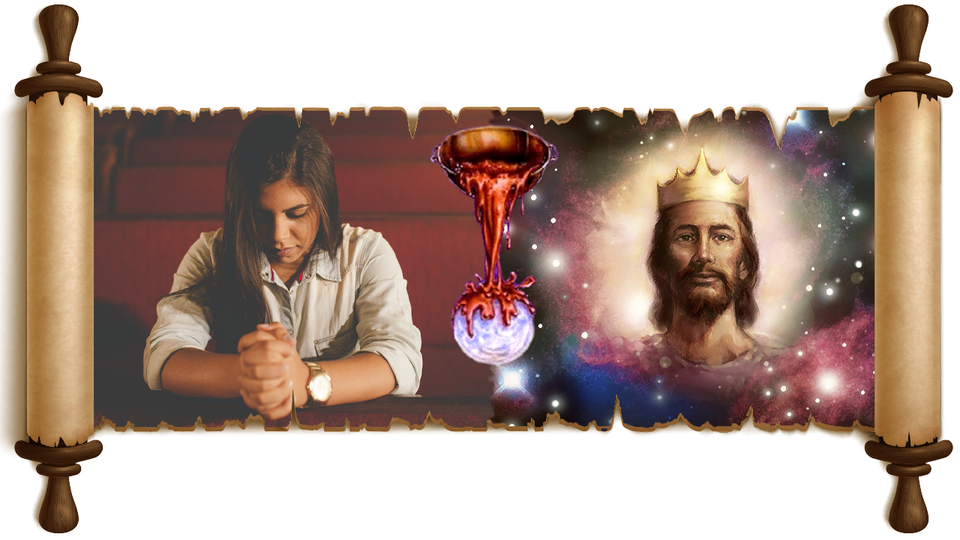

LABU SUNG A
PART 2
Simmun 9: May 31, 2025

Slide 2
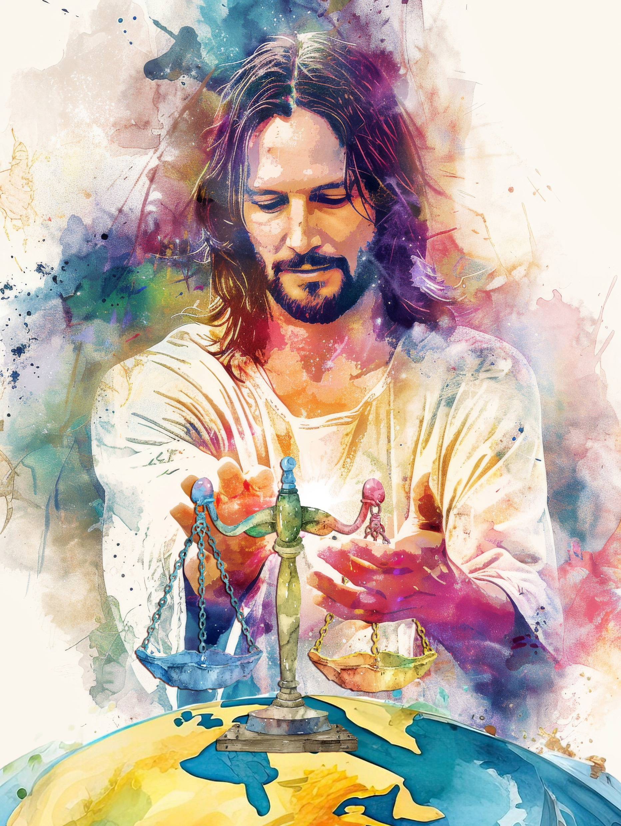
“Vo Pathien, mitin vaipi’n nangma vahchoi u hen; aboncha’n… navahchoi u hen. Namtin vaipi’n kipah thanuom in la sa u hen; nang in mitin thu kithuh chieh in natan pih in, leisiet namtin na lamkai jing jieng e.”
Psalm 67:3, 4.

Slide 3

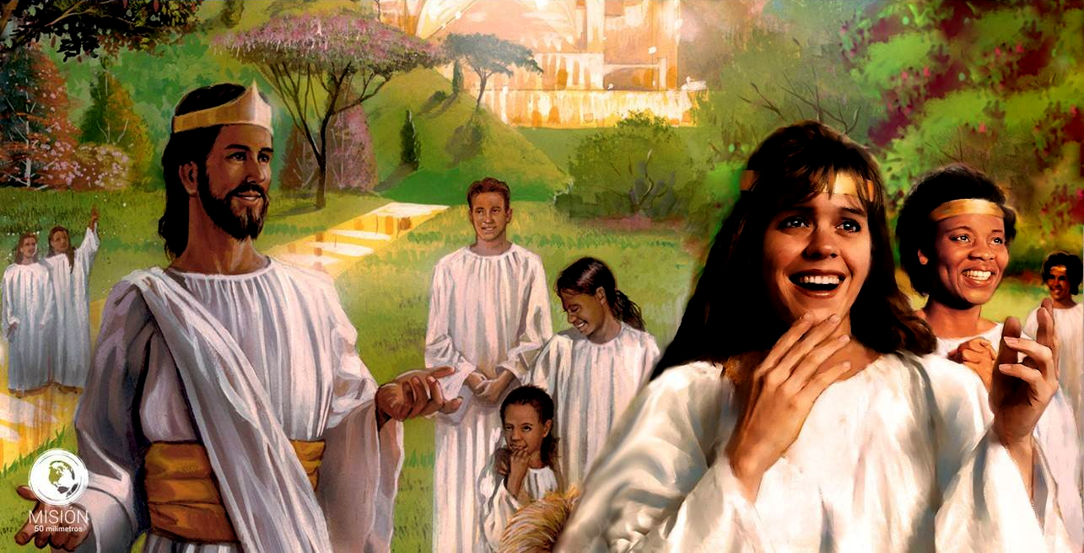




Labu a gaothu kisei lah a hin leisiet mite chung a Pathien vaihomna ahung kitun kit ding kisei masah hi kilang tah leh thanop um tah chu ahi.
Labu sung isim u toh kilhon hin Jesu hung kit masang chet leisiet thilsuoh ho banneicha a hung kitol leh Kum Sang Lenggam jouva chonsiet suhmang a aum ding jong imu ding u ahi.
Hite ho lung a vul pum hin hinkho iti iman diu ham?
Labu 46: Hesuoh pet a panpi.
Labu 47: Achaina kei dia galjona.
Labu 75: Chonsiet manthahna.
Labu 67: Tuni ibol diu natoh.

Slide 4

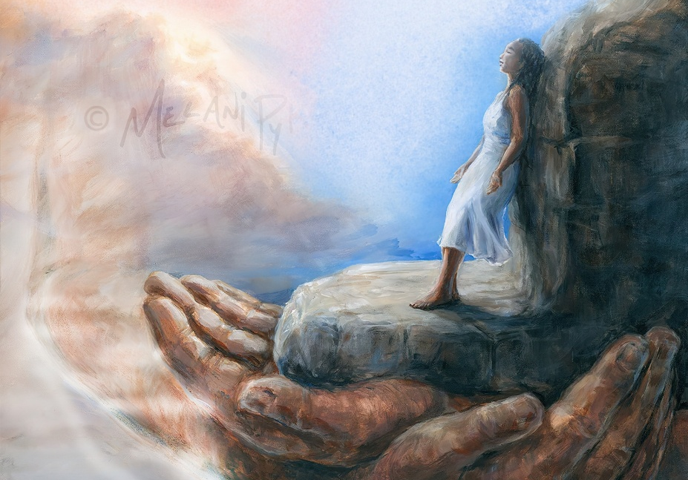
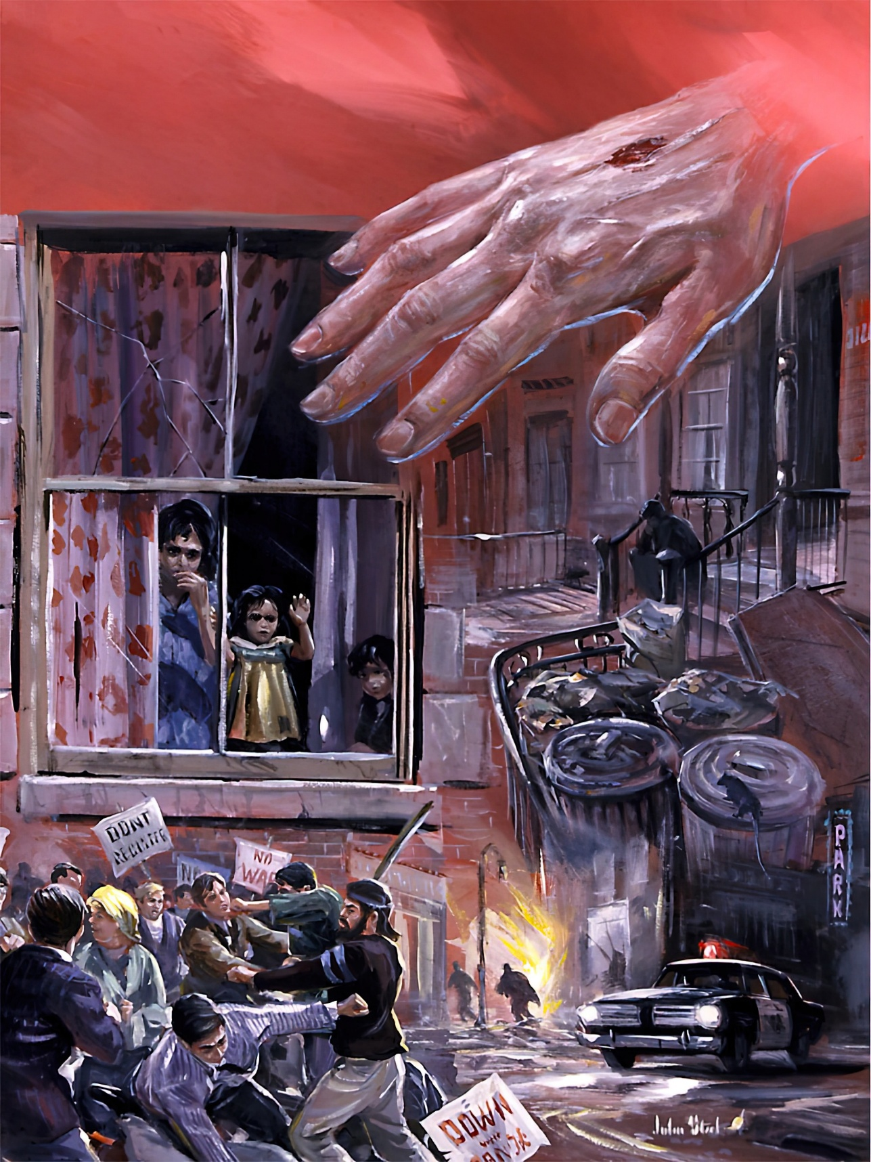
HESUOH PET A PANPI (1)
“Pathien chu eiho dia kielna le thahatna ahin; genthei hesuoh pet tah a ei panpi ahi” (Labu 46:1)
Labu 46 hin ahung lhung ding ipi aseidoh masah em? Thuphuon 6:14 leh 2 Peter 3:12 gaothu toh kimatna ipi anei em? Eiho dia ichan poimo hin tem?
Leisiet a ipi thilsuoh um ham?
Leisiet atolmang tai
Muolsang ho jong tolmang ta
Pathien in ipi abol em?
Amite aveng in, athahat sah e
Aman ei panpi un, ei kipasah uve
Ken ipi kabol ding ham?
Pathien thilbol kavet ding
Kicha lou ding
Tuipi ho jong ginglul lul jieng ta
Namtin lunghang ta
Leisiet ahalvam tai
Ikiselna u ahi
Gal kisat avotaang tai
Namtin lah a choisang in aum tai
Umthim ding, Pathien he ding
Ama a ka kisel ding

Slide 5


HESUOH PET A PANPI (2)
“Namtin vaipi alunghang uvin, lenggam jouse jong akiliing suoh ta uve;Pathien in lhaang asap leh leisiet ajollha suoh hiel tai” (Labu 46:6).
Hiche chaang 6 sung a hin Labu 46 hin ichenna u leisiet kichai nikho umdol asei e:
Namtin vaipi lunghang
Lenggam ho kiliingsuoh ding
Pathieng aw ging kisam
Leisiet jollha jieng ding
Ichenna u leisiet kisuhlouna tam cheh cheh ding, lenggam ho buoina meipi’n in achup ding, chutieng gam jouse hung dingkhom uva sahiem melchihna aboldoh ding u, hichu mithieng te dia gimbolna kipatna hung hi ding ahi.
Gamna nukhah jal chun namtin holiing a um ding, kithattuo ding u ahi (Rev. 17:16).
Jesu, “a aw toh […] chuleh “Pathien sumkon gin toh” hung a lenggam jouse asuhmang ding ahi (1 Thess. 4:16).
Jeremiah gao bang a leisiet akeo le ahomsa suoh ding ahi tai (Jer. 4:23-26).

Slide 6


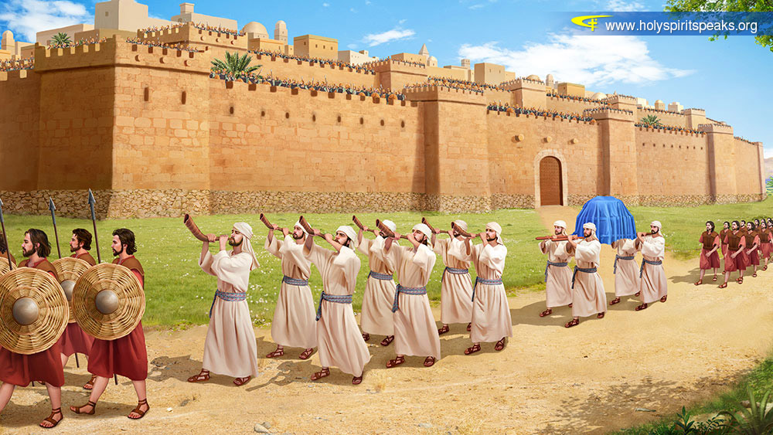


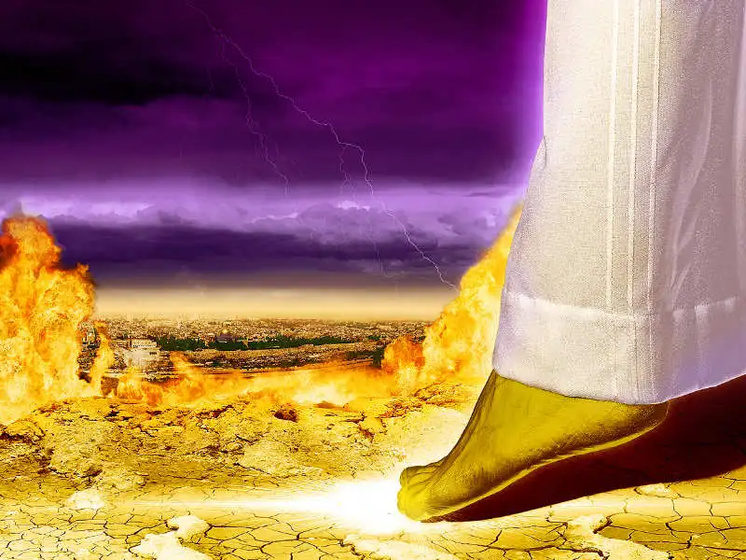
“Aman mitin vaipi eiho nuoi ah asonkun in, namtin vaipi hijat hi ikengto chotpha uvin akoi e” (Labu 47:3).
ACHAINA KEI DIA GALJONA
Puonlap kikhaisang hin agamneite aphuondoh bang in Khanglui lai chun kengphang chotphana chan agam ahi ti vetsahna ana um ji e (Deut. 11:24).
Pathien ang a Satan in, “Leisiet chung ah kanung kama kaga lhah in, chule chung le nuoi kaga koptuo’n, hiche a kuon a hung kit kahi” (Job 1:7) ati chun hiche leisiet neipa kahi ati avetsah nuom jieh a asei ahi.
Midang thilnei achudoh chu kinunglah pih a, anei dih tah kilepieh kit nikho hung lhung ding ahi. Hichu Jesu hung kit ni tah chu hinai pontin, ajieh chu aman hiche leisiet tuol chonkha nailou ding, vanlam joh eile pui ding u ahi nalai e (1 Thess. 4:16-17).
Vanmun a Kum Sang lenggam imankhom jou tieng u aman hiche leisiet akengto a achot kit ding, amelma te masang a Jerusalem Thah atundoh ding, galjona loupi anei ding ahi (Zech. 14:4-5; Rev. 20:7-9).

Slide 7

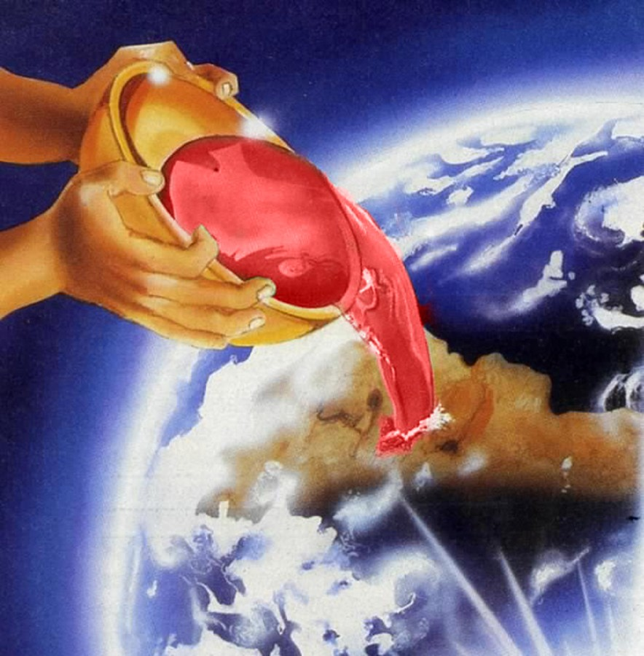
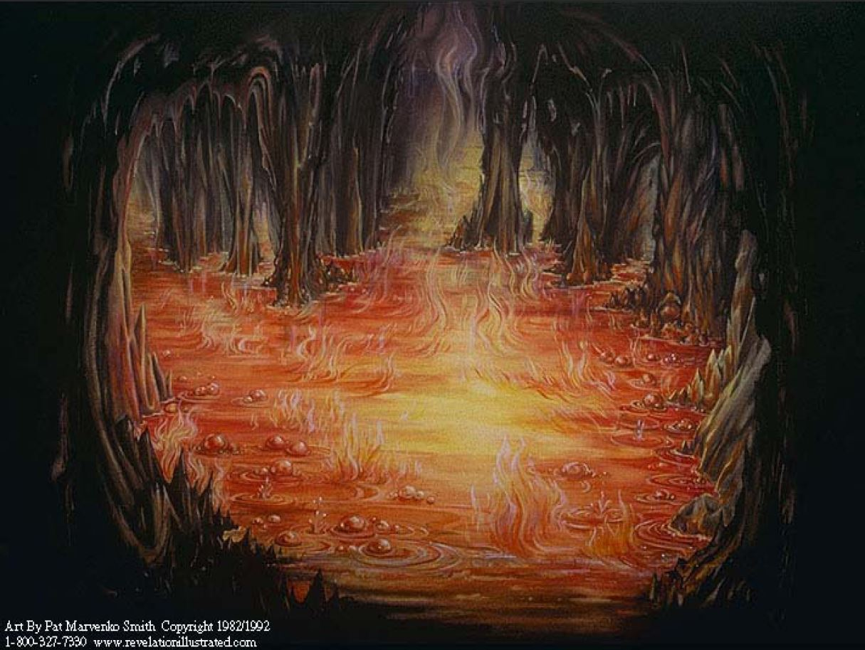

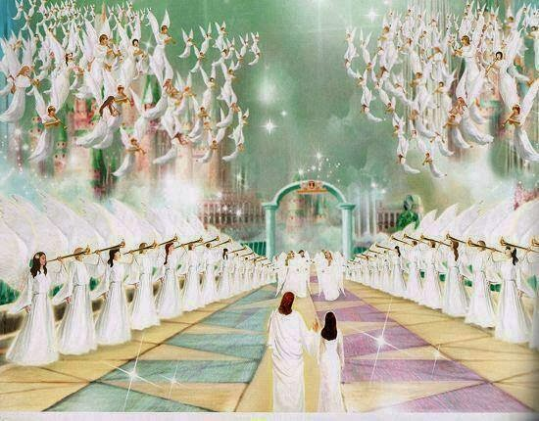
CHONSIET MANTHAHNA
“Ijieh in em iti leh Pakai khut ah khon khat aum in, juthuh kihal phuon bebu adimset in ahi. Aman hiche chu ahin sunlhah ding, leisiet mi giloute aboncha uvahiche juthuh chun abuoh lah a alhoh lut ding u ahi.” (Labu 75:8)
Labu 75 hi vantiil thumna thusap, migilou te’n khon a kuon Pathien lungsatna jutui adon diu kiti chu, toh abang e (Ps. 75:8; Rev. 14:9-10).
Kiletsah hoithona chun namtin leh mimal lhunna ding, tuonsot mun ding chu, akilah sah masa’i (Ps. 75:4-5). Lamkai pipui ho kiletsah hoithona leh thunei ding deichatna, mimal kiletsah lungput leh louchalna chun Pathien sang a mihiem kivahchoina aboldoh sah in, hichu chonsiet thet um pen chu ahi.
Hiche hi itih hung lhung ding ham? Thutan nikho jou tieng, migilou te jouse meidiil a suhmang hi diu, thi nina atekhah tieng u leh hung lhung ding ahi (Ps. 75:2, 7; Rev. 20:11-15).
Ahin, kineosah tah a Pathien hieng kipelut ho lhunna ding chuom beh ahi; vanmun thilsiem jouse lah a Pathien in adopsang ding u ahi (Ps. 75:10; Jacob 4:10).

Slide 8




TUNI IBOL DING U NATOH
“Chuti chun leisiet chung ah nangma lampi kiehdoh suohkei hen; namtin vaipi lah a jong na mihuhhingna thahat kihedoh suohkei hen.” (Labu 67:2)
Thuphuon lekhabu’n nikho khat tieng Pathien loupi vah emsel chun muntin asalvah suoh ding, nisa vah ngai talou ding ahi ti ei hil ui (Rev. 22:5).
Labu 67:1 hin hiche nikho chu alhangai abang e; ajieh chu Pathien “maivah nisa bang a vahsah” din atao e. Thiempu ho taona a jong hiti chun akisei ji e (Minbu 6:25).
Thingpel a Christa thi chun Pathien maivah mite chung ahin lhut kit tai. Ama kom idin tieng u leh avah bulhing set chun ei sal ding u ahi. Ahin, Pathien maivah in tun jong ei sal thei ding uvem?
Heng e! Ahin, hichu eiho kipa thanop ding jieng seh jieh hilou in, midang te phatthei channa dia aloupi kilahsah ding leh vannuoi in Pathien ahetdoh thei a, avahchoina ding u jieh jong ahi (Ps. 67:3-7).

Slide 9

“Ka khuoljin lampi lhonkhompi te ho, hiche leisiet muthim leh buoina meipi lah a lha jing ihi nalai ui; hinla, ei Huhhingpa u hung kilang loi ding, damna leh cholna ahin lhut ding ahi. Tahsan vang a Pathien deibang tah amel mu jing din um u hite. Vannuoi chonsiet jal thina hung chang Pa’n atahsan chan din Paradise kotpi ahong lien e.
Chomlou kah a hiche gal kisat bei ta ding, galjona chang ta ding. Tuonsot hin kuonna Mipa chu imit un ahin mu vah ding ahi tai. Ama kom i um tieng u leh hiche leisiet thohgim leh hahsatna jouse jong imalou bang ding ahi.”
EGW (Prophets and Kings, pg. 732)

