Slide 1
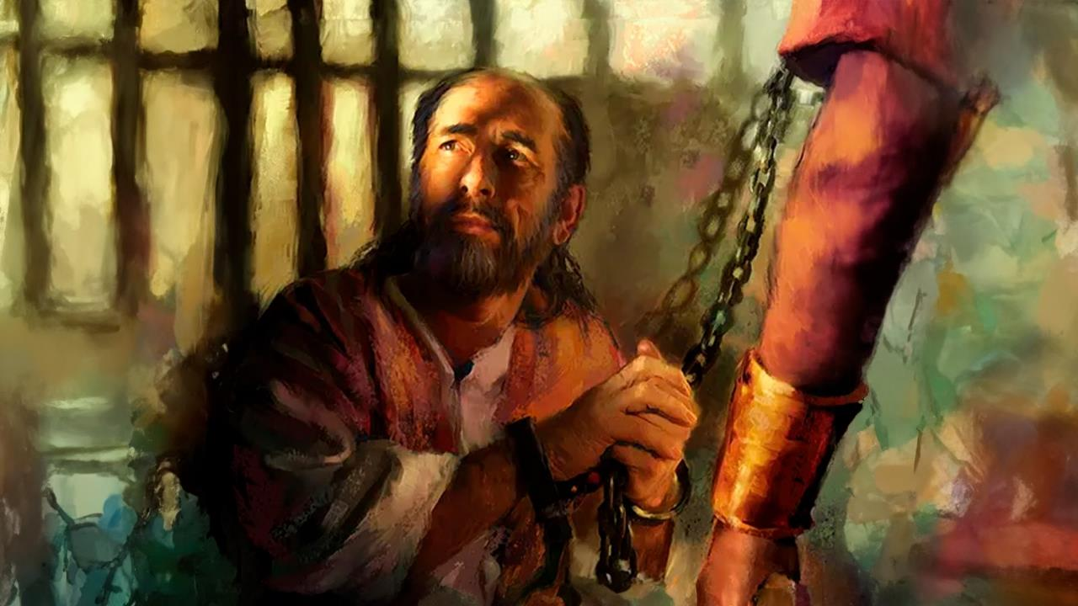
GIMBOLNA CHANG,
KIHAIPIH HILOU
Simmun 1: January 3, 2026

Slide 2

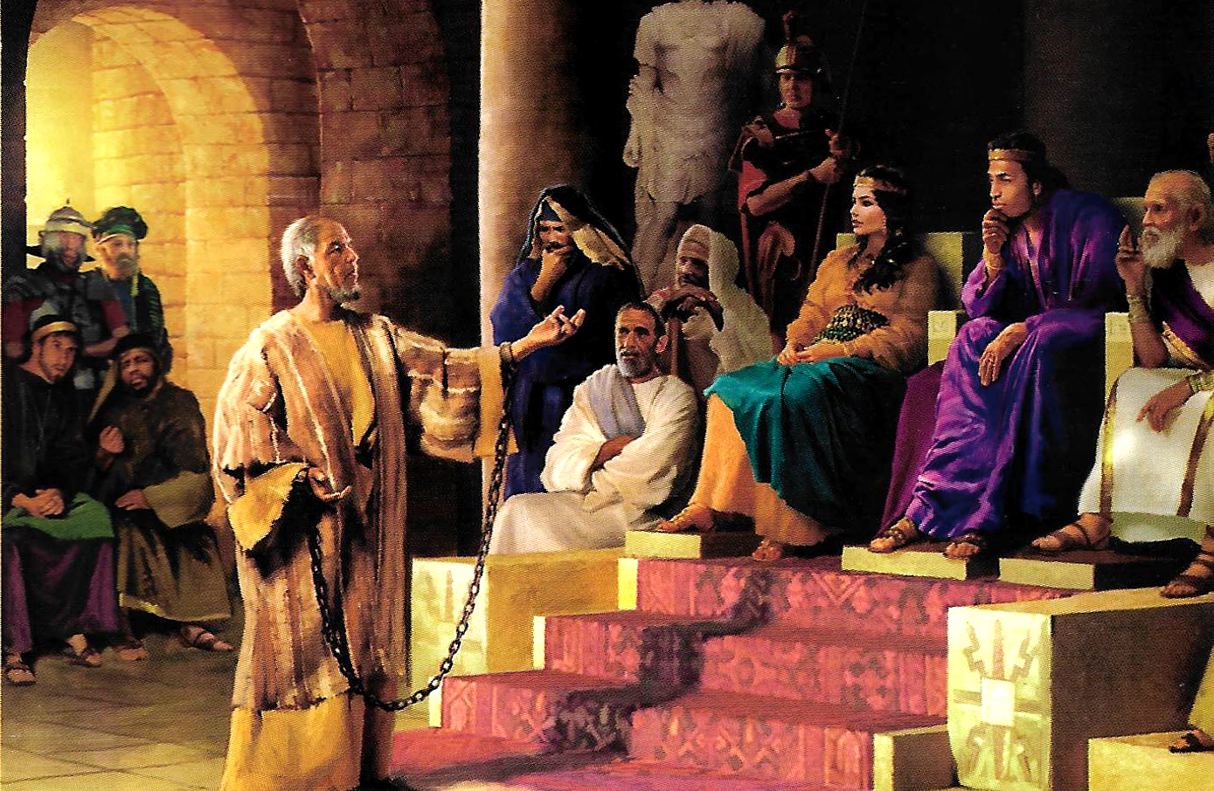
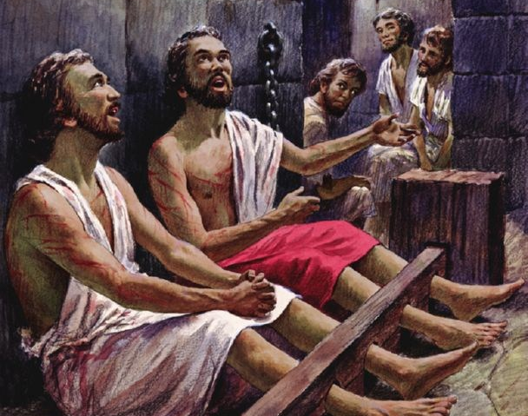
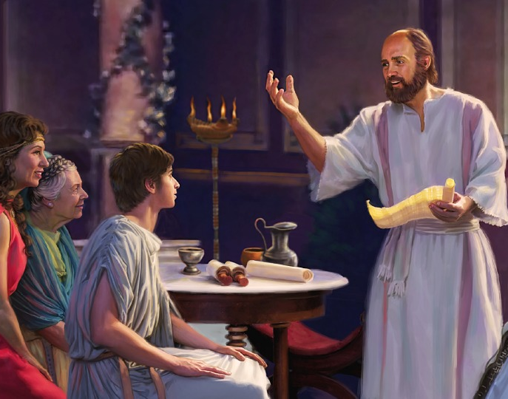
“Pakai chung ah kipah jing un, tikit le uving e kipah un.”
Philippi 4:4

Slide 3

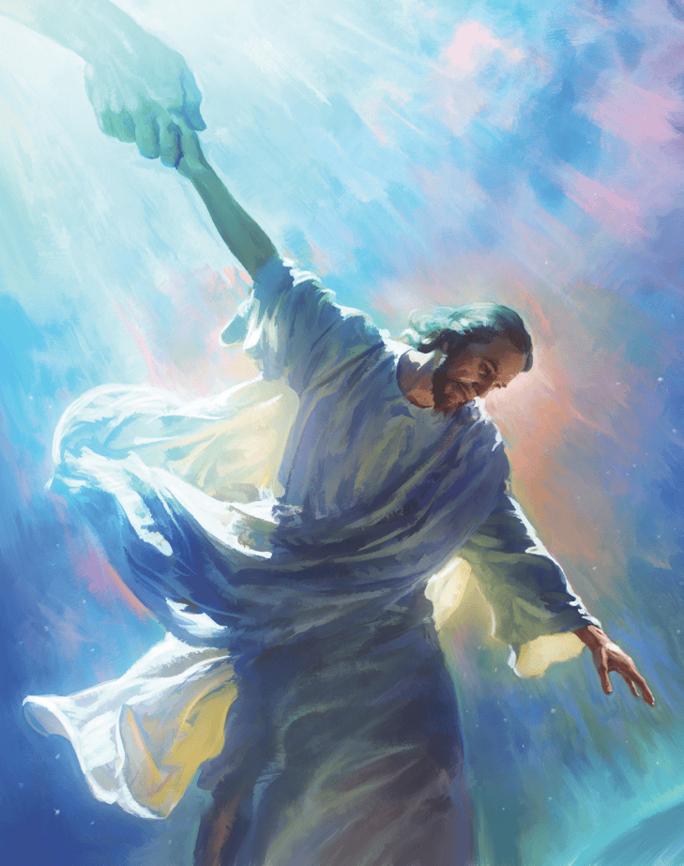


Pathien na atohna chan a hin, Paul in, aja nuom chan din, Van leh Lei gomkhom thei Huhhingpu Christa bou ahi aphuong jing e.
Philippi leh Colossa mite kom alekhathot a chun houbung leh Van chuleh Christiante khat le khat kinai tah a aumdoh theina diuvin asun in ahi.
Ni nunung houbung leh Van kithokhom jal a Jesu solna bang a vannuoi gospel lhutsuoh ahi ding dan jong avetsah e.
Lekhathot ho sunpa:
  Paul suongkul taang
  Thihkhao a kihen palaipa
Lekhat kithot ho:
  Philippi te khang thusim
  Colossa te khang thusim
  Philippi leh Colossa houbung mite

Slide 4
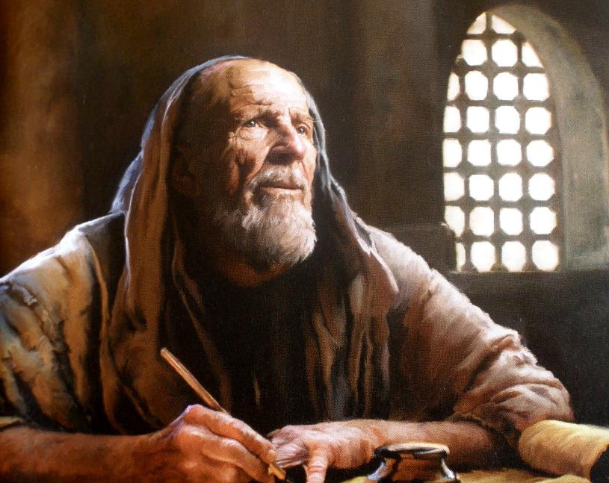

LEKHATHOT SUNPA

Slide 5

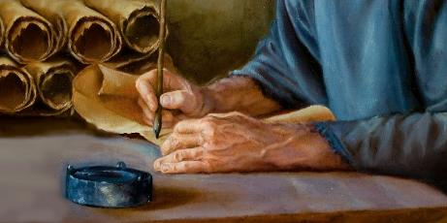
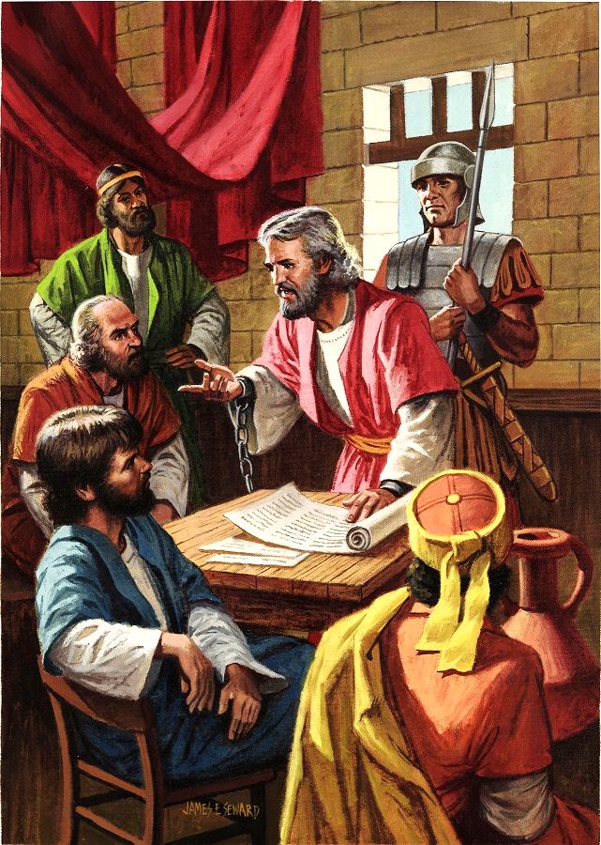
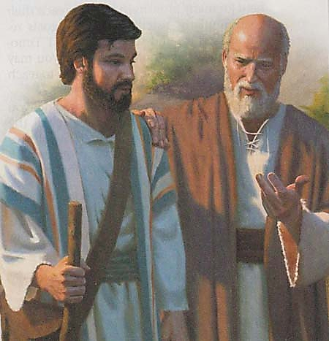
PAUL SUONGKUL TAANG
“Christa Jesu jal a suohchang Paul le sopi Timothy’n, ingailut tah u le itohkhompi u Philemon” (Philemon 1:1)
AD 60- 62 kah a Rome suongkul ataan masah chun Paul in lekhathot 5 tobang anasun doh e: Ephesia, Philippi, Colossa, Philemon leh Laodicea (achaina hi eiho kom ahung lhung jou tapoi).
Achung a ngohna khohse lom aumlou jieh chun inn khat alosah un, Rome sipai khat a-ngasah un ahi (Acts 28:16). Hijieh chun gospel aseile jom thei in, sipai angahpa jieng jong aseipih thei e (Philp. 1:13).
Alekhathot phatah a isim leh Paul hin kithopi jong anei mudoh thei ahi (Col. 4:7-14; Philm. 23-24). Caesar insung mi kijahmatpi jong ana nei e
(Philp. 4:22).
Suongkul apat apotvah ding ana kinem e (Philm. 22), avel nina suongkul a lot chun vang akinem tapoi (2 Tim. 4:6).

Slide 6

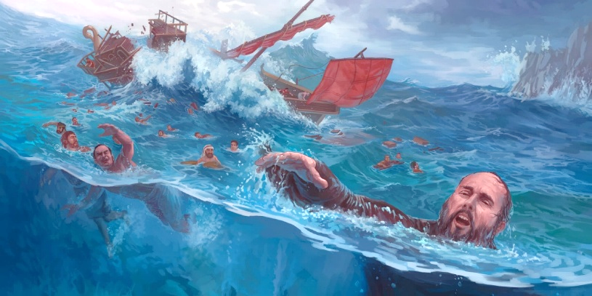
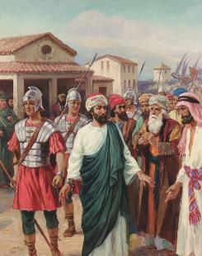
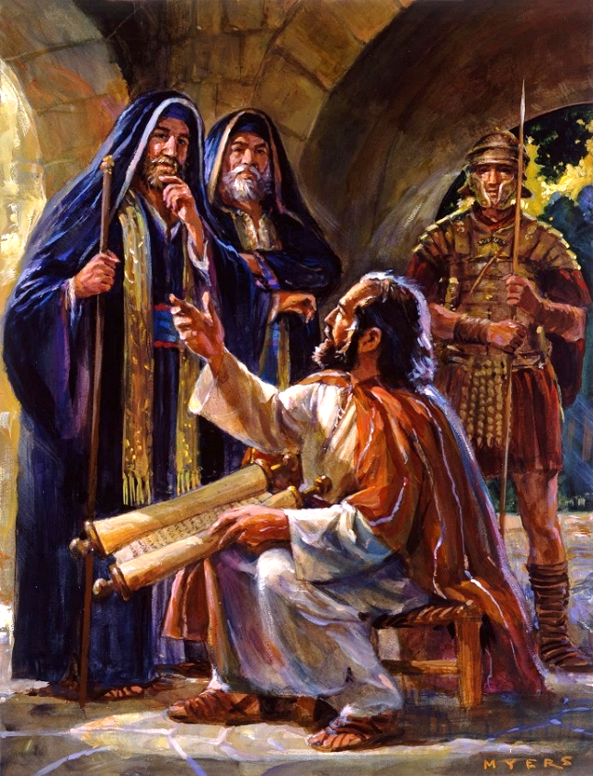

THIHKHAO A KIHEN PALAIPA
“Hiche ding a hi thihkhaova kihen a leng palai kahin, hiche laitah a hi kasei ding dol lom hang tah a kaseina ding ahi.” (Ephesia 6:20)
Christa palai dia akiguot apat Paul hinkho nuom toh akikhen tan ahi (2 Cor. 6:4-5).
Paul Rome alhut masang un suongkul 3 vei ataan akimui: Philippi (Acts 16:22-24); Jerusalem (Acts 23:10); leh Caesarea (Acts 23:33-35). Hiche tailou adang a jong suongkul tampi vei lut tei ding ahi (2 Corinth 11:23).
Hahsatna atuo jingna ho a hin Paul panpi neilouvin akigel kha poi (2 Cor. 4:7-9). Jalen tah a thupha asapphuong theilou vang in “thihkhao a kihen leng palai” ahung hidoh tai. (Eph. 6:20).
Paul in gospel aphuonjal jieh a hahsatna atuo jing lai a Christa a kingai jing ahi bang a eiho jong tahsanna itudet jing diu ahi, Athu lungsung ichinsah jing diu ahi (2 Tim. 2:15); thahat leh hansan kuonna Lhamuonsah, Lhagao Thieng, chu ituchah diu ahi (Zech. 4:6).

Slide 7
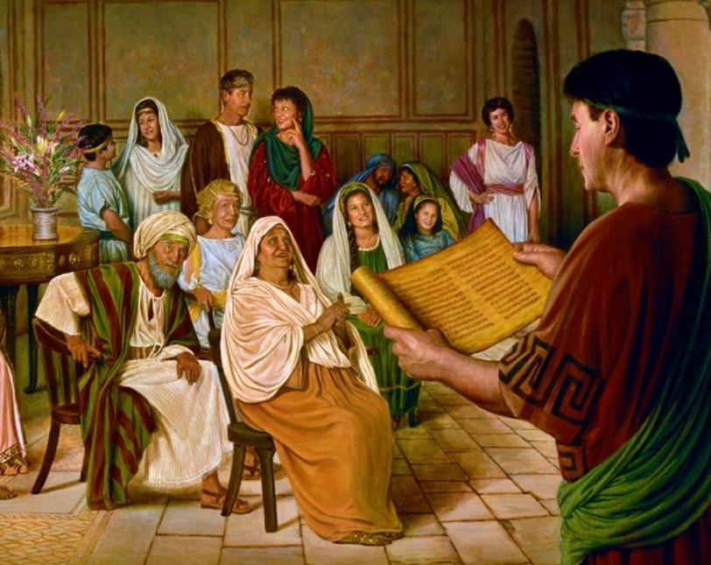

LEKHA KITHOT HO

Slide 8

“Solchah Paul ama khut a tahsanna kisan ho chung a mopuohna neitah in akigel e.
Thildang sang in kitahna dettah anei diu adei e; “Christa Nikho tieng kisonna a kanei thei a, kagimna le kacholna chengse hi moh ahilou je kichen ding ahi” ati (Phil 2:16).
Anatohga chung ah lung kidanna le tijatna tah anei ji’n ahi. Atoh ding dol abulhit louva, houbung in lhagao mang ding khohsahna neilouva aumkhah ding atijatpi in, ama tah jong suohcha louva aum ding atijatpi’n ahi.”
EGW (The Acts of the Apostles, p. 206)

Slide 9

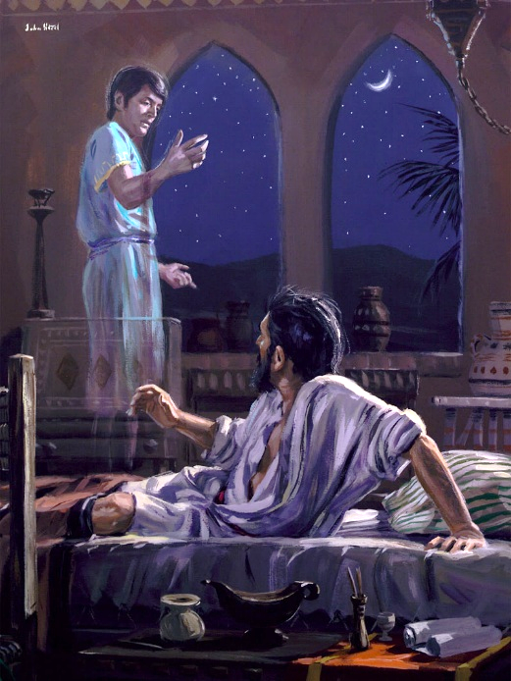
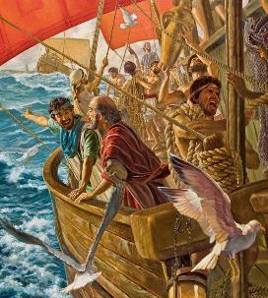
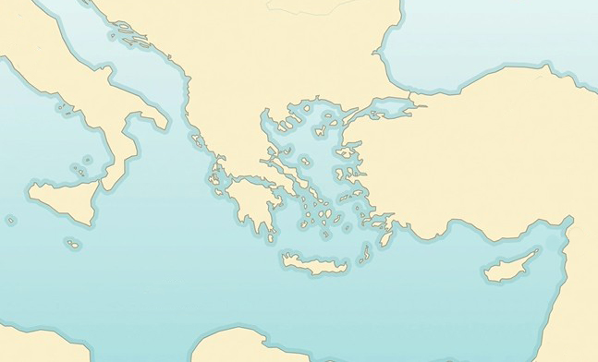

PHILIPPI TE KHANG THUSIM
“Hiche jan chun Paul agaochanna ah mu anei in, Macedonia mi khat hi ahungna ding in ataovin, "Macedonia hung galkai in nei hung kithopi uvin" ati ” (Acts 16:9)
Macedonia gamkai
Philippi
Neapolis
Bithynia
Samothrace
X
Missionary khuoljin ache 2 veina a chun Paul lunggel bang anahi tapon, Lhagao Thieng in alampi akomu pih jo tai (Acts 16:6-12):
Troas
Mysia
Galatia
Phrygia
Paul Phrygia ache (6a)
Hiva leh Galatia a chun thupha asei tapoi (6b)
Mysia alhun (7a)
Bithynia ache guot a ache theilou (7b)
Troas ache a gaothilmu anei (8-10)
Samothrace lam a kuong a akitol (11a)
Neapolis ajuotson (11b)
Achaina kei a Philippi alhun (12)
Acts 16:6-12
Lhagao Thieng in Europe gamkai a Thupha kiphuonpatna din Philippi alheng e. Rome lenggam khopi lhingset khat ahi jieh in Philippi mite chun kai apepo uvin, Rome citizen hina anei ui.

Slide 10

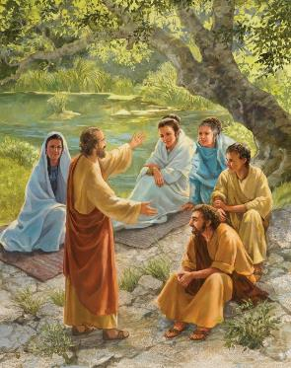
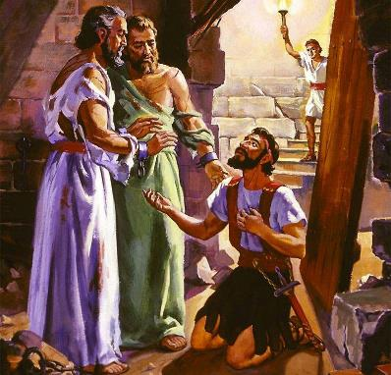
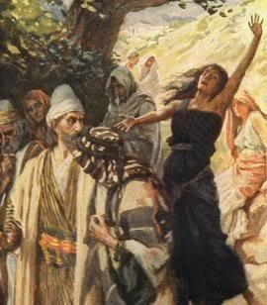
PHILIPPI TE KHANG THUSIM
Hiche jan chun Paul agao channa ah mu anei in Macedonia mi khat hi ahungna ding in ataovin, "Macedonia hung galkai in nei hung kithopi uvin" ati. (Act 16:9)
Khopi thah alhun tieng Paul Judate kikhopna inn (Synagogue) avil masa pen ji e. Ahin Philippi a chun kikhopna inn aum pon ahi. Sabbath nikho chun kikhopna ding inn khat amu un, numei hung kikhomho chu thupha aseipih tai (Acts 16:13).
Hiva hin Europe gamkai dia tahsan masa pen Lydia leh a insung mite baptisma ahung chang ta uve (Acts 16:14-15).
Ahin melmapa jong aumthim pon ahi. Mite lungthim sunohphah din mitpheldoi thiem khat Paul apanhu sah tai (Acts 16:16-17). Numei chapang nu asuhdam lhon chun Paul le Silas din buoina meipi ahin lhut tai (Acts 16:18-24).
Agasuoh: suongkul ngahpa le a insung mite’n tahsanna akisan (Acts 16:25-33). Lhagao Thieng thahat le mapuina jal in Thupha chu Europe gamkai alut thei tai.

Slide 11

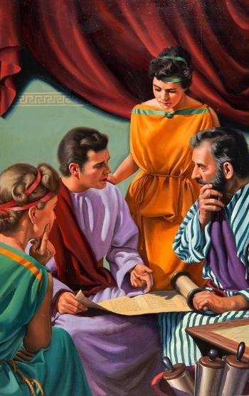
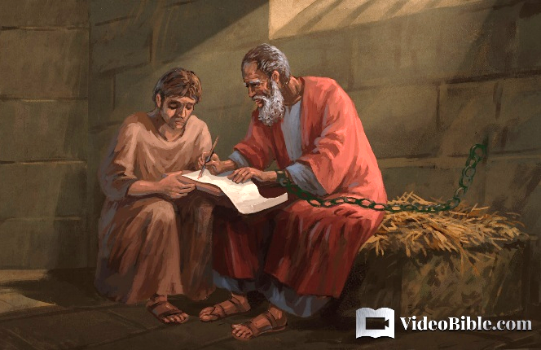
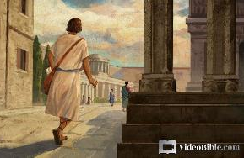
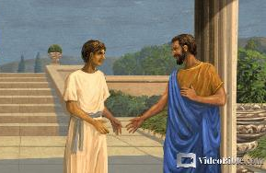
COLOSSA TE KHANG THUSIM
“…suohna katoh khompi u Epaphras a kuon a nahetdoh u ahin, ama hi Christa ding a keiho cheng thalheng a tahsan umtah le lhacha a pang ahi” (Colossa 1:7)
Rome a Paul suongkul taan chun Epaphras akiloipi anahi (Philm. 23). Colossa gammi ahin (Col. 4:12), hiche khopi a gospel lhuttu jong anahi (Col. 1:7).
Colossa hi Phrygia gamkai khopi khat ahi; Laodicea leh Heriapolis toh kinaicha ahi (Col. 4:13). Juda mi tampi chenna jong ahin, amaho lah Philemon chu hetthei tah khat anahi. Ama chu Paul toh kitho leh a inn a kikhopna jong aneiji u ahi (Philm. 1-2).
Philemon suoh a pang Onesimus chu Rome lam ajammang in, hiva chun Paul khut ah Jesu anakisan tai (Philm. 10-11). Paul in Onesimus chu apupa kom alhut kit in, pupa leh suohpa, achungnung le anuoinung, kikah kiguolchat ding dol je atahlah e (Philm. 12-17).

Slide 12

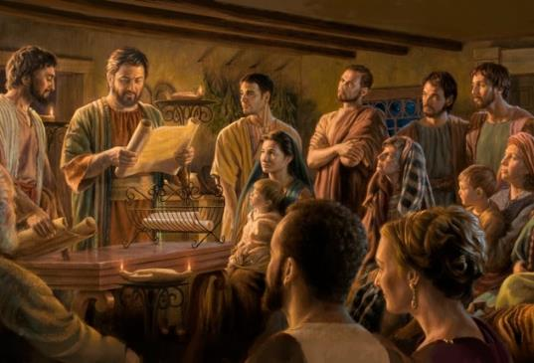
PHILIPPI LEH COLOSSA HOUBUNG MITE
“Jesu Christa suohte ni Paul le Timothy’n Philippi kho a um Jesu Christa tahsan mithiengte le Houbung lamkai chengse, lhacha chengse heng a” (Philippi 1:1)
Philippi leh Colossa mite lekhathot thupatna teni hin kibahna tah anei in, hetdoh bai tah 2 atahlah e (Phil. 1:1; Col. 1:1-2)
Pathien mitmu’n houbung mite chonse tah hijong leh thieng leh kitah tah ahi
Houbung sung kilamkai dan kituptah ahin, khat sang a thunei le mopuohna neijo loi aum in ahi:
Paul solchah ahin, lamkai pipen ahi
Timothy akithopi ahi (pastor)
Bishop ho houbung lamkai ahi (upa)
Deacon hon houbung avesui uve
Philippi ten kithopina ahin thot jal un Paul in suongkul apat kipa thuthot ahin nei e (Phil. 4:18).
Paul in akithopi a pang ho Colossa mite lhamuon din asolpih e (Col. 4:7-9).

Slide 13

“Paul hinkho hi chomcha gelpih tadi ute. Houbung bolgim leh lengvai a aum a, Paul panpina angaichat lai tah chun suongkul ahung lut tan, thihkhao in akihen tai. Ahin hiche phaat hi Pathien kilapna ding phaat chu ahung hi tan, galjona manlu tah achansah tai.
Mite mitmu a Paul ima boltheilouva akilah lai tah chun thudih chu leng le vaihom te kom alhung tan ahi. Paul in giltah a thupha asei chu hilouvin, thihkhaova akihen joh chun mite lung alakha ten tan ahi. Suongkul ataan vang chun Christa din galjou in aum tan ahi. Dihlou tah a sotpi suongkul akitaansah vang chun lungnieng tah leh kineosah tah in athuoh tun tun in, itobang mi bep hitan tem tin mite kigelna aneisah thei tai.”
EGW (Reflecting Christ, December 10)

