Slide 1
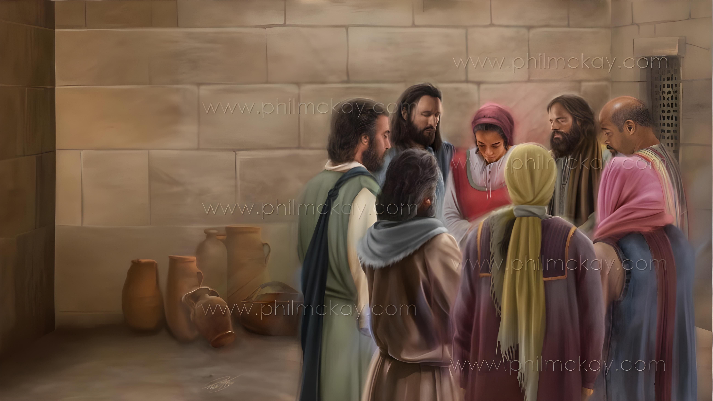
THANGVAH LEH TAONA DING JIEH
Simmun 2: January 10, 2026

Slide 2


“Hiche a hin nangho sung a thilpha bolpa chun Jesu Christa nikho gei a amuolsuo tei ding dettah in katahsan e.”
Philippi 1:6

Slide 3

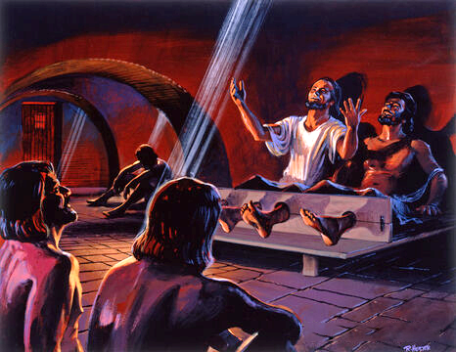
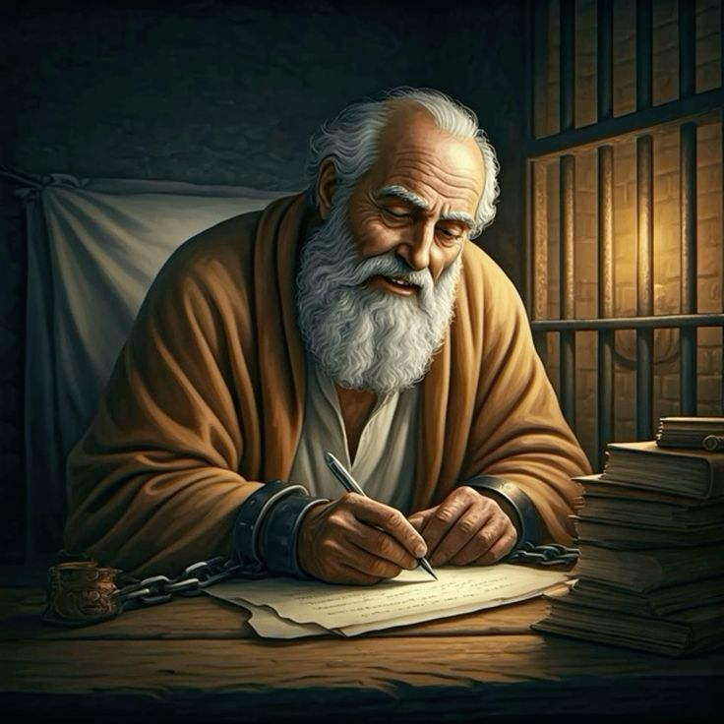







Paul din nikho hahsa ahung lhung tai. Ajalenna alhaso tan, kigelsiet leh kingaisiet a umden ding bai tah ahi.
Hinlah, Philippi suongkul thimpi jiing sung a Pathien choi-atna la asah bang in, Philippi le Colossa houbung mite din akipana thuthot ding tampi anei nalai e.
Suongkul ataan chun Apa ahoupi asutaang jou pon, midang ataopih jong anongkai sah jou dieh poi.
Philippi te lekhathot a thangvah le taona ding jieh asut:
  Kipa ding jieh (Philippi 1:3-8)
  Taona ding ho (Philippi 1:9-11)
Phaat hahsa sung a thangvah leh taona (Philippi 1:12-18)
Colossa te lekhathot a thangvah leh taona ding jieh asut:
  Kipa ding jieh (Colossa 1:3-8)
  Taona ding ho (Colossa 1:9-12)

Slide 4
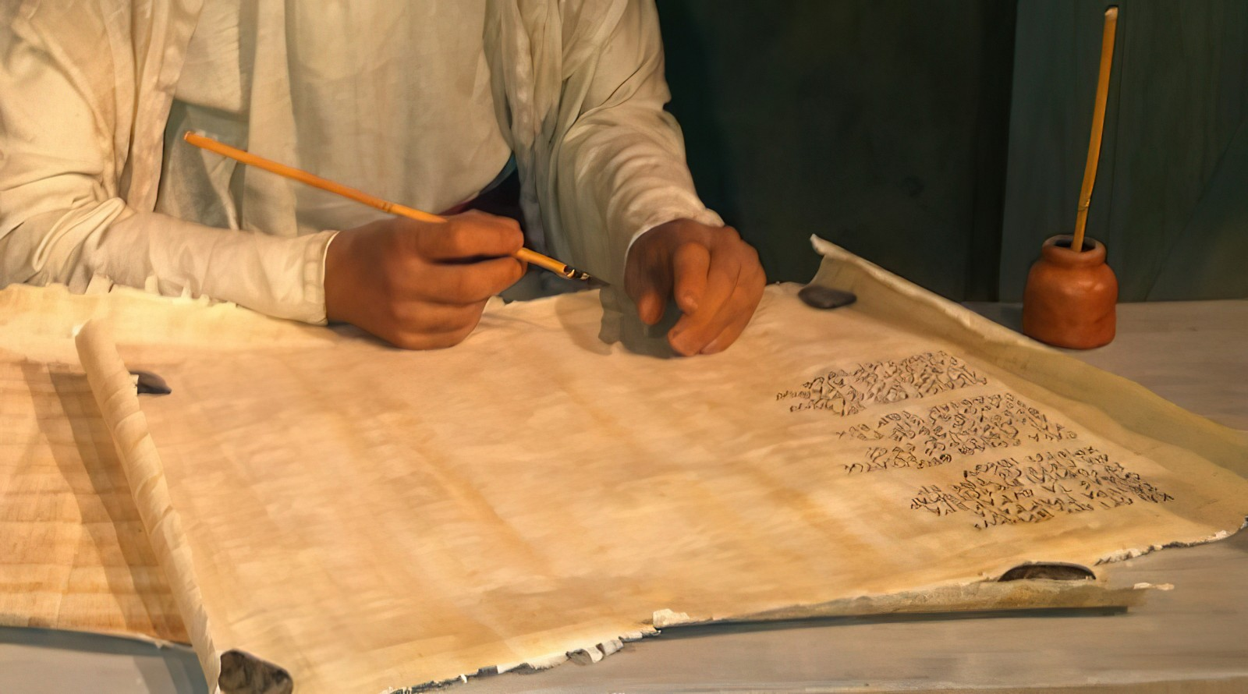
Philippi te lekhathot
a thangvah le tao
ding jieh asut

Slide 5


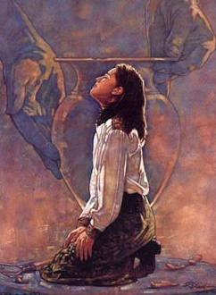
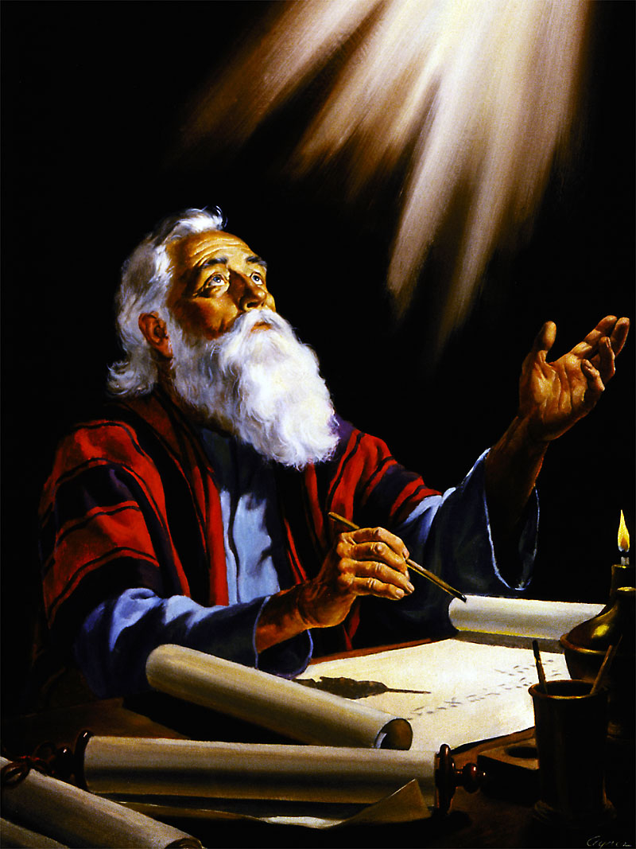
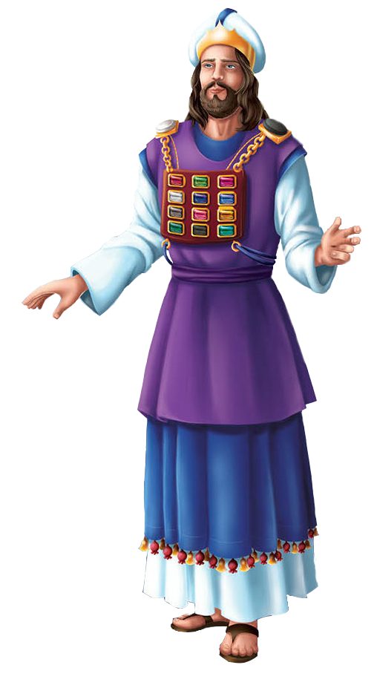
KIPA DING JIEH
“…nang ho sung a thilpha bolpa chun Jesu Christa nikho gei a amuolsuo tei ding dettah in katahsan e” (Philippi 1:6)
Paul in Philippi te lekhathot a chun hiche khopi a angailut mama tahsan chate (Phil.1:8) jal a Pathien athangvah thu’n apan e (Phil. 1:3).
Thiempu Chungnung in Israel phung 12 min suongmantam a kisun a oplhang a akivon bang in, Pathien ang a taopih dia adin tieng Paul in hiche houbung mite khat chieh in “alungthim in avop jing” e (Phil. 1:7).
Akipana pen tah chu hiche Philippi mite gospel din kitah tah in ading jing un, Pathien in ani ani in tahsan chamkimna lampi ah apuitou jing amu jal ahi (Phil. 1:5-6).
Akipana jieh athum channa chu Philippi mite’n “kabulput kahen lhahna hihen lang Kipana Thupha lam a kihonna thusei le phudetna ding dol hijongle neichankhompi chieh u ahi e” (Phi 1:7) ati jieh ahi.

Slide 6


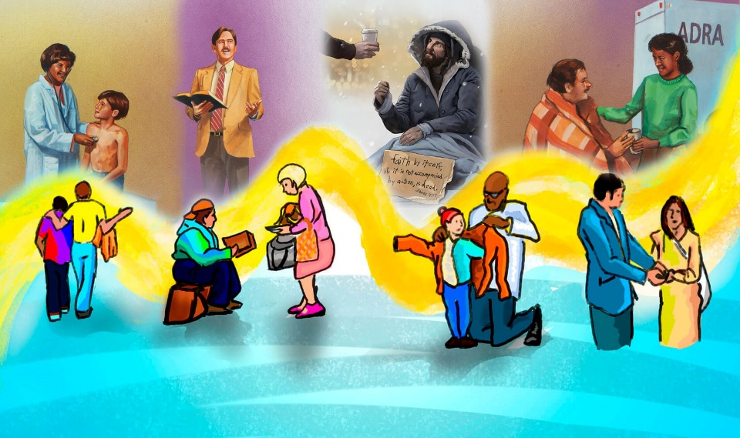
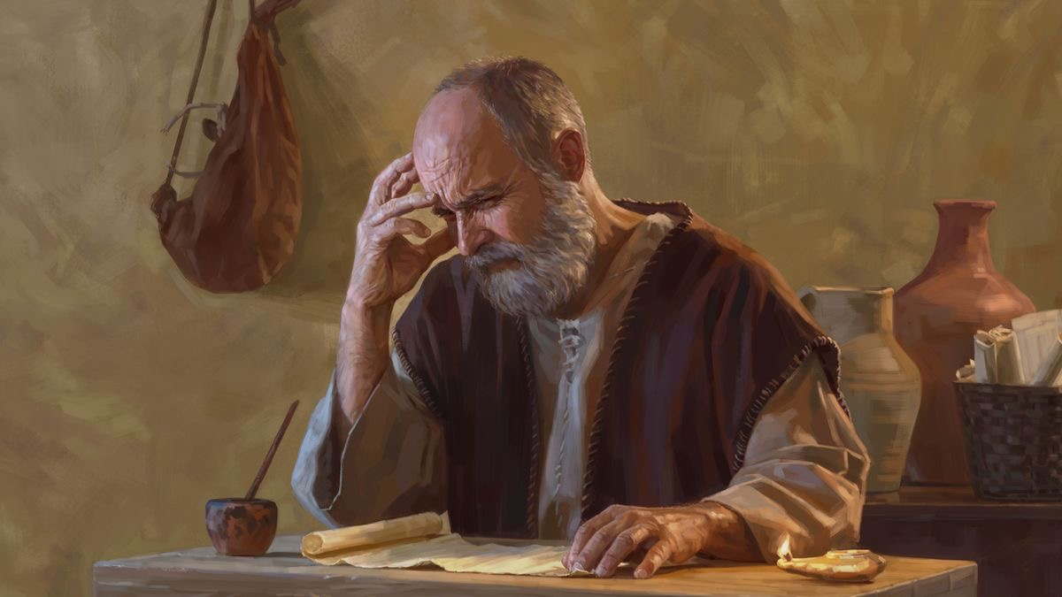
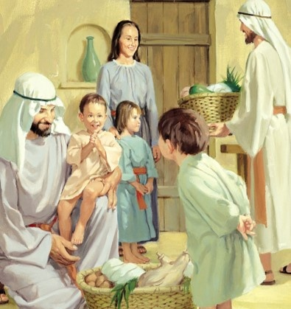
TAONA DING HO
“Hiche kataona lo pen chu: ngailut nanei u chu agil cheh cheh a, hetna gelkhenna aletsetna ding kati ahi. Chutile nang hon thilpha datchilje nahet uva, Christa nikho ni le thengsel nuolna bei nahi diu, Jesu Christa vang a Pathien loupina le vahchoina ding a thildih ga chu nadim ding u ahi” (Philippi 1:9-11)
Paul “thihkhao a kihen” pum a ataopih ahi ihe uve (Phil. 1:9-11):
Ngailutna agil cheh cheh a
Gelkhenna aletsetna ding
Thipha datchil je ahetna diu
Thiengsel le nuolna bei ahina diu
Thildih ga adimna diu
Pathien loupina le vahchoina ding
Iti leh ngailutna ineibe ineibe thei ding u ham? Christian hinkho dia ibol a hiti poimo hin tem?

Slide 7
PHAAT HAHSA SUNG A THANGVAH LEH TAONA

Slide 8

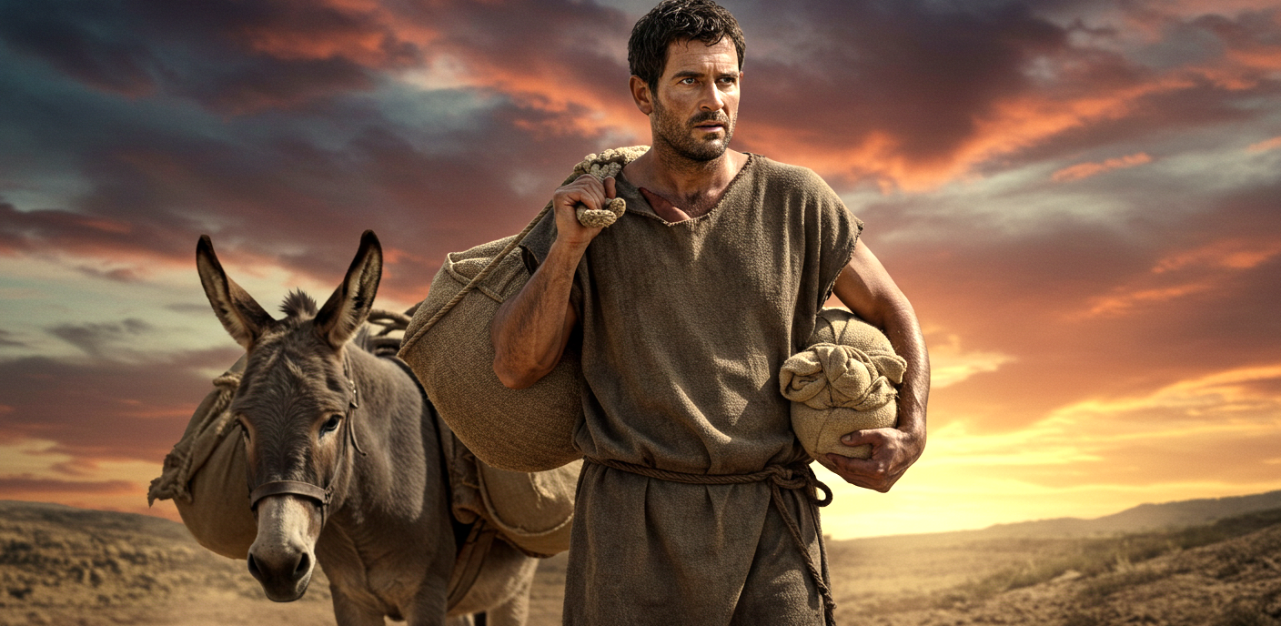
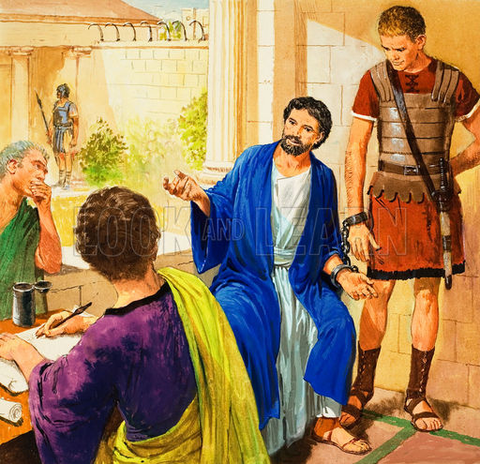
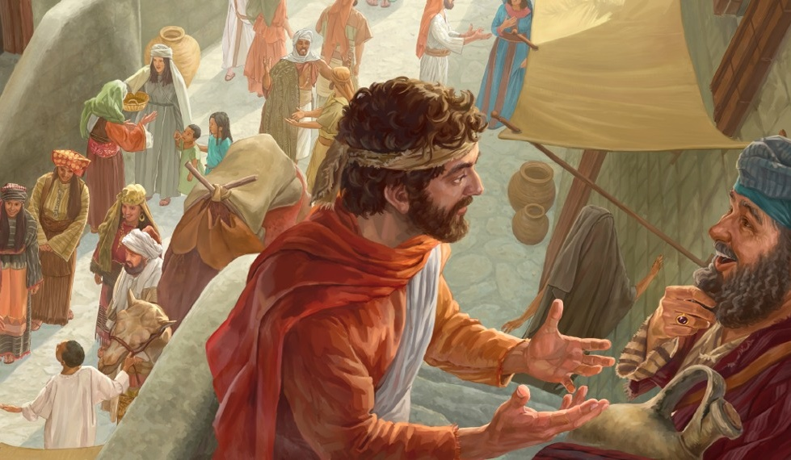
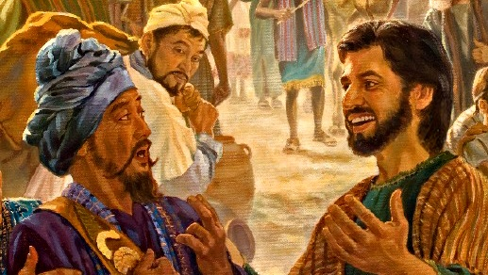
GOSPEL DINPI DIA PHAAT LEMCHANG
“Sopite, keima chungchang thusuoh hi Kipana Thupha machalna joh ahidan nahet diu kadei e.” (Philippi 1:12)
Philippi mite’n Paul suongkul ataan ajah u chun alunggimpi lheh un, Epaphroditus akithopi din asolpih uve (Phil. 4:18).
Paul vang chu lunggim kipelou in, suongkul ataan Pathien athangvah jo’i. Iti dan hin tem? Ajieh chu suongkul ataan jieh chun Thupha japhalou ding tampi kom alhutpih thei tan ahi (Phil. 1:13).
Chujong leh, solchahpu lungput amu’u chun tahsan chankhompi tampi’n kitiilkhouna’n anei un, Thupha hangsan tah in asamthei ta uvin ahi (Phil. 1:14).
Gospel lhangphuong tah a saple hin Paul hahsatna ahin lhutpih ding ahi ati vang un Gospel sapphuongna dia lemchang ahung suoh doh tai (Phil. 1:15-18).

Slide 9
Colossa te lekhathot a thangvah leh taona ding jieh asut

Slide 10


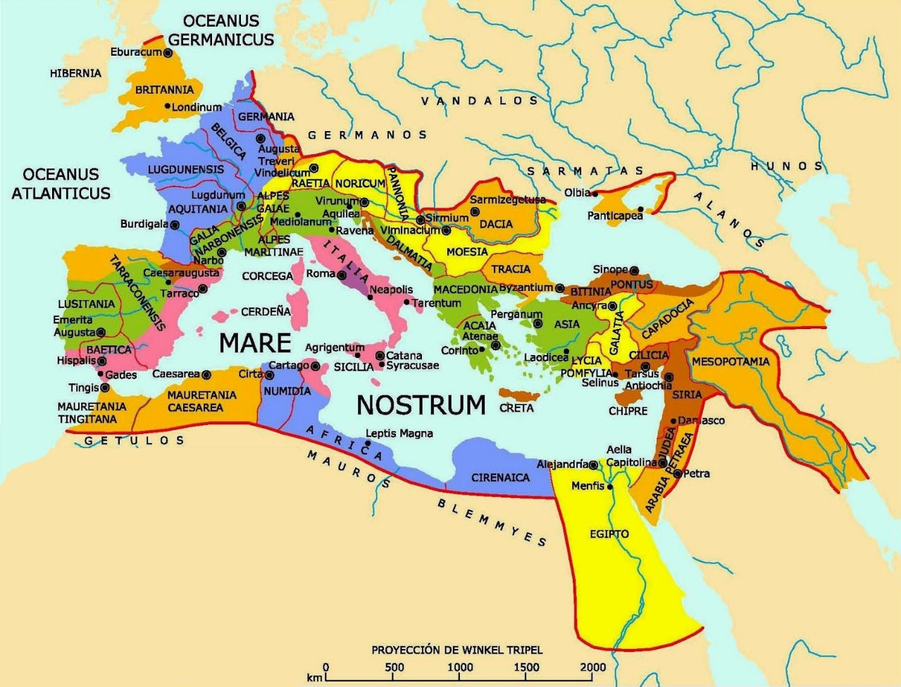
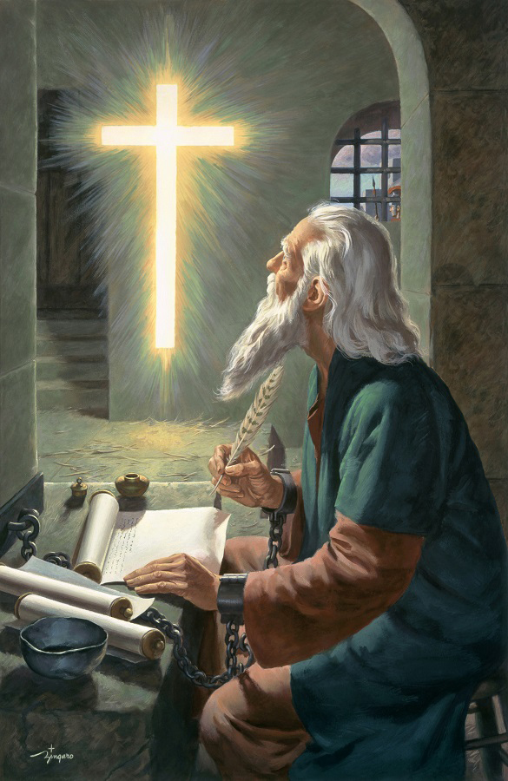

KIPA DING JIEH
“Keiho phaat jouse’n nangho din kataovun, i Pakai u Jesu Christa Pa Pathien kathangvah jing ui.” (Colossa 1:3)
1 Corinth 13:13 a kisun bang in, Colossa mite’n Christian chonchan phatah thum: tahsan, kinep leh ngailut- anei jal un Paul in Pathien hatah in athangvah e (Col. 1:4-5).
Hiche chonchan phatah hohi “Christa a kuon” ahin “mithieng te” toh kisamkai dan siemtuoh a pang ahin, “Gospel thupha jal a” keihon kanei u ahi tai”.
Paul in hiche gospel hi Colossa te kom goh a kisamphuong ahipon, “vannuoi pumpi a” machal ahitai ati (Col. 1:6)... Kum 30 kah bep hinalai ahi!
Lhagao Thieng vang a Pathien thahat keiho kom hung lhung chun Bible hi “hinna thu” aso ahi (Phil. 2:16). Hichun Gospel kisan chan chun tuonsot hinna anei ahi tan, agouchan ding “van a kholsa ahi tai” ti atahlah e (Col. 1:5).

Slide 11



TAONA DING HO
“Hijieh a chu hiche kajah ni uva pat chihna tincheng le Lhagao jal a Ama lungdei lam hetna le datkhen dol nadimsetna diuvin nangho din taopih le thumpihna tanglou hiel kahi uve.” (Colossa 1:9)
Paul taona hin Colossa te ding thilpha tampi asei e (Col. 1:9-11):
chihna tincheng le Lhagao jal a Ama lungdei lam hetna le datkhen dol nadimsetna diuvin
Pathien chate bang a imalam jouse a naumtheina diuvin
Thilpha lam natohna jouse a nagatheina ding un
Thil ijakai thuoh hat tah a nathuoh theina diuva
Hiche taona hi “Pa Pathien thangvahna ding ahi”
(Col. 1:12).
Paul taona eiho dia natong tah ahina din Pathien in lampi 4 in amuolso e:
Bible
(Psalm 119:105)
Thiemgao thusei (Spirit of Prophecy) (Rev. 19:10)
Pathien in kidang tah a na atohnaho(Col. 4:3)
Lhagao Thieng
(Is. 30:21)

Slide 12

“Ihinkho u Christa hinkho a hung kai ding ahi; van a kuon hung kumlha Hinna Changlhah a kuon ineh diu, hinna tui idon diu, ama a kuon ikisan jing diu ahi; hiche tuinah chu hing sitset, lhahsam tih neilou chu ahi.
Pakai chu imasang uva ikoi jing uva, lungsung kipa leh vahchoina adim jing a ahi leh lhagao hinna hal jing chu ineithei diu ahi. Chutieng Pathien kom taona jong gol ngaitah toh kihou bang suoh ding ahi. Athuguh kidang ho ei seipih ding u ahi.
Jesu’n ikom ahin nai kipa thanopna chun eibom ji diu ahi. Enoch akivoppi bang a eiho kivoppi dia eihin nai tieng u leh ilungsung u soulah lah ding ahi. Hitobang hi Christian khat hinkho man dihtah ahi thei tieng, ahinkho a chun kineosahna, nunnemna, lungthim kingainiemna tiho hung kilangdoh thei in tin, akipolpi jouse muthei in Jesu toh umkhom leh Jesu a kuon pilhinna hin neidoh ahi hung kilang tante.”
EGW (Christ’s Object Lessons, p. 129)

