Slide 1
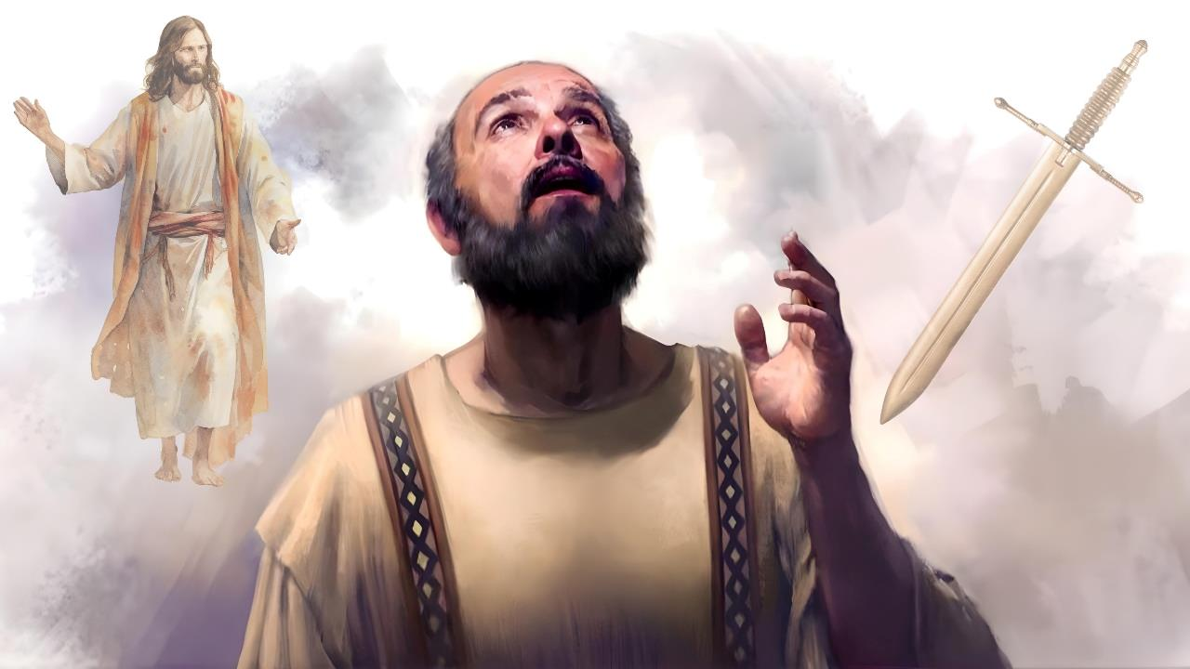
HINNA LEH THINA
Simmun 3: January 17, 2026

Slide 2

“Ijieh in em itile keima din hin chu Christa ahin, thi chu hamphatna ahi.”
Philippi 1:21

Slide 3


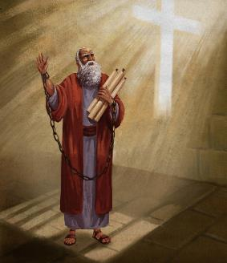


Lungsietna bei Nero’n achungthu atan ding Paul in angatho ahi tai. Amalam khankho ding Caesar lungphut a kingai abang tai.
Ahin Nero khut a amalam khankho kingai tah mong ahilou Paul in ahekeu keuve; Pathien khut a um jo ahibouve. Hijieh chun houbung mite’n ataopih jal un jalenna amukit tei ding atahsan e.
Hinlah, (suongkul ataan bang a) athi jal a gospel natoh hung machal ding ahi leh Christa dia ahinna pieh ding anuom in ahi.
Christa dia hin ding ham, thi ding ham?
Paul in Christa achoi-at (Philippi 1:10-20, 25-26)
Christa dia hin ding ham, thi ding ham? (Philippi 1:21-22)
Paul in lampi kika ni asei (Philippi 1:23-24)
Christa dia hin ding kiti hi ipi tina hin tem?
Nun le khan Christa thupha toh kituosah ding (Philippi 1:27a)
Gospel dia lungkhat a galsat (Philippi 1:27b-30)

Slide 4

CHRISTA DIA HIN DING HAM, THI DING HAM?

Slide 5



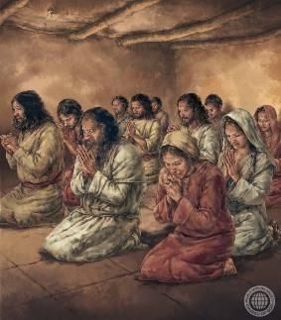
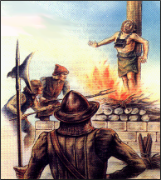
PAUL IN CHRISTA ACHOI-AT
“Kadei gil pen le kakinepna chu…a-itih phat hihen tutah jieng hijongle hakat tah a kapan ngam a, hinna hihen thina hijongle katahsa pumpi a hi Christa choiatna ding hi ahipen'e.” (Philippi 1:20)
Paul in tamveipi bolgim a chu akipapi’n ahi (Col. 1:24a; 2 Cor. 11:23-27). Suhgimna achan akipapi ahipon, Christa ding jal a athuohgim a, houbung machalna aso chu akipapi ahijo’i (Col. 1:24b; 2 Cor. 11:28).
Athuohgimna a Christa bang a apan a, thina gei a Christa khonung ajui jou jieh in Paul in Christa hatah in achoi-at in ahi (Col. 1:20).
Philippi mite alekhathot a chun Paul in hiche pet a thina atuokhah leh Christa dia phachuom behseh hilouva, chusang chun houbung mite taona jal leh Lhagao Thieng natoh jal a suongkul akuon ahung jalen a, thupha asap jom thei ding atahsan joh kichieh tah in asei e. (Phil. 1:19, 25-26).
Hiche khang mite khangitlouna asan behseh jieh chun Christa bang a hin ding chu Christa bang a bolgim a um a, Ama thi bang a thi ding tina jong ahung hi. (2 Tim. 3:12).

Slide 6



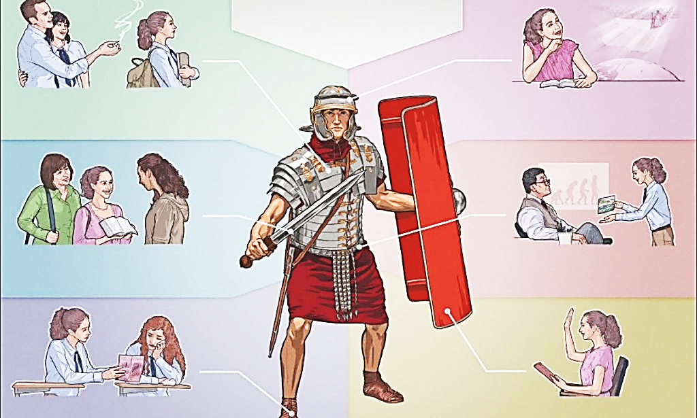

CHRISTA DIA HIN DING HAM, THI DING HAM?
“Ijieh in em itile keima din hin chu Christa ahin, thi chu hamphatna ahi.” (Philippi 1:21)
Thuohgimna jouse hung umdoh hi van le lei, mun jouse, a se le pha, Satan le Christa, kidouna tuni gei a aum jieh ahi
Hiche hi lhagao gal ahin, lhagao galvon a sat ding ahi. Melmapa mite chun Christiante thilthet tah tah ho ( jou, kidem, kinah, etc) galdouna’n amang un ahi.
Eihon vang thudih leh dihtah a thilbol chu galvon in imang uve (2 Cor. 6:4-7). Hichu “kulpi suhsiet theina galvon” ngen ahi (2 Cor. 10:3-5).
Ahin, kidouna a chondih khat in thina atuo tieng ipi thilsuoh um ji em? Paul in vang hitobang chu hamphatna ahi ati (Phil. 1:21).
Christa a kitah tah a um eiho din vang thina hin melmapa khut sophah khelpeh ei lhut ji un, bolgimna ei peldoh sah ji tauve (Pr. 14:32; Is. 57:1).

Slide 7



PAUL IN LAMPI KIKA NI ASEI
“Ni kah a lhen joh ding helouva moh lunggim kahi, kiteldoh a Christa to umkhom ding kadei lheh jieng e, hichu kei dinga gamcheng a phajo ding ahi. Ahinla tahsaphe a kahin nah lai ding hi nangho dia khohjo nalai ahi.” (Philippi 1:23-24)
Paul in lhenkah ding ahepon, ani in adei gel e (Phil. 1:23-24):
Kiteldoh ding
Christa toh umkho ding
Hin nahlai ding
Houbung dia phachuom ding
Hiche lai thusut hi mun dang toh simthalou in, Paul in thi thi a van a kaltouva Christa toh umkhom ngal ding ati abang e, Bible in hiti a chu ahilou vang in (Eccl. 9:5; Ps. 6:5).
Hiche Philippi mite alekhathot ma a chun Paul in Christa toh umkhom theina din thokitna nikho anga din asei in ahi (Phil. 3:8-11).
Mundang khat a chun, Paul in hiche tahsa hi puonbuh sesa (athi) toh atekah in, thitheilouna ahin kivon ding ahi ati (2 Cor. 5:1-4). Ahin, hiche kivonna chu Second Coming tieng le bou chang ding, athi jou jouva guilhung ding ahipoi ati (1 Cor. 15:42, 51-54).

Slide 8

CHRISTA DIA HIN DING KITI HI IPI TINA HIN TEM?

Slide 9


NUN LE KHAN CHRISTA THUPHA TOH KITUOSAH DING
“Nanun nakhan, nakhosah dol u chu Christa Kipana Thupha to kituoh pou pou hen.” (Philippi 1:27b)
“Nanun nakhan” kiti hi Greek thucheng politeuomai kuon a kiledoh, “gamsungmi bang a khosah ding” tina ahi. Paul in Philippi mite (eiho jieng jong) vangam mite chonbang a khosa dia adeisah ahi (Phil . 3:20).
Lhagao a vaicha
Kineosah
Thildih bol dia kiel leh dangchah
Hepina dim
Lungthim thieng
Chamna bol
Abieng langkhat jong dopih ngapcha
Melma ngailu
Agaosapte phatthei buoh
Avetda ho jong taopih
Ngailu le honphal
Hepina le kineosahna nei mi
Adang tampi jong
Muolchung a athuhil chun Jesu’n vangammi ho chonchan ding dan ahil e.
Achomlam a hiti seithei hinte: thildih bol ding, tantih neilouva lungsiet umsah ding, kineosah nun nemtah a um ding (Micah 6:8).
Paul in houbung pumkhat ding asei tieng hiche thumop hin apatna abolji e.
Houbung kibungkhenna hi hoithona leh khat chung a umchan phalou kibolho a kuon ahi ahe’i. Hijieh chun inun ikhan u ja um tah ahi ding aseikhoh ahi.

Slide 10



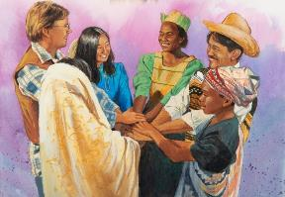

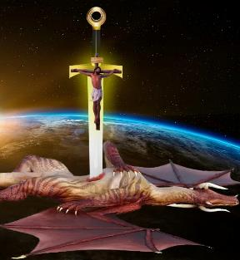

GOSPEL DIA LUNGKHAT A GALSAT
“Keima nahieng uva hung ing, hung mu’n, mu hih jong leng, Kipana Thupha tahsan lam a lungkhat tah a napankhom uva, Lhagao khat a nadinkhom jing u…” (Philippi 1:27a)
Chondih leh thudih tah hi vang a kidoupi melma neilou ding tina ahidieh poi (Phil. 1:30). Khuti malah, Job bang a Pathien in “Ama bang a kitah le pha leisiet chung a midang aum poi” (Job 1:8) atipa ngel jong thuohlel um tah tampi akimaitopi’n ahi, melmapa Satan natoh jal in.
Hiche galpi isat jing lai u hin kipumkhatna hi ngai poimo tah chu ahi. Paul in pankhom, dinkhom a hiche gal isat diuvin ei tiem uve (Phil. 1:27a).
Lungtup kibang ding, taona a hapan ding, Pathien Thu a khantou jing ding ahi (Eph. 6:18; Phil. 2:16).
Ase toh ikidinte tieng u leh eidouva pangho jieh a lungneo lou ding ahi (Phil. 1:28). Satan chu kidoupi gallelsa ahi ti geldoh jing ute; ajieh chu Christa’n thingpel a galjona aneisa ahi tai (Luke 10:18; Col. 2:15).

Slide 11

“Pakai huonlei a kum ijat um ah ihiu hitam? Ipupa diu ga phachuom ijat ipuohpih tah um? Pathien mit in giltah a ijakai avetchil jing ahin, hichu iti ikimaituopi diu ham? Ja-umna, ngailut, kineosah, Pathien dia dettah ihina ho uva khangtou jing ihi nah um? Pathien hepina ichan kipana a lethuh ding igelji nah um? Ivellah a mite phatthei chansah ding igel ji nah um?
Insung jieng a jong Christa chonchan itho ji nah um? Pathien Thu ichate u iseipih ji nah um, Pathien natoh kidang ho ihilson ji nah um? Christian khat chu mipha tah ahina leh thilpha abolna a Christa dinmun alo ahi. Chutieng hinkho chu gimnam tuitah kilhut bang ding, chonchan vethoi tah hung kilang ding, Pathien cha ahi leh van goulo ding khat ahi muthei a hung um ding ahi.”
EGW (You Shall Receive Power, December 10)

