Slide 1

VANMUN GAMMI HINA
Simmun 7: February 14, 2026

Slide 2
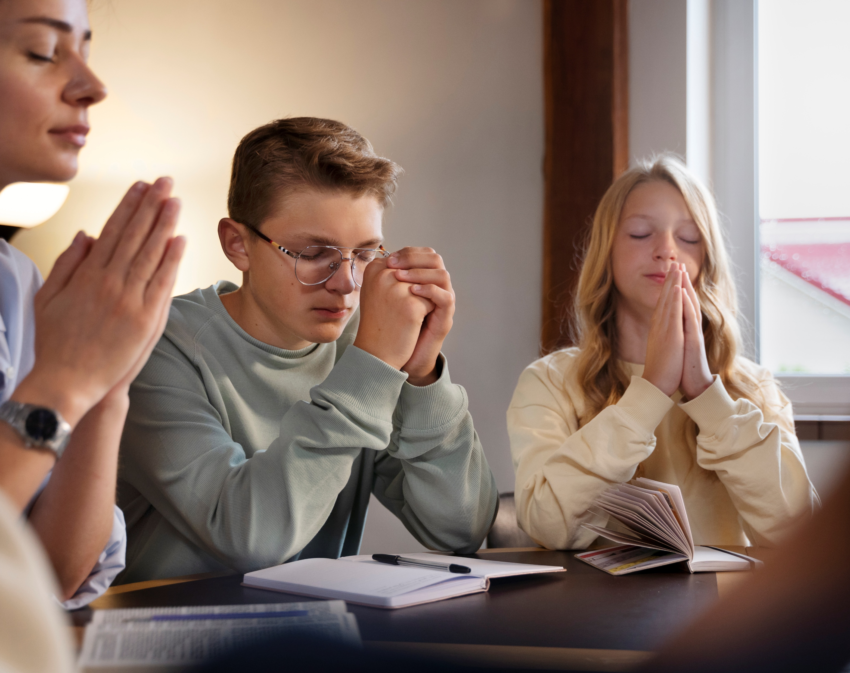
“Imacha lungkhamna nei hih hiel un, ahin ima lam jouse a taona le thuumna mang in
thangvah toh tho’n nathuum jouse u Pathien hetsah uvin.”
Philippi 4:6

Slide 3


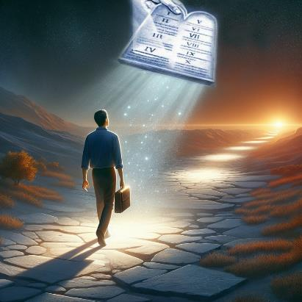


Alekhathot jouse a hin Paul in hiche leisiet gammi ihipo uve tin kichieh tah in asun e. Christa huhhingpu a kisaan chan chu piengthah ahitan, vanmun gammi hina chang ihi ta uve ati.
Hiche vannuoi chondan le kivaihop dan nuoi a um ihi vang un eiho chondan vang chondihna le thilpha bolna lam a hatah a chungnungjo hinkho chu ahi.
Vanmun gammi:
  Tahsan chate umchan jop un (Philippi 3:17-19)
  Gammi hina lhingset (Philippi 3:20-21)
Igam tahbeh ilhun kah un:
  Tohkhom leh kipakhom (Philippi 4:1-6)
  Lunggel thiengthou tah (Philippi 4:7-9)
  Kipa lungkim (Philippi 4:10-13, 19)

Slide 4

VANMUN GAMMI

Slide 5
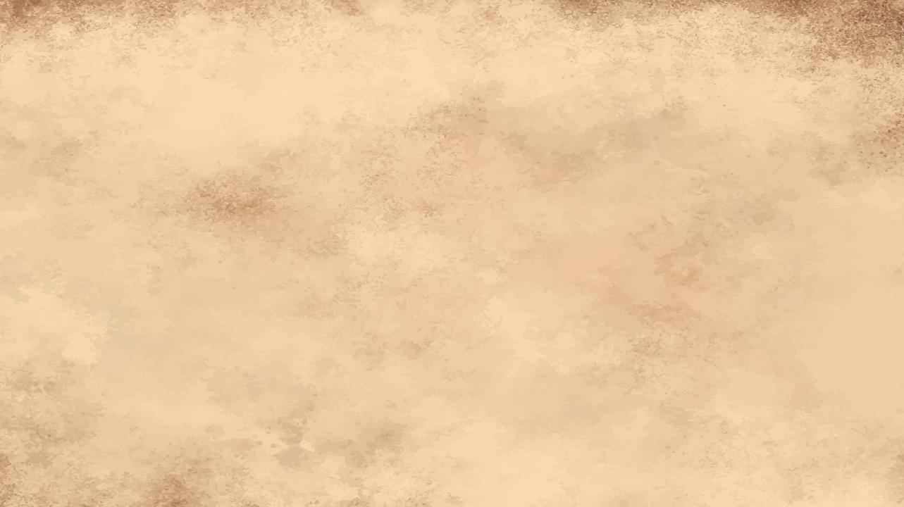

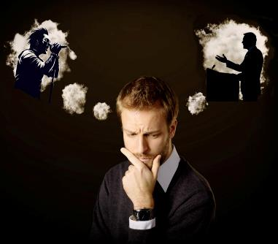
TAHSAN CHATE UMCHAN JOPN UN
“Sopite, naboncha uvin keima umchan jom uvin. Na vetkah diuva chon keiho umchan jop ho vechen uvin.” (Philippi 3:17)
Mijouse’n ahinkho a jopthei a amu, umchan leh thilbol dan kijilna aneidohna, mi anei tei e. Tumging thiem, kichep thiem, lasah thiem tiho ham, ahilou leh pastor, Pathien thusei, tahsanna a kitah tah ho ham chu hithei ahi.
“Vetjui tah” a inei hiche mite hin mimal khantouna lam ei makai u hinam, patep lou beh ding lampi ei puilut joh u hitan tem?
Paul in vetkah ding a lom ho umchan jom din ei tiem uve (Phil. 3:17). Tahsan chate lah jieng a jong Christa douna chonchan kilomlou nei jing aum in, amaho kuon kivengpha din agahchah jing e (Phil. 3:18-19).
Ichan a kikalto hitan tem? Tahsa thudol bou gel jing aum in, Christa bou lungsung veisah jing aum kit e. Vetjui dia lom tah chu Christa umchan jom ho ahi uve (1 Cor. 11:1).

Slide 6

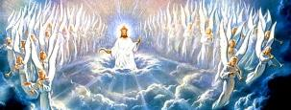

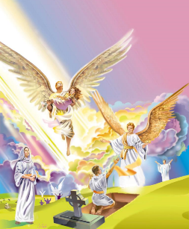
GAMMI HINA LHINGSET
“Eiho vang igammi hina u chu van chung a hung kipan ahin, hiche a kuon a chu Huhhingpa Pakai Jesu Christa hung ding kinem tah a i-nga u ahi” (Philippi 3:20)
Gah ve ute. Christian te hetthiem hahsa khat chu: gammi hina mun ni inei ui. Hiche vannuoi leh vangam, ani gel, a hin gammi hina inei ui. Alhenkah leh alepkah hahsa tah ahiji e (Rom. 7:22-23).
Itahsa u lhagaova kikhel ding, thi theilou leh muonmang thei ta lou ding ahi (1 Cor. 15:42-44, 50-54)
Loupina mel a ikikhel diu ahi (Col. 3:4;
Phil. 3:21)
Tahsa mel iput jing nahlai diu, imit tah uva Pathien imu diu ahi. (Job 19:25-27)
Itih tieng vanmun gammi hina lhingset inei thei diu hitam? Vannuoi leisiet gammi hina itih tieng ilha diu hitam? Christa hung kit nikho chu hi ding ahi (Phil. 3:20).
Thokitna nikho tieng thina’n ichung uva tha nei ta lou ding, adang ipi pi ineibe diu ham?

Slide 7

IGAM TAHBEH ILHUN KAH UN

Slide 8



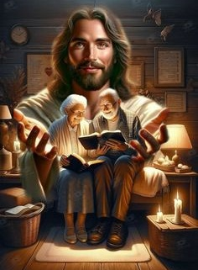
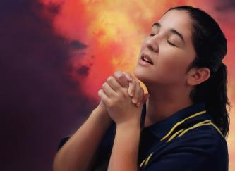
TOHKHOM LEH KIPAHKHOM
“Pakai chung ah kipah jing un, tikitle uving e kipah un!” (Philippi 4:4)
Lekhathot khumkhana’n, changval deisahna leh ajui diu thumop asun e. Syzygus (kivoppi kitah tah) leh Clement chun Euodia leh Syntyche akilungkhatsah din atiem e. Paul in atohkhompi ho chu “hinna lekhabu sung a hicheng min hi aum tai” tin aminphah e (Phil. 4:2-3).
“Kipah jing un[…] Imacha lungkhamna nei hih un” (Phil. 4:4, 6) ti thumop pom hahsa maithei ahi; buoina le hahsatna mun leisiet a hi hithei mong ding hinam?
Hinla “Pakai a kipah” ho din vang ahithei mama e (Phil. 4:4a). Lungkhamna jouse ama chung ah seplha un, aman eipoh jou pih na uve (Matt. 6:31-34; 1 Pet. 5:7).
Ahileh, lungkhamna ho iti achung iselhah diu ham? Taona kuon hiding ahi (Phil. 4:6).

Slide 9


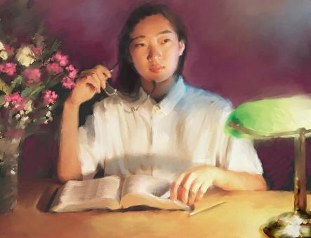
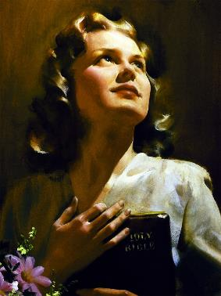
LUNGGEL THIENGTHOU TAH
“Sopite, tukalse’n vang ipi hile thutah dia kilompen, ja thei doltah, adih dia ginchat pen, thiengpen dia kilom, santhei dol tah, thucheng ngei pen, ipi hile phatna dia lom aum a pachatna thei aum le, hiti ho hi gel thiem uvin.” (Philippi 4:8)
Adih dia lom
Kitah tah
Dihtah a bol
Athieng dia kilom
Kithopi jing
Ja dia lom
Lungkhamna Jesu chung iselhah uva, ama a ikipa thei u chun chamna dihtah eipieh u ahi (Phil. 4:7). Vannuoi pieh bang hilou, alahmangpih thei jong hilou ahi (John 14:27; 16:33).
Paul in hiche chamna chu ei hongbit un apang in, lungthim le lunggel vengbittu in apang e ati (Phil. 4:7b). Hiche vengbittu kithopi dia ipiho chu lungsung iveisah ji diu ham (Phil. 4:8)?
Lahchom a sei din: “…thutah dia lom, adih dia lom, jathei dia lom, hiti ho hi gel thiem uvin.” (Phil 4:8b).

Slide 10






KIPA LUNGKIM
“Nang ho jong ka Pathien in ahao dungjui in loupina’n,
Jesu Christa hinkho’n, na ngaichat chan u subulhit nante.” (Phil. 4:19)
Ikipah thei un; lungkhamna ineipo uve; chamna ilah uva aleng in; ilungsung u ngaito jong thiengthou tah ngen ahi; hinkho jong chamkim leh bulhing tah inei uve… Ahin, inei mong u hinam?
Agur bang a Pathien kom a aval jong hilou, avat jong hilou, ahun bepseu pe dia ithuum diu ahi (Pr. 30:8-9).
Hitobang tah a Pathien a kisuonna inei tieng u leh “Ei hatsahpa vang a ijakai bolthei a kahi” (Phil. 4:13) iti thei ding u . ahi.
Inchen phattheina um hen, ngaichat le hahsatna um jong leh, Paul bang a Pathien lhamuonna dihtah inei thei tieng u le bou Pathien a kisuonna det tah ihinnei doh ding u ahi (Phil. 4:11-12, 19).

Slide 11

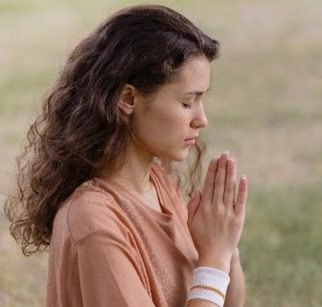
KIPA LUNGKIM
“Nang ho jong ka Pathien in ahao dungjui in loupina’n, Jesu Christa hinkho’n, na ngaichat chan u subulhit nante.” (Phil. 4:19)
Ingaichat tah a igel ineilou tieng iti ji em?
Pathien kom kithuum ji ute, Ama lunglam ahi leh eipieh tei ding u ahi (James 4:2b; 1 John 5:14-15).
Ithuum chan u ama lunglam jieng hinam ti phaat sieh in akihe ji poi; hinlah, itobang kimkhat vang chu ama lunglam mong mong ahi nai ti akihe ji thou e:
Loi khat, ngailut tah khat sochatna ding (1 Tim. 2:3, 4)
Tahsanna thu seiphuongna dia hansanna (Rev. 22:17)
Chonsiet kisih leh nungsun jouva ngaidam chan ding (1 John 1:9)
Pathien Thupieh nitna ding thahat (Heb. 13:20, 21)
Eithet le bolse ho ngailut ding (Matt. 5:44)
Phaat hahsa galkaina dia chihna (James 1:5)
Pathien Thu a thudih mudoh le hetthiem theina ding (John 8:32)

Slide 12

“Lei thah le van thah lut ding ho hinkho iman ding u ahi. Tupna neilou, chopletlut hinkho man hi vetsiet um tah ahi. Tup le doi nei hinkho iman ding u, hinlo kichieh tah inei ding u ahi.
Changval kipiehdohna hinkho, chang ding bou khohsah hilou, chang phatchuomna ding leh chang ding kiti tapou gel masalou ihitheina ding u Pathien in eipieh diu ahi; hiche leisiet a tohphat man kisaannuom man a thilpha bol hilouva, eiho hinkho thiltup le hinlo khat ahi jieh joh a ibol diu ahi joi.”
EGW (Our High Calling, August 24 )

