Slide 1
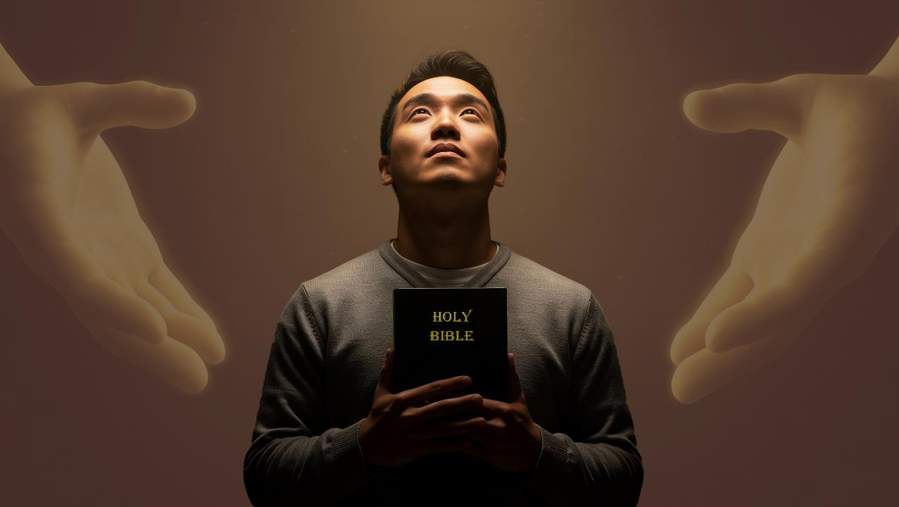
KICHAMNA LE KINEPNA
Simmun 9: February 28, 2026

Slide 2


2 Corinth 5:21
“Chonsiet helou hiel
pa chu, Ama hinkho a Pathien dihna ichan theina diuvin,
eiho khel in Pathien in chonse’n asiem tai.”

Slide 3


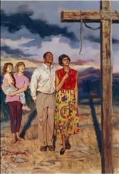
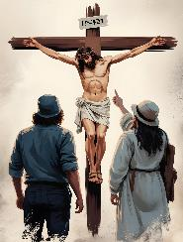
Christa thingpel in lei le van kah a chamna asiem (Col. 1:20) asei jou chun Paul in hiche chamna hin mihiemte hinkho kikhelna alhutje asei e.
Ipi lampang a kikhelna muthei a um em? Pathien in ahung lhung ding ahetsa hin tem? Mite kom iseipih uva, chamna le kinepna ineisah thei ding u ham?
GOSPEL A KUON KICHAMNA LE KINEPNA
Kichamna kuon phachuom ho
Mise a kuon mithieng kisuoh (Col. 1:21-22)
Longlouva dingdet
(Col. 1:23)
Kinepna
Kinepna lhut pih (Col.1:24-25)
Pathien thuguh ki-im
(Col. 1:26-27)
Gospel thahat je
Gospel phuonjal (Col. 1:28-29)

Slide 4

KICHAMNA KUON PHACHUOM HO

Slide 5

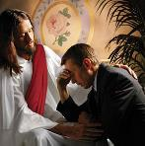
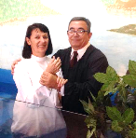
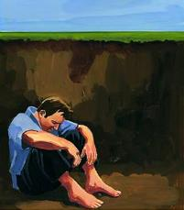
MISE A KUON MITHIENG KISUOH
“Masang lai a thilse nabol uva lunggel a nadou lai un Pathien a kuon a pamse nahi uvin; tua vang Ama angsung a nuolna bei hiel le buoh beh lou, athieng a dinsah ding a tahsaphe pu a, athina tahsa jal a chu nakichampi u ahitan—.” (Colossa 1:21-22)
Athu umdol het ahahsa poi. Ase jieng bol eiho tuonsot thina chang ding inahi ta uve (Rom. 6:23; Rev. 21:8).
Eiho chonsiet man pe din thingpel ah athi tai (Rom. 5:8)
Tahsanna, kisihna leh baptisma chan vang in chonsiet a kuon lhatdoh ihithei ta un, Pathien ang a buoh behlou le nuolna bei a ei kisim u ahi tai (Thiemchanna) (Rom. 5:10; Col. 1:22)
Lhagao Thieng natoh vang in hinkho kikhelna ineibe ineibe thei un, Pathien ang a athieng in ei kisim ta uve (Thienchanna). (Rom. 8:1; 2 Cor. 5:17)
Idinmun u sepphat theina lampi inei po un, kilhatdoh theina lampi jong aum ta poi (Psalm 49:7-8).
Pathien in vang tohguon thupi koisa anei e.

Slide 6


LONGLOUVA DINGDET
“Tahsan a nadindet jing uva, det tah le longlouva najahsa u Kipana Thupha kinepna a chu longlou hiel a napandet jing ding u ahi.
(Colossa 1:23a)
Pathien kom a thiemchang ihi ta uve, thienna chang jong ihi ta uve; hinla lampi che ding saopi aum nalai e. Hiche kahlah hin lamlhang lho khiel leh lam lhun joulouna jong umthei nalai ahi. Hijieh chun Paul in hilchahna thum jen eipe uve (Col. 1:23a):
Tahsanna a dindet
Peter bang in notou jing in; suongkul apat apot chun mite’n athuhil angaipih chan un Peter in natoh anotou jing e
(Acts 12:11-16)
Dettah
Bible thudih a kiphutdet leh suong bang a tah tahsanna nei ngai ahi.
Longlou
“Gospel kinepna” inei u chu longle lou, taan tih neilou, hi ding ahi.

Slide 7

KINEPNA

Slide 8

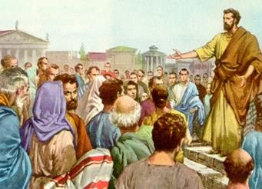
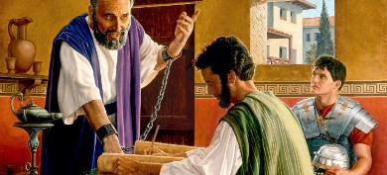
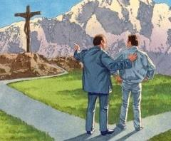
KINEPNA LHUT PIH
“Hiche ding a chu Pathien gouching kahi a, naheng uva Pathien thu lhingkei a seiphuong ding a ei kinganse dungjui a keima lhacha a pang kahi” (Colossa 1:25)
Pathien in huhhingna tohguon asiem chu Jesu thi a kuon mite thiemchanna le thienna channa alhut pih ding chu ahi. Hinla akisam khat aum nalai e: ikisan theina diuva ihet masah u ngai ahi. Ei seipih u khat um angai tai.
“Pathien vaihom” umdol [Pathien in thilsuoh ho, lunggel ho, mite ho, etc. akaituoh je] chun ima jouse achamlouvin, kituoh chet in, alhun sah e (Col. 1:25).
Bolgimna atuo matchet vang in, Pathien vaihomna lhacha apan Paul akipah thanuom lheh e (Col. 1:24). Rome suongkul ataan apat athi gei in Thulhun Thah lekhathot 14 lah a 7 anasun doh e.
Pathien tohguon ah Paul in panmun pha tah ala in, akipa thanoppi lheh e. Eihon jong mite Christa thupha ilhut pih uva, Pathien tohguon a pan pha ilah thei u ahi. Hichu ikipana pen u hiding ahi!

Slide 9

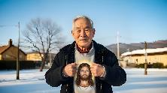
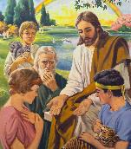

PATHIEN THUGUH KI-IM
“hiche thuguh hi tuonsot tuonsot, akhang khang a ki-im ahin, tua vang amithiengte heng a kiphuongdoh ahitai” (Colossa 1:26)
Paul in thuguh ki-im, Christa thokit jouva kiphuongdoh, thudol chu asei e (Col. 1:26). Hiche masang chun neocha bou hetthei anahi. Hiche thuguh ki-im chu ipi mong hin tem? “Kinepna loupi pen, nasung uva Christa achen hi ahi” (Col. 1:27).
Vannuoi leisiet bul kiphu masang a agot ahi tai (1 Peter 1:20).
Vantil te jieng in jong ahet bukim joulouvu ahi (1 Peter 1:12).
Hiche kinepna thudol neocha Adam le Evi musah anahi (Gen. 3:15)
Thiemgao ho kom kihetsah ahi tai (1 Peter 1:10-11)
Jesu’n Judate anaseipih masa’i (Mt. 15:24)
Achaina’n, vannuoi mitin hieng ah akiphuongdoh tai (Col. 1:27)
Hiche thuguh ki-im hi kiphuongdoh chai nailou ahi. Tun vang loupina chang dia kinepna nei ihita uve. Iti kidan hitam! Hetthiem hahsa tah thupha ahi! Christa huhhingna thisan chun chonse chu thiem achan in, thienna achan in, loupina achan sah tai! Hiche thuguh kidang hi tuonsot a ikhuol diu le ihetdoh be jing diu chu ahi.

Slide 10

GOSPEL THAHT JE

Slide 11

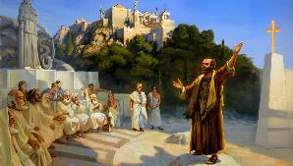
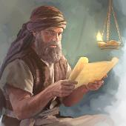
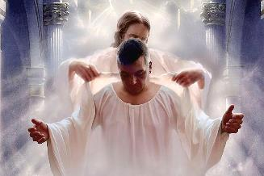
GOSPEL PHUONJAL
“Ama bou hi kaphuonjal uva, mitin kathumop uva, chihna top a mi jouse kahilchah u ahi; ajieh chu amitakip hi Christa ding a pilhing sa a kadinsah nuom u ahi.” (Colossa 1:28)
Paul in gospel iti aphuonjal em? Athuphuon lailung Christa thingpel thudol ahisah e (1 Corinthians 1:23). Jesu hin tahsan chan chu Christa a pilhing asuo chan in athumop in, ahilchah jing ji e (Colossians 1:28-29). Hichu iti amuolsuo thei hin tem?
Christian doctrine leh chondan ahilthiem pih e (2 Thessalonica 2:15)
Gospel nungsun kichat um tah ahi ahilchah e (Heb. 10:25-29)
Thuhil lhem ho a kuon kivendoh ding je ahilchah e (Acts 20:29-30)
Gah vekit tiem ute… “Christa a pilhing sa”… mi themcha bou hilou… “amitakip” atibou in ahi! (Col. 1:28b).
Greek thucheng “pilhingsa” (teleios) ti a kiledoh hi “thepmona neilou le chamkim tah” ti a jong ledoh thei ahi. Christian hinkho a ikhantou dungjui un Pathien Dan leh ibulhit diu umdol hetgilna akineibe cheh cheh e. Hijieh chun tup pipen chu Christa Jesu a pilhin ding chu ahung hi tai.

Slide 12

“Thingpel a kikhenbeh Lhandampu ivet chan un Van Leng Loupi kipiehdohna gilje leh thuhje ihetbe cheh cheh thei uve. Huhhingna tohguon ahung kilah emsel in, Calvary ngailutna’n lungsung ahotliing in, mihiem lunggil tah kipana ahin kaithou pih e.
Chutieng Pathien leh Kelngoinou vahchoina chun ilungsung u lo dim in tin, ikam un apachatna seichim ta ponte. Ajieh chu Calvary a ngailutna natoh lungmit a kilahsah jing chun kiletsah le chang kichoisangna lungput aneithei ji tapoi.”
EGW (The Desire of Ages, p. 661)

