Slide 1

CHRISTA
A
CHAMKIM
Simmun 10: March 7, 2026

Slide 2
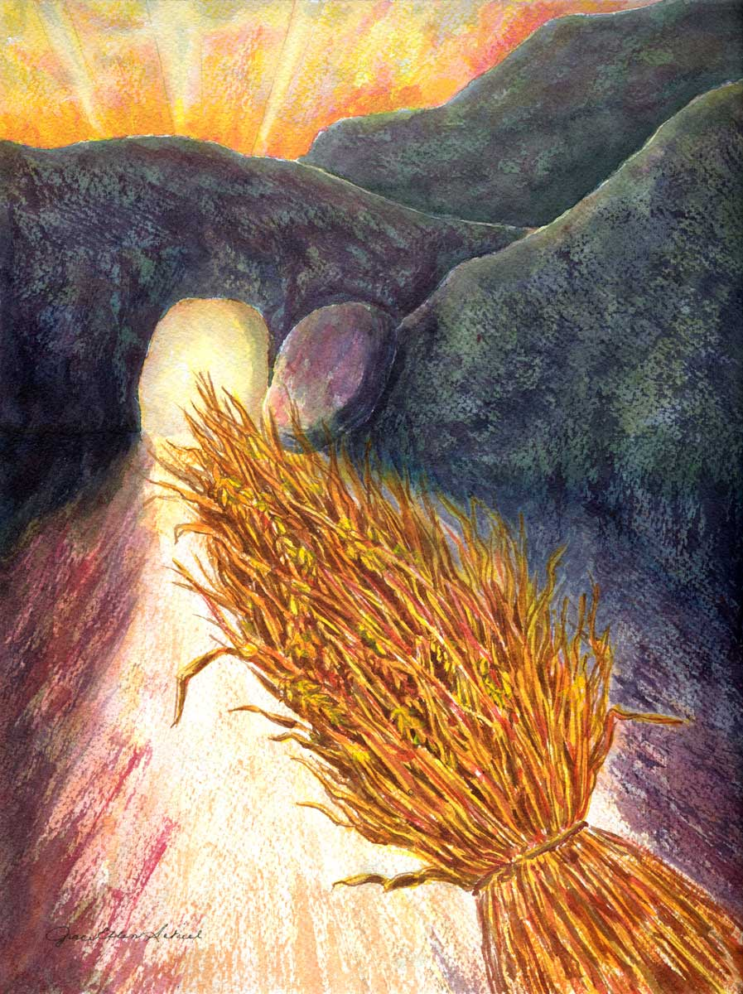
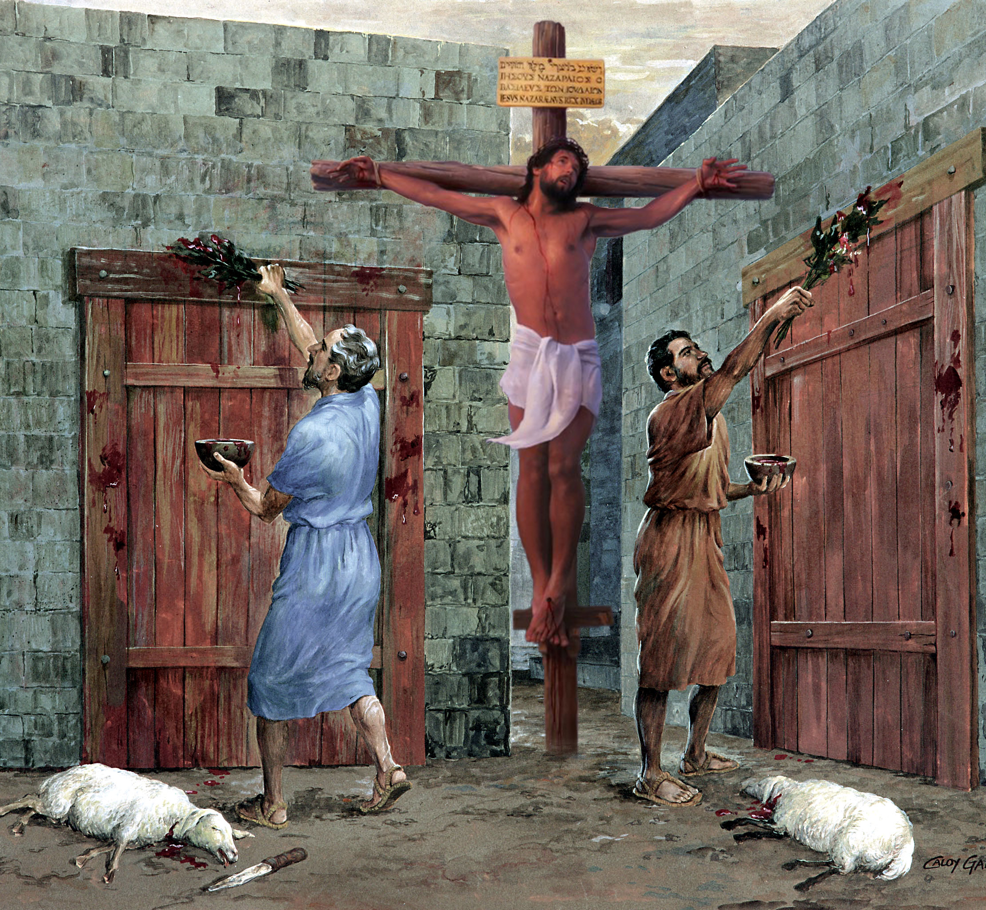
“Chuti ahijieh in koiman anneh thu, donthei thu, kut thudol, lhathah nit dol ham le choldo nikho thudol ham in nachung thu u khuol da hen;…ahung lhung ding thilho lim a um ahin, atahsa tahbeh chu Christa a umjo ahibou e“ (Colossa 2:16, 17).

Slide 3





Jesu a tahsanna ngaplhah hin thilpha chungnung tampi eihin lhutpih uve. Chonsiet ngaidam ei chan u ban ah lhamuonna, chihna le adang tampi jong aumbe nalai e.
Paul in tahsanna jungkho din ei tiem uve; hichu Pathien Lenggam dia, thingphung bang a, ga pha tampi igadoh theina diu ahi.
Iti ijungkho diu ham jong eihil diem uve; mihiem chihgut le lungsuhtuo bang hilouva, hing jing Pathien Thu joh a hiding ahi.
Tahsanna phatchuom dan:
  Lungmuon, pachat le kigahchah (Colossa 2:1-5)
  Christa a jungkho (Colossa 2:6-8)
  Khut a kisun danthu thingpel a khetbeh (Colossa 2:9-15)
Tahsanna suliing thei buoina ho:
  Kut thu, lhathah thu, choldo nikho thudol (Colossa 2:16-19)
  Mihiem thupieh le thuhil ho (Colossa 2:20-23)

Slide 4



TAHSANNA PHATCHUOM DAN

Slide 5

Chihna hoi a kimu’n tin, hetkhenthiemna hoi a kisimdoh ta’n tem?
(Job 28:12)
Christa sung a chun chihna le hetna gou jouse akisel e
(Colossa 2:3)

Slide 6

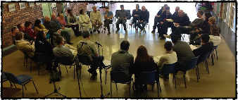
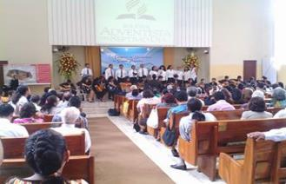
LUNGMUON, PACHAT LE KIGAHCHAH
“Tahsa hin nalah uva lha hih jong leng lhagaovin nangho toh kalhakhom in, kigahchah tah a napan det je u le Christa natahsan je u kipah in kasei jing e.” (Colossa 2:5)
Paul in Colossa houbung mite chu tahsa tah a akimelhetpi ahilou vang in, lhagao thudihlou alah uva alaan ahe’n ahi (Col. 2:1, 4).
Hijieh hin amaho chu lekha athot in, melma natoh ananjouna diu thil thum abol tei diuvin ahilchah e (Col. 2:2):
Lungthim akilhepbi thei uva
Ngailutna a akikankhom uva
Hetkhenna lhingset le nieng jeng jung a anei uva
Pathien selguh le thuki-im Christa a um chu ahetdoh theina diu ahi
Kihilna dihlou alah uva alaan asei masang in Colossa mite pachatna jong asei e: kigahchah tah leh pangdet jing ahi uve (Col. 2:5).
Paul in “kigahchah tah” ati hi houthu a kigahchah, houbung kivaihopna a kigahchah ahijal u ahi. Houbung kilamkaina phatah anei uva, natoh le mopuohna kihom diel diel hi uva, kijato tah a tongkhom hi uva, hiti tobang ho adang tampi jal jong ahi. Hichun Gospel hat tah a aphuonjal sah uva, kihilna dihlou tampi ananjou sah u ahi.

Slide 7



CHRISTA A JUNGKHO
“Ama sung a jungkhovin, kisadoh un, nakihil bang uvin tahsanna’n kiphutdet un, thangvahna’n bulhingset uvin.” (Colossa 2:7)
Christa kisaan jal a huhhing chang ihi uvin, doctrine kisaan jal ahi poi (Col. 2:6). Hinla, anungthuop um a ahi. Paul in “nakihil bang uvin” Christa a lamlha un ati (Col. 2:7b).
Christa toh kilhon chu ama a jungkho ahi. “Aloupina ding a Pakai phusa thingphung bang diu” kiti chu ihi diu ahi (Isaiah 61:3) . Christa le athuhil a behden “thingphung” ihi diu ahi (Psalm 1:3).
Ven, tun doctrine jat ni aum e
Bible a kisun Christa thuhil bou
Hichun tahsanna ei phudet pih un, kipaje eihil ui (Col. 2:7)
Mihiem chihgut le chondan thusim apat hung kuon
Doha lhep, thiemmo chansah leh kipaman jong lahmang sah ji
(Col. 2:8, 16, 18)

Slide 8



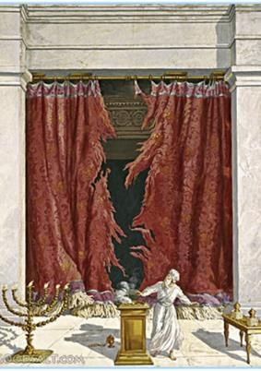
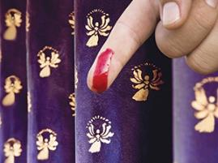
KHUT A KISUN DANTHU THINGPEL A KHETBEH
“Ei doudal uva pang khut a kisun kihilna lhongpi Danthu chu Christa’n anoimang a, hichu asumang suoh in, Thingpel ah akhetbeh tai.” (Colossa 2:14)
Abraham in Pathien toh akitepna cheptan in anamdet e (Gen. 17:11). Eihon Christa toh ikitepna u “Christa ding a cheptan” ti a jong kisei baptisma chan in inamdet uve (Col. 2:11–12). Hichun tahsa cheptan ngaitahlou dan avetsah e. Hiche thudol ahilchet jou in Paul in thingpel a Jesu natoh umdol asei e. Jesu’n ipi pi amuolsuo em?
Chonsiet angaidam a, ei chohing kit u ahi (Col. 2:13)
Ei doudal uva pang jing, danthu jal a bat inei u ei noimang pih ta uve (Col. 2:14)
Vaipuoh thuneina le siet thahtna jouse ajousuoh tai (Col. 2:15)
Ephesia 2:14-15 in eiho doudal a pang jing “kihilna ho” ati hi Mouse chondan thuhil ho, tuni gei a Juda le Gentile kah kibungkhenna pang jing chu atina ahi.
Tun vang Thulhung Lui a kisun Mouse chondan thuhil ho lungkhampi angai ta poi, ajieh chu abon a Christa a kisubulhing leh kichai suoh ahi tai.

Slide 9

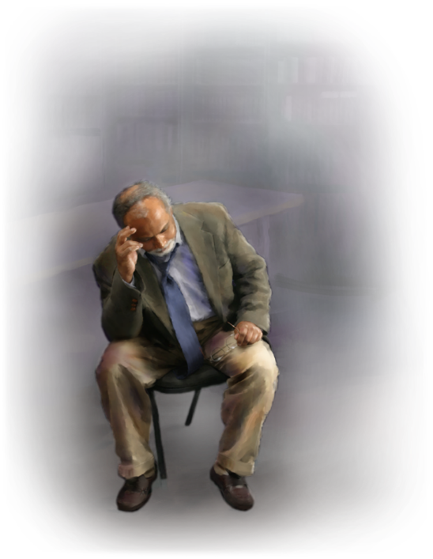
TAHSANNA SULIING THEI BUOINA HO

Slide 10


KUT THU, LHATHAH THU, CHOLDO NIKHO THUDOL
“Chuti ahijieh in koiman anneh thu, donthei thu, kut thudol, lhathah nit dol ham le choldo nikho thudol ham in nachungthu u khuol da hen” (Colossa 2:16)
Juda mi leh Gentile mi kikhenna cheptan thudol bou ahipoi. Kutpi ho leh golnop kimangho thudol a jong ahi.
Paul in cheptan thudol phatah a ahilchetsa ahi tai. Paul in “eiho doudal a pang kihilna” (ceremonial law) suhmang ahitah dan leh sochatna dia bulhit ngaikhoh talou ahi dan asei in, Jesu’n kutpi kimanlona ho thingpel a abulhit suoh ahi tai ati (Mt. 27:51; Col. 2:16).
Houbuh natoh umdol thu thuguol khat a asei lhah jieng hi Paul in Hosea 2:11 apansat abang e. Hichun hiva choldo nikho (sabbath) kiminphah hi Kutpi sabbath 7 ho ahi avetsah e.
Hiche nikho chu ipi nikho hijong leh sabbath ti a kisei ji ahin, ni 7 lhin ni Sabbath vang chu ahipoi. Ni 7 ni Sabbath vang chu Juda hihen Gentile hileh vannuoi mitin ding a kipe, Danthu Som a kisun, chu ahi.

Slide 11


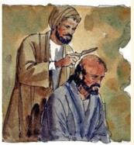

MIHIEM THUPIEH LEH THUHIL HO
“Hicheng hin akimanchah tieng mangthah ji thil ho aseidoh ahin, aboncha hi mihiem thupieh le thuhil jieng ahibouve.” (Colossa 2:22)
Paul in thuhil lhem ahi ti a vel tampi aminphah ho chu sochatna dia Juda chondan boljom ding a thuhille Juda ho chu ahi (Acts 15:1, 5). Hiche chondan a chun Juda houhil (rabbi) ho patdoh danthu tampi jong ajaotha’i.
Paul lungsuhtuo dan jui ute. Baptisma ichan u chun “vannuoi thilho” dia thi a, ontholna eipieh u ahi tai. Hiche Juda chondan buoipi nalai a, boljom lou jieh a buoh/nen beh a kigel nalai ihiu leh “akimanchah tieng mangthah ji” thil ho lah a cheng den nalai ihi ding u ahi (Col. 2:20-22).
Paul in ahilchetbena a chun, hiche Juda chondan hin lung kikhelna dihtah alhut theilou vang in chang kitiim le kithununjouna lampi asiempih thei e jong ati (Col. 2:23).
Chomkim tah a sei din, Pathien Lekhabu (Bible) kuon bouva kihilna inei ding u ahi; hichu Pathien a kuon ahin, mihiem chihgut leh lungsuhtuo vang ipampai ding u ahi.

Slide 12

“Christian te chu Lebanon cedar thingphung toh tekah ahi. Hiche thingphung hin leinuoi a jung akho mai mai ahipon, ajungkho chu leikuo nuoi lang peh a dettah a lut thuh a, kinga den louva aban chalsuh suh a, pansatna detjo cheh aholsuh be be ji ahi. Huipi hattah ahung nun tieng, hiche thingphung chu kiliinglouvin ading det thei tan ahi. Hichu pansatna jungkho tho tampi anei tah jieh ahi.
Hitobang chun Christian chun Christa ah jungkho dettah anei e. Lhandampu tahsanna dettah anei in ahi. Atahsan Mipa chu koi ahi ahethiem sel e. Jesu Pathien Chapa ahin, chonse te Huhhingpu ahi hetna lhingset anei e… Ajieh chu atahsanna jungkho chu nuoilang peh gei ah ahi. Lebanon cedar thingphung bang in Christian dihtah chun polam a muthei in akhang tul tul pon, Pathien joh ah jung akho’n, muol suongpi kah a kiphutdet chet abang e...”
EGW (Our High Calling, November 21)

