Slide 1
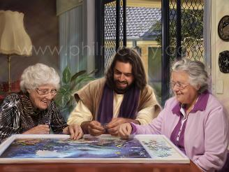
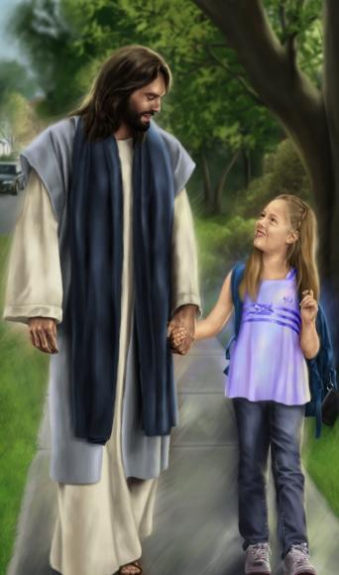
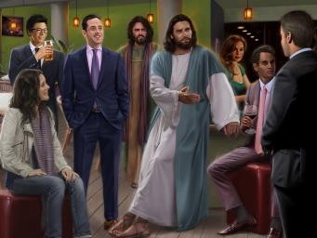
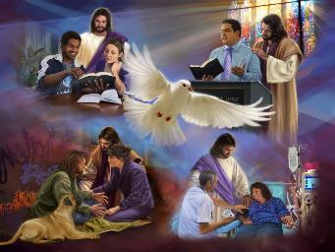
CHRISTA TOH HINKOM
Simmun 11: March 14, 2026

Slide 2

“Hicheng jouse chung a hin kikankhomna chamkim pen ngailutna nei un. Colossa 3:14

Slide 3

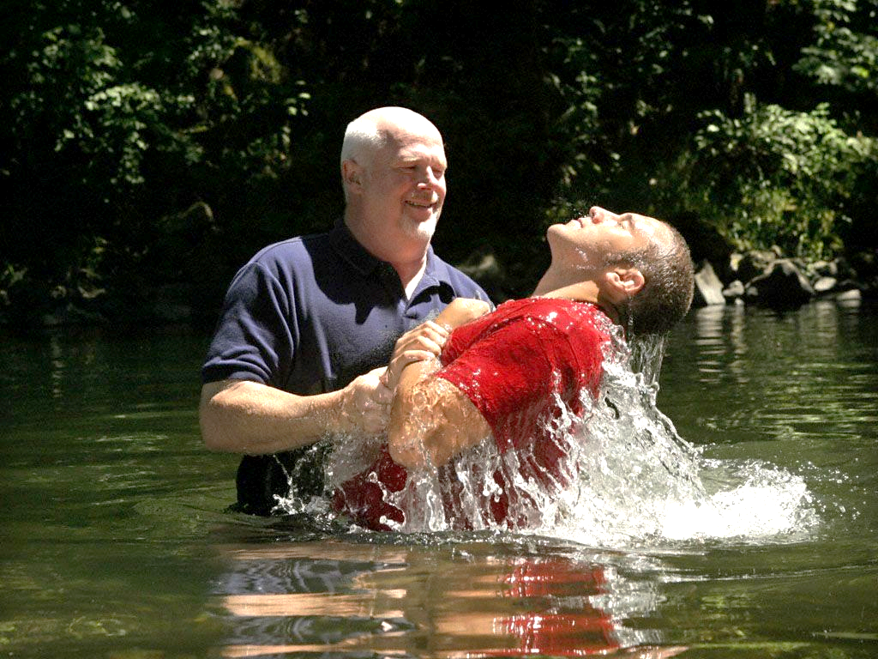






Baptisma tui a ikiphumlut tieng leh ichonsietna milui chu thi a ahitan, tui a kuon ihung dindoh tieng leh mithah akihi tai ti vetsah ahi.
Masang lungput le chondan chu ihaisan ahi tai. Cheva pat chun hindan le geldan ahung lamdang tan, leilam lungput hitalouvin vanlam lungput akihi ji tai.
Ahin khatvei vei leh imilui ahung thoudoh kit kigo ji’n, hijieh chun Paul in vanlam thilho a namit hei un, lei thilho nungngat un ati ahi.
Leilam lungput ham, vanlam lungput joh ham?
Gelkhoh pen (Colossa 3:1-4)
Leisiet thilho thi-san (Colossa 3:5-6)
Van loupina kivon (Colossa 3:7-11)
Chirsta a mithah hinkho chonchan:
Kikankhomna chamkim pen (Colossa 3:12-14)
Vanlam an tui (Colossa 3:15-17)

Slide 4


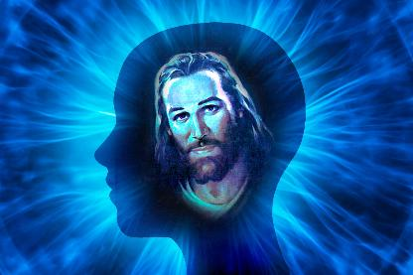
LEILAM LUNGPUT HAM, VANLAM LUNGPUT JOH HAM?

Slide 5

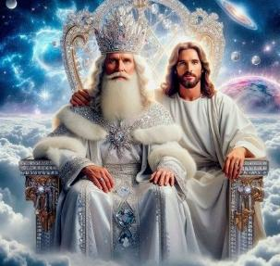

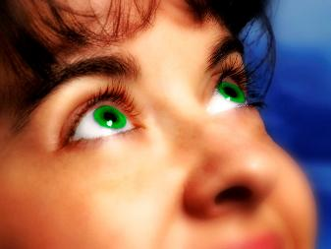
GELKHOH PEN
“Leisiet chung a thil ho hilouvin chunglam thil ho jieng gel uvin.” (Colossa 3:2)
Baptisma ichan chu Christa toh thoudoh khom (Col. 2:12) ihi vetsah ahi bang in, Christa thina kuon athodoh a Pa laltouna alut bang a, Christa khonung ijui peh diuvin Paul in ei tiem uve (Col. 3:1).
Hichu tahsa tah a iboldoh theina diu Christa hung kitna nikho chu hiding ahi (Col. 3:4). Hiche nikho lhunkah chun vanlam thil ho jieng gelna a kisalal ding ihi uve (Col. 3:2).
Eiho “athisa” ihi ta uvin, ihinna u “Pathien sunggil a Christa toh kiseltha ahi tai” (Col. 3:3). Hiva hinna kiti hi Christa ikisaan ni a hinna inei chu ahi.
Hiche hinna chu ahin jing theina dia nitin a an tui a akivah ngai ahi (2 Cor. 4:16). Nitin a “chunglam thil ho” igel diu, “Christa lam jieng” ivet ding u ahi (Heb. 12:2).

Slide 6

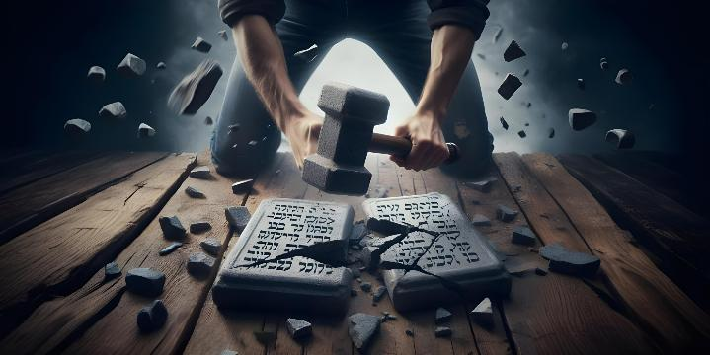




LEISIET THIL HO THI-SAN
“Hijieh chun leisiet chung a natibah chengse uva natong jonthanhuoi, thienlou, huh, lungtup gilou, milim hou, papsiet hicheng hi thatgam uvin.” (Colossa 3:5)
Christa toh thoudoh khom a, vanlam jieng gel ihi tah jieh un, lungtup thupi pen bulhitna ding daltantu a pang jing leisiet thil ho ithagam ding u ahi.
Koiman ahetkhiellouna din Paul in leisiet lunglam jieng gel kiti hi ipi tina ham, leisiet thil ho chu ipi pi hin tem ti kichieh tah in asei e:huh, thienlou, jonthanhuoi, papsiet, milim hou, lungtup gilou tiho ahi” (Col. 3:5).
Paul khanglai mite toh tukhang mite lungput kikhiehna lom lom ima aum nai poi. Thupieh Som sukeh ding a kigo jing mihiem lungput le khansietna chu tu nikho’n jong ilah u adimset nalai e.
Ibol a “thatgam uvin” kiti hin tem? Lungsung le thilbol toh kikhensah dapbeh ding ibol a kiti hin tem? Ajieh chu hiho chun “Pathien lungsatna” ahin lhut ji ahin, vangam lut ding mite chondan toh kikal del jieng ahi (Col. 3:6). Leisiet lunglam chun nahin tha ma in nang in that masa’n!

Slide 7




VAN LOUPINA KIVON
“Ama lim tobang a Siempa chu kichien tah a nahetna diuva tanglou hiel a siemthah jing jieng limthah chu na kivon joh u ahi” (Colossa 3:10).
Paul in leisiet lunglam 5 aminphah ho kikhenpi theina din leisiet lunglam thilbol 5 haisan din asei e: “lungsat, lunghan, mitthip, taitom, thujamo sei” ho ahi (Col. 3:8), akhumkhana’n hiho lah a phalou pen- “khat le khat thujou in kihou hih un” atibe’i (Col. 3:9).
Paul in “mihem lui achonna jouse pum a puonse lelhah bang a” ilelhah tah diuvin agel e (Col 3:9). I chonsietna jouse Jesu ilahmang sah tieng (Zech. 3:4) “puonse” bang chonna lehlha ihi thei diu ahi.
Kivonna lui sutlha a “von hoi” a kivon ding ngaicha ihi uve. Hiche von thah chun nitin in siemthah in tin, thienna hinkho a khantou sah jing ding ahi (Col. 3:10).
Pathien Thuthieng sim a kuon Lhagao Thieng siemthahna ichan tieng u leh khat le khat sukhen thei jouse jong lamang tante (Col. 3:11).

Slide 8
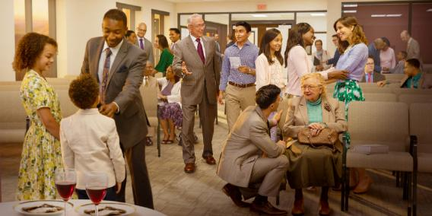

CHRISTA A MITHAH HINKHO CHONCHAN

Slide 9

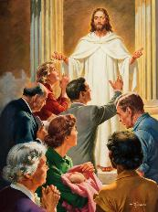


KIKANKHOMNA CHAMKIM PEN
“Hicheng jouse chung a hin kikankhomna chamkim pen ngailutna nei un” (Colossa 3:14)
Eiho “Pathien lhentum mithieng…ngailut te” ihi uve (Col 3:12). Peter in hiche chanvou nei jouse’n mopuohna lien tah jong aneitha ui ati (1 Pet. 2:9). Chuti ahi leh Pathien lhentum mit te iti chon ding u ham (Col. 3:12-13)?
1
2
3
4
Khotuona nei tah in
Chonnem tah in
Kineosah tah in
Nunnem tah in
Thuohhat tah in
Kidiemdai tuo chieh in
Kingaidam tuo chieh in
5
6
7
Hiho jouse hi kikankhomna chamkim pen- ngailutna- vang a bulhit hiding ahi (Col. 3:14). Phatchuomna le mopuohna jong umtha ahi tai.
PHATCHUOMNA
MOPUOHNA
Mite le eima dia phatthei kuonna ihithei ding u ahi.
Pathien loupina tahlang ding, mitin kitiilkhouna ding leh Jesu komu ding ihi uve.

Slide 10


VANLAM AN TUI
“Christa thu nasung uva dimset in cheng jing hen, chihna tin cheng in kihilto kithumop to uvin, tumging to tho’n, houla’n, thangvah to tho’n lhagao la’n nalungsung uva Pathien din sa uvin. (Colossa 3:16)
Colossa 3:15-17 in vanlam an tui neh je ei hil uve (hiche an hi chang seh a neh-oiva thei ahipoi ti akimudoh thei e; midang te toh kipolkhom a kuon umdoh thei bou hidan ahi):
Pathien a kuon chamna vaihom sah ding
Tipum khat bang a lungkhat hi ding
Kipah je he a, kipah jing ding
Bible sim pontho tah hi ding
Hetna khat le khat kihiltuo ding
Tumging toh tho a houla le lhagao la sah jing ding
Imalam jouse Jesu min a bol ding
“La hi natong thei tah, lhahdaina kuon a jong hatdoh sah kit thei thilpieh khat ahi. Lungsung chun Huhhingpu umpina nisa vah bang a vah lam chu angat tieng damna le phattheina chang ding ahi.” (Ellen G. White, “The Ministry of Healing,” p. 254) .

Slide 11

“Lungsung chonnem, khotuona dim chuleh hepi thiem tah neina din hakat in, hichu lhahsamna ahi tilou jen in; ijieh in em iti leh hiho chu Christa chonchan le hina ngen ahi. Mite itobang chonchan najilsah chingthei in. Chonchan thiengthou le gim namtui tah hisah in, mite’n nachonchan ahin jop tieng leh vethoi le vetlom tah khat ahi a, najumpi chonchan ahilouna din.
Tui vat tampi’n vadung ahin suo bang in, hinkho jong thil neocha cha ho jal a umdoh thei ahi. Hinkho hi vadung tobang, muong tah, chamna nei tah chuleh kipana tah hung hiji ahi; hichu ahilou leh vadung sose tah, nen le buoh tampi hin sepdoh ji tobang hung hikit ji ahi. Na hinkho hi Lhagao Thieng thunnunna nuoi a na kikoi thei ahi. Lhagao Thieng in thienna hinkho a napui tou touva, Christa na bahsah ding ahi.
EGW ( That I May Know Him , July 22)

