Slide 1
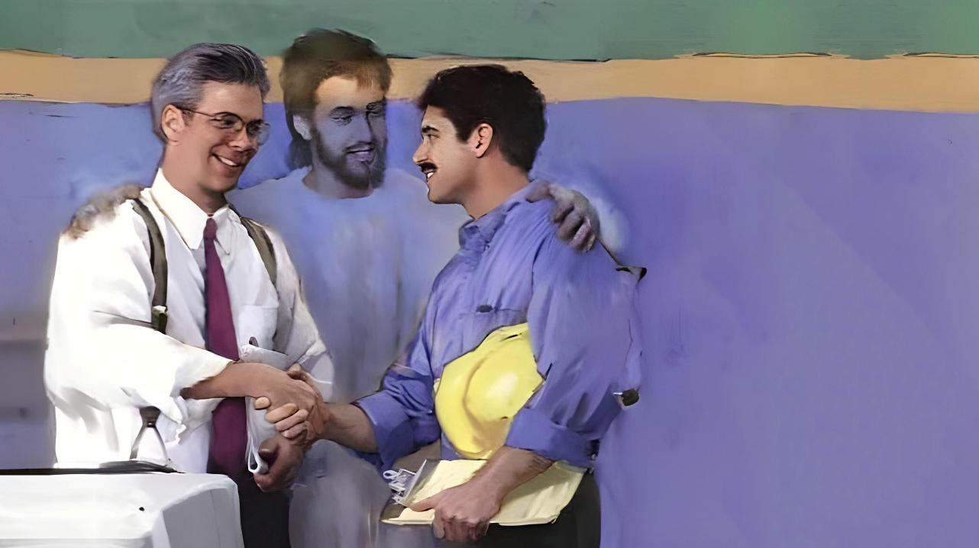
Simmun 12: March 21, 2026
KHAT LE KHAT
TOH
HINKHOM

Slide 2

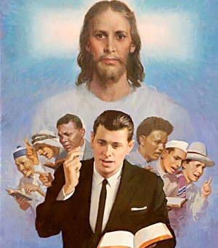
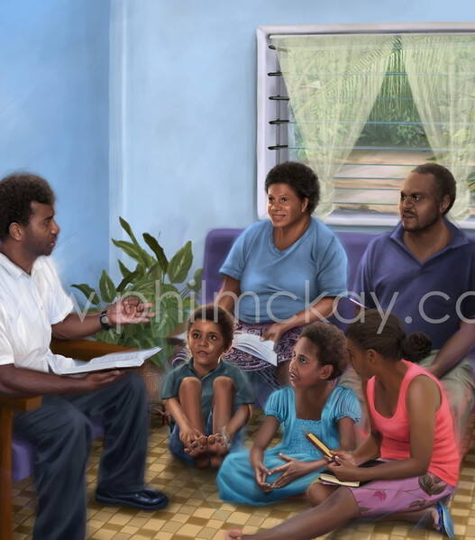

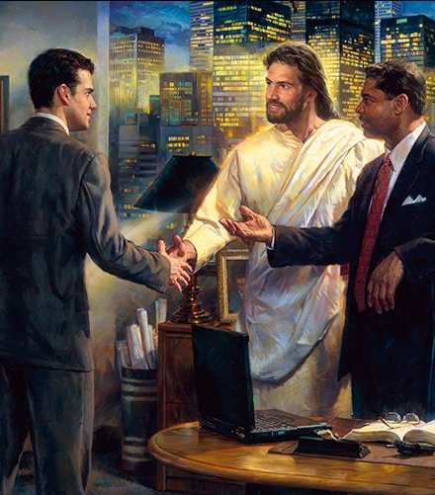

“Nathusei u chu phaat jouse’n onemheo le kituohchet, thanop um jing hen, chule thu nadong jouse u kituoh chet a donbut din kigosa diem hi uvin.” Colossa 4:6

Slide 3




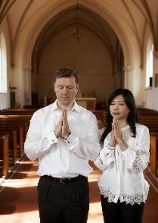

Paul in alekhathot a chun mite kah a nitin kipolkhomna thu umdol ho jong asun e.
Kipolkhomna kuon hin kinah le kinielbaotamna jong suoh ji ahi. Hijieh chun lhatkhom theina din thiltup le thilbol ho mitin dia dei um ahi ngai e.
Paul in nupa kikah, nu le pa leh chate kikah, houbung mite khat le khat kikah, chuleh tahsan chate leh midang te kikah siemphat theina ding tampi asei e.
Nupa kikah (Col. 3:18-19)
Nu le pa leh chate kikah (Col. 3:20-21)
Pute leh thalahho kikah (Col. 3:22-25; 4:1)
Houbung mite khat le khat kikah (Col. 4:2-4)
Tahsan chate leh tahsanlou te kikah (Col. 4:5-6)

Slide 4




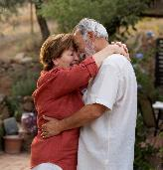


NUPA KIKAH
“Numeiho, Pakai dia lom tah in pasalte thu’n nung uvin. Pasal hon numeite chu ngailu uvin, nunbol da uvin. (Colossa 3:18-19)
Colossa leh Ephesia lekhabu teni kisut phaat thakhat ahijieh in asung thu kisun jong akibahna tampi aum in, nupa kikah thudol asut ho diehset hi kithuoptuo gel in akimui (Col. 3:18-19; Eph. 5:21-33).
Numei ho ajite’u thu a nung ding ahi uve (Col. 3:18; Eph. 5:22-24)
Khat le khat thu’n nung un kiti jal a khat chu khat joh thu a nung ding ahi (Eph. 5:21)
Pasal hon najite’u na ngailut ding u ahi (Col. 3:19; Eph. 5:28)
Christa’n angailut bang bang a ngailut ding ahi (Eph. 5:25)
Khat chung a thil lhung ding ama tah mopuohna ahi (Eph. 5:29)
“Khao” behseh in ima bolda’n, khat thet le deilou behseh in jong bolda’n.
Nupa chu hon khat bang a pangkhom ding, kijatuo le kihoumat jing ding, thulhuhna siemkhom ding ahi lhon e. Adol tah a pasal chu lubuh hi ding, khat joh phatna ding kibolpihtuo lhon ding ahi.

Slide 5

“Mitin in ngailutna pe doh chieh hen, kisaan ding ngaituo jing sang in. Chonchan pha nang a um chu pilhinsah ding ngaituo’n, midang phatna pachat je thiem in. Midang pachat ichan kihet hi kipa le kitiilkhouna phatah ahi. Mi’n ei hetthiem a, jana ei chan tieng hichu aphajo cheh boldohna dia tha eipe chu ahi; hichun tup sangna eipe’n, ngailutna akhansah e. […]
Numei in aji aja ding ahi. Pasal in aji angailut leh adei ding ahi; akitepna lhon in akankhom lhon bang a, Christa tahsan vang a pumkhat hi lhon ding ahi. Nupa kilungtuoh tah, Jesu thudol hetbe ding tup a, Christa Lhagaova dimset ding ngaituo jing a chu Pathien lunglhaina sang pen chang ding ahi.
EGW (The Christian Home, pp. 107, 114)

Slide 6




NU LE PA LEH CHATE KIKAH
“Chate, imalam jouse a nu le pa te thu’n nung uvin, ajieh chu hiche hi Pakai lunglhaina ahi. Pate, nachate u alungbeilo louna diuvin sulunghang hih un. (Colossa 3:20-21)
Tukhang hin ‘nu le pa’ akiti tieng nupa jong hithei, changseh a cha hin kisin ho jong hithei ahi. Paul in nu le pa leh chate kikah hoisel ahitheina din nu le pa te mopuohna bou ahipon, chante’n jong mopuohna anei ui ati.
Chate mopuohna (Col. 3:20; Eph. 6:1-3)
Chate thunung hitei tei ding u ahi
Thununna hi Thupieh 5na dungjui ahi
Thununna hin kipaman alhut tei ahi
Nu le pa te mopuohna (Col. 3:21; Eph. 6:4)
Chate lung lhahdaisah, lungneosah lou ding, akhantouna diuva hilthiem ding ahi
Lungtong le gitahlouva chate bollou ding, alunghanna diu bolpih lou ding ahi
Pathien lampi a hilthiem a, khantousah ding ahi (Deut. 6:6-7; Prov. 22:6)
Jingkah nilhah a Pathien houkhompi jing hi chate’n Pathien akimudoh uva, tuonsot lampi ding thulhuhna ahin kisiemtheina diuva kithopi phatah chu ahi. Chate ding a kihilna phapen chu nu le pa chonchan chu ahi.

Slide 7

“Nu le pa te ho, na chate’n na ngailutna amu uva, amaho ding nabol thei chan bol ding nahi ti ahetna diuvin bol in. Chuti leh bollou dia thugahna nasiempih ho chun khangdong lungthim a na nasatah a atoh joh ding ahi.
Domthiem tah leh khotuona nei tah in chate chung ah vaihom in, “van a um avantil te uvin ka-Pa mai amu jing u” ahi ti geldoh jing in. Hiche vantil hon na chate bolpih dia Pathien thusah ho abol diu nadei leh nang in jong panhu’n lang, nangma bol ding lom tah chu kibol in.”
EGW (The Christian Home, p. 193)

Slide 8



PUTE LEH THALAHHO KIKAH
“Suohte, mihiem mitvet mai a hilouvin, Pakai ginna’n lung jangkei in imalam jouse a tahsa lamdol a pakaite thu’n nung uvin.” (Colossa 3:22)
Paul khang a suoh le pute/pakaite tobang chet aum tah lou vang in, tukhang suoh le pute/pakaite lam chuom chuom in tampi aumkit in ahi. Hiche thumop hi tukhang pute le thalahho kikah umdol kiseina ilah ding u ahi.
Thahlahho bol ding (Col. 3:22-25; Eph. 6:5-8)
Mite mitmu louvin jong nabolthei chan bol in
Pathien dia bang in nabol chu ahoi pen hisah go’n
Housiet chang dia lom nahi tieng kisaan in
Natoh pha chu gasuo tei ahi
Pu phalou chun athalahho ahambol e (1P 2:18)
Pute bol ding (Col. 4:1; Eph. 6:9)
Dihtah le kitah tah a alampat ding ahi
Gihsalna apeji pon, gitahlouvin abolji poi.
Pupa chun ama chung a thunei pu khat anei kit tei e
Ibon uvin, pu leh thalah khat joh sang hijong leu hen, Christa thalah/suoh ihi uve, Ama dia tong ihi jieh un.

Slide 9

“Seijuite chun gamsung kivaihop le chondan umsa khelpih ding aguot jieng u ahipoi. Hichu gospel machalmona ding ahibouve. Hilah athuhilho’u chun suoh le kol kibolna hatah in adeh in, asei bang tah uva kijui leh kibol ding hita leh suoh le kol suhmang a hung um ding ahi. […]
Christian sakho hin pute le suohte kikah, leng le amite kikah, gospel lhacha natong le chonsiet a lhusa Christa hin kisaan thah kit mipa kikah dettah leh ngailutna a kisamkai hidin abolpih e. Abon un Christa thisan a kisopthieng ahi uvin, Lhagao khat chothou ahi uvin, Christa Jesu a pumkhat kisuo ahita uve.
EGW (The Acts of the Apostles, p. 460)

Slide 10


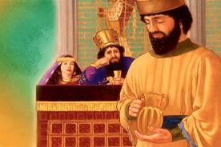
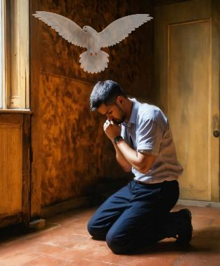
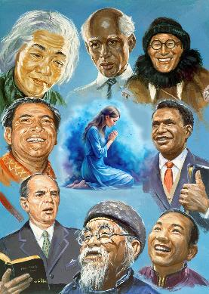
HOUBUNG MITE KHAT LE KHAT KIKAH
“Taona’n pang det jing un, hiche a chun kiging jing uvin thangvah toh tho uvin. (Colossa 4:2)
“Khat le khat kitaopih” dia kikou ihi uve. Ajieh chu “midih mi taopihna chu nasatah a natong thei ahi” (Jacob 5:16).
Jiingkah nilhah taona seh hilouvin jong aphaat sieh a kitaopihtuo din Paul in asei e (Col. 4:2; Eph. 6:18; 1 Thess. 5:17). Lengpa ang a Nehemiah’n lungthim taona anei bang in (Neh. 2:4), hoilai mun hijong leh Pathien kom tao theina chanvou inei uve.
Chuban a jong, Lhagao Thieng in itaona u gasuo pih tei din eiho din atao tao jing e (Rom. 8:26).
Paul in gospel lhangsam ho taopih jing din ngehna chuombeh anei e (Col. 4:3-4; Eph. 6:19). Thupha lhangsam ho hetna tampi nei himaithei, lhomcha nei himai na unte, hinla hiche natohna hin koima achamkim aum poi. Paul amatah atao jing in, thupha giltah aseidoh theina din houbung miten ataopih diuvin atiem jing e.

Slide 11

“Thudih kiphuonjalna chan a hin hetdan chuom chuom, boltheina thilpih chuom chuom, tohguon le natoh dan chuom chuom tiho kithokhom a, thupha lhangsap ahatsah ding ngaicha ahi. Mitin kihoutuoh a, taokhom jing ding u ahi.
Christa’n hitin asei e, “…leisiet a mini lung kituoh tah a nataovu leh van a um ka Pa’n na bolpih tei diu ahi.” (Matthew 18:19)”
EGW (Selected Messages, vol. 3, p. 24)

Slide 12

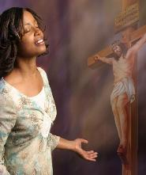
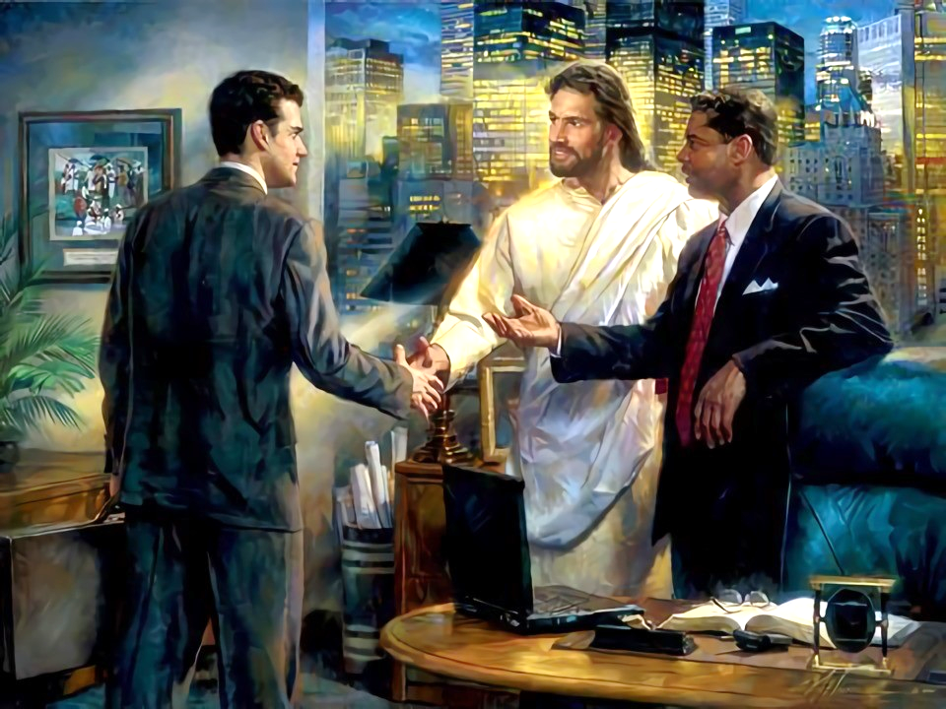
TAHSAN CHATE LEH TAHSANLOU TE KIKAH
“Polam miho kom a chihna mangcha’n chon un, phaat chu kitup kei in mangcha uvin.” (Colossa 4:5)
Chanpha tampi chang ihi uve: Jesu’n ei bolpih u ihe ta uve; abon in ikisaan ta uve; huhhing ihi u lungmuonna le kinepna nei ihi ta uve.
Khat in hiche thupha ei seipih jal uva ikihetdoh u ahin, hitobang chun eihon jong midang seipih son ute. Paul in Jesu Christa chanchin helou ‘midang te’ toh kisamkai ding je iti eihil um? (Col. 4:5-6)
Chihna nei pum a
Jesu Christa chanchin henailou te toh kisamkaina siemdohna din “van a hung kuon chihna” (James 3:17) ingaicha uve
Kamdam hieu cha a
I thusei doh chan u akisaan theina diuvin kamdam hieu cha a isei ji ding u ahi
“chi bang a al’ thucheng man ding
Midang te hetthei dol tah a, amaho dinmun toh kituoh a, houpi ji ding ahi
Donbutna kilom bep pieh ding
Lunggel kibang koima aumlou jieh in, Lhagao Thieng in aphaat toh kituoh a sei ding ahin pieh ding ahi

Slide 13

“Thudih leh natoh dihtah toh kilhon hikho chu phachuom tah ahi guoh hilouvin vethoi leh gimnam tui kilhut tobang ahi. Kamdam, mailhai leh kipah melsuo hin Christian chu dei um tah leh mite san thei dol tah hi’n atahlah e. Chang ding kigelna umlouvin, mite ding a vah, cham leh kipa homjal jing ahi jal chun kipana dihtah akimudoh thei in ahi.
Eiho jong chang ding kigel masah louvin, midang kipasah din kisalel jo leu hen, mite puohgih puohhu a, thilpha bolna leh midang ngailut in dimset jo ute.”
EGW (In Heavenly Places, June 22)

