Slide 1

PATHIEN LUNGLAM JOUSE DINPI
Simmun 13: March 28, 2026

Slide 2




“Imalam jouse a thangvah Jing un; ijieh in em itile hiche hi Jesu Christa jal a nangho dia Pathien lungdei lam ahi.
1 Thessalonica 5:18

Slide 3

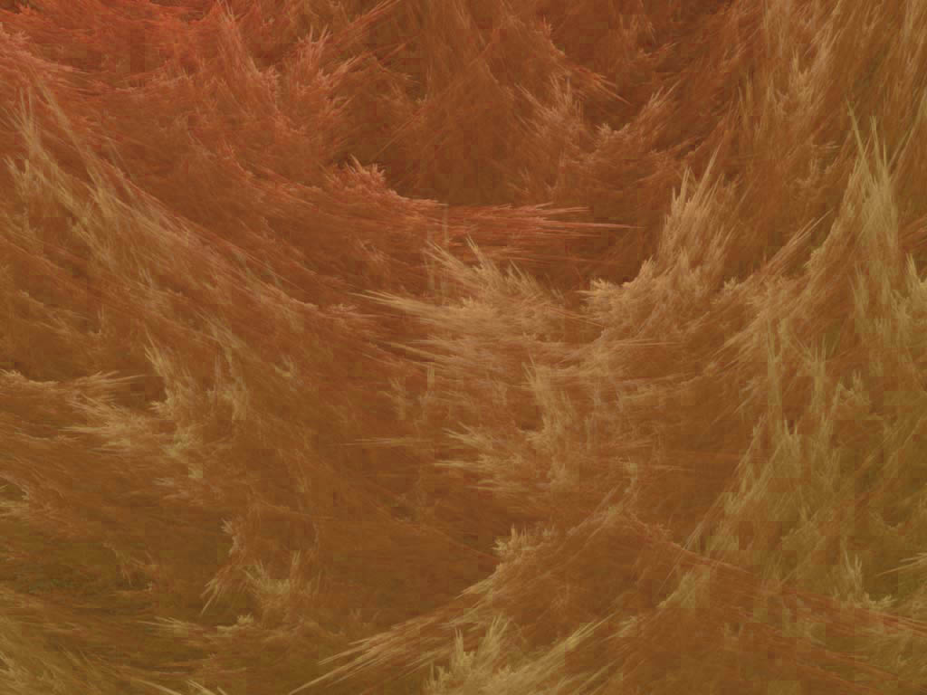
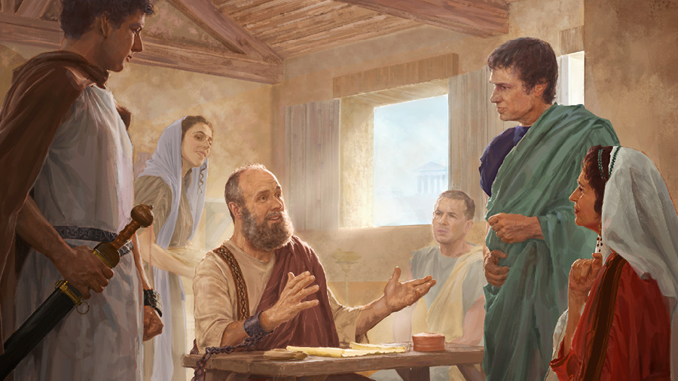
Paul in tohkhompi tampi anei e; atohkhompi hon lungthim pumpi a kipiehdohna anei jal un tohdoh tampi aneithei un, houbung ho vetup le hatsah in ahung pang thei uve ti akipapi e.
Thupo lhacha ho
Tychicus and Onesimus (Colossa 4:7-9)
Cheptan lah a kuon ho
Aristarchus, Mark, and Jesus (Colossa 4:10-11)
Thuhiltuoh a pang
Epaphras (Colossa 4:12-13)
Ngailut um leh vannuoi lungput neipa
Luke and Demas (Colossa 4:14)
Houbung lamkai ho
Nympha and Archippus (Colossa 4:16-18)
Colossa lekhathot achaina lam a chun Paul in atohkhompi ho a kuon kipa thuthot asun e. Colossa a sopi kitah tah ho ding jong kipa thuthot anei e.
Epaphras lungsung a vei jing “Pathien lungdei pumpi a bulhingset a nanun theina diuva… gunchu tah a tao jing a, na dindetna diuva thuum jing ahi” (Col. 4:12) ti jong aseipih e.

Slide 4

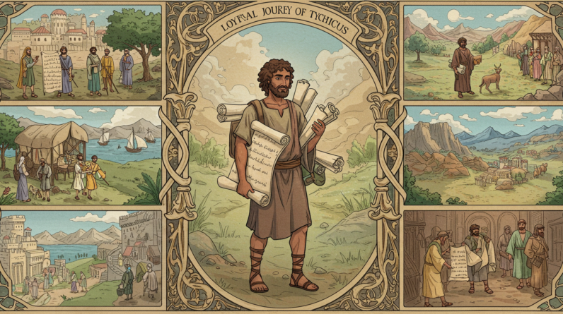
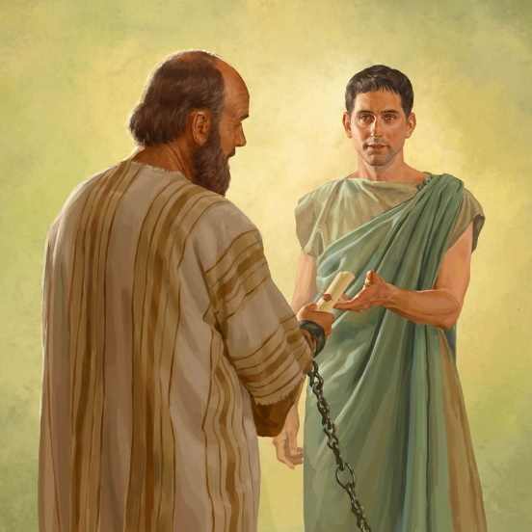


THUPO LHACHA HO
“Pakai ding a tahsan um lhacha le suoh, sopi deitah Tychicus hin ka chungchang thu nahet nuom chan naseipih na uvinte… Amato lhon in tahsan um le dei umtah sopi Onesimus, naloipa u hin hikom a thilsuoh nahet nuom chan nahil na uvinte.” (Colossa 4:7, 9)
Rome lenggam khopi thupi domse a thupha ahillhang jouvin, Paul in houbung ho ding lekhathot tampi asun in, tahsa a amukhahlou tahsan chankhompi ho thahatsah din tampi asun e.
Hiche lekhathot ho hi ngailut um leh kitah tah atohkhompi ho apiehsah ji ahi (Col. 4:7-9).
TYCHICUS
ONESIMUS
Paul khuoljinna athum channa chun Tychicus in akilhonpi’n, Jerusalem te ding nei donkhom chu agathah e (Acts 20:4). Rome khopi a Paul kithopi’n apang in, Ephesia le Colossa houbung te lekhathot gathahpih in jong apang e (Eph. 6:21; Col. 4:7). Paul lhadoh a aum chun Crete a Titus mun ah kipansah in (Titus 3:12), Paul suongkul ataan chaina phaat lai chun Ephesia te pastor in akisol e (2 Tim. 4:12).
Onesimus hi suoh apupa, Philemon, kom a pat jamdoh pa chu ahi. Paul suongkul ataan masah phaat lai chun tahsanna ahin kisaan e. Paul in apupa kom anungsol in, Christian khotuona dimset a ana kisaan din lekha athot e (Phlm. 1:10). Tychicus toh Colossa mite ding lekhathot gathah in jong apang e (Col. 4:9).

Slide 5

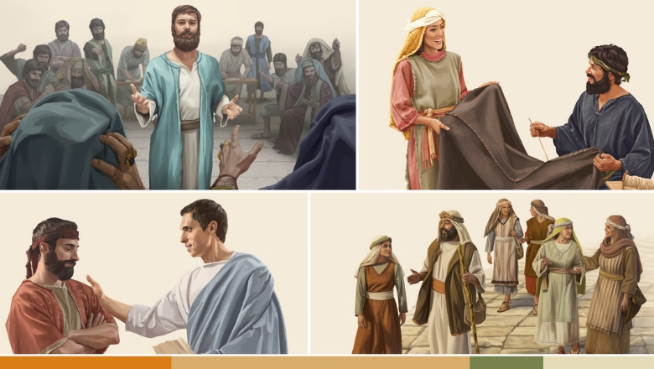
CHEPTAN LAH A KUON HO
“…cheptan ho lah a kuon a Pathien lenggam thudol a ka natohkhompi hicheng hibou ahi uvin, amaho hi kalungmuonpi lheh jieng in ahi. (Colossa 4:11)
Paul in houbung mite kibungkhenna thei jouse suhchimit ding atup e. Atohkhompi din muntin a kuon le lam chuom chuom a kuon mi akilhen e. Juda le Gentile mi, Asia le Europe mi, abon un lungkhat in atongkhom uve.
Alungtup chu houbung kipumkhat sah ding, gospel lhangsapna dia bou kisalel houbung phudoh ding chu ahi.
ARISTARCHUS
Thessalonica kho mi ahi (Acts 27:2). Ephesus khopi buoina a chun pan ananei e (Acts 19:29). Paul akilhonpi’n, Jerusalem a sum kidol ho thahlut in anapang e (Acts 20:4). Paul toh Rome suongkul alut khom in, Colossa le Philemon kom kipa thuthot ananei lhon e (Col. 4:10; Phlm. 1:24)
MARK
Paul kiloipi masa Barnabas ding a chate dol ahi. Pamphylia a chun Paul adalha’n, akinungle e; hijieh chun Paul in akhuoljin nina chun ana kilhonpi nuom tapoi (Acts 15:37-38). Hichun Barnabas in akilhonpi’n, khonung in Paul din evangelist phatah ahung hi (Acts 15:39; 2 Tim 4:11). Peter in chapa bang in anasin e (1 Peter 5:13). Gospel Mark hin sundoh pa chu ahung hi.
Ama hi Juda mi ahin, “Justus” tin jong akikou ji e ti lou athudol tampi het ahipoi. (Col. 4:11)
JESUS

Slide 6

THUHILTUOH A PANG
“Nangho lah a mi khat Epaphras, Jesu Christa suoh, ama jong chun na salam ui; ama hi Pathien lungdei pumpi a bulhingset a nanun theina diuva nangho ding a gunchu tah a tao jing a, na dindetna diuva thuum jing ahi.” (Colossa 4:12)
Epaphras jal in angailut mama Colossa, Hierapolis chuleh Laodicea houbung mite lah a gospel hatah in ahung machal e (Col. 4:13). Colossa mite dia Epaphras kipa thuthot Paul in ama thuthot ah apansah e (Col. 4:12):
Colossa mite din thuhiltuoh in anapang in, gospel hetthiemna giltah ana neisah e (Col. 1:7). Paul in seiphatna thucheng 3 ama kouna’n ana mang e: “suoh na tohkhompi ngailut um tah”, “Jesu Christa suoh” chuleh “suoh chankhompi”. (Col. 1:7; 4:12; Phlm. 1:23)
EPAPHRAS
Dindet ding
Suhliing huoi hilouva dingdet diu ahi, melma thangkuol olouna dia (Eph. 6:11)
Chamkim ding
Chang ding kigellou ngailutna jal a chamkim ding u ahi (Mt. 5:44, 48; Phlp. 3:12)
Bulhing set hi ding
Pathien a kuon a chan thei jouse dimset a chan chun bulhing set asuo diu ahi.

Slide 7

NGAILUT UM LEH VANNUOI LUNGPUT NEI PA
“Ngailut tah louthiem Luke le Demas in jong na salam ui.” (Colossa 4:14)
LUKE
Gospel Luke leh Solchahte Natoh sunpa ahin, Paul hinkho thusim sunpa hidin jong tahsan ahi (Luke 1:1-4; Acts 1:1). Louthiem/doctor ahin, Paul in “ngailut tah” tin aminphah e. Athigei in Paul ana lhonpi jing e (2 Tim. 4:11).
DEMAS
Paul Rome suongkul ataan masah lai chun atohkhompi’n anapang e (Phlm. 1:24). Hinla, suongkul ataan nukhah pen lai chun “vannuoi angailut jieh in” Paul ana dalha tai (2 Tim. 4:10).
Colossa 4:14 a akiminphah chan chun Demas chu Paul tohkhompi kitah tah anahi nalai e.
Phaat chomkhat jouvin Luke le Demas kibahlouna muthei in ahung kilang tai. Luke chun Gospel natoh jieng akisahlelpi in, Demas vang chun vannuoi angailut jo’n, Paul akikhenpi tai.
Luke chun Second Coming leh Lei Thah kinepna adindetpi’n, Demas vang chun ahung lhung ding loupina sang in leisiet loupina angailu jo’n ahi.
Jesu angailutna ahaisan in, vannuoi akilhen jo tai (1 John 2:15).

Slide 8

HOUBUNG LAMKAI HO
“Laodicea um sopite Nympha chule a insung a kikhom houbung chu salam uvin.” (Colossa 4:15)
Nympha thudol het umsun chu Laodicea houbung lamkai khat anahi ti ahi. Pasal ahi, numei ahi jong akihechien poi. Ajieh chu ama thudol kiseina ah “amapa in”, “amanu in” chuleh “amaho in” tin akisun e.
Colossa mi Philemon chapa chu phaat chomkhat Paul kilhonlepi’n anapang e. (Phlm. 1:1-2). Paul in Pathien lenggam a atohkhompi jom din ana tiem e (Colossa houbung deacon, pastor ahilou leh houbung upa din).
NYMPHA
ARCHIPPUS
Paul in Colossa mite alekhathot Laodicea mite masang a asimdohpih diuvin atiem e. Chuti ma chun Laodicea lekhathot jong Colossa mite masang a asim diuvin aseipih e (Col. 4:16).
Hijieh chun hiche houbung teni lamkai ni aminphah e: Nympha [Laodicea mi] leh Archippus [Colossa mi] (Col. 4:15, 17).
Paul in Laodicea mite itobang lekha anathot ahi akihe poi, ahin kum 30 jouvin Solchah John in Laodicea mite anathot e ti vang akimui (Rev. 3:14-22).

Slide 9

“Pathien natoh hin mihiem apumpi a akipiehdoh ding adei ahi- alung, alungthim, alhagao chuleh athaneina jouse adei ahi. Lungsa-ihna beihiel a Pathien dia kipumpieh jieng ding ihi uve; chuti leh hiche lei mihiem te bang hilouva, Pathien lim le mel joh iput thei ding u ahi. Hetna jouse mangcha a, lungthim limgeh cha a, ahao avai, alien aneo, aching amol, mitin ding a itoh thei ding u ahi.
Kelngoiching dihtahpa’n akelngoi noute apom a, akelngoi hon phatah a ahonbit a, hindohna lampi apuilut bang a eihon jong mite hinna lampi ipuilut ding u ahi. Christa nungjui hon Christa nunnemna le khotuona atahlah diu, thudih kisaan jouse ding a tuonsot hinna hung hidoh thupha chu hopjal ding thanopnachang a anei ding u ahi.”
EGW (Christ Triumphant, February 9)

