Slide 1



BIBLE PANLAHNA
Simmun 4: April 25, 2026

Slide 2

“Ijeh in em itile Pathien thu hi hing jing le na tong hat jing, hiemtuo chemjam sang a jong hiemjo, hinna Lhagao gu kisuhtona le lhin, hicheng gei a sukhen thei hiel a sun thei, lunggel le lungthim ngaituo hetuoh pai jen jieng thei ahi. (Hebrew 4:12)
Notes:
Buscar en biblia-espada

Slide 3


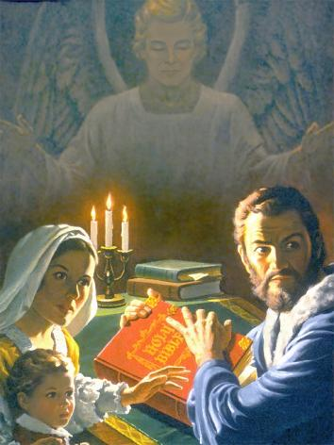
Vannuoi a lekhabu kikhong tam pen chu Bible ahi; anina sang in jong le 5 jen in akikhong tam jo nalai e! Hinla hiti chu hi jing anahi poi.
Phaat khat lai chun Bible nei jieh, sim jieh, Bible thu seile jieh in jong suongkul ataansah ji un, bolgimna le thina gei in jong ana chansah ji un ahi.
Pathien in avenbit lou hileh sotlai a Bible suhmang a um ding anahi tai. Iti dan hin tem? Bible sung a ipi um a, tampi’n angailut a, tampi ma’n athet kit hin tem?
Bible melma
Bible sim dan dih le dihlou
Bible chu ipi ham?
Bible sim phattheina ho
Bible guolpha

Slide 4


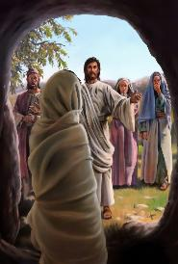
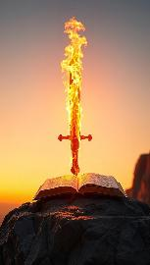

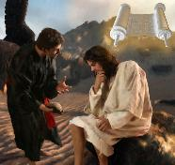
BIBLE MELMA
“Lhagaova kuon Pathien Thu chu chemjam bang in mang un” (Ephese 6:17)
Pathien seidohsa athu thahat je gah gel tiem ute: hinna boldoh le pethei a chu ahin (Psalm 33:6), athisa jong akaithou thei e (John 5:28-29).
Pathien thu sutdoh a um Bible kiti hin ipi abol thei em? Eiho venbit jouna thahat anei in (Eph. 6:17b) hinkho akikhelsah thei e (Heb. 4:12). Jesu’n lhep patep a aum chun kivenna’n amang e (Matt. 4:4, 7, 10).
Satan in Bible thahatna ajo ngei ngei lou ding akihet e. Hijieh chun Bible bu umsun suhmang tei ding ago’n ahi. Ahin alosam tan, Bible society tampi’n bu simsenlou asuodoh un, ahomjal tauvin ahi. Aban in, Bible thuhil adihpoi tin asei kit e. Isim manlouna diuvin ilungsung u luodim ding gamtin thu athejal kit in ahi.
Satan thilbol lolhinsah kahi kha dem? Bible simna dia ka phaat chomcha beh kapieh theilou ding ham? Isim tieng kikhelna akinei ji’n, melma Satan kisatpina ding thahat eipe ji uve.

Slide 5

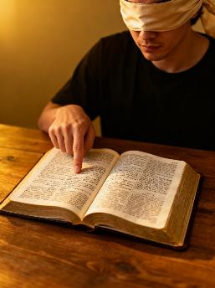



BIBLE SIM DAN DIH LE DIHLOU
“Kipatep thiem changsa bang a Pathien kom a dinjouna din nang le nang kihabol in, kijumsona beihiel natong mi hina din thutah chu jangkei in mangcha’n.” (2 Timothy 2:15)
Simdan dihlou
Eima lungsuhtuo toh kituoh ding bou hol le
Bible munkhat pou pou moh sim ji
Simdan dih
Pathien lungdei bou hol le
Khuolgil le bidoi nei tah a sim ding
Eima deilai kisipchah a, deilou lai kihetmosah ding
Thu kisun tapou nahsahmo a koilou ding, giltah a vetchil ding
Lungsung ngaituona kichieh tah nei pum a Bible sim ding, ahin Lhagao Thieng thilbol theina suong jo a kimapui sah ding ahi.
Ibol in em? Ajieh chu eiho lungsung ngaituona thahat chu lhinglel le lhasam tah ahin, Bible Sunpa chihna chu chungnung jo ahin, hichu ihol joh diu ahi.

Slide 6



BIBLE CHU IPI HAM?
Mite lah, Christian te lah jieng a jong, thudih hi kikhellou ahipon, amun le aphaat dungjui a kikhel jing ahi ti’n tampi’n atahsan uve.
“Na danthu mugil chu atah ahin, dihtah a thu natan ho hi tuonsot a ding ahi!” (Psalm 119:160)
Hinla Bible hin asung a um Pathien Thu hi tuonsot thudih ahi ati (Psalm 119:160; John 17:17; Jacob 1:18). Thieng tah leh mihiem duha lhepna kuon kivendohna pho pha pen ahi (Thuchih bu 30:5). Eiho a kuondoh “thudih” itiu chutoh suhtuo thei ahipoi, Pathien ma-ang a jousei isuo bep diu ahi (Thuchih bu 30:6).
Thudih le thutah iti jouse’u Bible patepna idinsah masah diu ahi. Bible thusei toh lungsuhtuo ‘thudih’ kiti ho kikalna aum tieng geldan 2 ahung umdoh thei e: eima geldan dihlou hintem, Bible isutdan u dihlou joh hintem, khat joh chu hitei ding ahi.

Slide 7


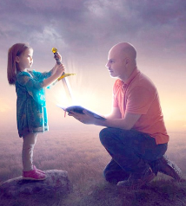


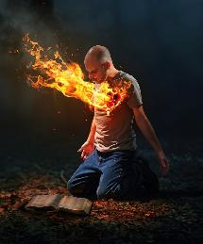
BIBLE SIM PHATTHEINA HO
“Nang douva ka chonsietlouna din ka lungthim in na danthu kaching jing e!” (Psalm 119:11)
Bible deilou hon jong mihiem hinkho akikhel sah jou apom un ahi. Paul in hiemtuo chemjam thahat tah toh atekah e.
Ihina bang tah ei kimudoh sah e (Heb. 4:12)
Chonsietna toh ei chuomkhen e (Psalm 119:11)
Ilhagao din an in apang e (Jer. 15:16)
Lhagao pilhinna lampi ah eipui tou e (1 Peter 2:2)
Hinna eipe uve (John 6:63)
Bible bang a lungsung suthou dang aum poi. Athuhil hinkho a chepi ding iti tieng leh phatna le damna lampi ei puilut ji uve.
Lungkot kihong pum a isim a, Lhagao Thieng mitvahna ithuum tieng leh ihinkho kikhelna um jieng ji ahi.

Slide 8

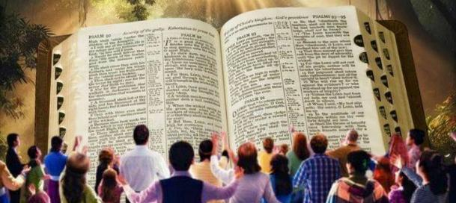
“Chujongle atahbeh mong a Pathien thu ahi jieh chun kathusei u chu mihiem thu bang a gellouva Pathien thu a najah jieh uvin Pathien ka thangvah jing jieng ui; hiche thu chun atahsan nang ho lah a na atong jing e.” (1 Thessalonica 2:13)
BIBLE GUOLPHA
Bible dihtah ahi ti ipom thei tieng u leh…
Pathien toh ikah itobang ahi ei mudoh sah uve
Pathien toh kiguijopna hatsah ding dan ei komu uve
Hinkho kikhelna ei neisah tou peh ji uve
Jesu kom inai cheh cheh ji uve
Huhhingna thudol a chihna ineithei ji uve
Thudih hetna in ikhangtou thei uve
Tahsanna akibe in, ahatsah e
Kinepna ineithei ta uve
Hinkho hoijo, tuonsot a kidang tah chu, nei ding kihetna eipe uve
Bible guolpha hon Pathien Thu Hing Jing ahi tin akisaan thei uve (1 Thessalonica 2:13). Ken jong hiti a chu iti ka kisaan thei ding ham?
Paul in hiti ding chun lhagao mitvahna kiti lhagao thil hetthiem theina chu inei masah u angai e ati (1 Corinth 2:14). Hijieh chun Bible hi Pathien thuthieng ahi ti pomtheina hi Lhagao Thieng in lungsung a na atoh jal ahibouve.

Slide 9

“Bible in thudih het bailam tah in ei hil un, mihiem lung ngaichat le lha-ngai bang tah in aseidoh pih e. Athu gilje vannuoi miching hon adatmo lheh un, hinla mimol leh lhasam pen hon huhhingna lampi akimuna kit un ahi.”
“Asung a thudih kisei ho gil le sang chungnung ahi jieh in mihiem hetna banphah jou huoi ahipon, Pathien thusah ahi ti a ipom diu tilou lampi dang aum poi. […] Bible ikhuolgil chan a hing jing Pathien a kuon bou ahi ti kilang cheh cheh ding, Pathien athu kiphuonna ahi ti ihetdoh chun mihiem eima hetna imalou ahi dan ei pomsah ding ahi.”
EGW (Steps to Christ, p. 107)

