Slide 1

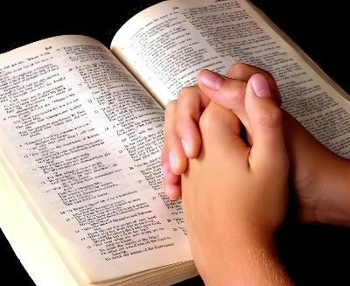
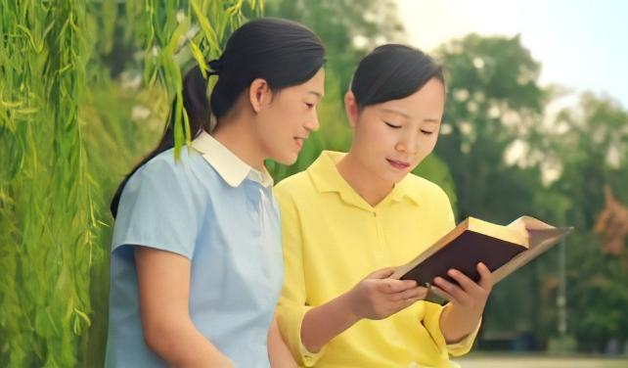
BIBLE SIM DING DAN
Simmun 5: May 2, 2026

Slide 2

“Kaseidoh jong chuti ding, Kahisah nuom chu amuolsuo tei ding; Kasollo pen chu abol jieng ding ahi.” (Isaiah 55:11)

Slide 3

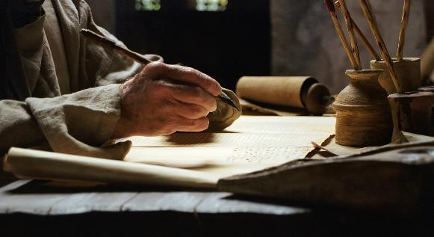

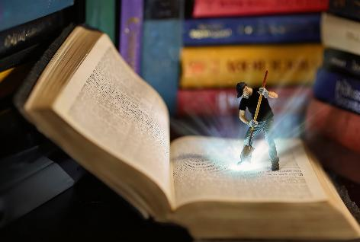
“ Lhagao Thieng chothouva mithieng hon Pathien a kuon a aseidohji ahibouve” (2 Peter 1:21), chuti chun Pathien thu chu Bible a kisunlut ahi tai.
Hiva hin hinna, kinepna, kitiilkhouna, nopna…tiho kimudohna’n inei thei uve. Muthei ngal aum in, hatah hol a mu ding jong aum e.
Pathien in Bible a ei koipih u manlu tah chu iti ikimudoh thei diu ham? Bible sim a kuon ipi phachuom inei doh thei diu ham?
Bible sim ding dan:
Phaat
Amun
Kimanchah dan
Bible sim phatchuomna:
Athu hopjal phatchuomna
Athu neh phatchuomna

Slide 4

BIBLE SIM DING DAN

Slide 5

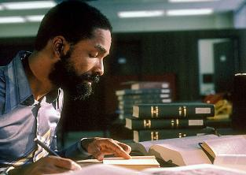
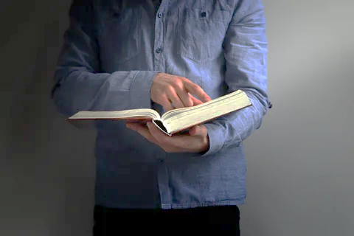

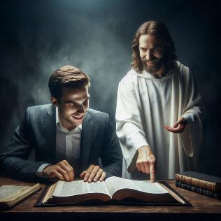
PHAAT
“Neihol un natin, neimu vin nate, ajieh chu lungthim pumpi a neihol diu ahitai.” (Jeremiah 29:13)
Bible sim ding phaat kilem pen itih hin tem?
Iti idonbut diu ham: sim kisuhselna ding le phaat kilem ahi ding poimo tah ahi.
Buoi lheh jong leu hen phaat ipieh thei chan uva phachuom ding ahi: minute 5 sang in pungkah 1 pe thei leu hen gamcheng a phachuom ding ahi ihe uve.
Ahin moh sim mai mai ding bep a phaat pieh ding ahipoi. Hiva hin thanopna dihtah nei ahung poimo lheh e. Bible ibol a kasim ding ham? Hetna kibena ding bou ham, Pathien hetna giltah kaneitheina ding ham?
Pathien toh phaat mankhom ding lungtup ahi tieng, Pathien thugil ei kipe hetnopna dihtah nei ahi tieng Bible sim hin phatchuomna dihtah ahin lhut ding ahi (Jer. 29:13), kipa thanopna inei thei ding u ahi (Ps. 37:4).

Slide 6





AMUN
“Jiingpi matah, khovah lhah masang in Jesu athouvin, gamthip ah ache’n, hikom a chun agataove.” (Mark 1:35)
Jesu’n Pathien toh phaat giltah mankhom ding anop tieng jiingpi matah in athou ji’n, munthip khat akihol ji e (Mark 1:35). Hiti hin tao le Bible sim tieng bol ji ding ahi.
Mun eu lenglung lah, mitin kititna mun ho a lekhabu akisim thei poi. Mun kilem, munthip, mi umlouna mun a vang akilem pen e.
Nikho kipatna ham, kichaina ham lam leh mitin athip ji’n, Pathien thu sim le ngaituona din akilem pen e.
Aphaat le amun kilem pen ihetdoh tieng nitin a kimanchah jing ji ding ahi. Alou theilouva akipelna phaat um ji jong leh Bible toh phaat mangkhom louva kidiesot lou ding ahi.

Slide 7



BIBLE SIMDAN(1)
“Kaseidoh jong chuti ding, ka hisah nuom chu amuolsuo tei ding, kasollo pen chu abol jieng ding ahi.” (Isaiah 55:11)
Bible thuhlut jep a ikhuol tieng kimanchah dan 4 a hopkhen thei ahi
Taona
Simgil le hetthiemna
Taona
Hopjal ding
Bible na khuolgil kithopi din Lhagao Thieng panpina kithuum in
Bible chaang ham behkhat ham kilhendoh masa’n
Nasim chan na hetthiem sah din na lungsung hin suthou inte.
Nalungsung aveiden theina din kisutdoh in
Athupi kisei ipi ahi hedoh go’n
Athupi a kuon geldoh hetdoh ipi nanei sundoh in
Nahetdoh thah chu na boldoh theina din Pathien panpina kithuum in
Koi kom na seipih thei ding gel ta din

Slide 8

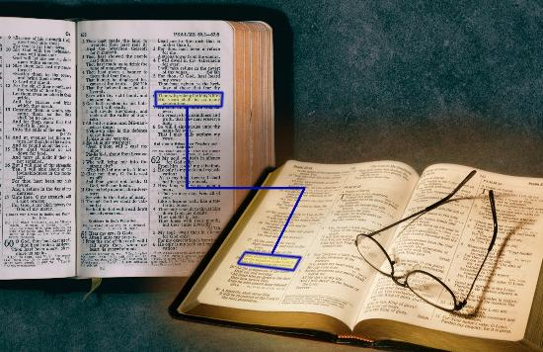
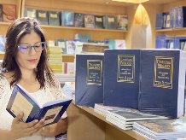
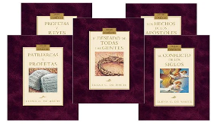
BIBLE SIMDAN(2)
“Kaseidoh jong chuti ding, ka hisah nuom chu amuolsuo tei ding, kasollo pen chu abol jieng ding ahi.” (Isaiah 55:11)
Bible sim dan dang ho
Achaang achaang vetkah ding (Isaiah 28:10)
Abung abung leh abu pumpi a sim ji ding
Concordance mangcha a thucheng le thupi kisun ho khuolgil ding
Bible commentary ham dictionary ham aum leh manchah ji ding
“Conflict of the Ages” kiti Ellen White in asut toh simkop ji ding

Slide 9

BIBLE SIM PHATCHUOMNA

Slide 10



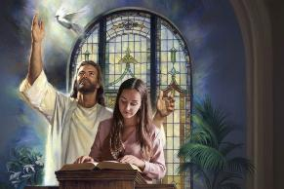


ATHU HOPJAL PHATCHUOMNA
“Hat chungnung Pakai in sei ding eihil in, alhasamte katiilkhou thei e. Jiingkah sieh le thanuom tah in eilha’n, ei hil ding kajah nuom lheh e!” (Isaiah 50:4)
Sabbath kikhopni a thusei din nahung kise tai. Taona toh tho’n Lhagao Thieng in nalung atohkhahna tah khat sei din nakigo’n, thanei tah in nasei tai. Hiche sermon a kuon chun ko’n aphatchuompi pen ta dem?
Bible thuhil a ipot tieng, hou in mun hihen mimal kom hileh, aphatchuomna leni hiji ahi.
Akhatna’n, en jong tampi akijil doh be’n, anina’n iseipihte’n ahetna u kibena ban a khuolgil cheh ding ahin lungvul ji uvin ahi.
Ani gel a hin Pathien toh kikah asuhat in, aphutdet e. Hitobang chu ahi Pathien Athu thahat je, asollo amuolsuo ding, athon a kinungle lou ding ahi (Isaiah 55:11).

Slide 11

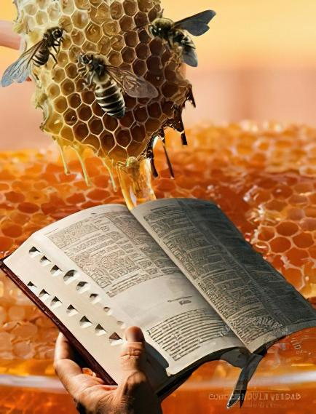

ATHU NEH PHATCHUOMNA
“Na mihil angei behseh in, khoiju sang a lhumjo’n kabol e!” (Psalm 119:103)
Pathien Thu ineh ding u ahi (Jer. 15:16)!
Khoiju sang a lhum jo ahi akiti na’n, kam sung a lhaitho tahbah ding chu ahi dieh poi (Psalm 119:103). Bible sim hi lhagao ding a an tui pen chu ahin, ilhagao kisuhhalna dihtah leh chonchan puidih a chu ahi.
Aban ipi iseibe ding u ham, hiche an chu manbei a ei kipe hinalai! (Isaiah 55:1)!
Ibol diu umsun chu Jesu kom inai uva, Bible a kuon ei houpi na u ikisaan diu chu ahi (Isaiah 55:3). Bible thu kisun isim tam chan uva lhagao hatsah an tui ineh tam thei ding u, phattheina tam cheh ichan ding u ahi.
“Mihiem chihgilna sang tah gei jong leh Bible phatah a sim a, asungthu khuolgil ding ngaichatna nei talou din kigel da hen. Vah lien jo mube ding um jing nalai ahi. Hon khat ihivang un gaothu hethei dia amimal a kikou ihi uve.”
Ellen G. White, Counsels to Writers and Editors, p. 41

Slide 12

“Bible gah moh sim mai mai chun Van a Pa thilguon abulhit jieng poi; sim gil ding, lung a gut tun tun ding ahi. Lunggil tah a tupna umlouvin koiman Pathien hetna aneithei poi. Bible taimah tah a isim ding u, ihetthiem teina ding uva Pathien kom a Lhagao Thieng panpina ithuum ding u ahi. Bible chaang deilhen chu isim uva, Pathien in hiche chaang a athu ei koipih u hetdoh teina dia lunggil tah a ikhuol ding u ahi.[…]
Pathien Thu chu hinna changlhah ahi. Hiche Thu ne a, oivana nei a, abol atoh chan hiche Thu thusah bang a bol a, achonchan jieng jong hiche Thu toh kilhonsah a chu Pathien thahatna a khangtou cheh cheh ding ahi. Hichun lhagao tuonsot thahatna ape’n, ahinkho’n chamkimna alhutpih in, tuonsot a vei jing ta ding kipana jong ape’i.
EGW (Lift Him Up, April 7)

