Slide 1
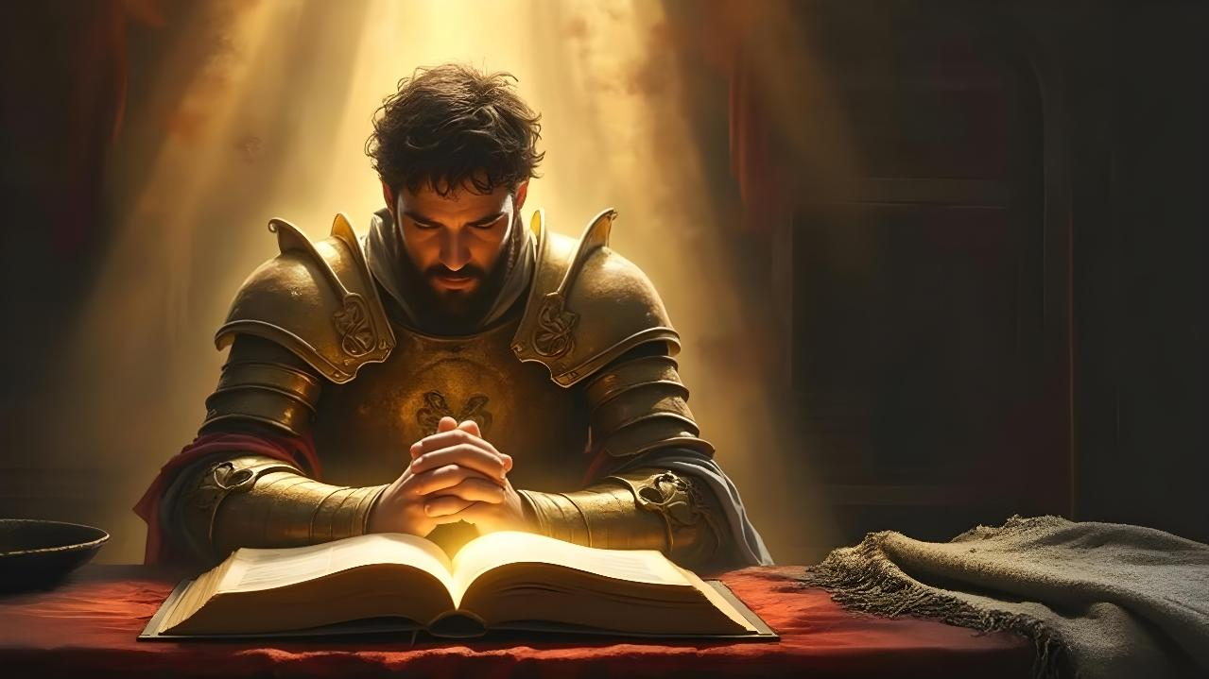
TAONA GALSAT HO
Simmun 6: May 9, 2026

Slide 2

“Ka taona sang a, kathuum ei pe jing Pakai ka ngailu’i! Kakou chan in Pakai in ei hou jing e!” (Psalm 116:1, 2)

Slide 3


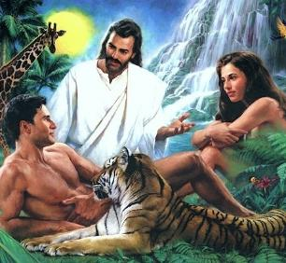

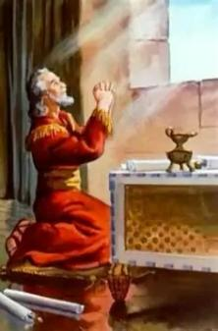
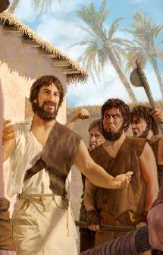
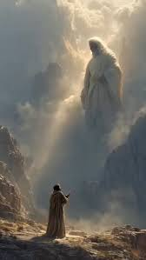


Mihiem jaona thilsiem jouse Pathien in asiem chun khat le khat kihoumat thei ding, Ama tah toh jong kihoumat jing ding a ana siem ahi.
Vangsiet um tah in Adam le Eve achonsiet lhon chun Pathien toh changmel a kihoumat theina chu ana tan tai.
Hinla, Pathien in thilpieh manlu tah ei dalhah pih kit thou thou un ahi. Ama toh kihoumat jing jieng theina “telephone”- taona- chu ahi.
Daniel, Enoch, chuleh Mose ho a kuon hiche thilpieh manlu tah manchah je mudoh thei ahi.
Daniel:
Kichat tijat phaat lai a tao
Tou le din kisuhsel a tao
Enoch:
Taona hinkho
Mose:
Pathien kihoupi
Midang ding a tao

Slide 4

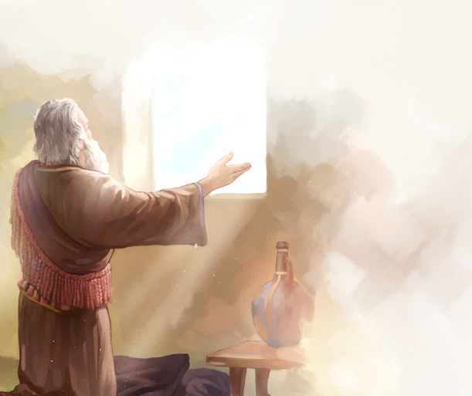
DANIEL

Slide 5


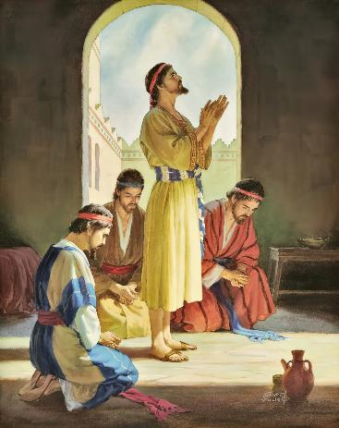
















KICHAT TIJAT PHAAT LAI A TAO
“Chu in khaodip puon sil in, an ngol in, leivui lah a touvin,
Pakai Pathien kom a lunggil tah in kataovin, ka ngeh e.” (Daniel 9:3)
Pathien apum tahsan jieng jieh in Daniel chu chihgilna achan in, mangle theina le hetna sang tah jong ape’n ahi (Dan. 1:8, 17, 20). Ama leh aloite dinmun kichat tijat um tah ahi chun Pathien kom lam asang in atao tai (Dan. 2:17-23).
Tao jing jieng mi ahi jieh chun itobang chonchan nei mi hi a Daniel hung kihe’m (Dan. 6:3-5)?
VAIHOP THIEM
KITAH TAH
KIPUMPIEH
DIHTAH A DING
KAINA DET TAH NEI
CHONCHAN
PHA BOU NEI
MUON UM
JA UM

Slide 6

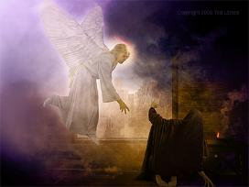
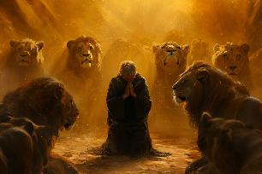
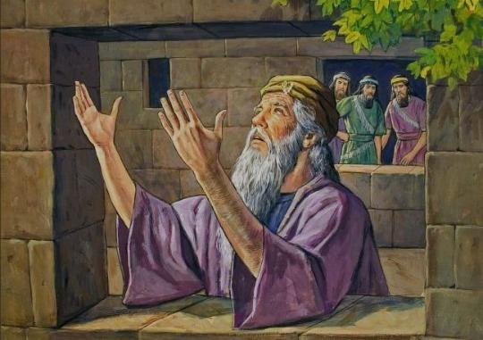
KICHAT TIJAT PHAAT LAI A TAO
“Chu in khaodip puon sil in, an ngol in, leivui lah a touvin,
Pakai Pathien kom a lunggil tah in kataovin, ka ngeh e.”(Daniel 9:3)
Van in Daniel taona lunglut tah in angaipih e (Dan. 9:20-23; 10:12). Hiche kiguijopna asuhkeh louvu leh Daniel melmate’n achung a tha ima aneijou lou diu ahi (Dan. 6:5-7).
Thithei dinmun alhun in jong Daniel in ataona abol jom jing in, ataang dieh poi (Dan. 6:10):
Kipel lou hiel in ni khat in 3 vei atao ji e
Atao kuon leh apindan kotneo ahong ji’n Jerusalem lam anga ji e
Tao ding akisah a, ahung tao tieng adilsu ji e
Thangvah le ngaichat kichieh sel in ape ji e

Slide 7

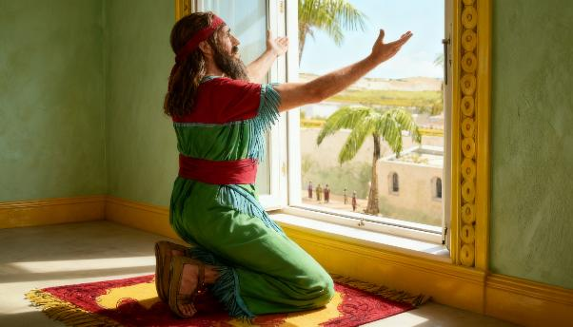


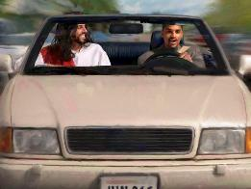
TOU LE DIN KISUHSEL A TAO
“Hiche dan chu lengpan kikhut henna abolkhum ahet phaat in Daniel inlam a achen, a indan chungnung a chun Jerusalem lam bangkot phabep akihong e. Hiche bangkot khat kom a hin, abolngai bang bang in, ahongdoh in, abohkhup in, nikhat sung in Pathien hieng a thumvei ataove.” (Daniel 6:10)
Itao tieng u leh guol kom bang a Pathien houpi ihi uve. Ahin, Pathien eiho tobang ahipon, Vanmun jouse Leng ahibouve.
Hijieh hin Daniel atao tieng adilsu ji’n, Pathien ang ah akun ji’n, Leng chungnung ahi atahlah ji e.
Ipi dinmun hihen, itih hijong leh Pathien kom itao jing thei u ahin, hijieh chun phaat jouse a Daniel bol bang bang a bol tei ngai jong hi dieh lou ahi.
Mitsin taona hin lungthim akipumpieh sah e. Ahin mitsin louva tao jong umthei ahi (lamjot pet, gari tol pet, etc.)
Pathien kom itao tieng Pathien chan ding lom tah ginna le jana sang pen pum ahi ji ngai ahi.

Slide 8

TOU LE DIN KISUHSEL A TAO
“Hiche dan chu lengpan kikhut henna abolkhum ahet phaat in Daniel inlam a achen, a indan chungnung a chun Jerusalem lam bangkot phabep akihong e. Hiche bangkot khat kom a hin, abolngai bang bang in, ahongdoh in, abohkhup in, nikhat sung in Pathien hieng a thumvei ataove.” (Daniel 6:10)
Bible a hin apet dinmun chuom chieh a Pathien kom tao tampi akimui:
Mipi masang a Jehoshaphat din pum in Pathien kom atao e. (2Chr. 20:5)
David atou in, atao e. (2 Sam 7:18)
Solomon adilsu in, akhut teni adomtou in, atao e (1Kings 8:54)
Mipi tuol ah abohkhup un atao uve (Neh. 8:6)
David ajalkhun ah akun in, atao e (1Kings 1:47)
Nehemiah lengpa masang ah ading in, lungthim taona anei e (Neh. 2:1-4)
Ipi dinmun a um hijong leu hen Bible in tanglouva tao jing ding (1 Thess. 5:17), taona a pangdet jing ding (Col. 4:2) chuleh taona a pontho jing din ei tiem uve (Rom. 12:12).

Slide 9

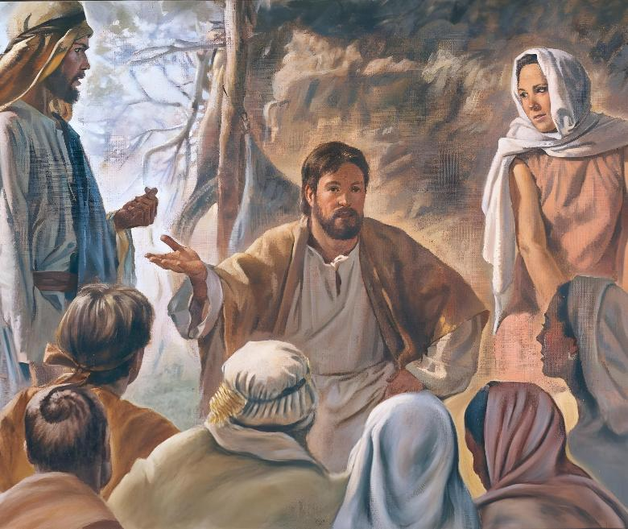
ENOCH

Slide 10

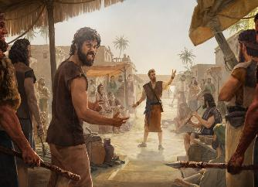
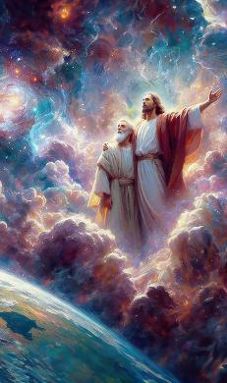
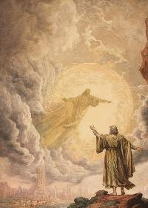
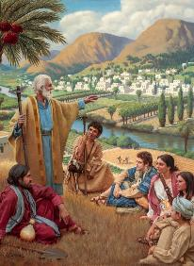

TAONA HINKHO
“Enoch ahinkho lhumkei in Pathien toh akivop jing in, Pathien in ahing lai a alah phaat in akiholmo tai.” (Genesis 5:24)
Tuisaang let masang, chonsietna letlha abah lai, phaat hahsa lai tah chun Enoch ana leng e. Chapa ahin nei chun Pathien ngailut saan je ahin hethiem cheh in, Pathien toh phaat hatah in ahin mangkhom tai (Gen. 5:21-24).
Taona louvin Pathien toh phaat amangkhom ngei poi. Toh ding thupi le tampi anei chan in Pathien kom hatah in atao cheh e. Phaat khat phaat khat tieng mi umlouna mun ache ji’n, Pathien toh akipol ji’n ahi. Amite kom ahung kile kit ji’n, Pathien thu ahetbe jouse aseipih ji’n ahi.
Mi tintang lah hi hen, chang umna mun hi jong leh itaona Pathien in ei ngaipih e. Leisiet chung a hin ajah phahlou, amu phahlouna mun aum poi. Aw ging taona (lunggil tah a itao theina u) hihen lungthim taona (lungsung a um cheng isunlhah theina u) hi jong leh asaanmona ding aum poi. Athupi pen chu taona a Pathien kihoupi ingah lou hiel ding u ahi.

Slide 11

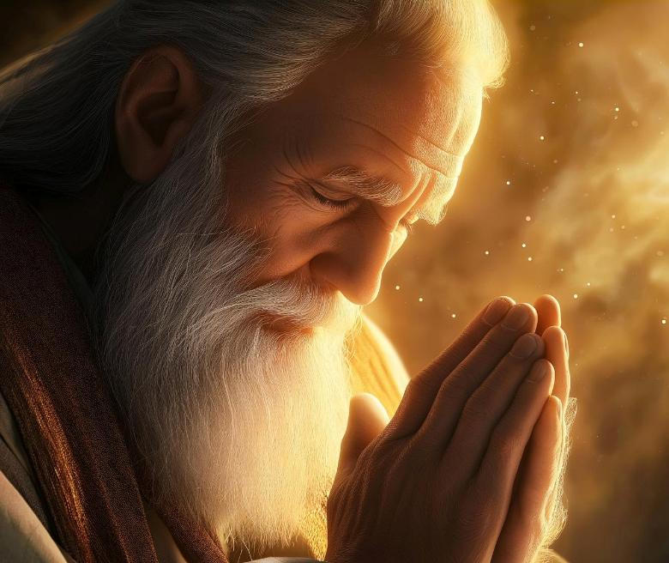
MOSI

Slide 12


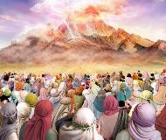
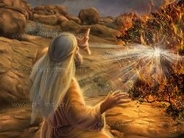
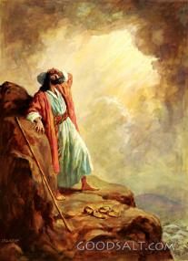

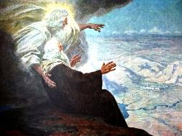
PATHIEN KIHOUPI
“Israelte lah a Mosi tobang thiemgao apieng khapoi; Mosi vang Pakai in kimaituo’n akihoupi e.” (Deuteronomy 34:10)
Sinai muol a Pathien awgin ajah jah u chun Israel chate kichatna’n adim un, Pathien in amaho kom hilouva Mosi apat ahin houpi ji din athuum ta uve (Ex. 20:18-19).
Mosi vang Pathien toh kimaituo’n akihou ji’n, thi ding kichatna ima anei poi (Deut. 34:10). Kum 40 sung in (hamboh meikuong amu apat athi gei in) Mosi Pathien toh guolkhat bang in akihou jing e (Exod. 33:9-11).
Bible a hin ni 40 kitina phabep aum e. Hiche phaat sung hin Pathien in Mosi houbuh asah sah in, danthu jong ape’n ahi. Pathien toh akihou tieng Mosi’n amite ngaidamna athuum pih ji e.
Pathien toh kimaituo a kihouna ineikha po uve. Ahin taona kuon hin Pathien toh kihouna bulhing set ineithei kit uve.

Slide 13



MIDANG DING A TAO
“Aaron chung a jong thadoh jieng theina khop in Pakai alunghang e. Hijieh chun ama din jong katao pih in ahi.” (Deuteronomy 9:20)
Midang dia tao kiti hi midang ngaidam chan theina dia taopih chu ahi (Jacob 5:16; Matthew 5:44; 1 Timothy 2:1-4).
Mun le muol chuom chuom a Mosi midang din Pathien kom atao e:
A INSUNG MITE DIN
⁕ Aaron chonsiet thoidamna din (Deut. 9:20)
⁕ Mary phunchil ngaidam channa din (Nm. 12:10-13)
MITE DIN
⁕ Hatah a adangchah pet un (Ex. 15:24-25)
⁕ Kiel nasa tah athuoh pet un (Nm. 11:11-13)
⁕ Achonsiet pet un (Ex. 32:30-32)
Mosi ibol a midang tao pih ding guttah hija hin tem?
Eiho jong ikhuti ding u ahi: ngailut vang a taopih ding kimansa hi jing ding.

Slide 14

“Insung taokhomna nei jing ding ahi; adieh a chang a guhthim taona inei jing ding u, hichu lhagao hinna pe a ahi. Taona ngaisah louva um chu alhagao damthei din kinep da hen, hichu hithei ngei ngei lou ahi. Insung ham, milah ham bouva taona nei ji hi abulhing poi. Chang in phaat mang ji hen lang, Pathien mitmu a ichan ahi kihetdoh thei hen.
Guhthim taona hi guhthim a jathei um sun Pathien bou het hi hen. Midang het ding a kimang hilou ding ahi. Guhthim taona akiman tieng avel a mi’n asuhbuoi tahlou ahin, alung lamang thei umlou ahi tai. Lung ol tah le choldam tah a Pathien kom tao thei a ahitan, Pathien a kuon akisaan houpina chu kipa le thanop um tah hi ding ahi. Guhthim a hin mu Pathien chun lunggil tah a hung kuon ataona chu angai pih tei ding ahi.”
EGW (Steps to Christ, p. 98)

