Slide 1
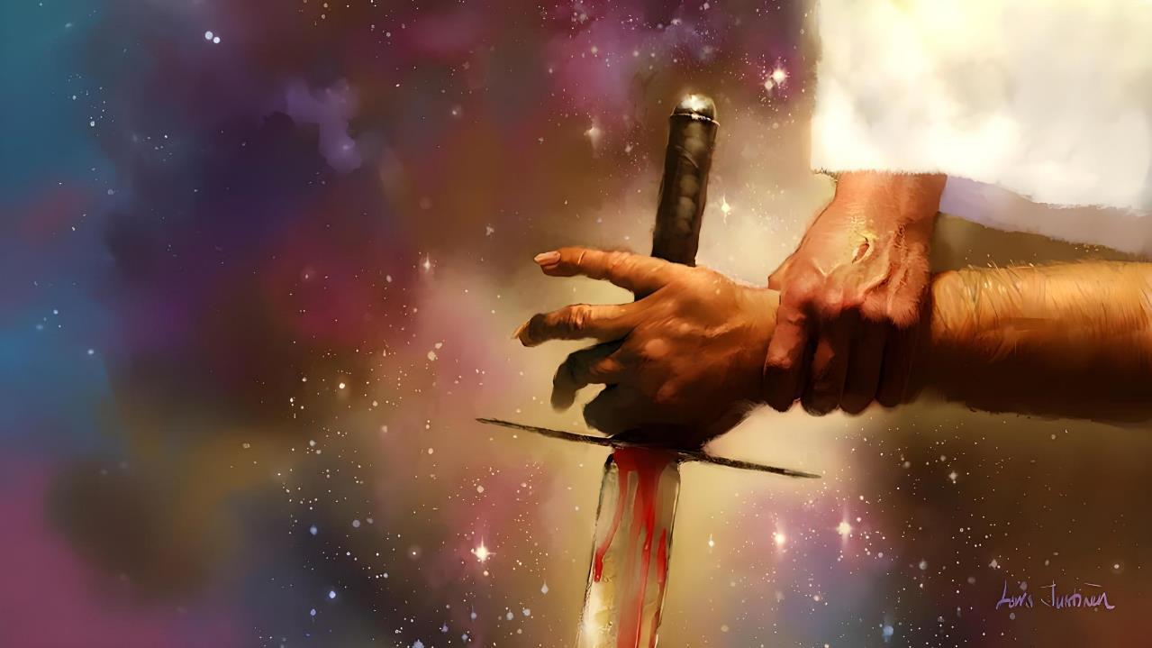
vy;yh Nkhjy;fSf;Fk; gpd;dhd Nkhjy;
ghlk; 4 mf;Nlhgu; 25, 2025

Slide 2
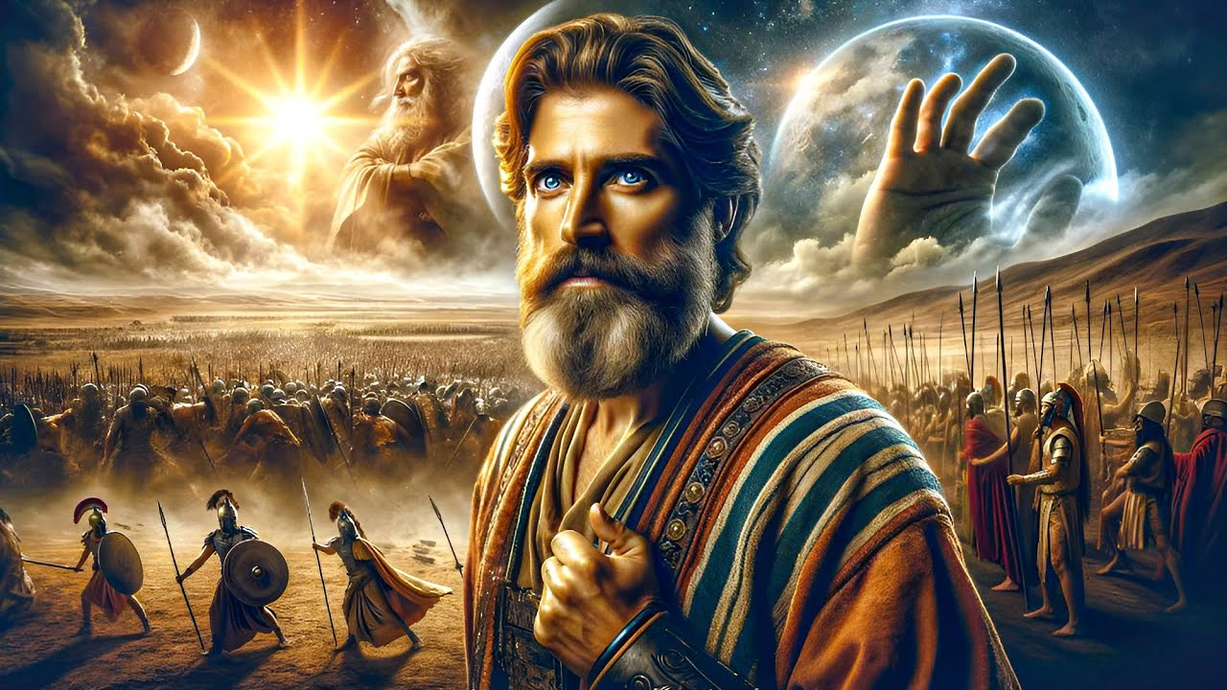
“,g;gbf; fh;j;jh; xU kdpjDila nrhy;Nfl;l me;ehisnahj;j ehs; mjw;F Kd;Dkpy;iy mjw;Fg; gpd;Dkpy;iy. fh;j;jh; ,];uNtYf;fhf Aj;jk;gz;zpdhh;.”
NahRth 10:14

Slide 3

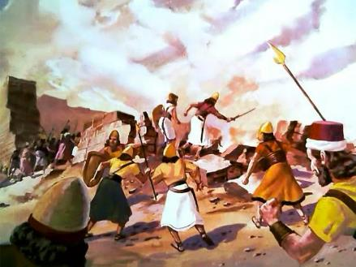
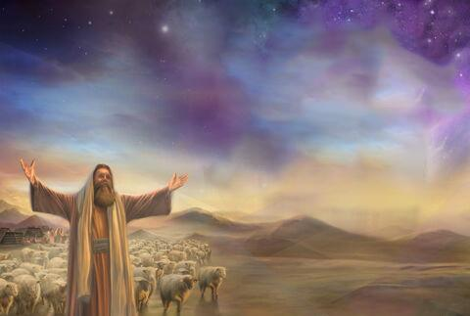
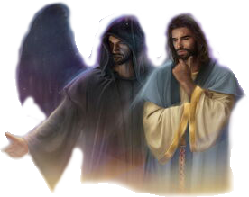
fhdhid ifg;gw;WtJ Njtdhy; fl;lisaplg;gl;l xU mopg;G NghuhFk;. Mdhy; Njtd; md;ghdtu; vd;why;, mtu; Vd; ,g;gb xU gLnfhiyf;F cj;jutpl;lhu;?
,e;j epfo;TfSf;fhd fhuzq;fis gw;wpa xU ghu;itiag; ngw> ehk; ek; ghu;itia ngupjhf;f Ntz;Lk;.
(fhdhid ntd;wJ cl;gl) midj;J Nkhjy;fSf;Fk; gpd;dhy; ,Uf;Fk; Nkhjiy ehk; ftdpf;Fk; tiu> ekJ ghu;itia fhzf;$baijj; jhz;b tpupTg;gLj;j Ntz;Lk;: fpwp];JTf;Fk; rhj;jhDf;Fk; ,ilapyhd> ed;ikf;Fk; jPikf;Fk; ,ilapyhd ngupa Nghuhl;lk;.
Nkhjypy; cs;s jug;gpdu;:
Njt Nridapd; mjpgjp.
jPa Nridapd; mjpgjp.
kpfTk; ty;yikahd khtPuu;.
Nkhjypd; cj;jpfs;:
Njtd; ekf;fhf Aj;jk; gz;Zfpwhu;.
NjtDf;fhf ehk; Aj;jk; gz;ZfpNwhk;.

Slide 4

Nkhjypy; cs;s jug;gpdu;

Slide 5


Njt Nridapd; mjpgjp
“mjw;F mth;: my;y> ehd; fh;j;jUila Nridapd; mjpgjpaha; ,g;nghOJ te;Njd; vd;whh;@ mg;nghOJ NahRth jiuapNy Kfq;Fg;Gw tpOe;J gzpe;Jnfhz;L> mtiu Nehf;fp: vd; Mz;lth; jkJ mbNaDf;Fr; nrhy;YfpwJ vd;dntd;W Nfl;lhd;. (NahRth 5:14)
vupNfh gl;lzj;ij ifg;gw;w nja;tPf elj;Jjiy Nfl;L NahRth n[gpj;jg;NghJ> cUtpa gl;laj;Jld; xU Nghu;tPud; mtu; Kd; epd;dhu;(NahR. 5:13).
NahRth tprhupj;j NghJ> ,e;j Nghu;tPuDf;F G+kpf;Fupa ve;jg; gilAlDk; jdf;F njhlu;gpy;iy vd;W kWj;jhu; me;j Njt Nridapd; jsgjp(NahR. 5:14).
njhOifia tw;GWj;Jtjd; %yk;, jhdpNay; Gj;jfj;jpy; ,NaR kpfhNty; vd;W miof;fg;gl;L jd;id Njtdhf ntspg;gLj;jpdhu; (NahR. 5:15; jhdp. 12:1).
n[gj;jpw;F gjpy; fpilj;jJ. NahRthTf;F epk;kjp mspf;Fk; tpjkhf, NjtNd ,e;j eltbf;ifapd; fl;lisia Vw;Wf;nfhz;lhu;. ,];uNtypd; fhzf;$ba jsgjpahf, NahRth cz;ikahd jsgjpahfpa NjtDila fl;lisfis gpd;gw;w Ntz;bapUe;jJ.

Slide 6


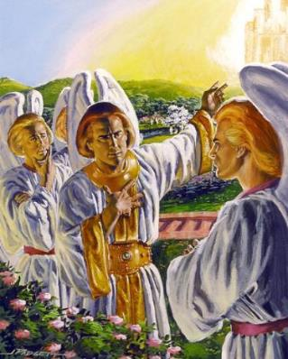

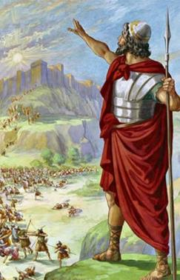
jPa Nridapd; mjpgjp
“mjpfhiyapd; kfdhfpa tpbnts;spNa> eP thdj;jpypUe;J tpOe;jhNa! [hjpfis <dg;gLj;jpdtNd> eP jiuapNy tpo ntl;lg;gl;lhNa!” (Vrhah 14:12)
mtu; jhd; Nghiu fz;Lg;gpbj;jhu; vd;W ehk; $wyhk;. mtu; xU ,sturuhf gpwe;jhu;; kpf cau;e;j gjtpapy; ,Ue;j xU Nf&g;; NjtDila gf;fj;jpy;; ,uj;jpdkakhd fw;fspd; eLtpy; elg;gJ; tpiykjpg;gw;wJ; G+uzkhdJ… (vNr. 28:12-15).
Njtdhy; gilf;fg;gl;l midj;J mwpthu;e;j capupdq;fs; NghyNt – Rje;jukhd tpUg;gj;Jld; – Y}rpgu; fyfk; nra;J NjtDila rpk;khrdj;ijNa ifg;gw;w KbT nra;jhd; (Vrh. 14:12-14).
mtDila fyfk; Njhy;tpaile;jhYk;, md;wpypUe;J gpugQ;rk; Nghupy; Ko;fpAs;sJ. G+kpia ifg;gw;wpd rhj;jhDf;Fk;, mtid gpd;gw;wpd NjtJ}ju;fSf;Fk; xNu Nehf;fk; cz;L: kdpj ,dj;ij fhg;ghw;Wtjw;fhd Njt jpl;lq;fis jfu;g;gJ.
,e;j Nkhjypy; fhdhid ifg;gw;WtJ xU Kf;fpakhd Nghuhf ,Ue;jJ.

Slide 7

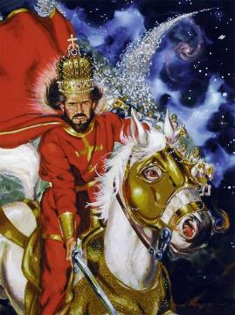
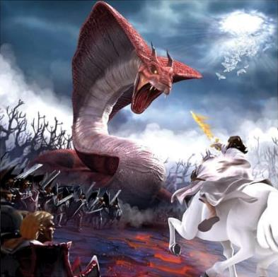
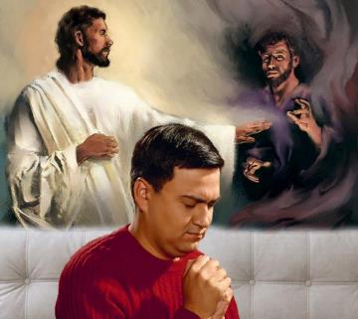
kpfTk; ty;yikahd khtPuu;
“fh;j;jNu Aj;jj;jpy; ty;yth;@ fh;j;jh; vd;gJ mtUila ehkk;.” (ahj; 15:3)
Njtd; jhNk xU “khtPudhf”> Nghupy; kpfTk; typikahd Nghu;tPudhf rpj;jupf;fg;gLfpwhu;. (ahj;. 15:3; rq;. 24:8).
Mdhy; Njtd; kdpju;fSld; my;y> khwhf mtu;fs; gw;wpf; nfhz;bUf;Fk; Md;kPf rf;jpfSld; NghupLfpwhu;. vdNt, thijfs; vfpg;jpd; flTs;fSf;F vjpuhd Nghuhf> mjhtJ Nga;fSf;F vjpuhd Nghuhf Kd;itf;fg;gLfpd;wd (ahj;. 12:12; cgh. 32:17).
Njtd; G+kpapypUe;J jPikia xopf;f tpUk;gpdhu;. Mifahy;> rhj;jhdpd; gf;fk; ,Uf;fj; Nju;e;njLj;jtu;fis fhdhdpypUe;J ntspNaw;wp> mtiu gpd;gw;wpa kf;fSf;F Njrj;ij toq;fpdhu;.
,d;Wk; Nghu; njhlu;fpwJ, Mdhy; vy;iyfSf;fhf my;y. ,e;j Nghupy; xt;nthU FLk;gj;jpw;Fk; xt;nthU jdpegUf;Fk; eLepiyahd jsk; ,y;iy. Xd;W ehk; NjtDld; ,Uf;fpNwhk; my;yJ vjpupAld; ,Uf;fpNwhk;.

Slide 8

Nkhjypd; cj;jpfs;

Slide 9

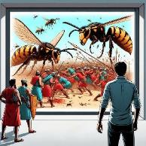
Njtd; ekf;fhf Aj;jk; gz;Zfpwhu;
“fh;j;jh; cq;fSf;fhf Aj;jk;gz;Zthh;@ ePq;fs; Rk;khapUg;gPh;fs; vd;whd;.” (ahj; 14:14)
mtu; vfpg;jpa gilia nrq;flypy; Ko;fbj;jhu;(ahj;. 14:24-28)
fhdhdpau;fSf;F vjpuhf mtu; fy;kioia gad;gLj;jpdhu; (NahR. 10:11)
vypahit mtkjpj;jtu;fis mtu; mopj;jhu; (2 ,uh[h 1:9-10)
vyprhit Nfyp nra;jtu;fSf;F vjpuhf mtu; fubfis mDg;gpdhu; (2 ,uh[h 2:23-24)
rPupa ,uhZtj;ij FUlhf;fp mikjpia mile;jhu;(2 ,uh[h 6:14-23)
mk;Nkhdpau;fisAk; Nkhthgpau;fisAk; rz;ilapLk;gb nra;jhu; (2ehsh. 20:15-17, 22-24)
mtu; xNu ,utpy; 185,000 mrPupau;fis nfhd;whu; (2 ,uh[h 19:35)
mtu; VNuhJf;F xU nfhba Nehia mDg;gpdhu; (mg; 12:21-23)
,];uNtyu;fs; Nghuplhky;> ,aw;iff;F mg;ghw;gl;l topKiwfshy; fhdhid ifg;gw;WtNj NjtDila mry; jpl;lkhf ,Ue;jJ (ahj;. 23:28). kf;fspd; mtek;gpf;if kl;Lk; ,y;iynad;why;> ,J ele;jpUf;Fk;.
Njtd; jk; kf;fis fhg;ghw;Wtjw;F vd;d nra;a KbAk; vd;gjw;F rpy cjhuzq;fis Ntjk; gjpT nra;fpwJ> mtu;fs; jq;fs; vjpupfSf;F vjpuhf ve;j MAjq;fisAk; vLf;f Ntz;ba mtrpakpd;wp:

Slide 10

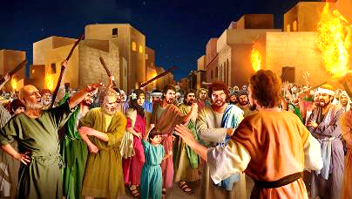
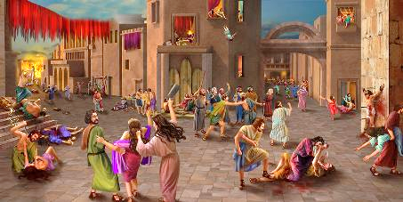

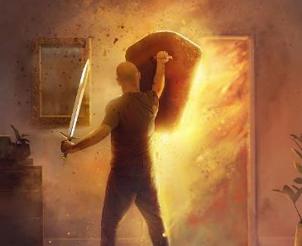
NjtDf;fhf ehk; Aj;jk; nra;fpNwhk;
“gl;lzj;jpypUe;j GU\iuAk; ];jphPfisAk; thypgiuAk; fpotiuAk; MLkhLfisAk;fOijfisAk; rfyj;ijAk; gl;laf;fUf;fpdhy; rq;fhuk; gz;zpdhh;fs;.” (NahRth 6:21)
[yg;gpuaj;jpw;F Ke;ija fhyj;ij NghyNt> my;yJ NrhNjhk; nfhNkhuhitg; NghyNt> fhdhdpau;fSk; fpUigapd; vy;iyfis kPwp> rhj;jhDld; jq;fis ,izj;Jf; nfhz;ldu;(Mjp. 6:5; 18:20-21; 15:16).
mtu;fs; midtUk; ,uz;lhtJ kuzj;jpw;F> epj;jpa kuzj;jpw;F tpjpf;fg;gl;ltu;fs;. ,q;Nf jq;fs; tho;f;ifia ePbg;gJ mtu;fspd; ,Wjp tpjpia khw;whJ. NkYk;, ,e;j re;ju;g;gj;jpy; (fhdhid ifg;gw;wpaJ), ,];uNtyu; gLnfhiyapy; jPtpukhf gq;Nfw;f Njtd; mDkjpj;jhu;.
mtu; jpl;lkpl;lgb, mij mtNu Vd; nra;af;$lhJ? Vndd;why; mtu;fspd; mtek;gpf;ifapd; fhuzkhf. ,];uNtypd; Kjy; Nghupd; Rit, “fh;j;jh; jq;fs; eLtpy; ,Uf;fpwhuh ,y;iyah?” vd;gij mwptpj;jgpwF jhd;(ahj;. 17:7-9).
Nghupy; jPtpukhf gq;Nfw;gjd; %yk; (mtu;fSf;F cly; uPjpahdJ, ekf;F Md;kPfk;), NjtDila cjtpapy; epge;jidaw;w ek;gpf;ifia tsu;j;Jf; nfhs;fpNwhk;.

