Slide 1
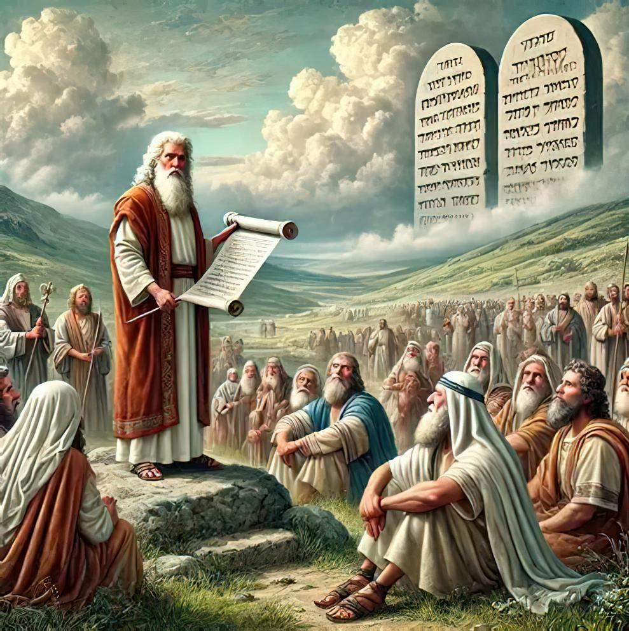
,Wjp nka;g;gw;W: Aj;jg; gFjpapy; njhOif
ghlk; 7 etk;gu; 15, 2025

Slide 2
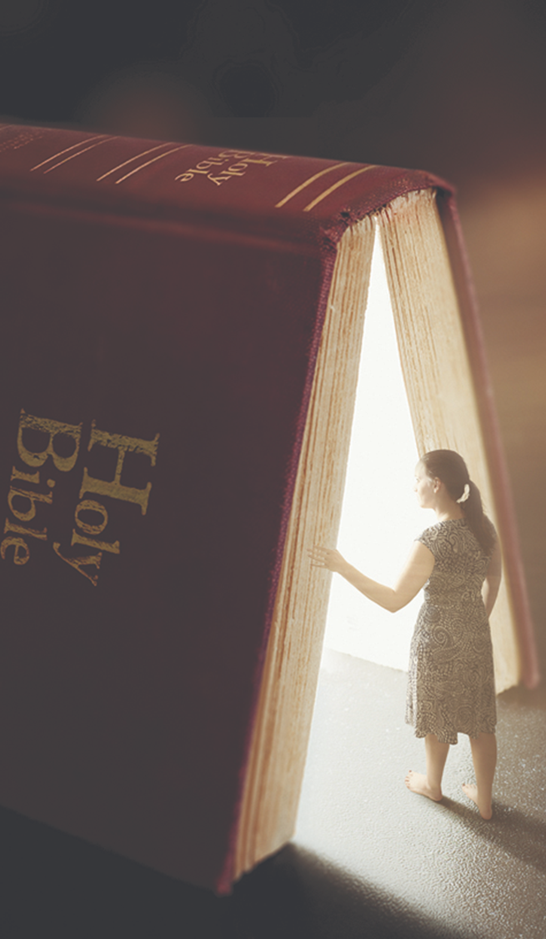

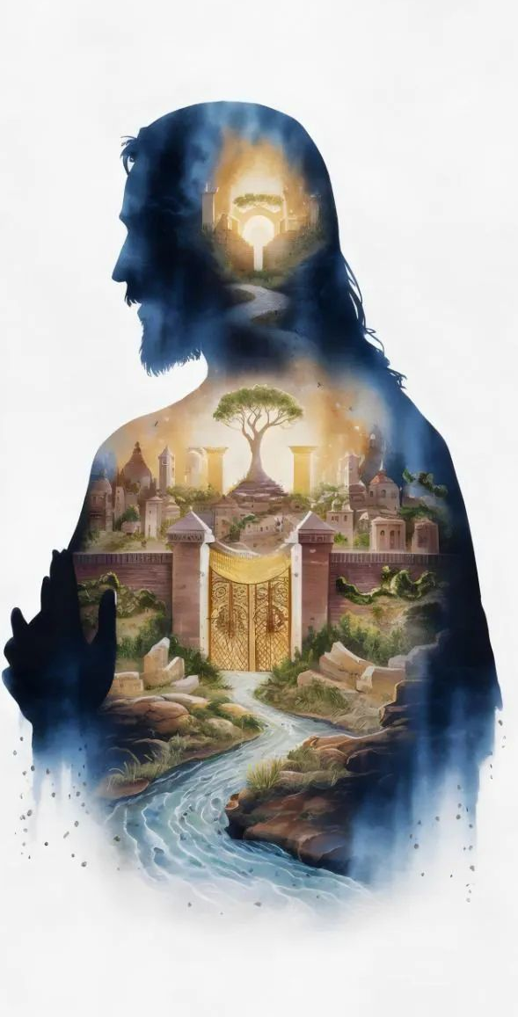
“KjyhtJ NjtDila uh[;aj;ijAk; mtUila ePjpiaAk; NjLq;fs;> mg;nghOJ ,itfnsy;yhk; cq;fSf;Ff;$lf; nfhLf;fg;gLk;.”
kj;NjA 6:33

Slide 3

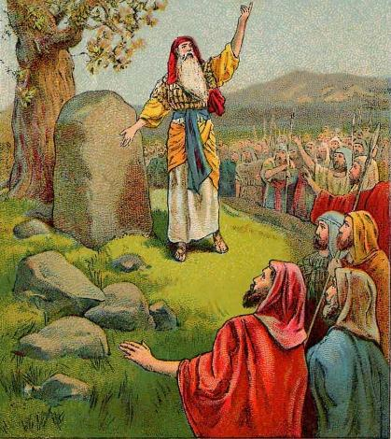
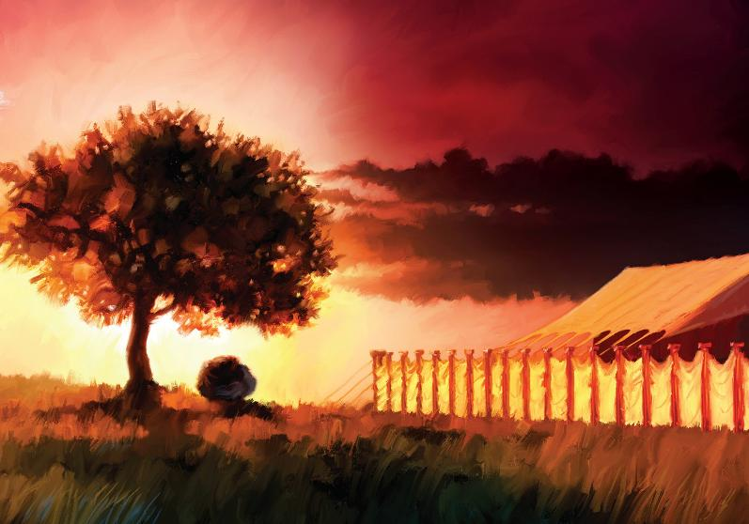








mw;Gjtpjkha; Nahu;jhid fle;jij fz;L, vy;yh fhdhdpa ,uh[hf;fSk; fyf;fkile;jhu;fs; (NahR 5:1). cldbahf ifg;gw;Wtjw;F ikjhdk; jahu; nra;ag;gl;lJ.
,Ug;gpDk;, ,J ,];uNtypd; Kjy; Kd;Dupik my;y. mtu;fs; Kjypy; NjtNdhL njhu;G nfhs;s Ntz;Lk;.
ntw;wpapd; kj;jpapy;, Vghy; kw;Wk; nfuprPk; kiyfSf;F ,ilNa xU ngupa re;jpg;gpy; jq;fis NjtDf;F kPz;Lk; mw;gzpf;f xU ,ilntsp vLf;f KbT nra;jdu;.
Vwf;Fiwa ntw;wpia Kbj;J, mtu;fs; topghl;bd; xU Gjpa iky;fy;iy mile;jdu;: mtu;fs; rPNyhtpy; Mrupg;Gf; $lhuj;ij epWtpdu;.
ntw;wpf;F Kd;dhd njhOif:
cld;gbf;ifia GJg;gpj;jy; (NahRth 5:1-9)
fhdhdpy; Kjy; g];fh (NahRth 5:10-12)
kiyfspd; kj;jpapy; njhOif:
njhOiff;F xU gypgPlk; (NahRth 8:30-31)
epahag;gpukhzj;ij epidj;jy; (NahRth 8:32-35)
njhOif nra;tjw;F xU rpwg;ghd ,lk;:
Mrupg;Gf;$lhuj;ij vOg;Gjy; (NahRth 18:1)

Slide 4

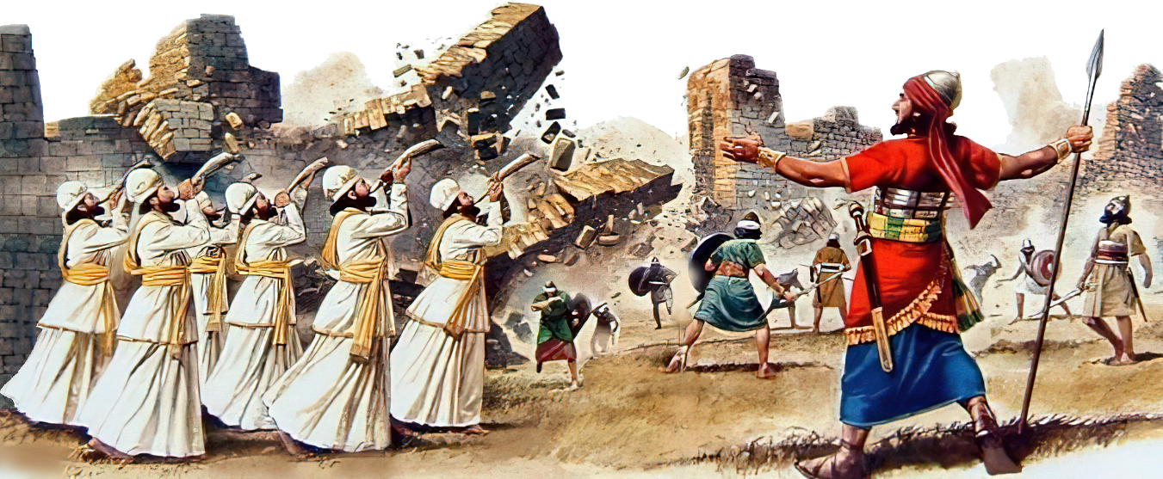
ntw;wpf;F Kd;dhd njhOif

Slide 5

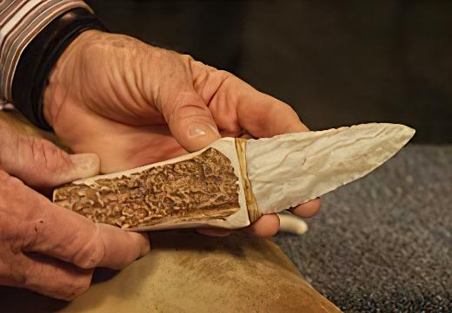

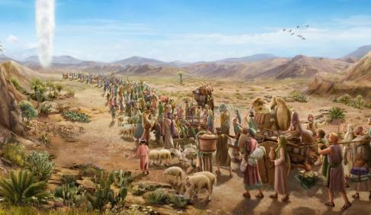
cld;gbf;ifia GJg;gpj;jy;
“mf;fhyj;jpNy fh;j;jh; NahRthit Nehf;fp: eP fUf;fhd fj;jpfis cz;lhf;fp> jpUk;g ,uz;lhk;tpir ,];uNty; Gj;jpuiu tpUj;jNrjdk;gz;Z vd;whh;.” (NahRth 5:2 )
fpy;fhy; vd;gJ ,];uNtypd; ghisaj;jpw;F nfhLf;fg;gl;l ngau;, ,J ntw;wpapd; Muk;g fhyj;jpy; fl;lis ikakhf ,Ue;jJ. ,e;j ngaUf;F vd;d Kf;fpaj;Jtk; nfhLf;fg;gl;lJ (NahR. 5:9)?
vfpg;ij fle;J te;J 40 tUlq;fs; MfpapUe;jhYk;, ,];uNtyu; ,d;Dk; jhq;fs; thf;fspf;fg;gl;l Njrj;jpw;Fs; Eioatpy;iy. ,g;NghJ, mtu;fSila fhy;fs; mij kpjpj;Jf;nfhz;bUe;jd. “vfpg;jpd; epe;ijia” mfw;wp> NjtDld; cld;gbf;ifia GJg;gpf;f Ntz;ba Neuk; ,J.
Before eating the first Passover, Israelite males were circumcised, for no uncircumcised person could partake of it (Ex. 12:48). But because they refused to enter Canaan the first time, the covenant was broken, and no Israelite was circumcised in the wilderness (Josh. 5:5).
To renew the covenant, it was necessary to repeat that physical sign (Gen. 17:10). This act put what was important first. For us, it is an example to follow: “But seek first his kingdom and his righteousness, and all these things will be given to you as well.” (Mt. 6:33).

Slide 6

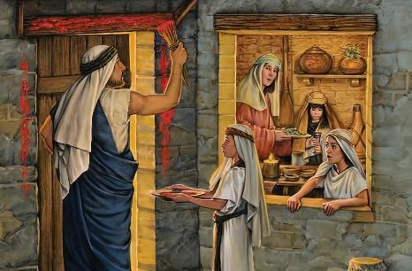
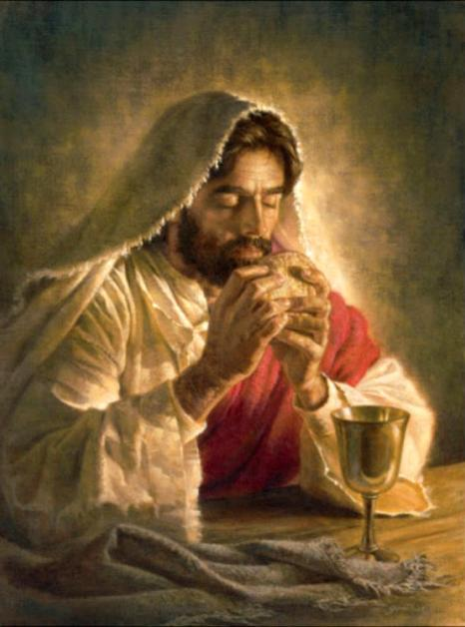
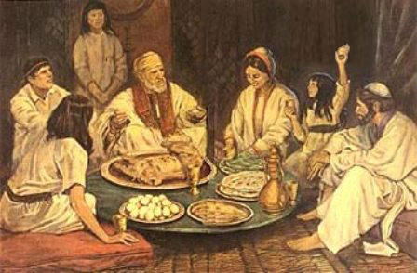
fhdhdpy; Kjy; g];fh
“,];uNty; Gj;jpuh; fpy;fhypy; ghsakpwq;fpapUe;J> khjj;jpd; gjpdhyhk; Njjp me;jpNeuj;jpNy vhpNfhtpd; rkdhd ntspfspNy g];fhit Mrhpj;jhh;fs;.” (NahRth 5:10)
From Egypt to Canaan, Israel followed a “chiastic” process, repeating the events in reverse order:
Egypt
Circumcision and Passover
Crossing the Red Sea
Desert
Crossing the Jordan
Circumcision and Passover
Canaan
The first Passover was a symbol of the liberation from Egypt. The second Passover, celebrated by the new generation, was a symbol of their taking possession of the Promised Land.
Shortly before his crucifixion, Jesus gave this rite a new meaning, with new symbols: the lamb became bread, and the blood became wine.
They are now symbols of the body and blood of our Redeemer, who brings us out of Egypt (that is, out of our sin), and brings us to the Promised Land (1 Cor. 11:23-26).

Slide 7

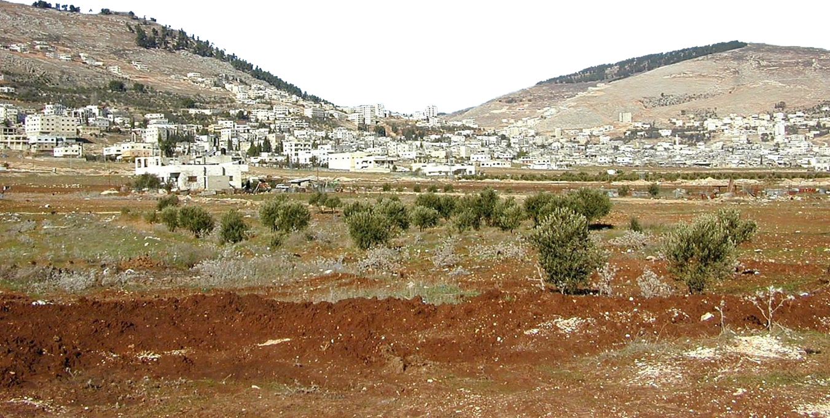
kiyfSf;F kj;jpapy; njhOif

Slide 8

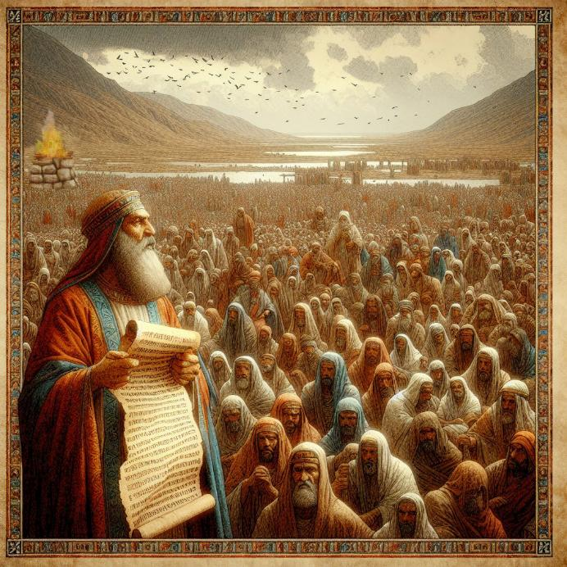
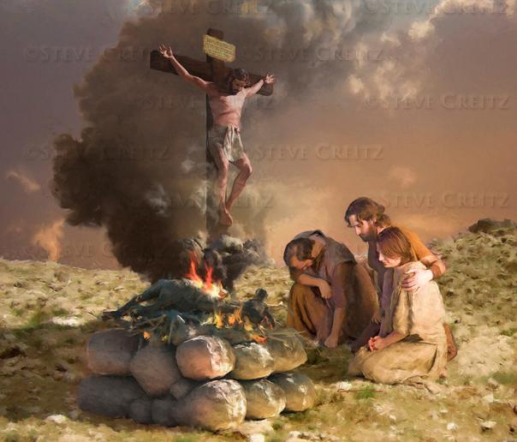
njhOif nra;tjw;F xU gy
“mg;nghOJ NahRth: … Vghy; gh;tjj;jpy; ,];uNtypd; Njtdhfpa fh;j;jUf;F ,Ug;ghAjk;glhj KOf;fw;fshy; xU gypgPlj;ijf; fl;bdhd;.” (NahRth 8:30)
Moses had commanded that upon entering Canaan, an altar should be built on Mount Ebal, and praise should be given to God (Deut. 27:5-7). Why on Mount Ebal and not on Gerizim?
Both the altar and the laws that were to be written on a monument and read to the people were related to blessings and curses. (Deut. 27:12-13). The blessing was pronounced on Gerizim, and the curse on Ebal.
Jesus became a curse for us, so that we might receive the blessing (Gal. 3:13-14). This altar is, for us, a clear image of Jesus' sacrifice on our behalf.
In the midst of conquest, Israel sought a moment to rededicate itself to God. This is an invitation for us to imitate their example, rededicating ourselves to God, not only individually, but also as God's chosen people.

Slide 9

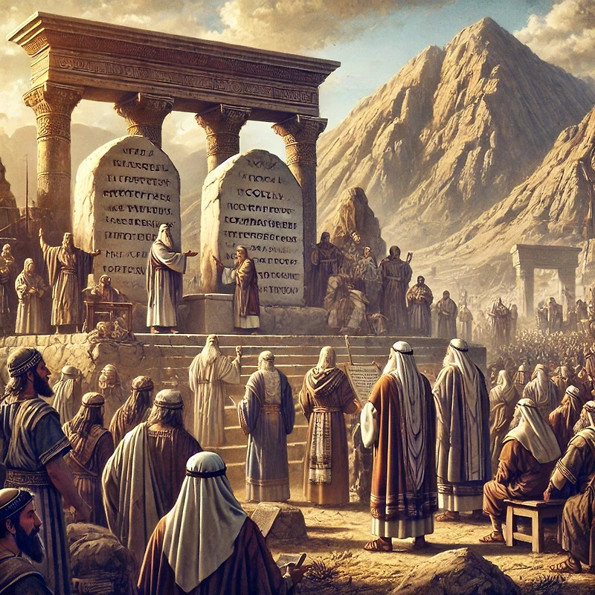
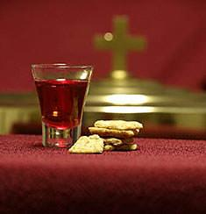
epahag;gpukhzj;ij epidj;jy;
“,];uNty; Gj;jpuUf;F Kd;ghf NkhNr vOjpapUe;j epahag;gpukhzj;ij mtd; mq;Nf fw;fspy; Ngh;j;njOjpdhd;.” (NahRth 8:32)
After building the altar on Mount Ebal, Joshua set up some stones and plastered them with lime. Then he wrote on them a copy of the law [Deuteronomy, which included the Ten Commandments and various laws, along with blessings and curses] (Josh. 8:32; Deut. 27:2-3).
Finally, the law was read to the people, divided into two parts—one on each mountain side (Josh. 8:33-35). In this way, the covenant between God and his people was renewed.
This is a calling for us as well. As God's remnant people, we must periodically renew our covenant with Him, remembering how He has led us this far and the blessings He has bestowed upon us.
In addition to our personal renewal, the Holy Communion also provides us with that special moment of renewal as the people of God.

Slide 10
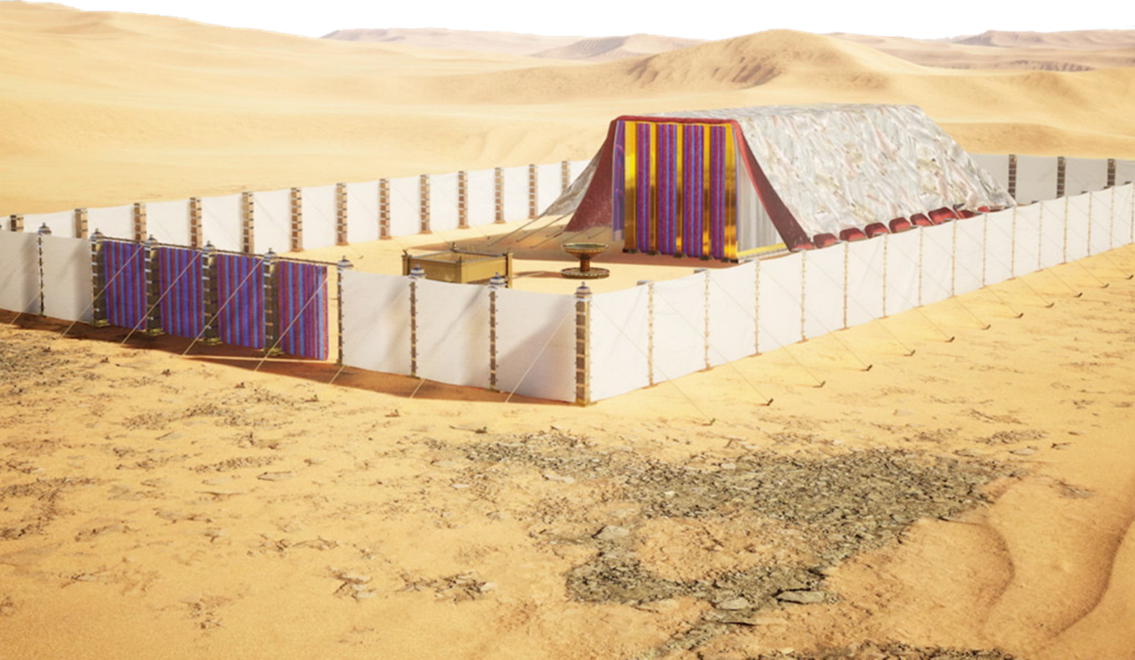
njhOif nra;tjw;F xU rpwg;ghd ,lk;

Slide 11
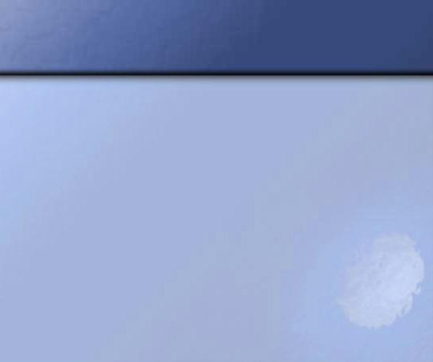
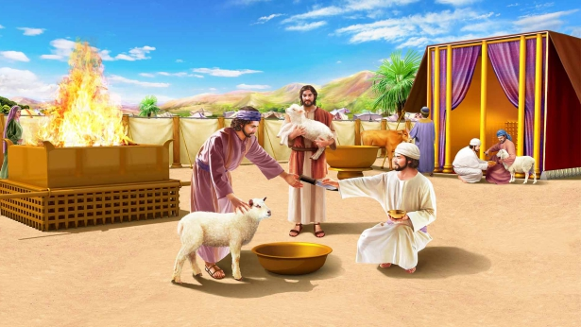
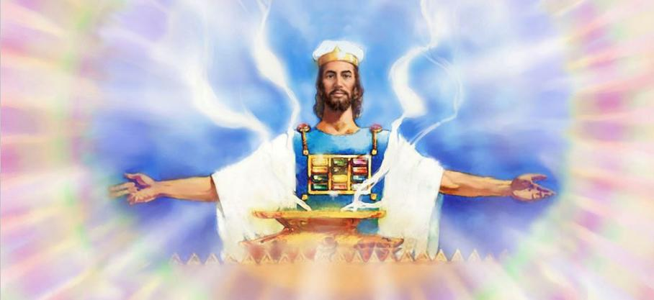
Mrupg;Gf;$lhuj;ij vOg;Gjy;
“,];uNty; Gj;jpuhpd; rignay;yhk; rPNyhtpNy $b> mq;Nf Mrhpg;Gf; $lhuj;ij epWj;jpdhh;fs;. Njrk; mth;fs; trkhapw;W.” (NahRth 18:1)
The land had been subdued by Israel. The territory had been divided among the most prominent tribes, although seven tribes had not yet received their share. The warriors of Reuben, Gad, and the half-tribe of Manasseh were to be sent to their possessions beyond the Jordan.
Before the tribes separated, a special and essential act was performed: the erection of the Tabernacle, the center of Israel's worship (Josh. 18:1).
The Sanctuary, as God's visible dwelling place, was the point of unity where all united in worship. Without God's presence, the possession of the land was meaningless.
Today, when there are still modern and postmodern giants to overcome, it is vitally important that we focus our attention on the Heavenly Sanctuary, where Jesus intercedes for us.

Slide 12

“It had not been many weeks since Moses gave the whole book of Deuteronomy in discourses to the people, yet now Joshua read the law again.”
Not alone the men of Israel, but “all the women and the little ones” listened to the reading of the law; for it was important that they also should know and do their duty. […]
Every chapter and every verse of the Bible is a communication from God to men. We should bind its precepts as signs upon our hands and as frontlets between our eyes. If studied and obeyed, it would lead God’s people, as the Israelites were led, by the pillar of cloud by day and the pillar of fire by night.
EGW (Patriarchs and Prophets, pp. 500-504)

